Slide 1
Arctic
survival

Slide 2
Scenario

Slide 3
Mid-January is the coldest time of year in Northern Canada.
The first problem the survivors face is the preservation of body heat and the protection against its loss. This problem can be solved by building a fire, minimizing movement and exertion, using as much insulation as possible, and constructing a shelter.

Slide 4
The participants have just crash-landed. Many individuals tend to overlook the enormous shock reaction this has on the human body and the deaths of the pilot and co-pilot increases the shock. Decision-making under such circumstances is extremely difficult. Such a situation requires a strong emphasis on the use of reasoning for making decisions and for reducing fear and panic.
Shock would be shown in the survivors by feelings of helplessness, loneliness, hopelessness, and fear. These feelings have brought about more fatalities than perhaps any other cause in survival situations. Certainly, the state of shock means the movement of the survivors should be at a minimum, and that an attempt to calm them should be made.

Slide 5
Before taking off, a pilot has to file a flight plan which contains vital information such as the course, speed, estimated time of arrival, type of aircraft, and number of passengers. Search-and-rescue operations begin shortly after the failure of a plane to appear at its destination at the estimated time of arrival.

Slide 6
The 30km to the nearest town is a long walk under even ideal conditions, particularly if one is not used to walking such distances. In this situation, the walk is even more difficult due to shock, snow, dress, and water barriers. It would mean almost certain death from freezing and exhaustion. At temperatures of -25C to -40C, the loss of body heat through exertion is a very serious matter.

Slide 7
Once the survivors have found ways to keep warm, their next task is to attract the attention of search planes. Thus, all the items the group has salvaged must be assessed for their value in signaling the group’s whereabouts.

Slide 8
The ranking of the survivors’ items was made by Mark Wanvig, a former instructor in survival training for the Reconnaissance School of the 101st Division of the U.S. Army. Mr. Wanvig currently conducts wilderness survival training programs in the Minneapolis, Minnesota area.
This survival simulation game is used in military training classrooms.

Slide 9
Task

Slide 10
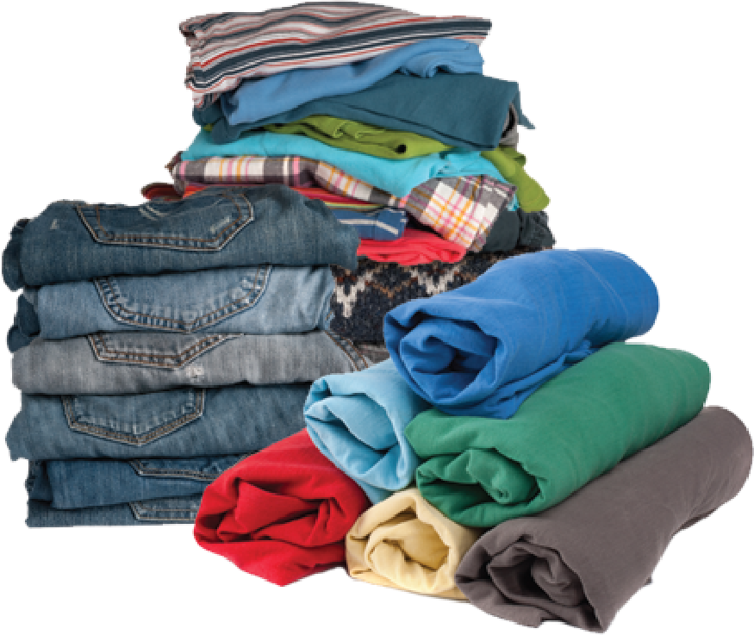
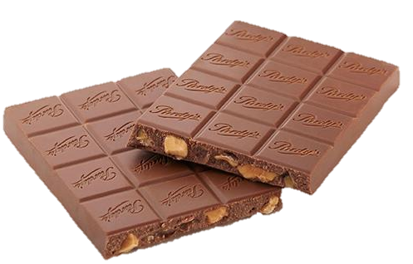
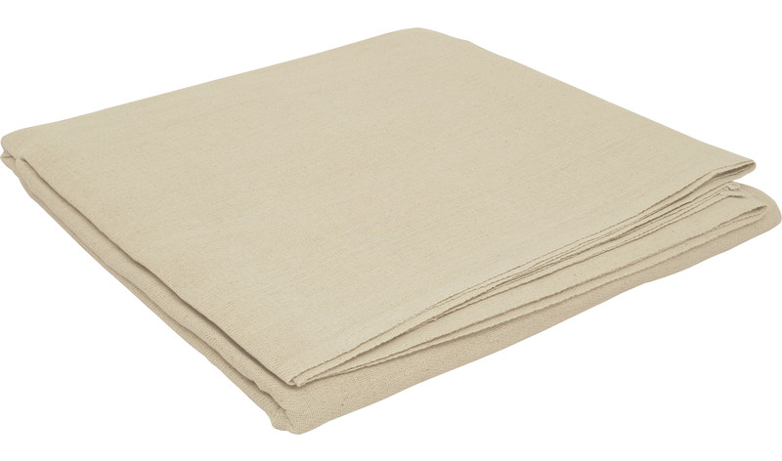
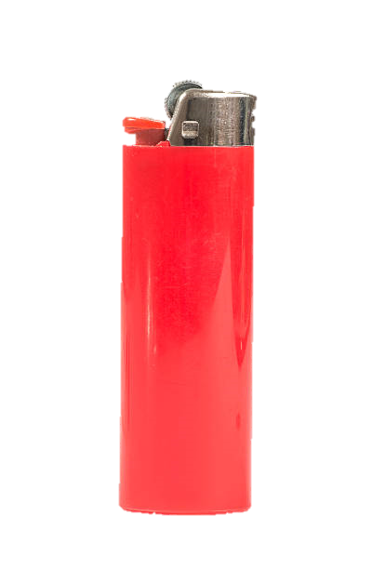
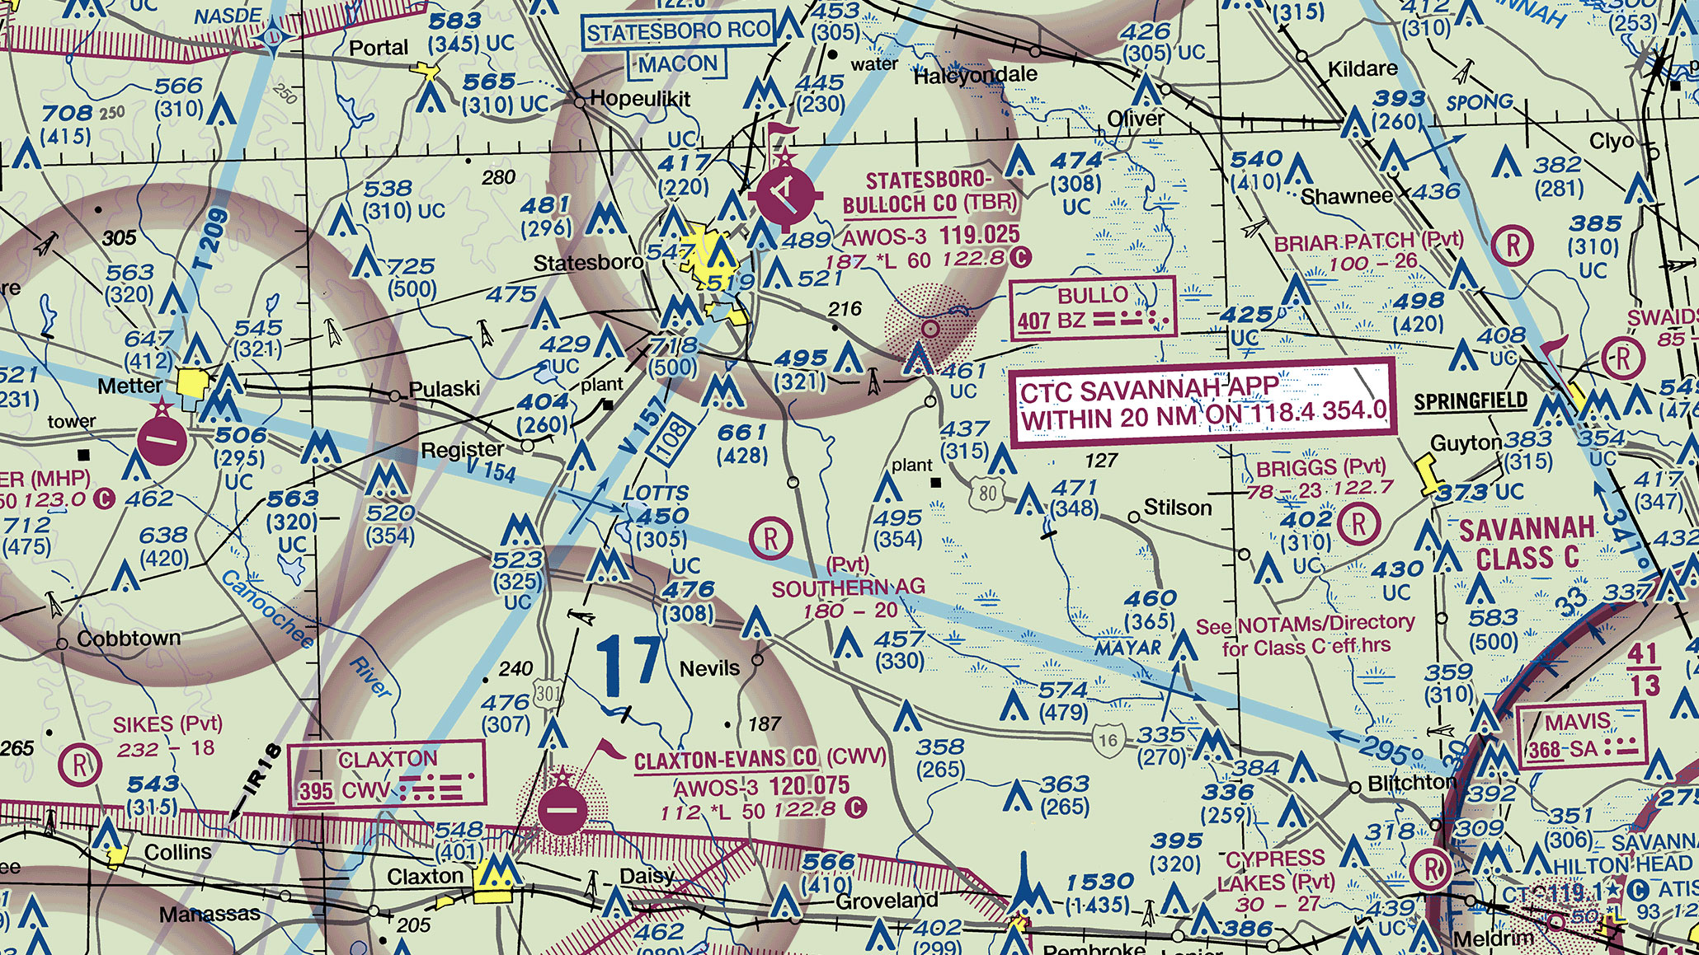
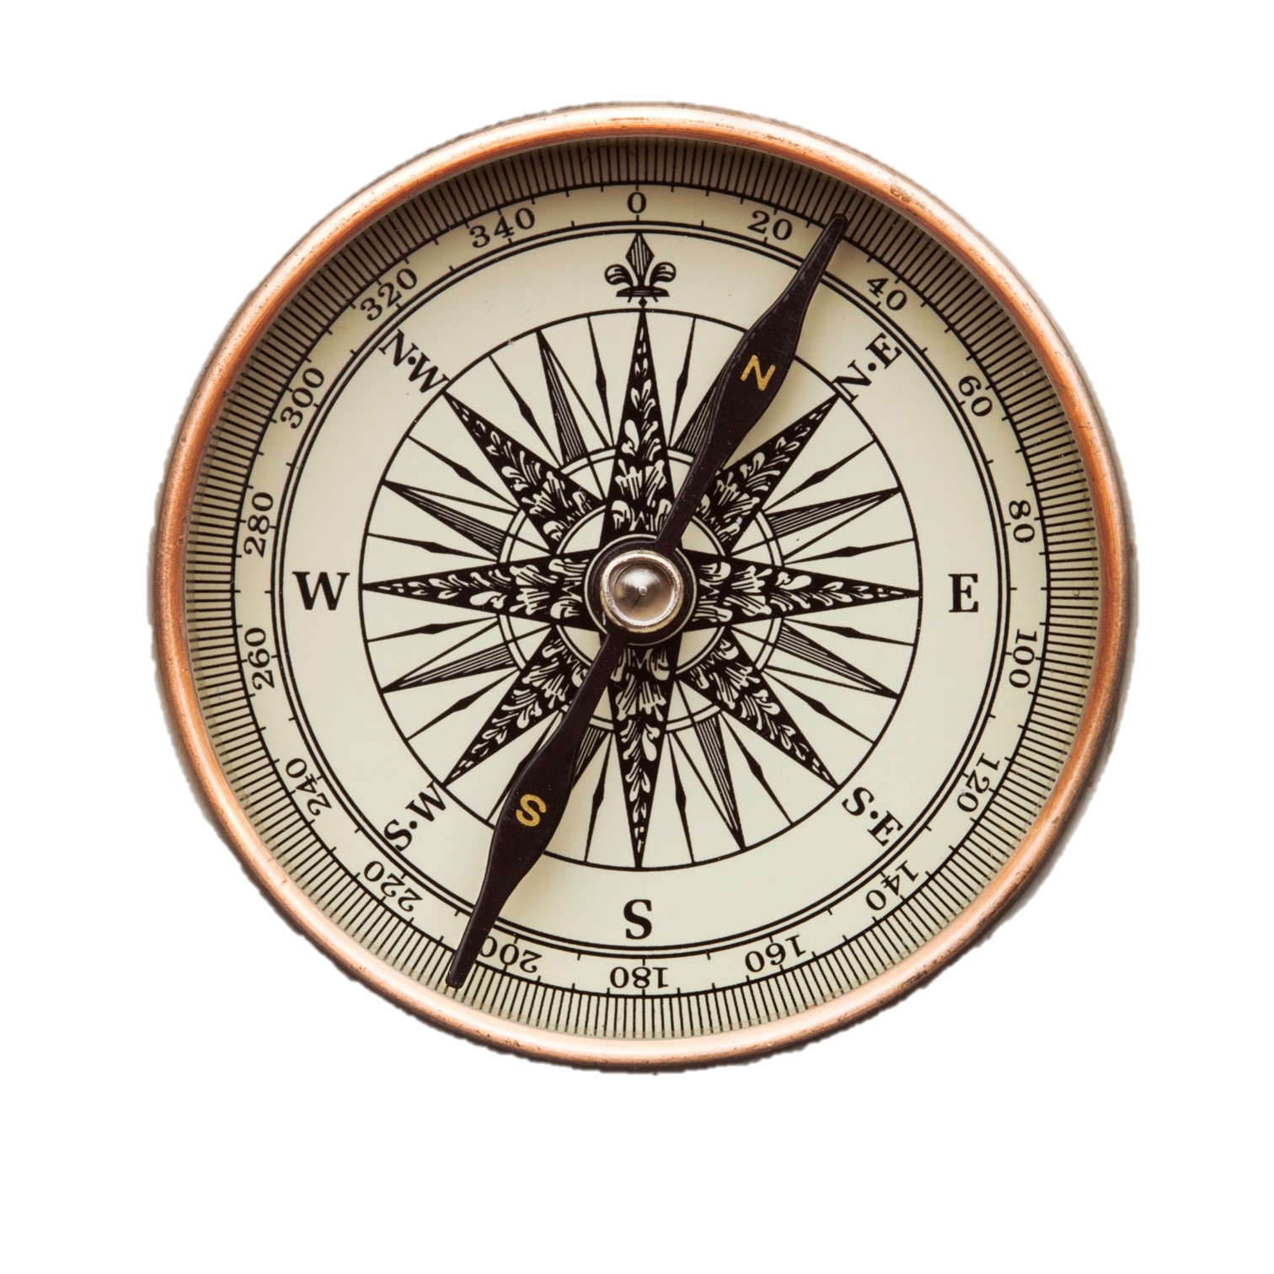
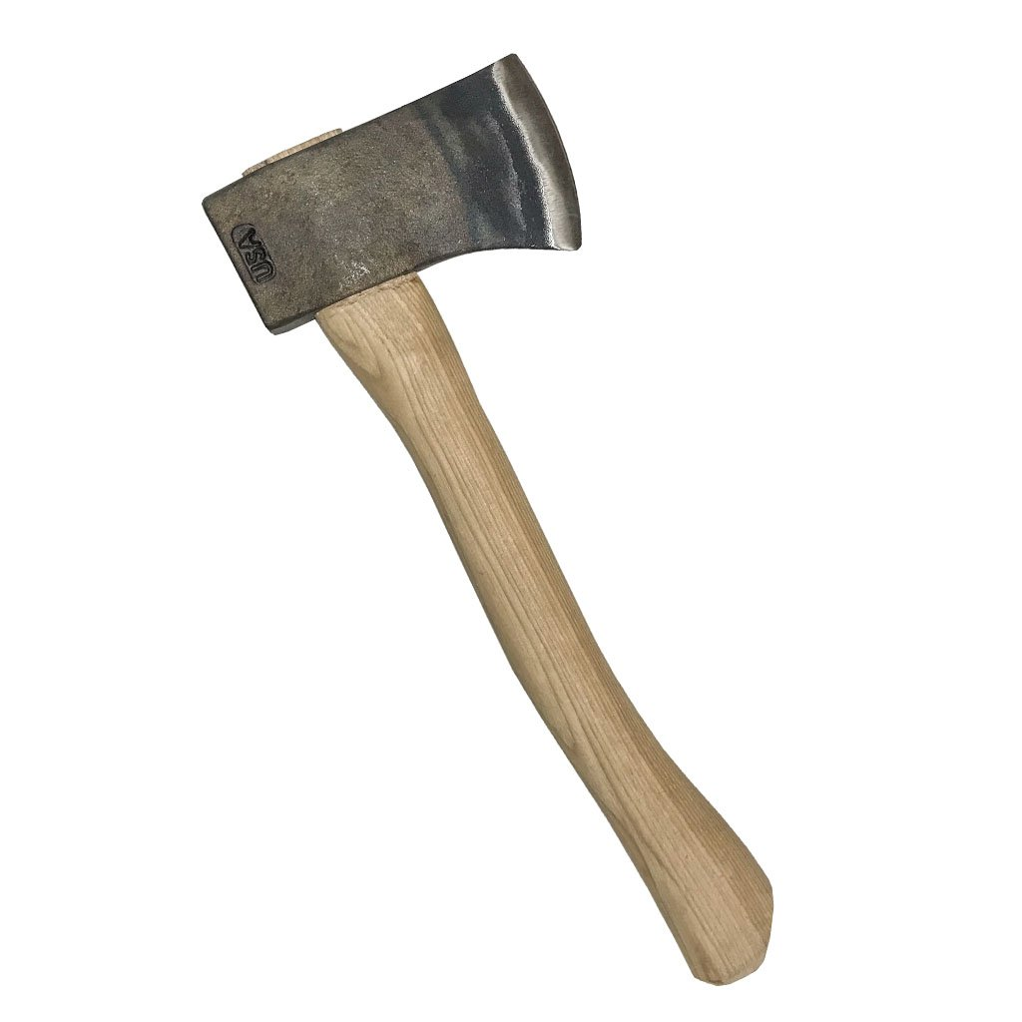
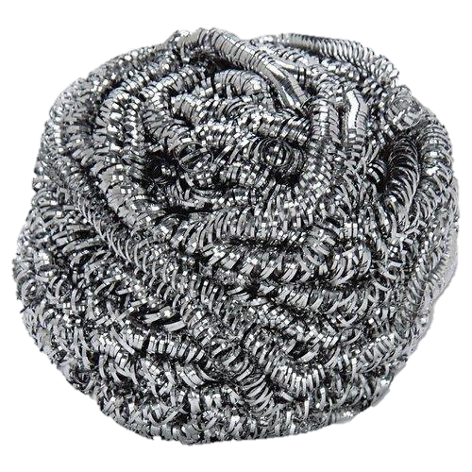
Rank the following items in order of importance:
Extra shirt and pants for each survivor
6x6m piece of canvas
Can of Crisco shortening
Family size chocolate bars
(one per person)
Sectional air map made of plastic
Cigarette lighter
1 liter of 100 proof whiskey
Newspapers
(one per person)
Compass
Loaded .45-caliber pistol
Small axe
Ball of steel wool

Slide 11
Rank the following items in order of importance:
Items | Individual | (difference) | Team | (difference) | Mr. Wanvig
extra clothes (each survivor)
6x6 canvas
Crisco shortening
family sized chocolate bars
air map (made of plastic)
Cigarette lighter
1L of 100 proof whiskey
Newspapers (per person)
compass
Loaded .45 caliber gun
Small axe
Ball of steal wool

Slide 12
Ranking

Slide 13
1
Cigarette Lighter
(without fluid)
The gravest danger facing the group is exposure to cold. The greatest need is for a source of warmth and the second greatest need is for signaling devices. This makes building a fire the first order of business. Without matches, something is needed to produce sparks, and even without fluid, a cigarette lighter can do that.

Slide 14
2
A ball of
Steal Wool
To make a fire, the survivors need a means of catching he sparks made by the cigarette lighter. This is the best substance for catching a spark and supporting a flame, even if the steel wool is a little wet.

Slide 15
3
Extra Clothes
for each survivor
Besides adding warmth to the body, clothes can also be used for shelter, signaling, bedding, bandages, string (when unraveled), and fuel for the fire.

Slide 16
4
Can of Crisco
shortening
This has many uses. A mirror-like signaling device can be made from the lid. After shining the lid with steel wool, it will reflect sunlight and generate 5 to 7 million candlepower. This is bright enough to be seen beyond the horizon. While this could be limited somewhat by the trees, a member of the group could climb a tree and use the mirrored lid to signal search planes. If they had no other means of signaling than this, they would have a better than 80% chance of being rescued within the first day.

Slide 17
4
Can of Crisco
shortening
There are other uses for this item. It can be rubbed on exposed skin for protection against the cold. When melted into oil, the shortening is helpful as fuel. When soaked into a piece of cloth, melted shortening will act like a candle. The empty can is useful in melting snow for drinking water. It is much safer to drink warmed water than to eat snow, since warm water will help retain body heat. Water is important because dehydration will affect decision-making. The can is also useful as a cup.

Slide 18
5
A 6x6m piece of
Canvas
The cold makes shelter necessary, and canvas would protect against wind and snow (canvas is used in making tents). Spread on a frame made of trees, it could be used as a tent or a wind screen. It might also be used as a ground cover to keep the survivors dry. Its shape, when contrasted with the surrounding terrain, makes it a signaling device.

Slide 19
6
Small Axe
Survivors need a constant supply of wood in order to maintain the fire. The ax could be used for this as well as for clearing a sheltered campsite, cutting tree branches for ground insulation, and constructing a frame for the canvas tent.

Slide 20
7
Family sized
Chocolate Bars
Chocolate will provide some food energy. Since it contains mostly carbohydrates, it supplies the energy without making digestive demands on the body.

Slide 21
8
Newspapers
(one per person)
These are useful in starting a fire. They can also be used as insulation under clothing when rolled up and placed around a person’s arms and legs. A newspaper can also be used as a verbal signaling device when rolled up in a megaphone-shape. It could also provide reading material for recreation.

Slide 22
9
loaded
.45 Caliber Gun
The pistol provides a sound-signaling device. (The international distress signal is 3 shots fired in rapid succession). There have been numerous cases of survivors going undetected because they were too weak to make a loud enough noise to attract attention. The butt of the pistol could be used as a hammer, and the powder from the shells will assist in fire building. By placing a small bit of cloth in a cartridge emptied of its bullet, one can start a fire by firing the gun at dry wood on the ground. The pistol also has some serious disadvantages. Anger, frustration, impatience, irritability, and lapses of rationality may increase as the group awaits rescue. The availability of a lethal weapon is a danger to the group under these conditions. Although a pistol could be used in hunting, it would take an expert marksman to kill an animal with it. Then the animal would have to be transported to the crash site, which could prove difficult to impossible depending on its size.

Slide 23
10
1L of 100 proof
Whiskey
The only uses of whiskey are as an aid in fire building and as a fuel for a torch (made by soaking a piece of clothing in the whiskey and attaching it to a tree branch). The empty bottle could be used for storing water. The danger of whiskey is that someone might drink it, thinking it would bring warmth. Alcohol takes on the temperature it is exposed to, and a drink of minus 30 degrees Fahrenheit whiskey would freeze a person’s esophagus and stomach. Alcohol also dilates the blood vessels in the skin, resulting in chilled blood belong carried back to the heart, resulting in a rapid loss of body heat. Thus, a drunken person is more likely to get hypothermia than a sober person is.

Slide 24
11
Compass
Because a compass might encourage someone to try to walk to the nearest town, it is a dangerous item. Its only redeeming feature is that it could be used as a reflector of sunlight (due to its glass top).

Slide 25
12
A sectional
Air Map
made of plastic
This is also among the least desirable of the items because it will encourage individuals to try to walk to the nearest town. Its only useful feature is as a ground cover to keep someone dry.

Slide 26
Score

Slide 27
How to score: Each team should list its top 5 choices in order prior to seeing the answer sheet. To award points, look at the ranking numbers on this answer sheet. Award points to each team’s top choices according to the numbers here. For example, the map would earn 12 points, while the steel wool would earn 2 points.
Lowest score wins (and survives).

Slide 28
https://www.fradleycroft.co.uk/wp-content/uploads/2018/02/Survival-Exercise-Team-Building-Storming-Answers.pdf

Slide 29
ESL toybox
www.esltoybox.com

