Slide 1

What is the Ugliest Color?
Pantone 448C

Slide 2
Ranking
Discussion Games

Slide 3
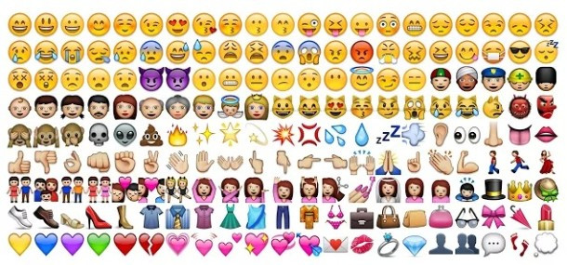
Emojis

Slide 4

Most Popular Emojis
Choose which one you think is most popular on Twitter…

Slide 5
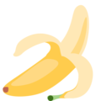
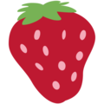
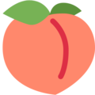
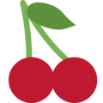
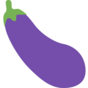
Most Popular Fruit Emoji

Slide 6
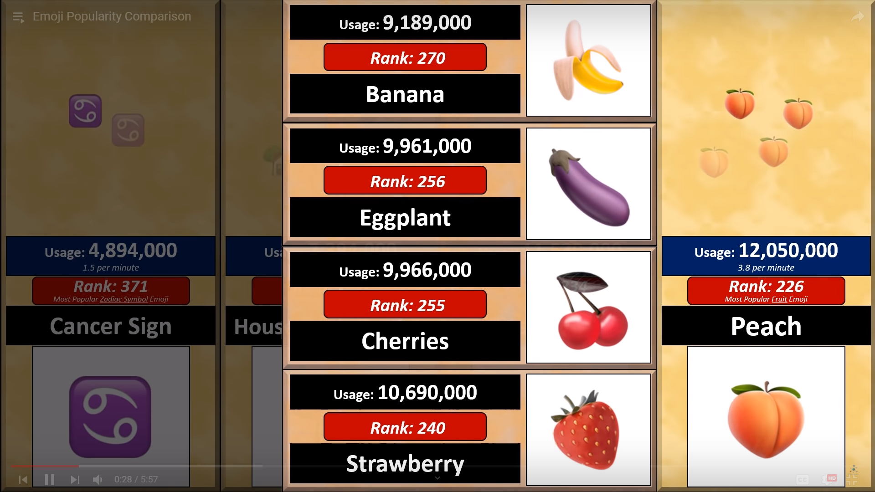

Slide 7
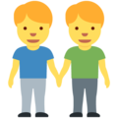
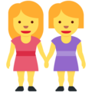
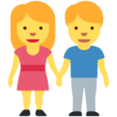

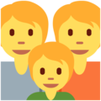
Most Popular Family Emoji

Slide 8
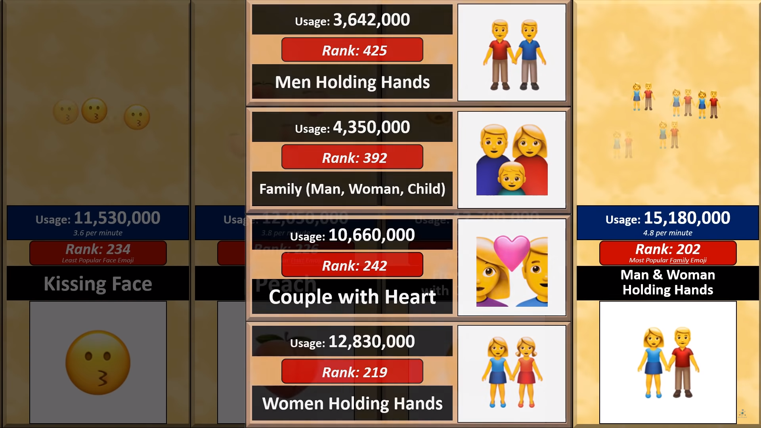

Slide 9

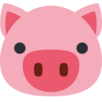



Most Popular Animal Face Emoji

Slide 10
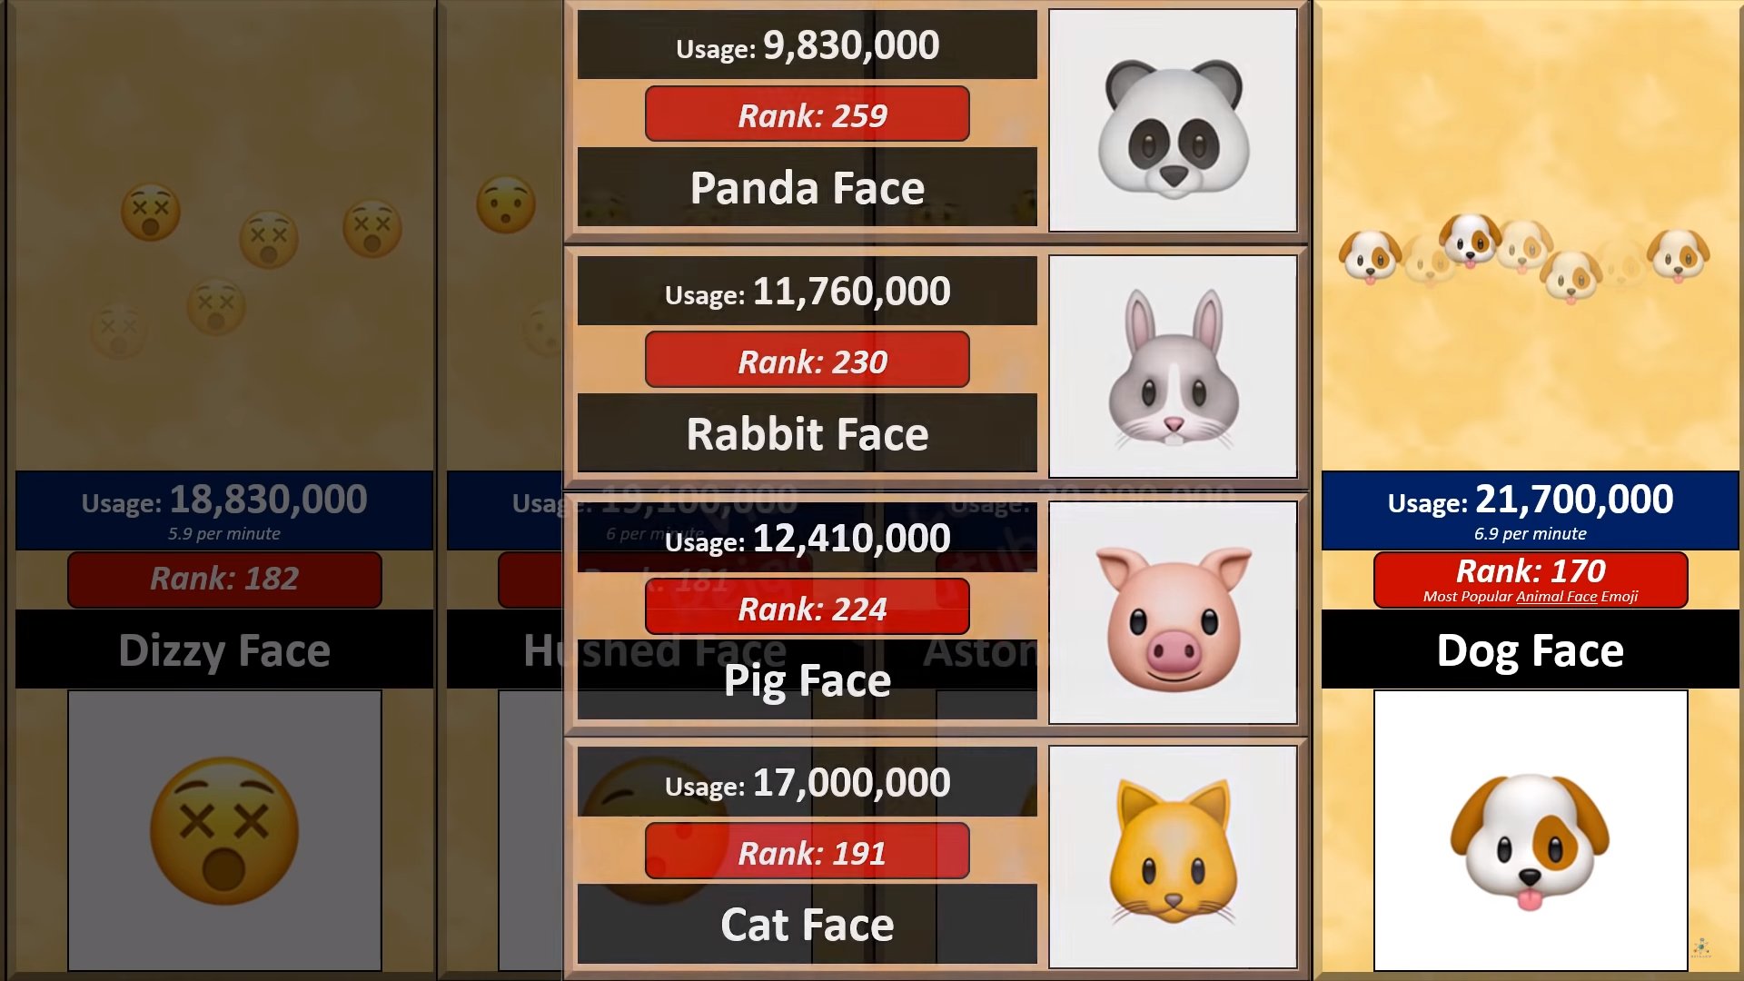

Slide 11



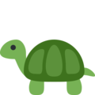

Most Popular Full Animal Emoji

Slide 12
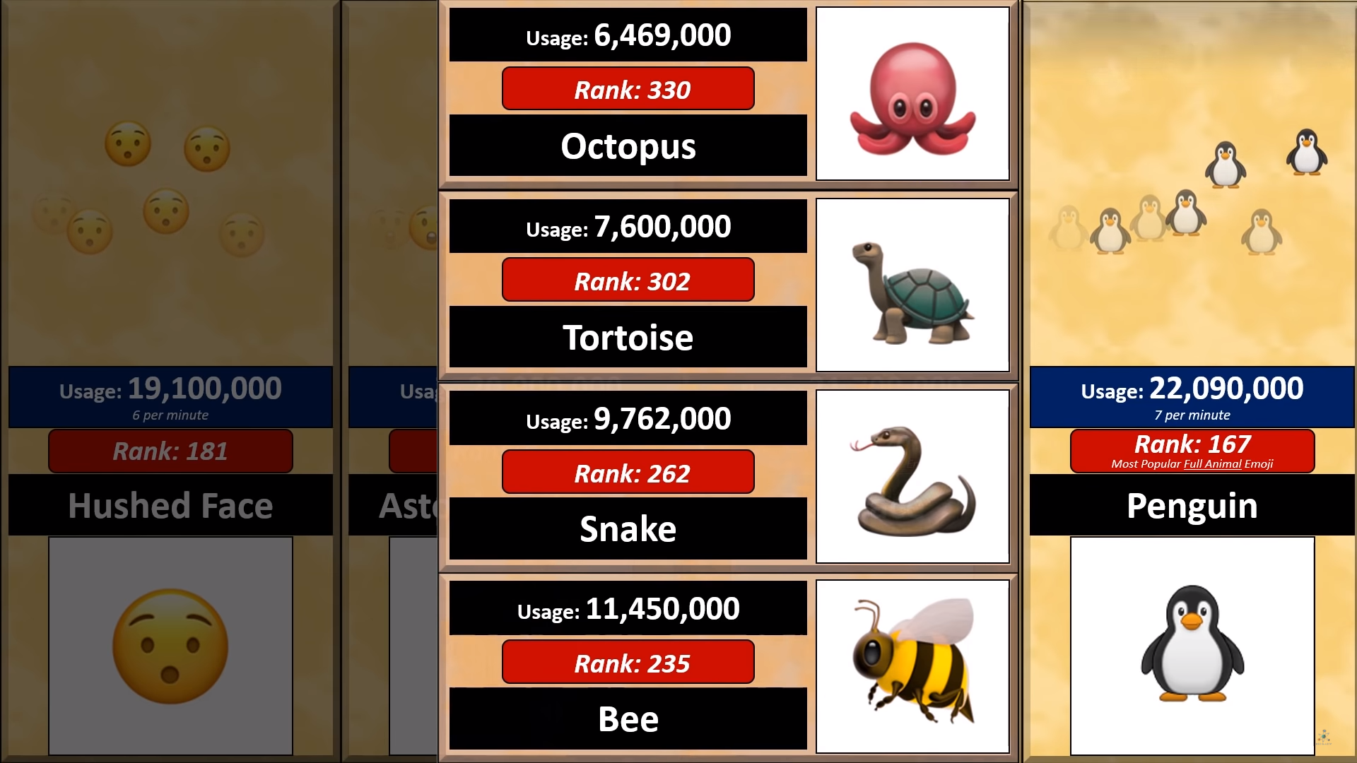

Slide 13


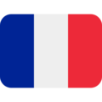


Most Popular Flag Emoji

Slide 14
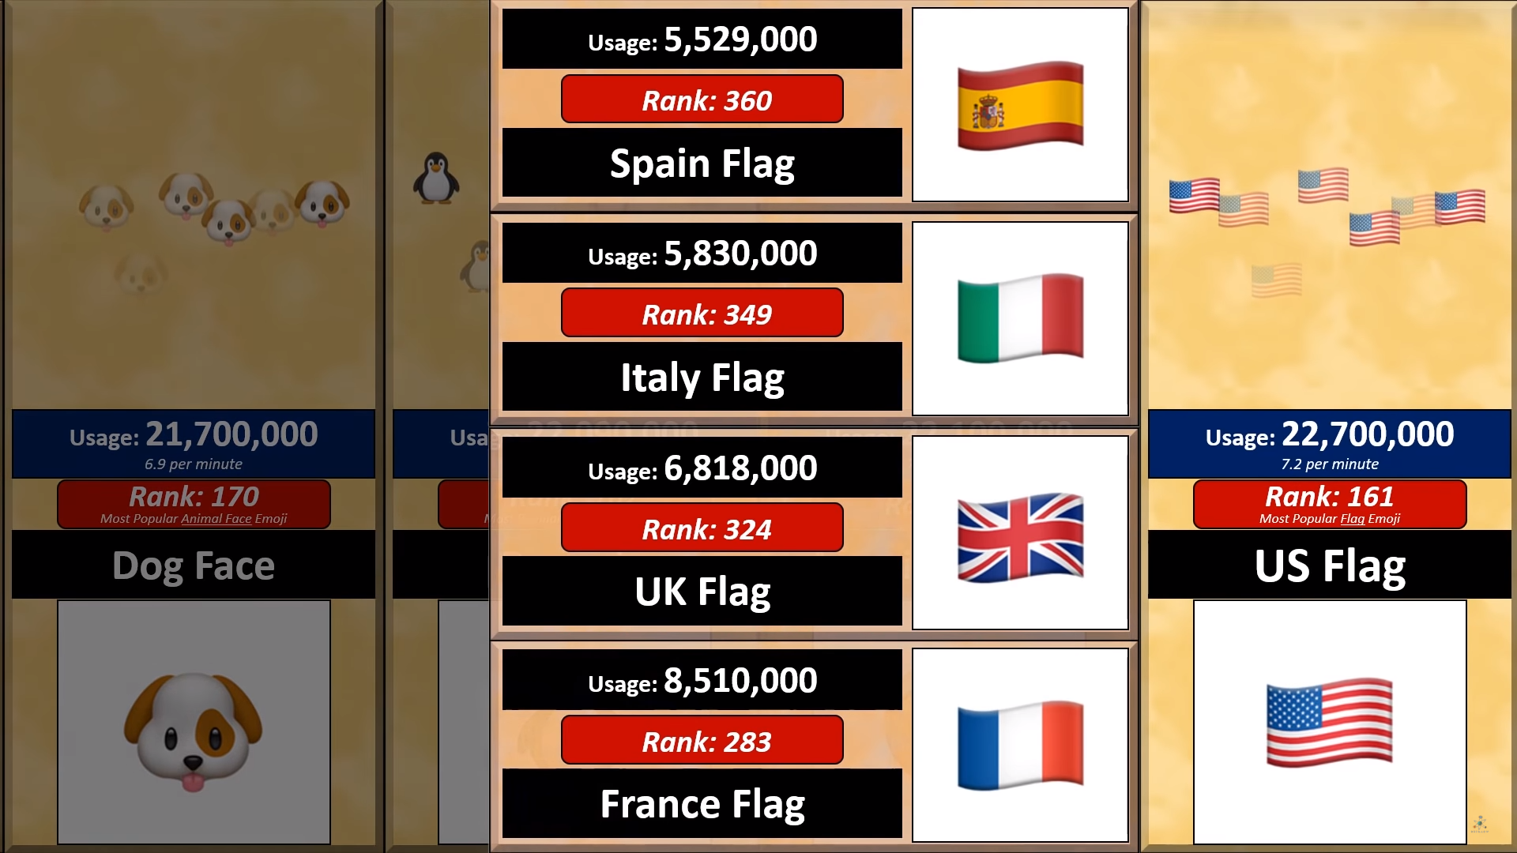

Slide 15


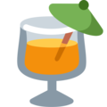


Most Popular Drink Emoji

Slide 16
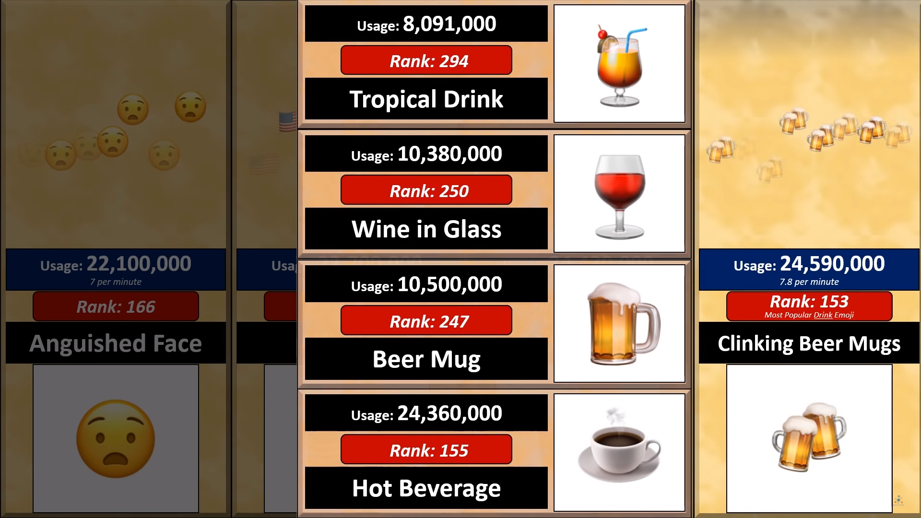

Slide 17
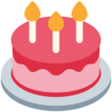
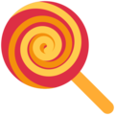
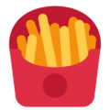


Most Popular Food Emoji

Slide 18
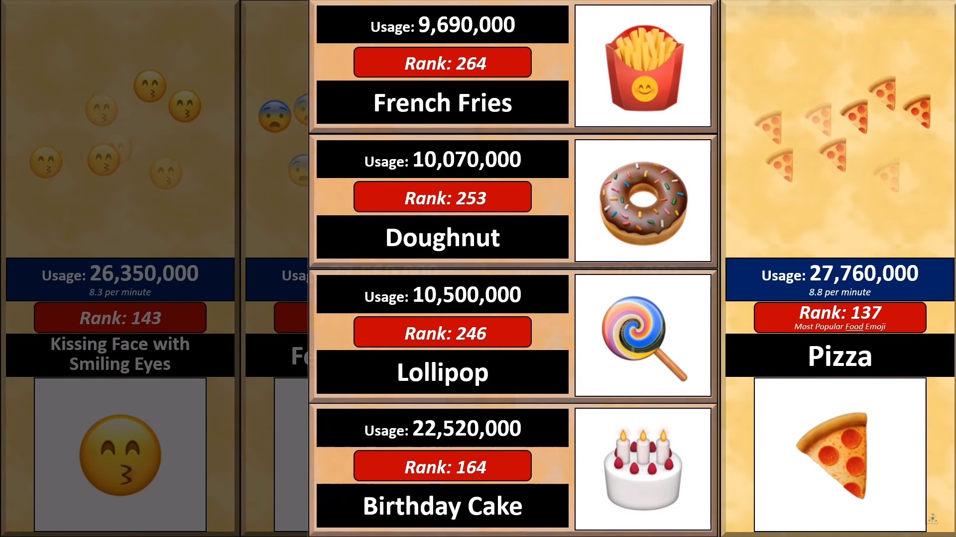

Slide 19





Most Popular Activity Emoji

Slide 20
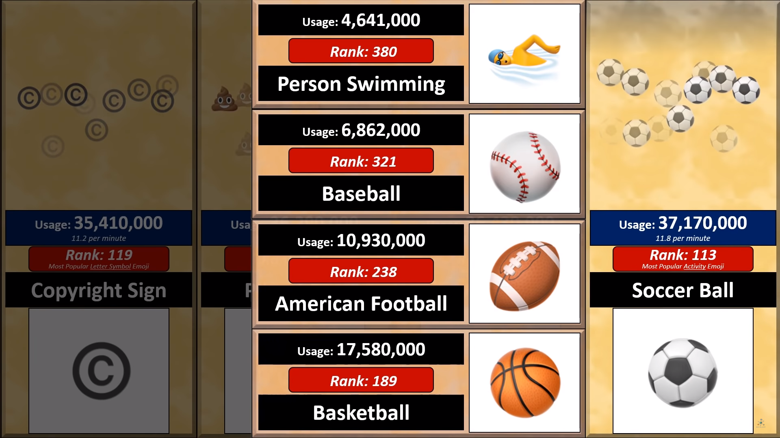

Slide 21
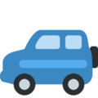


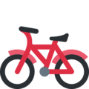
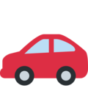
Most Popular Travel and Places Emoji

Slide 22
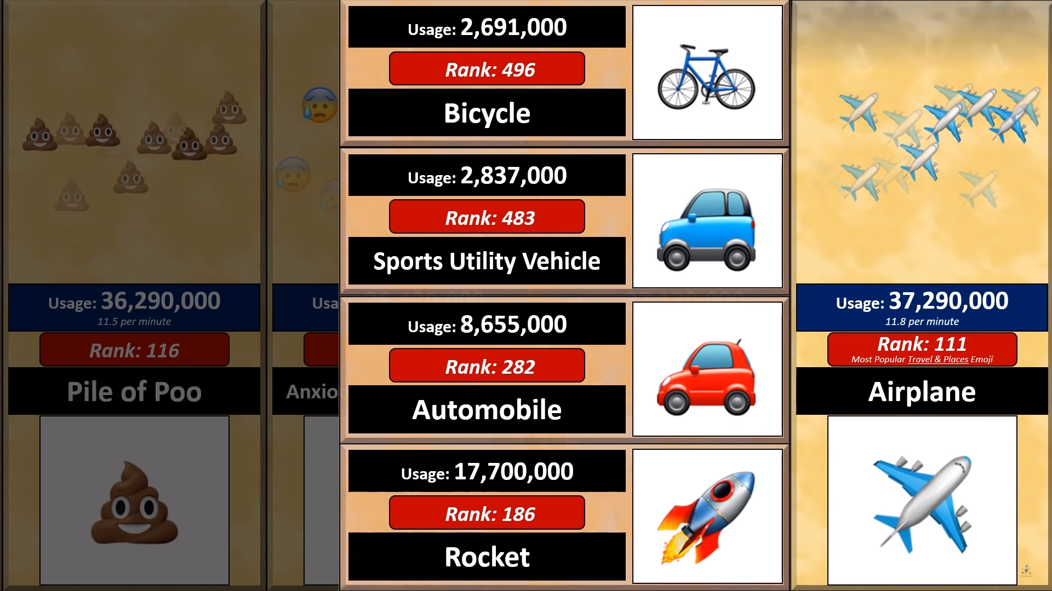

Slide 23



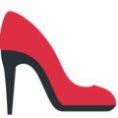
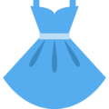
Most Popular Clothes Emoji

Slide 24
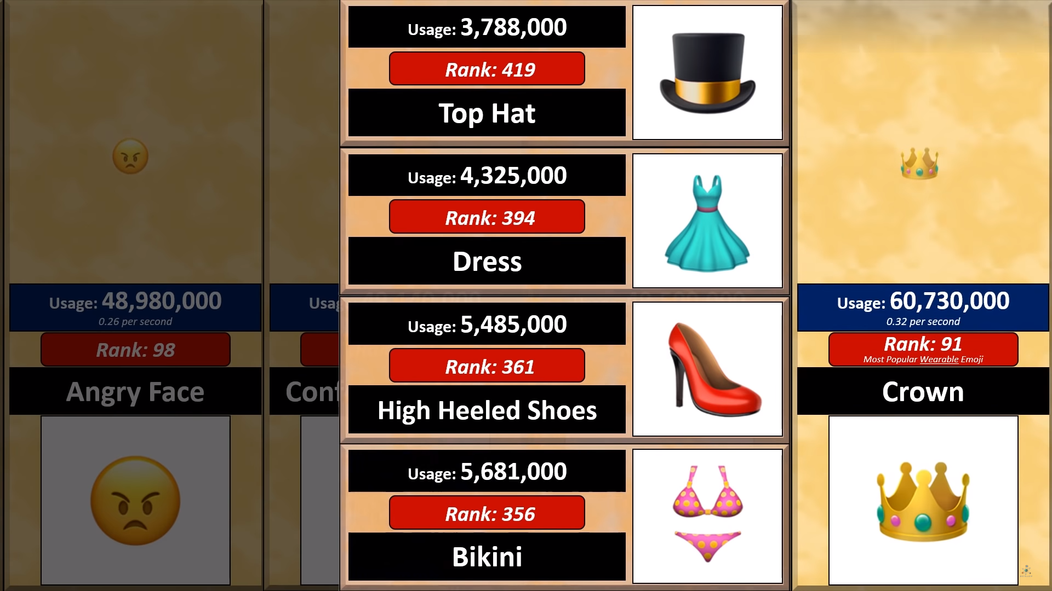

Slide 25
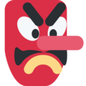
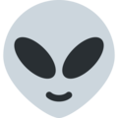
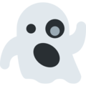
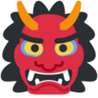

Most Popular Humanoid Face Emoji

Slide 26
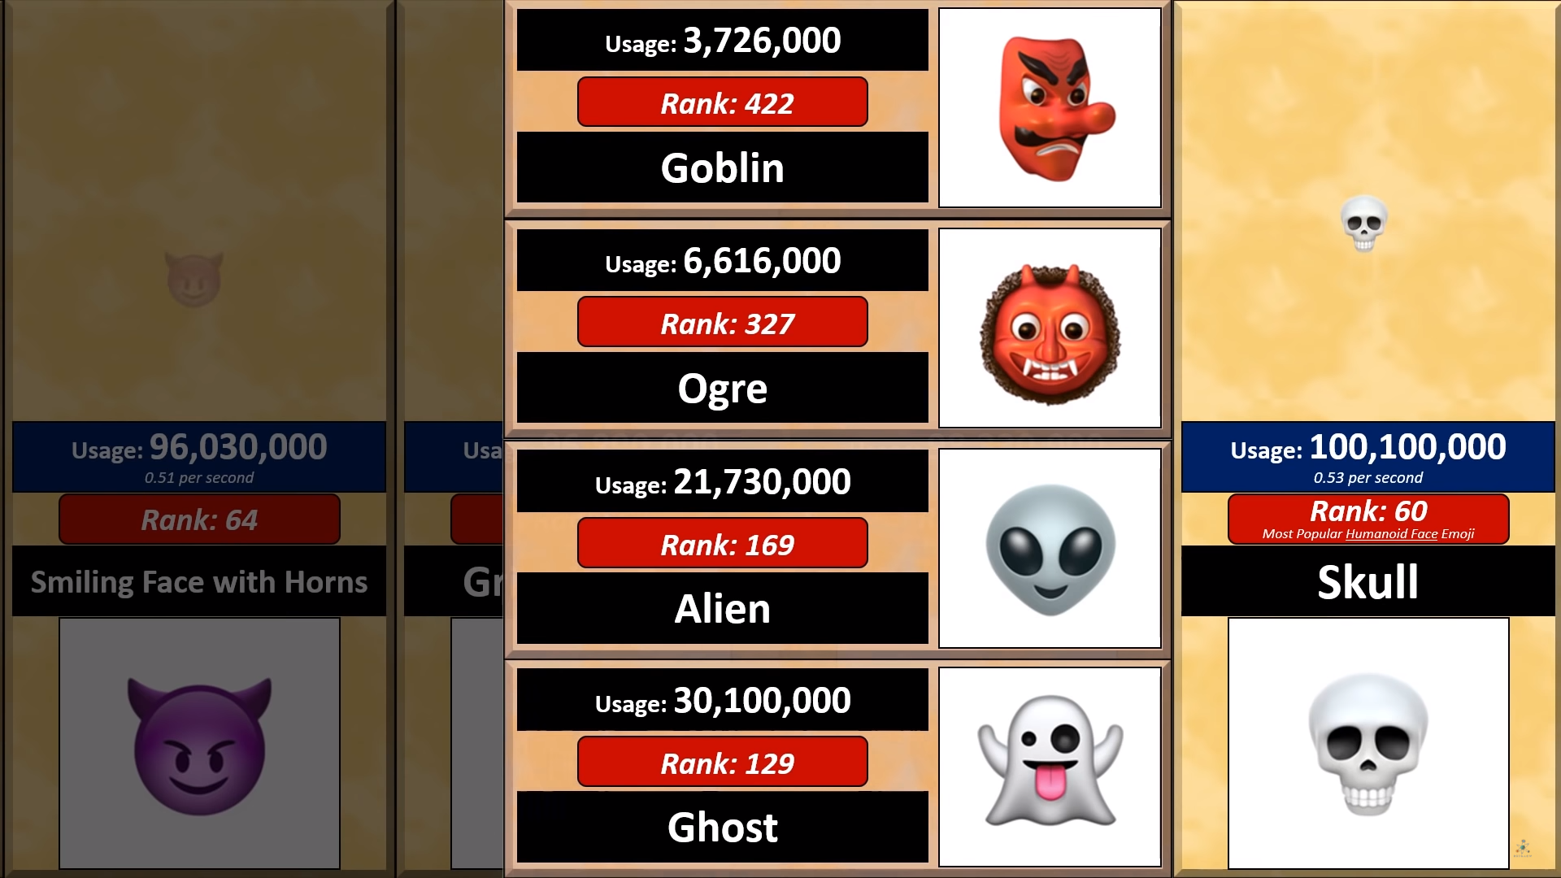

Slide 27
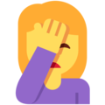


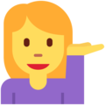

Most Popular Body Gesture Emoji

Slide 28
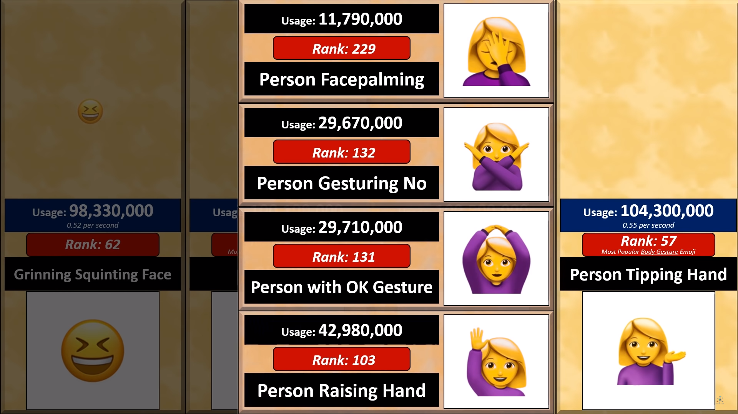

Slide 29





Most Popular Flower Emoji

Slide 30
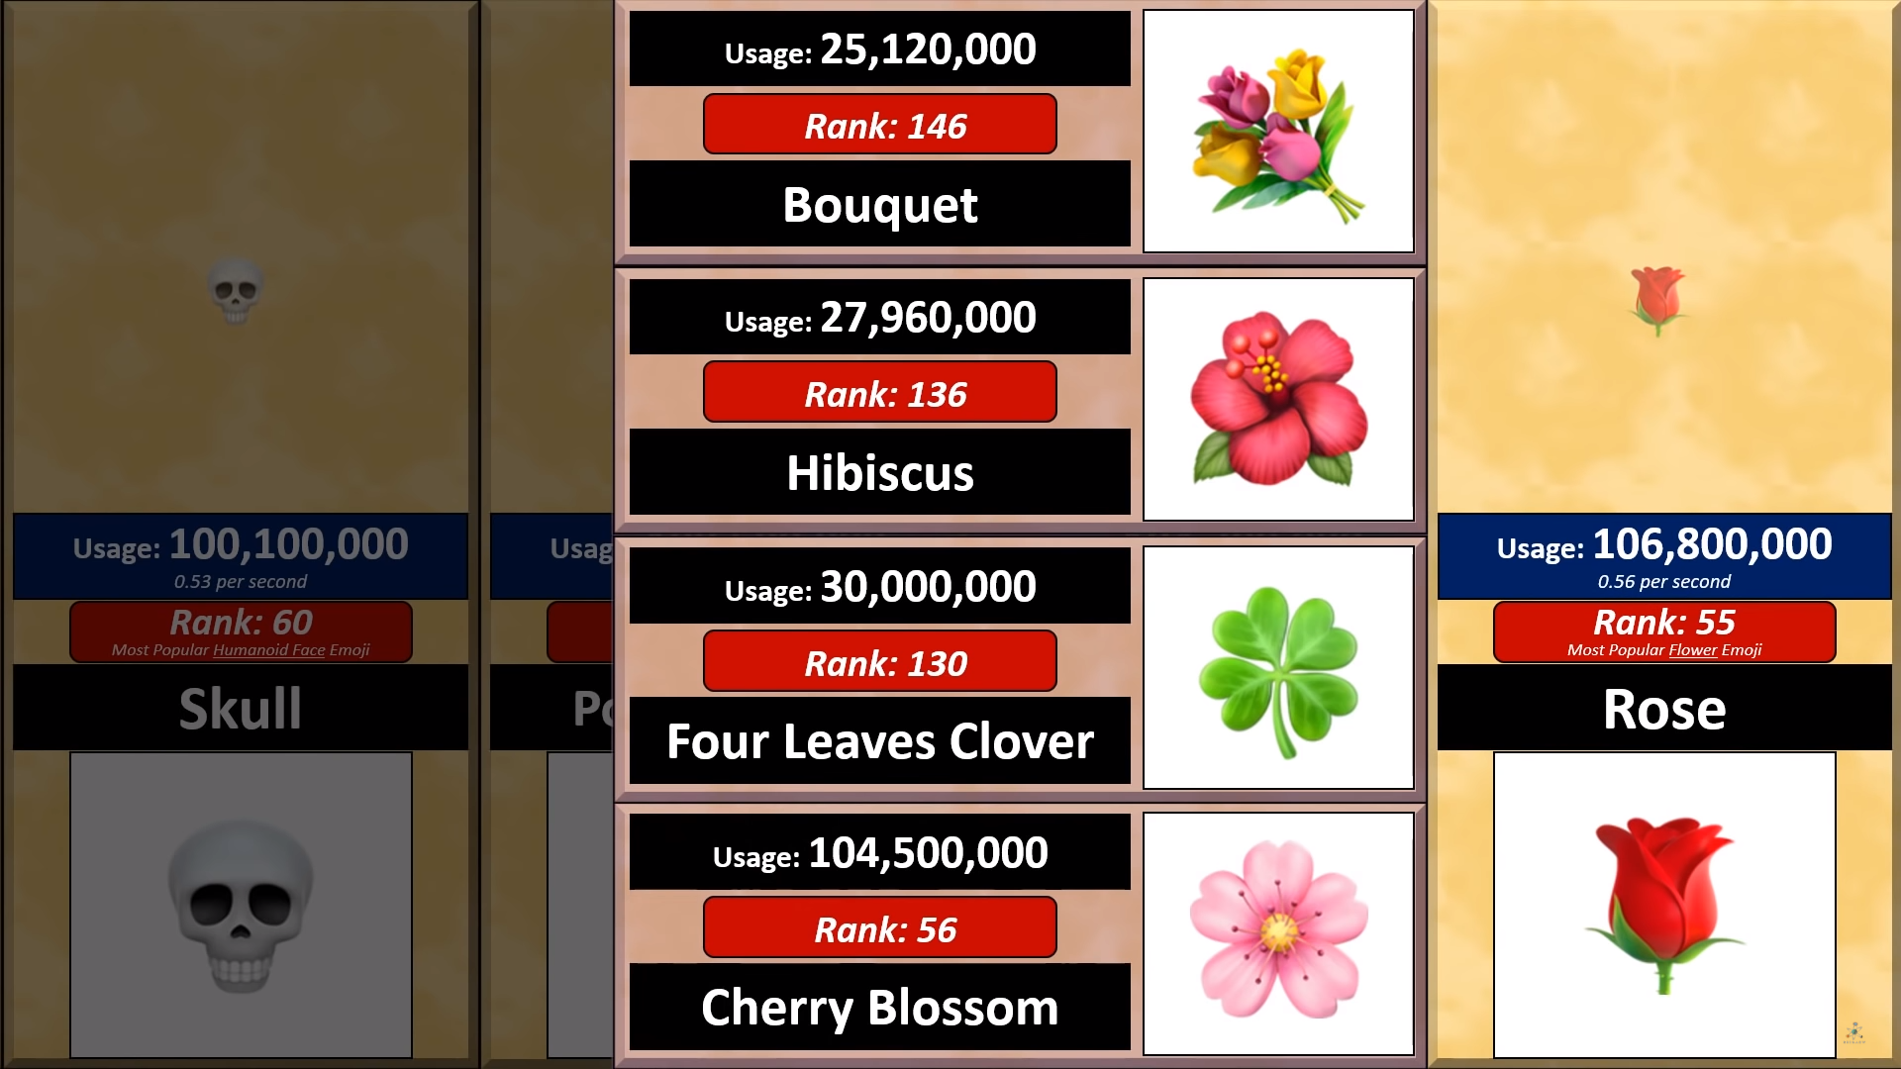

Slide 31





Most Popular Elemental Emoji

Slide 32
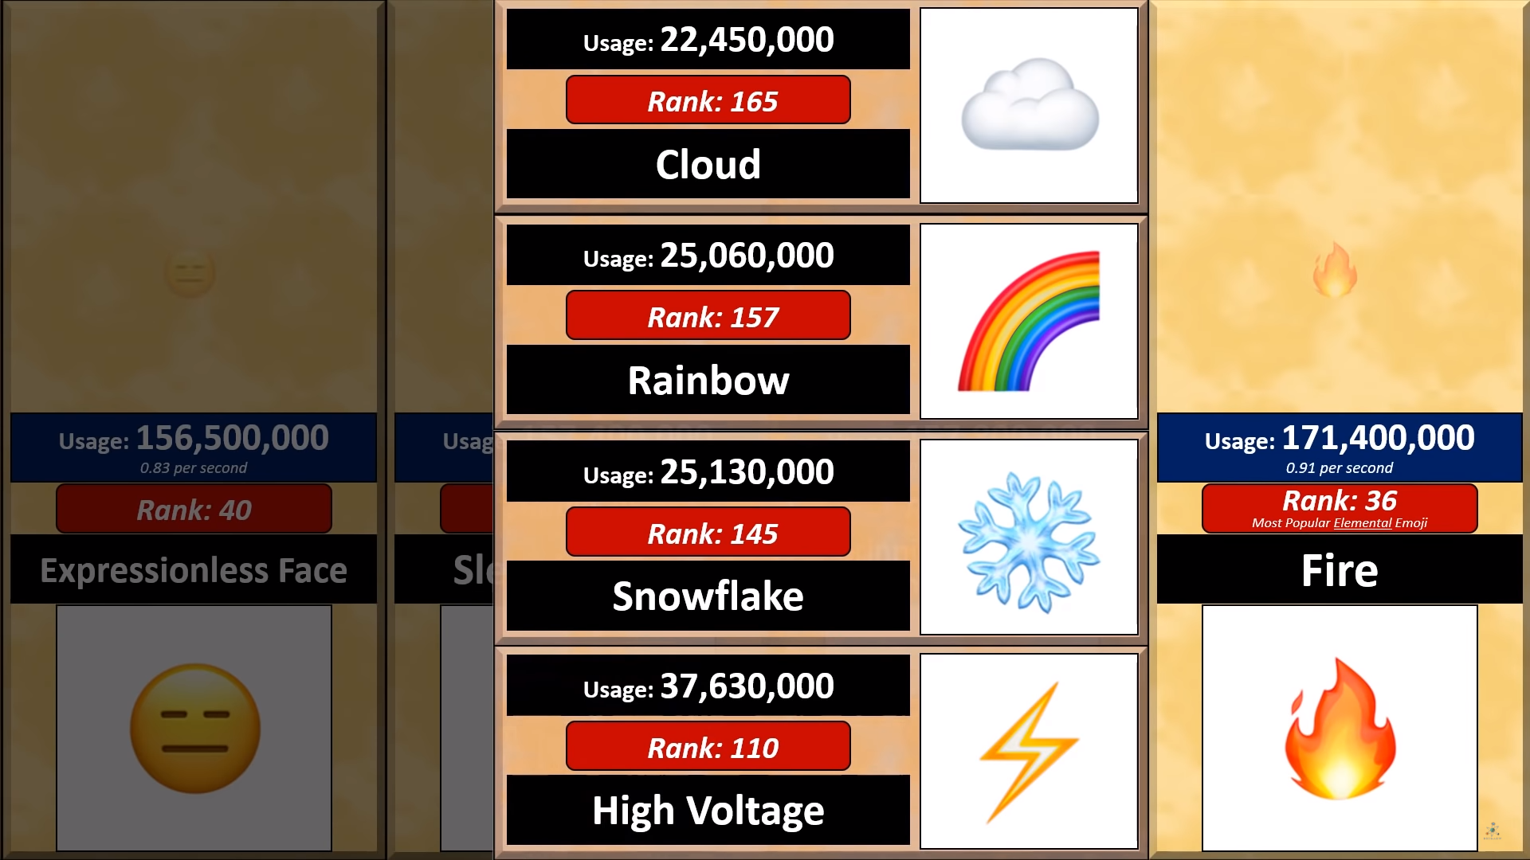

Slide 33



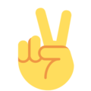

Most Popular Hand Gesture Emoji

Slide 34
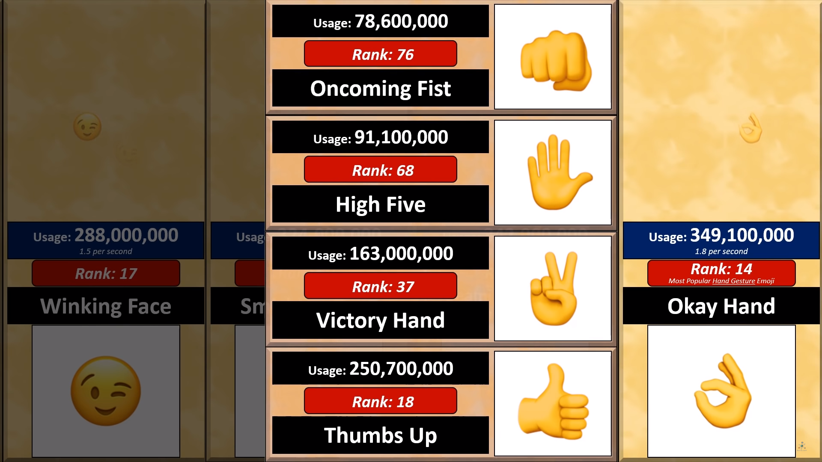

Slide 35







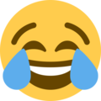

Most Popular Emoji

Slide 36
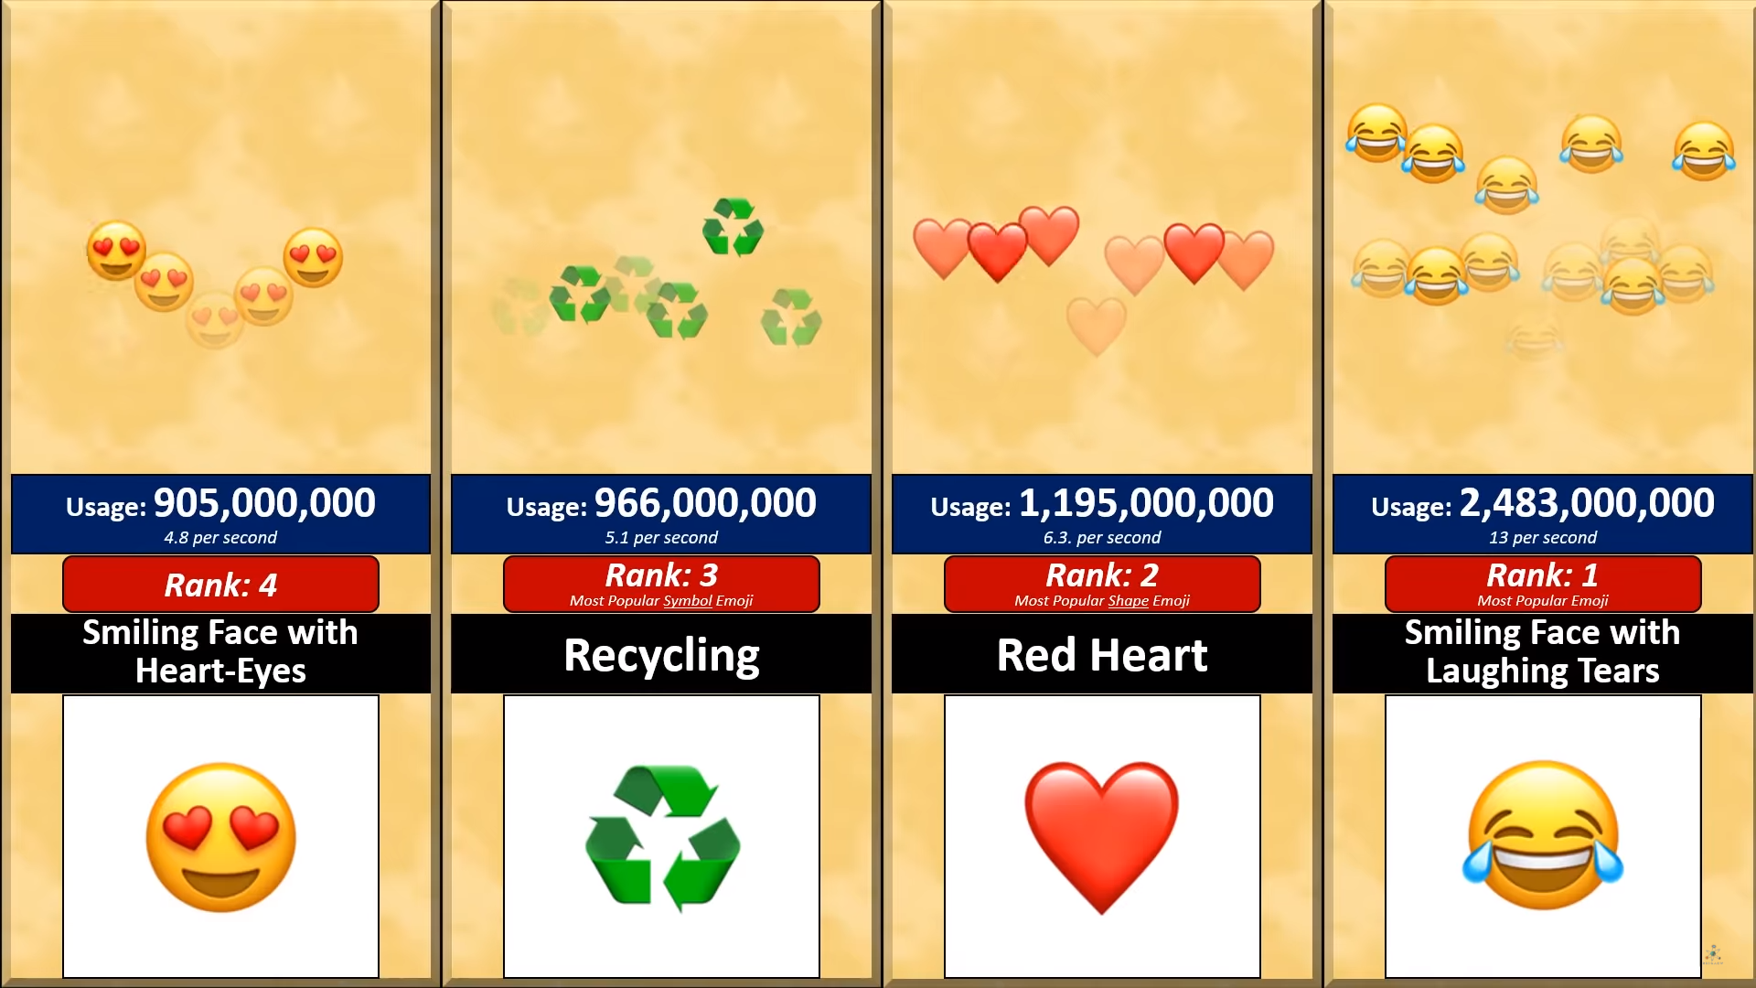

Slide 37
Does this Color Turn You Off?
https://www.theage.com.au/national/does-this-colour-turn-you-off-20120816-24bf4.html
Emoji Popularity Comparison
https://www.youtube.com/watch?v=W49KAyAKjHM&list=PL9i6nLIBlfKvunIYrc60Hsw0vNQsANk5n&index=58
Tier Lists
https://knowyourmeme.com/memes/tier-lists
Who Should go to Mars?
https://www.theverge.com/2016/9/30/13099134/space-x-elon-musk-mars-mission-colonists-personality-fitness-health-requirements
Michelin Star Chef Ranks Top 5 Fast Food Chains * Top 5 Breakdown
https://www.youtube.com/watch?v=36oRiPAn4Tw&fbclid=IwAR2gb3SKi2_iAa3gdcgB5cH3Rf660wAyWOTkqY8wPuwxfnt3MtecU5vw6lE

Slide 38
ESL toybox
www.esltoybox.com

