Slide 1
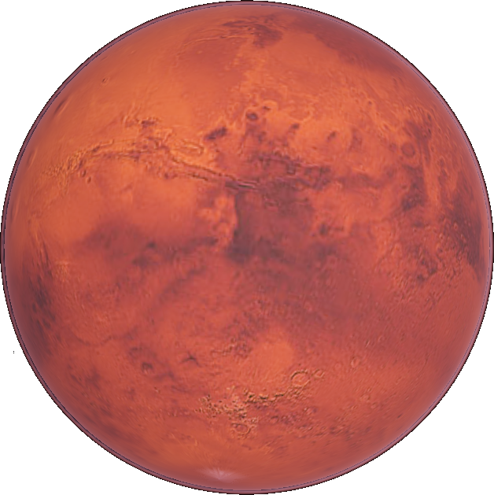
Settling
Mars

Slide 2
Things to Consider
Make a List

Slide 3
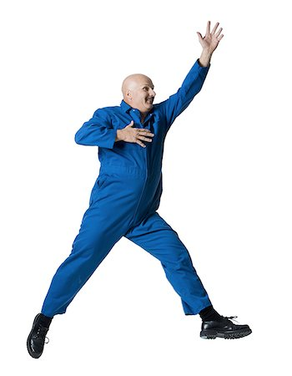

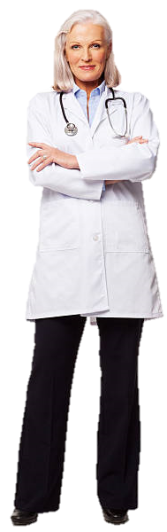
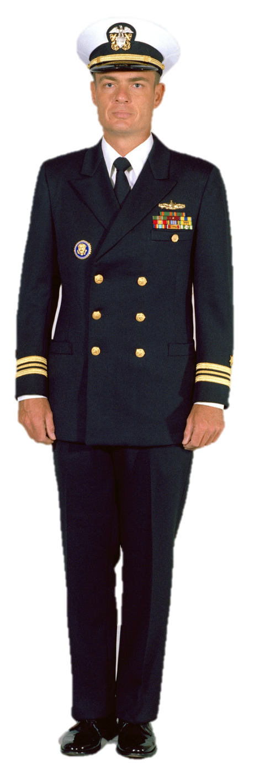



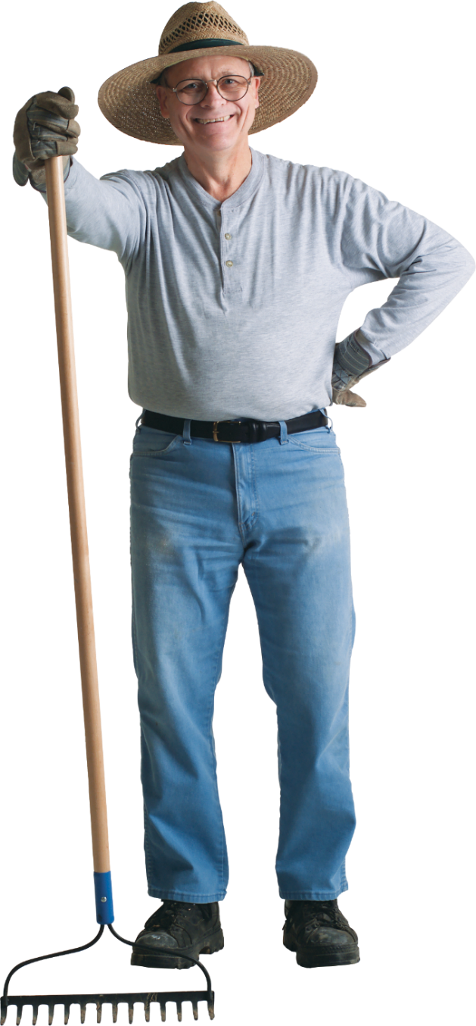



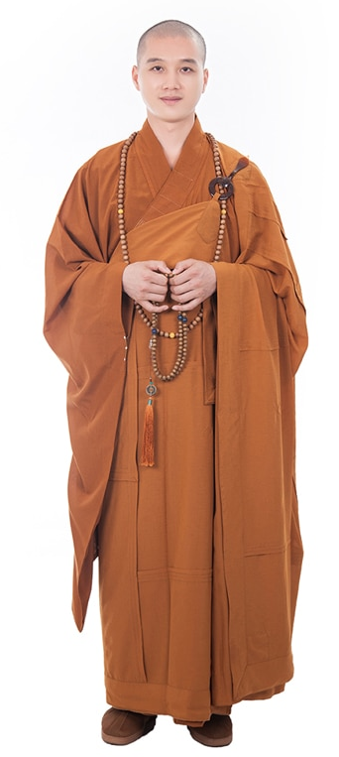
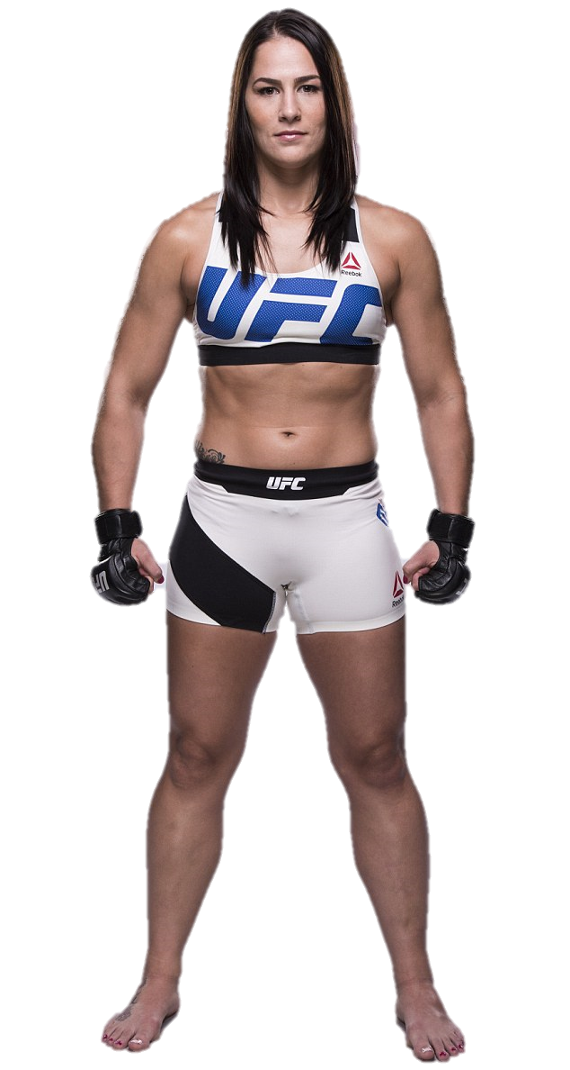

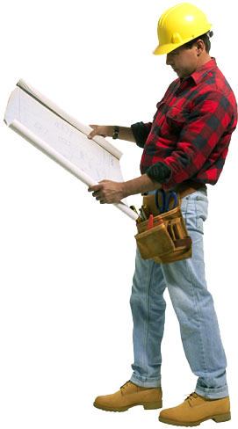

5
1 Leader + 4 Teammates
Crew members

Slide 4
Who should go?
Read
p. 231 - 234

Slide 5
Characteristics
Prepared to die
MARS
Space physical
Good vision
Good blood pressure

Slide 6
Characteristics
Technical degree
MARS
3 years work experience
Cool under pressure
Adventurous spirit

Slide 7
Characteristics
Disciplined
MARS
Work well with others
Drive to survive
Tolerant

Slide 8
Characteristics
Think outside the box
MARS
All men = bad
Range of ages
Skillset diversity

Slide 9
Characteristics
Sense of common purpose
MARS
No homesickness
Resilient to loneliness
Overview effect

Slide 10
Would you go?

Slide 11
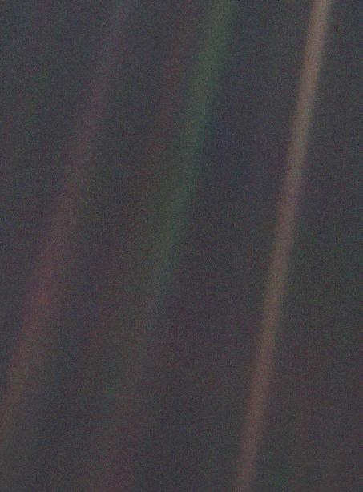
Overview Effect
Pale Blue Dot

Slide 12
Look again at that dot. That's here. That's home. That's us. On it everyone you love, everyone you know, everyone you ever heard of, every human being who ever was, lived out their lives. The aggregate of our joy and suffering, thousands of confident religions, ideologies, and economic doctrines, every hunter and forager, every hero and coward, every creator and destroyer of civilization, every king and peasant, every young couple in love, every mother and father, hopeful child, inventor and explorer, every teacher of morals, every corrupt politician, every "superstar," every "supreme leader," every saint and sinner in the history of our species lived there--on a mote of dust suspended in a sunbeam.
Pale Blue Dot

Slide 13
The Earth is a very small stage in a vast cosmic arena. Think of the rivers of blood spilled by all those generals and emperors so that, in glory and triumph, they could become the momentary masters of a fraction of a dot. Think of the endless cruelties visited by the inhabitants of one corner of this pixel on the scarcely distinguishable inhabitants of some other corner, how frequent their misunderstandings, how eager they are to kill one another, how fervent their hatreds.
Pale Blue Dot

Slide 14
Our posturings, our imagined self-importance, the delusion that we have some privileged position in the Universe, are challenged by this point of pale light. Our planet is a lonely speck in the great enveloping cosmic dark. In our obscurity, in all this vastness, there is no hint that help will come from elsewhere to save us from ourselves.
Pale Blue Dot

Slide 15
The Earth is the only world known so far to harbor life. There is nowhere else, at least in the near future, to which our species could migrate. Visit, yes. Settle, not yet. Like it or not, for the moment the Earth is where we make our stand.
Pale Blue Dot

Slide 16
It has been said that astronomy is a humbling and character-building experience. There is perhaps no better demonstration of the folly of human conceits than this distant image of our tiny world. To me, it underscores our responsibility to deal more kindly with one another, and to preserve and cherish the pale blue dot, the only home we've ever known.
  — Carl Sagan, Pale Blue Dot, 1994
Pale Blue Dot

Slide 17
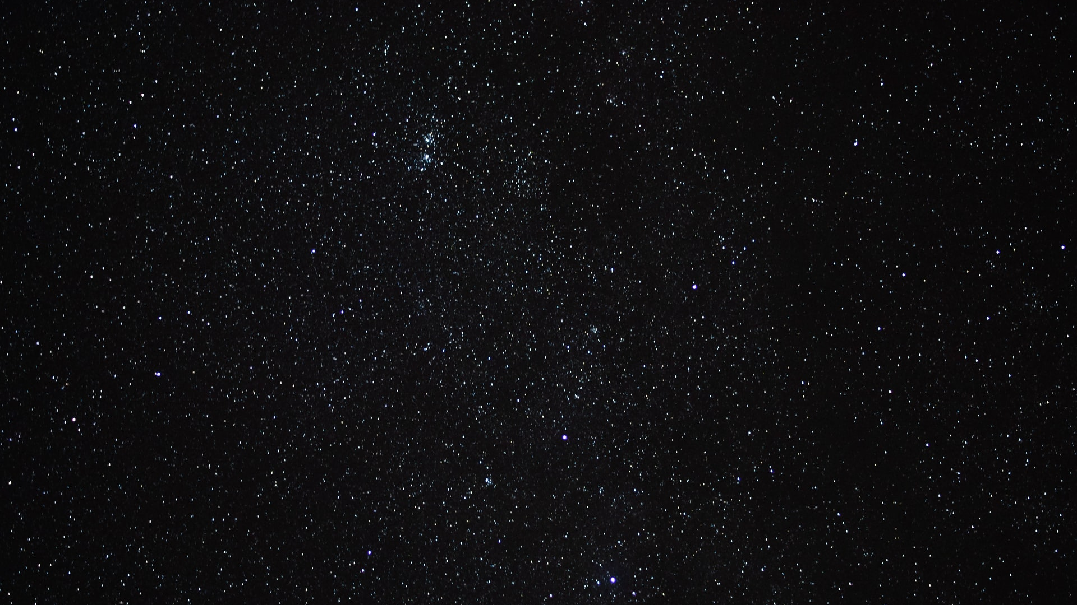

Slide 18
Does this Color Turn You Off?
https://www.theage.com.au/national/does-this-colour-turn-you-off-20120816-24bf4.html
Emoji Popularity Comparison
https://www.youtube.com/watch?v=W49KAyAKjHM&list=PL9i6nLIBlfKvunIYrc60Hsw0vNQsANk5n&index=58
Tier Lists
https://knowyourmeme.com/memes/tier-lists
Who Should go to Mars?
https://www.theverge.com/2016/9/30/13099134/space-x-elon-musk-mars-mission-colonists-personality-fitness-health-requirements
Michelin Star Chef Ranks Top 5 Fast Food Chains * Top 5 Breakdown
https://www.youtube.com/watch?v=36oRiPAn4Tw&fbclid=IwAR2gb3SKi2_iAa3gdcgB5cH3Rf660wAyWOTkqY8wPuwxfnt3MtecU5vw6lE

Slide 19
ESL toybox
www.esltoybox.com

