Slide 1
Attraction
35+ Interesting Things That People Find Attractive in Countries Around the World

Slide 2
What do you find attractive?
Write on scrap paper
You can change it

Slide 3
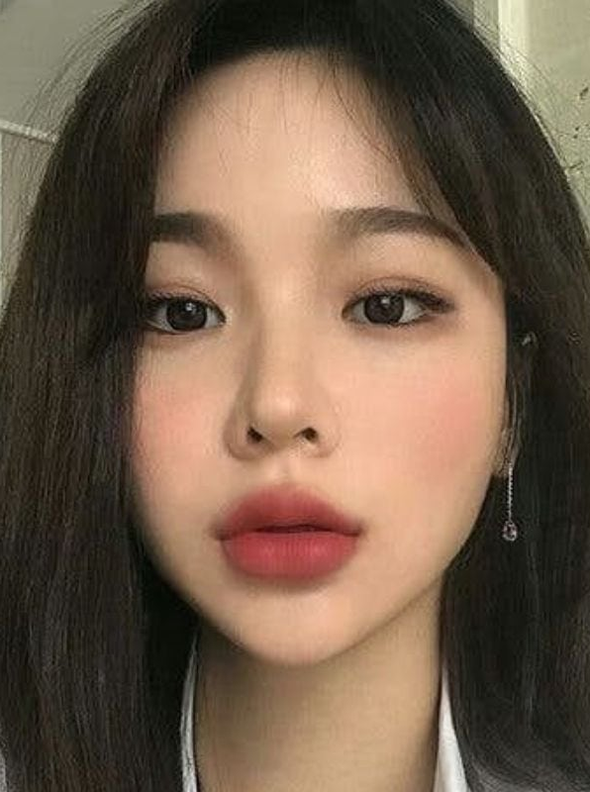
Heart-Shaped Face
There are some countries in the world that really put a big stock on looks, and so people in these places tend to be more open to cosmetic surgery. Take, for instance, South Korea, where you will often see advertisements for procedures.
One of these procedures is intended to help the women there achieve a particular attribute that is seen as a true sign of beauty. This, of course, is the heart-shaped face which can only be done with a little cosmetic surgery on the chin.
Heart-Shaped Face

Slide 4
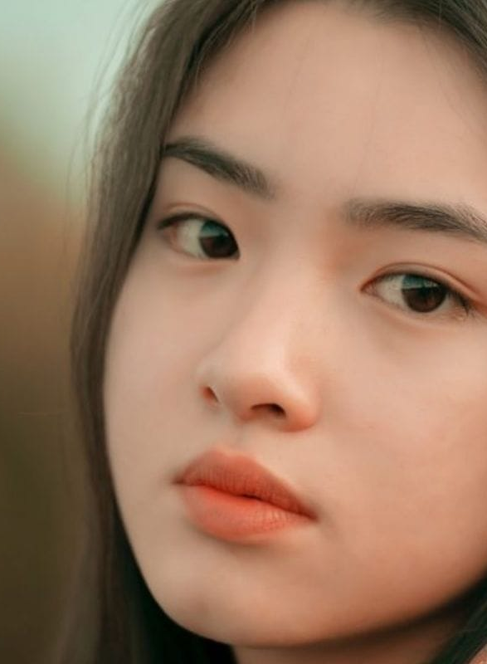
Double Eyelids
We know that this physical attribute may sound like something that belongs to a science fiction alien character or something but this is actually something that in South Korea is believed to help you look more beautiful.
So, in order to achieve double eyelids, there is a specific surgery available there, or you can simply use eyelid tape to make this happen. What it does is widen the eyes, which many people there feel is a sign of beauty.
Double Eyelids

Slide 5
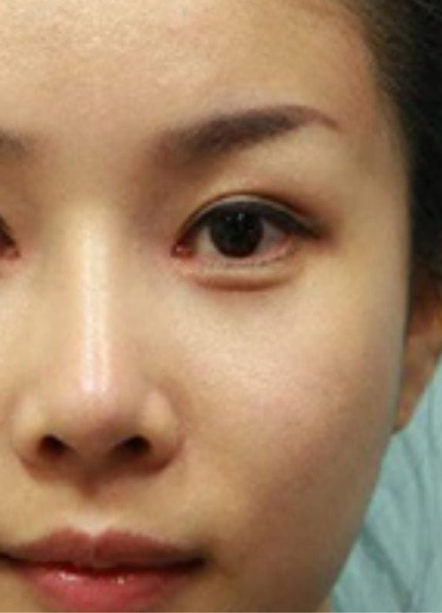
Skinny Noses
It seems that one of the biggest trends in many Asian countries is to alter their face so that it appears less Asian, and this may be due to the Western influence on their cultures. Not only do they want larger eyes, but they also admire skinny noses.
Since not everyone in this country is born with a thin nose, they have come up with rather drastic techniques, such as nose squeezing, to help get a skinnier nose profile.
Skinny Noses

Slide 6
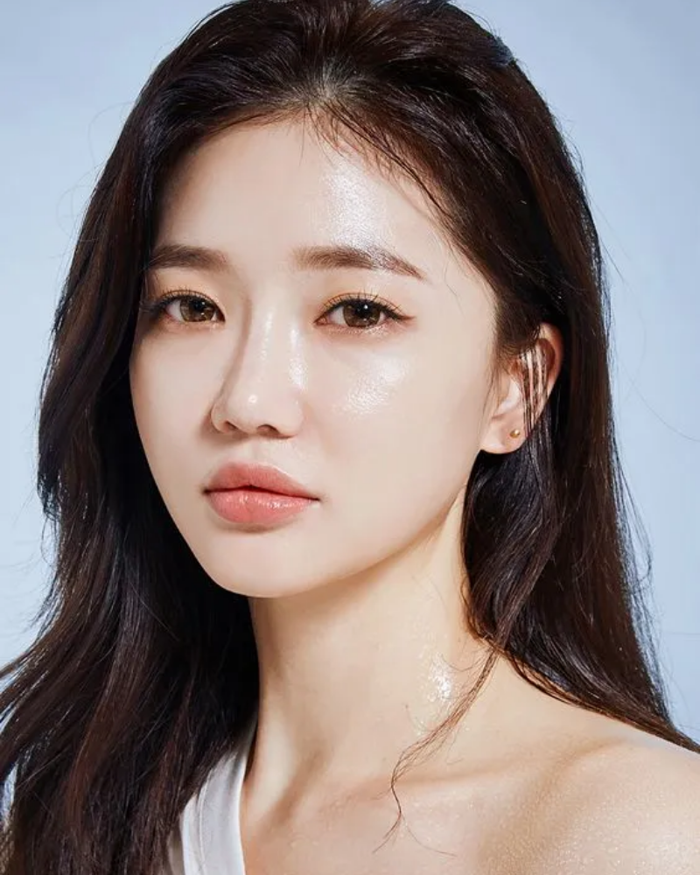
Glass Skin
While some cultures believe that makeup can cover any skin issues, South Koreans prefer to focus on having the most flawless skin they can get. Known as glass skin, for its shiny and almost translucent look, the look has become the standard for beauty in the Asian country.
The look is supposedly achievable by implementing a ten-step regimen that includes face scrubs, toner, moisturizers, and cleansers. If you have extra time on your hands, this dewy and bright skin can be yours.
Glass Skin

Slide 7
Cheek Reduction Surgery
Most of us associate round faces and plump cheeks with youth. While these features may be desired in some parts of the world, in South Korea many people are turning to plastic surgery to get a more defined facial structure.
Known as buccal lipectomy, this surgery reduces the buccal fat pads in our cheeks resulting in a thinner face. Another popular surgery, zygoma reduction, reduces the size of your cheekbones. Both surgeries completely change the appearance of face shapes and are becoming increasingly popular.
Cheek Reduction

Slide 8
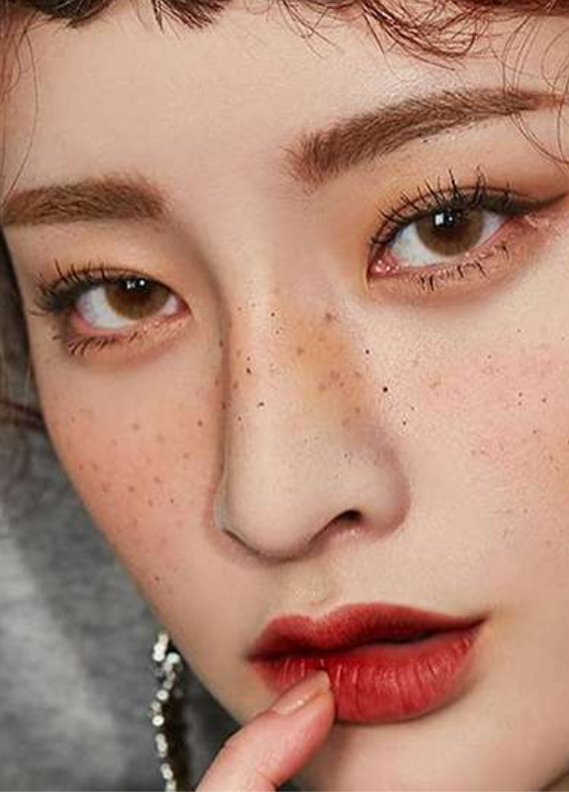
Straight Eyebrows
While many women in the West are turning to eyebrow pencils and botox injections to give them an arched eyebrow look, many South Korean women are choosing to wear their eyebrows completely straight.
This linear look is thought to give the wearer a more youthful appearance. In South Korea, it has become one of the most popular beauty trends. Some women with naturally arched eyebrows have even resorted to cutting or waxing their eyebrow hair to achieve this look.
Cheek Reduction
Straight Eyebrows

Slide 9
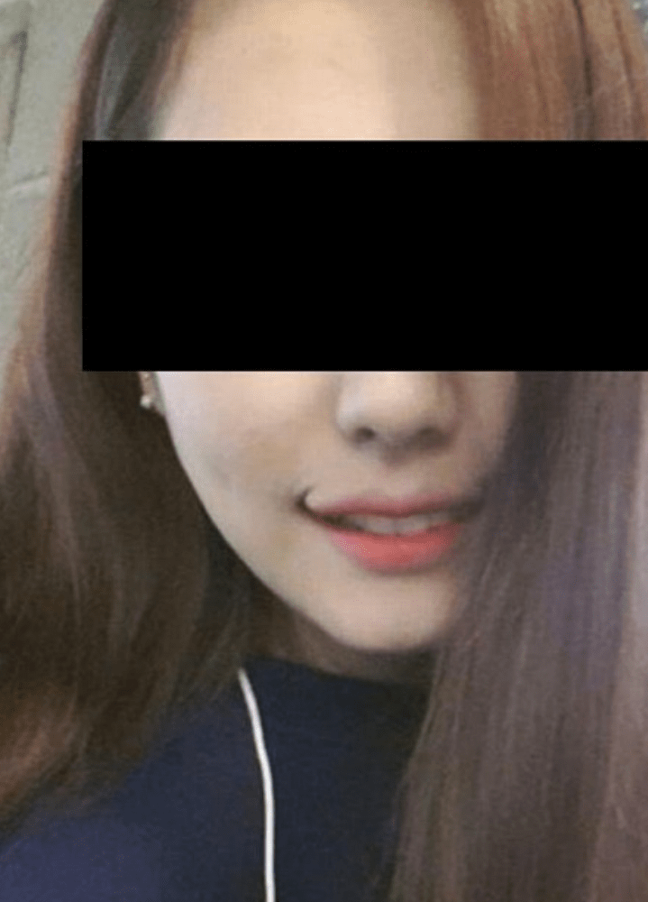
Perfect Smile
It seems that across the globe, one physical attribute that is the focus of a lot of beauty trends is the smile. Whether that is the lips or the actual teeth, the smile seems to be a universal sign of beauty.
However, in South Korea, they have a little bit of a different take on what exactly makes a smile beautiful. In order to get the perfect smile, many women go through a procedure known as smile lifting. This gives them almost a permanent smile at all times.
Perfect Smile

Slide 10
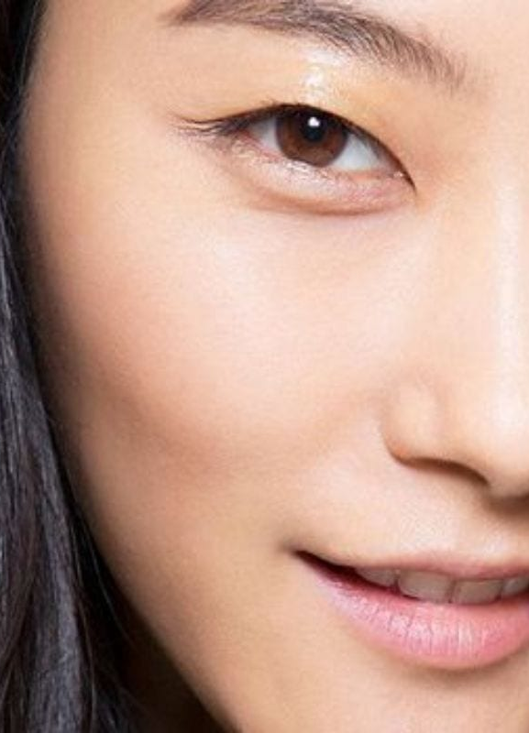
Puffy Under Eyes
Sometimes the reason for a physical attribute being beautiful has to do with the culture itself. For instance, in South Korea, bags under your eyes don't always mean you're tired. In fact, often, people look at this attribute as a sign of youth.
That may be why this is one of those physical attributes that people find very attractive. And just like everything else in South Korea, that is why there are cosmetic surgeries that can help women achieve this look.
Puffy Under Eyes

Slide 11
Androgynous
Androgenous Male
Known as Kkonminam, this new generation of South Korean men is challenging long-held beliefs about what it means to be masculine. Kkonminam are young men who enjoy fashion, different hairstyles, and even cosmetics.
Their style can be seen in many famous Korean pop bands and male celebrities. Most Kkonminam are clean-shaven with longer hair. South Korean men are increasingly becoming fans of skincare products and cosmetic surgery. Many fashion experts believe that this unique style will have a worldwide influence on men’s fashion in the future.

Slide 12
Information
Gathering
Learn about various beauty standards Where, Describe, Why
Independent (15 minutes)
Group (15 minutes)

Slide 13
Independent
15 Minutes
Group
15 Minutes

Slide 14
Review
Discussion Questions

Slide 15
Read and React
Discussion questions

Slide 16
Which beauty standard was the most shocking?

Slide 17
Which ones do you agree / disagree with?

Slide 18
Who decides what is attractive?

Slide 19
Does being beautiful give someone an advantage in life?

Slide 20
Is “beauty only skin deep”?

Slide 21
What is the first thing you notice about someone?

Slide 22
Is there anything we can learn about someone from their physical appearance?

Slide 23
Are beauty standards changing in Korea?

Slide 24
Do you think tattoos are beautiful?

Slide 25
How often do you think about your physical looks?

Slide 26
How often do you think about how other people look?

Slide 27
If you could change a physical attribute with cosmetic surgery, what would you change?

Slide 28
What do you think about body piercings?

Slide 29
Can unusual hair colors look good?

Slide 30
Should men wear more makeup or use skin care products?

Slide 31
Do we judge women by appearance more than men?

Slide 32
Is there a connection between beauty and intelligence?

Slide 33
Does looking good make you feel more confident?

Slide 34
How much money should someone spend on fashion per month?

Slide 35
Have you ever seen someone that looked truly bizarre? Describe them.

Slide 36
Attractiveness
Map
Group work

Slide 37
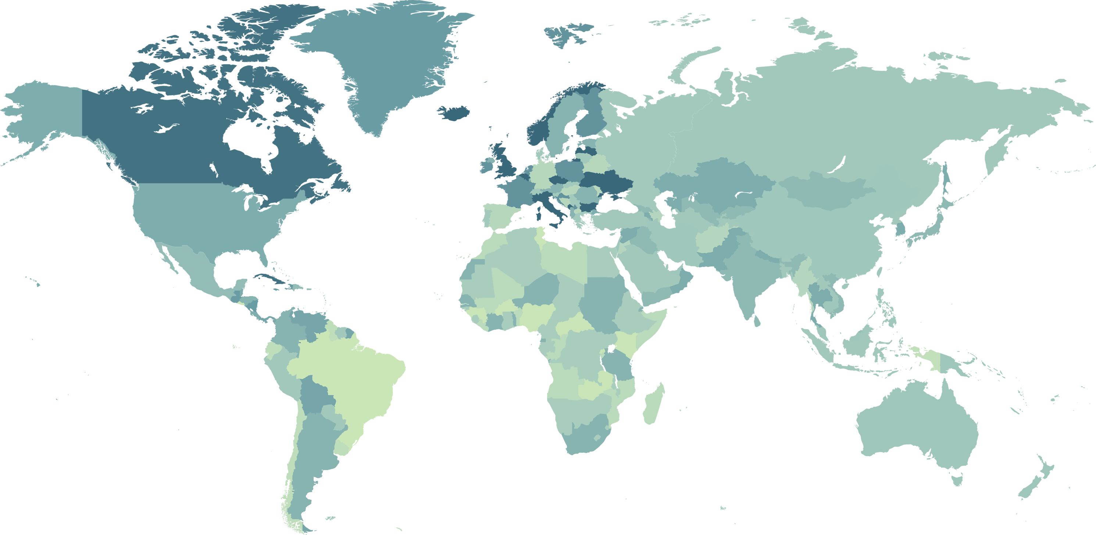

Slide 38
Review
Crossword
Group work

Slide 40
Draw
The perfect face

Slide 41
Read and Draw
The Perfect Face

Slide 42
Information gathered from:
Shepherd, B. T. (2021, November 2). 35+ Things People Find Attractive in Various Countries Around The World. BigGlobalTravel. https://bigglobaltravel.com/trending/interesting-world-fb/?utm_campaign=interesting-world

