Slide 1
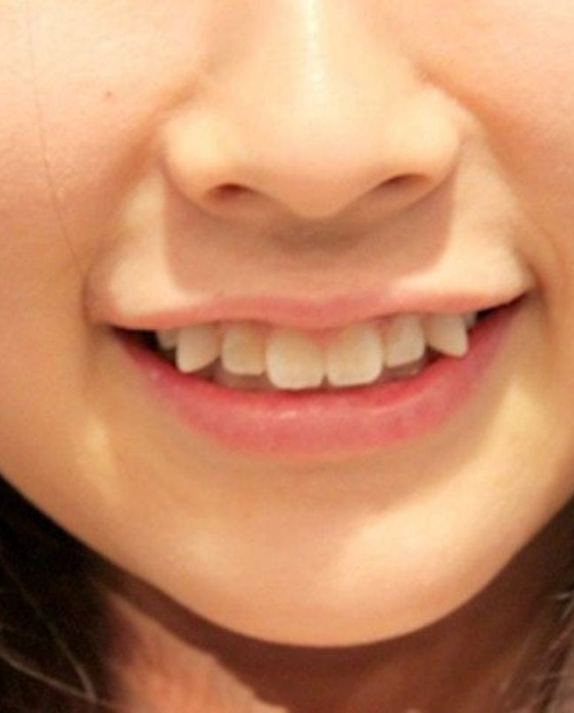
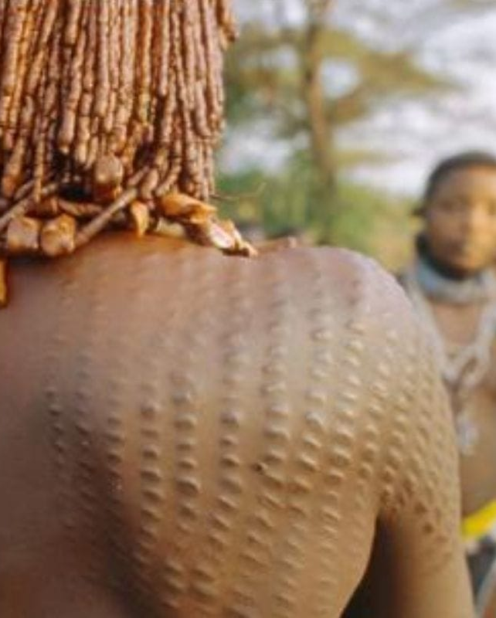
For the most part, if you live in the Western part of the world, having a set of straight pearly whites is a must. In fact, many of us that don't, often tend to smile less because we don't want to show the world that we don't have this feature.
However, in Japan, their take on teeth is a little bit different. They actually think that when you have crooked teeth, you are cuter. This change is starting to be seen as attractive in the Western world.
Crooked Teeth –
Japan
We know what you're thinking – scars are not really something that is universally accepted as being a beautiful attribute. That may be the case in most parts of the world, but for the inhabitants of New Guinea and some African tribes, they are most definitely a sign of beauty.
When it comes to these tribes, the beauty quotient of these scarifications is solely attached to the females. For the men, the scarifications are a sign of strength and being a warrior.
Body Scarification – West Africa

Slide 2
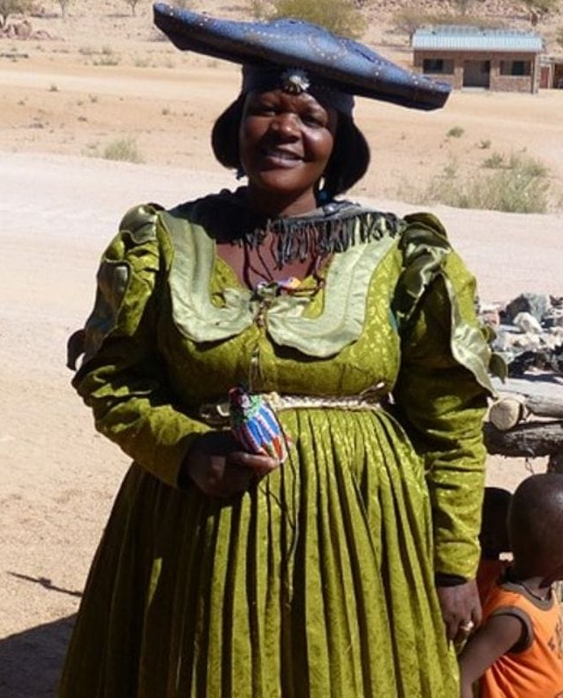
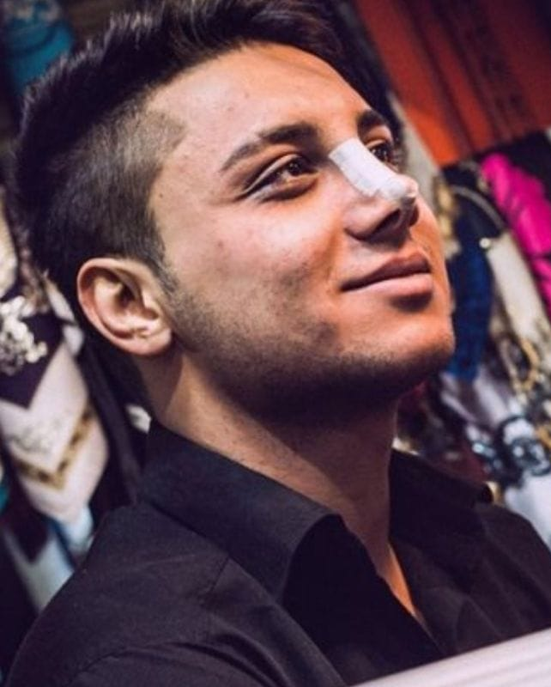
People take their body image seriously all over the world. In most countries, when you have a little bit of extra weight, you feel a bit self-conscious as it's not necessarily looked at as attractive. Though this may be changing slightly, it is still a known struggle.
But for the women of Mauritania, this is not the case. In fact, men find women there that have extra weight vastly more attractive than those that don't.
Extra Weight – Mauritania
No matter where you live, you may find yourself wanting to get a little work done on your nose. Maybe it's too big or too small or maybe you just want a different look. There are a lot of people out there that want to make some adjustments.
In Iran, this procedure is very common, even though it is also pricey. To have a straight nose in this country is deemed beautiful, and so many people, both men, and women go under the knife.
Surgical Dressing –
Iran

Slide 3
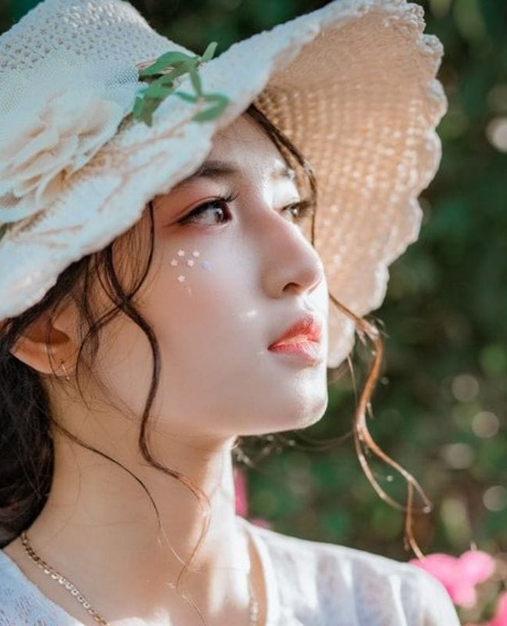
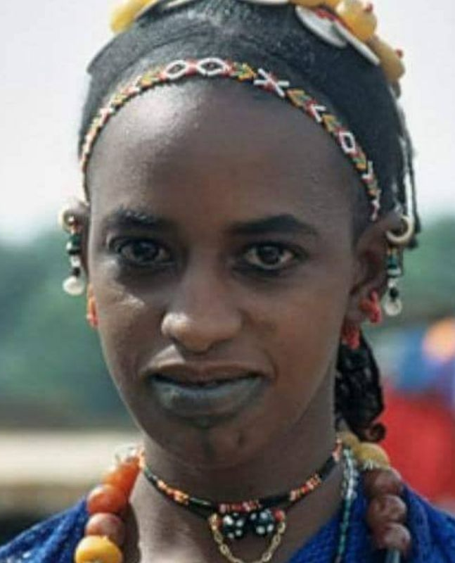
Pale Skin –
China
It may seem counterintuitive to many people from the Western world who long to have a golden tan, but some countries in the world feel that pale skin is a sign of beauty — places like China, for example.
To obtain this paler skin, many of the beauty products sold within this country have some sort of bleaching agent involved. Chinese people will also try to stay out of the sun or wear masks so that they can achieve their desired skin tone.
Many different parts of the body, depending on the culture you come from, are found to be attractive. For instance, if you come from the Fula tribe in Africa, you may find that you want to have a high forehead.
Many of these tribal women will go as far as to remove parts of their hair so that they can create a higher forehead. When you really think about it, the lengths we go to, in order to achieve our standard of beauty is quite astonishing.
High Forehead –
Africa

Slide 4
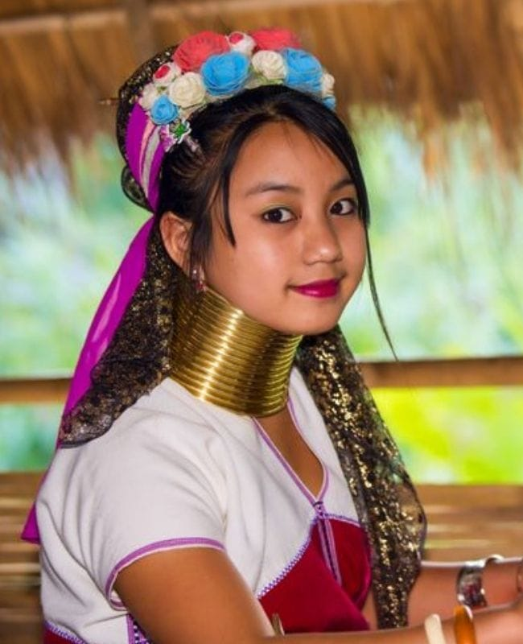
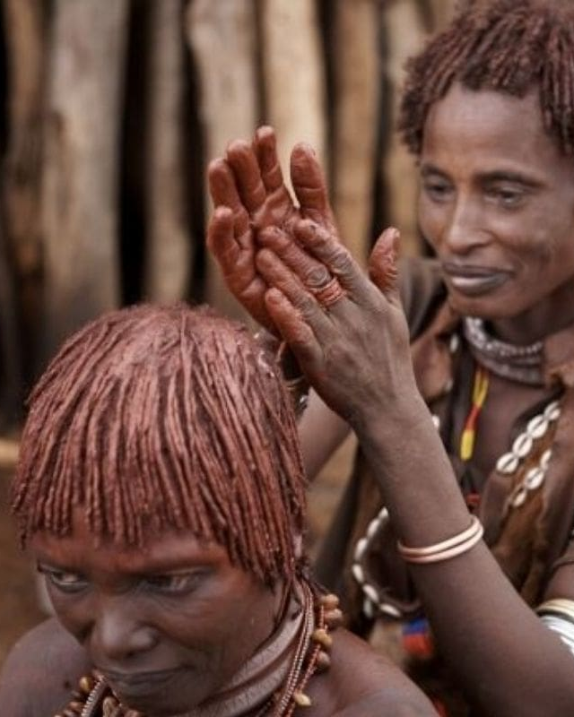
It is not a surprise that there are many places in the world that find the neck one of the most attractive parts of a woman. Typically though, these places don't require you to do anything to them, except maybe to lift your hair off your neck.
However, in Eastern Burma, this isn't the case. In fact, the women of the Kayan tribe there actively stretch their necks out. They do this by wearing a brass ring necklace that helps elongate the neck. Ouch!
Long Necks –
Burma
Red Skin –
Africa
It's not a big surprise that one of the physical attributes people find attractive has to do with skin tone. In some parts of the world, you want to be darker, and in others, you would want to be lighter, but in Africa, there is a tribe that wants to be redder.
The Himba tribe in Namibia uses a mixture of red ochre and fat to help keep them safe from the harmful rays of the sun. Because of this mixture, their skin tone turns red, and this has become one of the features that this tribe deems beautiful.

Slide 5
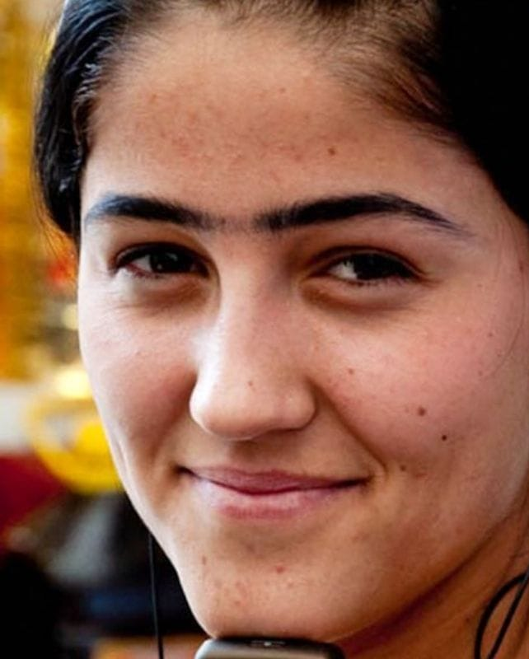
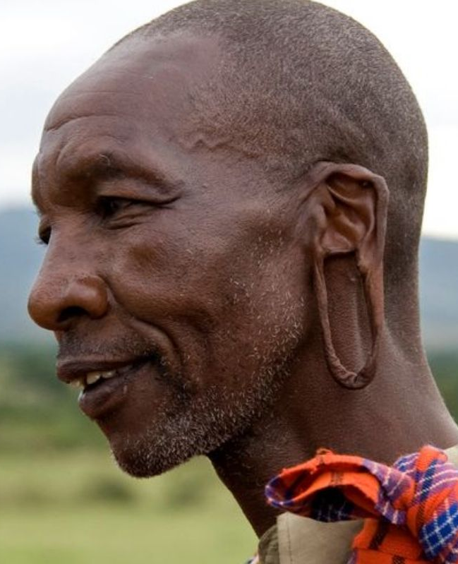
Unibrows –
Tajikistan
In most places in the Western world, if you walked around with a unibrow, you would be mocked or at the very least stared at. This is because it is not very beautiful in these areas to go ungroomed in this way. But that isn't the case everywhere.
In Tajikistan, the unibrow is actually a sign of beauty for both the male and the female. So much so that even if a young girl doesn't have one, she will pencil it in.
Most of the world agrees that a woman who has pierced ears and can don beautiful jewelry is very attractive. But there are some parts of the world where the practice of wearing heavy jewelry and stretching your earlobes out is considered beautiful.
In fact, members of the Masai tribe purposely stretch out their ear lobes over time. This is seen as a status symbol for the women of the tribe and because of this, everybody pays attention to how long their ears are.
Stretched Earlobes – Africa

Slide 6
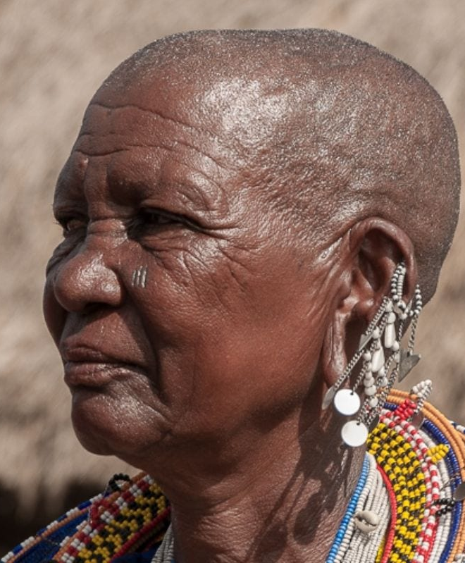
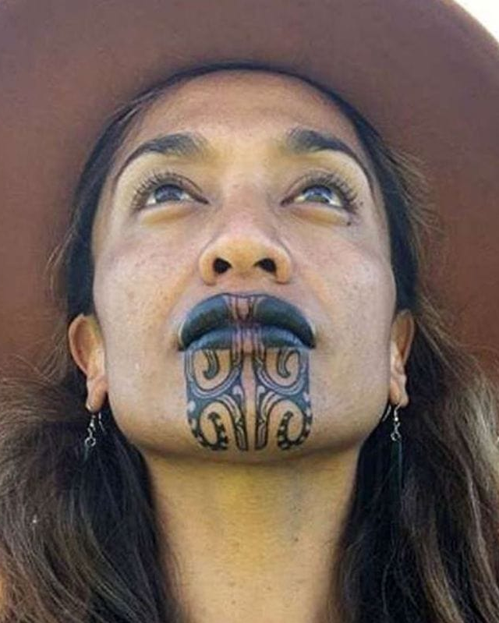
Shaved Heads –
Africa
Most people, when they think of beautiful women, think of long luscious locks that flow down their back. However, some cultures believe quite the opposite.
In some parts of Africa, it is thought that women with shaved heads are much more attractive than those with long hair or braids. So, as we're starting to realize, beauty standards are very different depending on where you are situated.
The Mallory tribe of New Zealand are well known for their love of the tattoo. Every tattoo is different and meant to give honor to their ancestral heritage. For women, these tattoos also allow others to see which tribe they come from and where they stand in that tribe. As a result, these women tend to tattoo their lips and their chins, which is solely for beauty reasons. What do you think of the look?
Face Tattoo – New Zealand

Slide 7
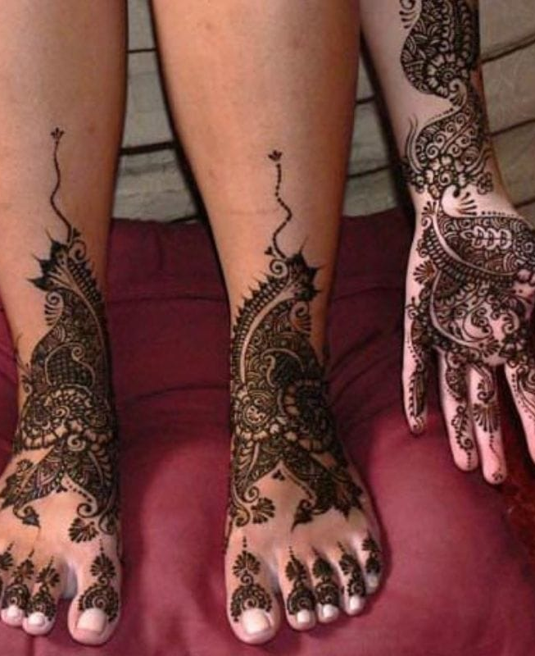
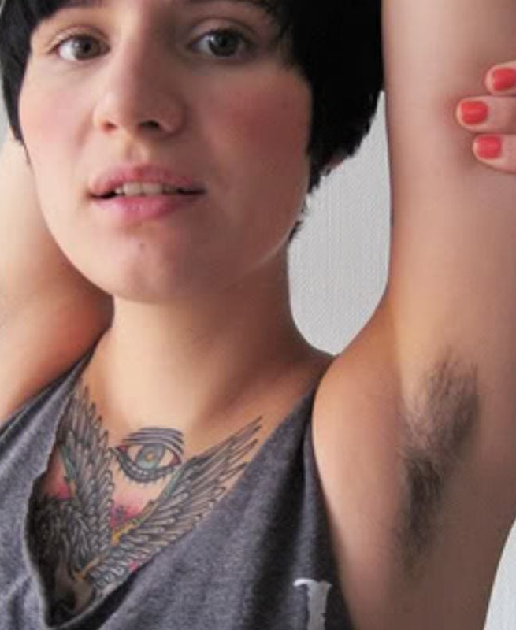
Henna Tattoos –
India
There are a lot of beauty trends in India, and one of these is henna tattoos. These special tattoos are applied to make themselves look more interesting, especially when it comes to big occasions like weddings or holidays.
Women will put them on their hands and feet to accentuate their beauty, but these tattoos are also an expression that is looked at as being very spiritual too. Do you see the beauty in henna art?
We find this hard to believe, but there are some places in the world that actually feel that being natural in any way is more attractive than not. For some, this means letting some of the hair on their body grow out.
Though we're not so sure that this trend is quite as popular as it used to be, there are still some that feel they don't need to shave as much as others.
Body Hair –
France

Slide 8
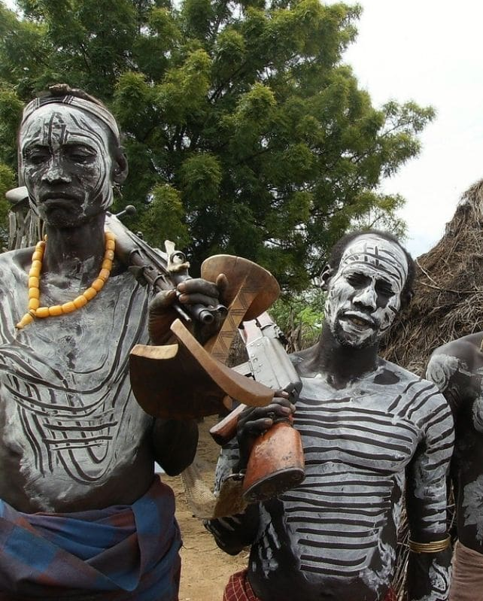
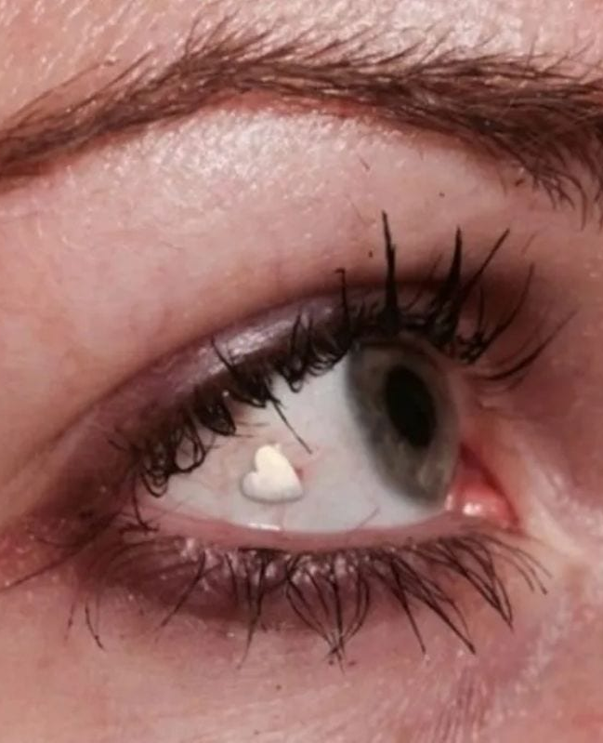
Chalk Body Covering –
Africa
Make-up is basically a form of body painting. Though for most of the world, the only place that it belongs is on the face. This is not the case when it comes to the body painting of the Caro tribe in Ethiopia.
The people of this tribe use white chalk to create spider motifs all over the body. This body painting is deemed a mark of beauty among both men and women.
Extraocular Implant – Netherlands
Many people in the world believe that one of the features that they find the most attractive is their significant other's eyes. This may be why in the Netherlands extraocular implants are seen as such a symbol of beauty.
To do this, the person goes under a small surgical procedure that implants a piece of molded platinum in a specific shape that they have chosen into their eye. It sounds a little scary but the end result is pretty cool.

Slide 9
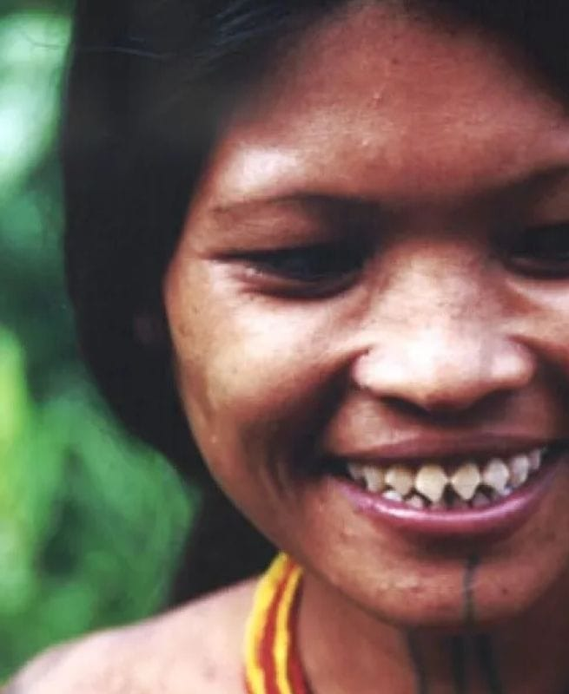
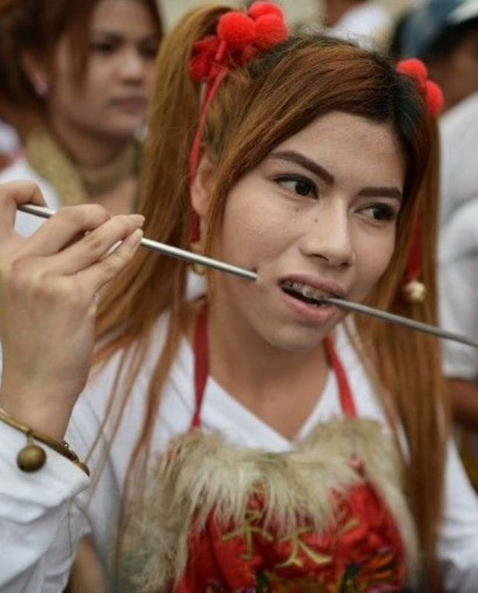
Sharp Teeth –
Indonesia
A great smile is always attractive, but that great smile actually depends on where you're from. It might be straight and white or, in the case of tribes in Indonesia, sharp and pointy.
There are some tribes in Indonesia who file their teeth into sharp points and this for them is a mark of beauty. The procedure to achieve this is actually is quite painful, but even still, women rush to get it done so they can attract a mate.
Cheek Piercing –
Thailand
In the Western world, it is very common nowadays to get dimple piercings. These are one thing, but in Thailand, they go a step further with the cheek piercing. Cheek piercing in Thailand is not only looked at as a beauty attribute but also is a sign of religious devotion. Both men and women execute this beauty trend, and when it comes to the size of the piercing, that can vary from very small to very large.

Slide 10
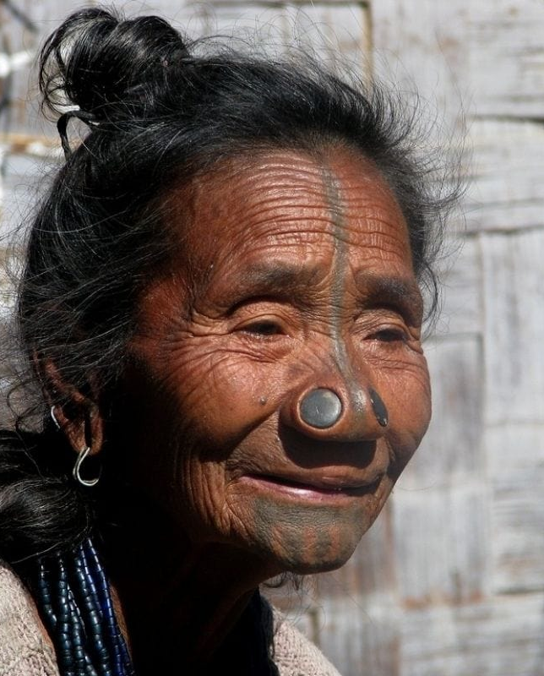
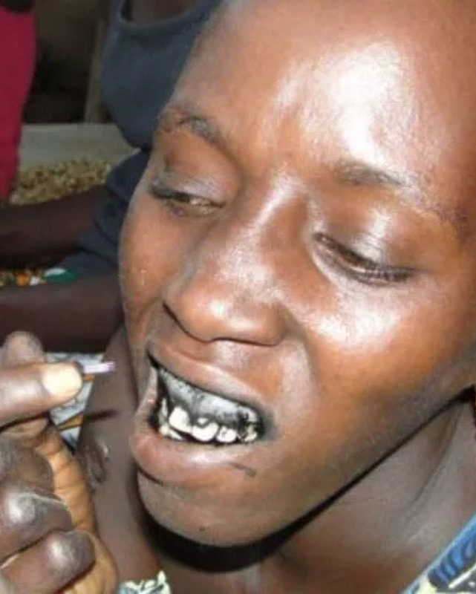
It is common knowledge that there is a wide range of beauty techniques that are carried out in India. One of these also offers an interesting take on physical attributes and what can be deemed as beautiful.
In the Apatani tribe in India, the women sport traditional nose plugs. These are plugs that are inserted in the nose like a gauge. It is an important aspect of their culture. As you can tell from the photo, the plugs also extend the size of their nostrils.
Nose Plug –
India
Gum Tattoo –
Africa
Many cultures across the globe believe that tattoos are a sign of beauty as well as status and power. Typically these tattoos are on areas that you can see at all times, but in Senegal, the women have a unique place that they like to get tattooed.
Senegalese women go through a process of gum tattooing because they feel that this makes their smiles not only unique but beautiful. Each to their own, right?

Slide 11
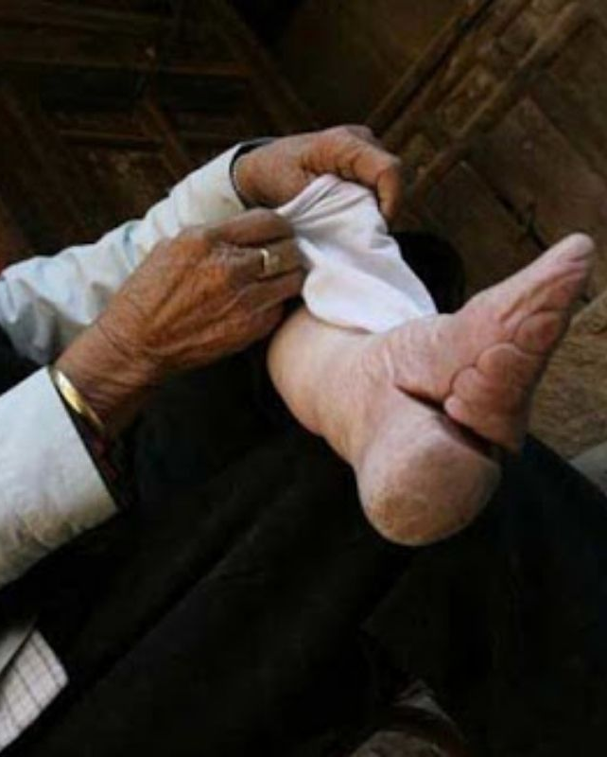
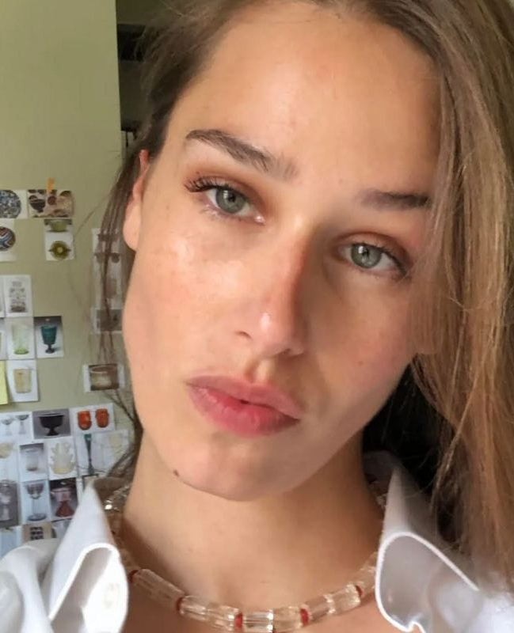
Feet size is not typically something that many people think of when they think of physically attractive attributes. That is unless you live in rural China, in which the tradition of footbinding is still seen as an important beauty routine.
This process is painful and takes quite a bit of time. Footbinding basically breaks the woman's feet down into a small form. This then makes them into lotus feet.
Lotus Feet –
China
Minimal Makeup –
France
In the Western world, you rarely find a culture that wants women to embrace unconventional beauty. For the most part, women in these countries tend to try to emulate what they see in the media which in turn makes many look alike.
In France, however, they are different, and they love to embrace an alternative idea of what beauty can be. This gives these women a little bit more liberation and a lot more room to play things up or down. So, minimal makeup is actually admired here.

Slide 12
Fake Tan –
USA
Unlike many of the Asian countries, when you head to the West, particularly in the United States, having pale skin isn't always thought of as being beautiful. That is why so many people sit out in the sun or head over to the tanning salon.
Even though this puts them at risk for health concerns, it is still not a deterrent as most people feel that having tan skin is a physical attribute that is very appealing.
In the United States, there is a lot of emphases put on body image. Women often feel pressure to keep up with the beauty trends of the time as they are also constantly changing.
One of the hottest body image trends going now is having what some might call the 'hip-hop booty.' This means that the woman has a tiny waist but a large posterior, like the hourglass shape. This is a shape that is also endorsed by celebrities like the Kardashians.
Big Bottom –
USA

Slide 13
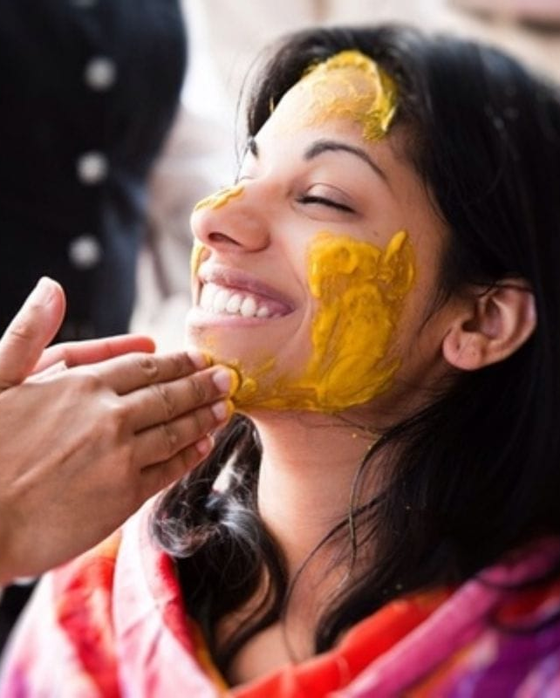
When you look at someone and decide whether or not you are attracted to them, often the first place you'll look at is their eyes. This is where the saying of how "the eyes are the window to the soul" came from.
In Japan and many other Asian countries, this may be why one of the beauty attributes that get the most attention is having big eyes. Of course, not everybody has that so sometimes people go under the knife to achieve this look.
Big Eyes –
Asia
If you are into health and beauty, then you probably have heard about the wondrous spice called turmeric. In Indian holistic healing as well as in beauty products across the globe, turmeric is touted as one of the best beauty treatments there is.
It might seem strange to rub this yellow spice on your face, but it does have a lot of great attributes. It will, however, stain your skin a bit. Yet interestingly enough, this yellowish tint in some places is looked at as a sign of beauty.
Turmeric Face –
India

Slide 14
The crowd you hang out with may also determine what physical attributes are seen as cool or deemed beautiful. There is a large population of people in the United States that are into alternative ideas of beauty.
For some, one of the most attractive physical attributes is body piercing, in particular facial piercings. While some find that less is more works better with this, others are excessive and want to have piercings all over their body.
Facial Piercing –
USA
Straight Teeth –
USA
Your smile can be one of the most beautiful and communicative attributes that you have. Many cultures appreciate different variations of this though. For example, some promote sharp-edged or even crooked teeth.
But in the US, that does not meet the beauty standard. In fact, if you're in the US, then you want to make sure that those pearly whites are perfectly straight and white. Are you on board with the notion of pearly whites?

Slide 15
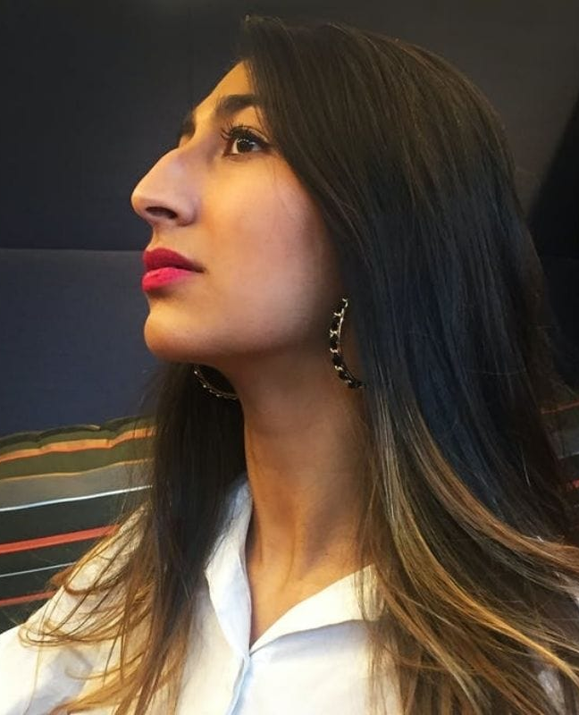
Extra Plump Lips –
USA
Sticking with the United States, other physical attributes that are synonymous with beauty here are linked to the world of celebrities. Nowadays, what's promoted besides a great smile and hourglass shape, is extra plump lips.
But not everyone is born with thick lips and so because of this, many people are now turning to both surgical and non-surgical measures to achieve this overall look.
While the Western world normally associates beauty with smaller and straight noses, that is not the case universally. Some societies actually see a larger nose as a symbol of beauty.
Like for Afghani women, who actively seek to have their noses enlarged. So much so that there is a large demand for rhinoplasty surgery in Afganistan. It's so interesting to see how different countries want different looks, don't you think?
Bigger Noses –
Afghanistan

Slide 16
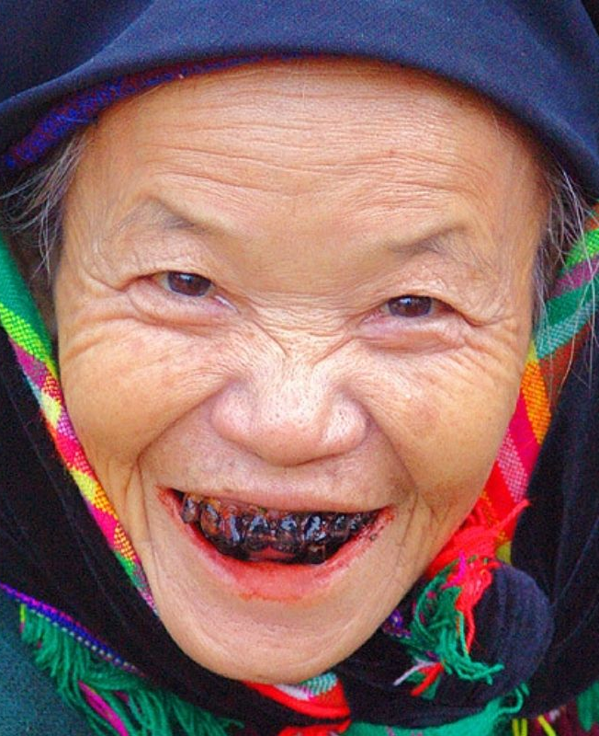
In Brazil, their ideal body image differs from other countries because they see people who are overly thin as looking weak or malnourished. Because of this, they promote a stronger and fuller physique there known as the guitar-shaped body.
This shape allows the woman to have wider hips but a small chest. And while this is not the idea of beauty everywhere, when it comes to Brazilian women, it is one of the most sought-after physical attributes.
Guitar Shape –
Brazil
Dyed Teeth –
China
In most of the Western world, we have all been told that brushing our teeth is crucial so that there is no discoloration. But that is not a universal beauty requirement because some rural areas of Asia have a different take on this.
There are some tribes in Asia that dye their teeth as a sign of beauty. This tradition is not only done to reflect femininity but also to show other men in the tribes that they are married.

Slide 17
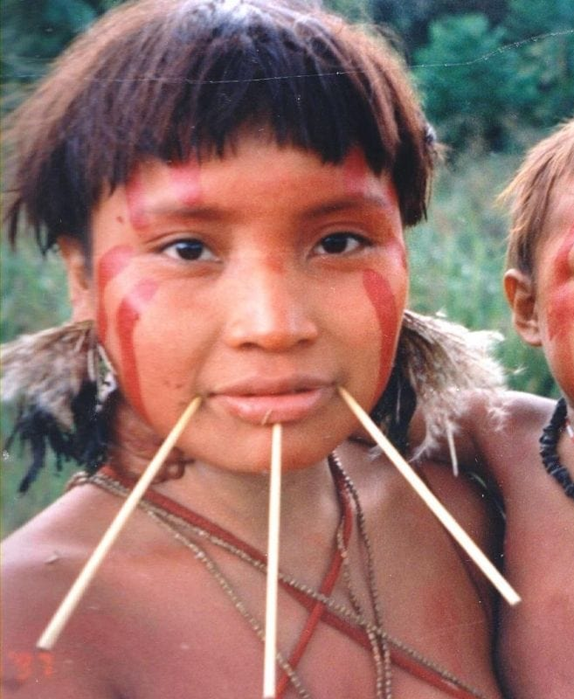
Though you may have to hike or canoe a distance to find the Yanomami clans of South America, if you did, you would find that they have a unique idea of what beauty actually is. You might be curious as to what so just look below and you'll see what we're referring to.
For the women of this tribe, the physical attribute that is seen as beautiful is having stick piercings. Typically these piercings are done in the face around the chin and mouth. What do you think of it?
Stick Piercing –
Brazil
In order to achieve a more hourglass figure and well-sculpted derriere, women in the US have caught on to waist trainers. The end goal is to get a super slim waist while allowing your hips to protrude.
We are not sure how healthy this is for the human body – surely you can crush your bones or organs with this? But even despite the potential health damage, it is something that is now considered beautiful.
Waist Training –
USA

Slide 18
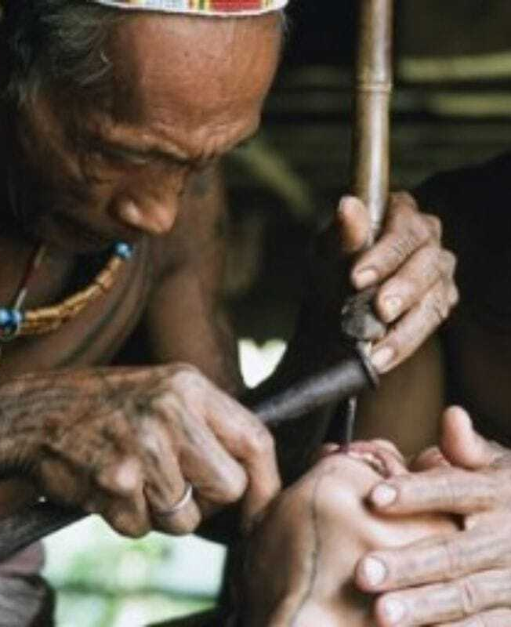
Teeth Chiseling –
Africa
There are several tribes in the world that deem having pointed teeth as a sign of beauty. This isn't only in Indonesia but also in the African nations as well. For many of these tribes, not only is having chiseled teeth beautiful but also a way to look fierce.
The process is quite painful, and many women go through it every year. This is a great way for them to show their status and feel beautiful.
In Asia, another prominent physical attribute that is looked at as being attractive is a slimmer waist contour. This is not always something that is given naturally, and so many women have taken to cosmetic surgery in order to have rib resectioning done.
This process allows them to have a thinner waist and therefore wear slimming shirts or even corsets. Having this procedure done seems to be a more extreme version of the US waist training.
Rib Resection –
Asia

Slide 19
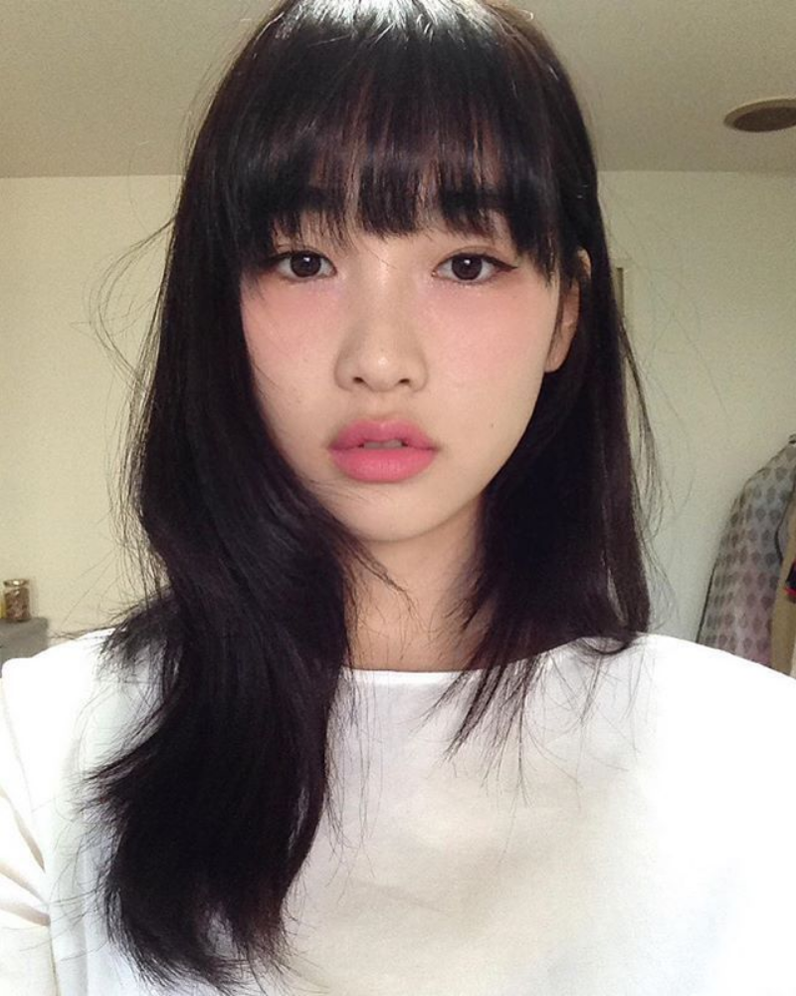
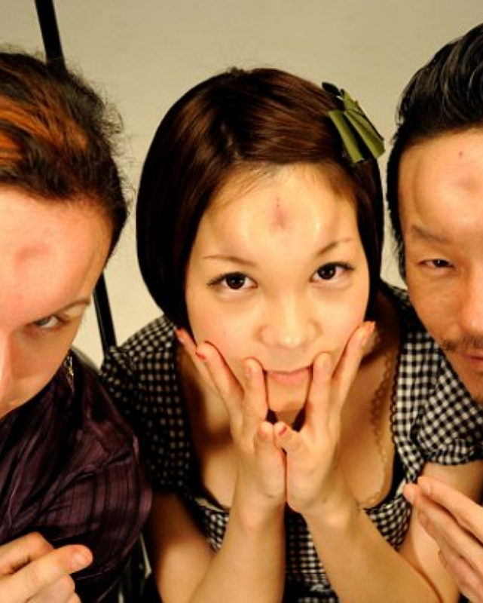
Red Under-Eyes –
Japan
While most women spend hours of their lives and hundreds of dollars on reducing under-eye discolorations, women in Japan are purposely applying red pigments to their under-eye area.
Known as byojaku, Japanese for 'sickly', the makeup is supposed to make the user look like they’re sick or suffering from allergies. The makeup is supposed to be combined with a pale color foundation to make the red even more obvious. Who knew sick days could inspire your next makeup look?
In 2012, news of a strange new body modification procedure spread across the globe. Known as 'bagel head', the procedure involves injecting saline into the forehead which is then shaped into a ring, or doughnut shape.
While the procedure was actually invented in Canada, it became a popular trend in the Japanese underground party scene. The injections last about 24 hours but come with several health risks. Seems like a real bagel or doughnut would be a better choice!
Bagel Head –
Canada and Japan

Slide 20
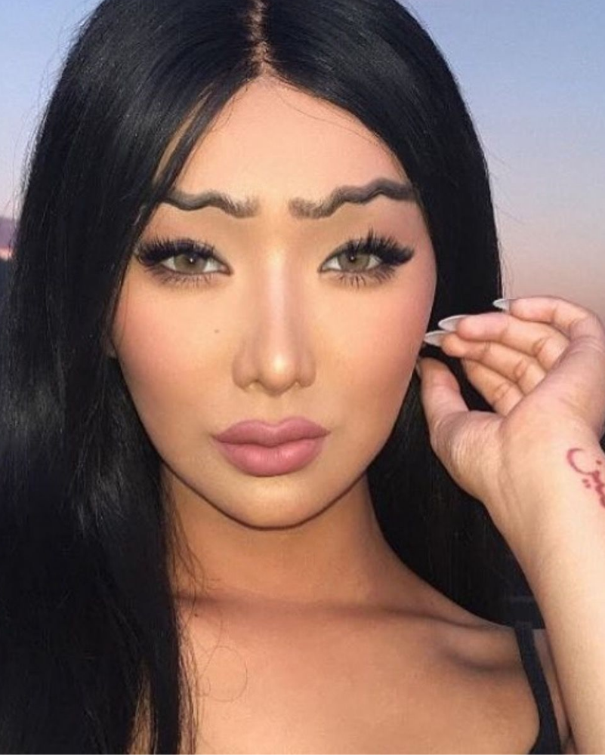
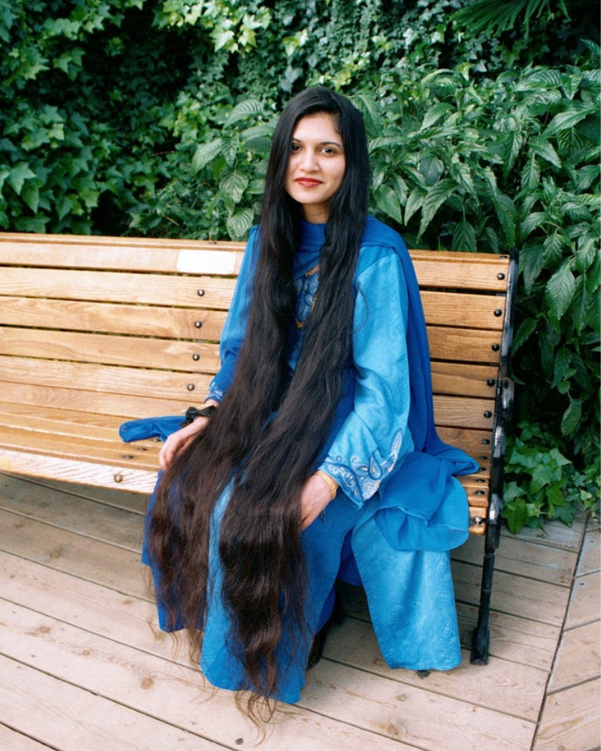
Thanks to social media and the rise of beauty bloggers, there has been an unprecedented focus on eyebrows. From bold and unnatural Instagram eyebrows to eyebrow tattoos, people across the world have used their social media pages to show off the latest in eyebrow trends.
In 2017 one crazy trend, the “squiggle brow”, went viral. Beauty influences uploaded pictures of themselves wearing the trend, and even mainstream media outlets covered this new style. Thankfully, natural eyebrow shapes have regained their status as being the most desirable look.
Squiggly Eyebrows –
United States
Extremely Long Hair –
India
Long hair has long been associated with femininity, fertility, and sensuality. For Indian women, growing their hair out is not just about beauty but also spirituality. One Indian woman, Akanksha Yadav, broke records with her almost ten-foot-long locks.
In some sects of Hinduism, hair is grown out and later donated to a temple as a spiritual offering. Many Sikh men follow a practice known as kesh in which they do not cut their hair, which they feel is God's creation and should not be changed.

Slide 21
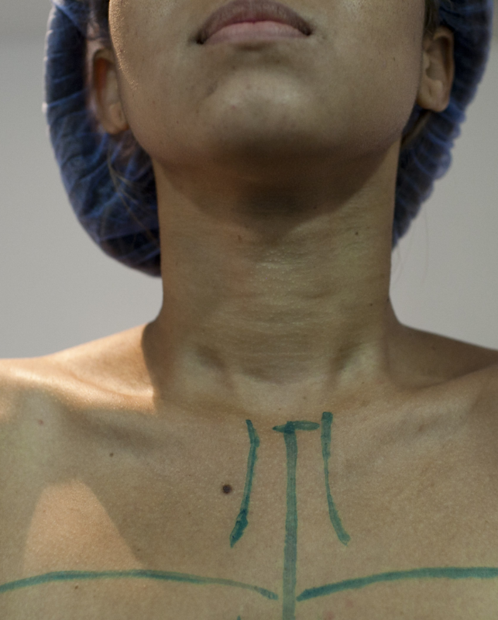
Mustaches –
The Middle East
While the popularity of mustaches has come and gone in many countries, there is one region in the world where this particular type of facial hair continues to be the most desirable - the Middle East.
Many men in this region consider the mustache to be a symbol of masculinity, prestige, virility, and even wisdom. The drive to have a mustache has even led to an emerging mustache hair transplant industry for men who wish to achieve a thicker mustache.
To be clear, Venezuela isn’t the only country where a bigger bust is considered more desirable. What makes Venezuela unique, however, is the sheer obsession the country seems to have with this popular plastic surgery.
Even political and economic turmoil hasn’t slowed down the population’s hunger for plastic surgery. Considered a regular part of life, the surgery does not carry the same stigma as in other countries. The pressure to look a certain way has resulted in chest augmentations being a popular gift for girls as young as 15!
Chest Augmentation - Venezuela

Slide 22
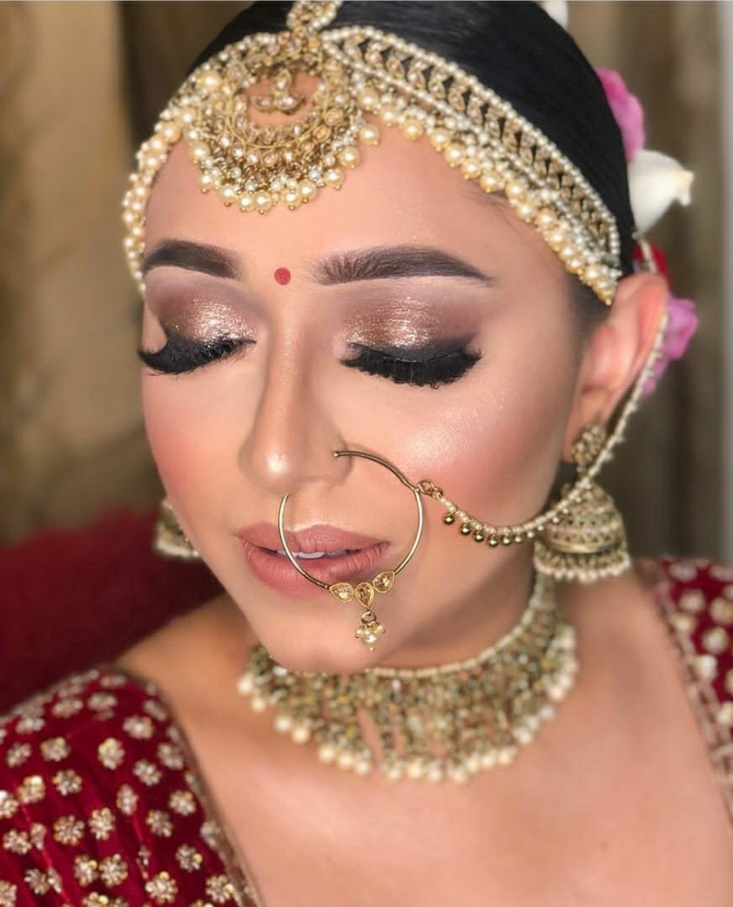
Nose Rings –
South Asia
Nose piercings and jewelry have long been associated with India, but the popularity has spread to nearby countries such as Pakistan, Nepal, Sri Lanka, and Bangladesh. In India, the piercing is traditionally done by a woman on the left side of the nose.
In addition to being considered a social status symbol, many consider the piercing to be associated with the Hindu goddess of marriage, Parvati. Indian women traditionally wear elaborate pieces of nose jewelry on their wedding day.
In East Asia, where darker-colored eyes are common, people have turned to contact lenses to achieve the effect of lighter or rounder eyes. Colored non-prescription contact lenses have become a common way to enhance appearances, and are available in a variety of colors.
Circle lenses give the eye a larger and more rounded appearance, resulting in an almost anime-like look. The lenses are very popular with younger people despite the health risks associated with them. Today, their popularity has resulted in them being seen almost like a fashion accessory.
Cosmetic Contact Lenses - East Asia

Slide 23
In China, a smaller frame is often associated with femininity and attractiveness. Women with larger figures are considered unattractive and less likely to find a husband. This pressure has resulted in several social media challenges encouraging women to show off their often disturbingly small frames.
One challenge showed women wrapping their arms behind their backs and reaching their belly button. Other challenges encouraged women to show how many coins would fit into the dip of their clavicle bone, while others had women compare their waists to sheets of paper.
Ultra Slim Physiques –
China
Our eyelashes have the important role of keeping our delicate eyes safe from dust and other debris. In addition to supporting eye health, eyelashes can also change the appearance of our eyes. Longer lashes can make our eyes look larger, more awake, and more feminine.
It’s no surprise that women have turned to false eyelashes to give them fuller and longer eyelashes. Lash growth serums and extensions have also become common cosmetic procedures for women seeking this wide-eyed look.
Extremely Long Eyelashes – United States

Slide 24
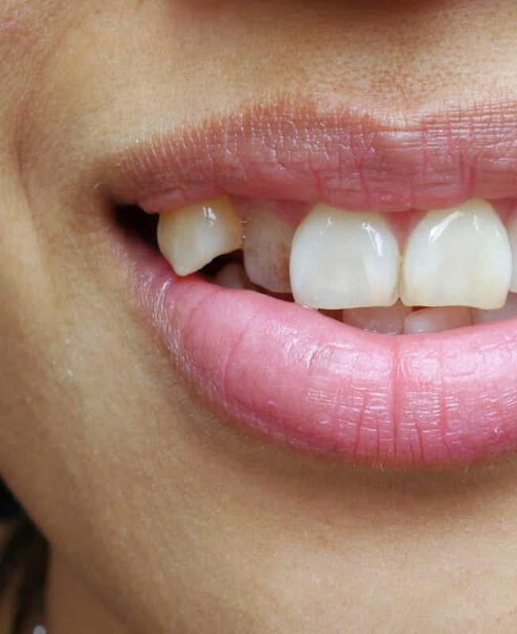
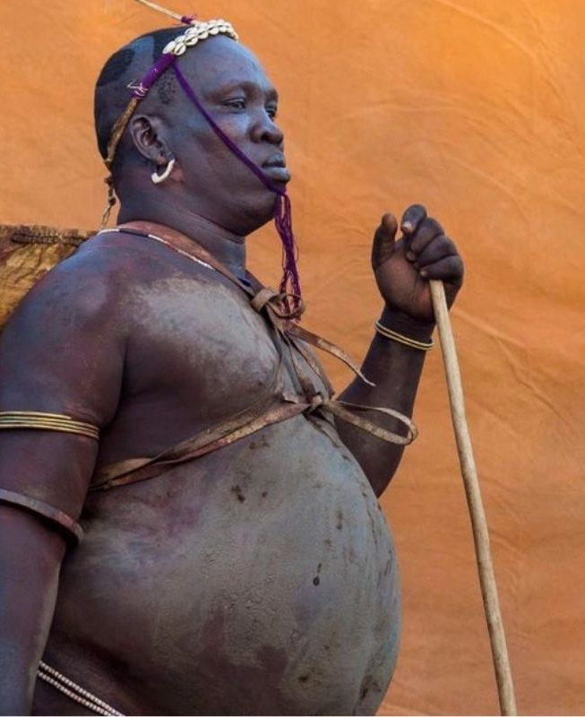
While most of us would associate sharp pointed teeth with Dracula or other monsters, many in Japan consider the fang-like teeth to be attractive. The canines, which separate our incisor teeth from our molars, are usually visible when we smile but can sometimes regularly protrude.
The Japanese call these protruding teeth yaeba, and associate them with youth. While many people turn to dental procedures to reduce the appearance of sharp canines, Japanese girls are actually putting caps on their teeth to increase their size.
Sharp Canine Teeth –
Japan
Big Belly –
Ethiopia
We've talked a lot about beauty when it comes to the female of the species. But some unique physical attributes across the globe are deemed attractive when it comes to men as well.
In Ethiopia, large bellies are seen as very attractive and as a result, the men there will eat more in order to achieve this look. There are also other traditions in place to ensure these men achieve that physique.

Slide 25
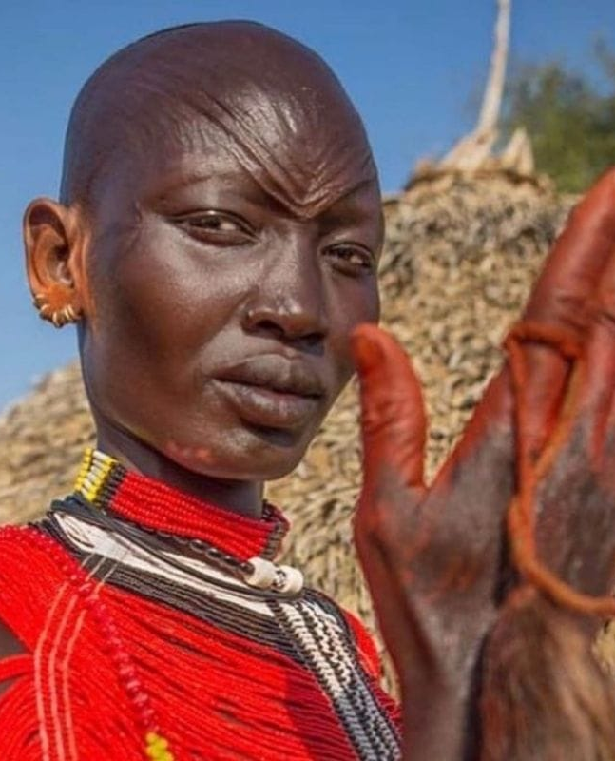
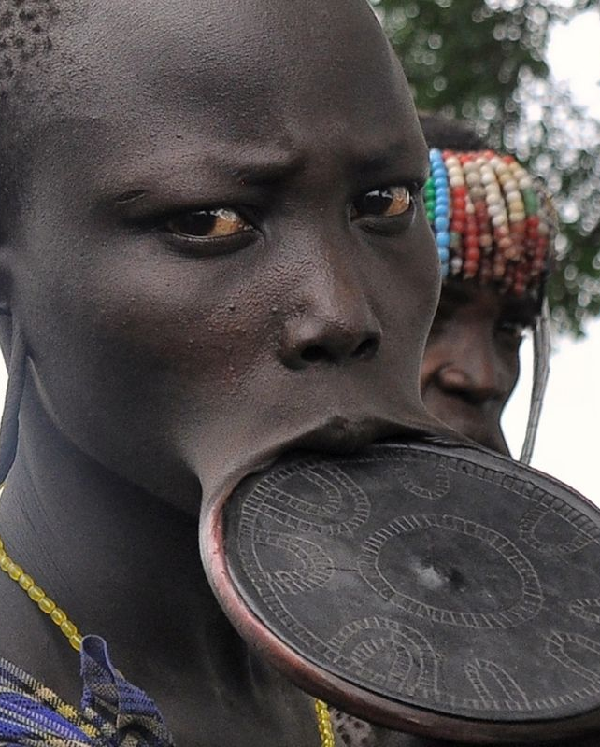
Body scarification is one thing, but when it comes to the face, this seems a little extreme to most. But that is not so when you find yourself amidst the Mundari tribe in Africa. Here facial scarification is looked at as a sign of beauty for both men and women.
There are set scar patterns that people attempt to achieve and this look tends to be two to three parallel lines on the face. What do you think of it?
Facial Scarification – Africa
Stretched Lips –
Africa
We're sure you've all seen images in magazines like National Geographic of the African tribes who use discs to stretch their lower lips. While this might be strange to us in the Western world, to them, this is a sign of beauty.
The discs that the girls begin to stretch their skin out with vary in size, and the larger the disk, the higher the girl is seen in society. This, of course, means that the dowry will be larger as well when she gets married.

Slide 26
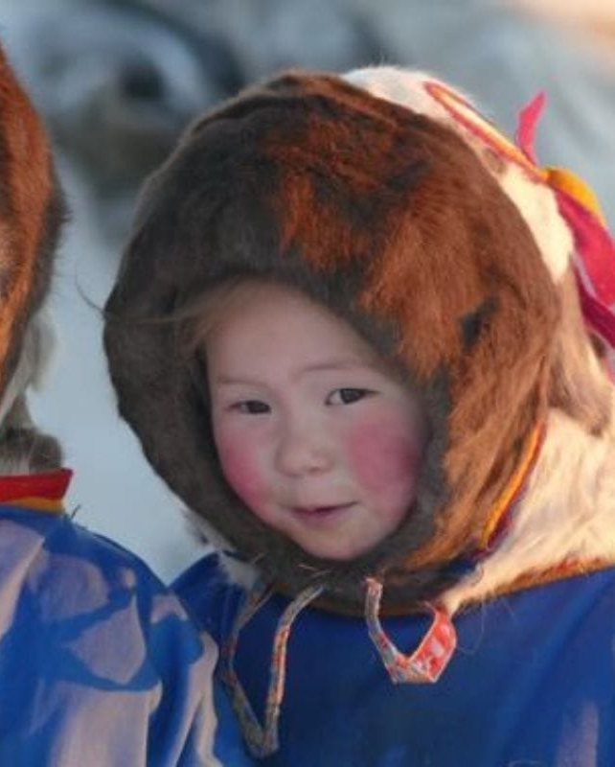
Rosy Cheeks –
Arctic
Though many of us may not realize it, there are inhabitants of the Arctic Circle. The Chukchi people of the Arctic live in extremely challenging climates. Because of this, the people have grown to have red and rosy cheeks from being so cold.
Though this is not a physical attribute they're born with, and more an environmental consequence of where they live, it has become something that the people find very beautiful. Cute kids with rosy red cheeks - what could be sweeter?

