Slide 1
the
Moral
https://www.moralmachine.net
Machine

Slide 2
classic
Trolly
Problem
What would you do?

Slide 6
Ethics

Slide 7
Utilitarianism
The greatest good for the greatest number of people

Slide 8
Consequentialism
The consequences of your actions determine if they are good or bad.

Slide 9
Deontologicalism
An action is right or wrong regardless of consequence.

Slide 11
Autonomous
vehicle
Problem

Slide 12
Yet just as with email and smartphones, looking “under the hood” of self-driving cars reveals a much more sophisticated set of functions and potential abilities than their conventional forebears. Yes, self-driving cars will drive themselves, but they’ll likely be able to do so much more as well. They might “intelligently” decide when to arrive at your house for your morning commute, based on the contents of your calendar that day. They might know (from your fridge — or your glucose monitor) which groceries you’re low on, and autonomously go fetch some (just in case the thirty minute wait for an Amazon drone proves too onerous). In a similar sense, even the first iteration of the iPhone — which didn’t yet have an App Store — nonetheless had extraordinary potential as a multimedia device due in part to its connectivity.
Driverless

Slide 13
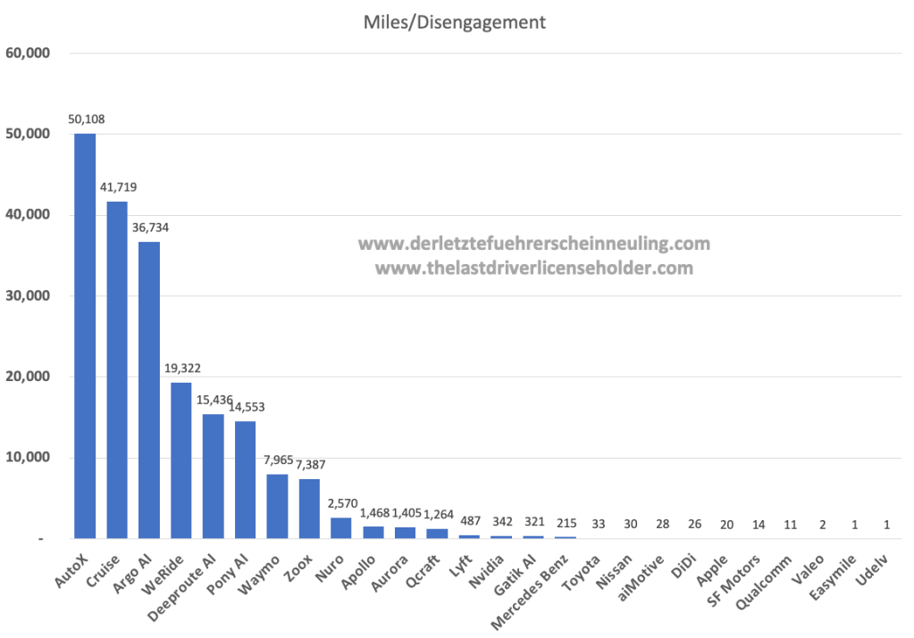
Driverless

Slide 14
In many ways it is easy to see why the trolley problem has become the canonical example in thinking about self-driving cars. Given the death toll that human-operated cars deliver every year, it is safe to assume that cars will continue to be at least somewhat hazardous, even with the vast improvements in efficiency that automation might bring. It follows, then, that we should think about the road-based equivalent of this track-based trolley problem as a matter of urgency, deciding whether and how to code societal values into autonomous vehicles.
Driverless
Driverless

Slide 15
Indeed, scientists at MIT’s Media Lab have launched an impressive attempt to experiment with just this question. The Moral Machine platform invites users to judge a series of hypothetical scenarios, making difficult decisions about the direction an out-of-control car should swerve. After answering a series of questions, the survey will rank a user’s implied “preferences” with almost disturbing granularity, in terms of gender, age, wealth, health, and much else.
Driverless
Driverless

Slide 16
The Moral Machine effort is laudable, and its significance self-evident. It serves to underline that the rise of automated technology, and specifically artificial intelligence, may have the unintended positive effect of encouraging society to be more open and explicit about those values. Code — whether in the form of law, or technological architecture — necessitates clarity, at least of a sort. Enabling a machine to make decisions demands declarations of our more fundamental values on which those decisions should rest.
Driverless

Slide 17
And yet, the prevalence of the trolley problem in the context of self-driving cars is itself, in a sense, problematic. At the most basic level, we are talking about self-driving cars on roads, not trolleys on a track, which opens up a far wider array of possibilities for aversive action — including skidding in any direction, rather than just taking one course or another, as in the trolley example.
Driverless

Slide 18
Since the trolley problem is purely hypothetical, it can be easily adapted for other contexts — the Moral Machine project, of course, adapts it for the road. But the basic simplicity that makes the problem so popular — the trolley or car can swerve left or right , so our decision is both binary and binding — is also what makes it problematic, in terms of reasoning about AI.
Driverless

Slide 19
By asking ourselves what we would do when faced with such an ethically thorny issue, we risk ascribing to AI a “thought process” that it doesn’t really have. The trolley problem is an ethical paradox, which forces us reflect on our own values and biases. Though the fictitious problem involves the subject making a quick decision, the exercise is useful precisely because it shows how hard making such a decision would be in practice. Paradoxes that are easily solvable are not worthy of the name.
Driverless

Slide 20
Machines are less prone to introspection. A self-driving car would be able to execute a “decision” in milliseconds, but its decision-making process is unlikely to operate much like our own. True, self-driving cars take on a wealth of data from the surrounding argument using cameras and radar much as human drivers do using eyes and ears, and true, neural networks — which are designed to mimic the human brain — can be used to help recognize objects and even predict pedestrians’ movement.
Driverless

Slide 21
But these similarities are analogical, not biological. To the extent that an ethical preference (e.g., swerve into the dog to avoid the group of schoolchildren) can be coded into self-driving cars, the decision-making process would not be “rational” in a way we would understand. No ethical considerations would be in play during the making of the decision; rather, the decision would result from a set of pre-existing preferences implemented by coders — perhaps informed, as in the Moral Machine project, by the wider public.
Driverless

Slide 22
This is not to say that a decision with ethical consequences which is processed by a machine would necessarily be worse than one made by a human in a typical crash situation. In fact, it might well be better: the self-driving car would be drawing on pre-existing preferences to swerve this way or that, and so hypothetically, if these preferences were developed equitably, ethically, and with the input from a representative group of people, they might be more reflective of a collective human will than a split-second decision taken by an individual person, “programmed” with all her specific biases and particular life experiences.
Driverless

Slide 23
This is almost certainly naive, as technologies very often reflect the intentions and even the characteristics of their designers: consider, as an extreme example, facial recognition software, which can fail to recognize darker faces as effectively as lighter ones.
Regardless of the answer, the question is the wrong one to ask.
Driverless

Slide 24
If, as the available data suggest, self-driving cars are much less likely to be involved in fatal accidents, only the steeliest utilitarian would argue that means we should worry less about these situations. But it does suggest that the trolley problem is the wrong lens through which to think about self-driving cars and the artificial intelligence which will power them. Not only does the trolley problem give the wrong impression of how automated decision-making works, but it limits our focus to a very specific set of hypothetical possibilities, potentially distracting us from far weightier challenges.
Driverless

Slide 25
The
Moral
Machine

Slide 26
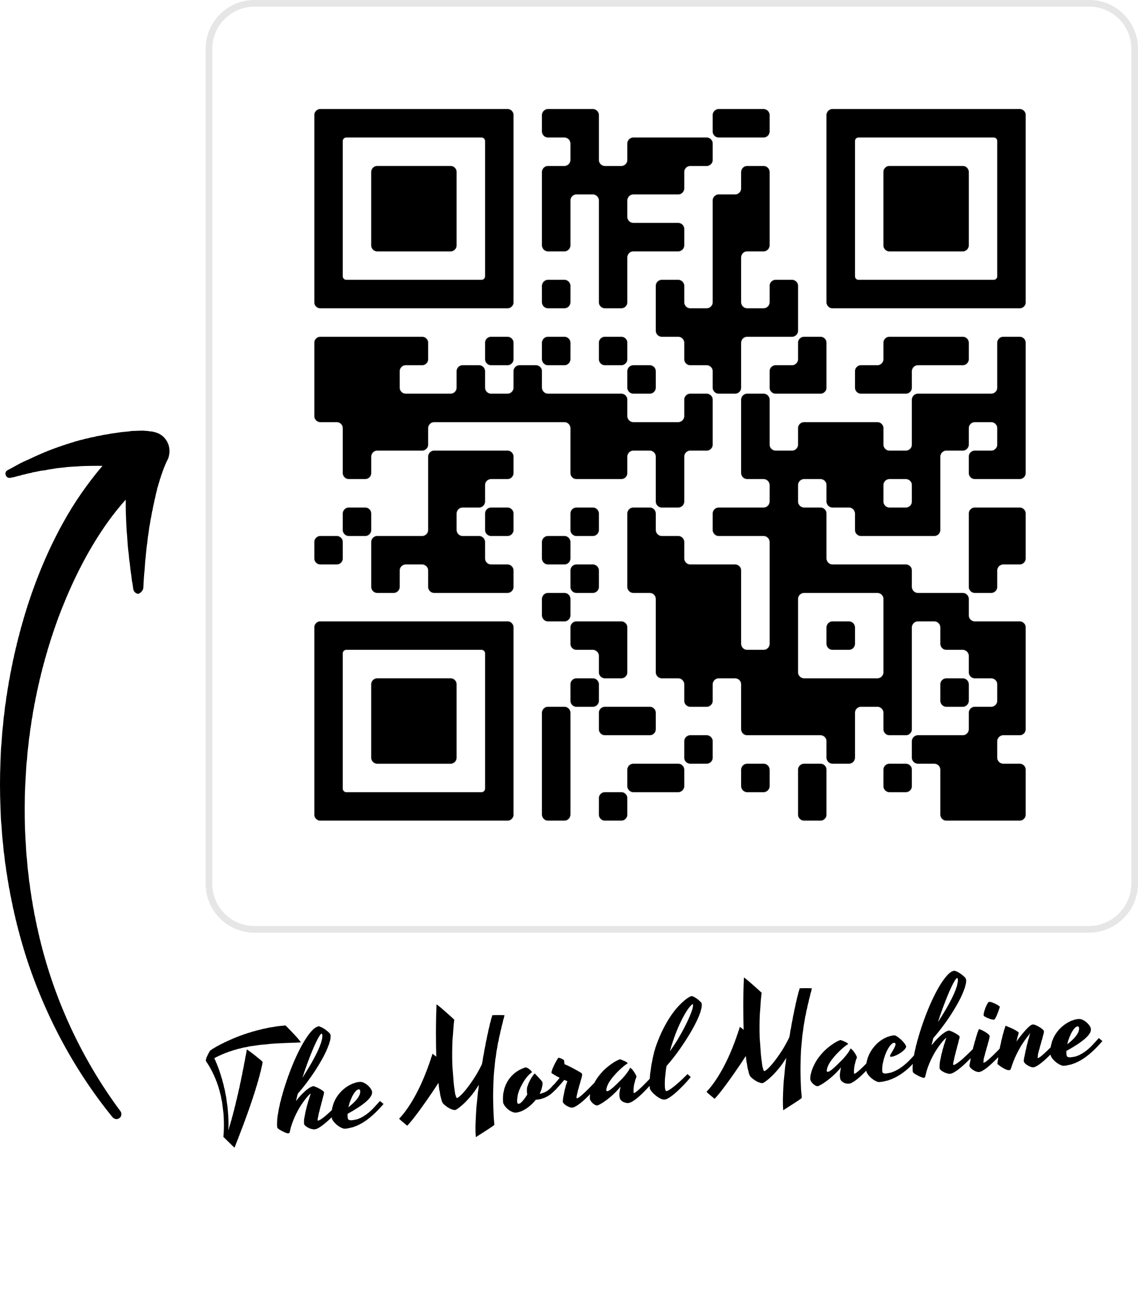

Slide 27
my Results
https://www.moralmachine.net/results/-1586200330

Slide 28
RESULTS

Slide 29
RESULTS

Slide 30
RESULTS

Slide 31
RESULTS

Slide 32
RESULTS

Slide 33
RESULTS

Slide 34
RESULTS

Slide 35
RESULTS

Slide 36
RESULTS

Slide 37
RESULTS

Slide 38
create your own

Slide 39
References

Slide 40
https://www.turing.ac.uk/blog/ais-trolley-problem-problem
https://thelastdriverlicenseholder.com/2022/02/09/2021-disengagement-report-from-california/
https://www.moralmachine.net/

