Slide 1
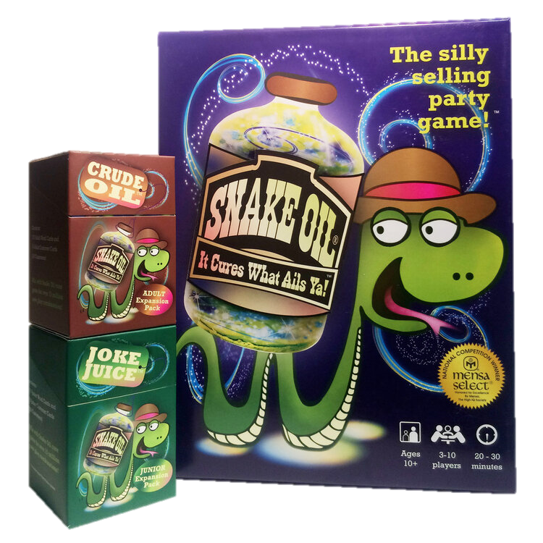
Snake Oil

Slide 2
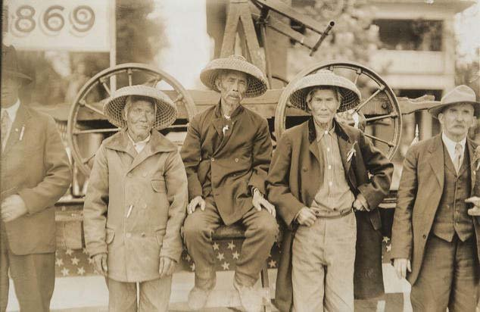
1800s – Chinese workers

Slide 3
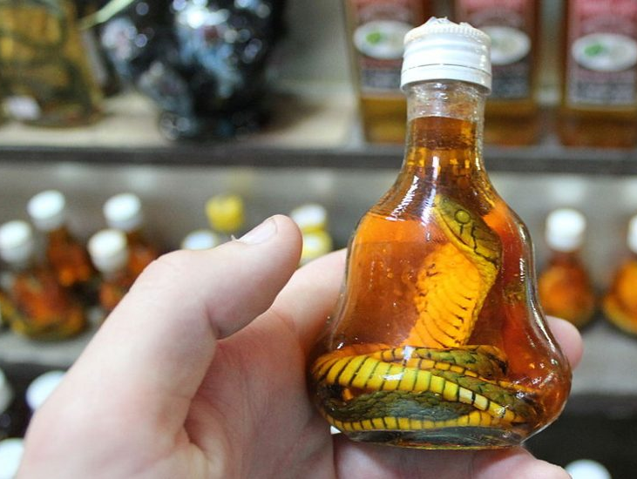
Traditional Chinese
Medicine
Chinese water snake

Slide 4
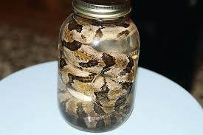
FAKE Chinese Medicine

Slide 5
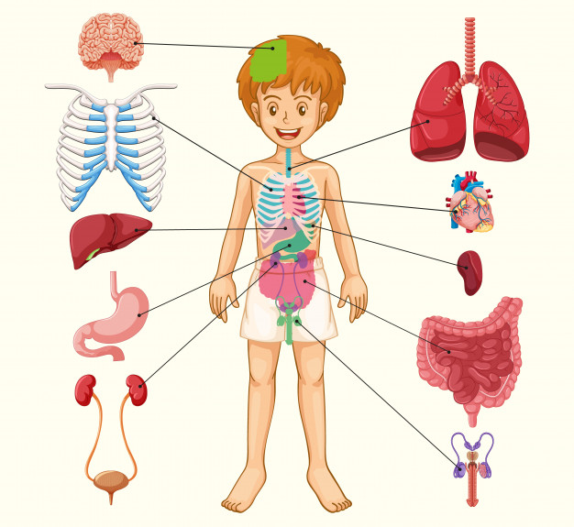
Promised it can cure
ANYTHING!

Slide 6
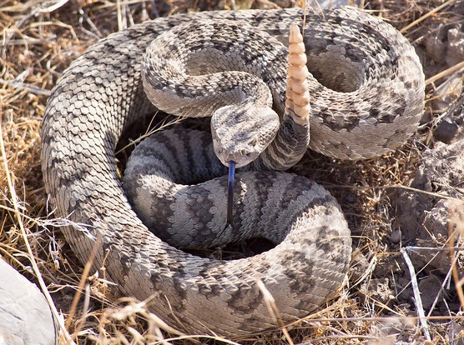
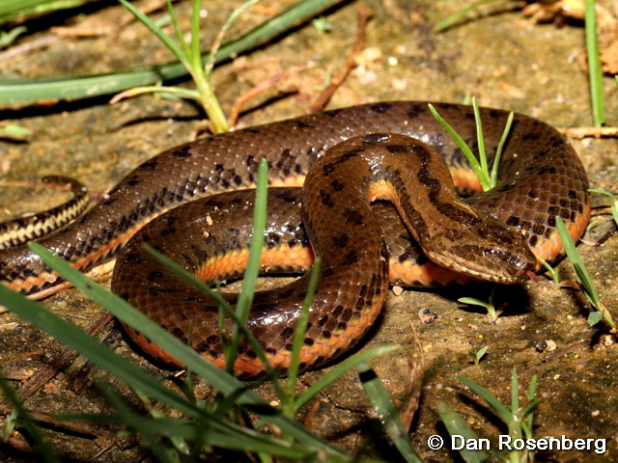
Rattlesnakes MUCH less effective
rattlesnake
water snake

Slide 7
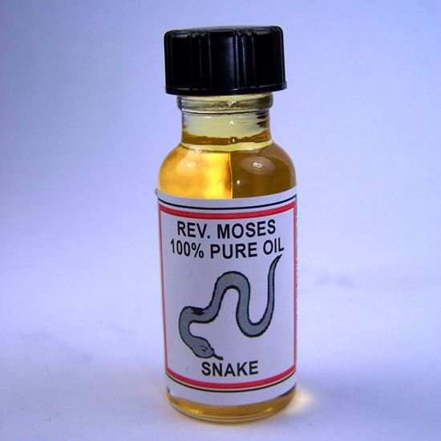
Usually DID NOT include snake oil

Slide 8
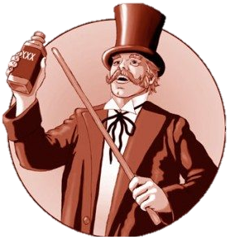
Convicted of fraud

Slide 9
Today - Wild Claims / Fraud

Slide 10
Snake Oil

Slide 11
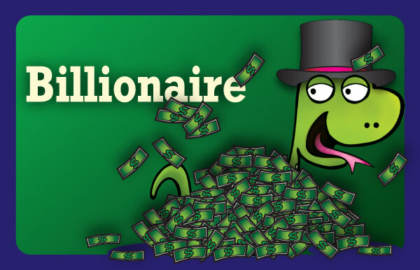
First player draws a card to select a customer ...

Slide 12
The other players create a 2-word product for that customer from their 7-card hands ...

Slide 13
Try selling the product.
It’s so hard for a billionaire to get away. Everybody wants your money.
Don’t you wish you could press a button and get away?
Now with the AMAZING Freedom Button, you have that power.
OMG! This is what you NEED!

Slide 14
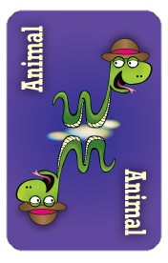
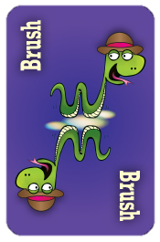
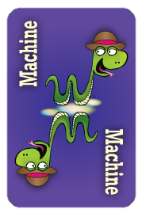
The customer chooses their favorite product.

Slide 15
ESL toybox
www.esltoybox.com

