Slide 1
27 Figures of Speech

Slide 2
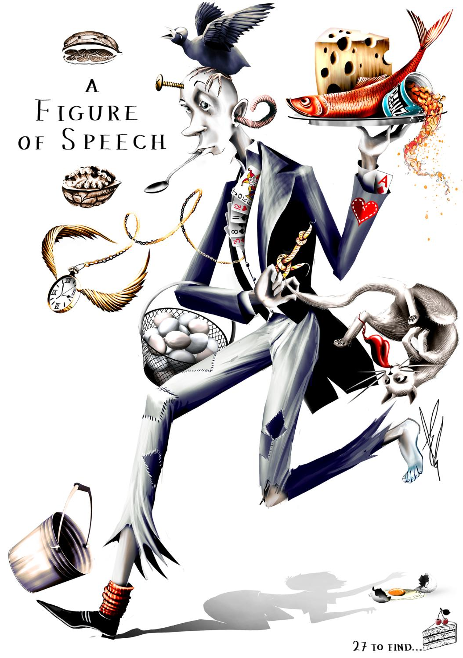
27 Figures of Speech
A non-literal word or phrase.
What would a literal representation of a figure of speech look like?

Slide 3
27 Figures of Speech
How many can you find?

Slide 4
27 Figures of Speech
Match the answers

Slide 5
27 Figures of Speech
Pull your socks up!
Stop making excuses and do the hard work

Slide 6
27 Figures of Speech
No room to swing a cat
There isn’t much room

Slide 7
27 Figures of Speech
Putting all your eggs in one basket
Taking a risk by committing all your resources (or effort) to one strategy.

Slide 8
27 Figures of Speech
Earworm
A song stuck in your head

Slide 9
27 Figures of Speech
Big cheese
An important person

Slide 10
27 Figures of Speech
Born with a silver spoon in your mouth
Born in a rich family

Slide 11
27 Figures of Speech
Kick the bucket
A euphemism for death

Slide 12
Time flies
Things are happening too quickly

Slide 13
Tie the knot
Getting married

Slide 14
Joker in the pack
An unpredictable (or different) person

Slide 15
Cherry on top
Something that makes it even better.

Slide 16
A shadow of your former self
Not as good as you were when you were younger

Slide 17
Stiff upper lip
Do not show your emotions when you are upset

Slide 18
Bald as a coot
No hair on your head

Slide 19
Spill the beans
To divulge a secret

Slide 20
Red herring
Mislead or distract

Slide 21
Cat got your tongue
You don’t know what to say

Slide 22
In a nutshell
A summary of what has been said

Slide 23
Apiece of cake
It’s very easy

Slide 24
A screw loose
A crazy or weird person

Slide 25
Keep your cards close to your chest
Don’t tell your secrets

Slide 26
Ace up your sleeve
A secret skill, knowledge, or weapon

Slide 27
Heart on your sleeve
Don’t hide your emotions and feelings

Slide 28
On a silver platter
Maybe they didn’t deserve it because they didn’t have to try hard

Slide 29
Walking on eggshells
You have to be cautious around someone

Slide 30
Cold feet
Hesitant to do something

Slide 31
27 Figures of Speech
From rags to riches
Someone who was poor but is now rich

Slide 32
Personal Story
Used in real-life context
Meaning
Definition
Example
Format
Origin
Deeper understanding
Discussion
Loosely related content

Slide 33
Choose a figure of speech:
Think of a story from your life
Create your own definition
Think of example sentences
Remember the history
Read & Research

Slide 34
Tell the others about your figure of speech:
Explain
Teach
Listen
Remember

Slide 35
Turning A Phrase

Slide 36
Turning A Phrase
Adapting a well-known phrase / idiom / proverb and changing it for the situation
Turn Of Phrase
A unique, interesting, or memorable way of saying something.

Slide 37
Turning A Phrase
Adapting a well-known phrase / idiom / proverb and changing it for the situation
Turn Of Phrase
A unique, interesting, or memorable way of saying something.

Slide 38
Knees of my Bees
Alanis Morrisette

Slide 39
You make the knees of my bees weak, tremble and buckle You make the knees of my bees weak You make the , tremble and buckle You make the knees of my bees weak You make the knees of my bees weak, tremble and buckle You make the knees of my bees weak
knees of my bees weak

Slide 40
knees of my bees weak
The bees knees
Weak in the knees
Extra special
The best thing
Nervous
Most used for attraction

Slide 41
We share a culture same vernacular Love of physical humor and time spent alone You with your penchant for spontaneous events For sticky and raspy, unearthed and then gone

Slide 42
You are a gift promised sent with a wink With tendencies for conversations that raise bars You are a sage who is fueled by compassion Comes to nooks and crannies, is bound for all stars

Slide 43
You are a spirit that knows of no limit That knows of no ceiling who baulks at dead-ends You are a wordsmith who cares for his brothers Not seduced by illusions of fair-weather friends

Slide 44
You are a vision who lives by the signals of Stomach and intuition as your guide You are a sliver of god on a platter Who walks what he talks and who cops when he's lied

Slide 45
27 Idioms
Your turn

Slide 46
Time flies. If you want to tie the knot before you kick the bucket, don’t keep your cards close to your chest but wear your heart on your sleeve. In a nutshell, it’s a piece of cake, use that ace up your sleeve to become the big cheese in your own life. Sometimes you need to have a stiff upper lip when it feels like there’s no room to swing a cat. Put all your eggs in one basket and ask them to marry you. What’s the matter, cat got your tongue? It might look like you have screw loose, but you have to spill the beans.

Slide 47
I promise that they won’t care if you were born with a silver spoon in your mouth or are always in the process of going from rags to riches. Don’t walk on eggshells around them. You have to pull up your socks, don’t get cold feet and just talk to them. It’s ok to be the joker in the deck every once in a while.

Slide 48
There is a lot of bad advice out there. It’s a red herring. Just listen to my advice before you become a shadow of your former self. I am giving you all this advice on a silver platter! If you follow these rules, you’ll be happy before you are as bald as a coot and the cherry on top is that every sappy love song will become an earworm.

