Slide 1
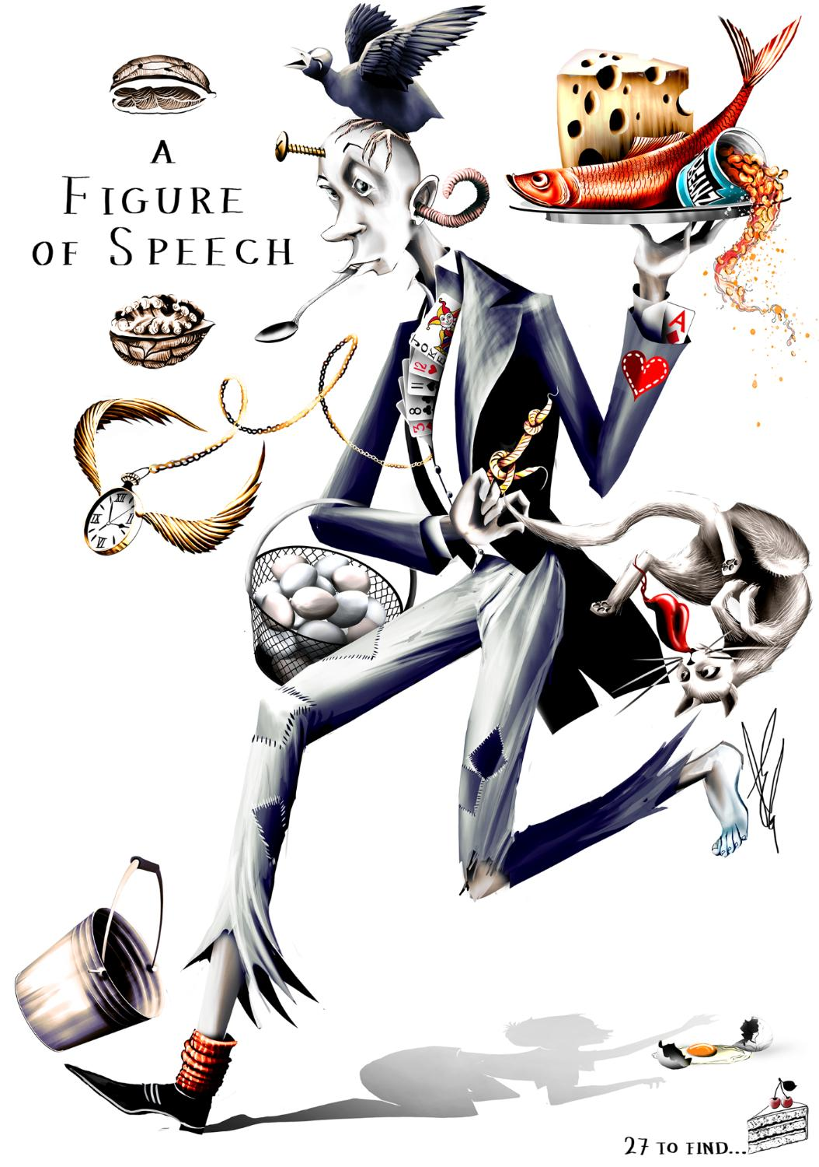
27 Figures of Speech

Slide 2
27 Figures of Speech

Slide 3
27 Figures of Speech

Slide 4
27 Figures of Speech

Slide 5
27 Figures of Speech

Slide 6
27 Figures of Speech

Slide 7
27 Figures of Speech

Slide 23
50

Slide 28
EC9B3C

