Slide 1
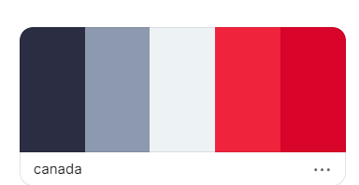
Canadian
food

Slide 2
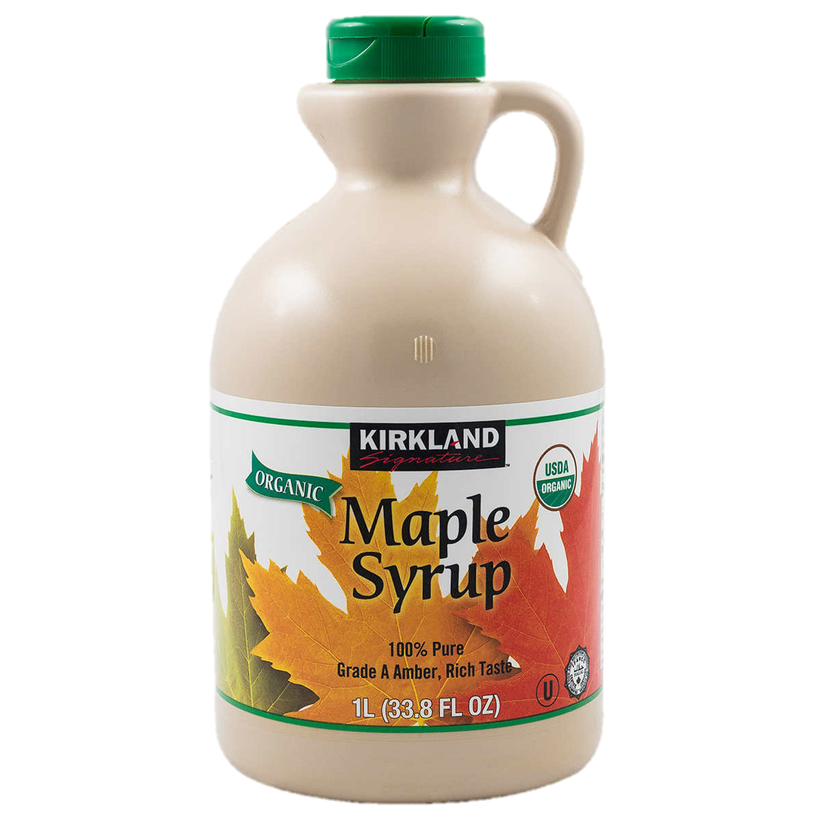
Maple
Syrup
A sugary liquid from maple trees. Trees store this liquid to give energy during the winter. 70% of maple syrup is made in Quebec.

Slide 3
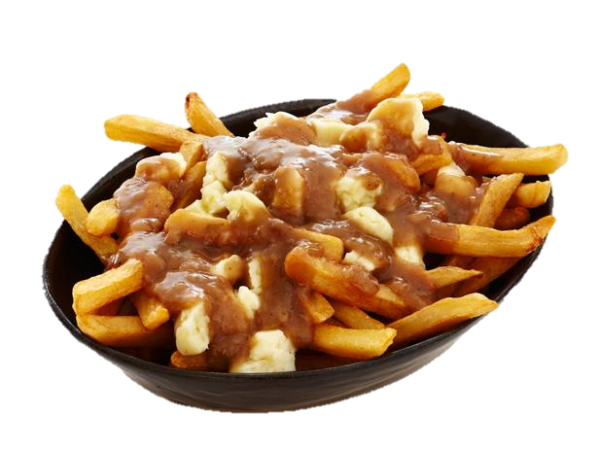
Poutine
Poutine is French fries covered in cheese curds and gravy sauce. After maple syrup, this is the most famous Canadian food.

Slide 4
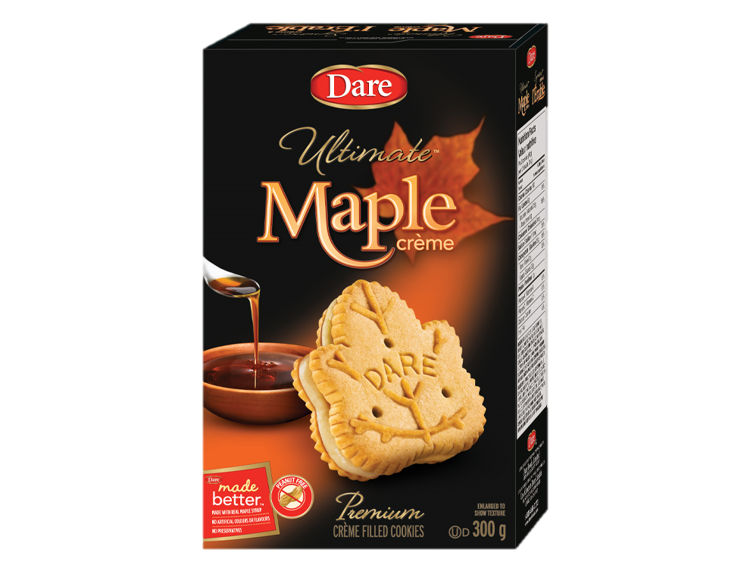
Maple
Cookies
This is a maple flavored cookie that is also shaped like a maple leaf. The maple leaf is a symbol of Canada.

Slide 5
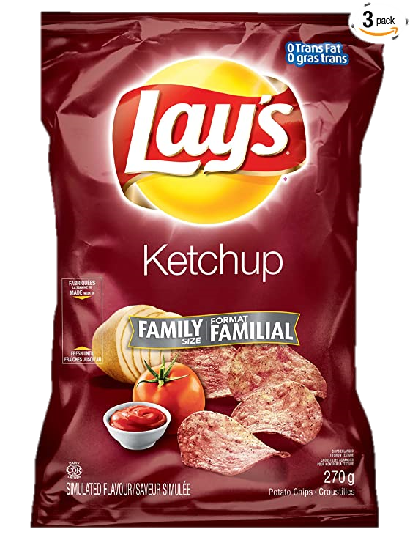
Ketchup
Chips
This is a strange flavor of potato chip. It doesn’t take too much like ketchup to me, but it is delicious.

Slide 6
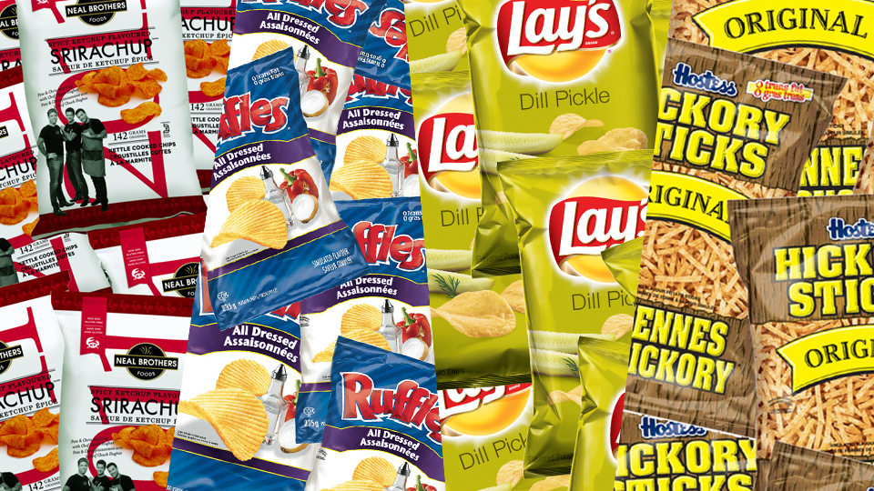
Joe Louis
All dressed
Dill Pickle
Hickory Chips

Slide 7
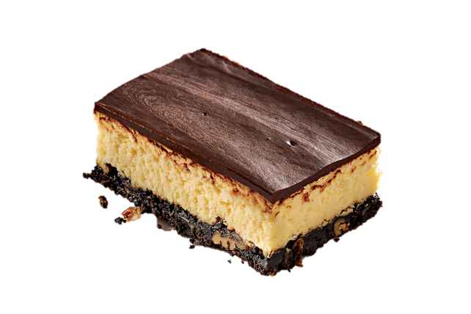
Naniamo
Bars
This snack is very sweet. There is a nutty bottom with coconuts and crumbs. The middle is custard and the top is chocolate.

Slide 8
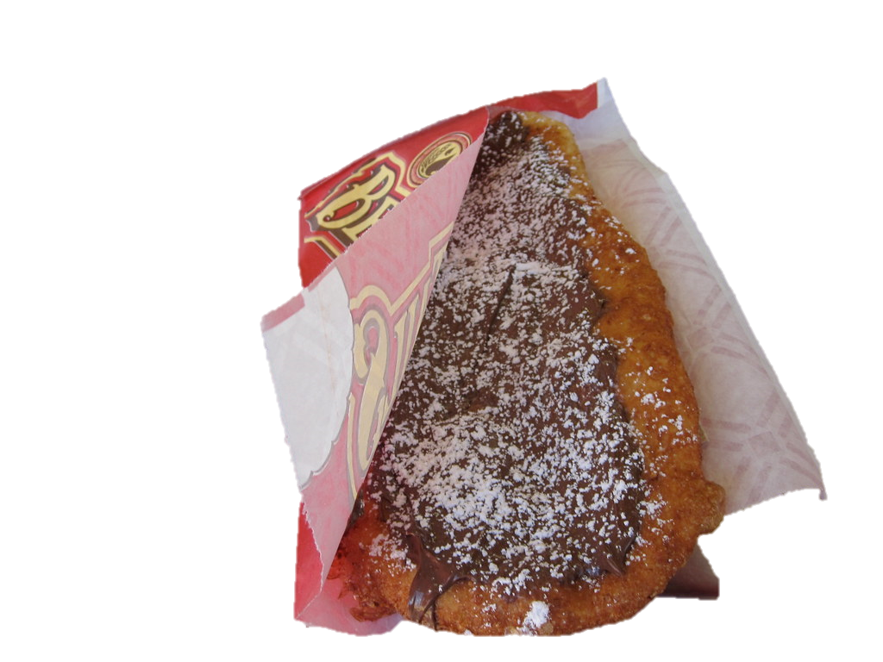
Beaver
Tails
This pastry looks like a beaver’s tail. It has a sweet bread with many different types of toppings.

Slide 9
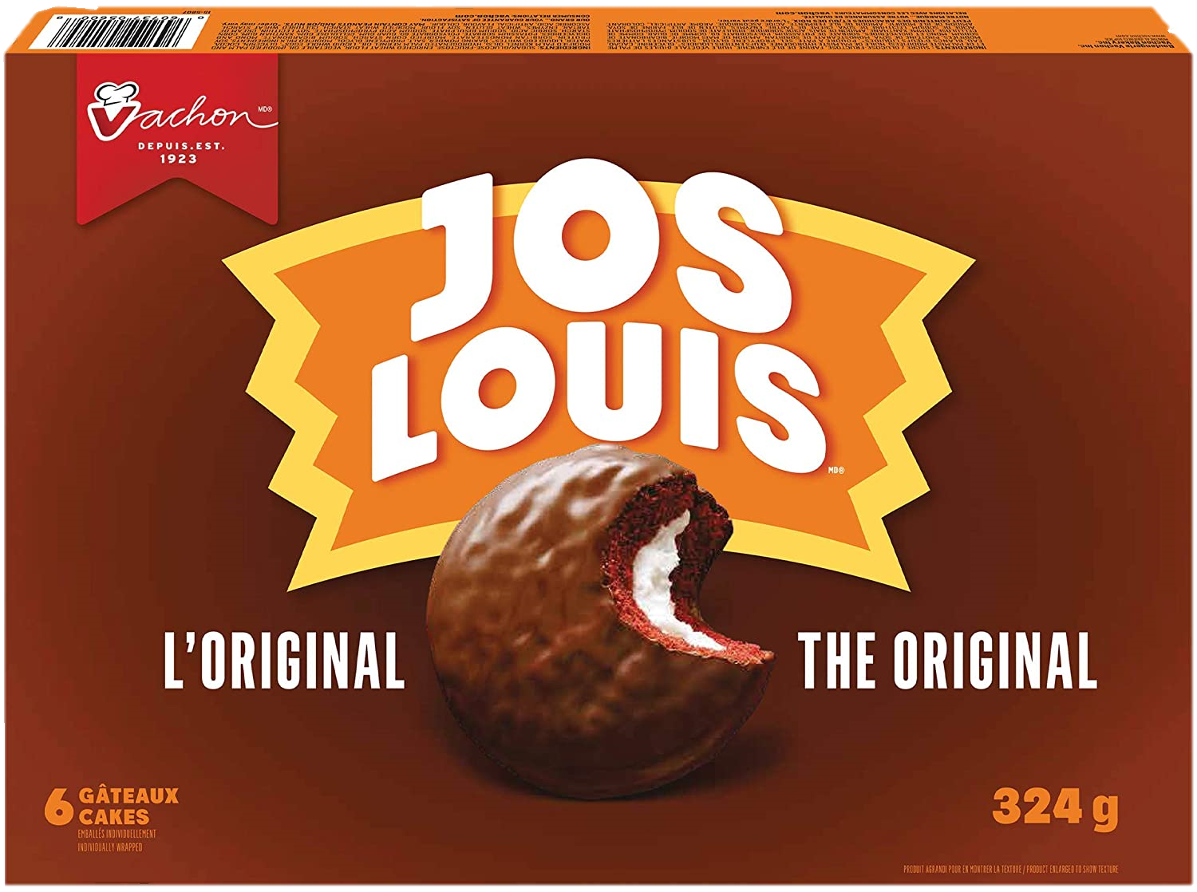

Slide 10
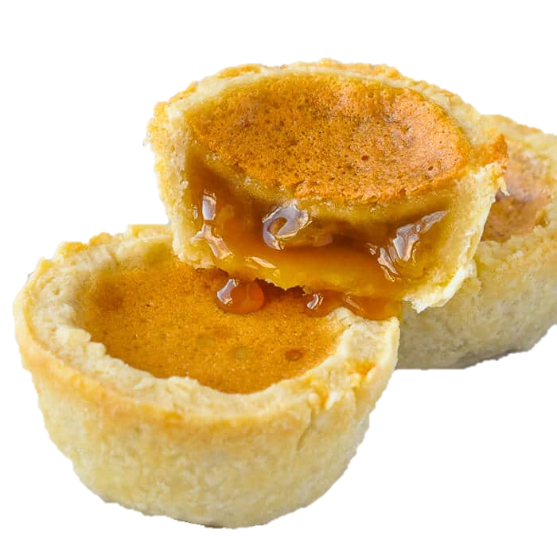
Butter
Tarts
The filling in this tart is butter, sugar, syrup and egg. The outside is crunchy, but the inside is creamy.

Slide 11
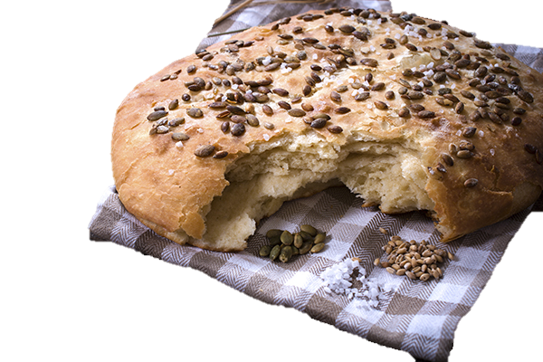
Bannock
Bannock is a
traditional bread in Canada. This style of bread was in Canada before it was discovered by Europeans.

Slide 12
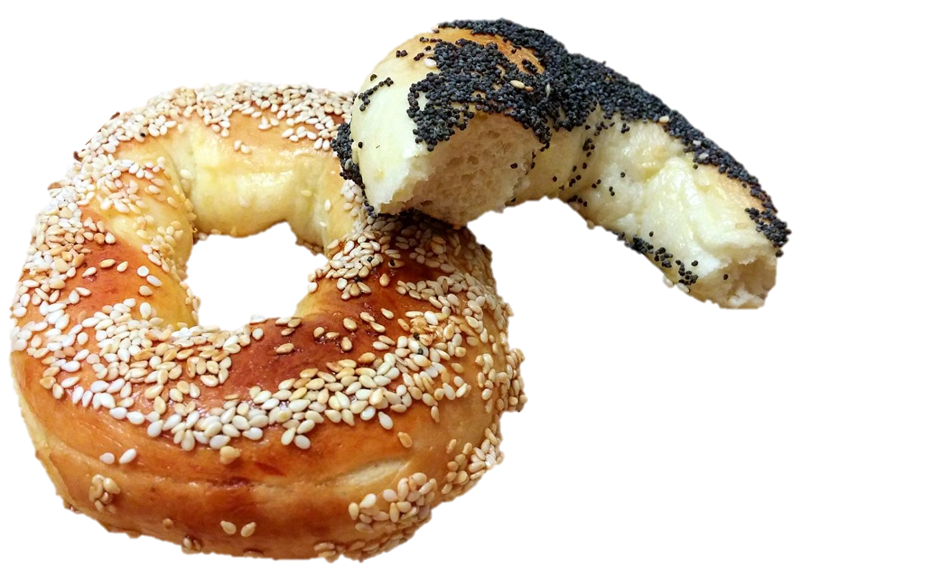
Montreal
Style Bagel
This is a type of bagel that
is baked in a wood-fire oven. It is made from sourdough. They are topped with sesame or poppy seeds.

Slide 13
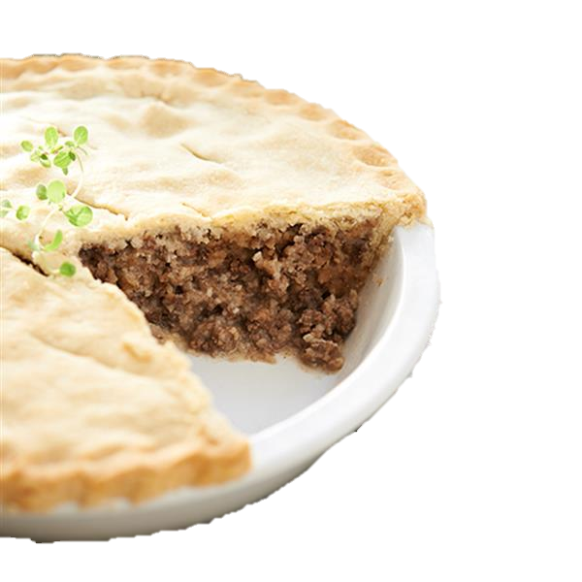
Tourtière
This is a meat pie from Quebec. It can be made with pork or beef.

Slide 14
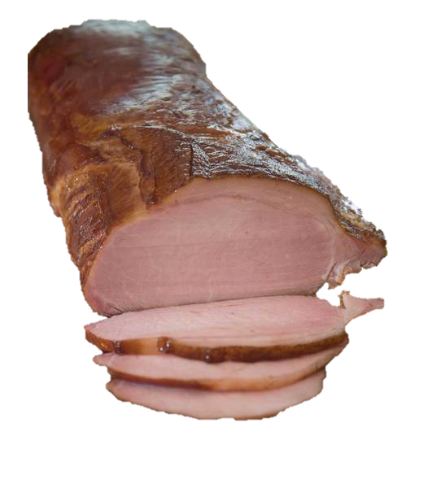
Canadian
Bacon
Canadian bacon is also called back bacon. It’s taken from the back of the pig. Then, it is cured, smoked and fully cooked.

Slide 15
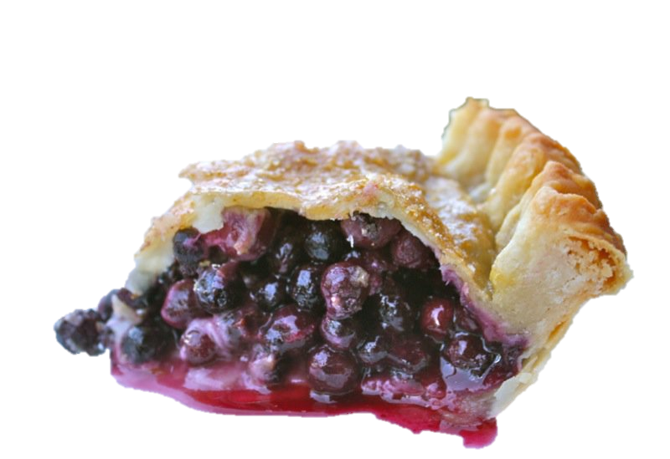
Saskatoon
Berry Pie
This pie is filled with saskatoon berries. The berries are unique to the province of Saskatchewan.

Slide 16
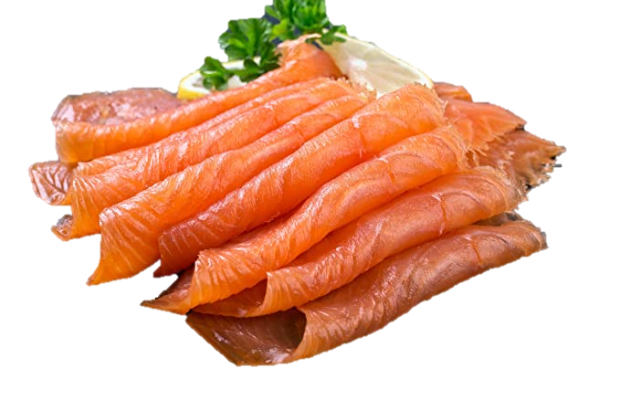
Smoked
Salmon
There are many salmon in Canada. They live near the oceans. If you put the meat in a smokehouse for a long time, it tastes great.

Slide 17
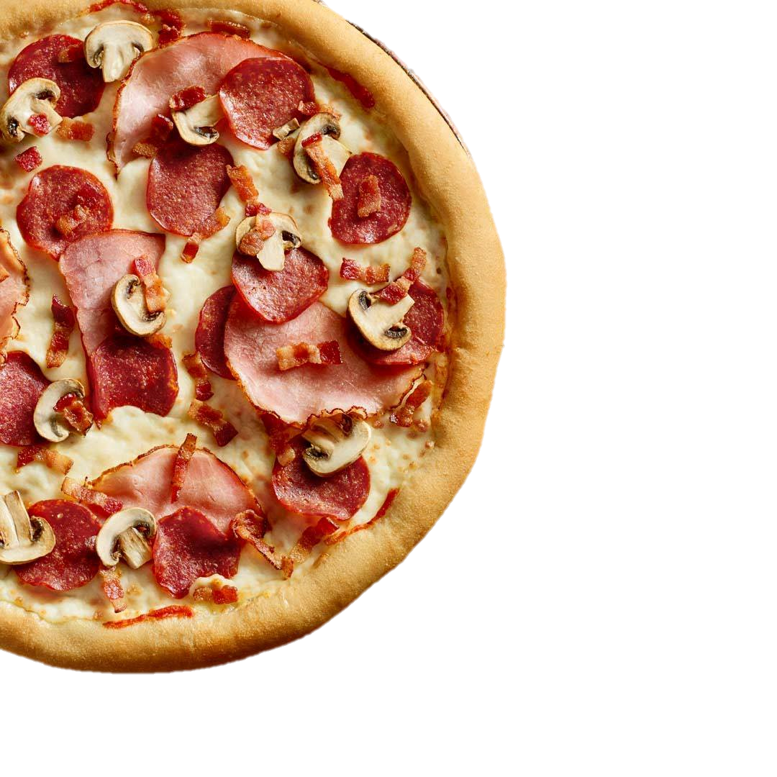
Canadian
Pizza
Canadian pizza is pizza with the following toppings: tomato sauce, mozzarella cheese, bacon, pepperoni and mushrooms.

Slide 18
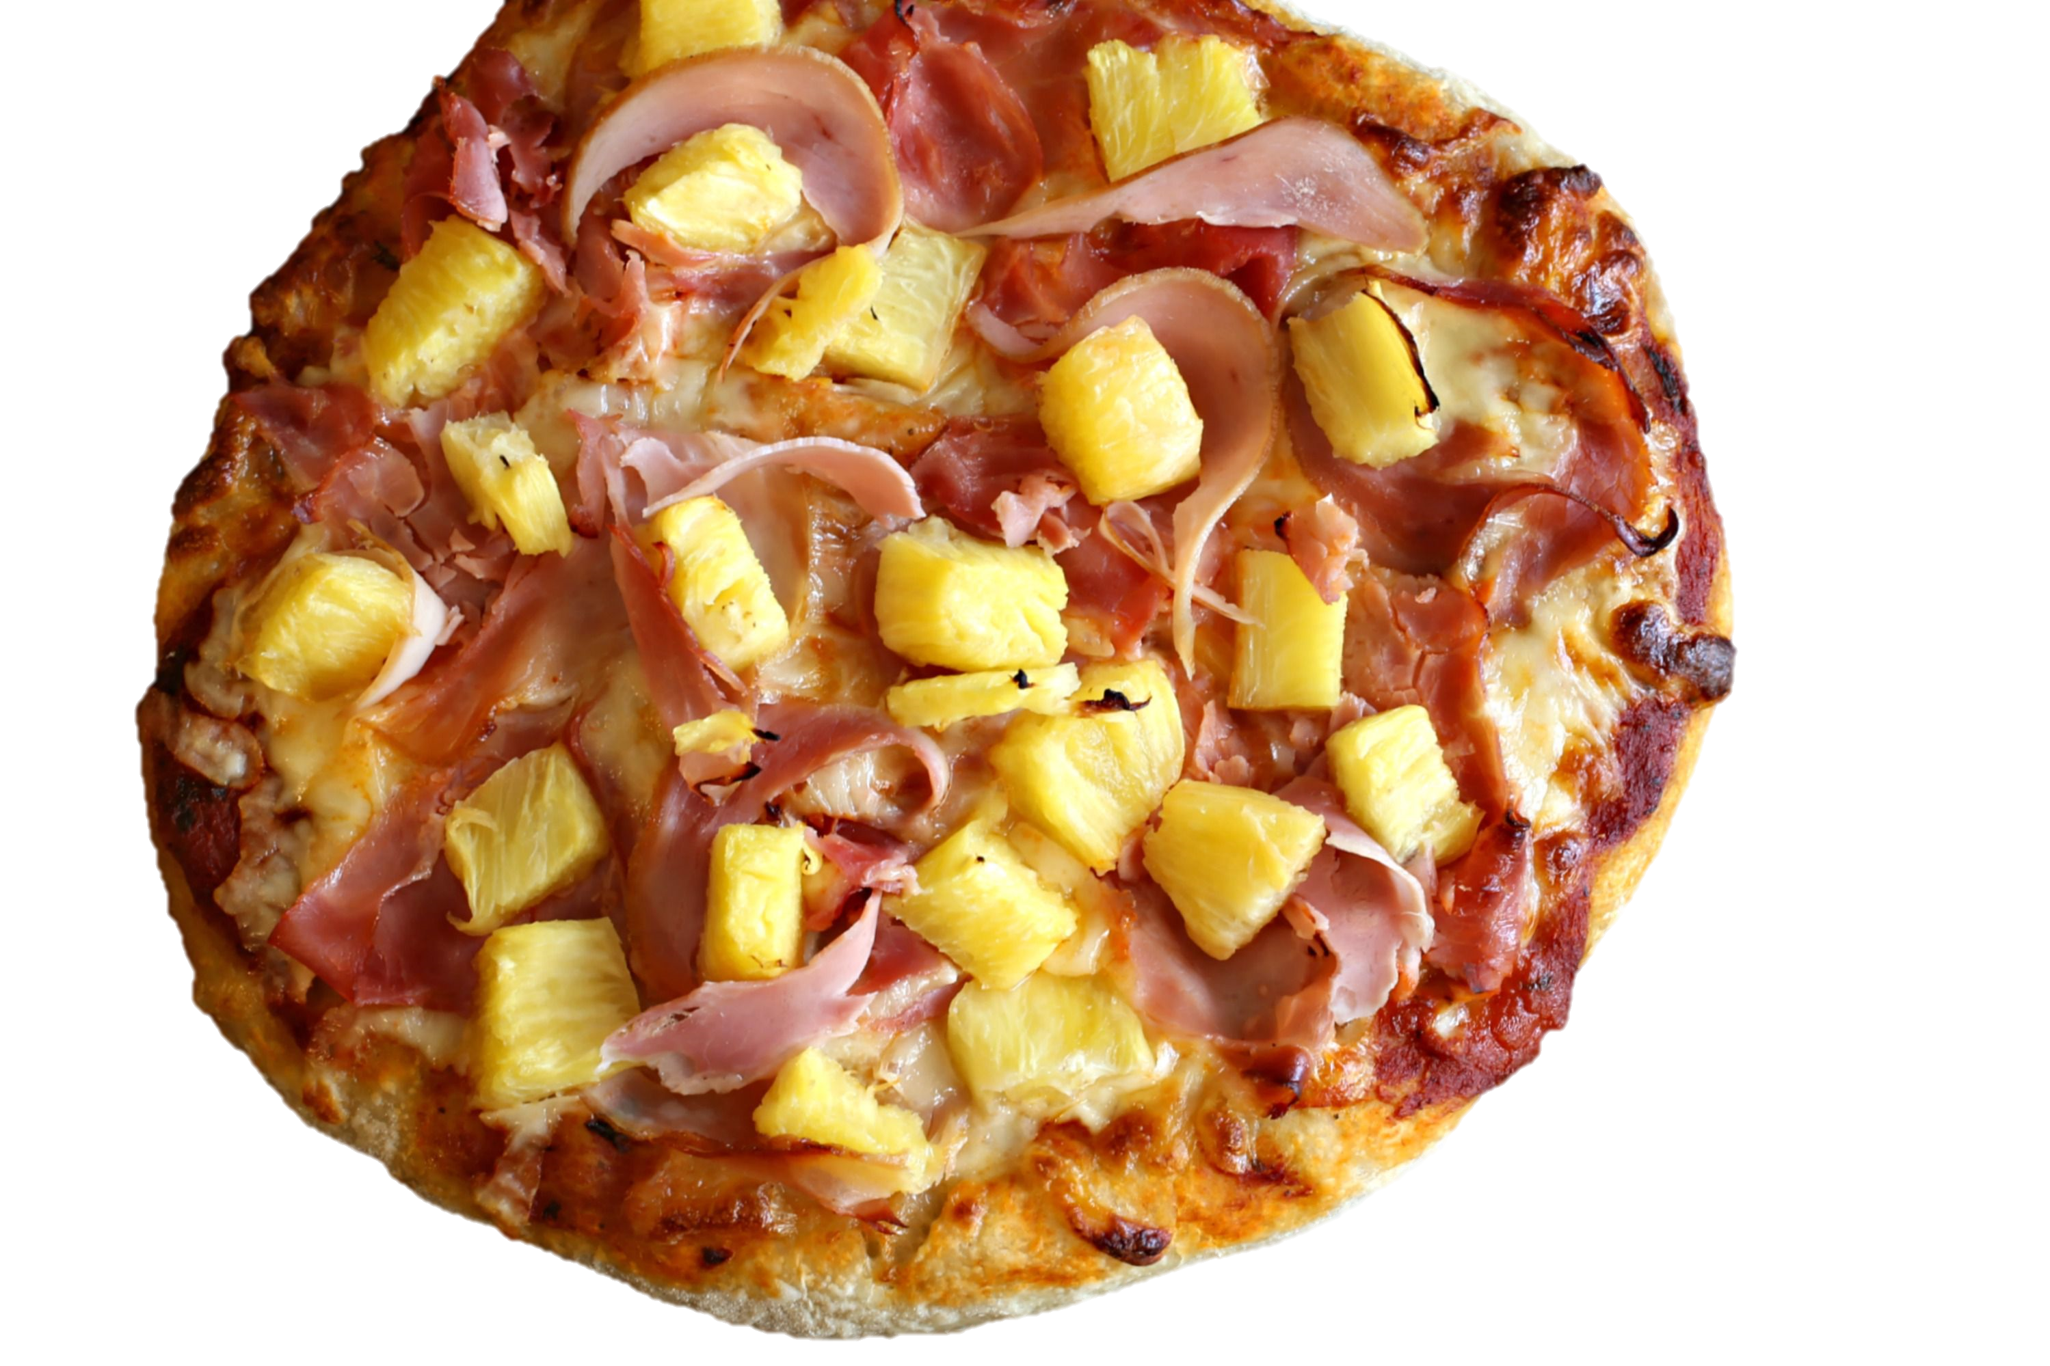
Hawaiian
Pizza
Did you know that Hawaiian pizza was actually invented in Canada? It is topped with pineapple and ham.

Slide 19
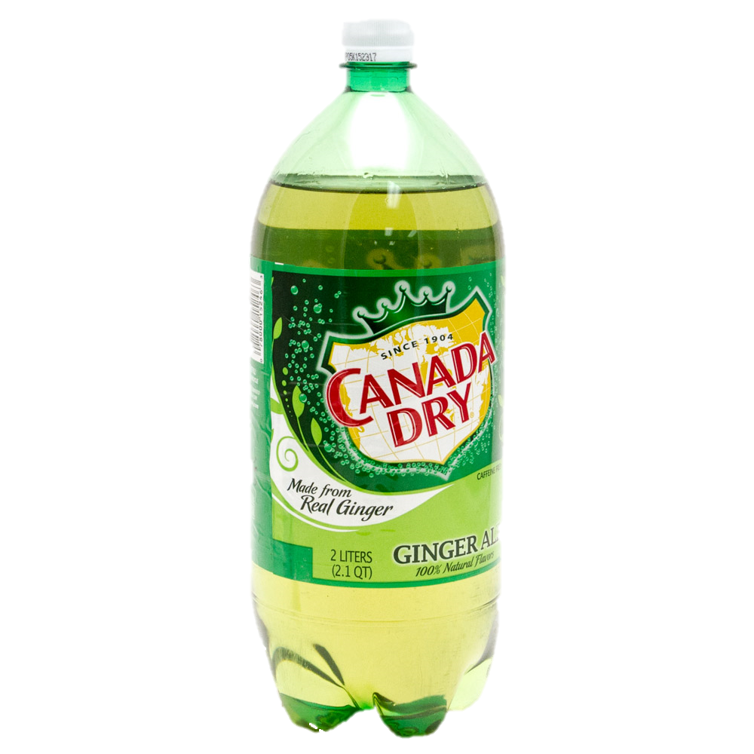
Ginger Ale
This soda is similar to cider but it has a stronger flavor.

Slide 20
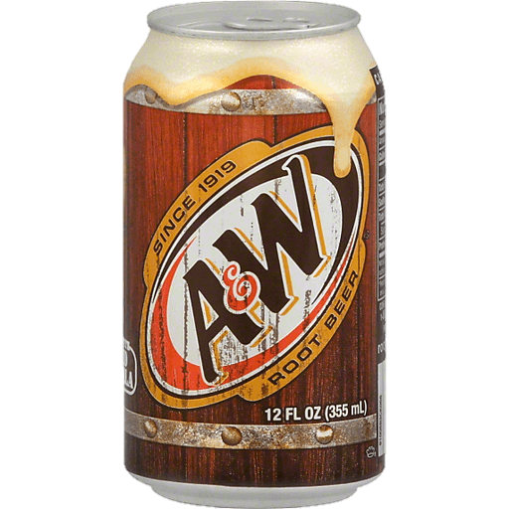
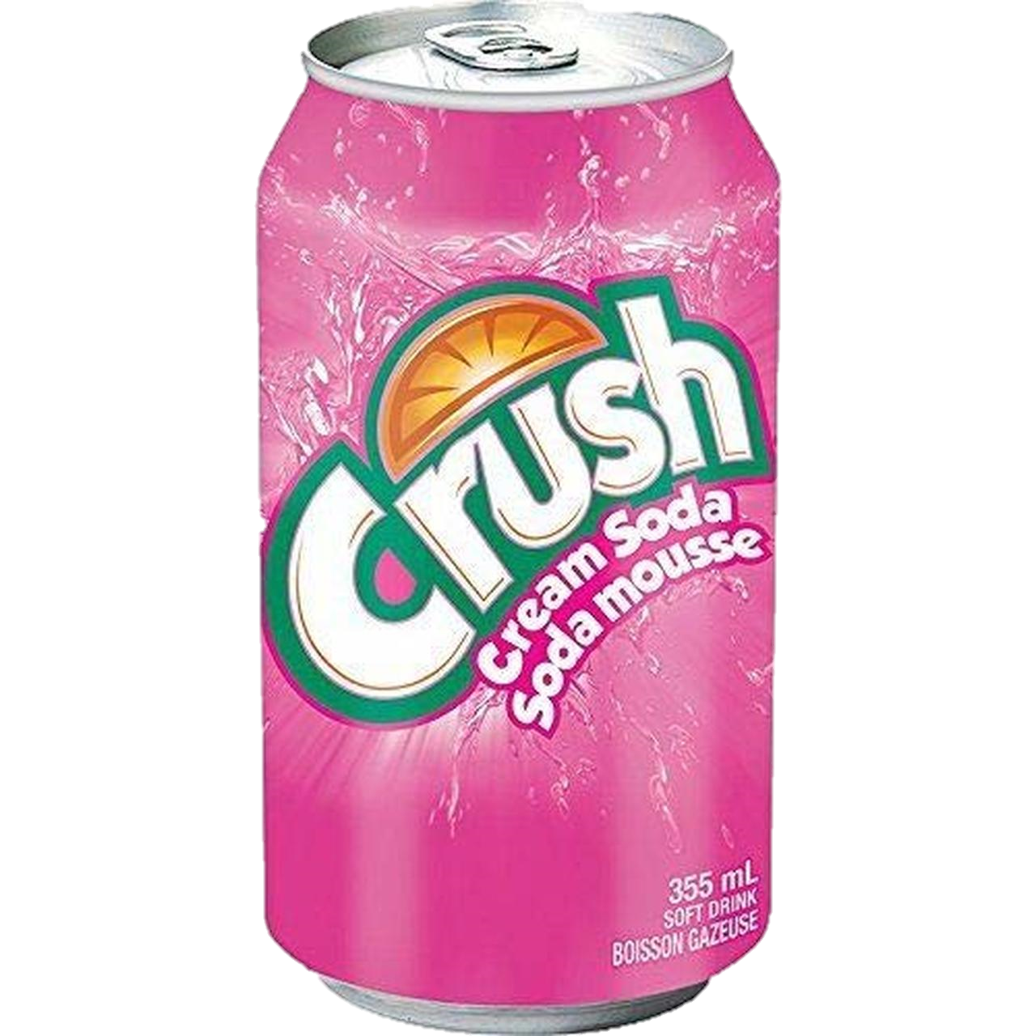

Slide 21
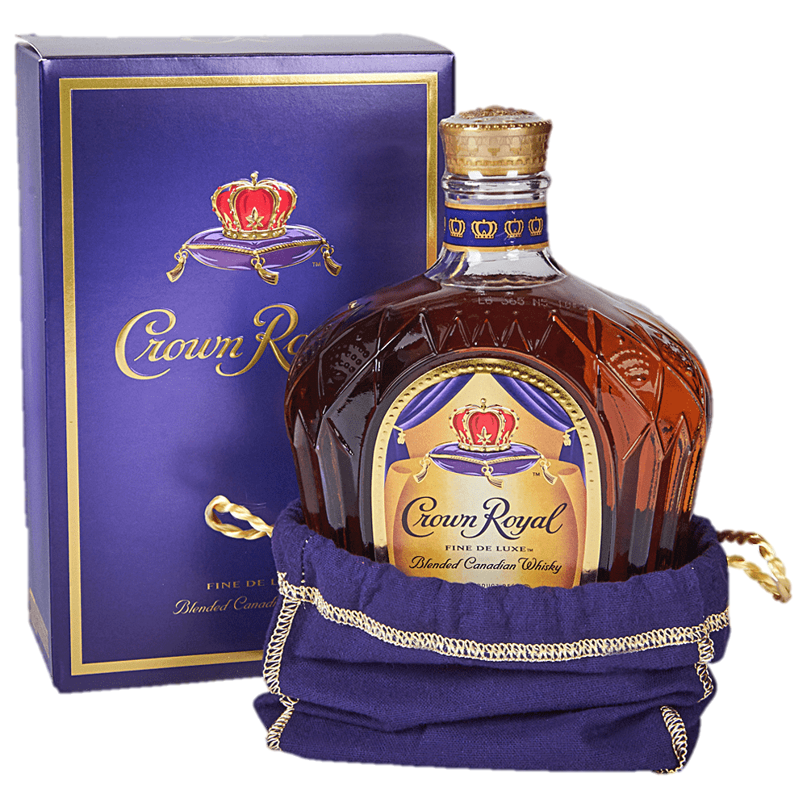
Crown
Royal
This is a Canadian whisky.
It is famous around the world.

Slide 22
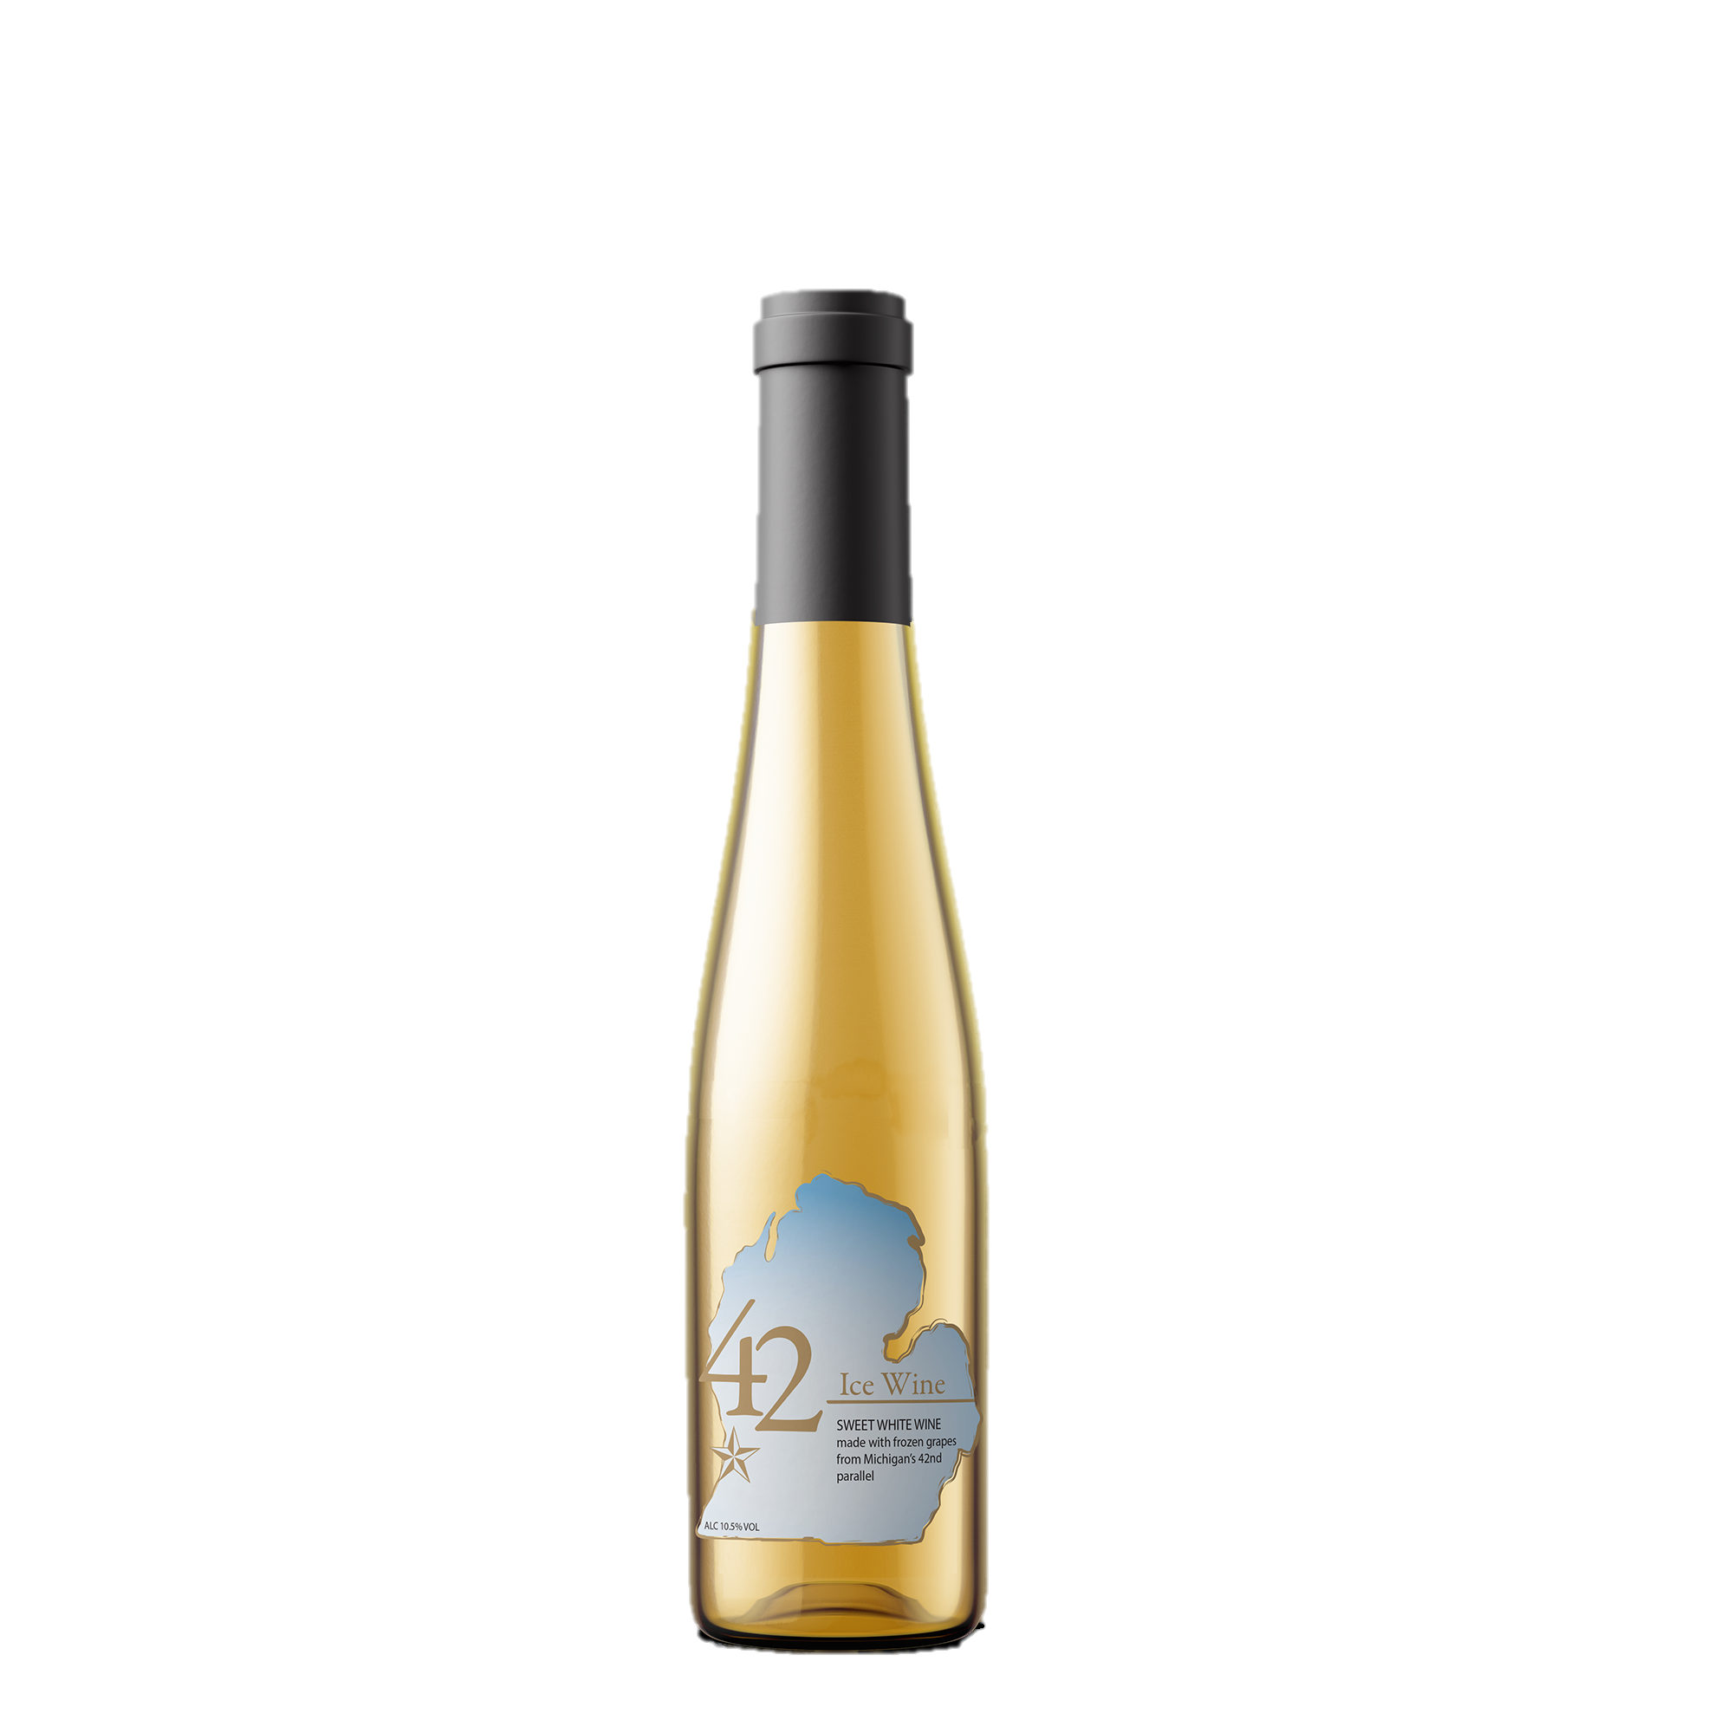
Ice Wine
The grapes are picked after they are frozen. This makes the wine very sweet. You can mix it with ice cream.

Slide 23
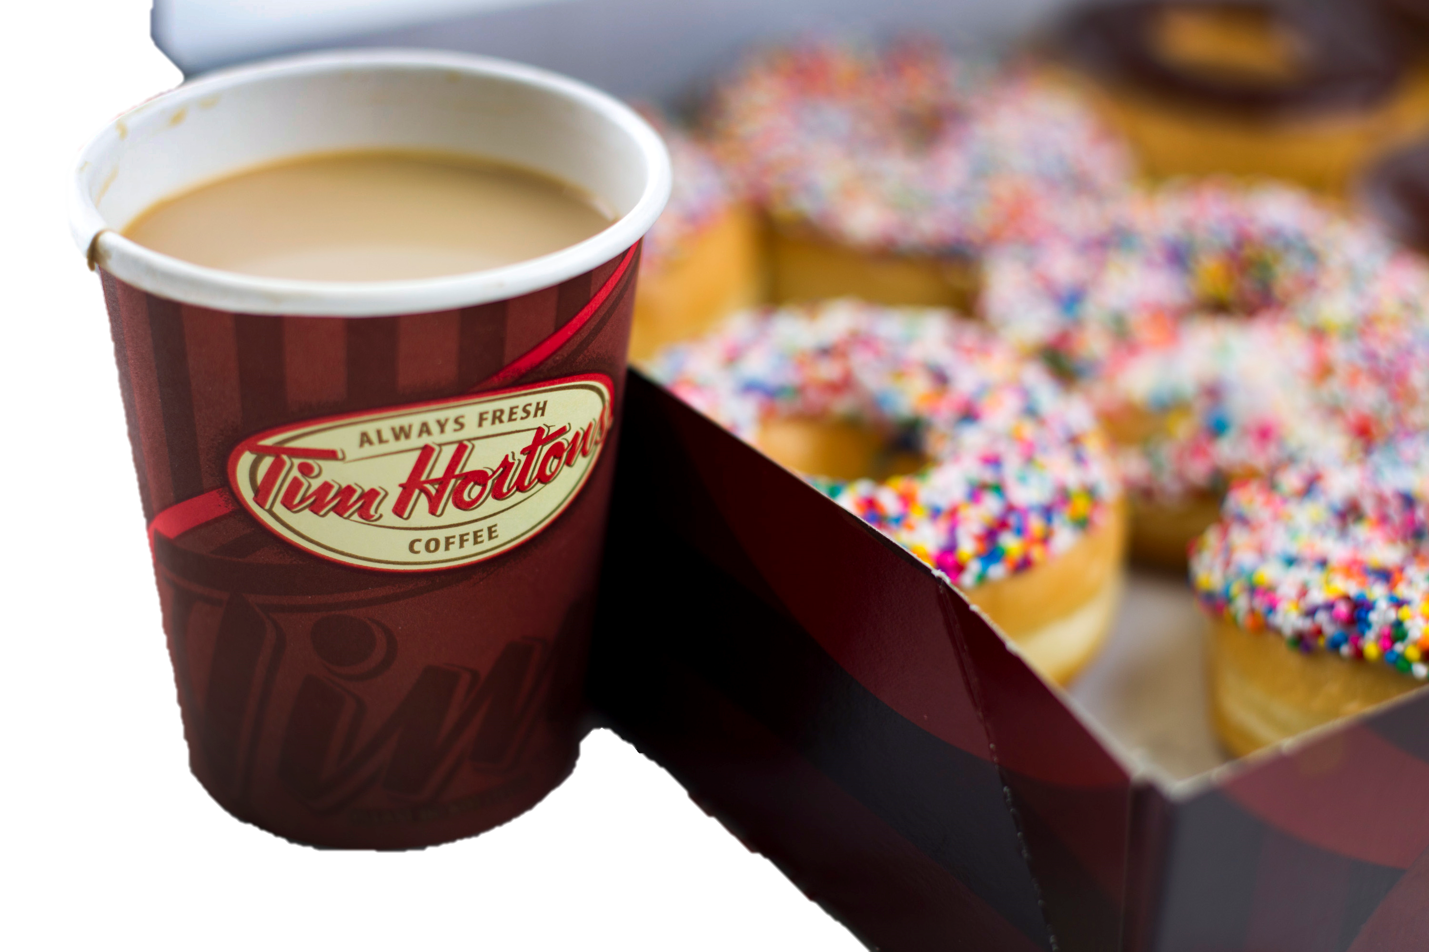
Tim
Hortons
Tim Horton was a hockey player a long time ago.
Now there is a chain of coffee shops named after him. They are very popular.

Slide 24
