Slide 1
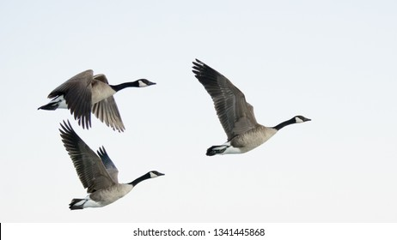
Canada
Geese

Slide 2
Step 1
Read
Read through the article and highlight words or phrases you are unfamiliar with.

Slide 3
Step 2
Read
With your team, use context to determine the meaning.

Slide 4
Step 3
Read
Check your guesses with a dictionary.

Slide 5
Step 4
Read
Discuss the article.

Slide 6
Highlight unfamiliar words
Use context to guess the meaning
Check your guesses
Discuss the article
Read

Slide 7
Canada Geese
Questions

Slide 8
Why are Canada geese a problem?

Slide 9
If there are too many, how will they affect the environment?

Slide 10
In Canada, Canada geese are a protected species. How can we deal with overpopulation?

Slide 11
Where do the geese like to live?

Slide 12
How would you get rid of them from your city?

Slide 13
If they move, where should they go?

Slide 14
What method would YOU use to discourage Canada geese from coming to your city?

Slide 15
Canada
Geese

Slide 16
The Canada geese that rode a truck from the 416 to the 506
https://www.cbc.ca/archives/the-canada-geese-that-rode-a-truck-from-the-416-to-the-506-1.5616072
Hundreds of messy, unloved geese trucked into Essex County
https://windsorstar.com/news/local-news/hundreds-of-messy-unloved-geese-trucked-into-essex-county
Hundreds of messy, unloved geese trucked into Essex County
https://globalnews.ca/news/7124540/canada-geese-extinction/
Indiana Geese Guidelines
https://www.in.gov/dnr/state-parks/files/CanadaGooseColorFAQ2007.pdf

