Slide 1
Canadian
Wildlife

Slide 2
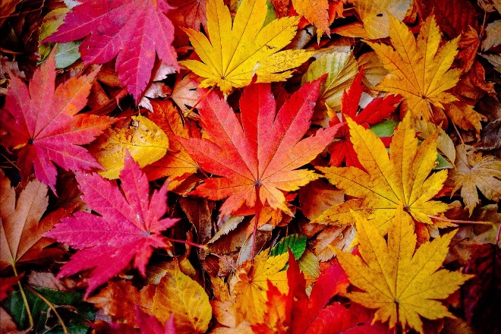
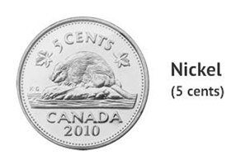
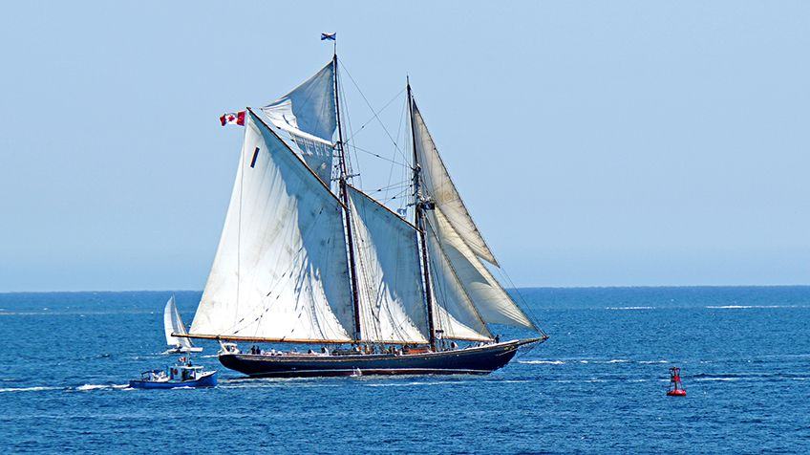
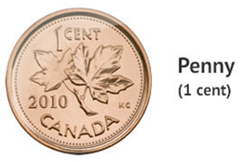
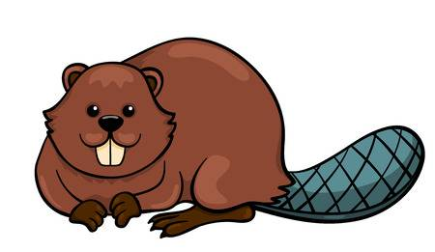
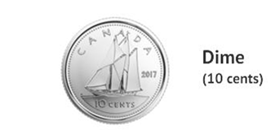
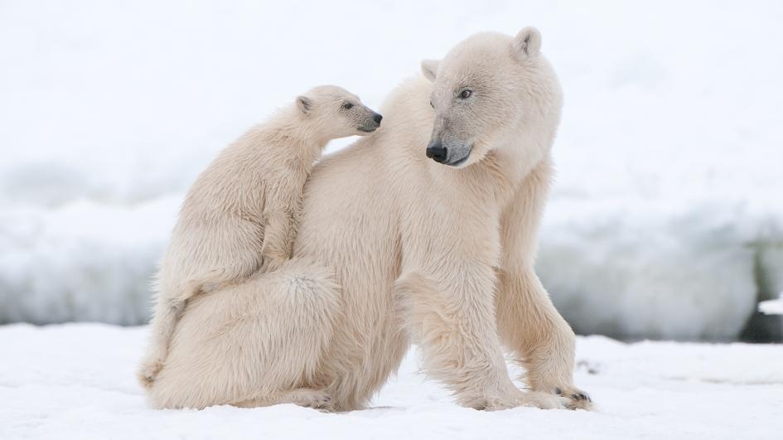
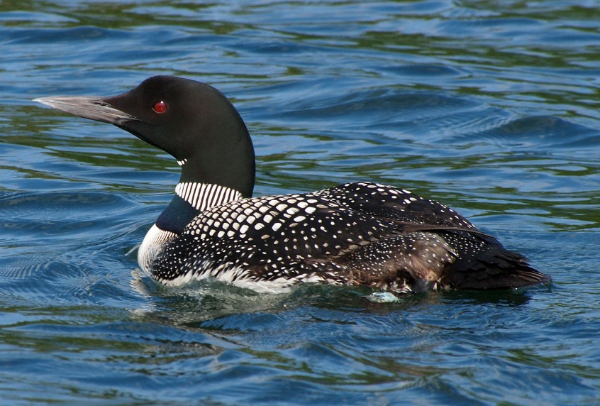
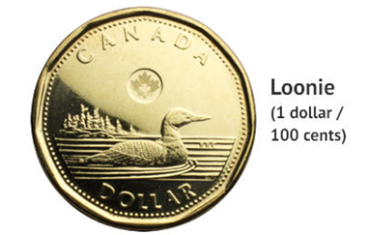
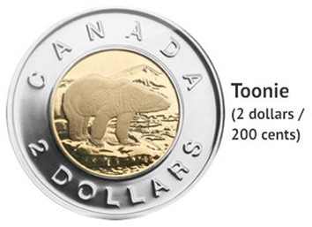
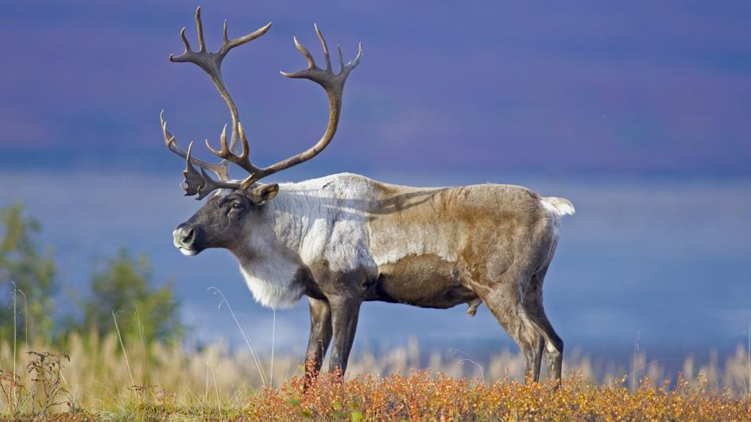
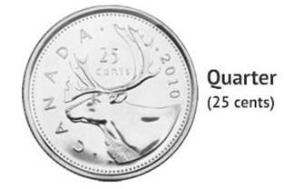
Maple Leaf
Beaver
Bluenose
Caribou
Loon
Polar Bear

Slide 3
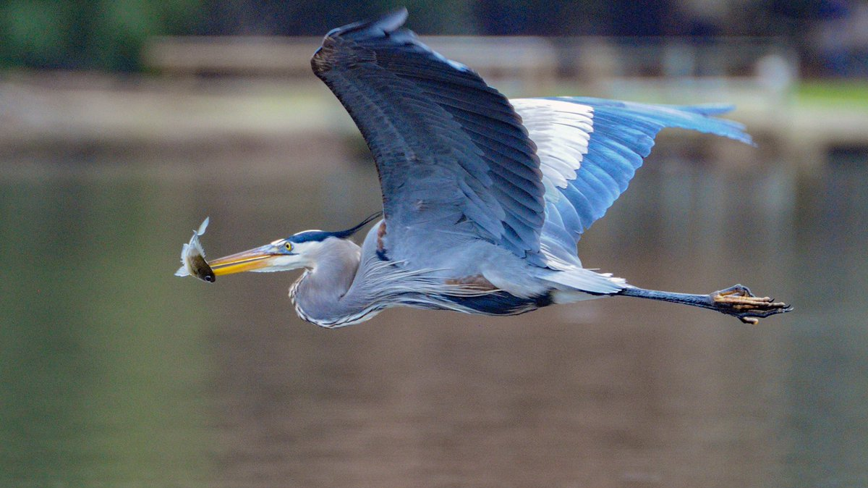

Great Blue Heron

Slide 4
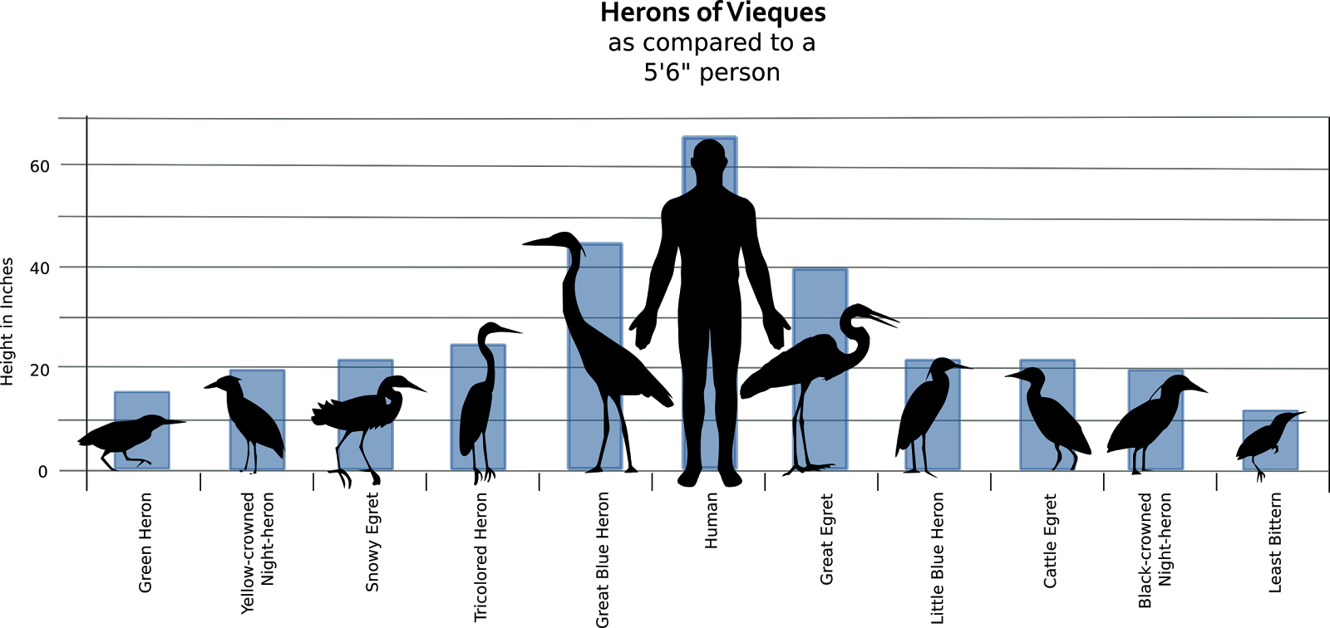

Slide 5
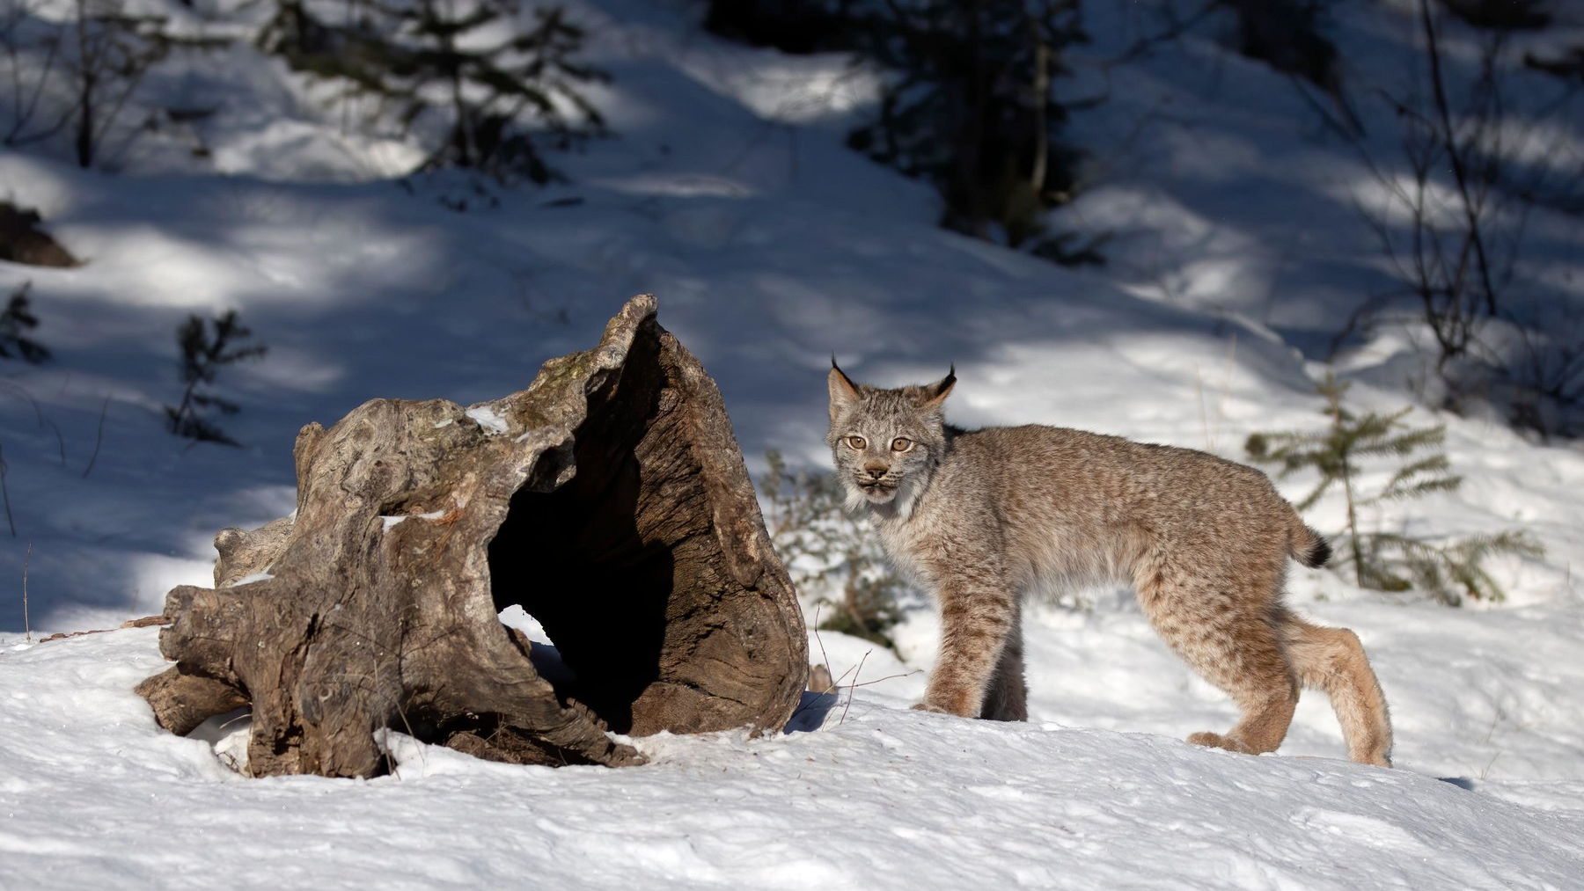
Lynx

Slide 6
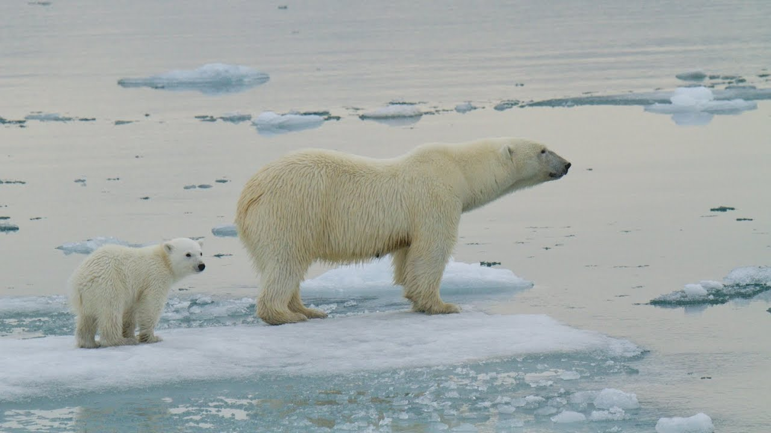
Polar Bear

Slide 7
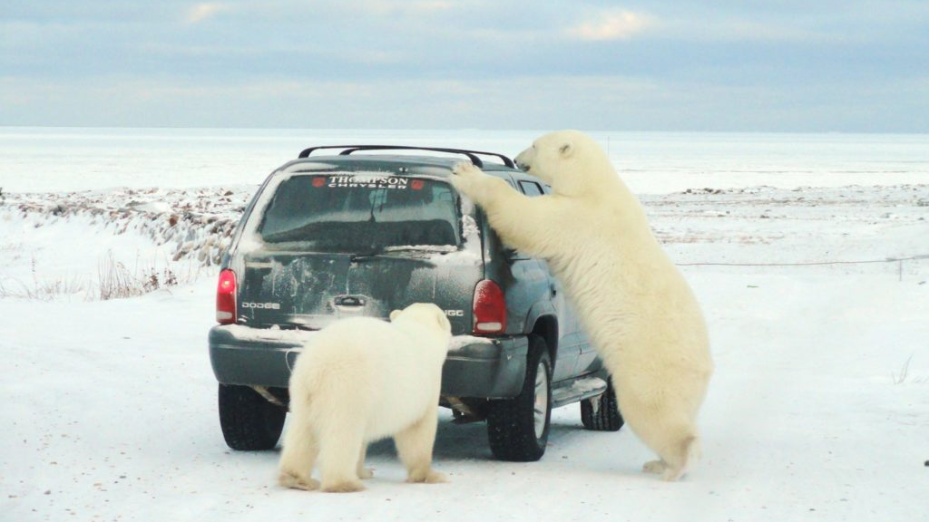

Slide 8
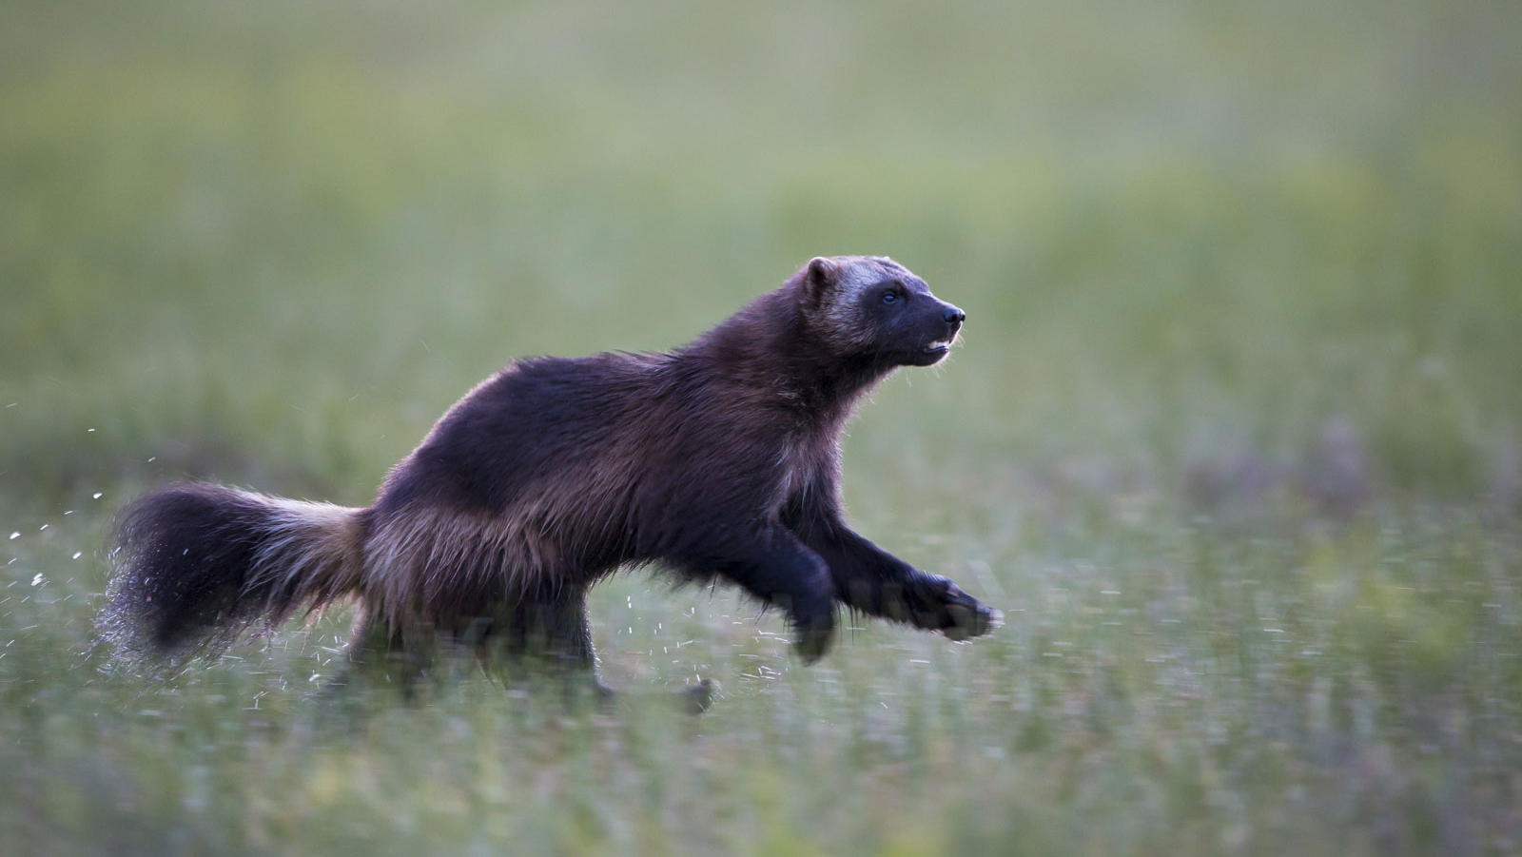
Wolverine

Slide 9
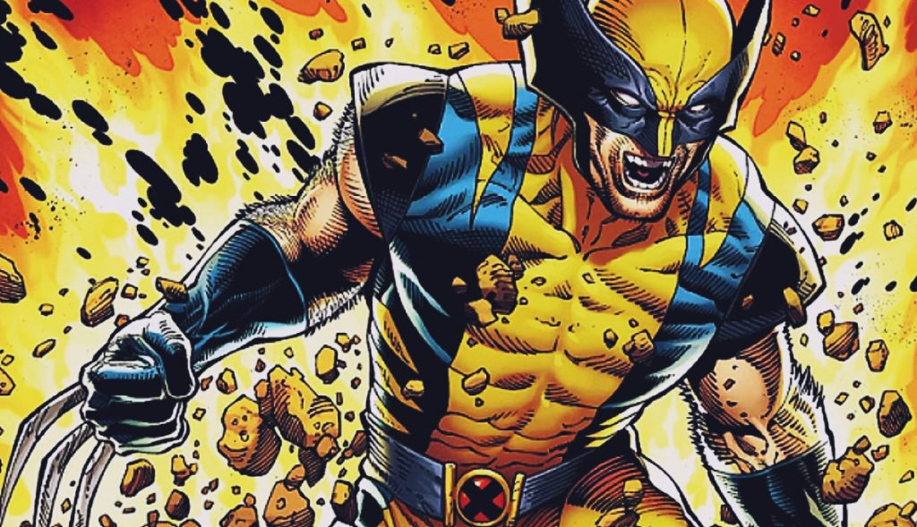

Slide 10
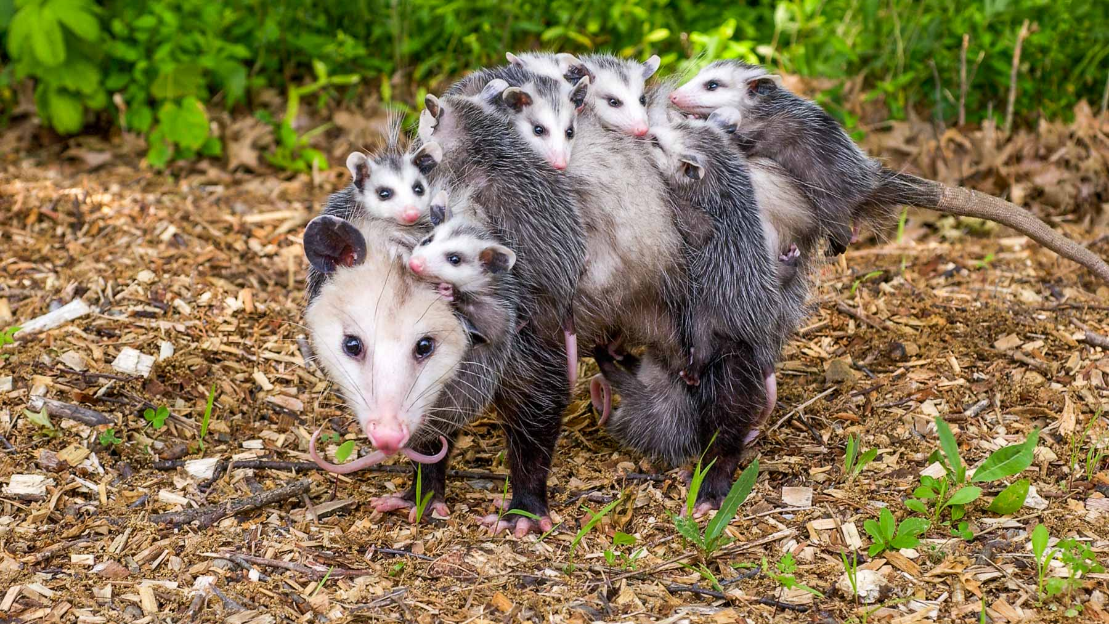
Opossum

Slide 11
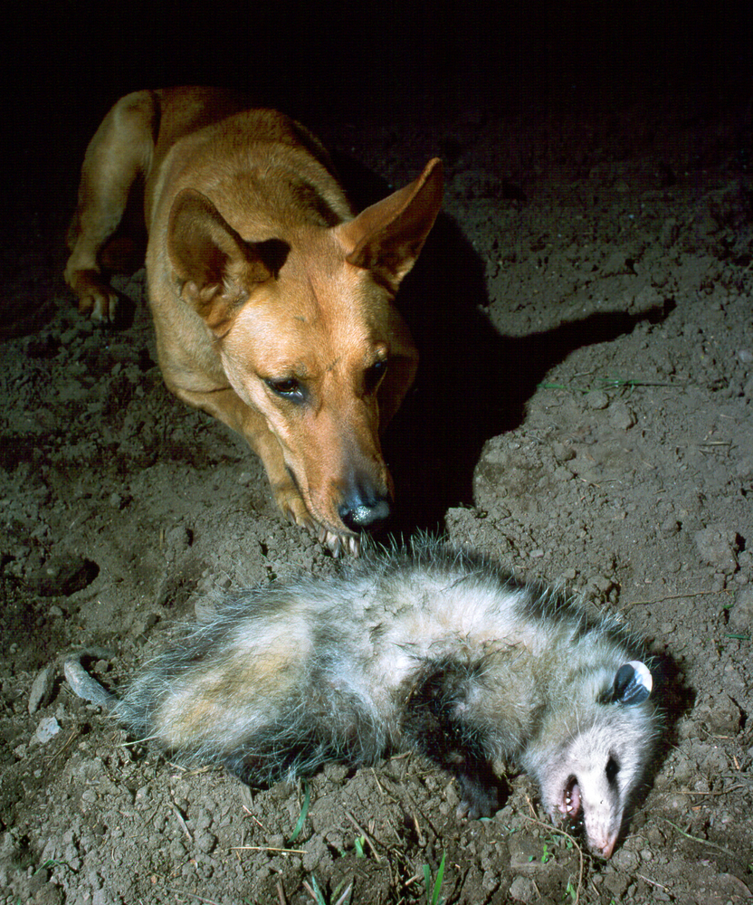
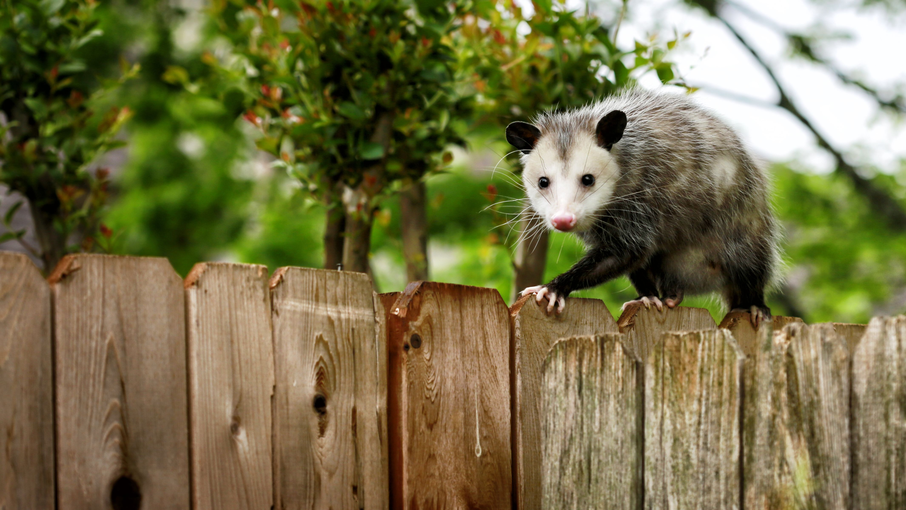

Slide 12
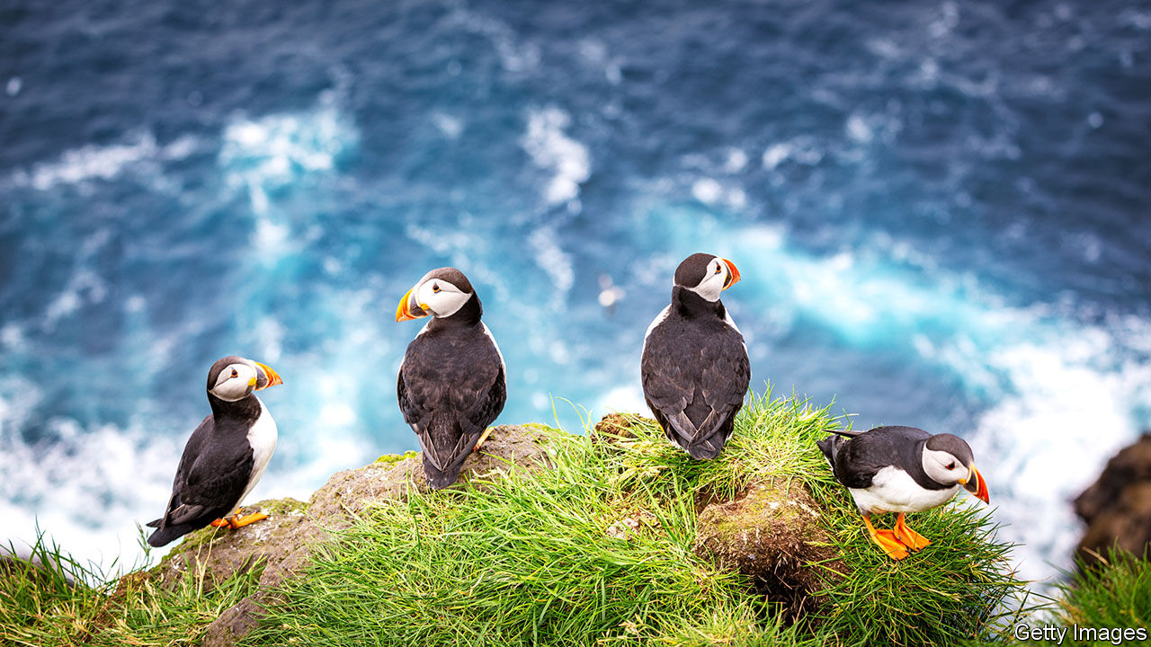
Puffin

Slide 13
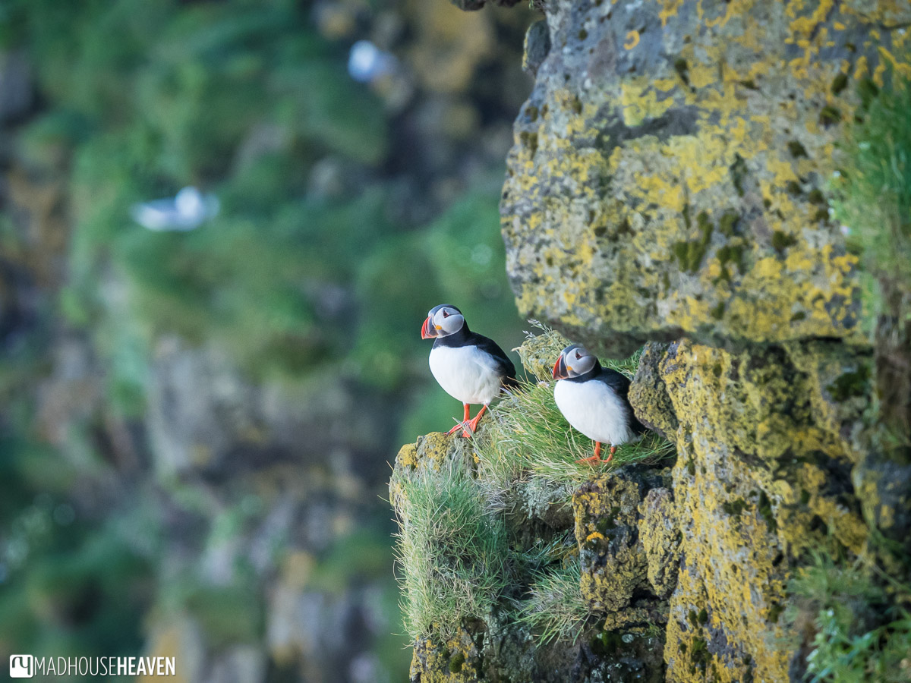

Slide 14
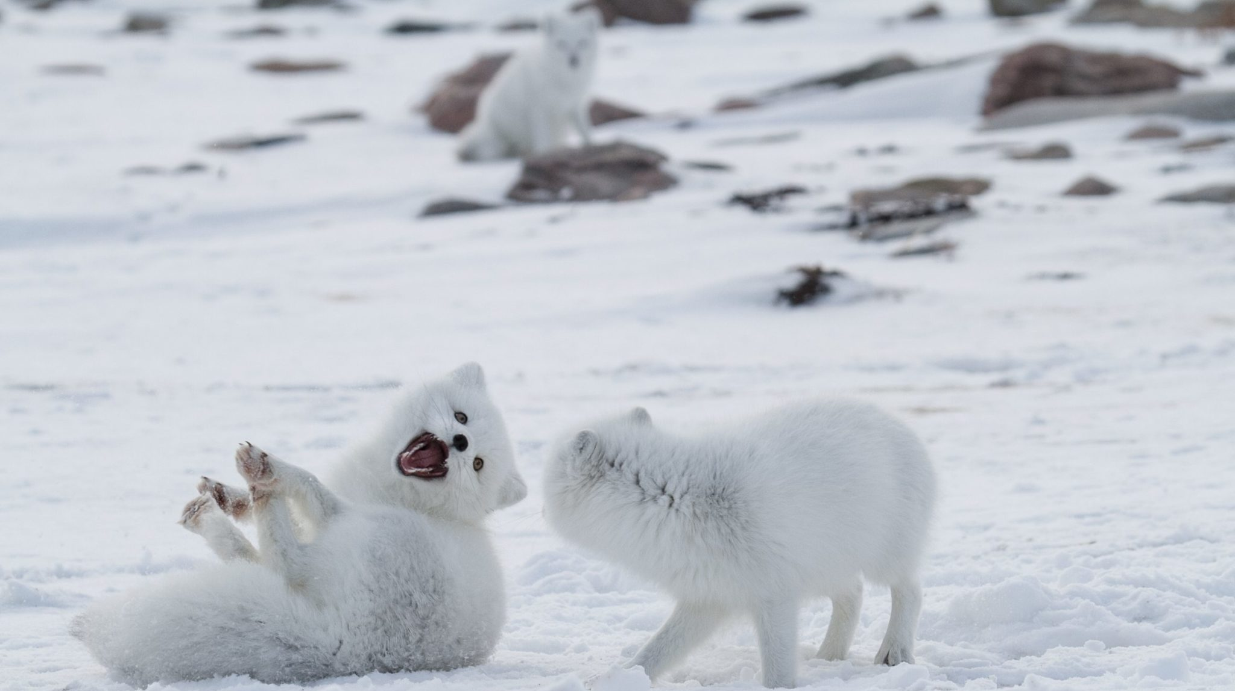
Arctic Fox

Slide 15
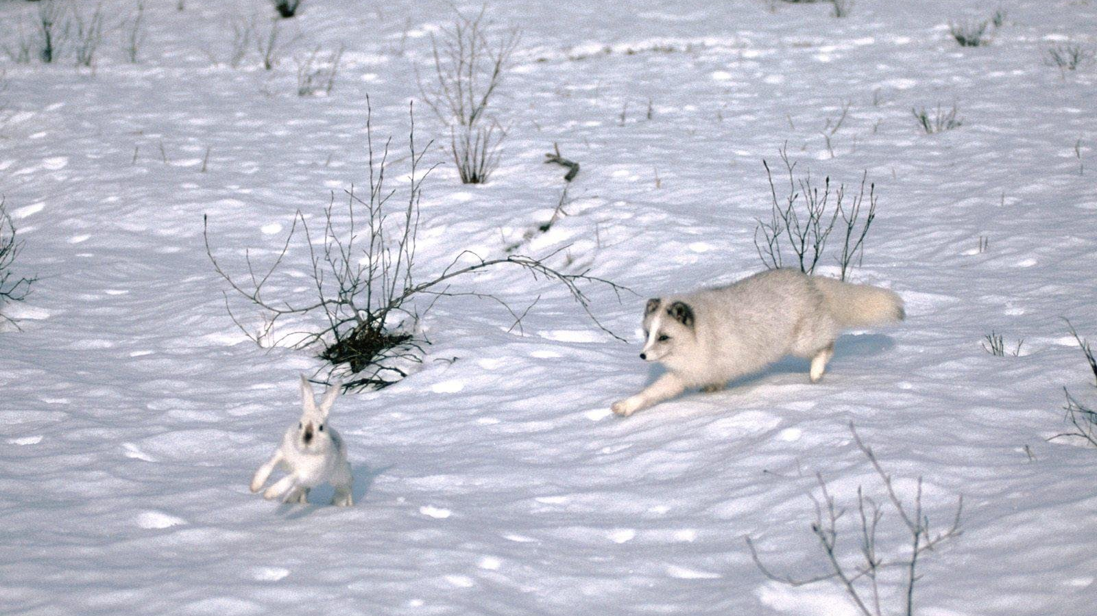

Slide 16
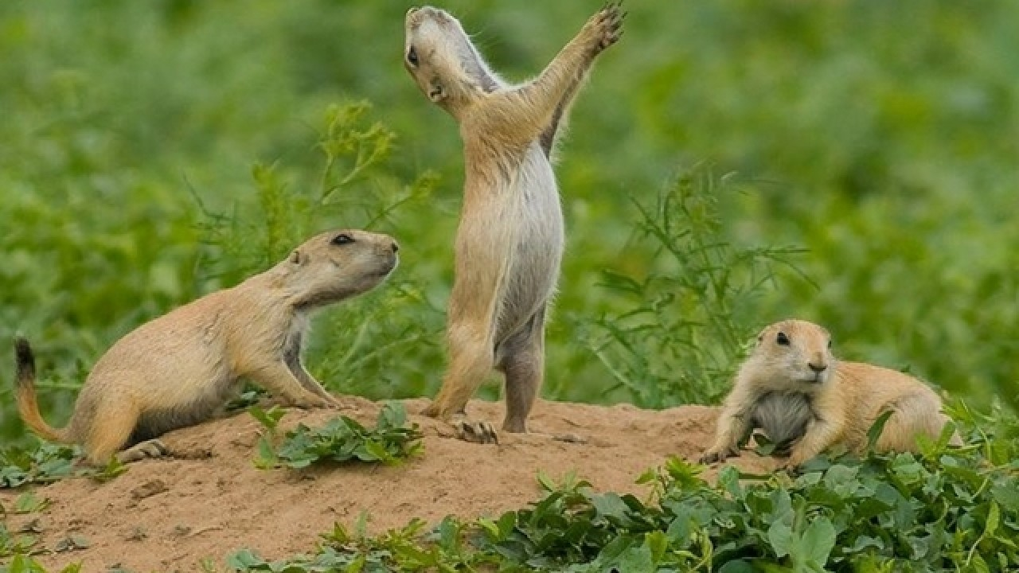
Prairie Dog

Slide 17
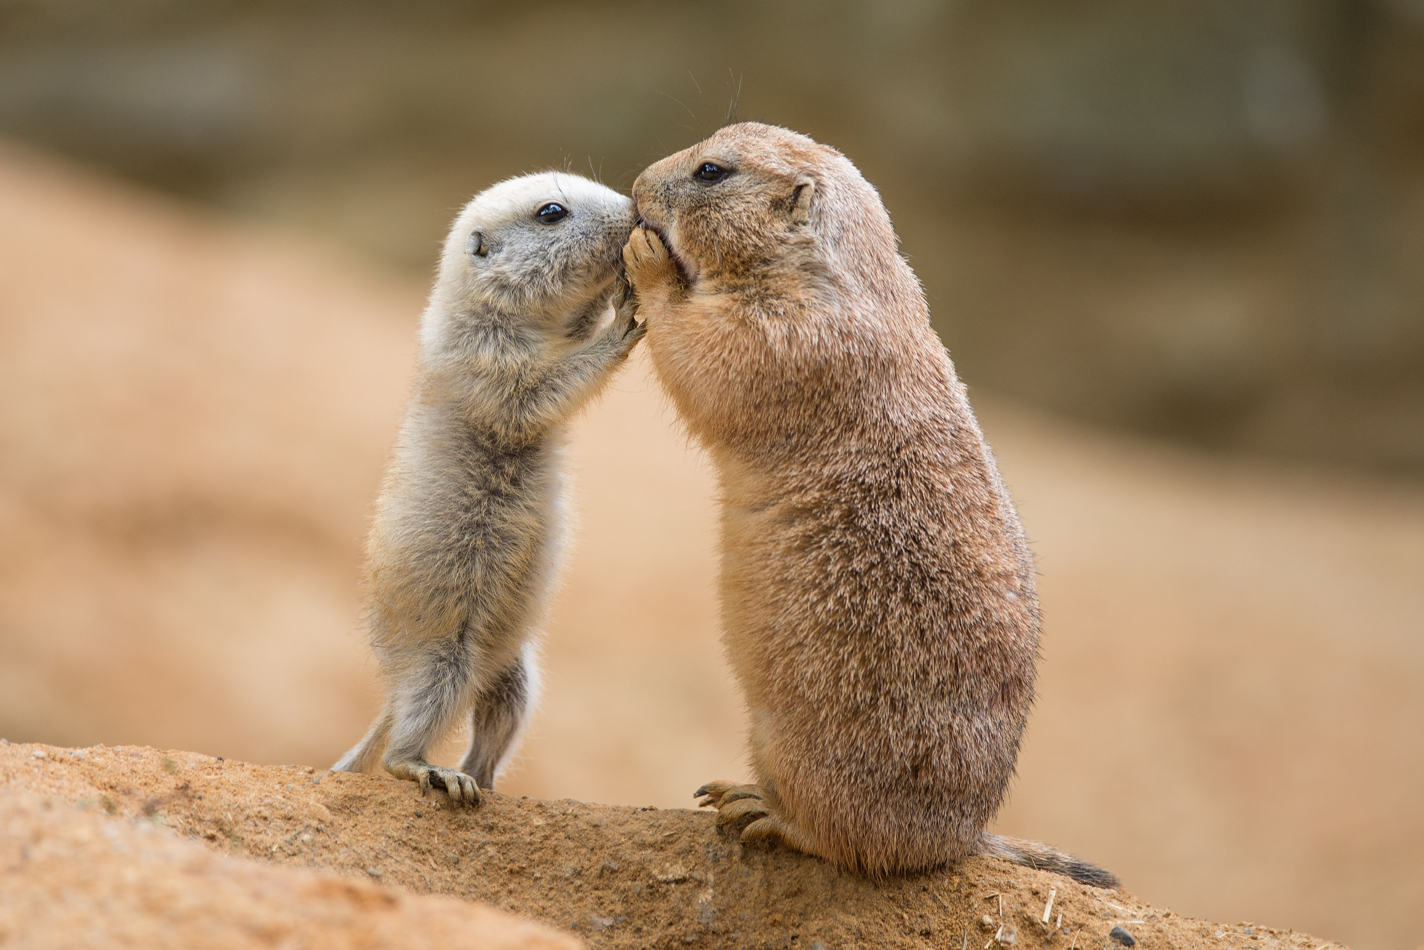

Slide 18
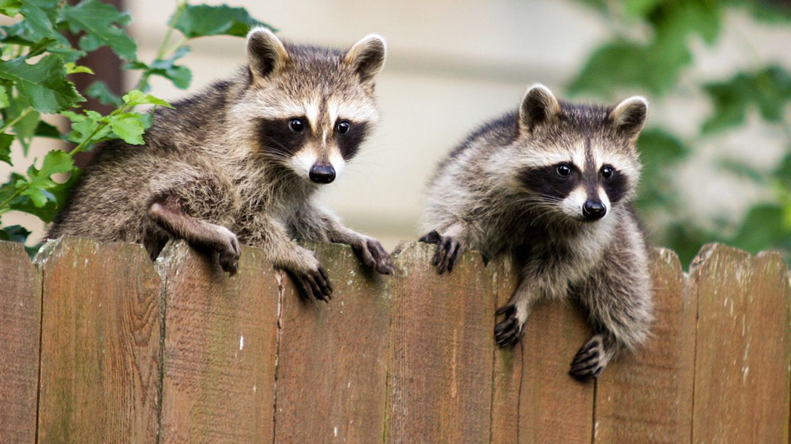
Raccoon

Slide 19
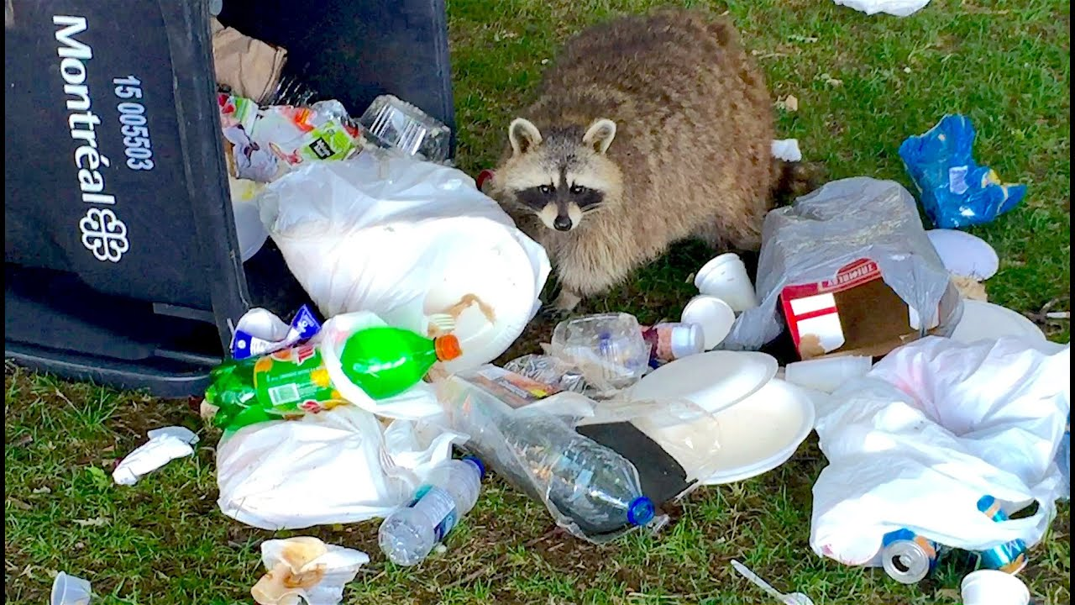

Slide 20
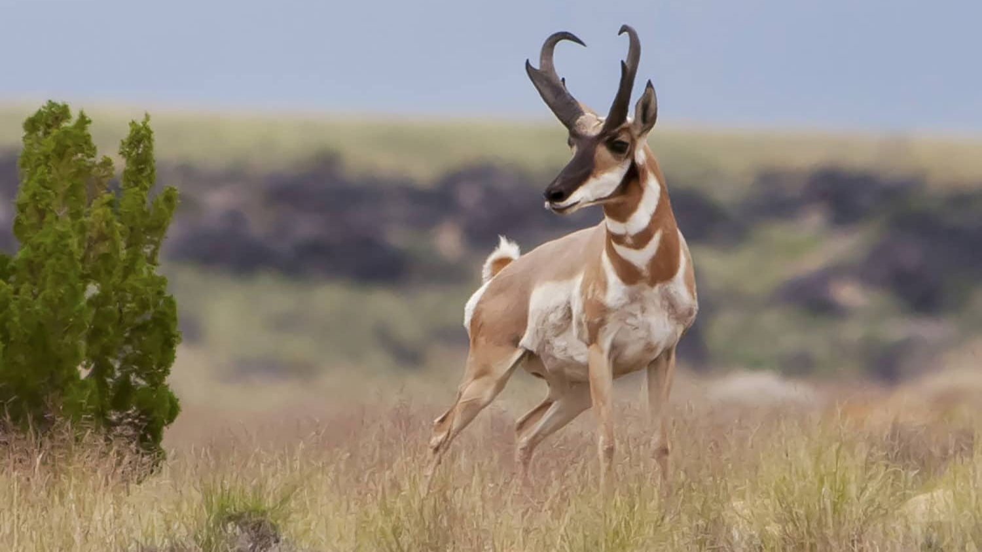
Pronghorn Antelope

Slide 21
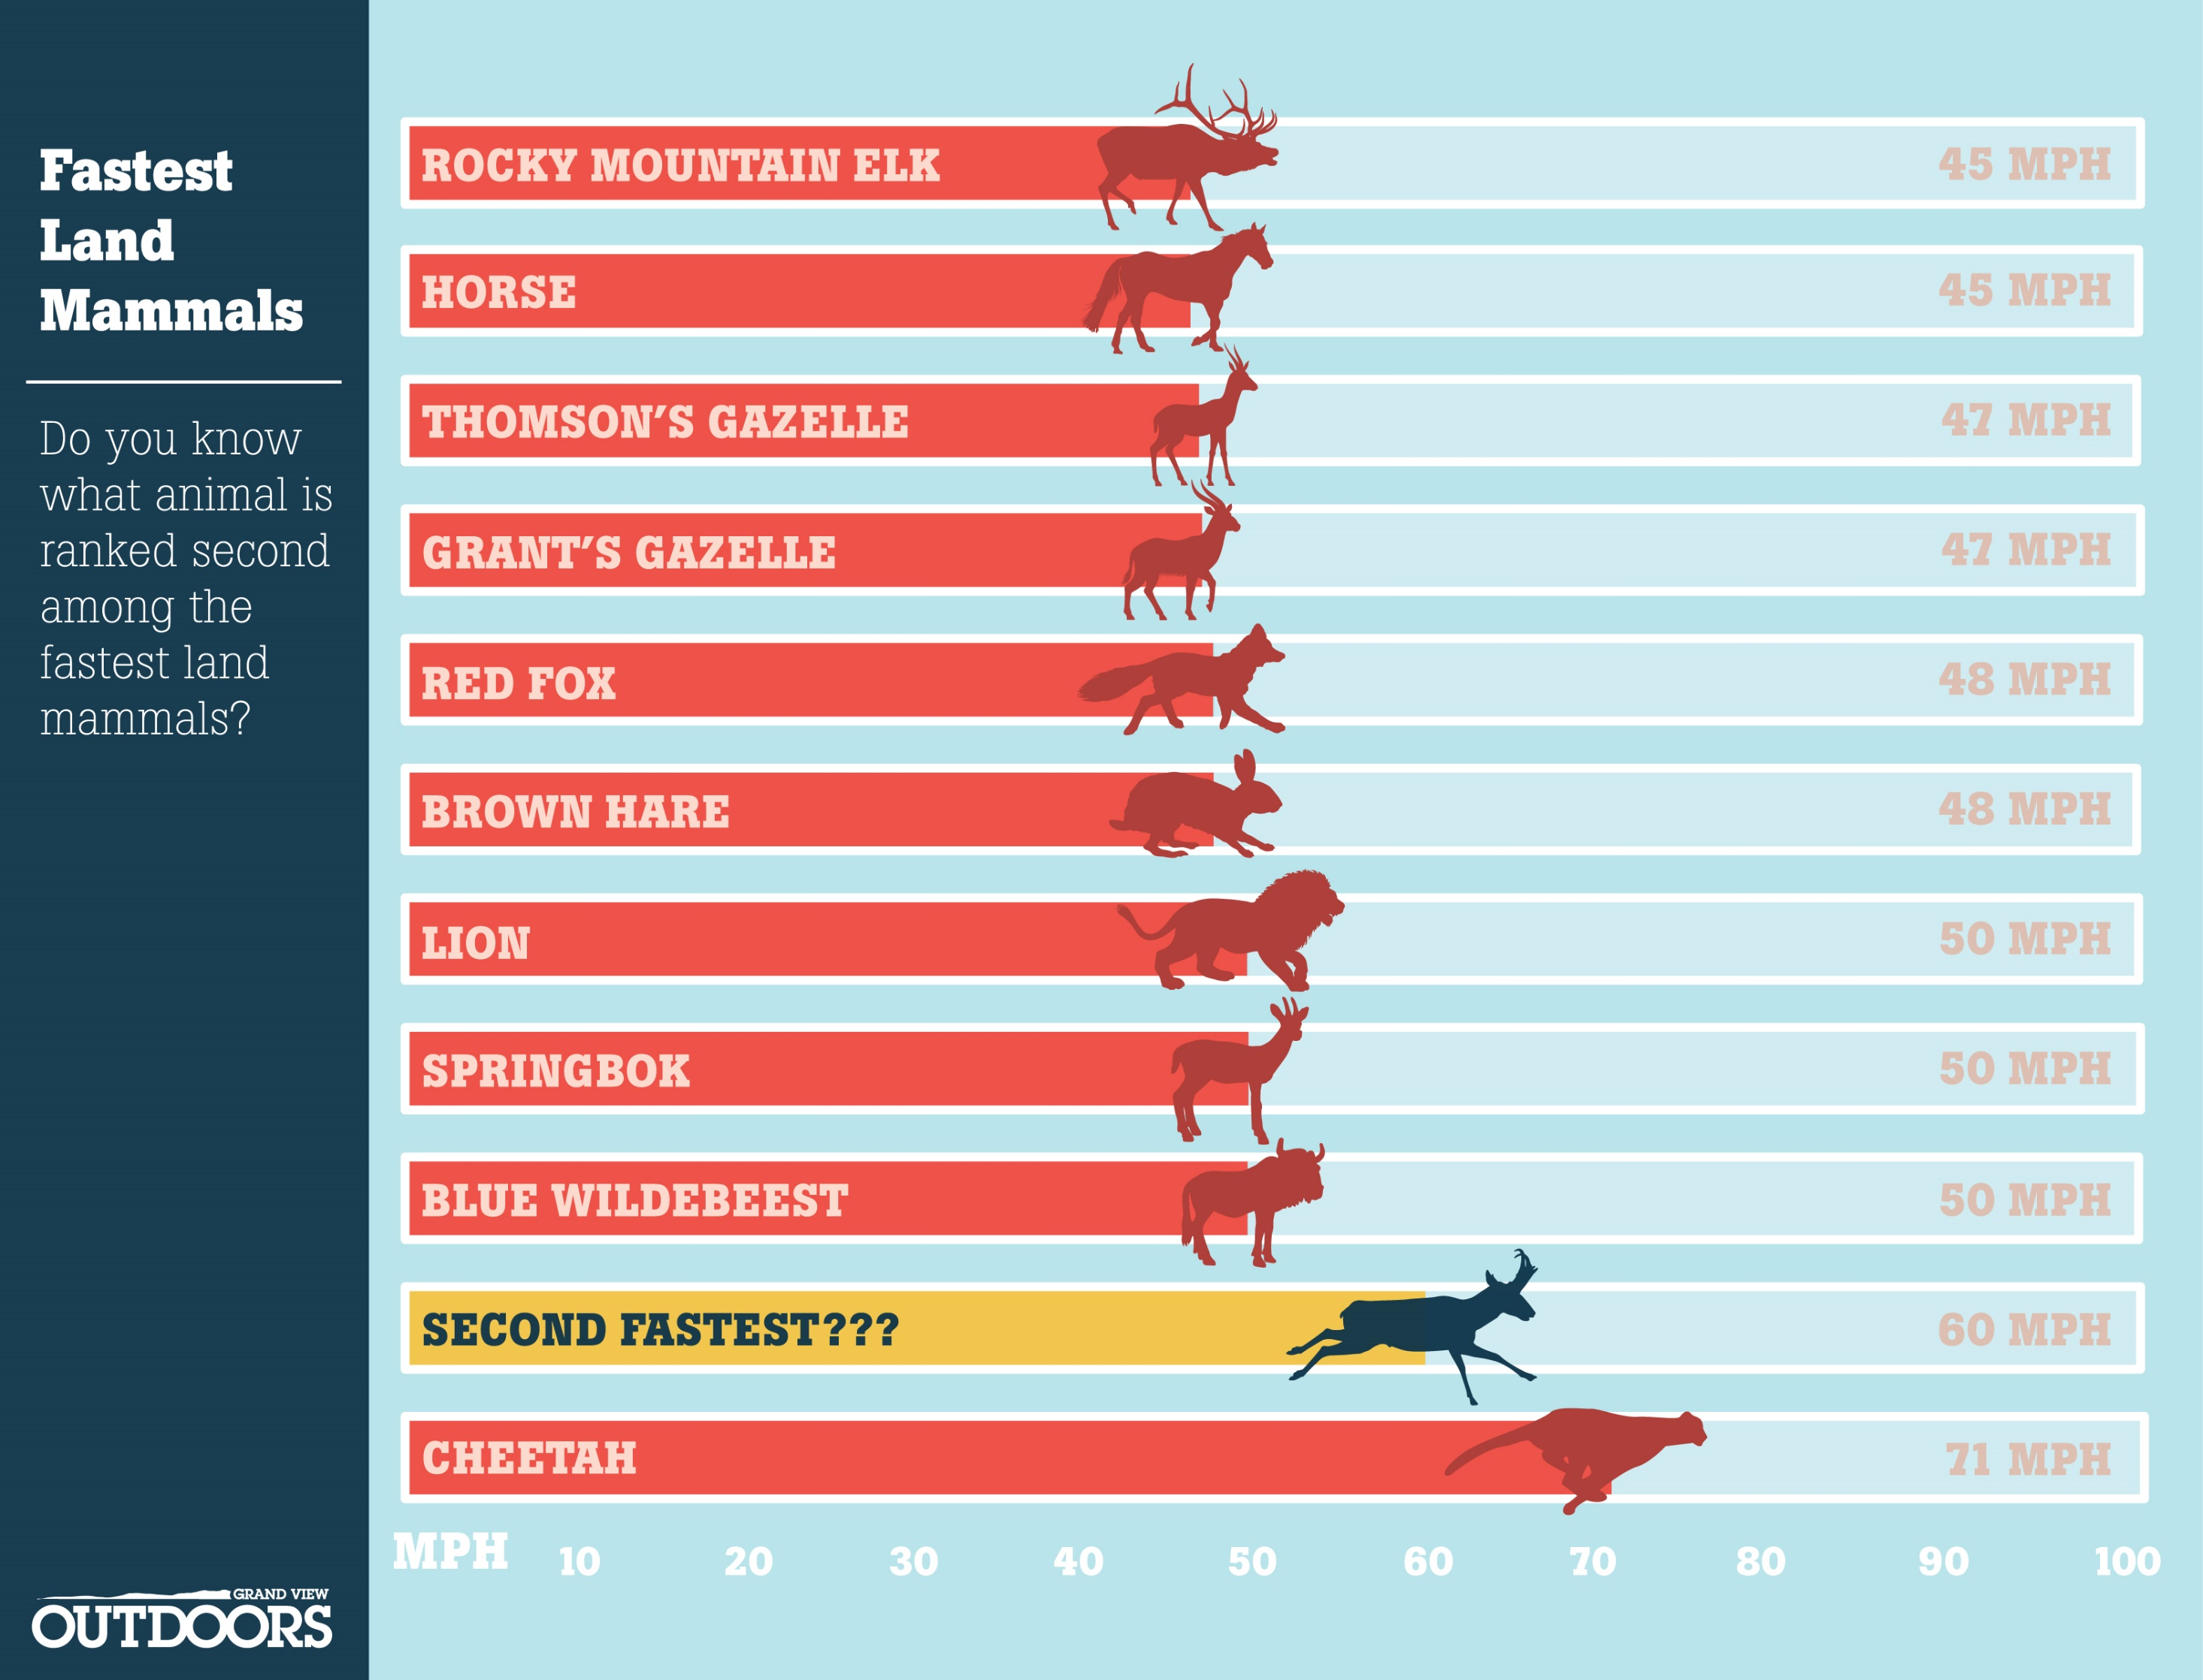

Slide 22
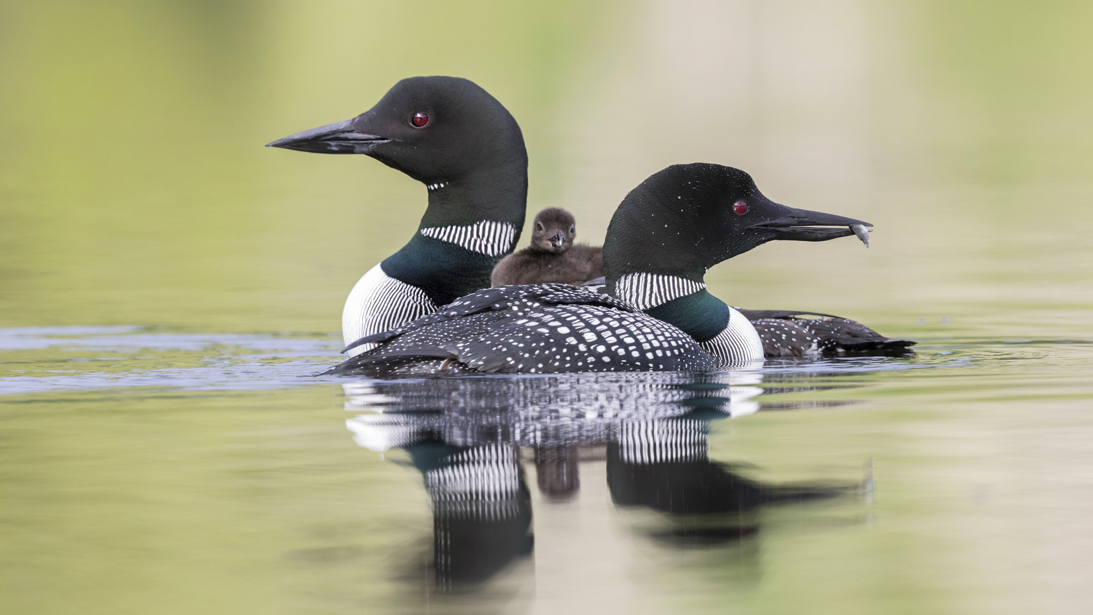
Loon

Slide 23
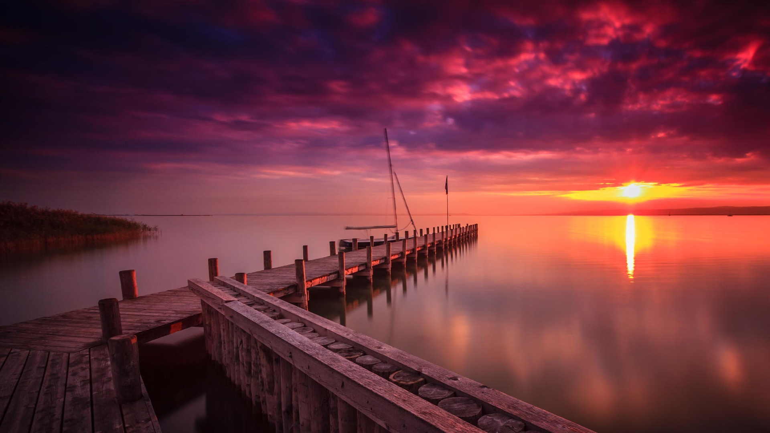

Slide 24
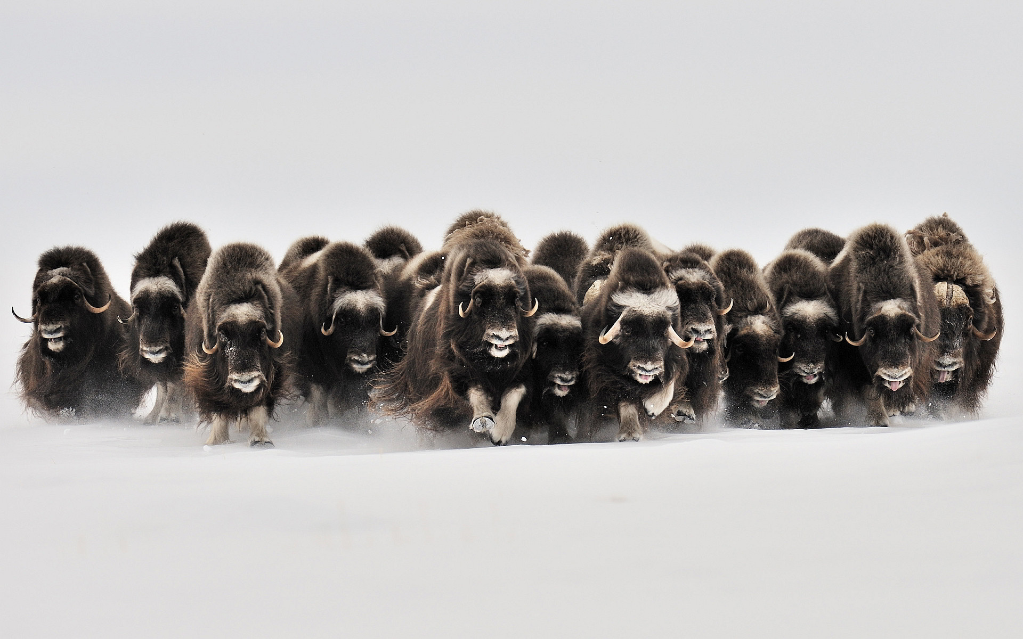
Muskox

Slide 25
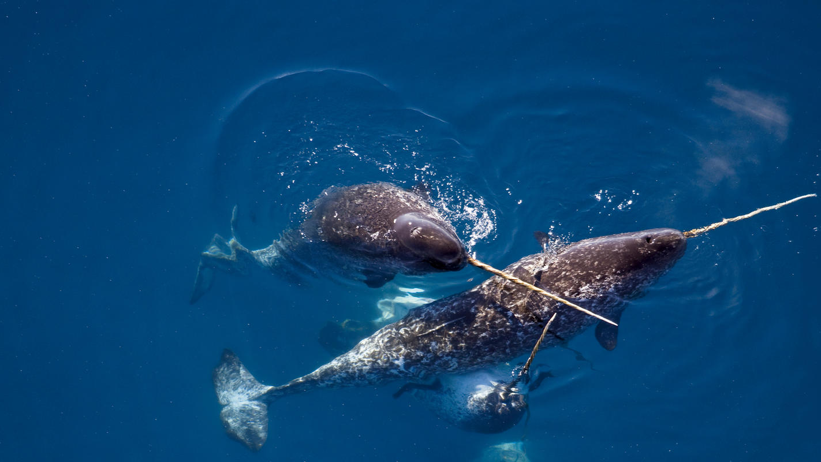
Narwhal

Slide 26
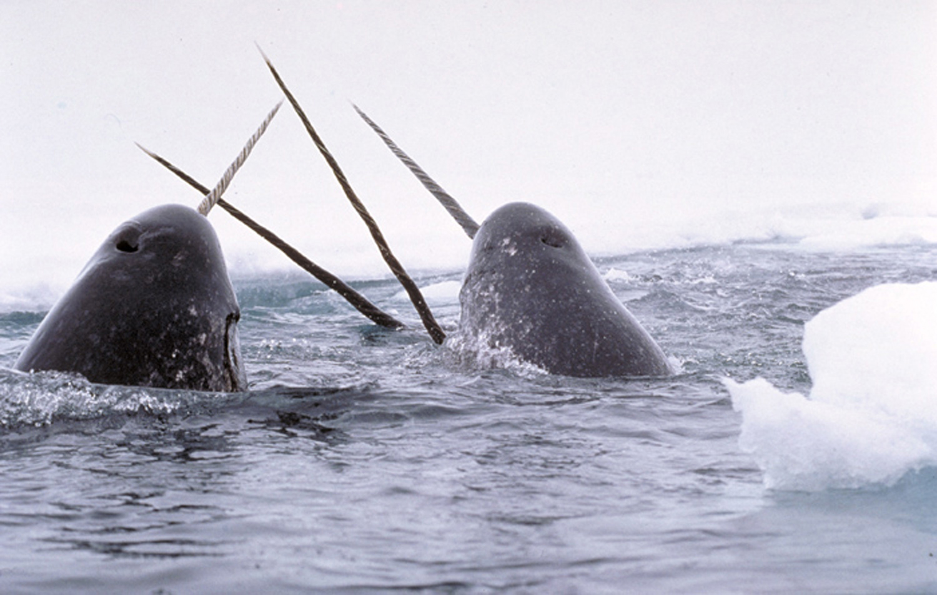

Slide 27
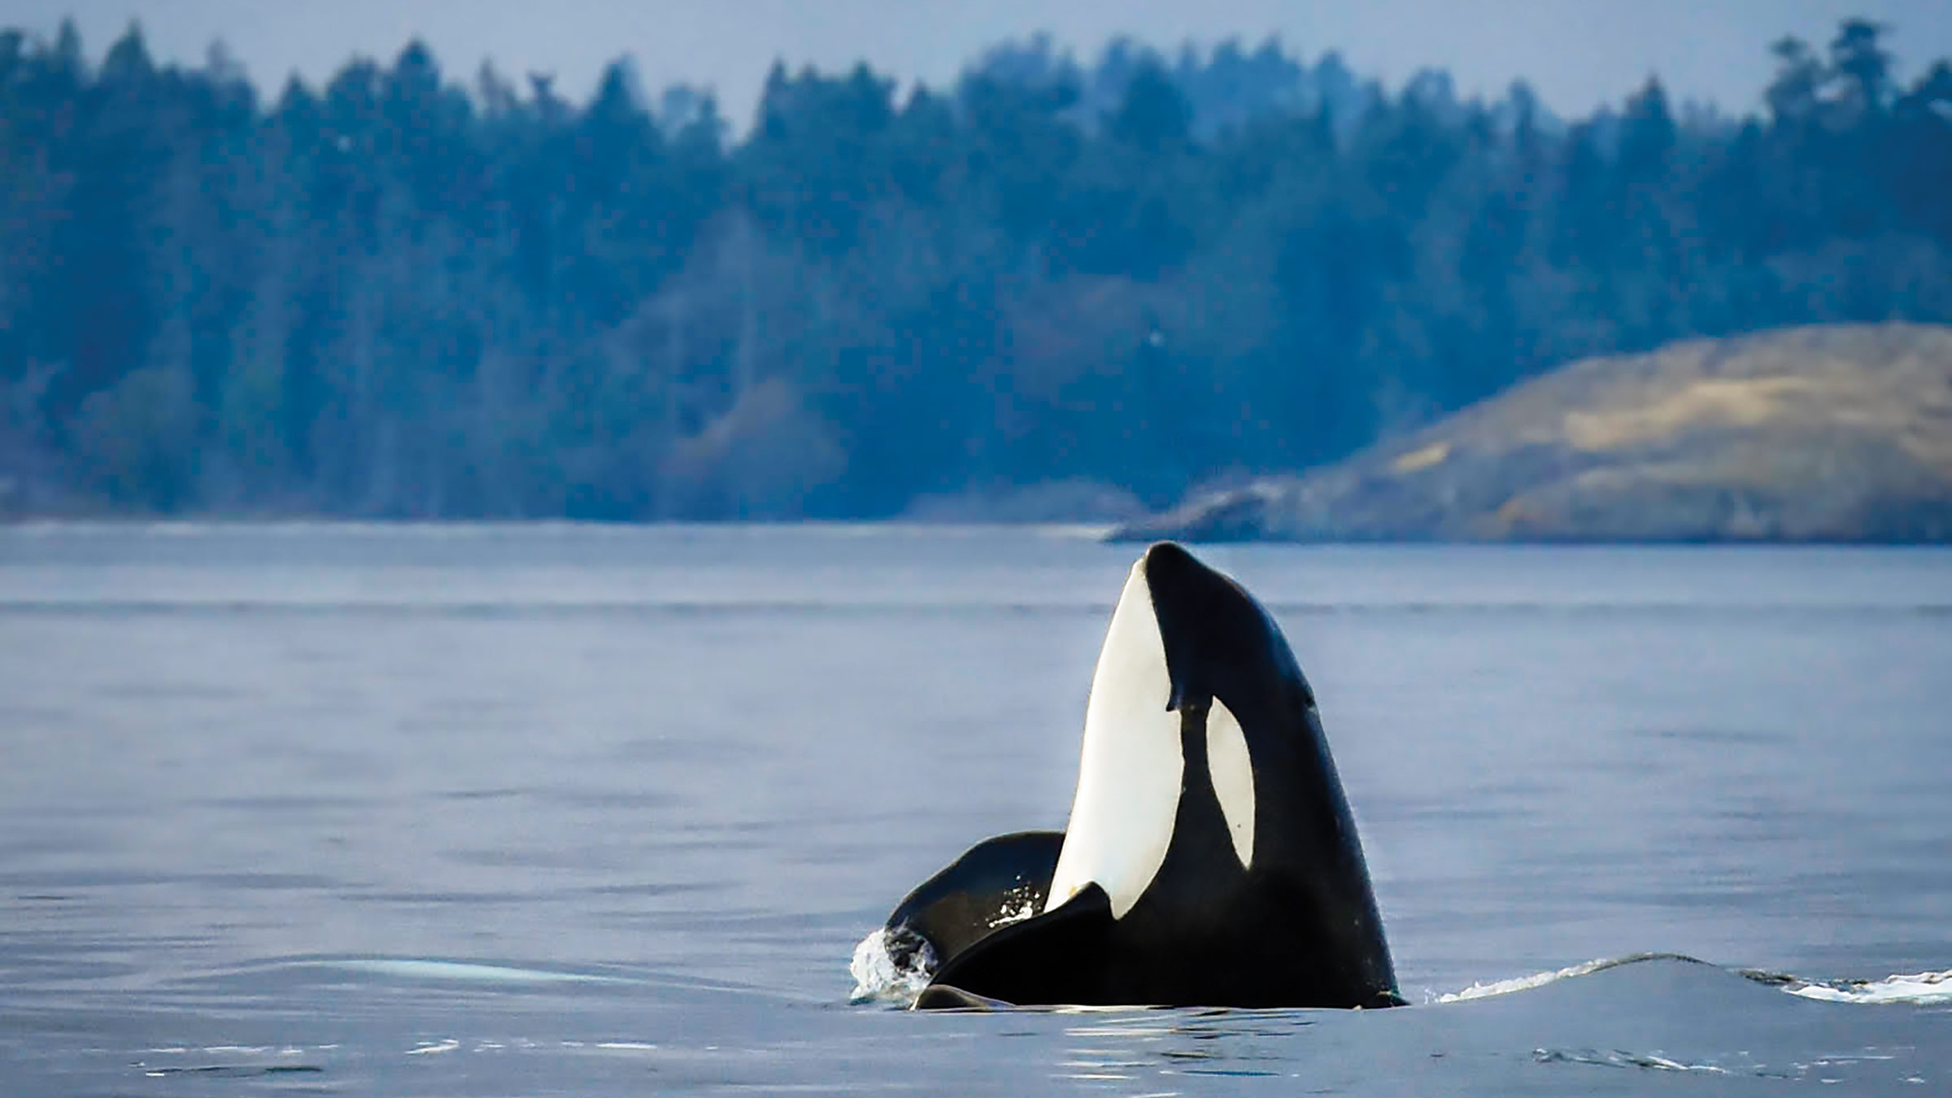
Orca

Slide 28
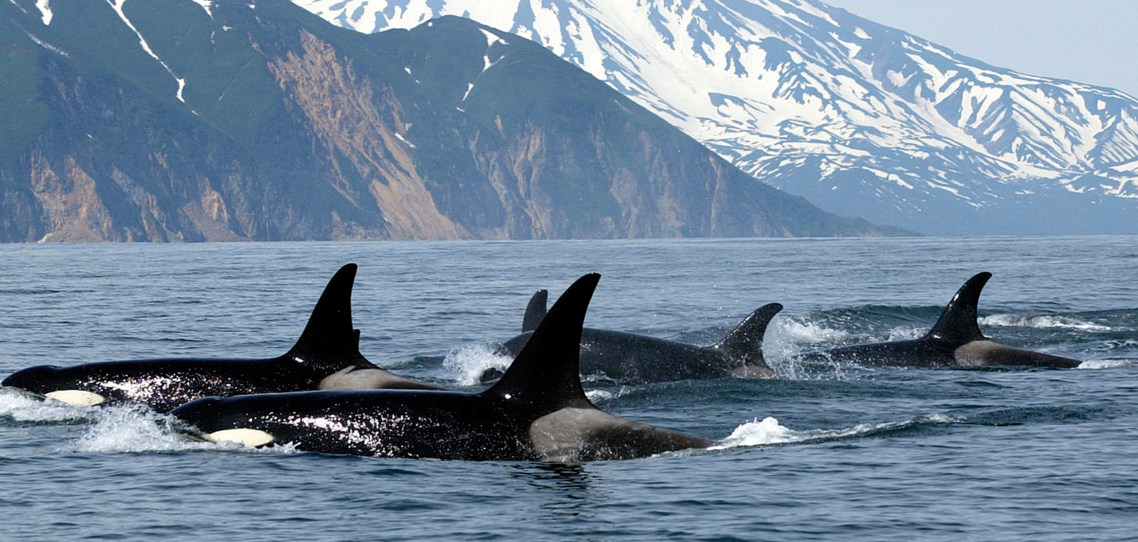

Slide 29
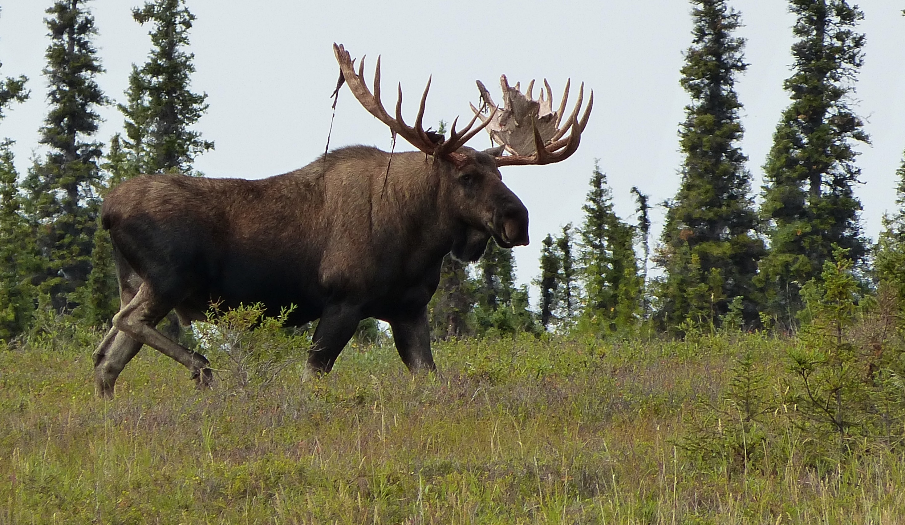
Moose

Slide 30
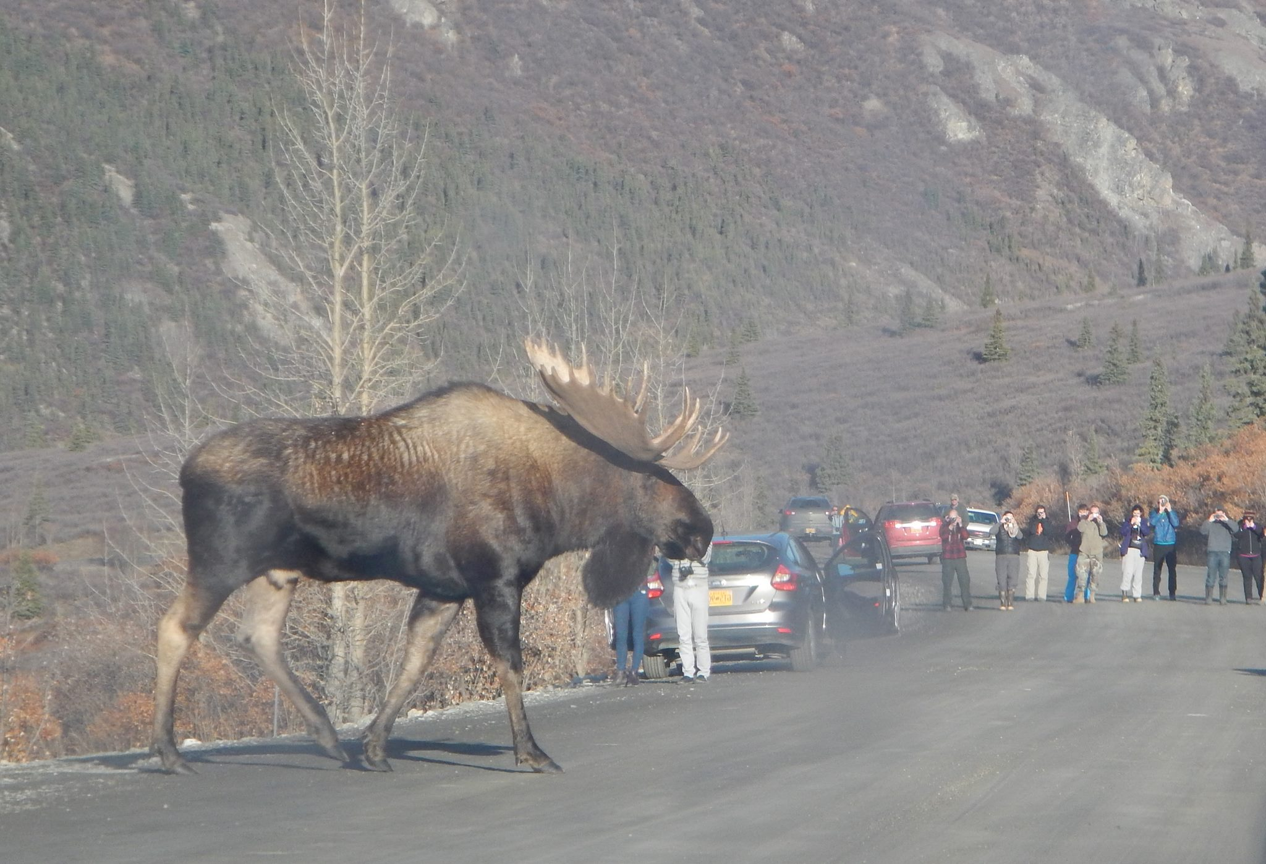

Slide 31
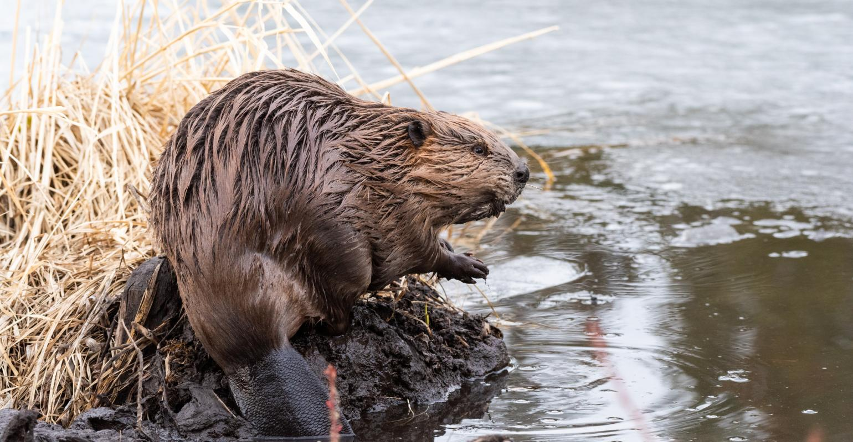
Beaver

Slide 32
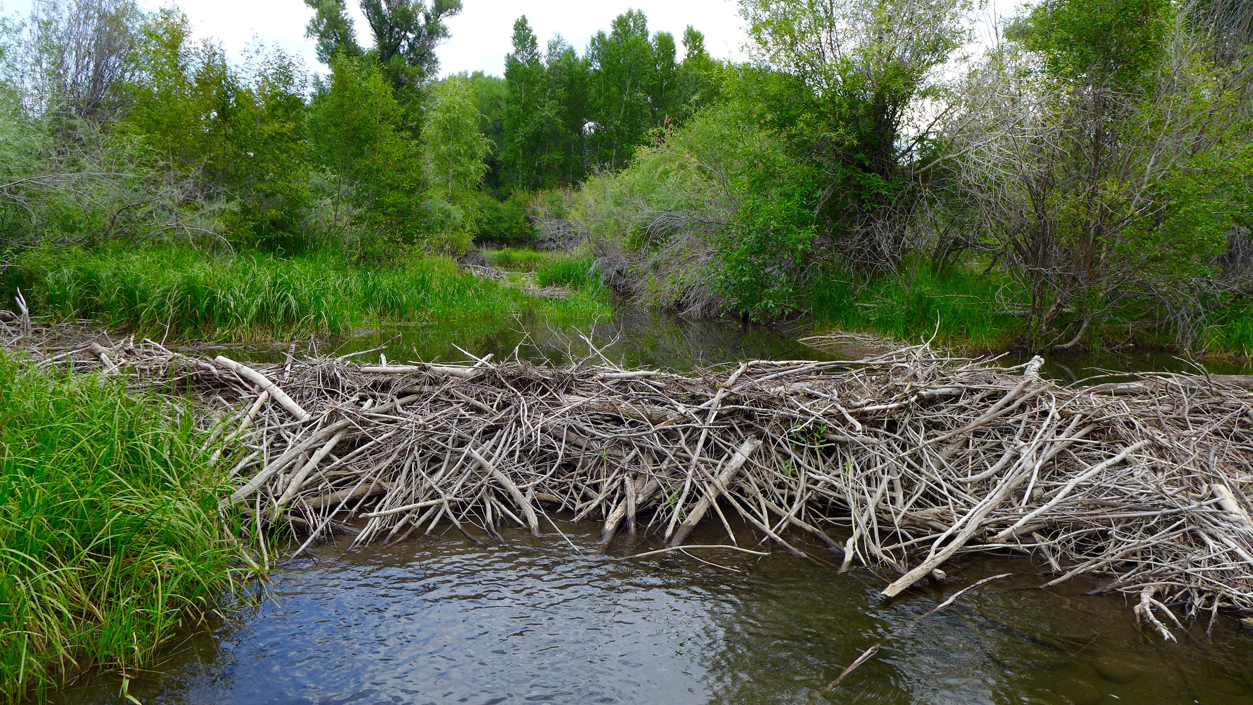

Slide 33
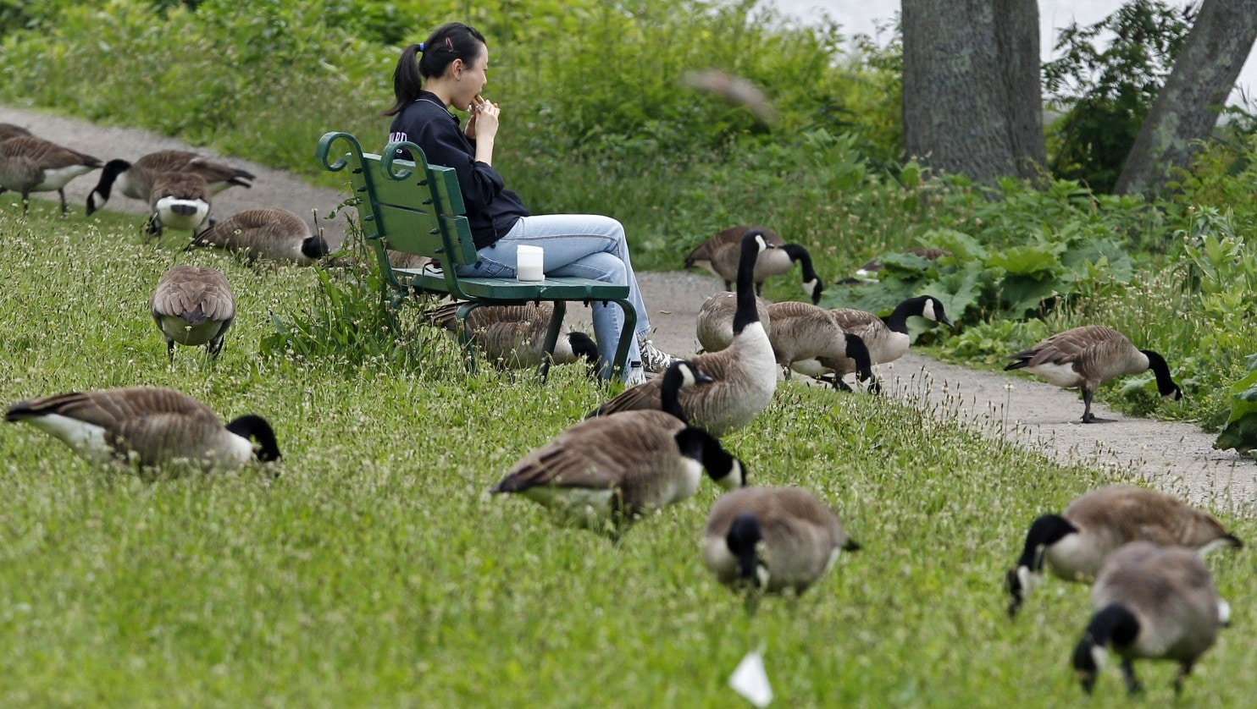
Canadian Goose

Slide 34
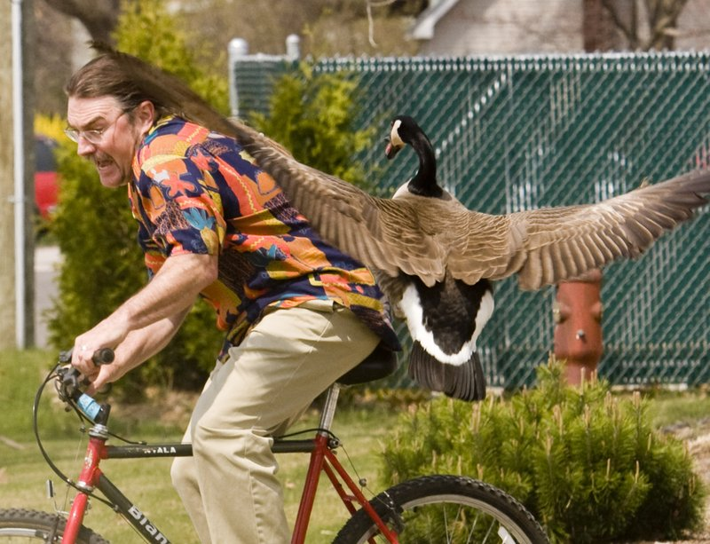

Slide 35
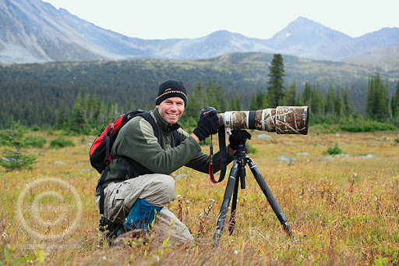


Slide 36
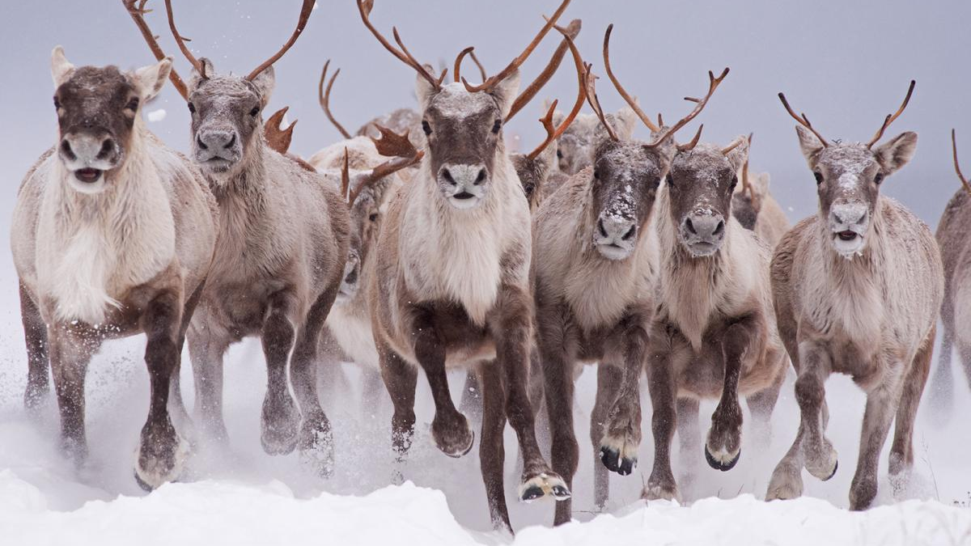
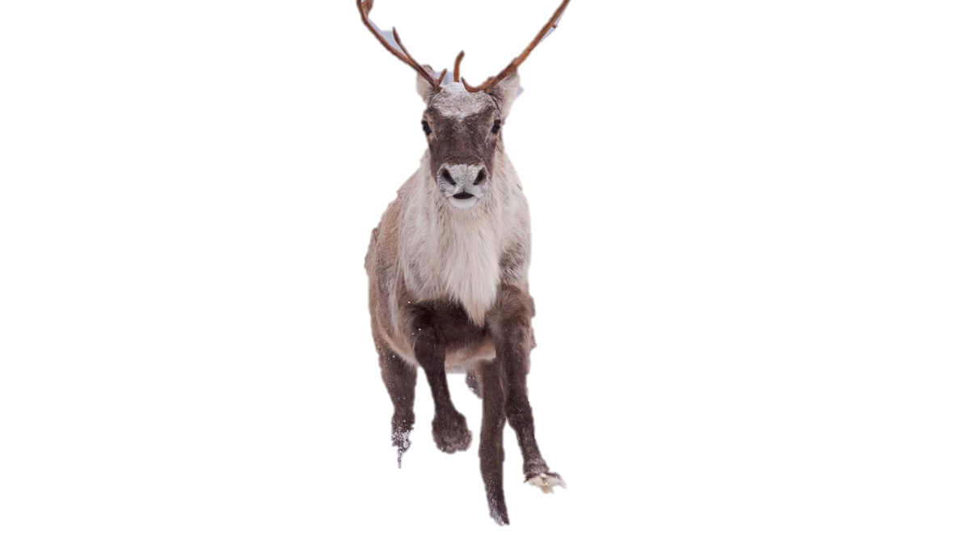
Caribou

Slide 37
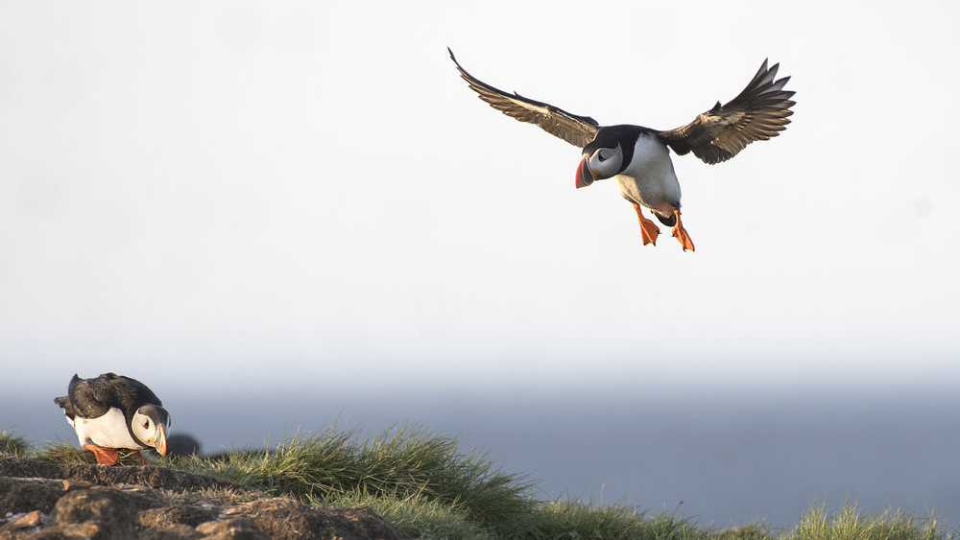
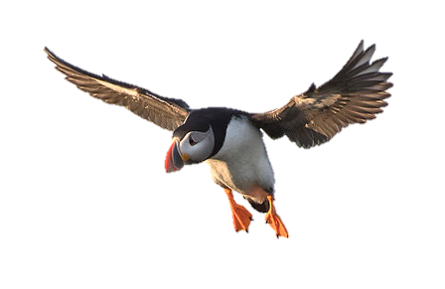

Puffin

Slide 38


Blue
Jay

Slide 39


Red Fox

Slide 40


Lynx

Slide 41


Brown
Bear

Slide 42


Elk
(Wapiti)

Slide 43


Canadian Goose

Slide 44


Polar Bear

Slide 45


Bighorn
Sheep

Slide 46


Snowy
Owl

Slide 47


Wolverine

Slide 48


Bison

Slide 49



Raccoon

Slide 50


Squirrel

Slide 51


Cardinal

Slide 52


Prairie
Dog

Slide 53


Pronghorn
Antelope

Slide 54


Grey Wolf

Slide 55


Loon

Slide 56


Muskox

Slide 57


Otter

Slide 58


Arctic
Fox

Slide 59


Moose

Slide 60


Orca

Slide 61


Great Blue
Heron

Slide 62


Beaver

Slide 63


Arctic
Hare

Slide 64


Cougar

Slide 65


Walrus

Slide 66


Ruby Throated
Hummingbird

Slide 67


Opossum

Slide 68


Snapping Turtle

Slide 69


Newfoundland
Dog

Slide 70


Beluga

