Slide 1
Bison
Muskox
Moose
Length
Weight
Lifespan
2.8m
680kg
14 years
Length
Weight
Lifespan
2.25m
295kg
24 years
Length
Weight
Lifespan
3m
540kg
22 years
Elk (Wapiti)
Caribou
Pronghorn Antelope
Length
Weight
Lifespan
2.4m
325kg
13 years
Length
Weight
Lifespan
1.9m
170kg
7.5 years
Length
Weight
Lifespan
1.4m
52kg
10 years

Slide 2
Polar Bear
Brown Bear
Black Bear
Length
Weight
Lifespan
2.7m
450kg
25 years
Length
Weight
Lifespan
2.1m
500kg
23 years
Length
Weight
Lifespan
1.4m
113kg
30 years
Grey Wolf
Red Fox
Arctic Fox
Length
Weight
Lifespan
1.3m
55kg
5 years
Length
Weight
Lifespan
67.5cm
8kg
4 years
Length
Weight
Lifespan
95cm
6.3kg
3.5 years

Slide 3
Raccoon
Lynx
Wolverine
Length
Weight
Lifespan
55cm
6.2kg
2.5 years
Length
Weight
Lifespan
94.5cm
9.5kg
14 years
Length
Weight
Lifespan
87.5cm
15.3kg
9 years
Beaver
Canadian Goose
Cardinal
Length
Weight
Lifespan
82cm
21.5kg
13 years
Length
Weight
Lifespan
92.5cm
9.7kg
21 years
Length
Weight
Lifespan
22cm
43g
3 years

Slide 4
Blue Jay
Loon
Snowy Owl
Length
Weight
Lifespan
26cm
87.5g
7 years
Length
Weight
Lifespan
80cm
4.8kg
26 years
Length
Weight
Lifespan
68cm
2kg
9 years
Narwhal
Beluga
Squirrel
Length
Weight
Lifespan
5.1m
940kg
50 years
Length
Weight
Lifespan
4.2m
1,400kg
42 years
Length
Weight
Lifespan
26.5cm
500g
12 years

Slide 5
Otter
Arctic Hare
Walrus
Length
Weight
Lifespan
68cm
8.1kg
8 years
Length
Weight
Lifespan
56.5cm
4.8kg
5 years
Length
Weight
Lifespan
3.6m
1,000kg
40 years
Puffin
Cougar
Porcupine
Length
Weight
Lifespan
32cm
490g
20 years
Length
Weight
Lifespan
2.4m
76.5kg
10 years
Length
Weight
Lifespan
75cm
10.8kg
6 years

Slide 6
Prairie Dog
Weasel
Great Blue Heron
Length
Weight
Lifespan
35cm
1kg
6.5 years
Length
Weight
Lifespan
19cm
143g
8 years
Length
Weight
Lifespan
1.2m
2.3kg
15 years
Ruby Throated Hummingbird
Bighorn Sheep
Western Toad
Length
Weight
Lifespan
8.2cm
3.1g
4 years
Length
Weight
Lifespan
1.6m
70kg
11 years
Length
Weight
Lifespan
10cm
57g
9 years

Slide 7
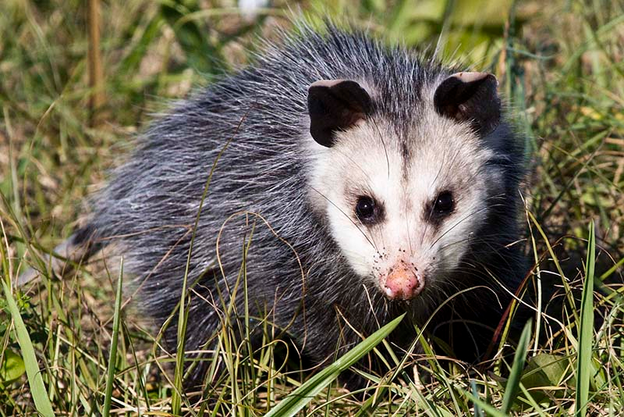
Newfoundland Dog
Snapping Turtle
Painted Turtle
Length
Weight
Lifespan
1.8m
65kg
9 years
Length
Weight
Lifespan
22.5cm
10kg
47 years
Length
Weight
Lifespan
16.5cm
500g
27 years
Opossum
Orca
Length
Weight
Lifespan
55cm
1.2kg
2 years
Length
Weight
Lifespan
8.3m
5,450kg
45 years
Opossum

Slide 8
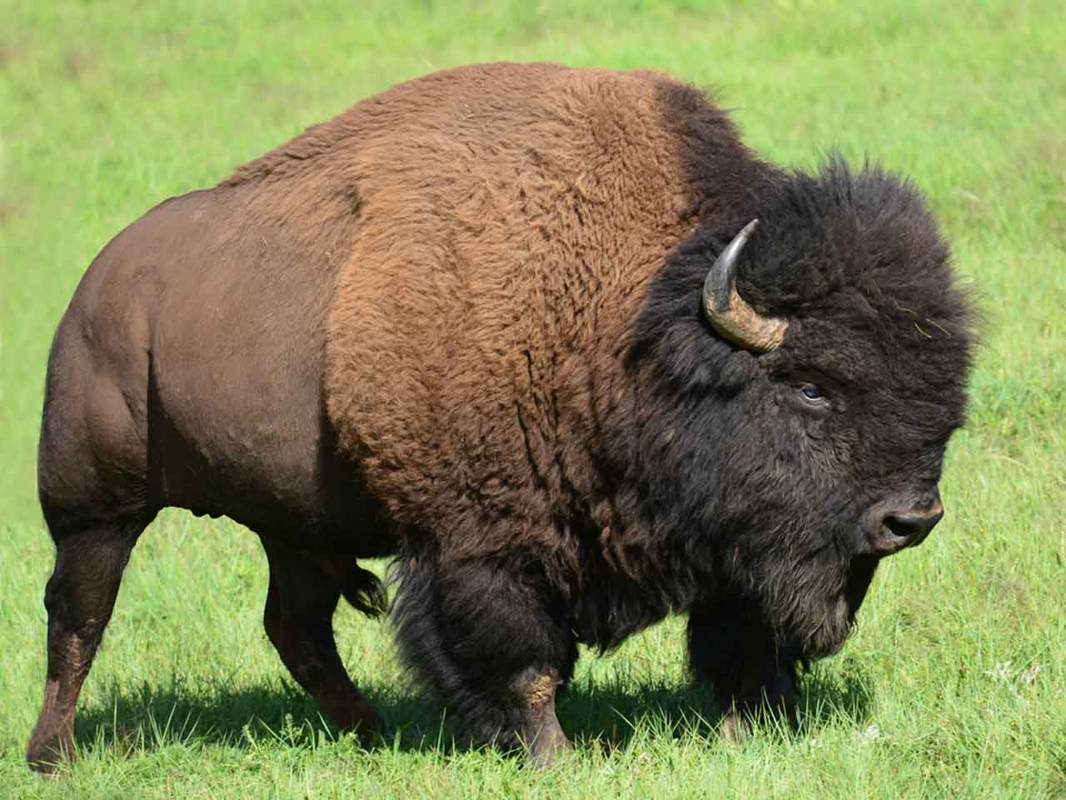
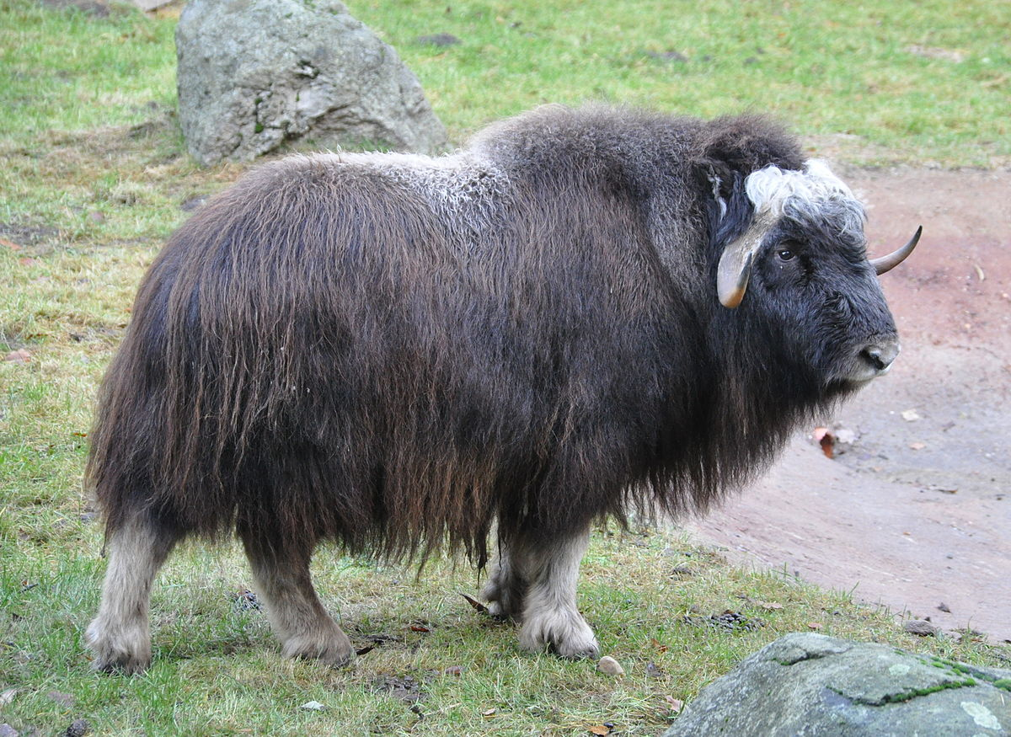
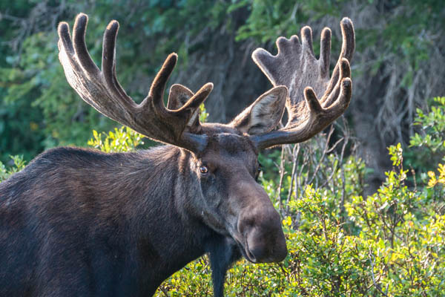
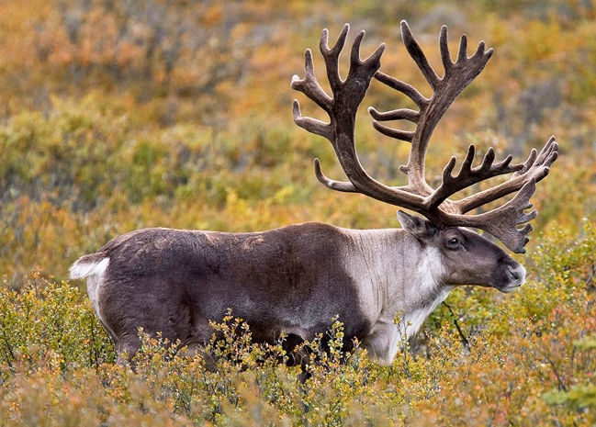
Bison
Muskox
Caribou
Moose

Slide 9
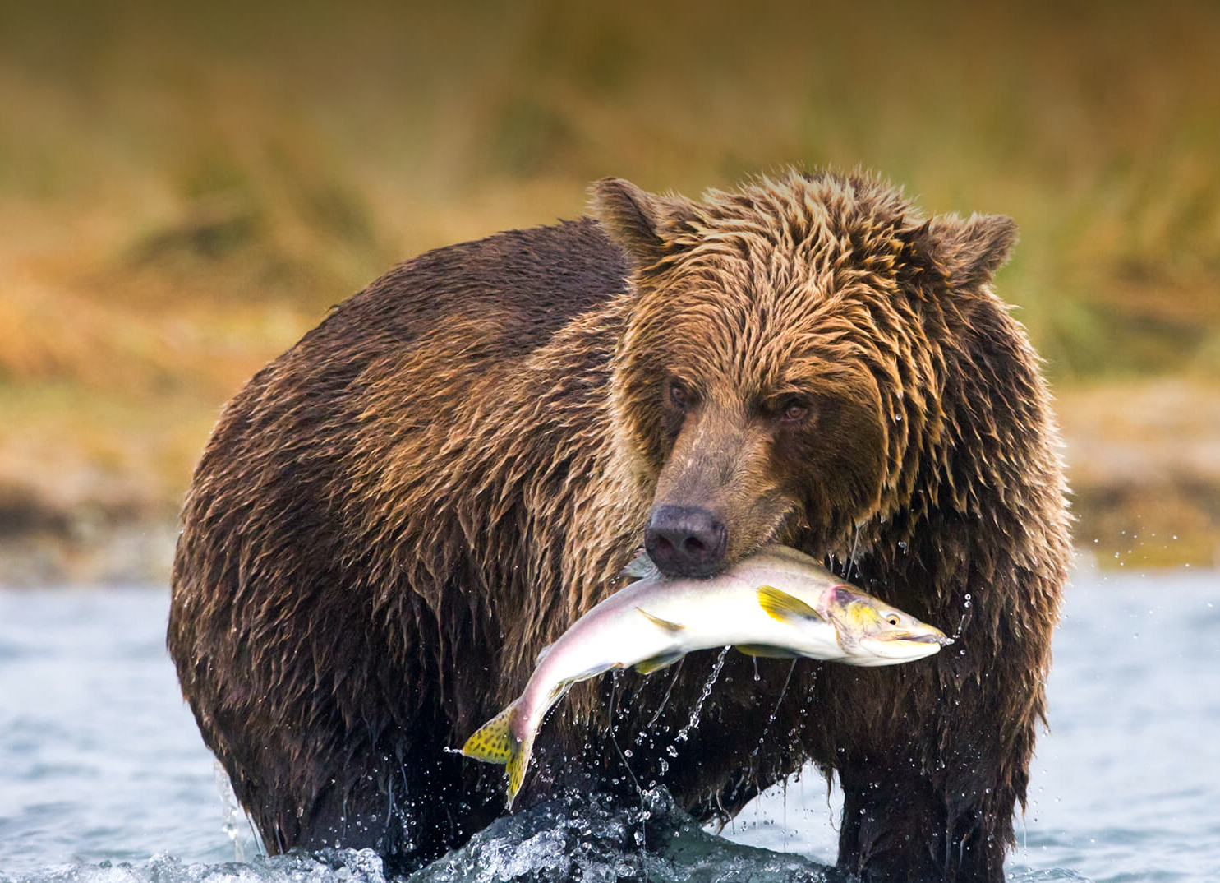
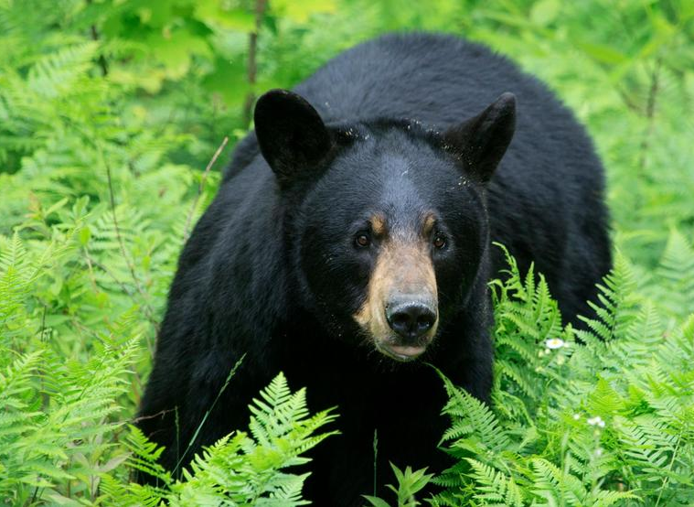
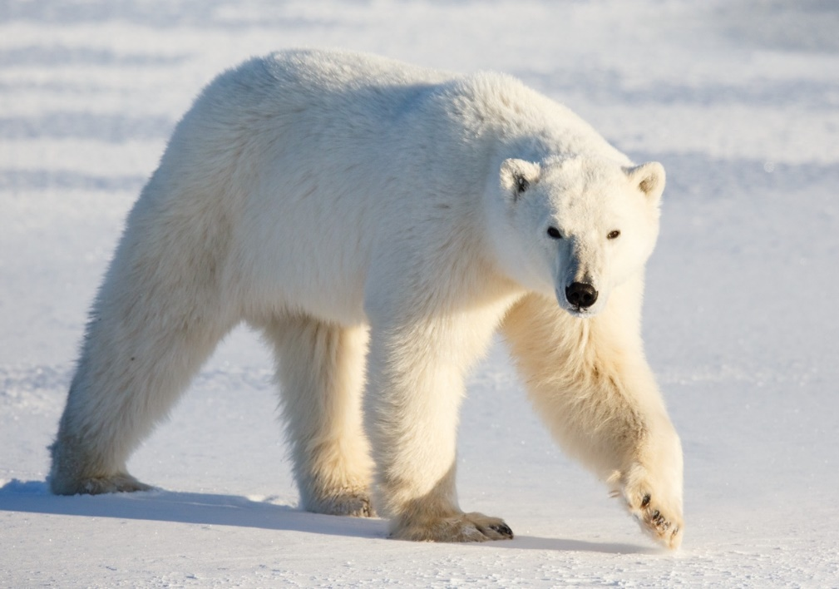
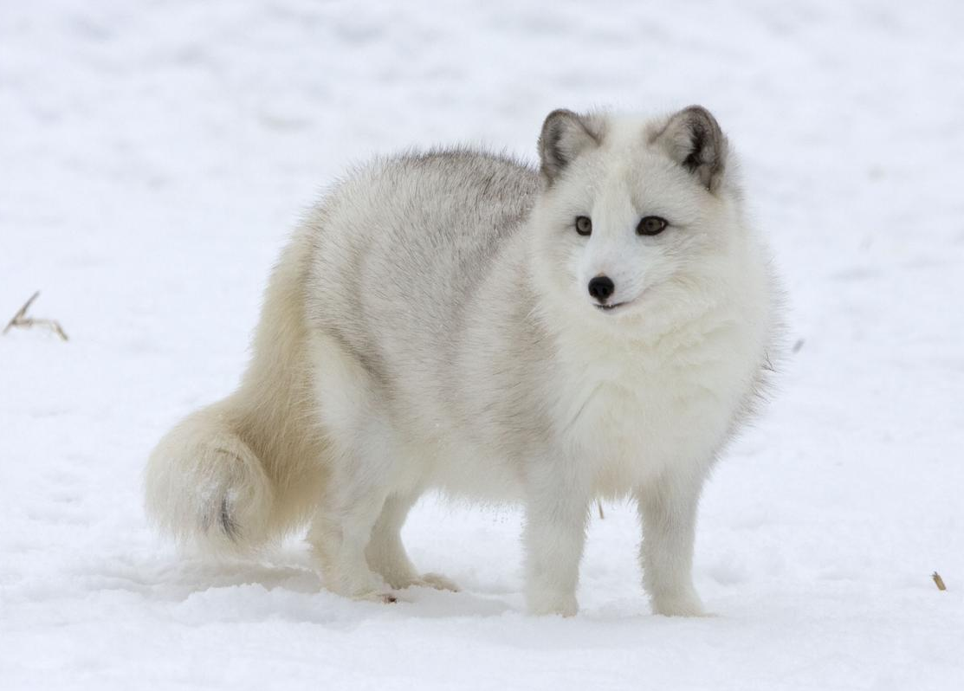
Brown Bear
Black Bear
Arctic Fox
Polar Bear

Slide 10
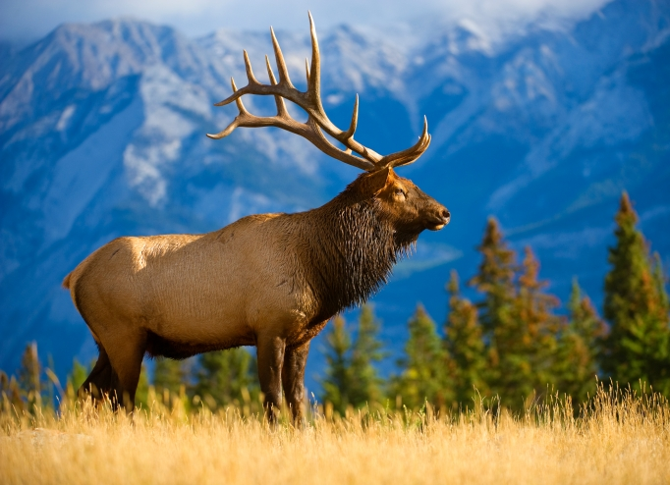
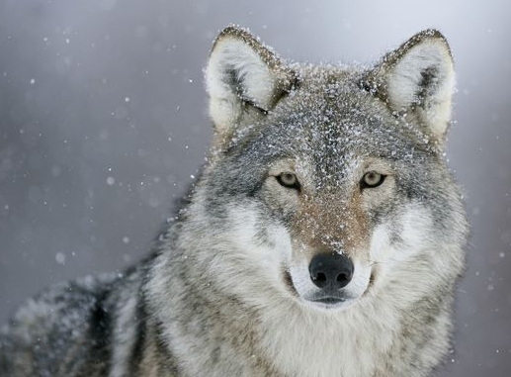
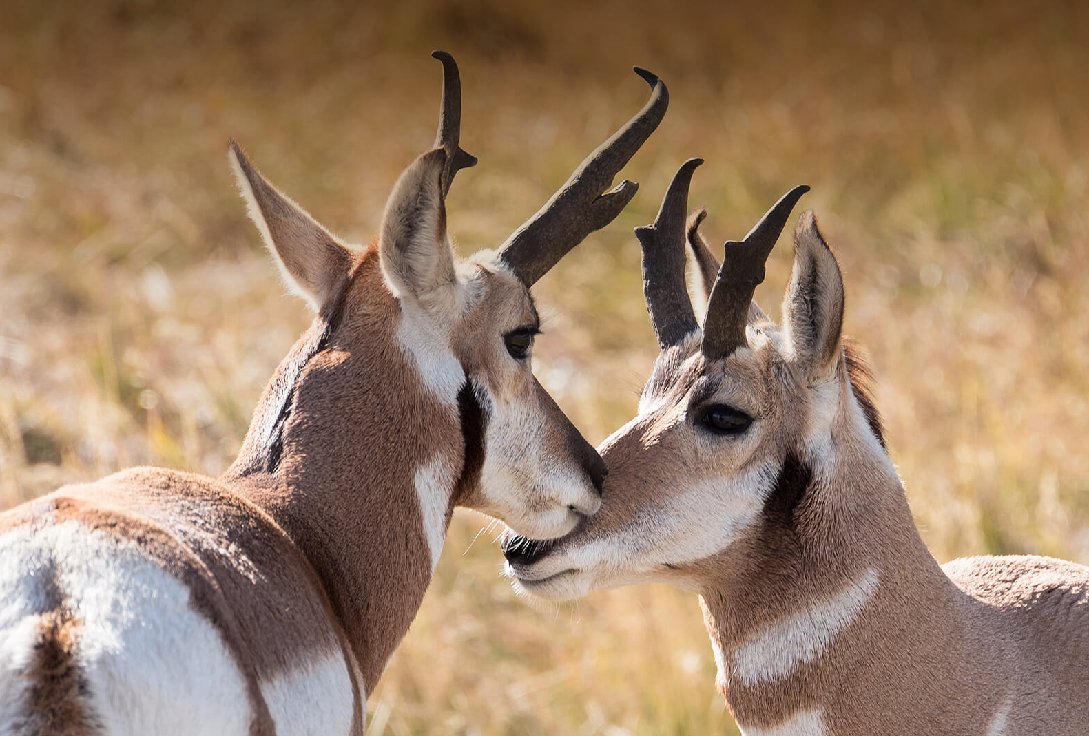
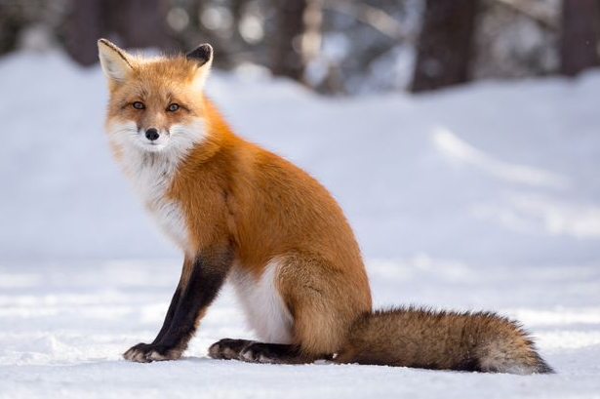
Grey
Wolf
Elk (Wapiti)
Pronghorn Antelope
Red
Fox

Slide 11
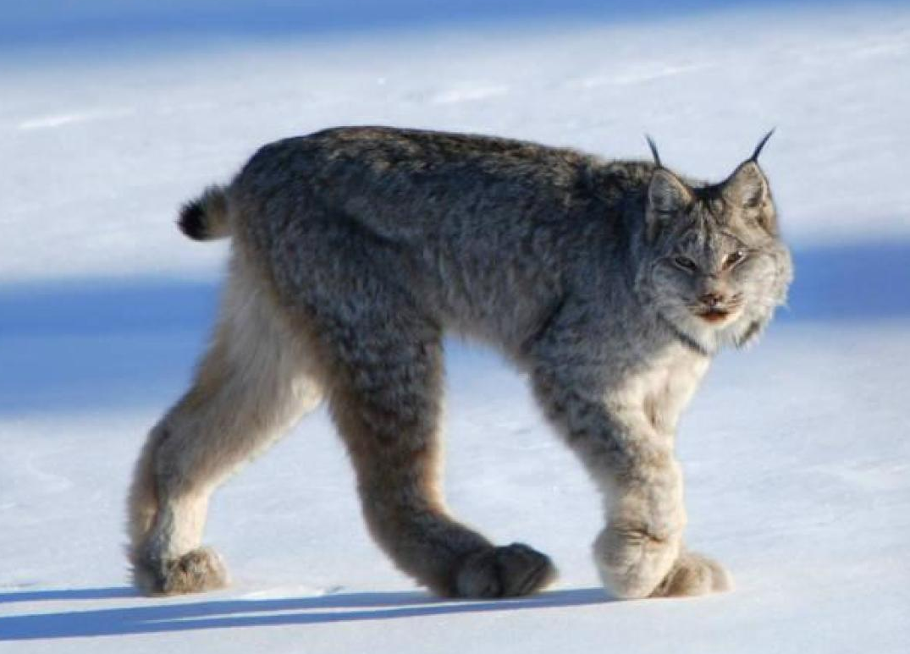
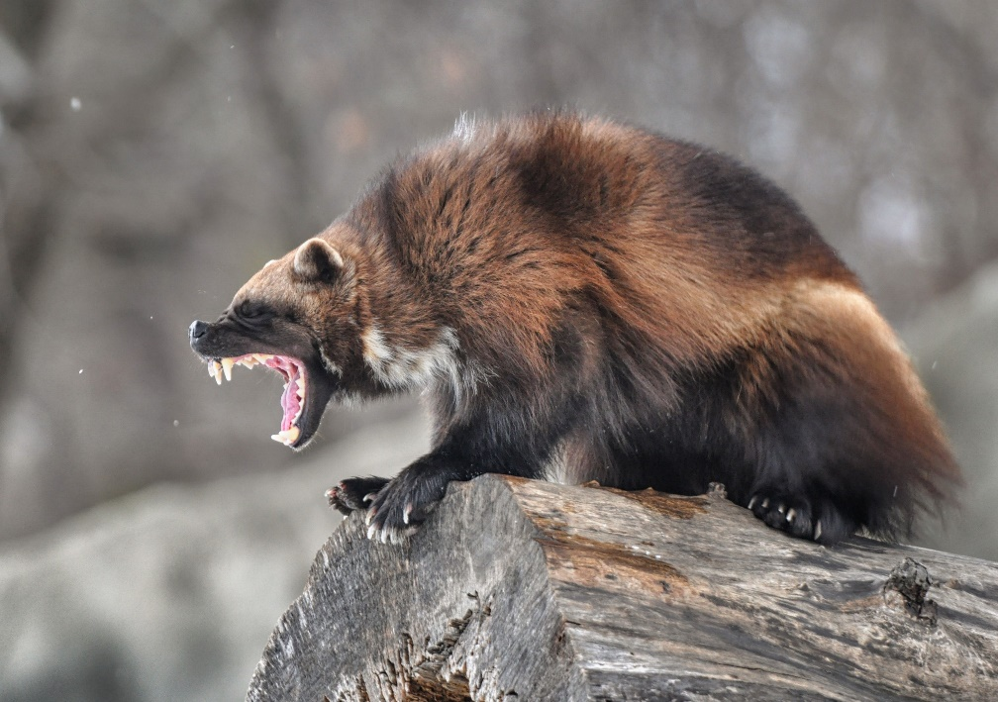
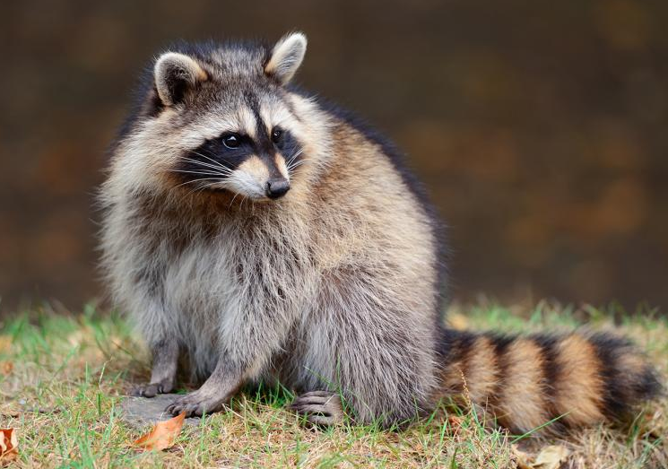
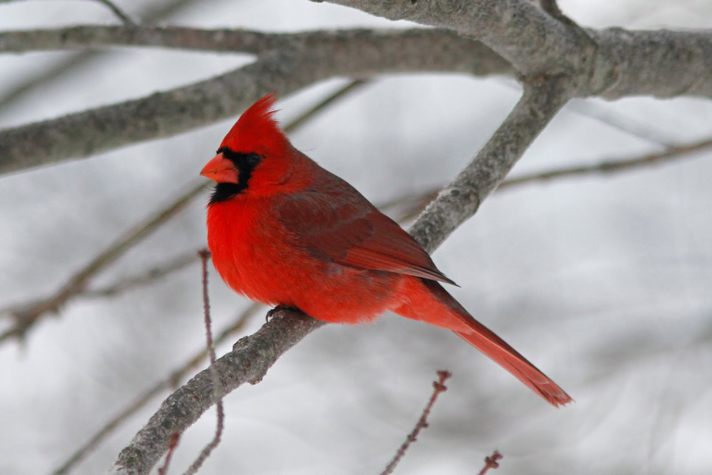
Wolverine
Lynx
Raccoon
Cardinal

Slide 12
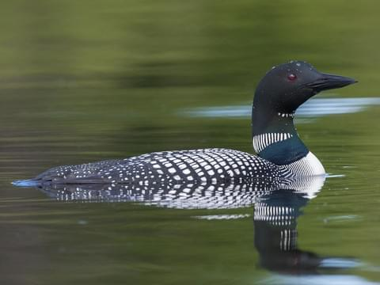
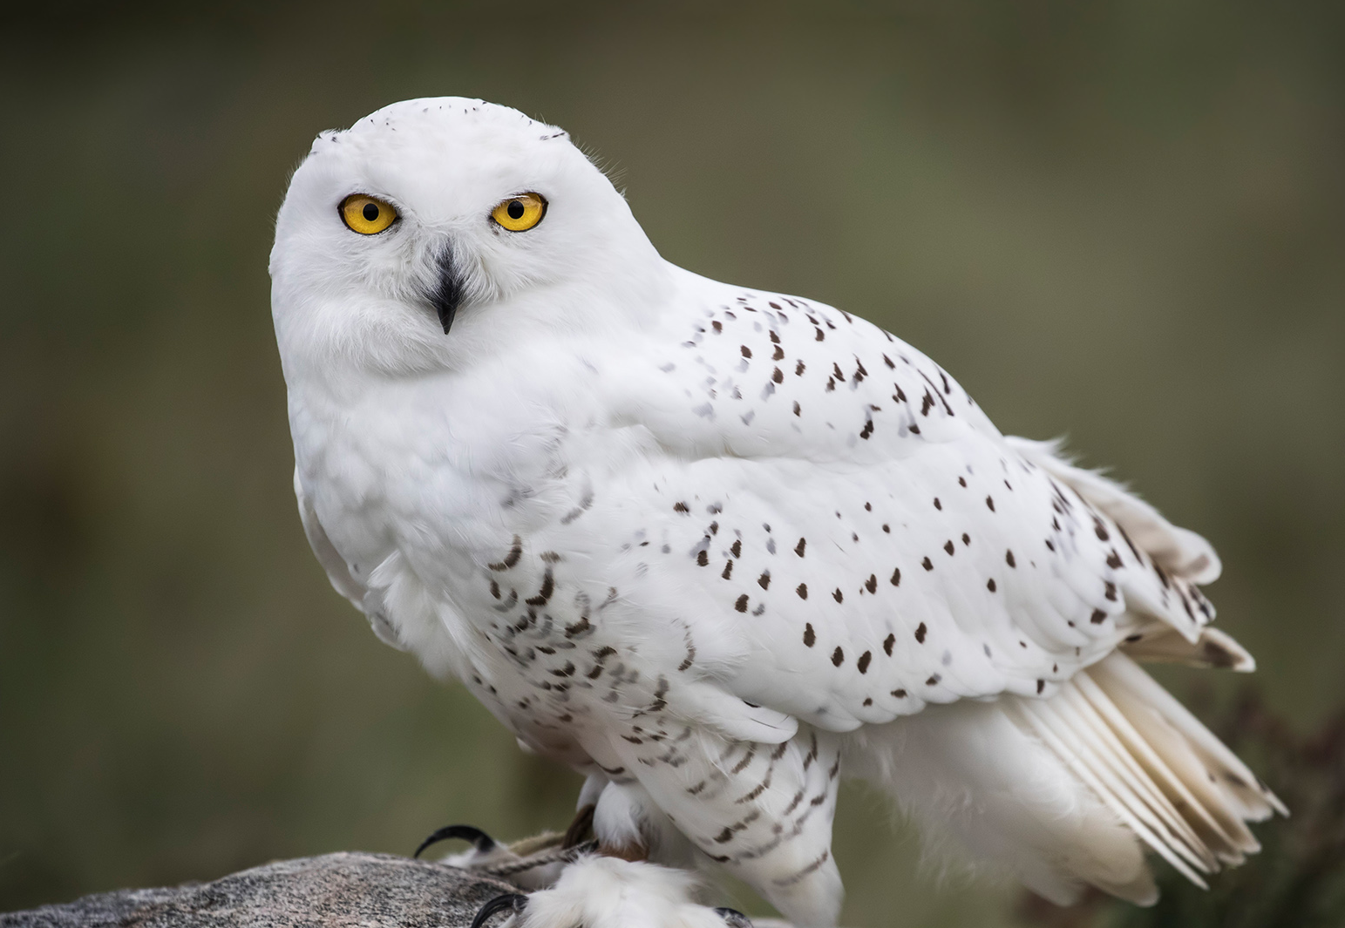
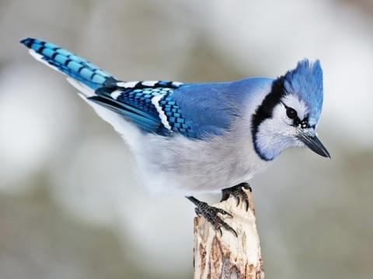
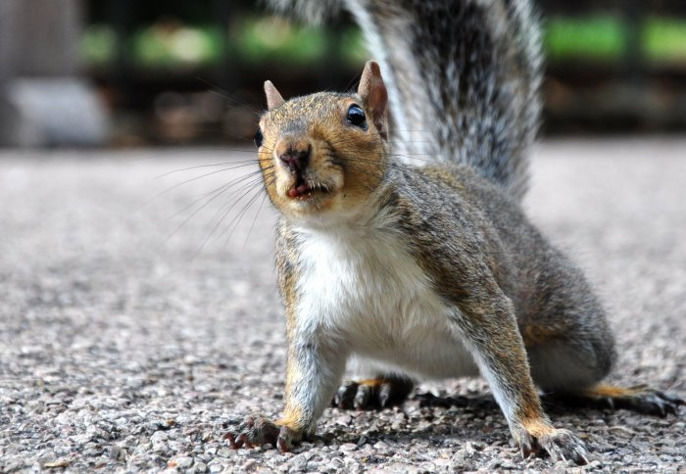
Snowy Owl
Loon
Squirrel
Blue Jay

Slide 13
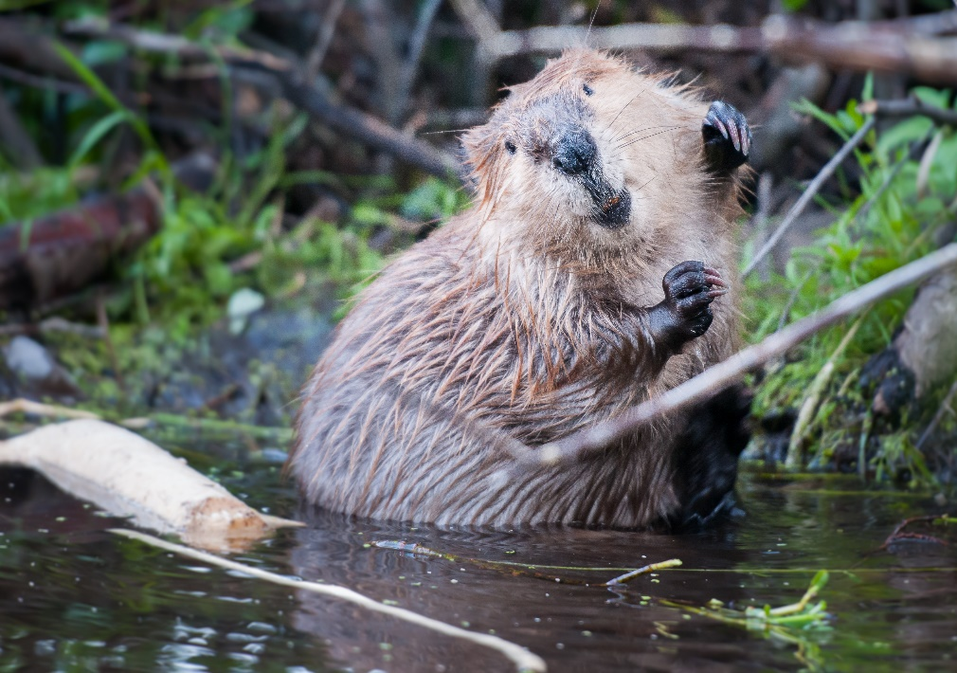
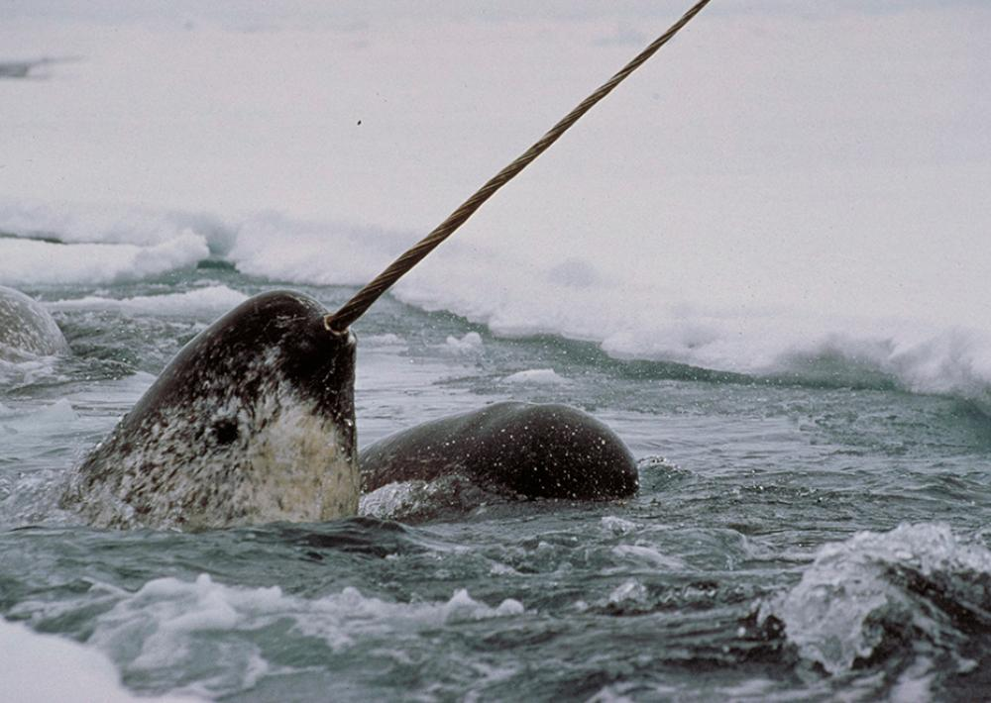
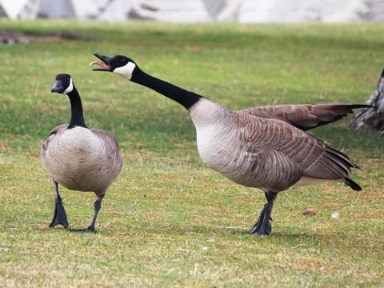
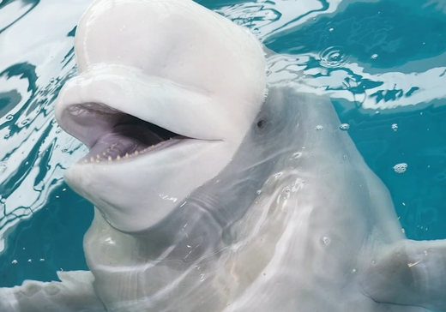
Beaver
Narwhal
Beluga
Canadian Goose

Slide 14
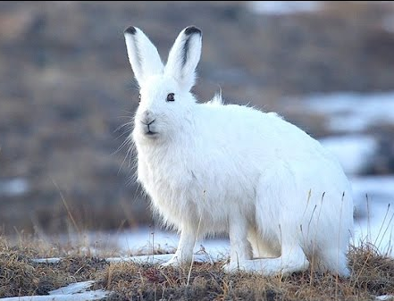
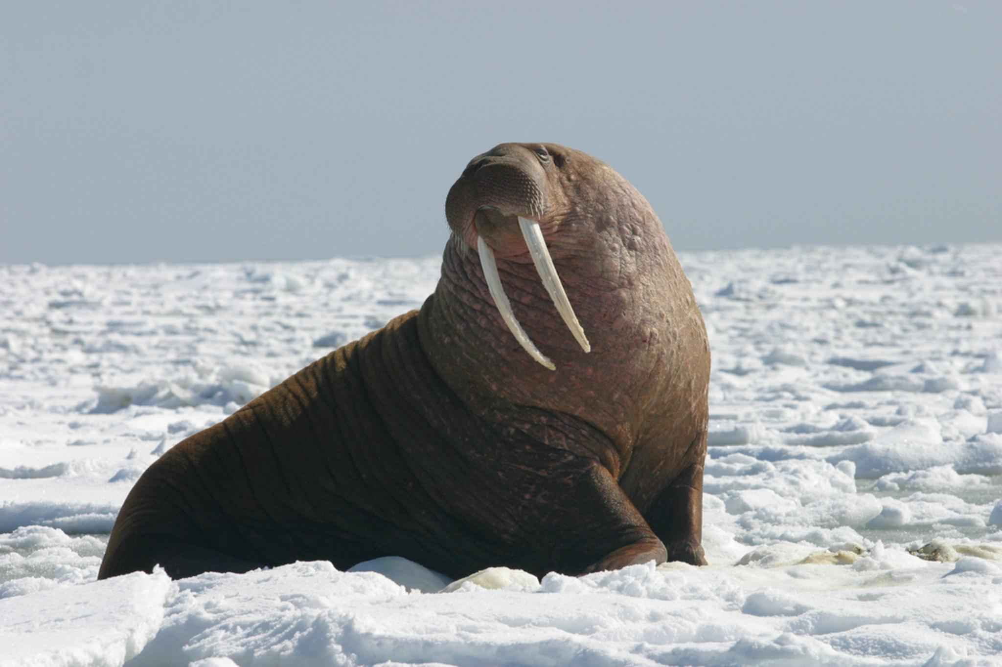
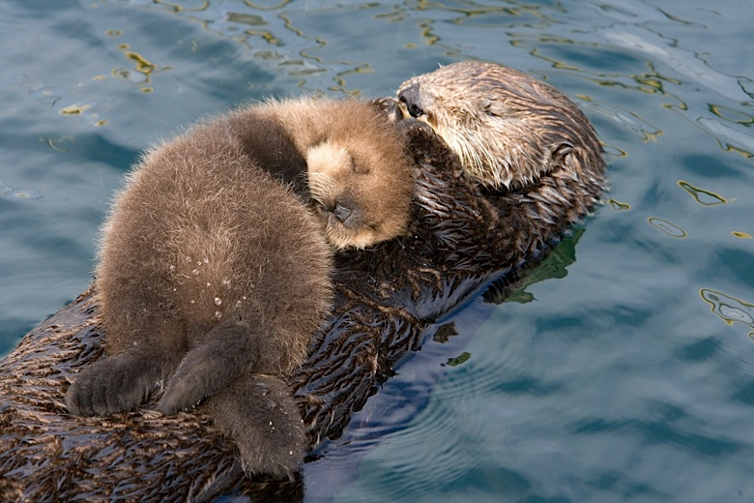
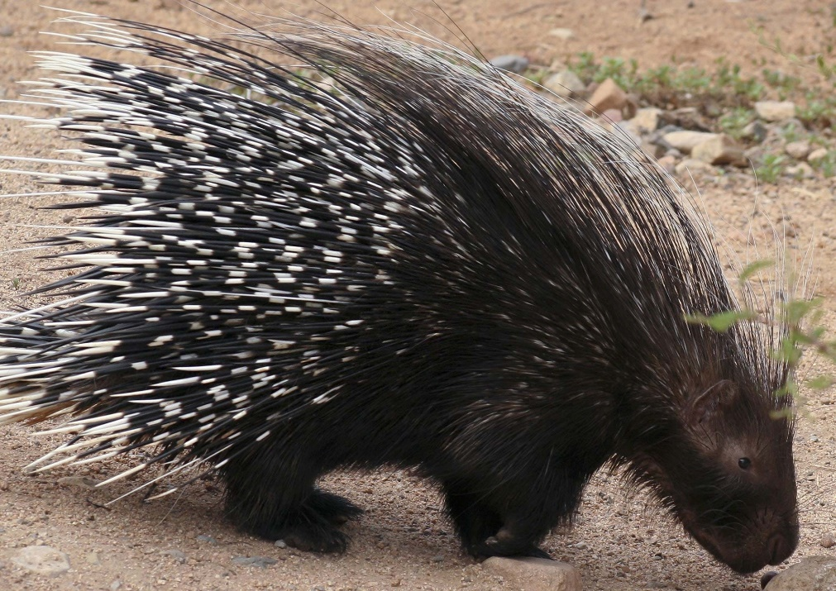
Walrus
Arctic Hare
Porcupine
Otter

Slide 15
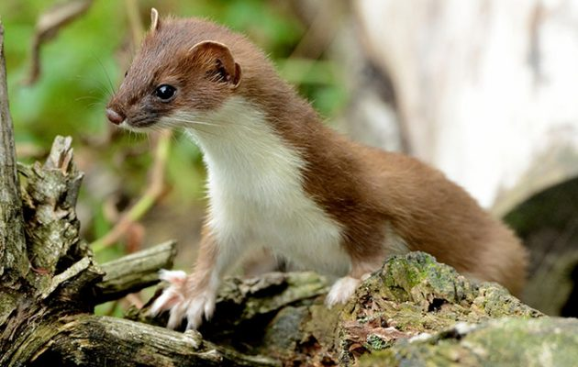
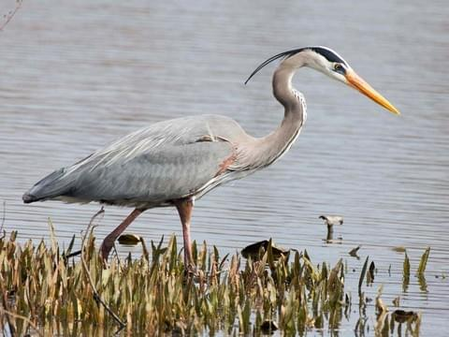
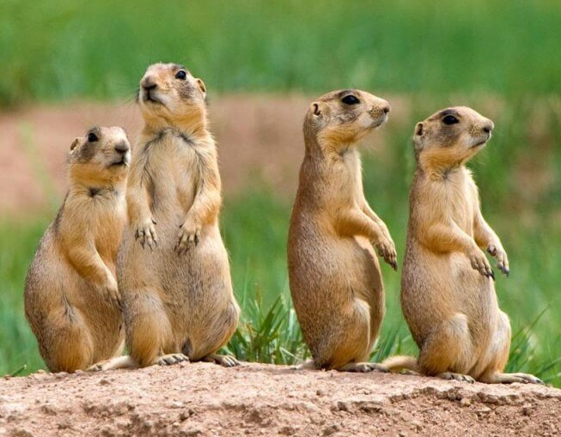
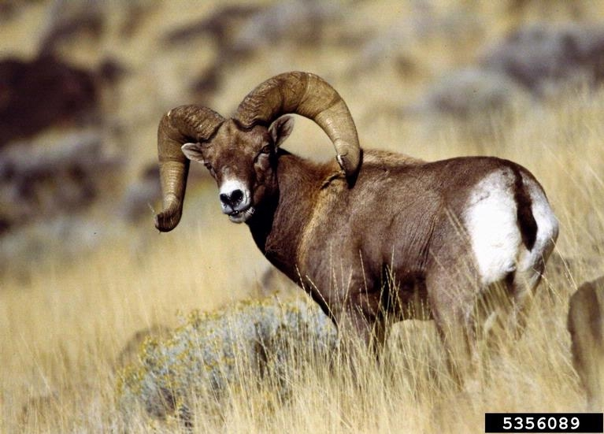
Great Blue Heron
Weasel
Prairie Dog
Bighorn Sheep

Slide 16
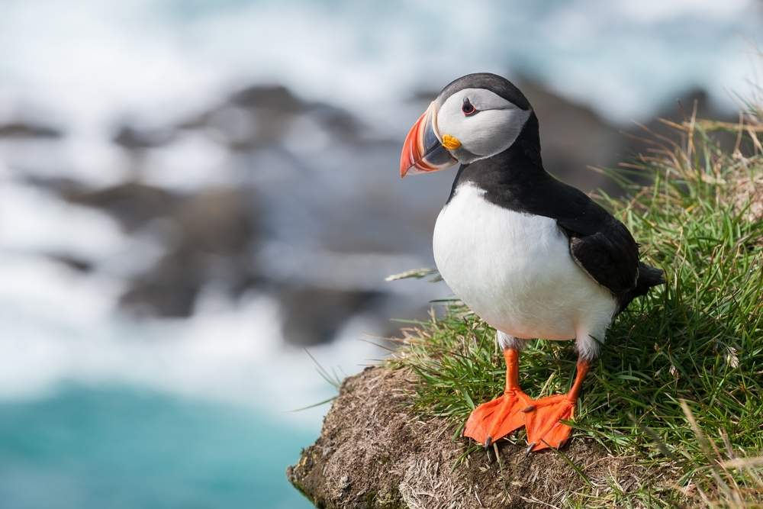
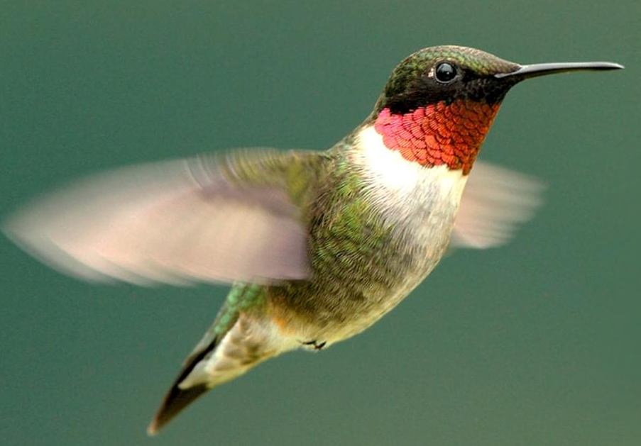
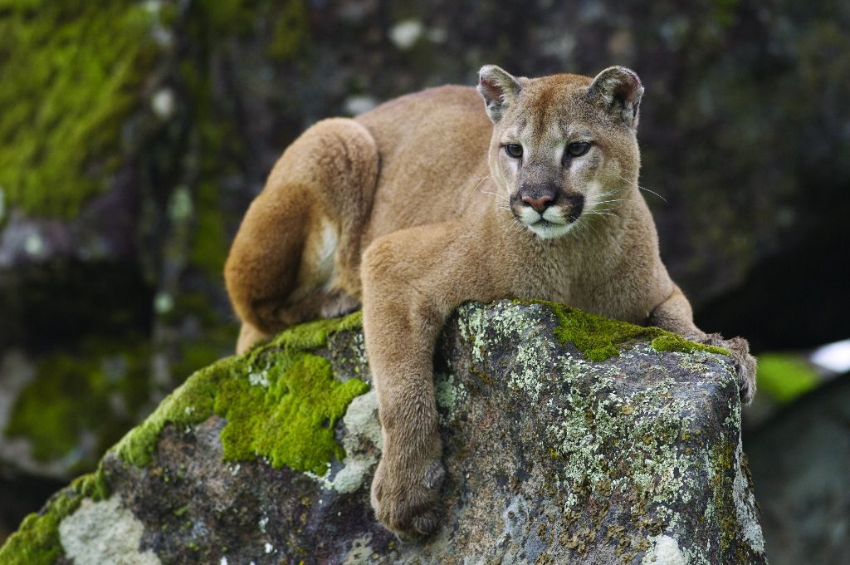
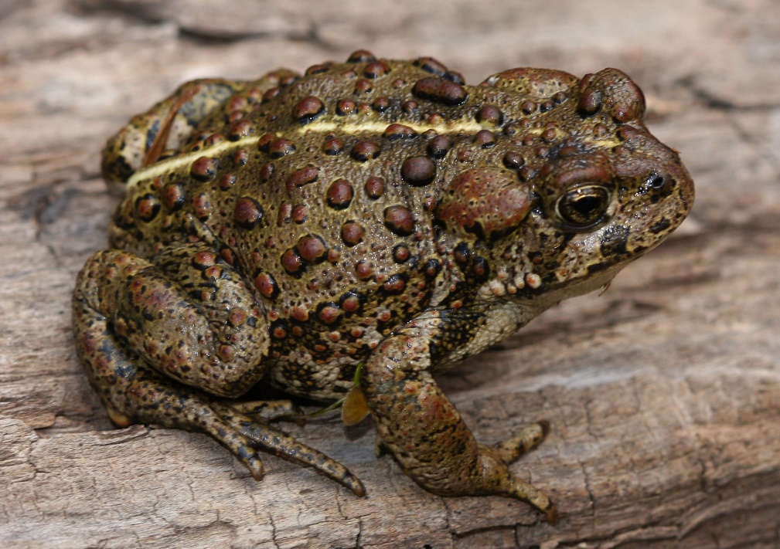
Puffin
Ruby Throated
Hummingbird
Cougar
Western Toad

Slide 17
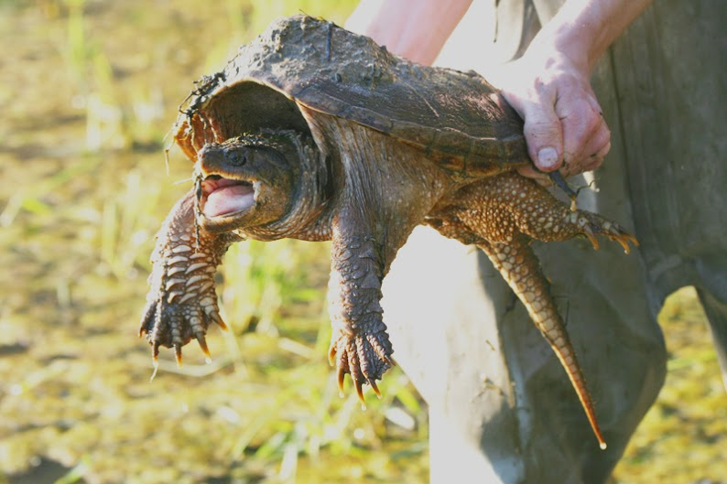
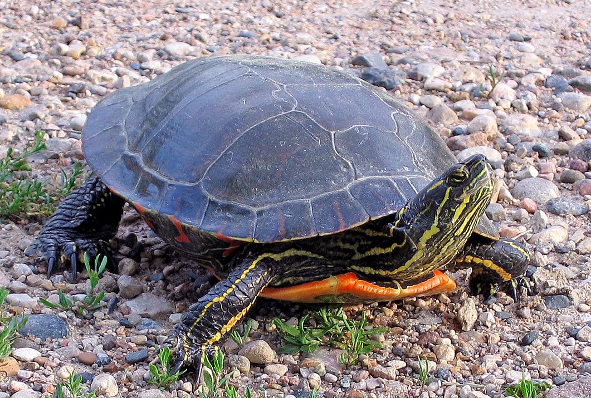
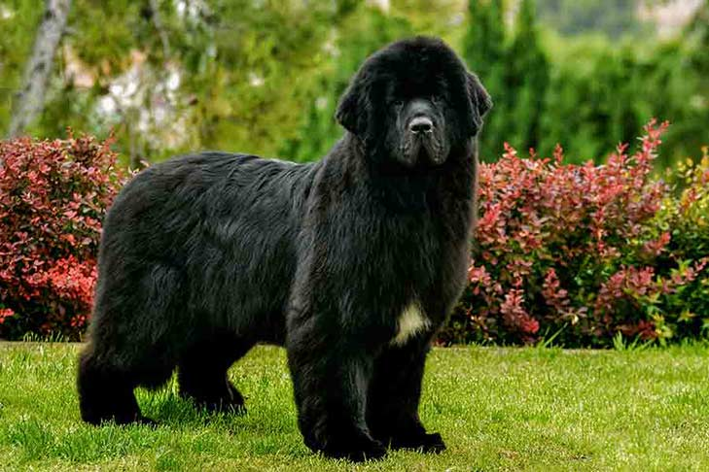
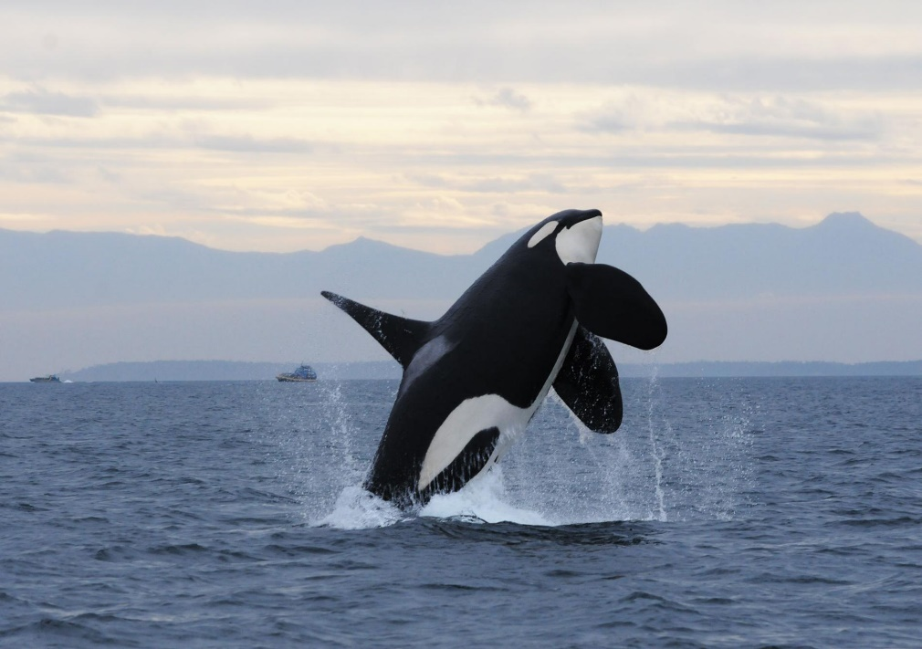
Painted Turtle
Snapping
Turtle
Orca
Newfoundland Dog

