Slide 1
SAY
anything

Slide 2
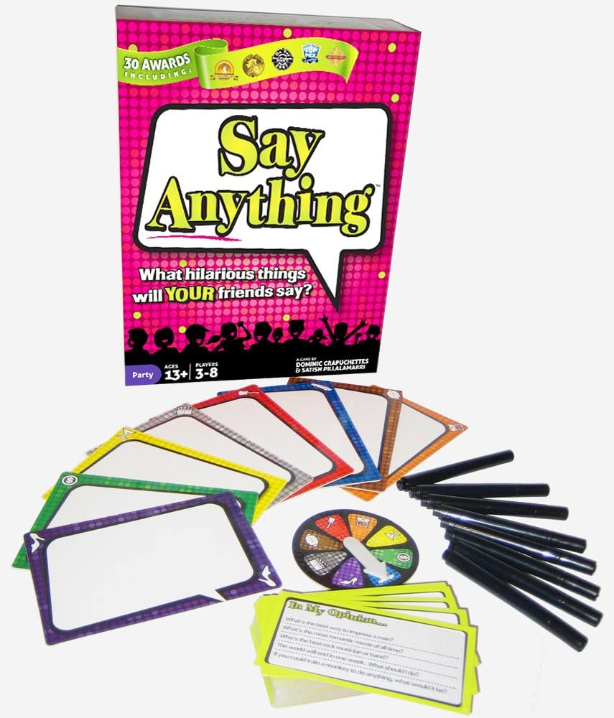
Rules
Each player gets:
Whiteboard
Marker
Eraser
2 tokens

Slide 3
Rules
Choose a judge.

Slide 4
Judge
Read a question.

Slide 5
Players
Write an answer.
dog
cat
hippo

Slide 6
Judge
Select the best answer.
dog
cat
hippo

Slide 7
Players
dog
Vote
(what you think the judge chose).
hippo
cat

Slide 8
Judge
Show your choice.

Slide 9
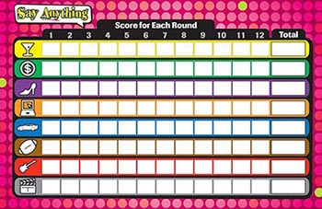
Points
Each player gets:
1 point for the correct answer
1 point for each correct vote
hippo
cat
dog

Slide 10
Points
The judge gets:
1 point for each correct vote
hippo

