Slide 1
Human
library

Slide 3
Challenge prejudice,
reduce discrimination,
discuss taboo topics openly.

Slide 4
How it
works

Slide 5
Who are the books?

Slide 6
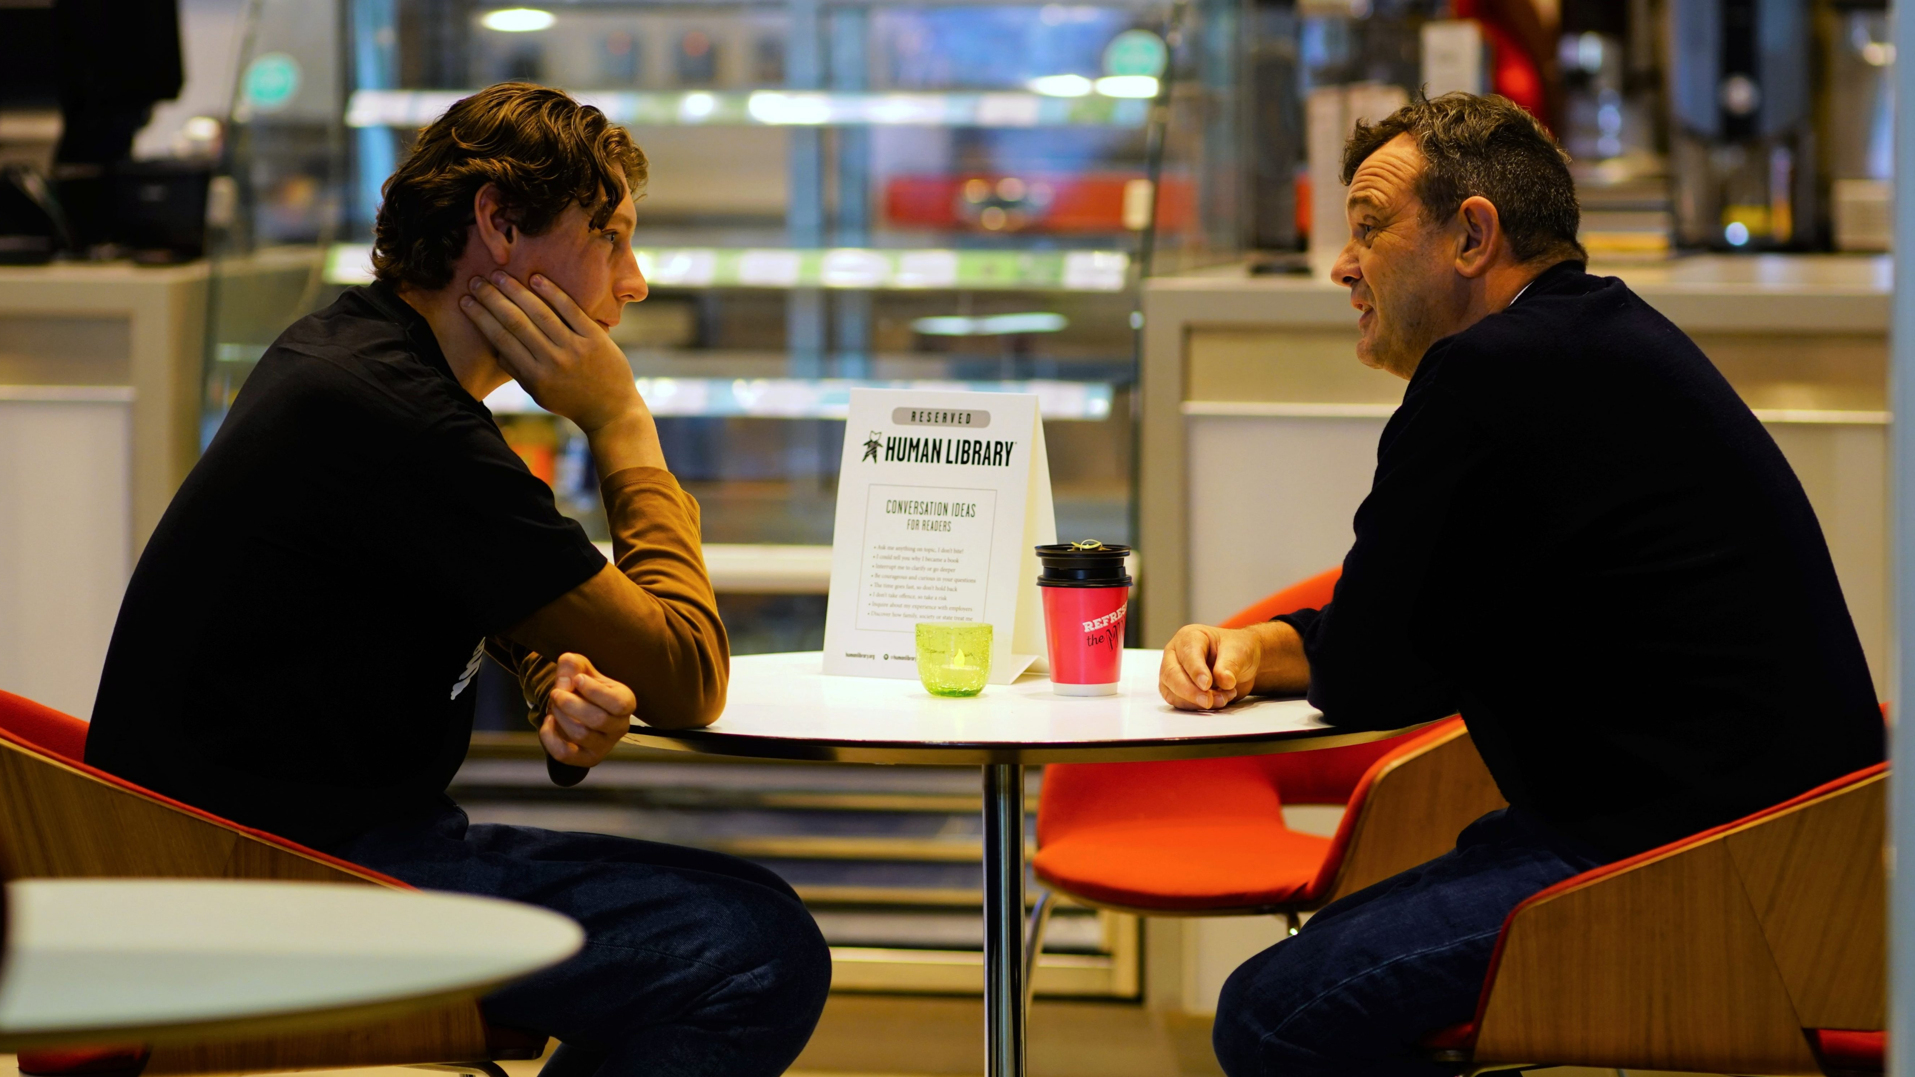
People are books.
Notes:
https://humanlibrary.org/new-human-library-book-depot-open-in-edinburgh/

Slide 7
How can you read a book?
Notes:
https://humanlibrary.org/new-human-library-book-depot-open-in-edinburgh/

Slide 8
Notes:
https://humanlibrary.org/new-human-library-book-depot-open-in-edinburgh/

Slide 9
Human
library

Slide 10
Our
Schedule

Slide 11
Today: introduction + video
Thursday: Research
Friday: Presentations
Monday: Presentations + Review

Slide 12
The
Process

Slide 13
Step 1
Vocabulary
prepare for reading

Slide 14
Step 2
Pre-Listening
prepare yourself

Slide 15
Step 3
Watch
general understanding

Slide 16
Step 4
Listen
CCQs

Slide 17
Step 5
Post-Listening
analyze + opinion

Slide 18
Step 6
Research
more information

Slide 19
Our
Library

Slide 20
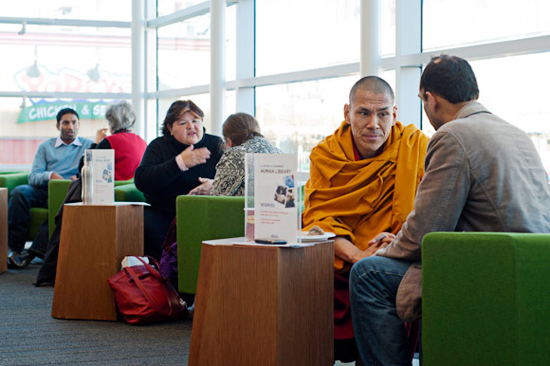
Represent your person.
Notes:
https://boundinjapan.files.wordpress.com/2011/12/human-lib-3.jpg

Slide 21
3 Classes
~10 minutes
meet the books

Slide 22
Use new vocabulary.

Slide 23
5 Questions

Slide 24
Choose
Someone

Slide 26
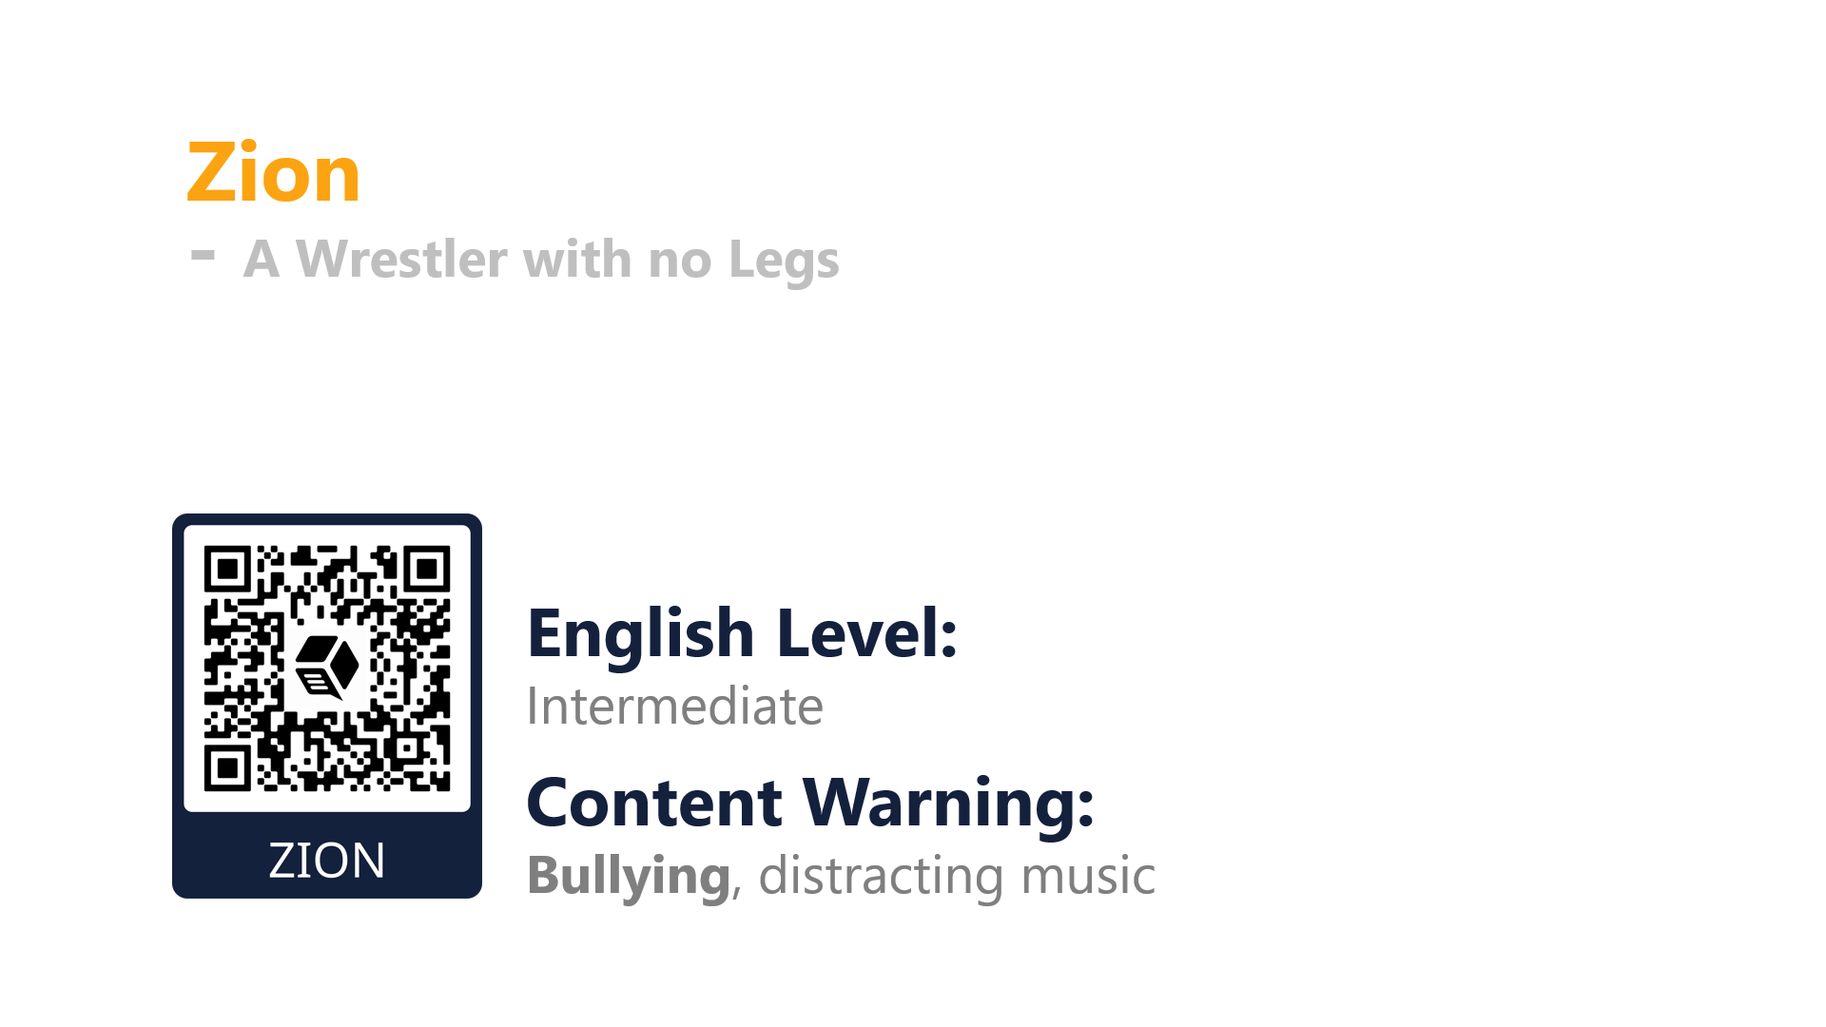

Slide 27
ESL toybox
www.esltoybox.com

