Slide 1
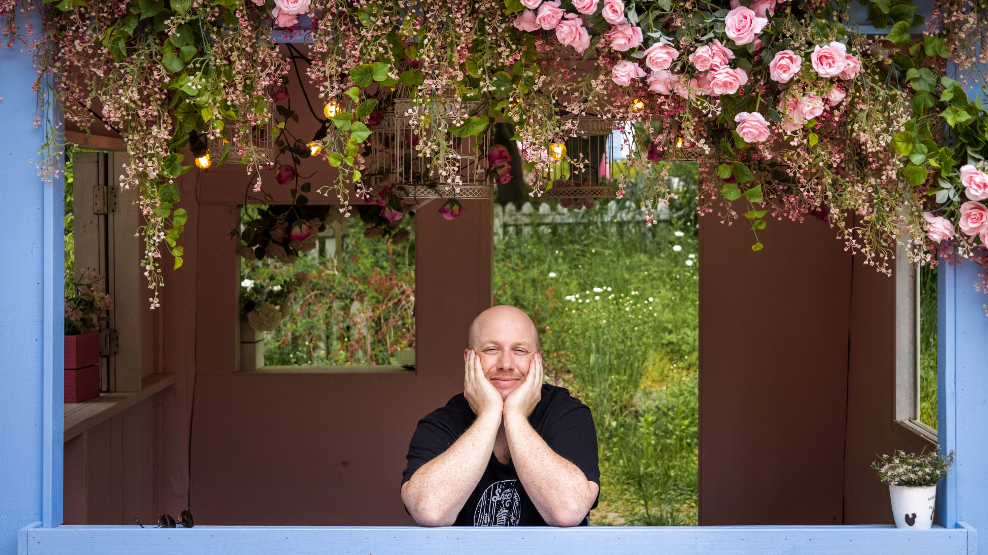

TIM
TIMOTHY JACK SCHILSTRA

Slide 2

Where am I from?

Slide 3
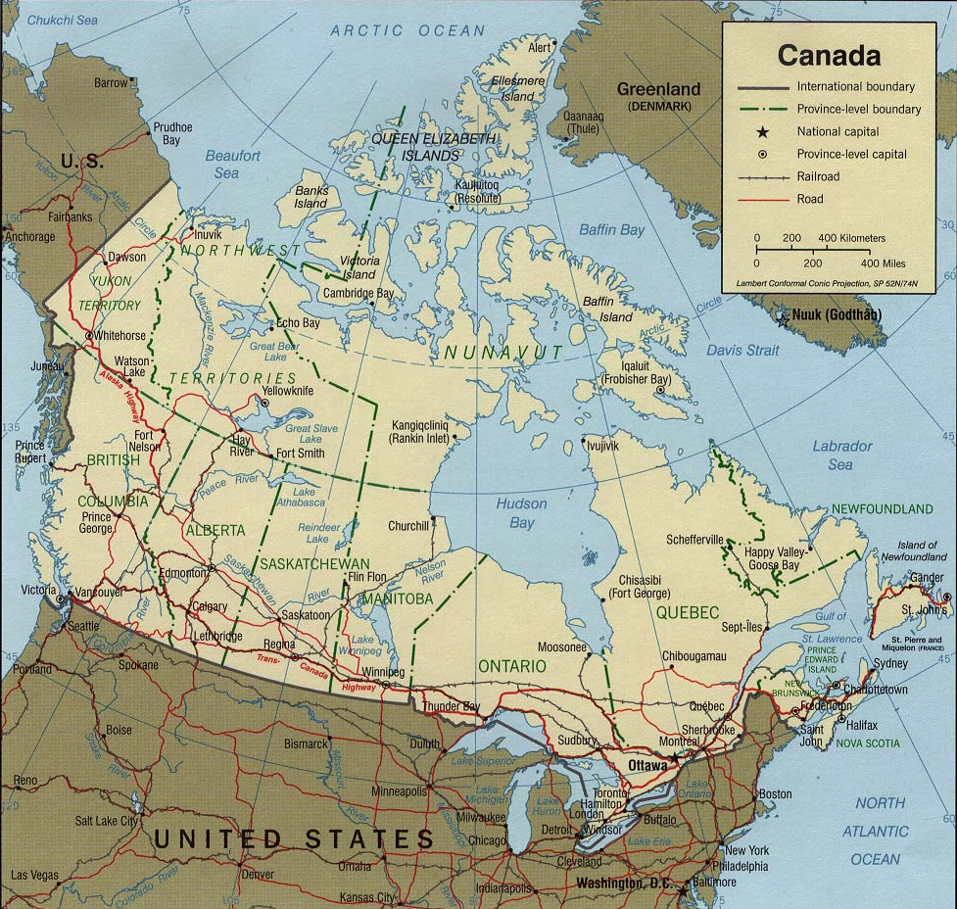
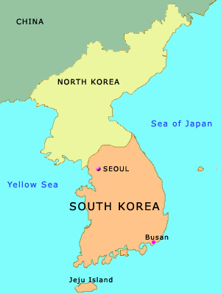

Slide 4
How many are there in my family?

Slide 5
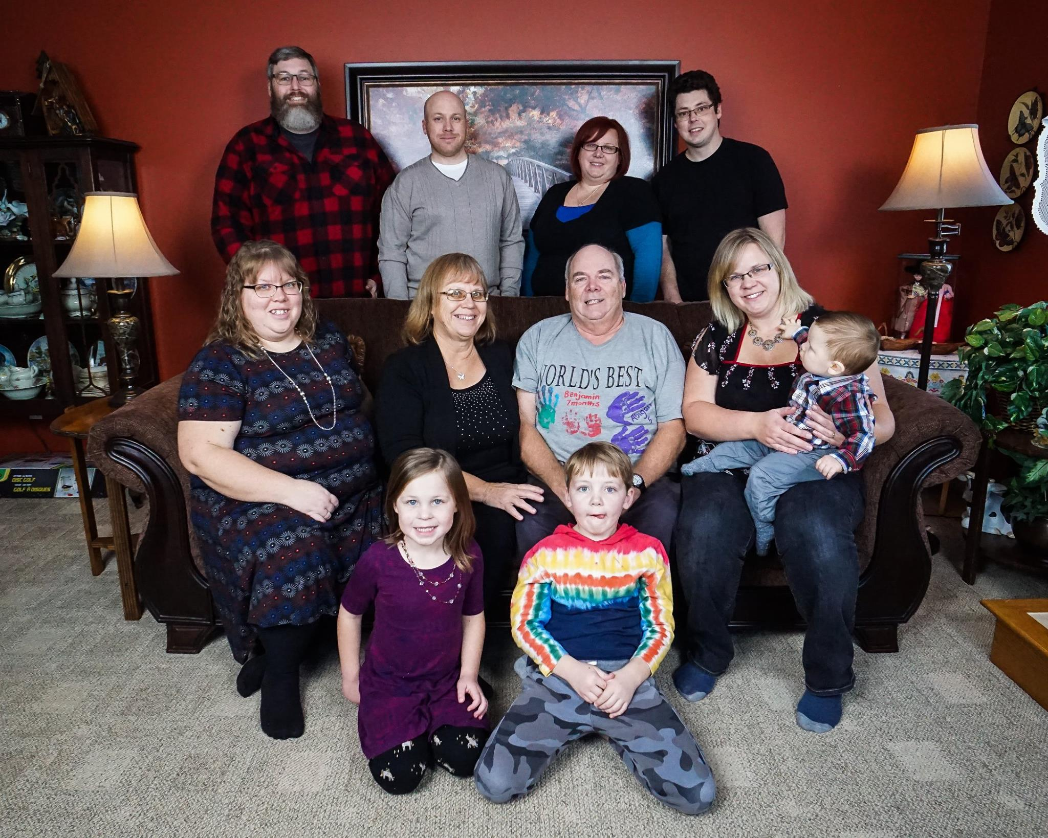
My Family

Slide 6
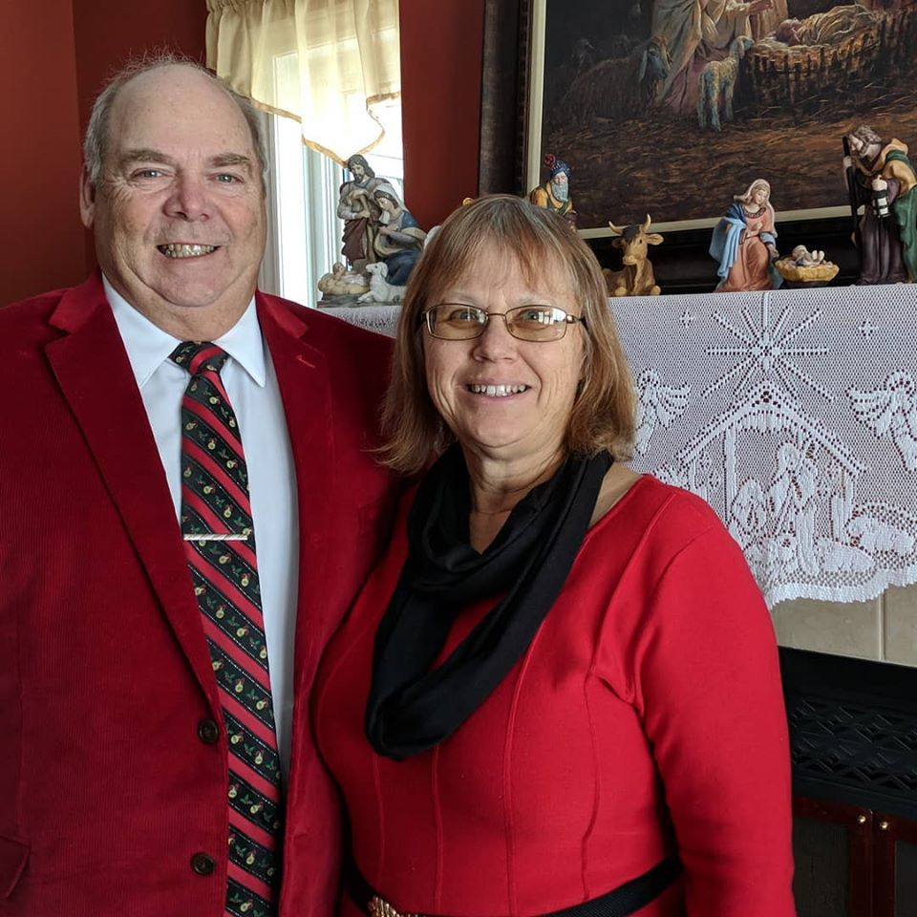
Nelly and Harold

Slide 7
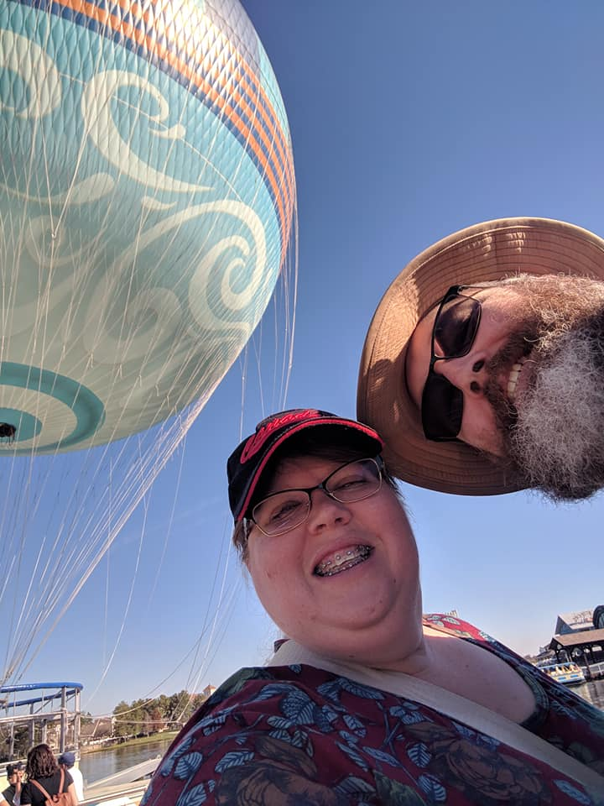
Debbie and Dave

Slide 8
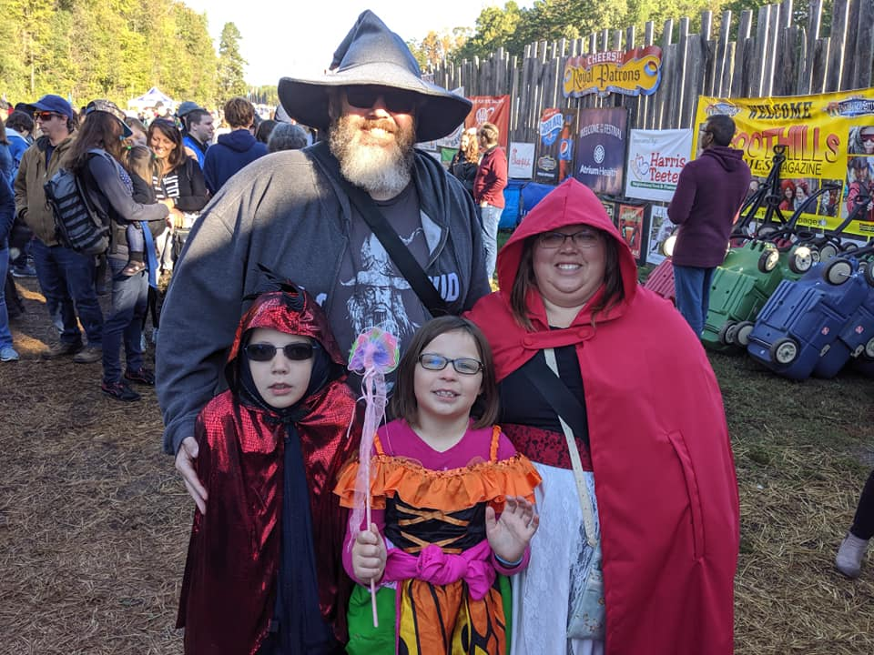
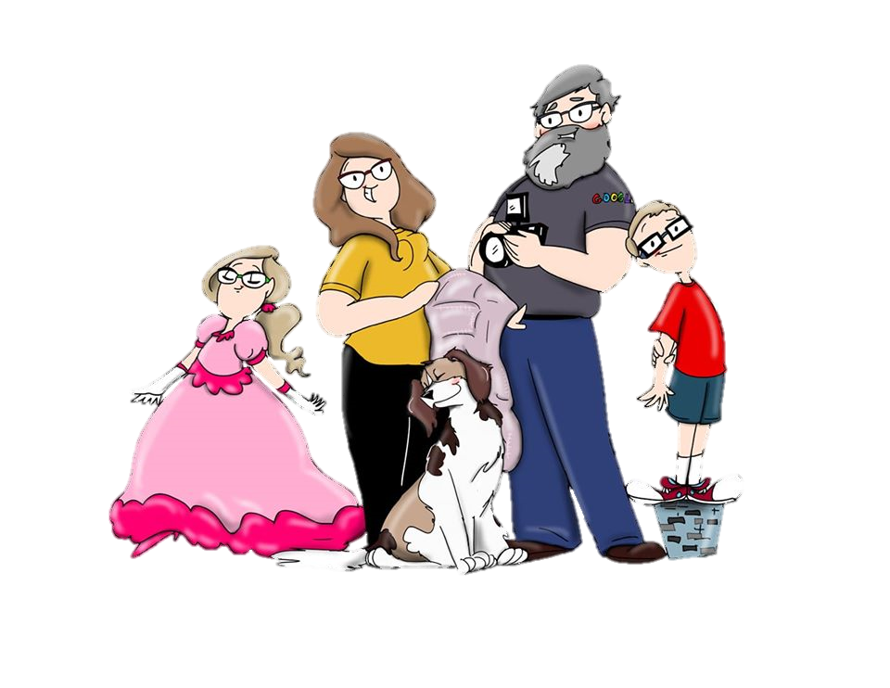
Zeke and Abigail

Slide 9
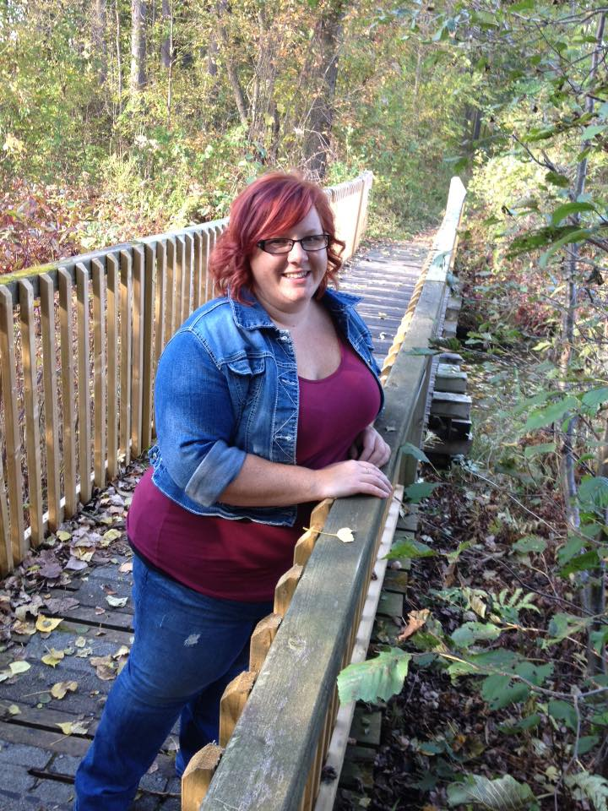
Amanda

Slide 10
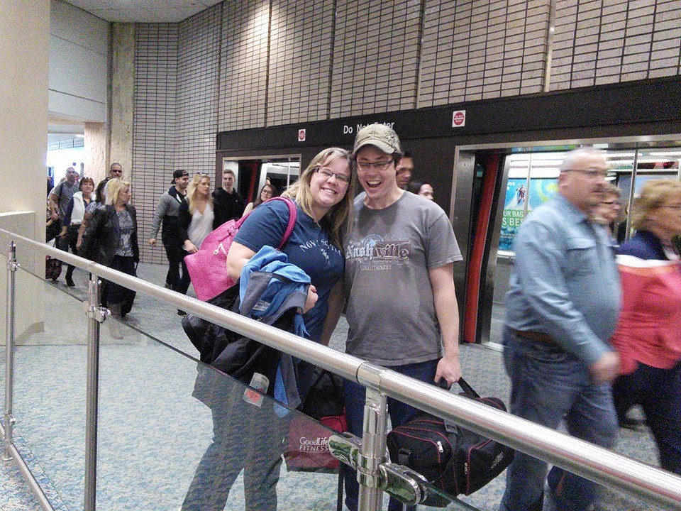
Melissa and Bob

Slide 11
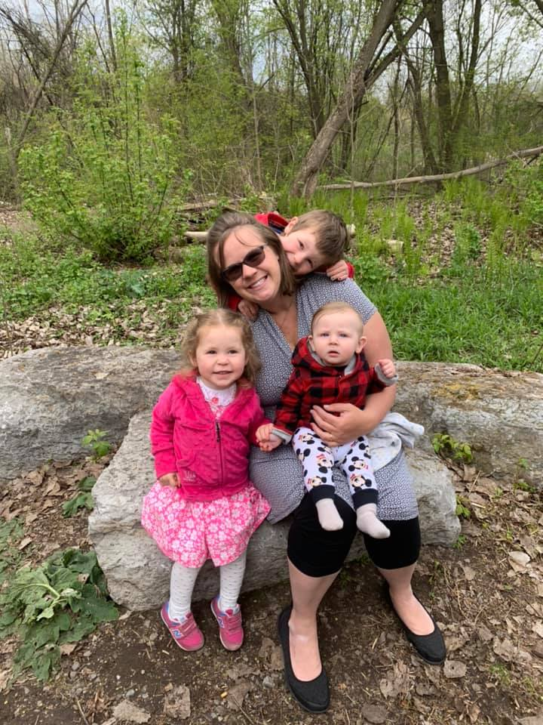
Benjamin
Lydia
Harold

Slide 12
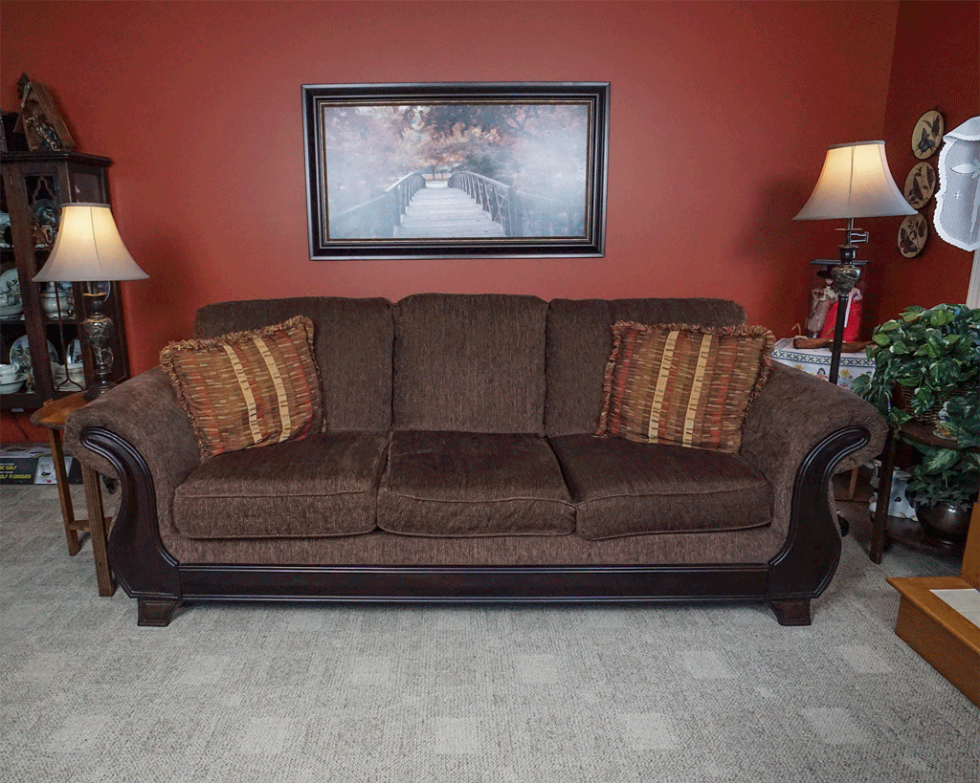

Slide 13
How long have I lived in Korea?

Slide 14
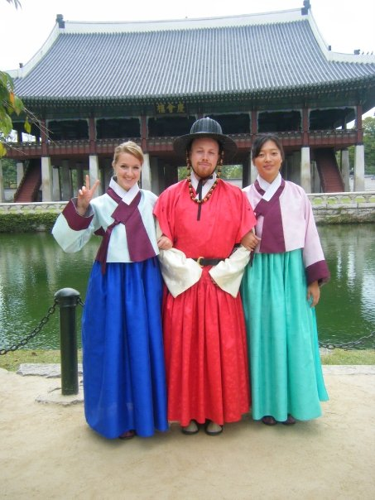
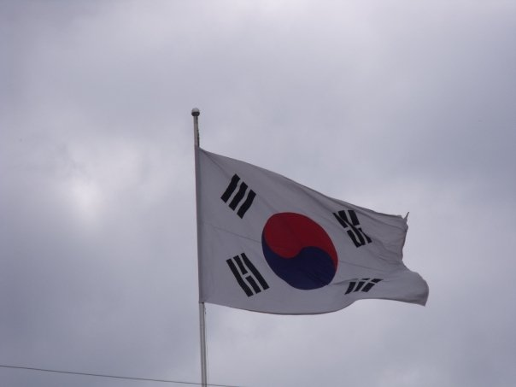
Mr.S in Korea
2009

Slide 15

Yuseong Bio-Science and Technology High School

Slide 16
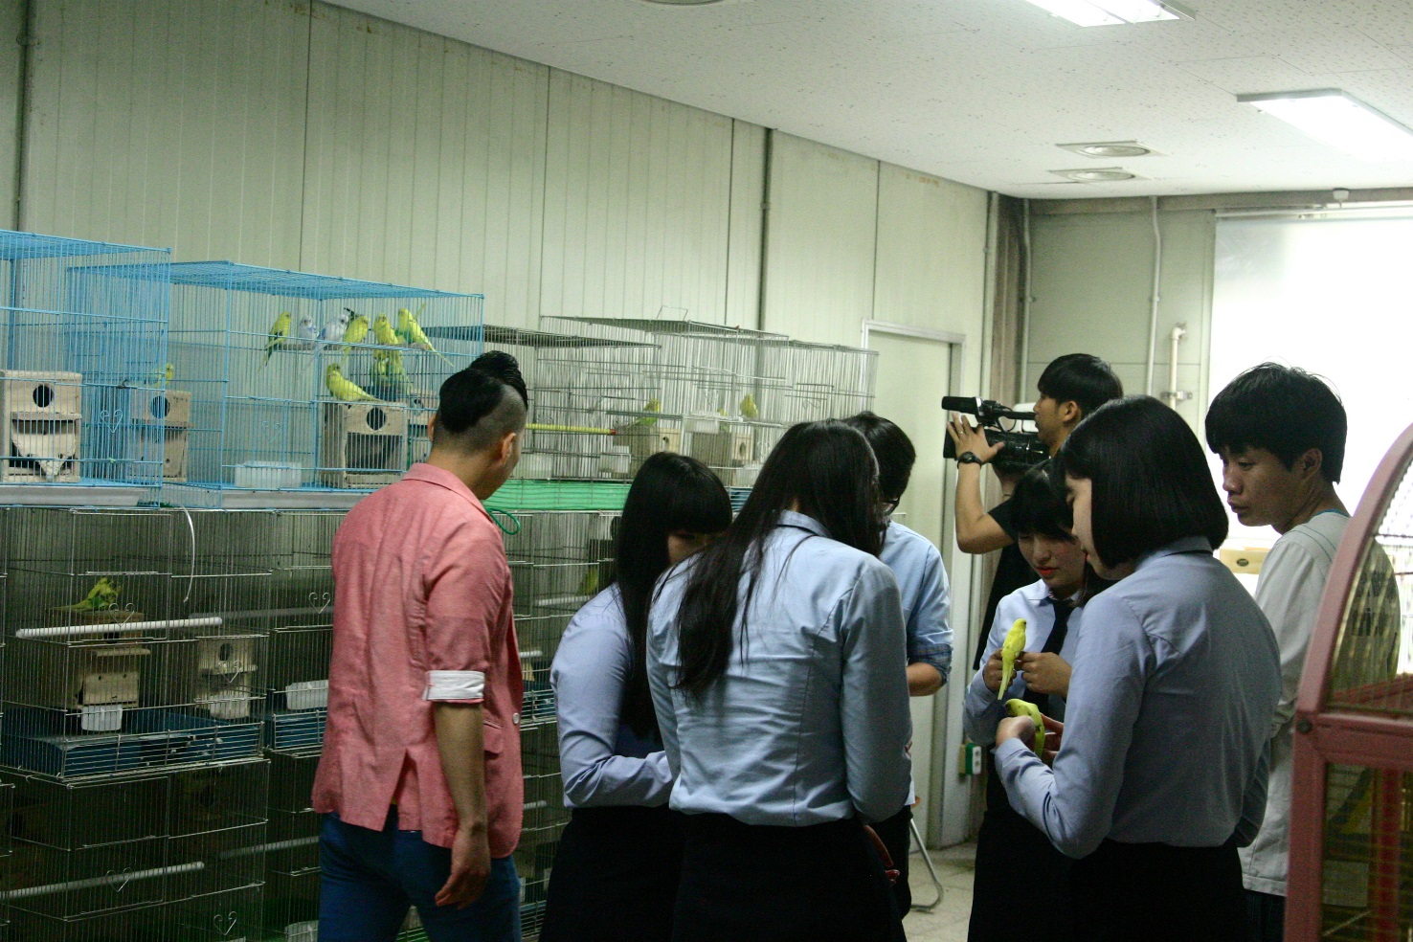
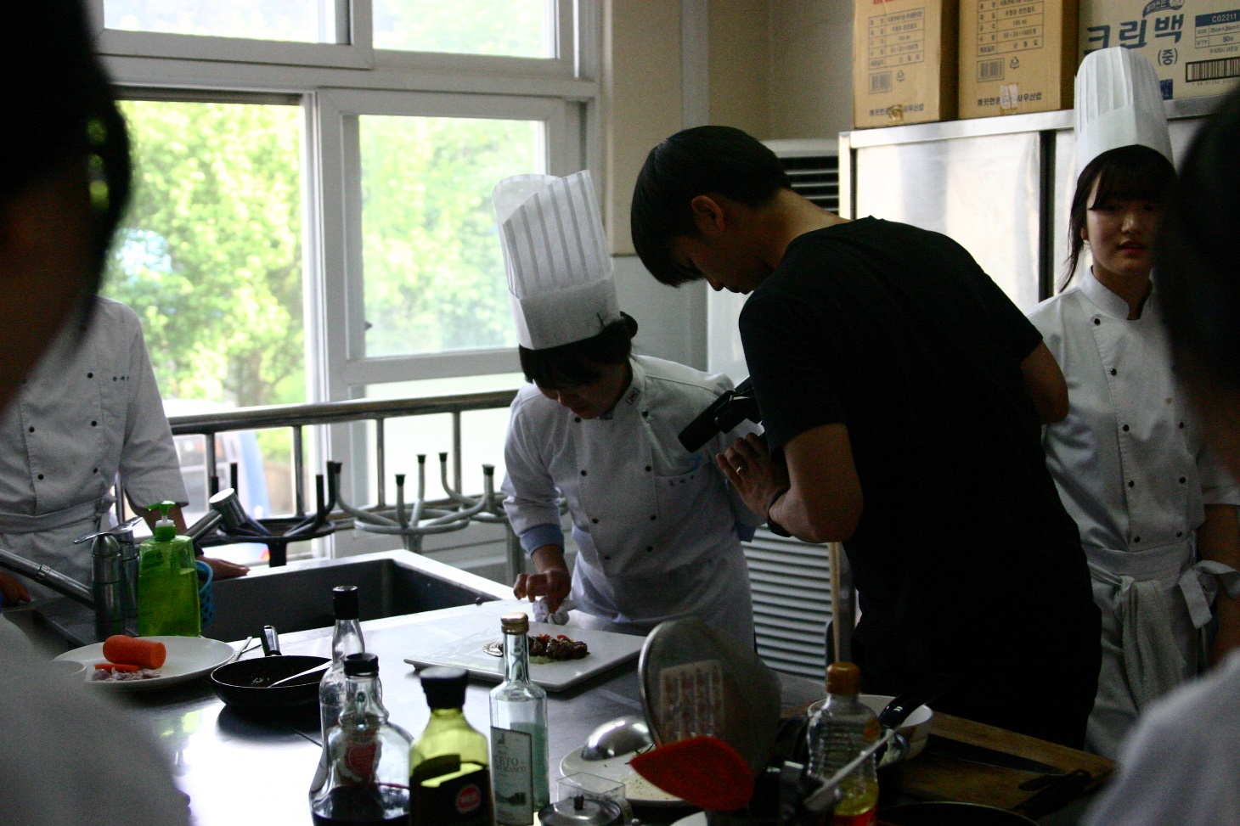
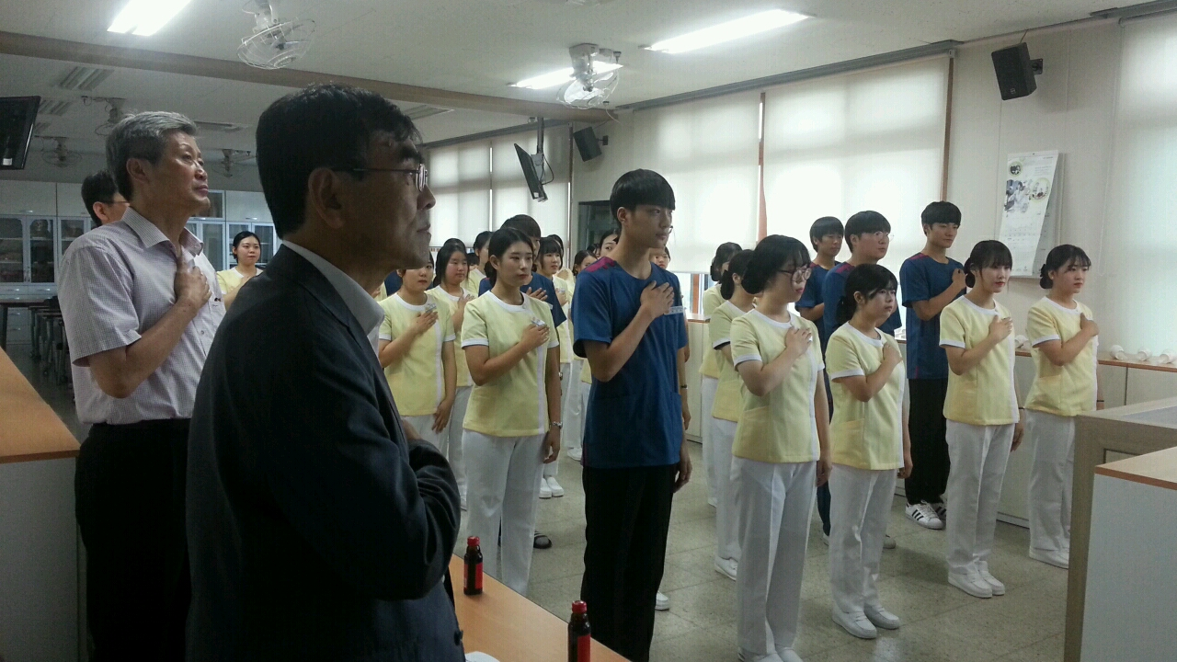
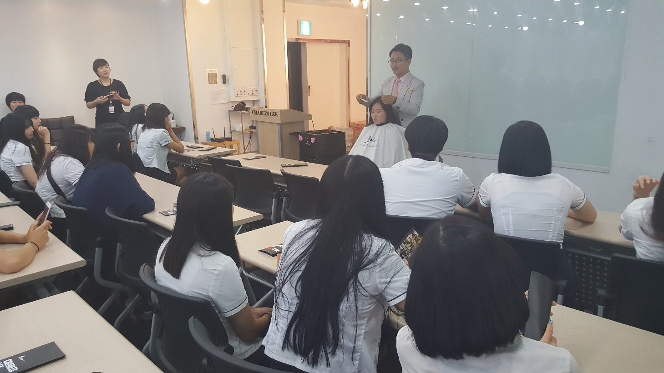

Slide 17
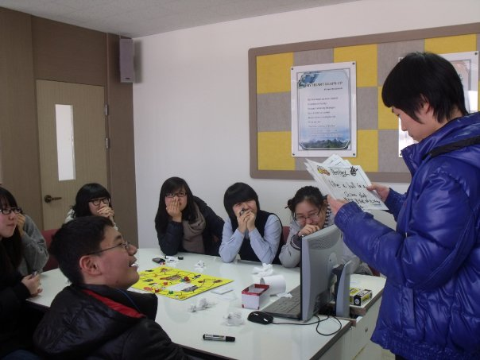
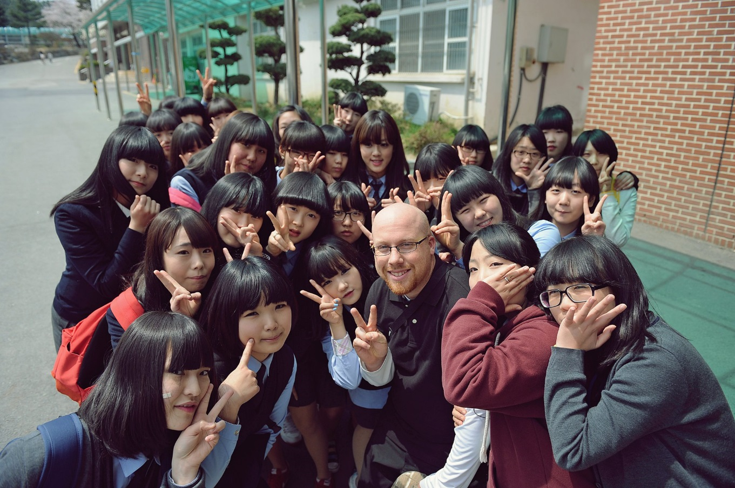

Slide 18

Eoeun Elementary School

Slide 19
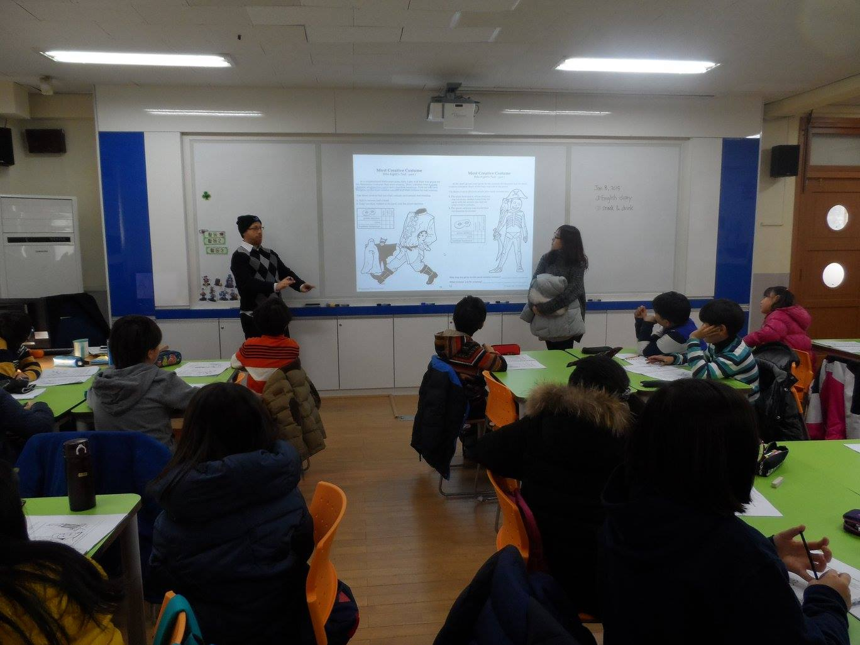
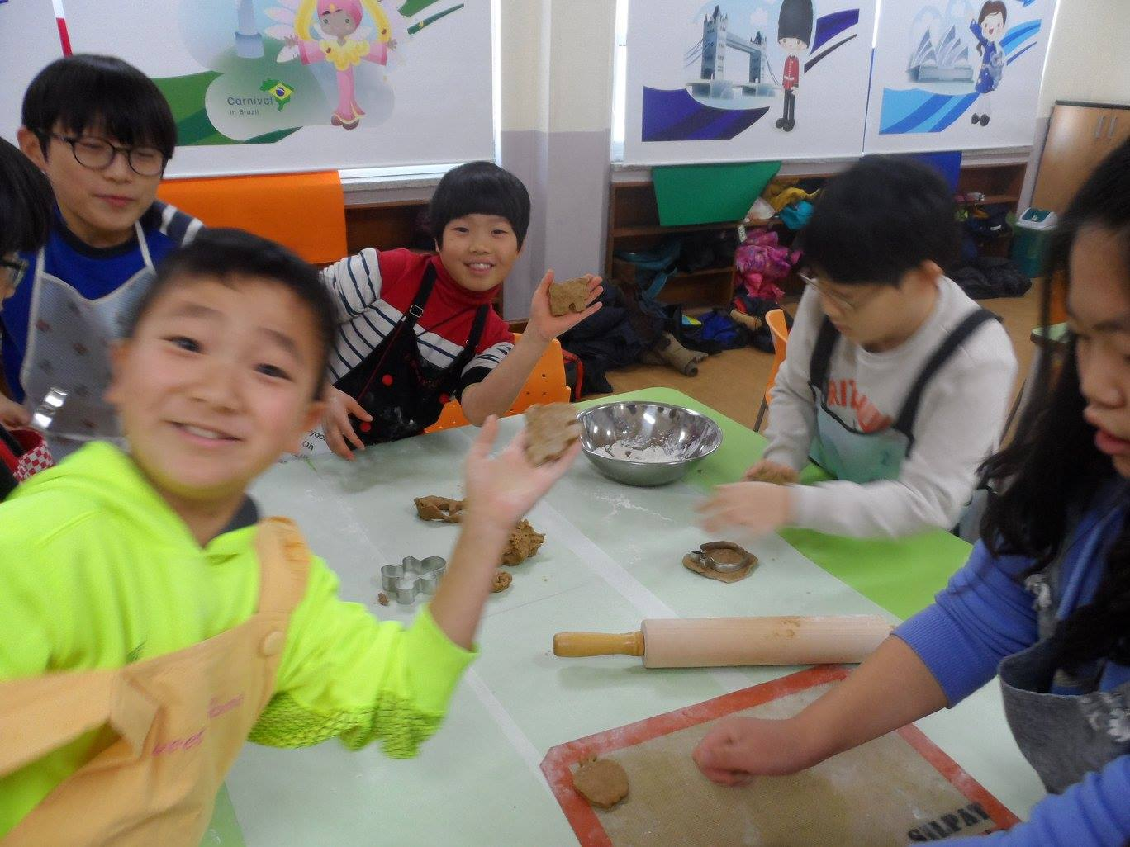

Slide 20

Shinhan High School

Slide 21
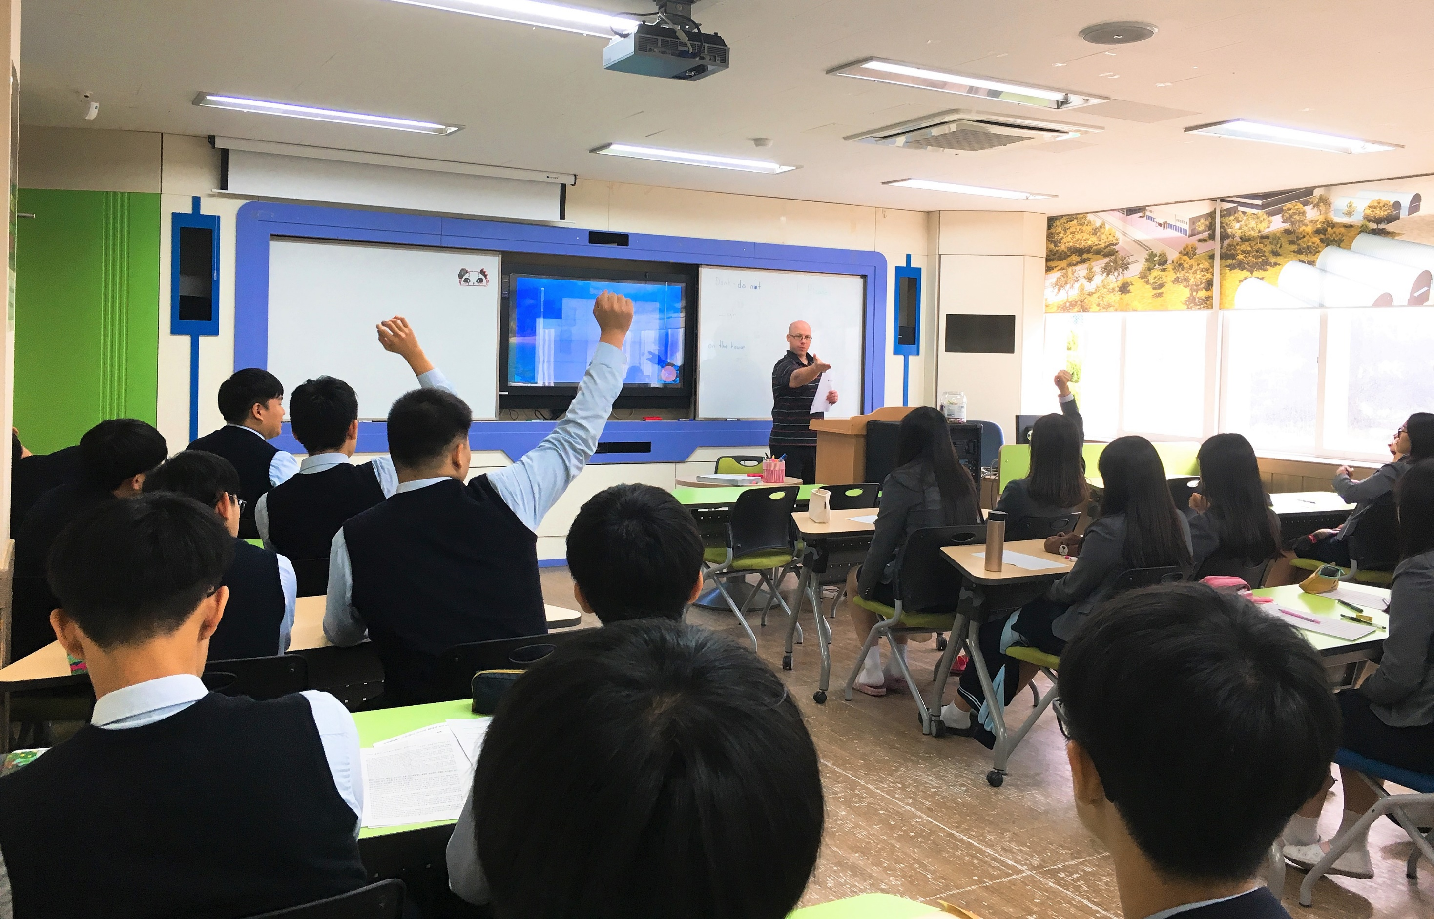
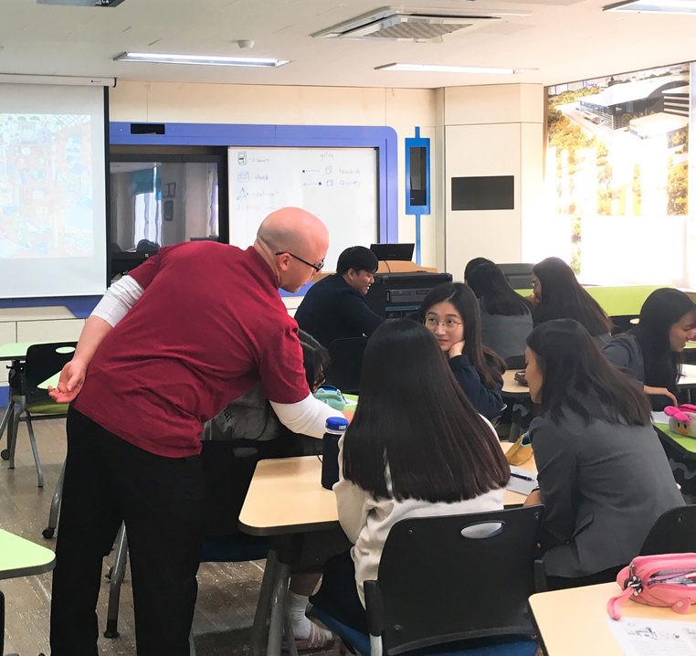

Slide 22
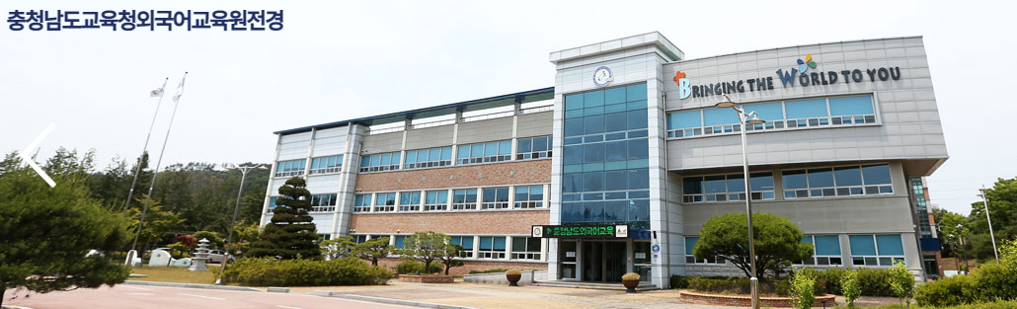
COEIEI

Slide 23
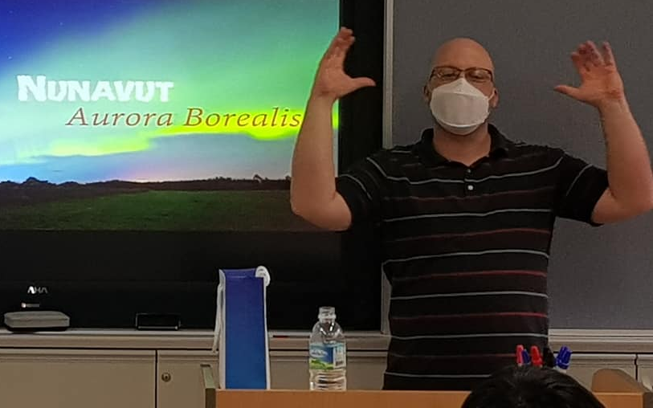
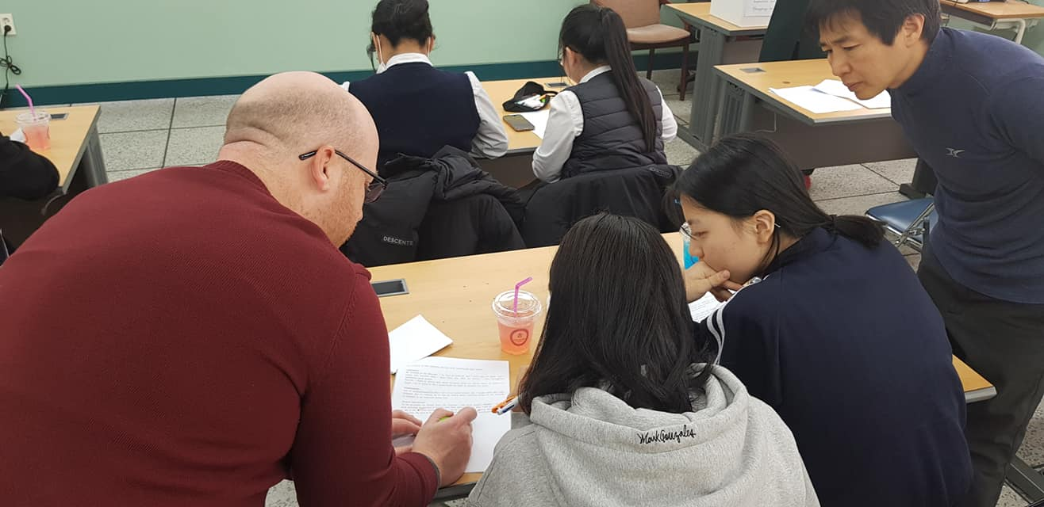
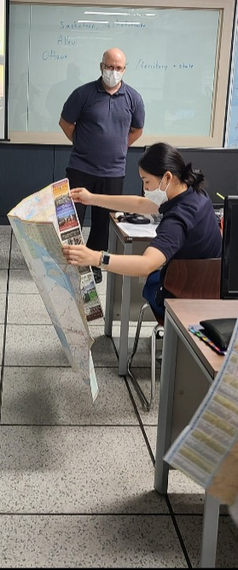
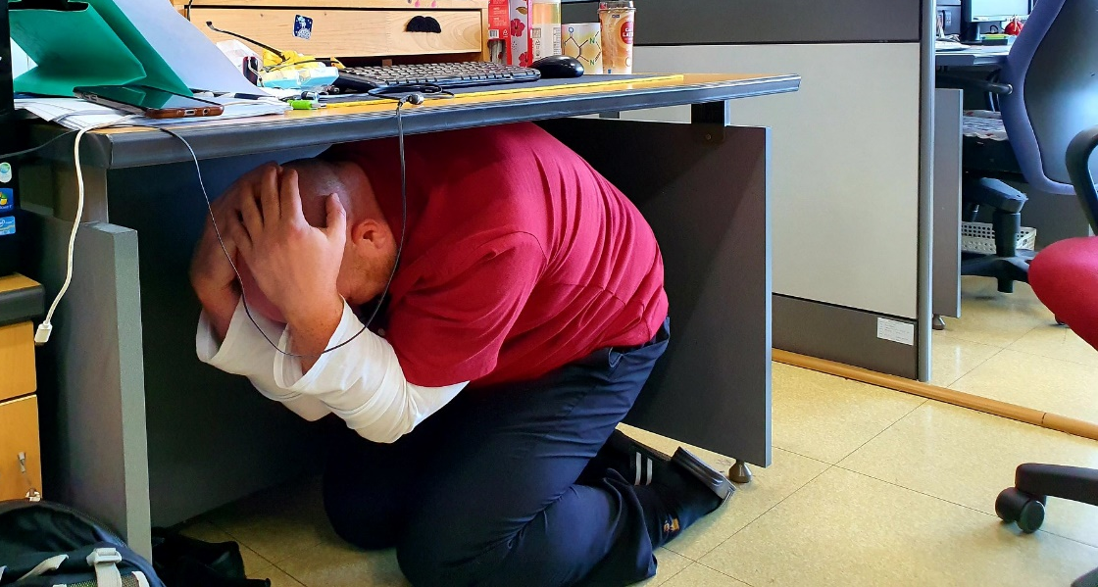
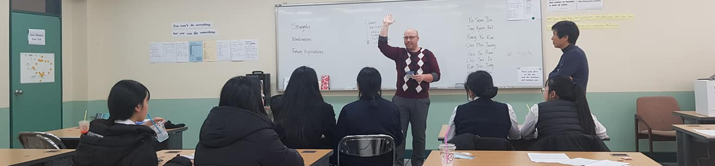

Slide 24
What kind of student do I like?

Slide 25


Slide 26
What was my major?

Slide 27
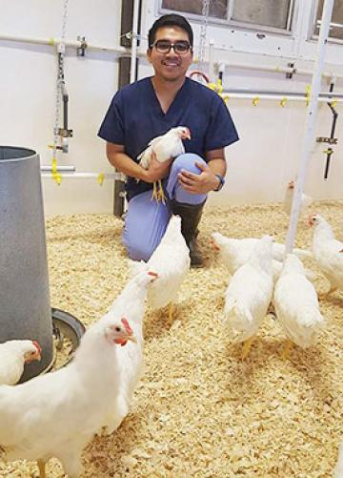


Slide 28
What was I like as a high school student?

Slide 29


Slide 30
What was my first job?

Slide 31
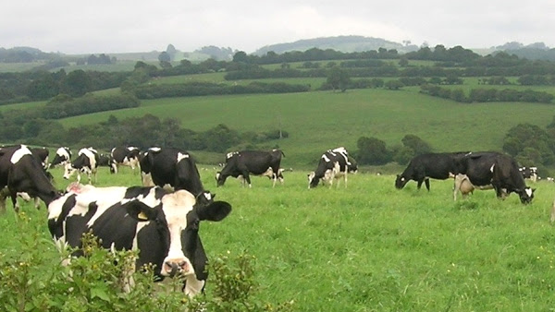
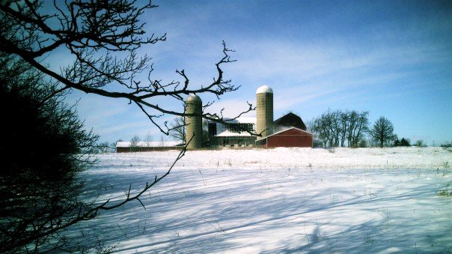

Slide 32
What is my favorite
Korean Food?

Slide 33
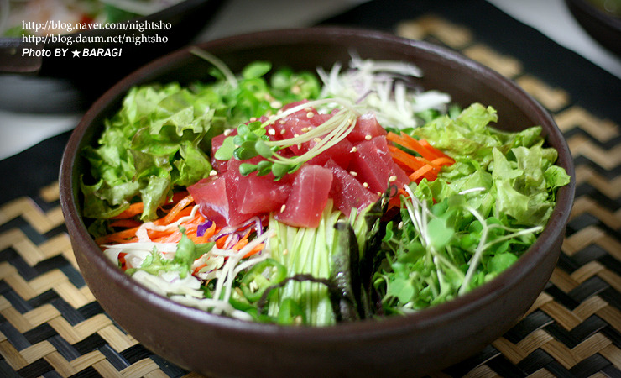
What is my favorite Korean Food?

Slide 34
What are my hobbies?

Slide 35
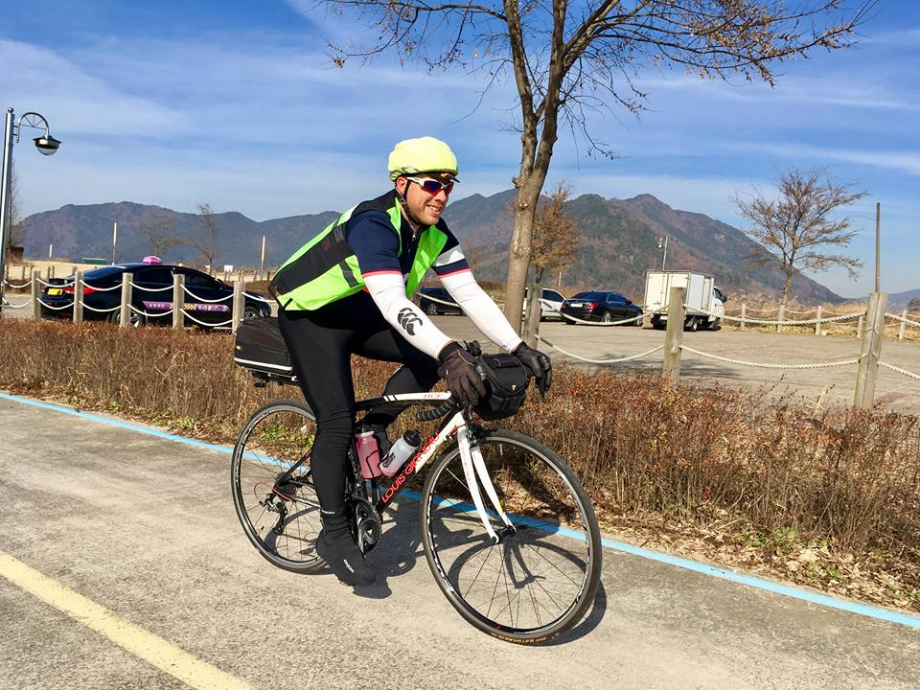
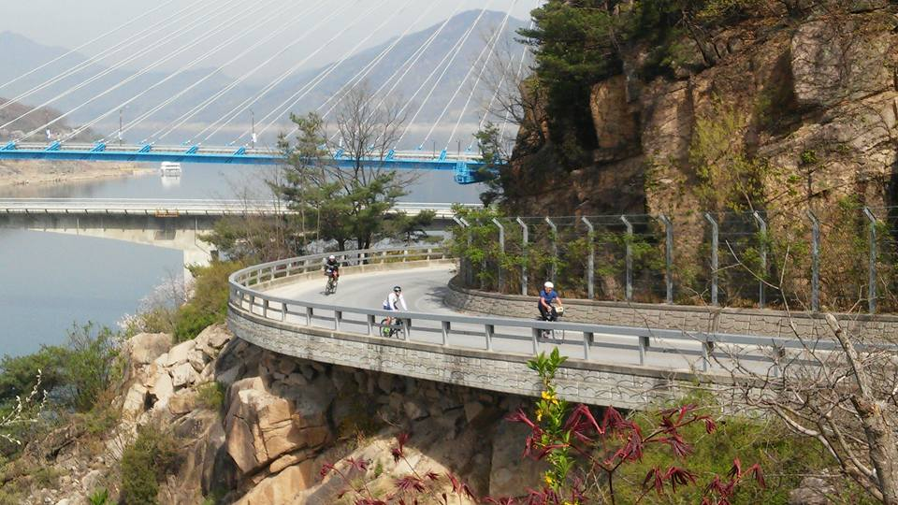
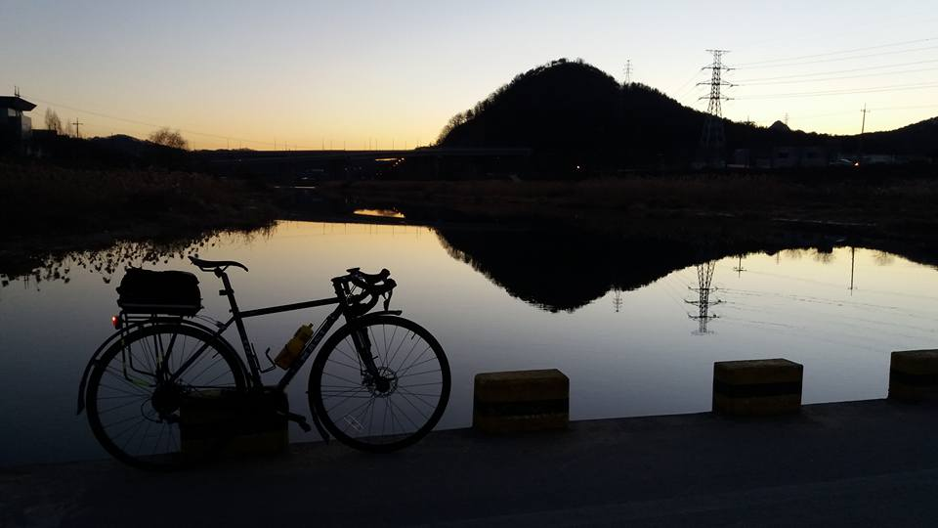

Slide 36
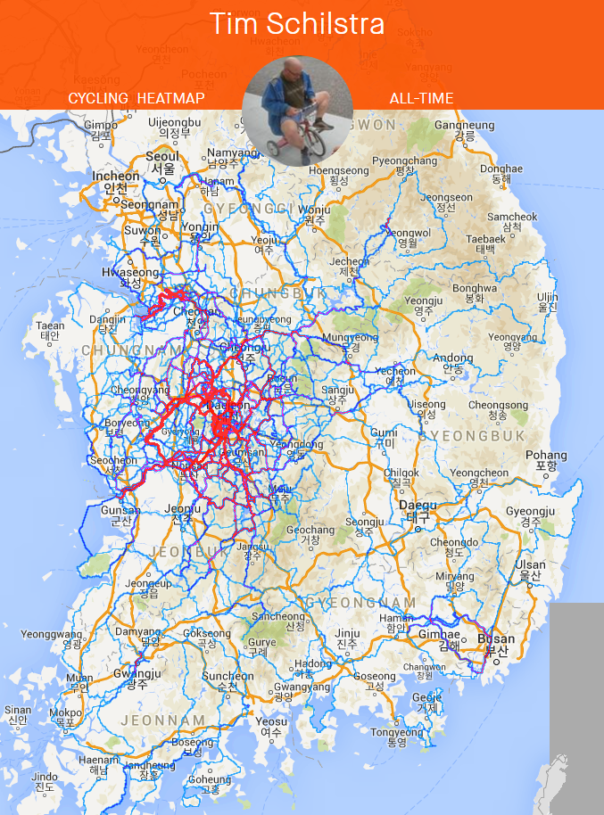

Slide 37
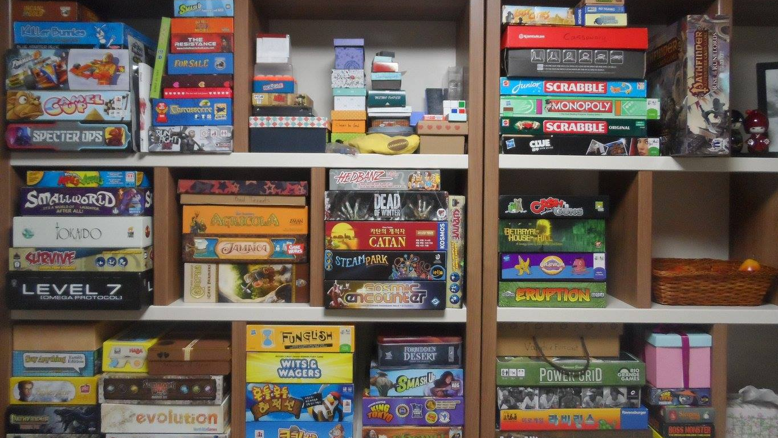

Slide 38
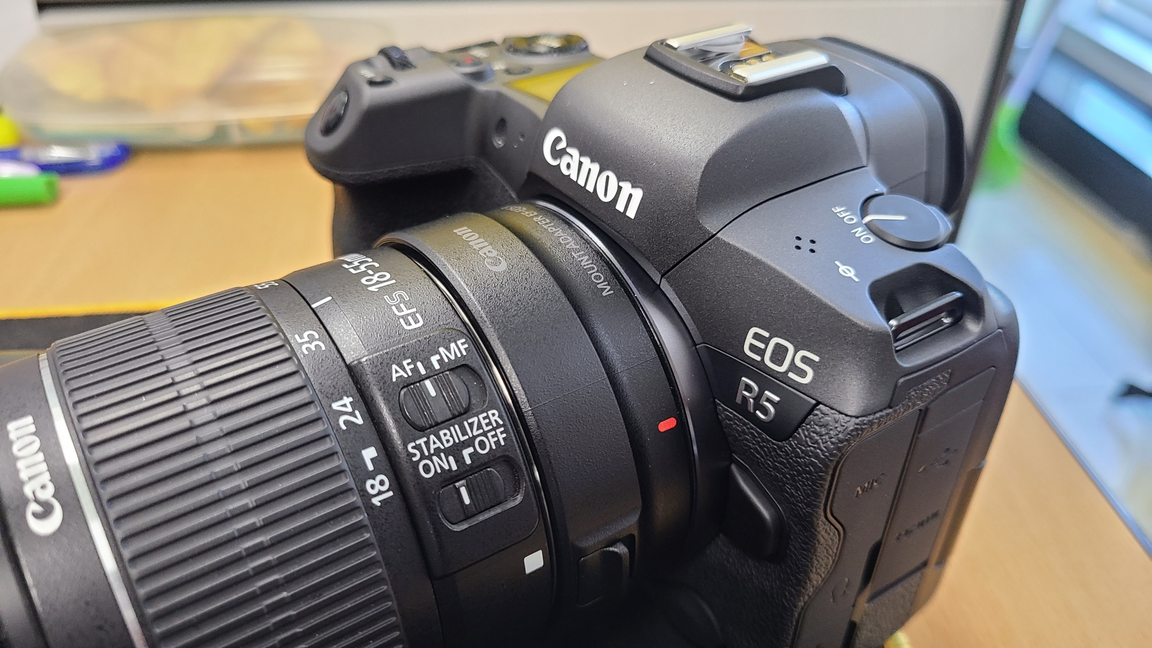

Slide 39
What is my favorite animal?

Slide 40
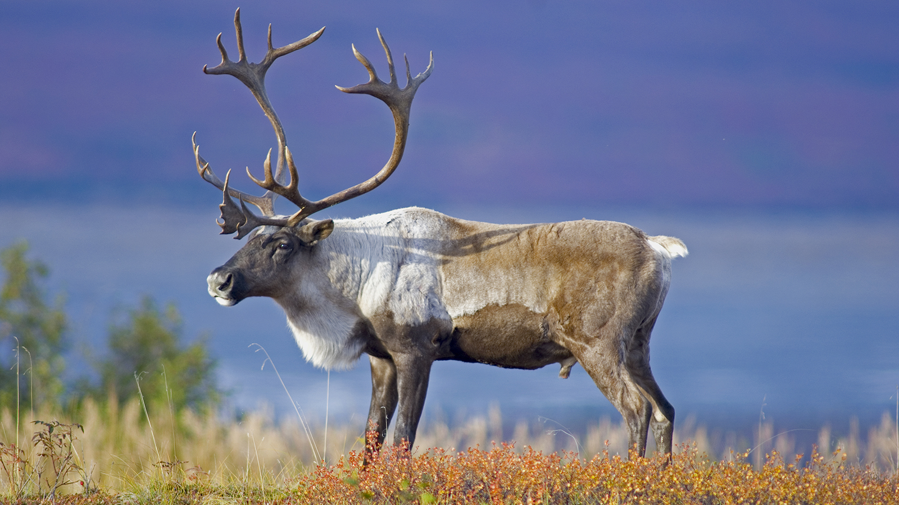
What is my favorite animal?

Slide 41
What is the strangest place I have been?

Slide 42
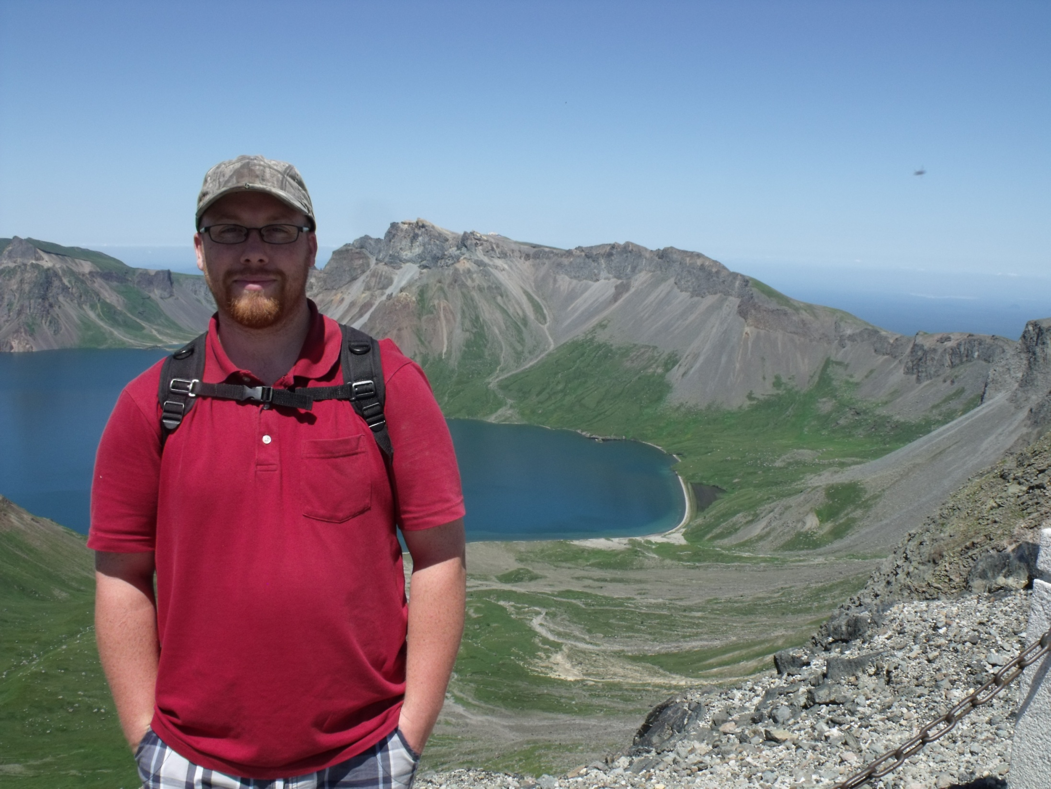

Slide 43

GOALS
SPEAKING III

Slide 44
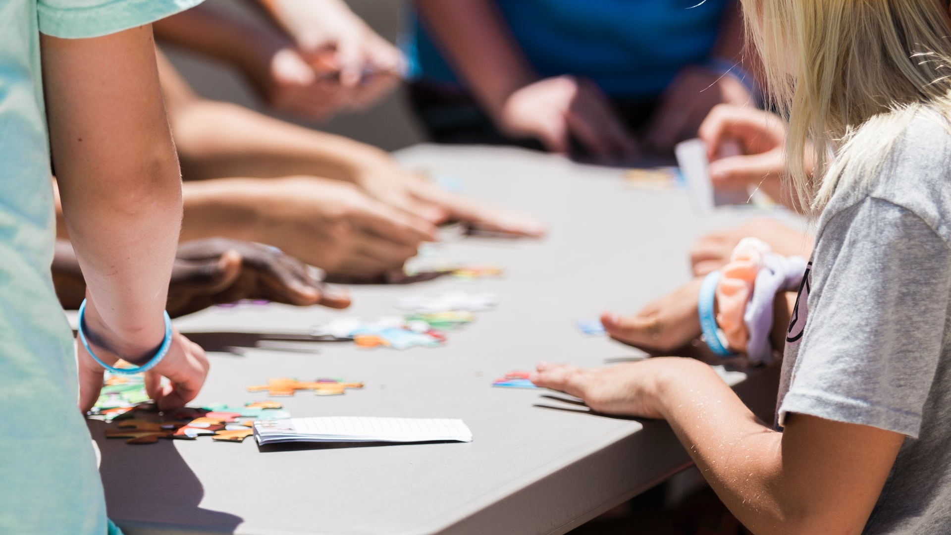
Games & activities
Board games, Apps, Challenges

Slide 45

Variety
Bartering, Maps, Mars, Role play

Slide 46
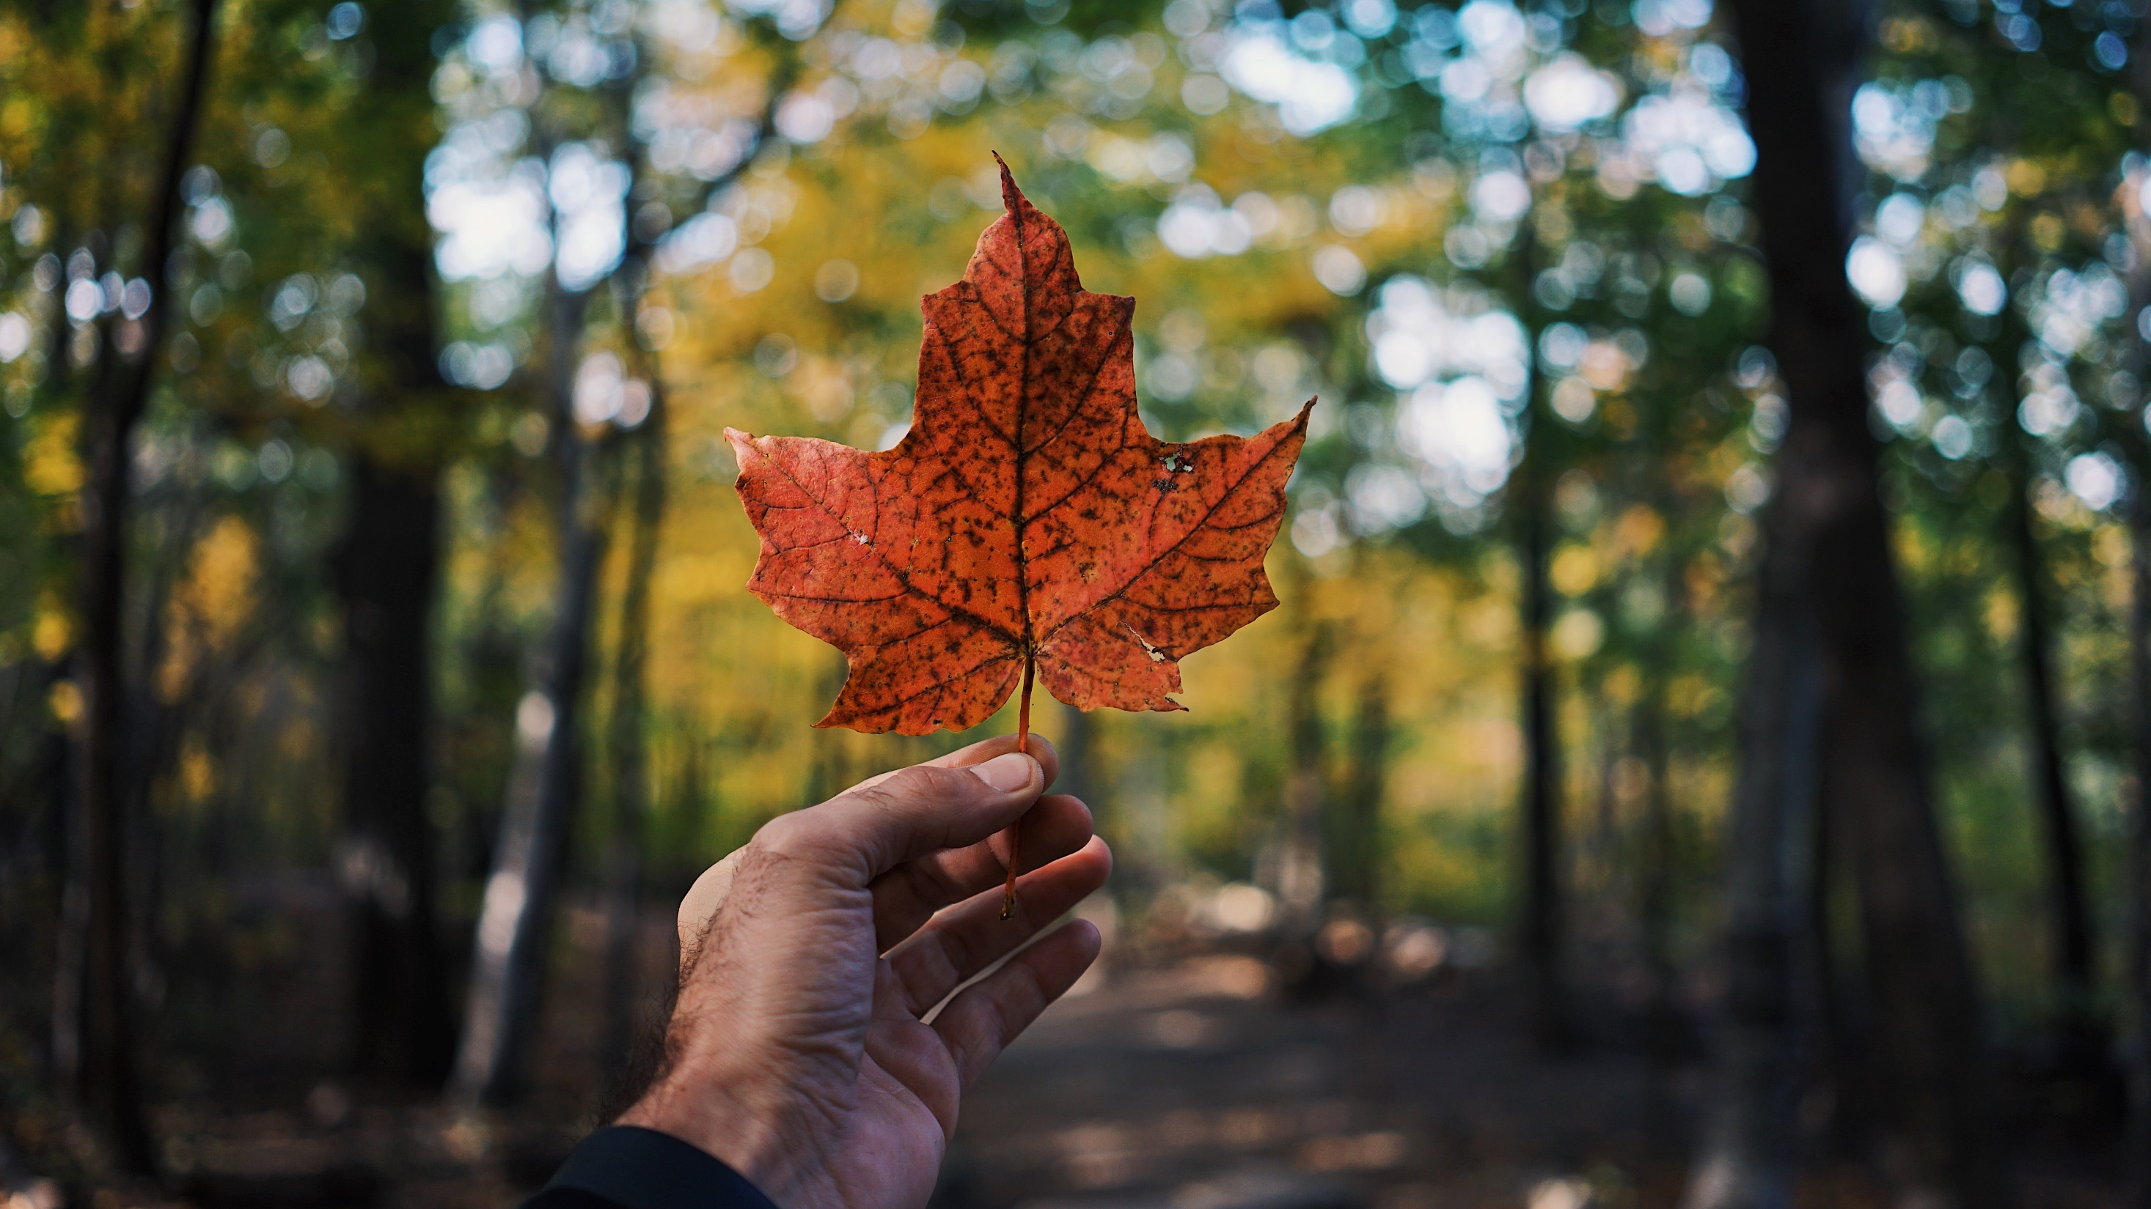
GOALS
CULTURE

Slide 47

Human Library
Greatest Canadian

Slide 48
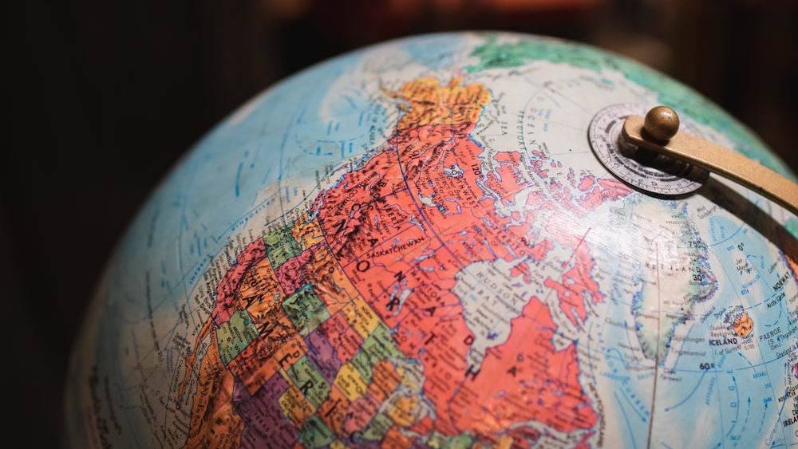
geography
Regionalism, Places of Interest, Travel

Slide 49
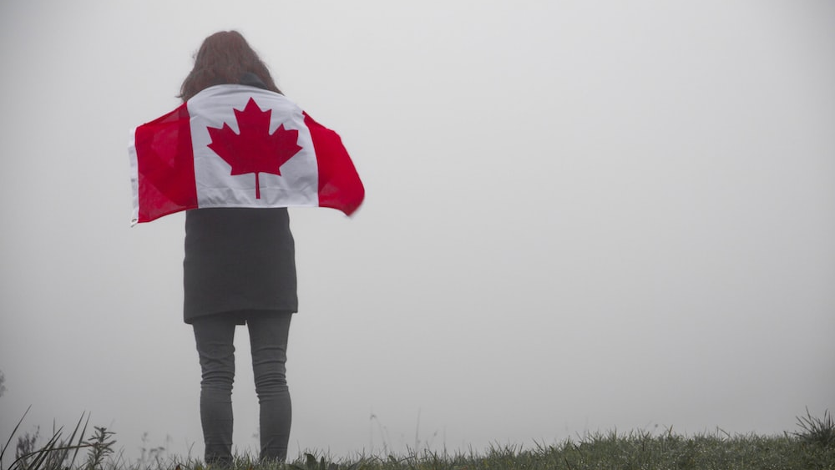
Other things
Celebrities, Food, Sports, Holidays

Slide 50
GOALS
CONVERSATION

Slide 51
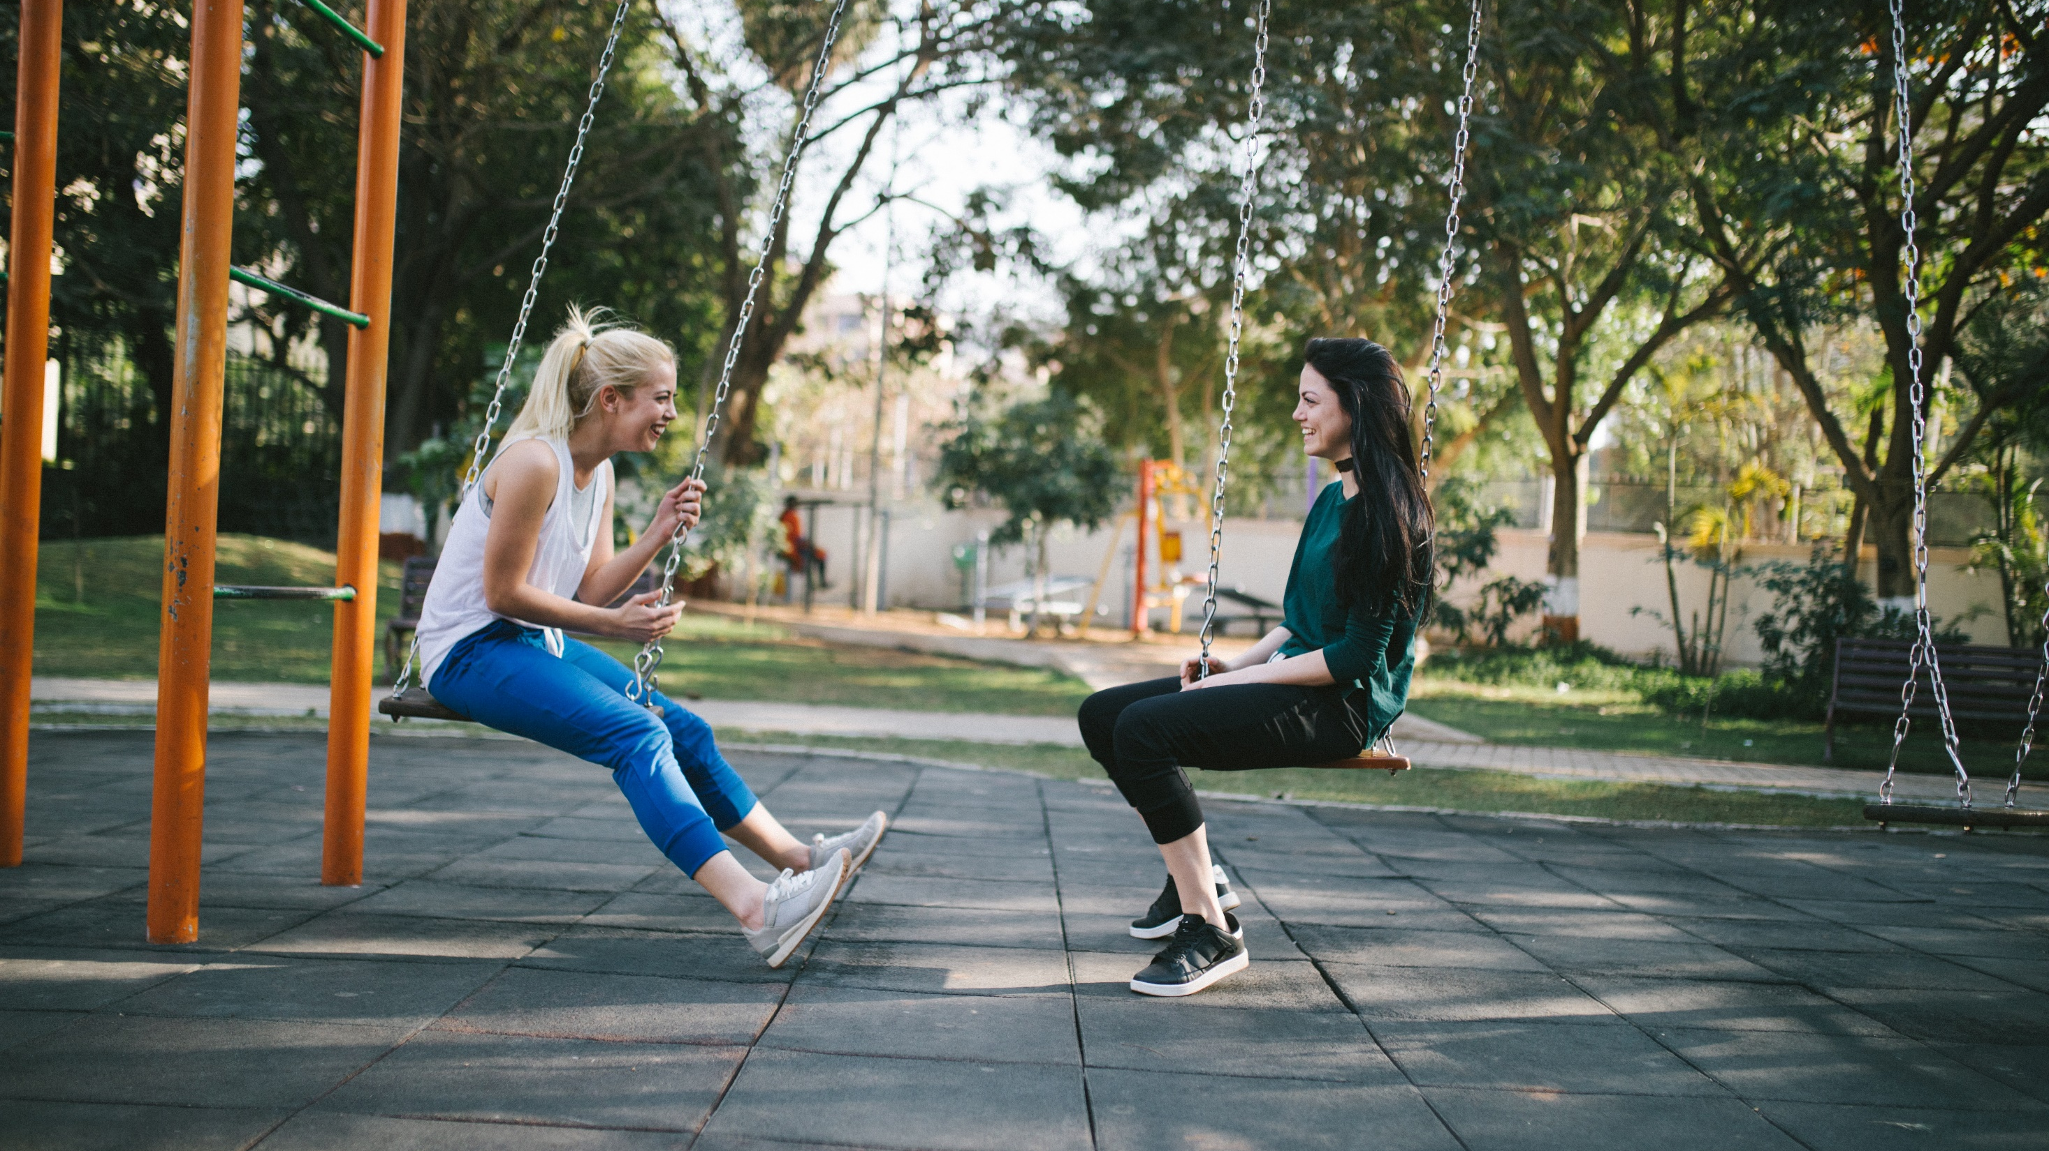
CONVERSATION
Talk and Games

Slide 52





ESL
ToyBox

Slide 53
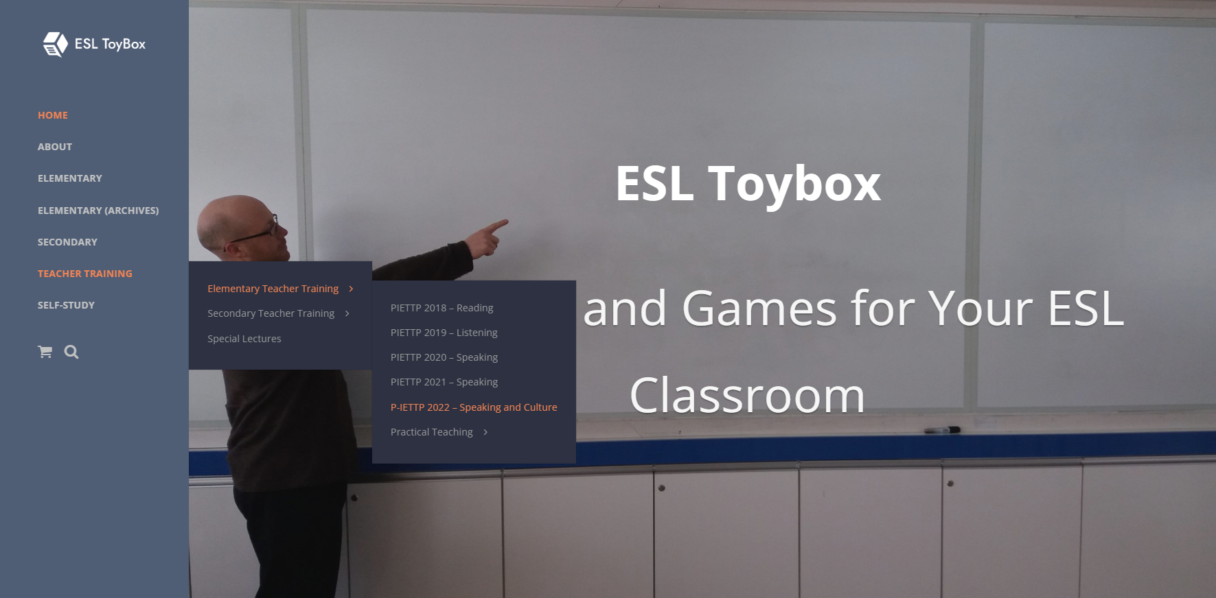



Slide 54
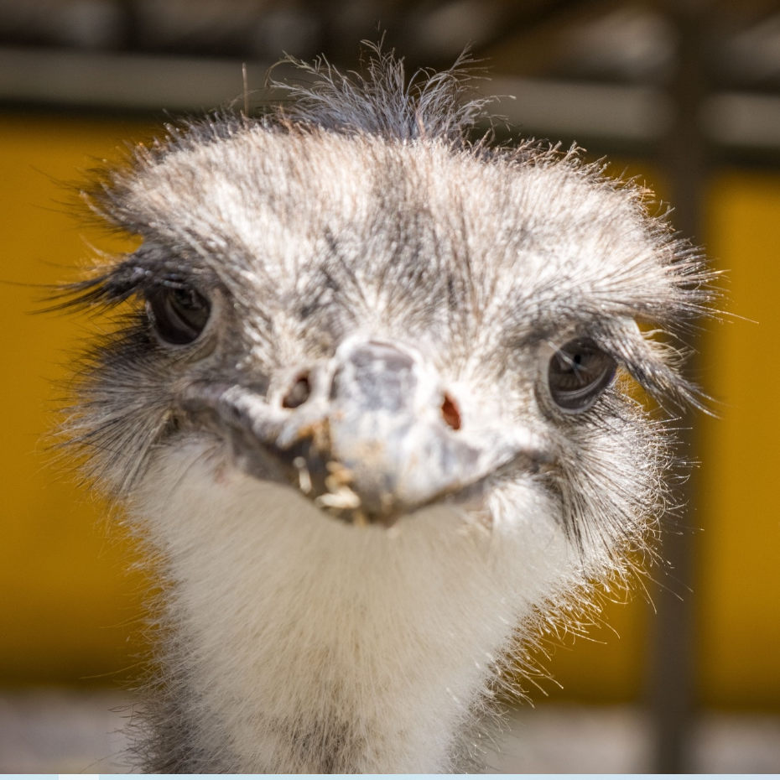

작은 마을
Small Town Korea

Slide 55
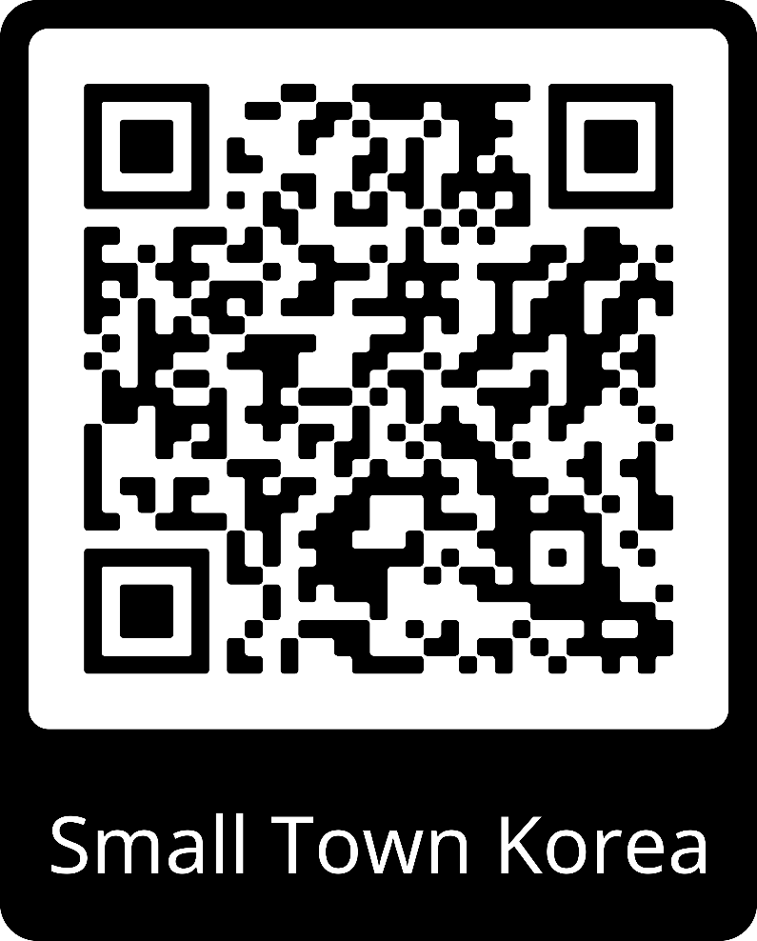


Slide 56

https://create.kahoot.it/share/s-iettp-2022-introduction-questions/63afef81-9c88-4fa3-93c8-6fb0bbcc91bb

