Slide 1
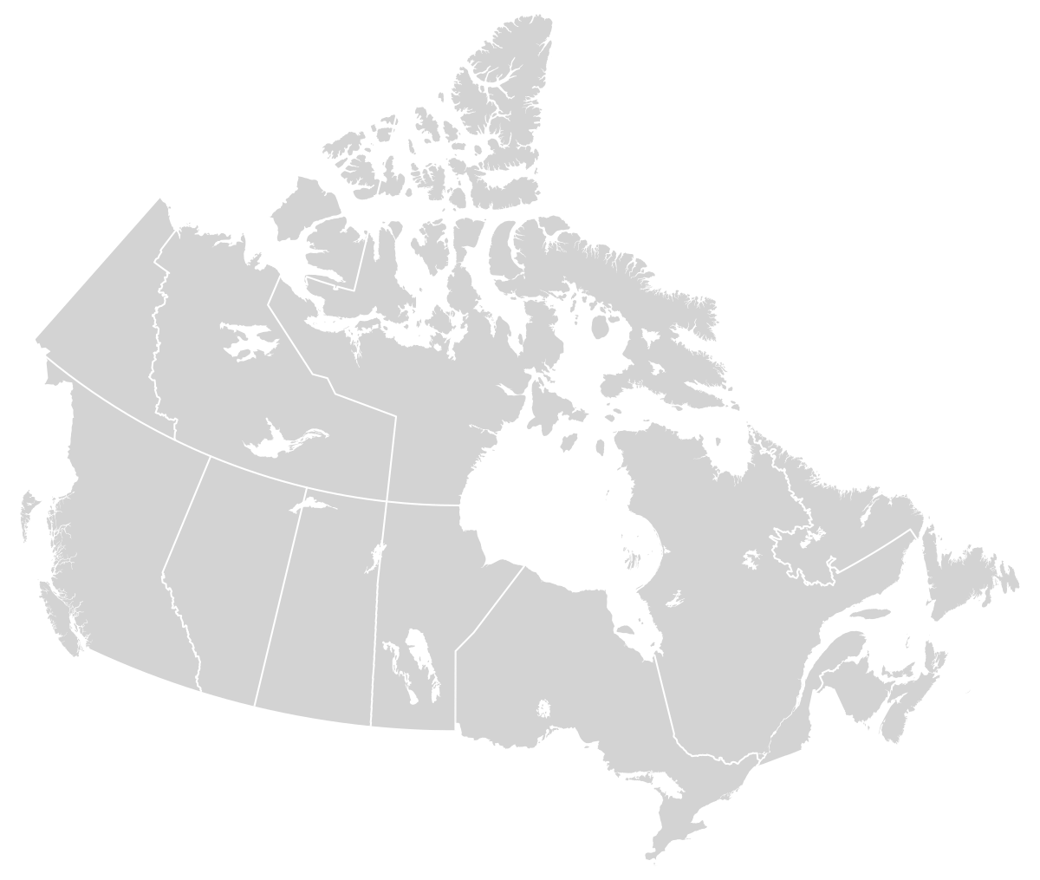
Alberta
British Columbia
Manitoba
New Brunswick
Newfoundland
Nova Scotia
Northwest Territories
Nunavut
Prince Edward Island
Ontario
Quebec
Saskatchewan
Yukon
1
2
3
4
5
7
13
6
11
8
9
10
12

