Slide 1
Drawing a
CANADIAN
Map

Slide 2
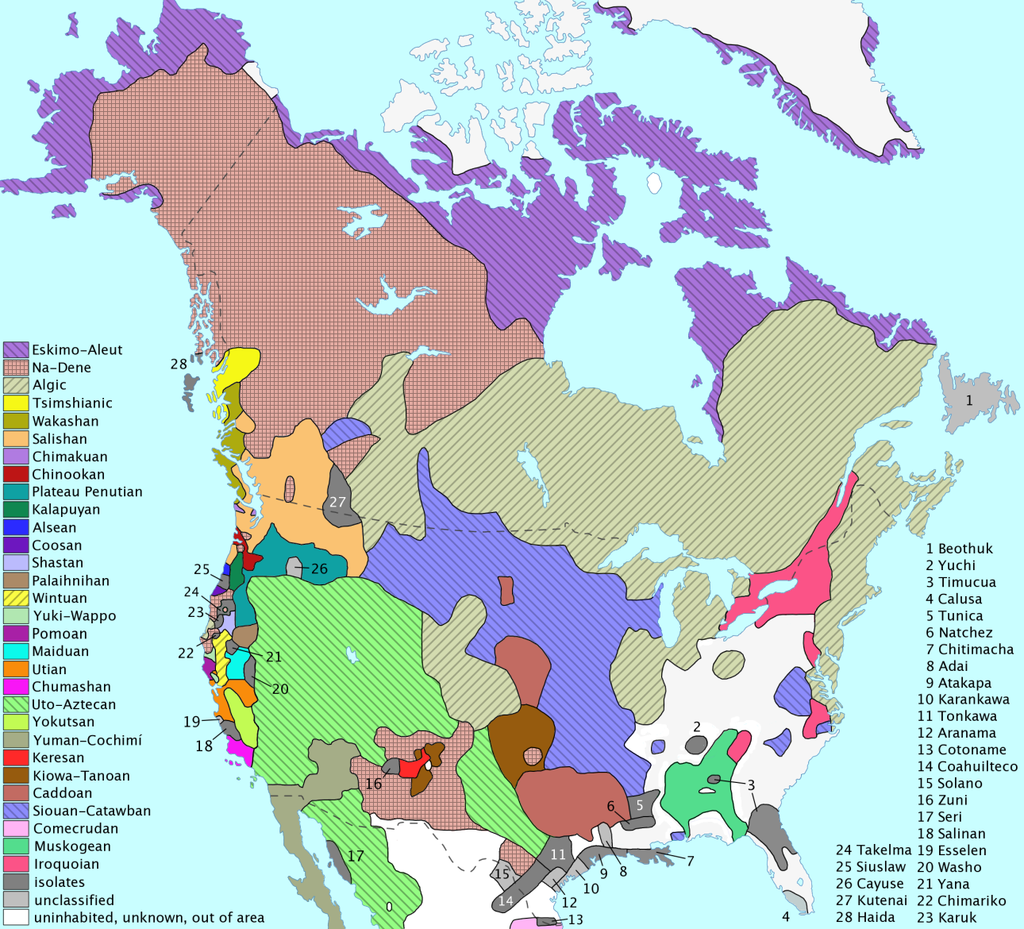
Pre-
Colonization

Slide 3
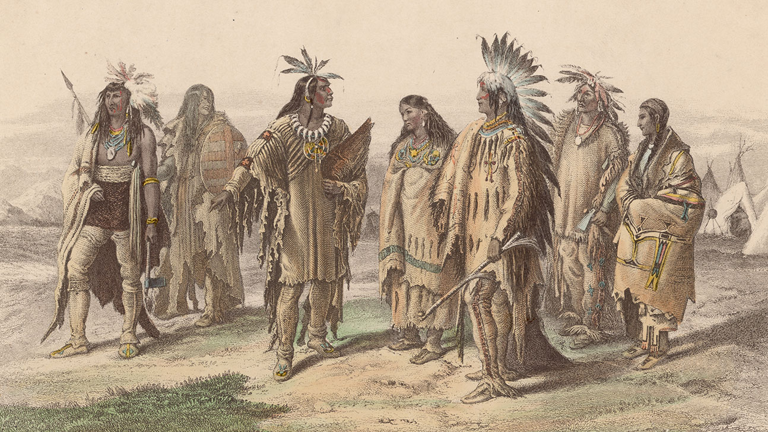

Slide 4
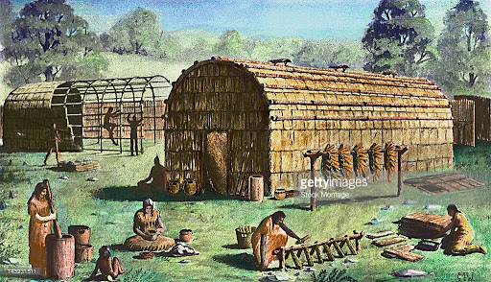
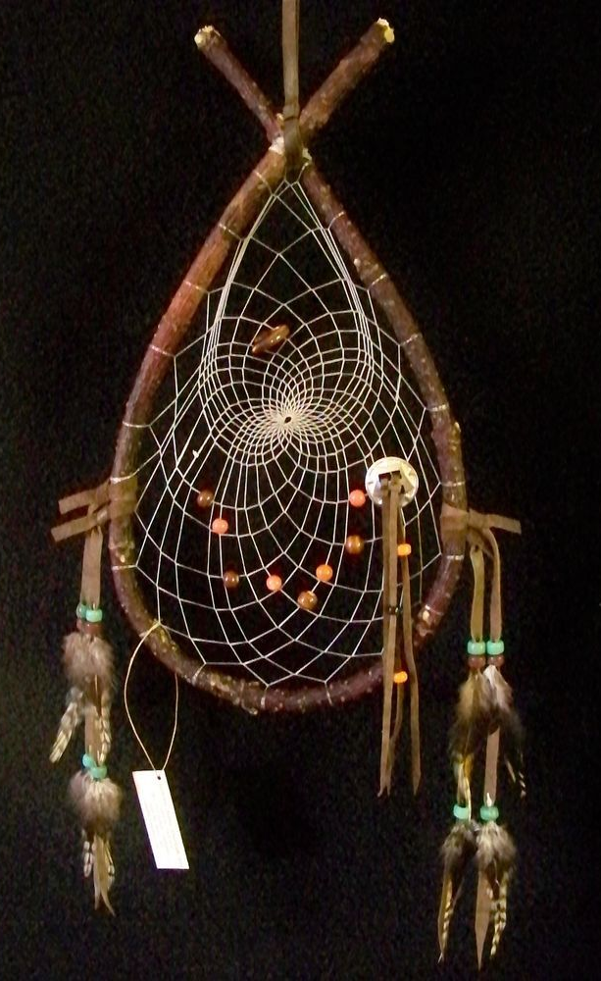
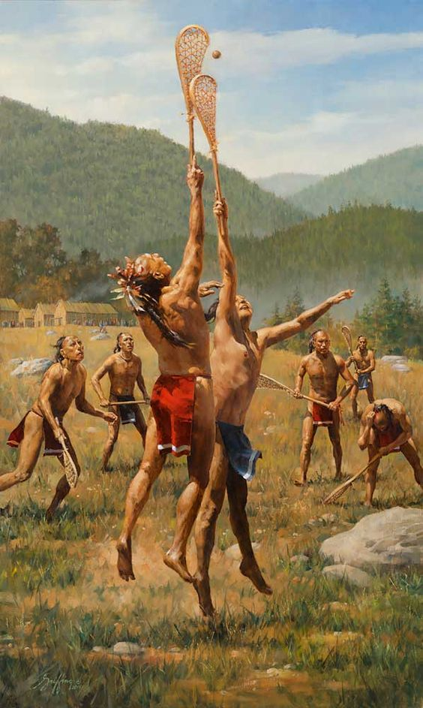
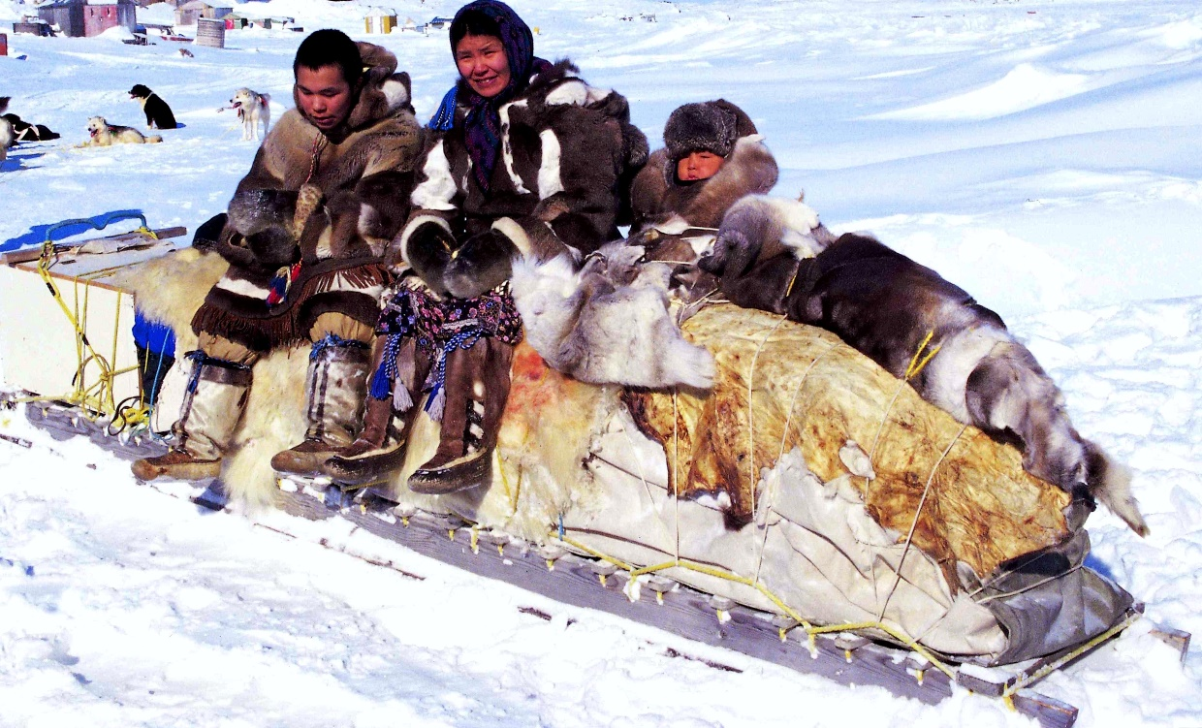
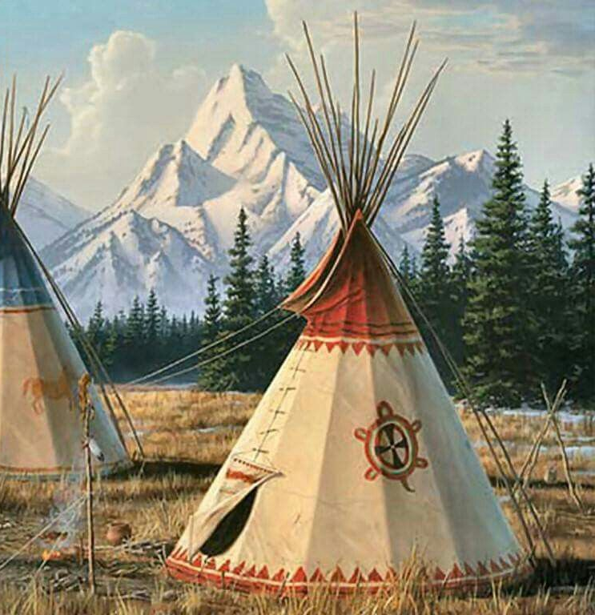

Slide 5
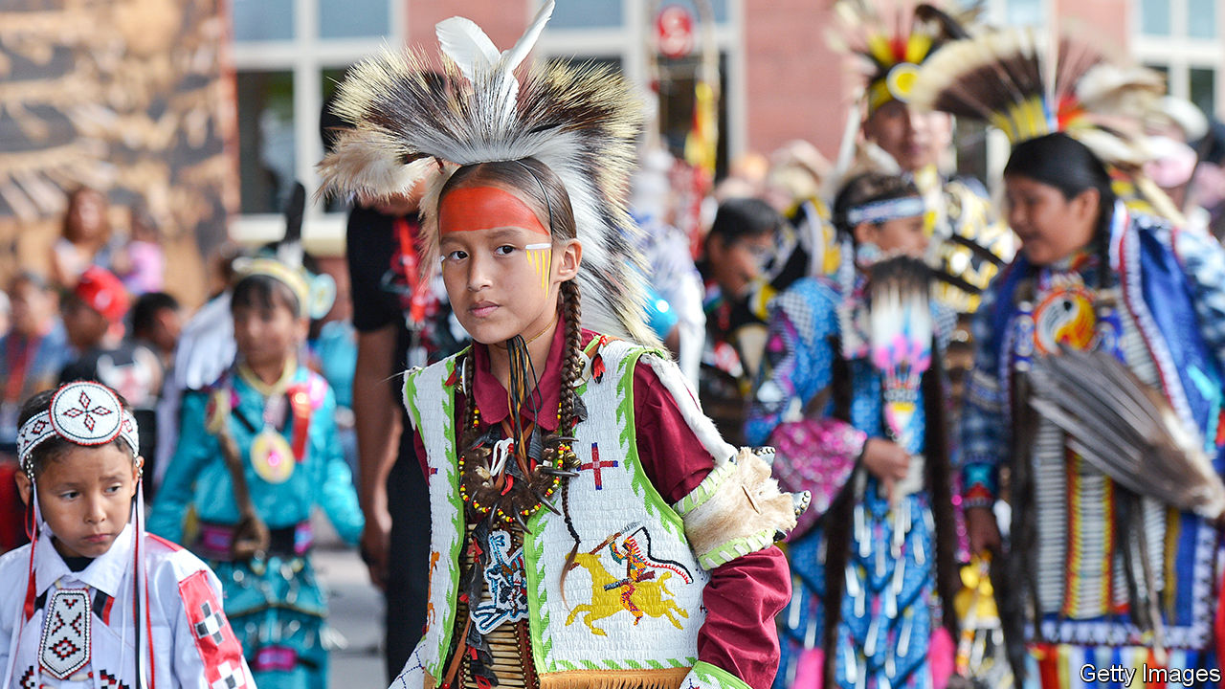

Slide 6
WHEN DID
EUROPEANS
COME TO
CANADA

Slide 7
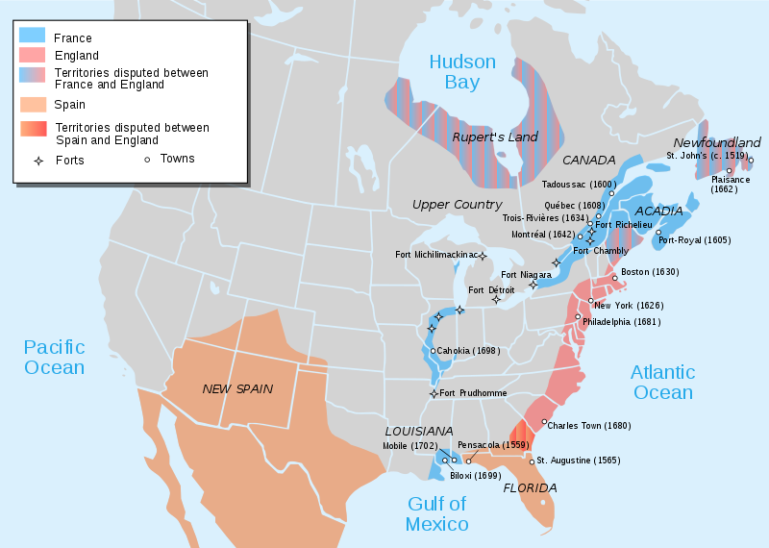

Slide 8
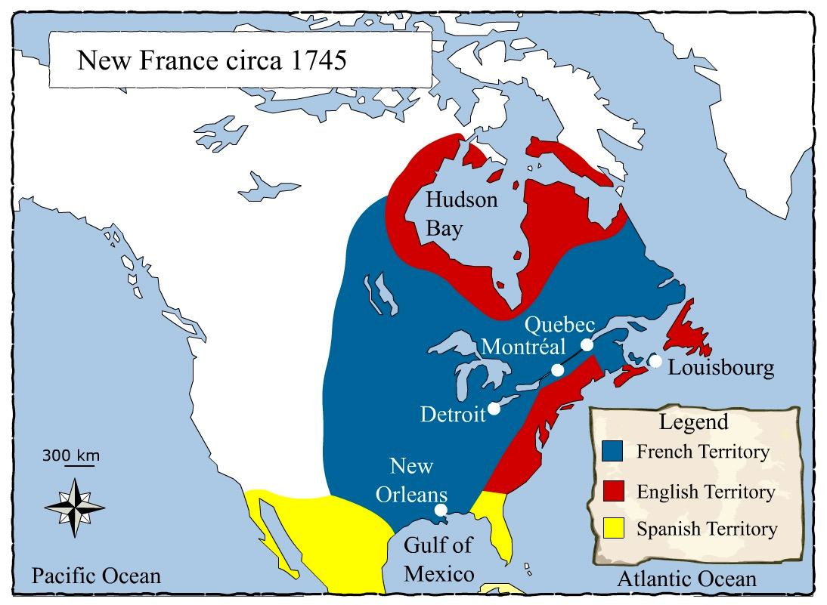

Slide 9
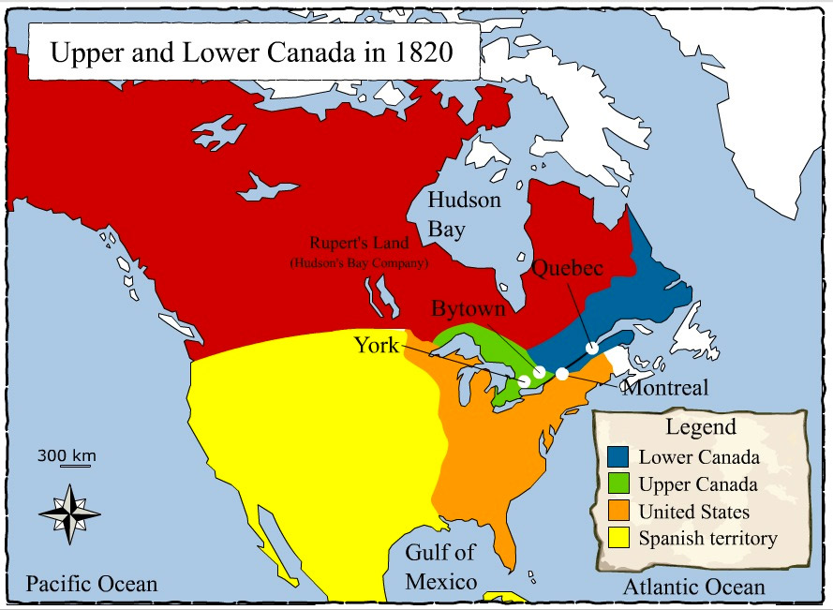

Slide 10
DRAW THE
PROVINCES
AND
TERRITORIES

Slide 11
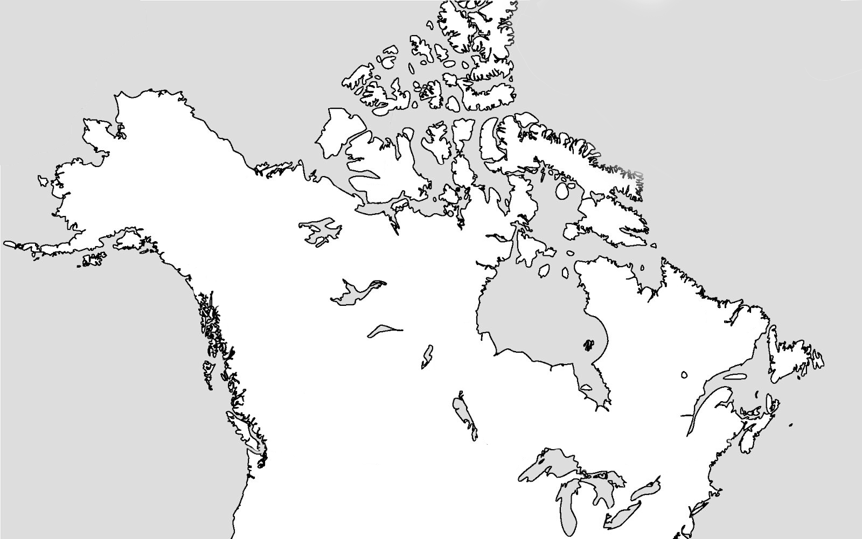

Slide 12
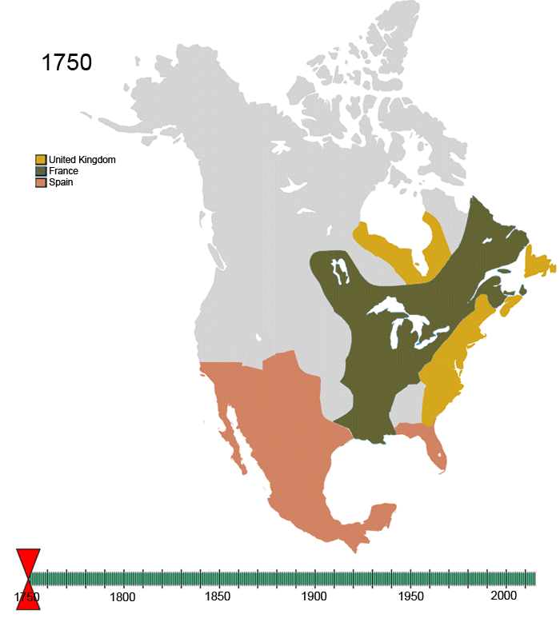

Slide 13
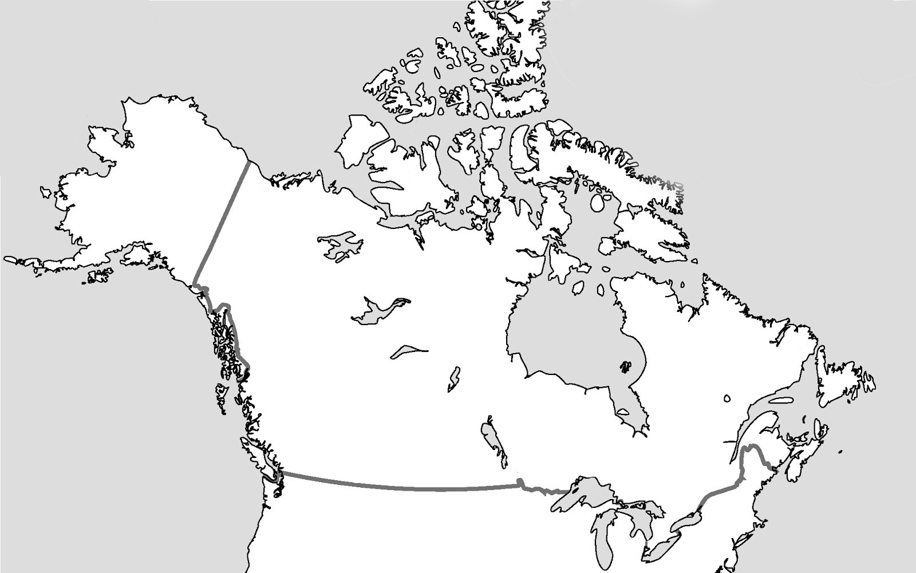

Slide 14
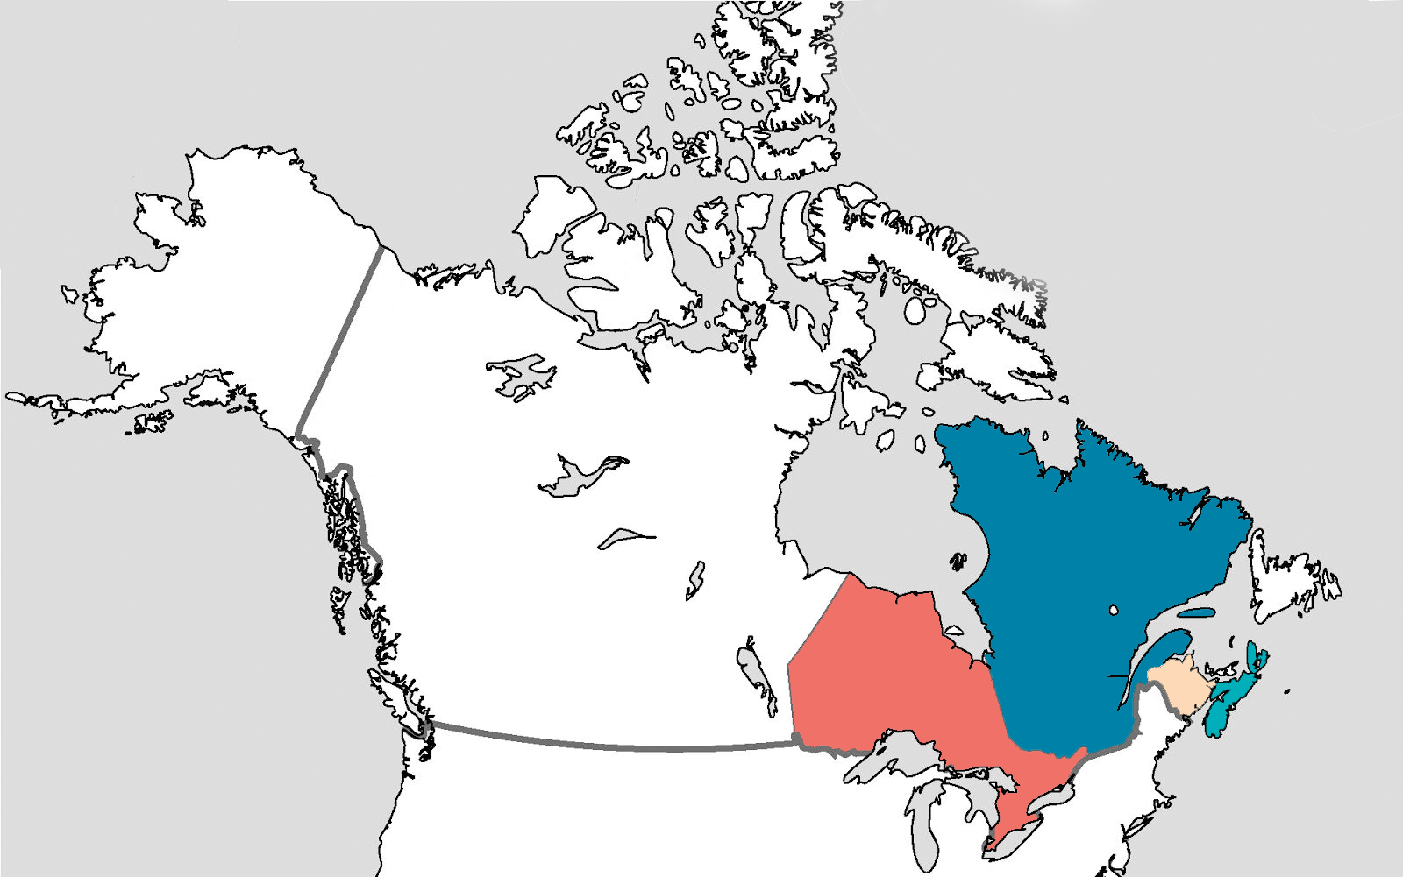
1867
QUEBEC
ONTARIO
NOVA SCOTIA
NEW BRUNSWICK

Slide 15
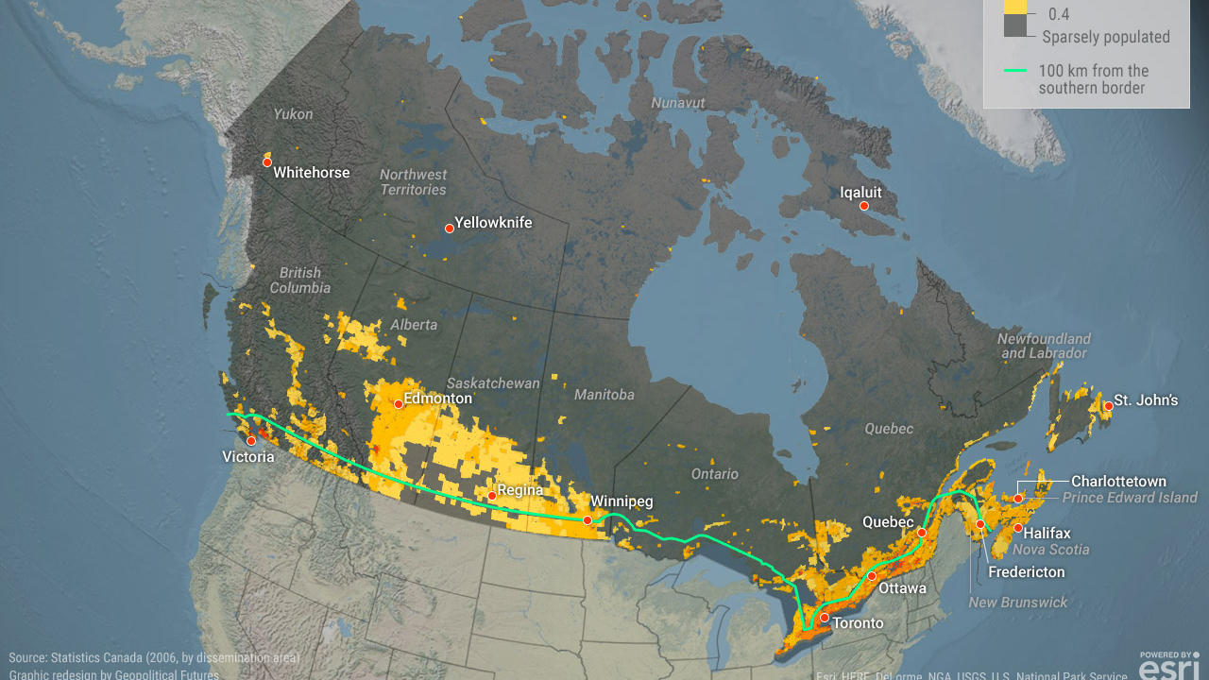

Slide 16
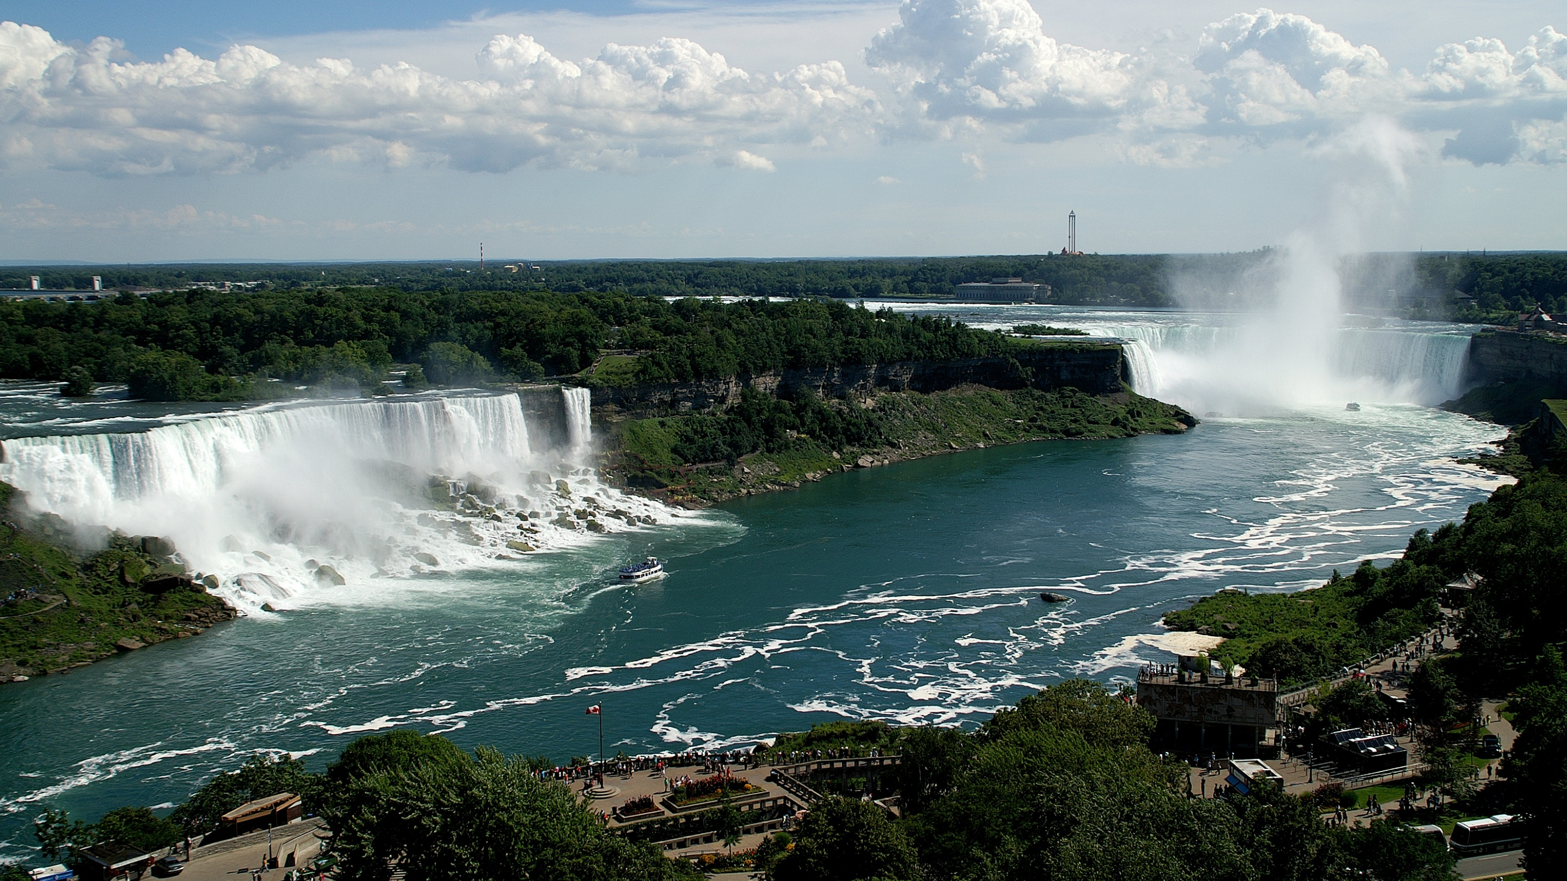
Ontario
Niagara Falls

Slide 17
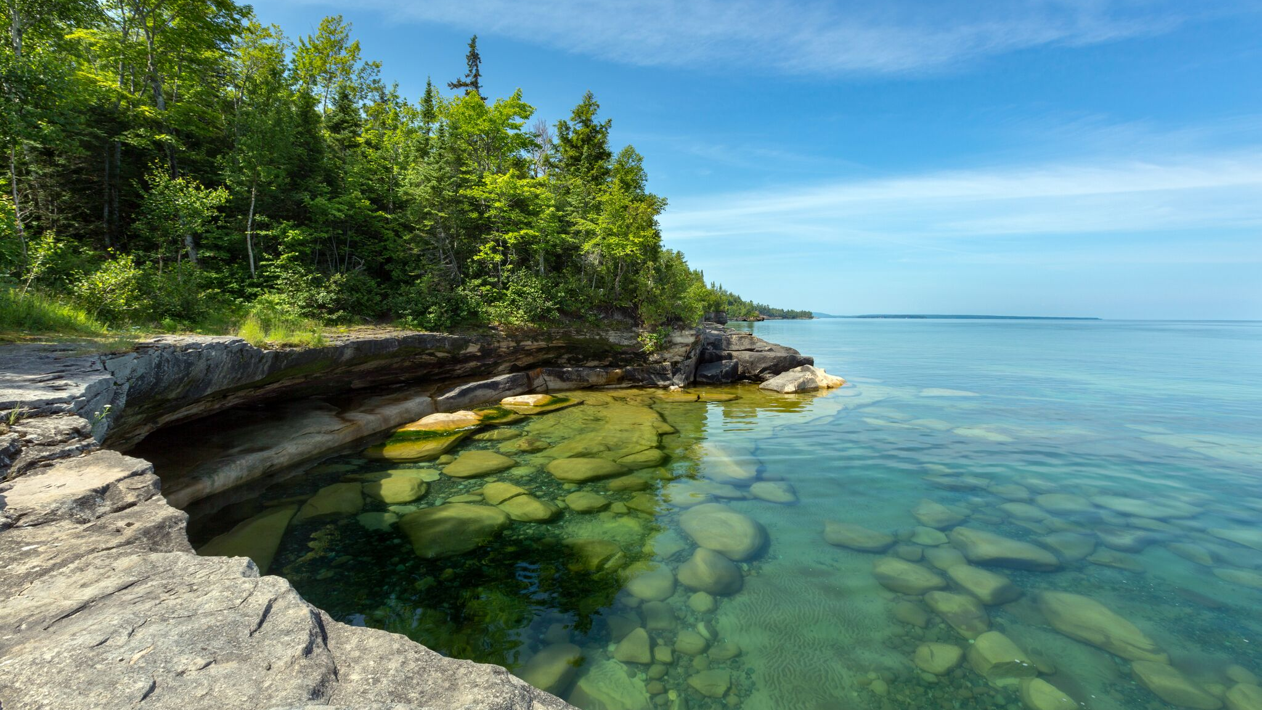
Ontario
Great Lakes

Slide 18
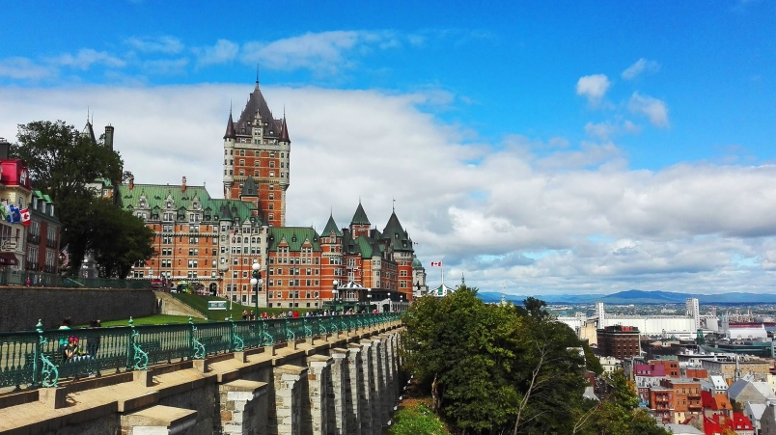
Quebec
French

Slide 19
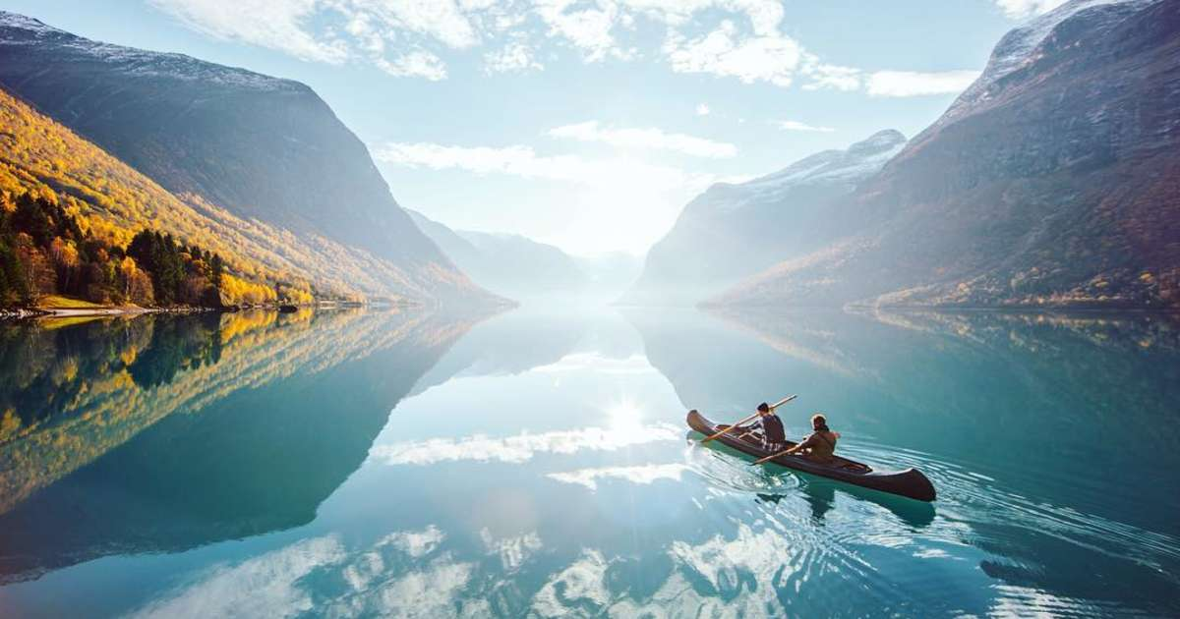
Quebec
The most water

Slide 20
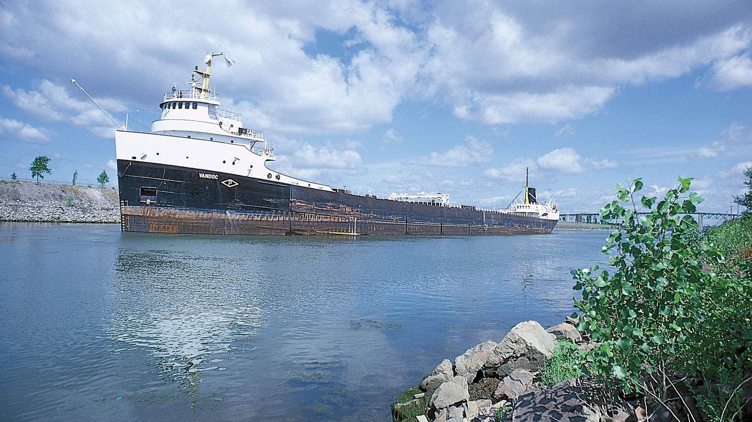
Quebec
Saint Lawrence River

Slide 21
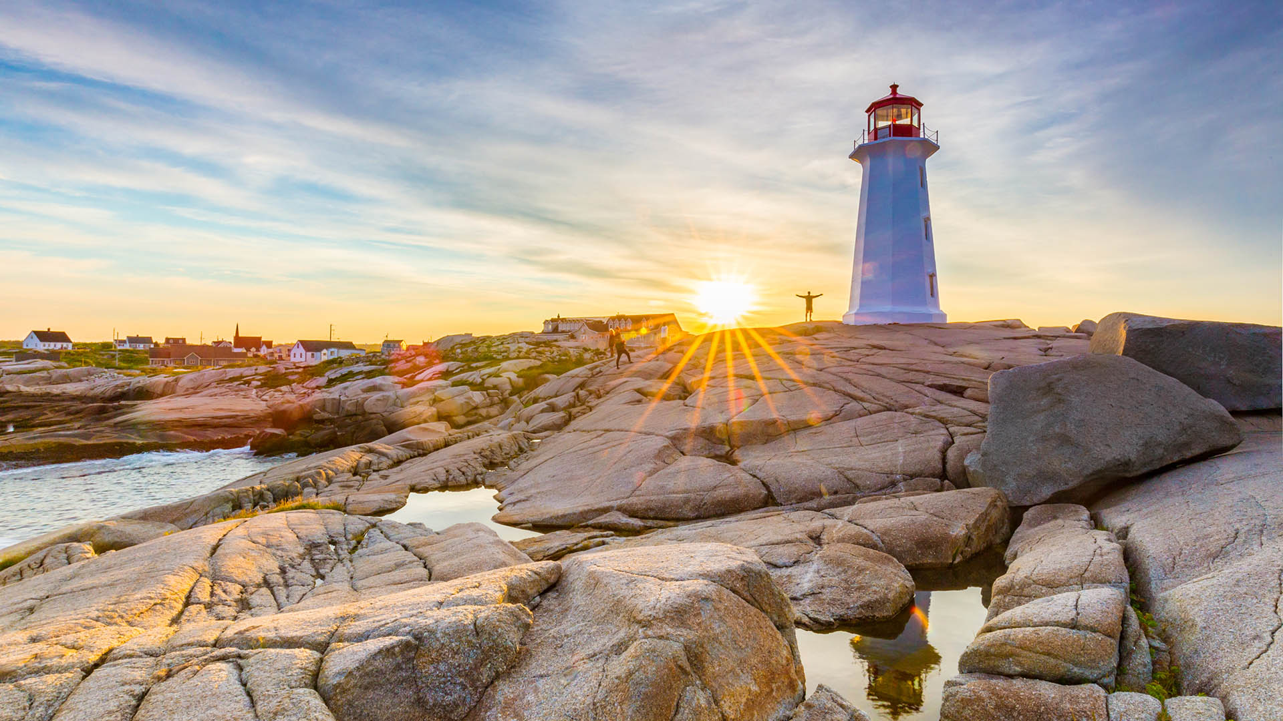
Nova Scotia
Peggy’s Cove

Slide 22
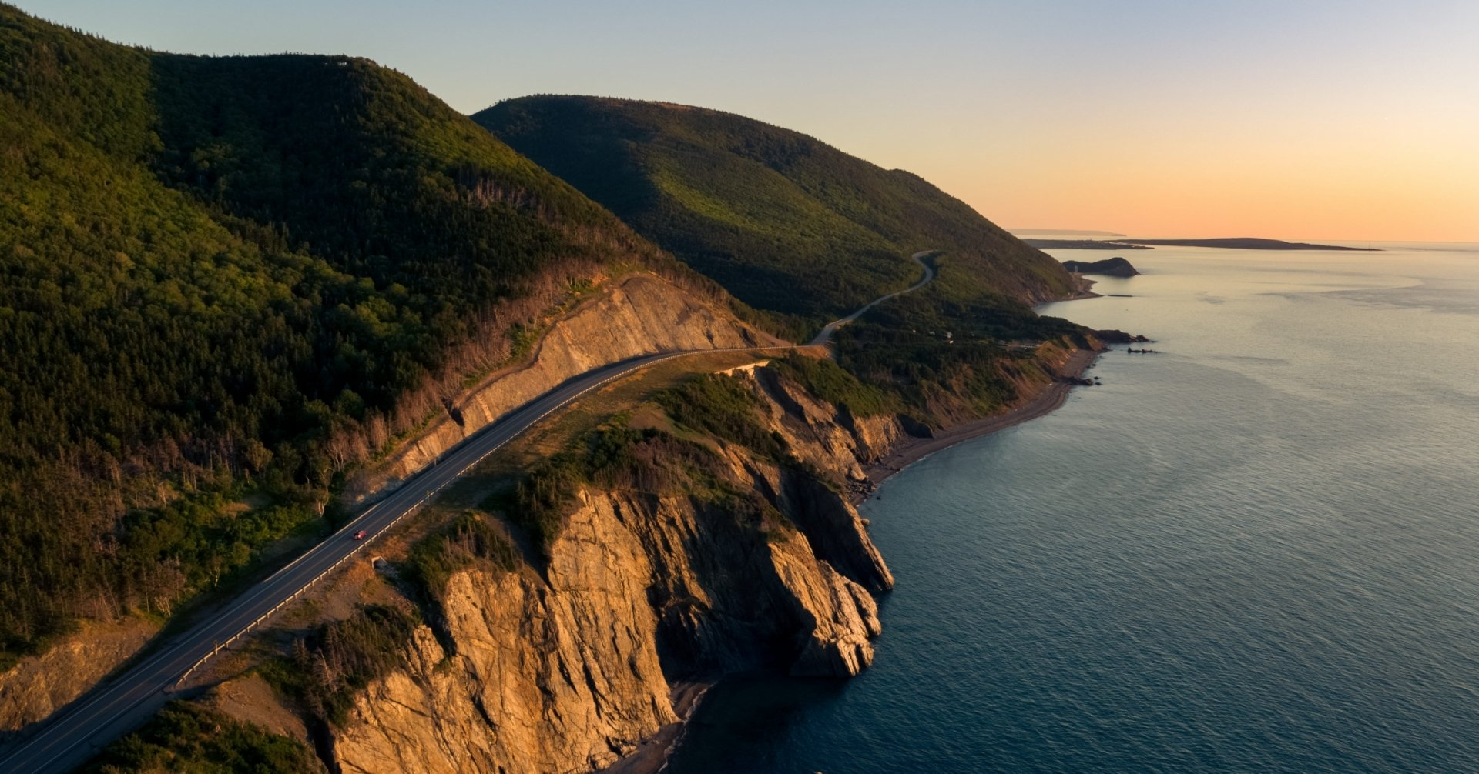
Nova Scotia
Cabot Trail

Slide 23
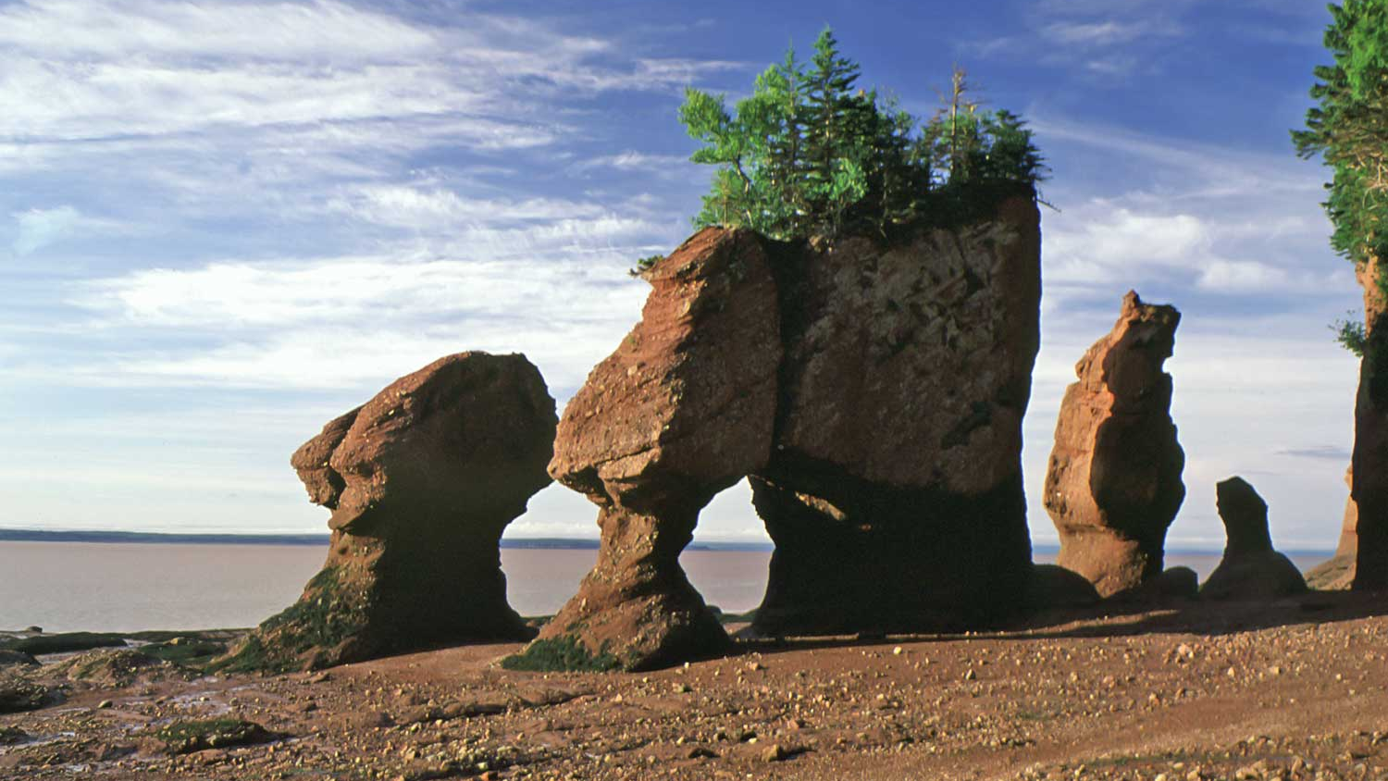
New Brunswick
Bay of Fundy

Slide 24
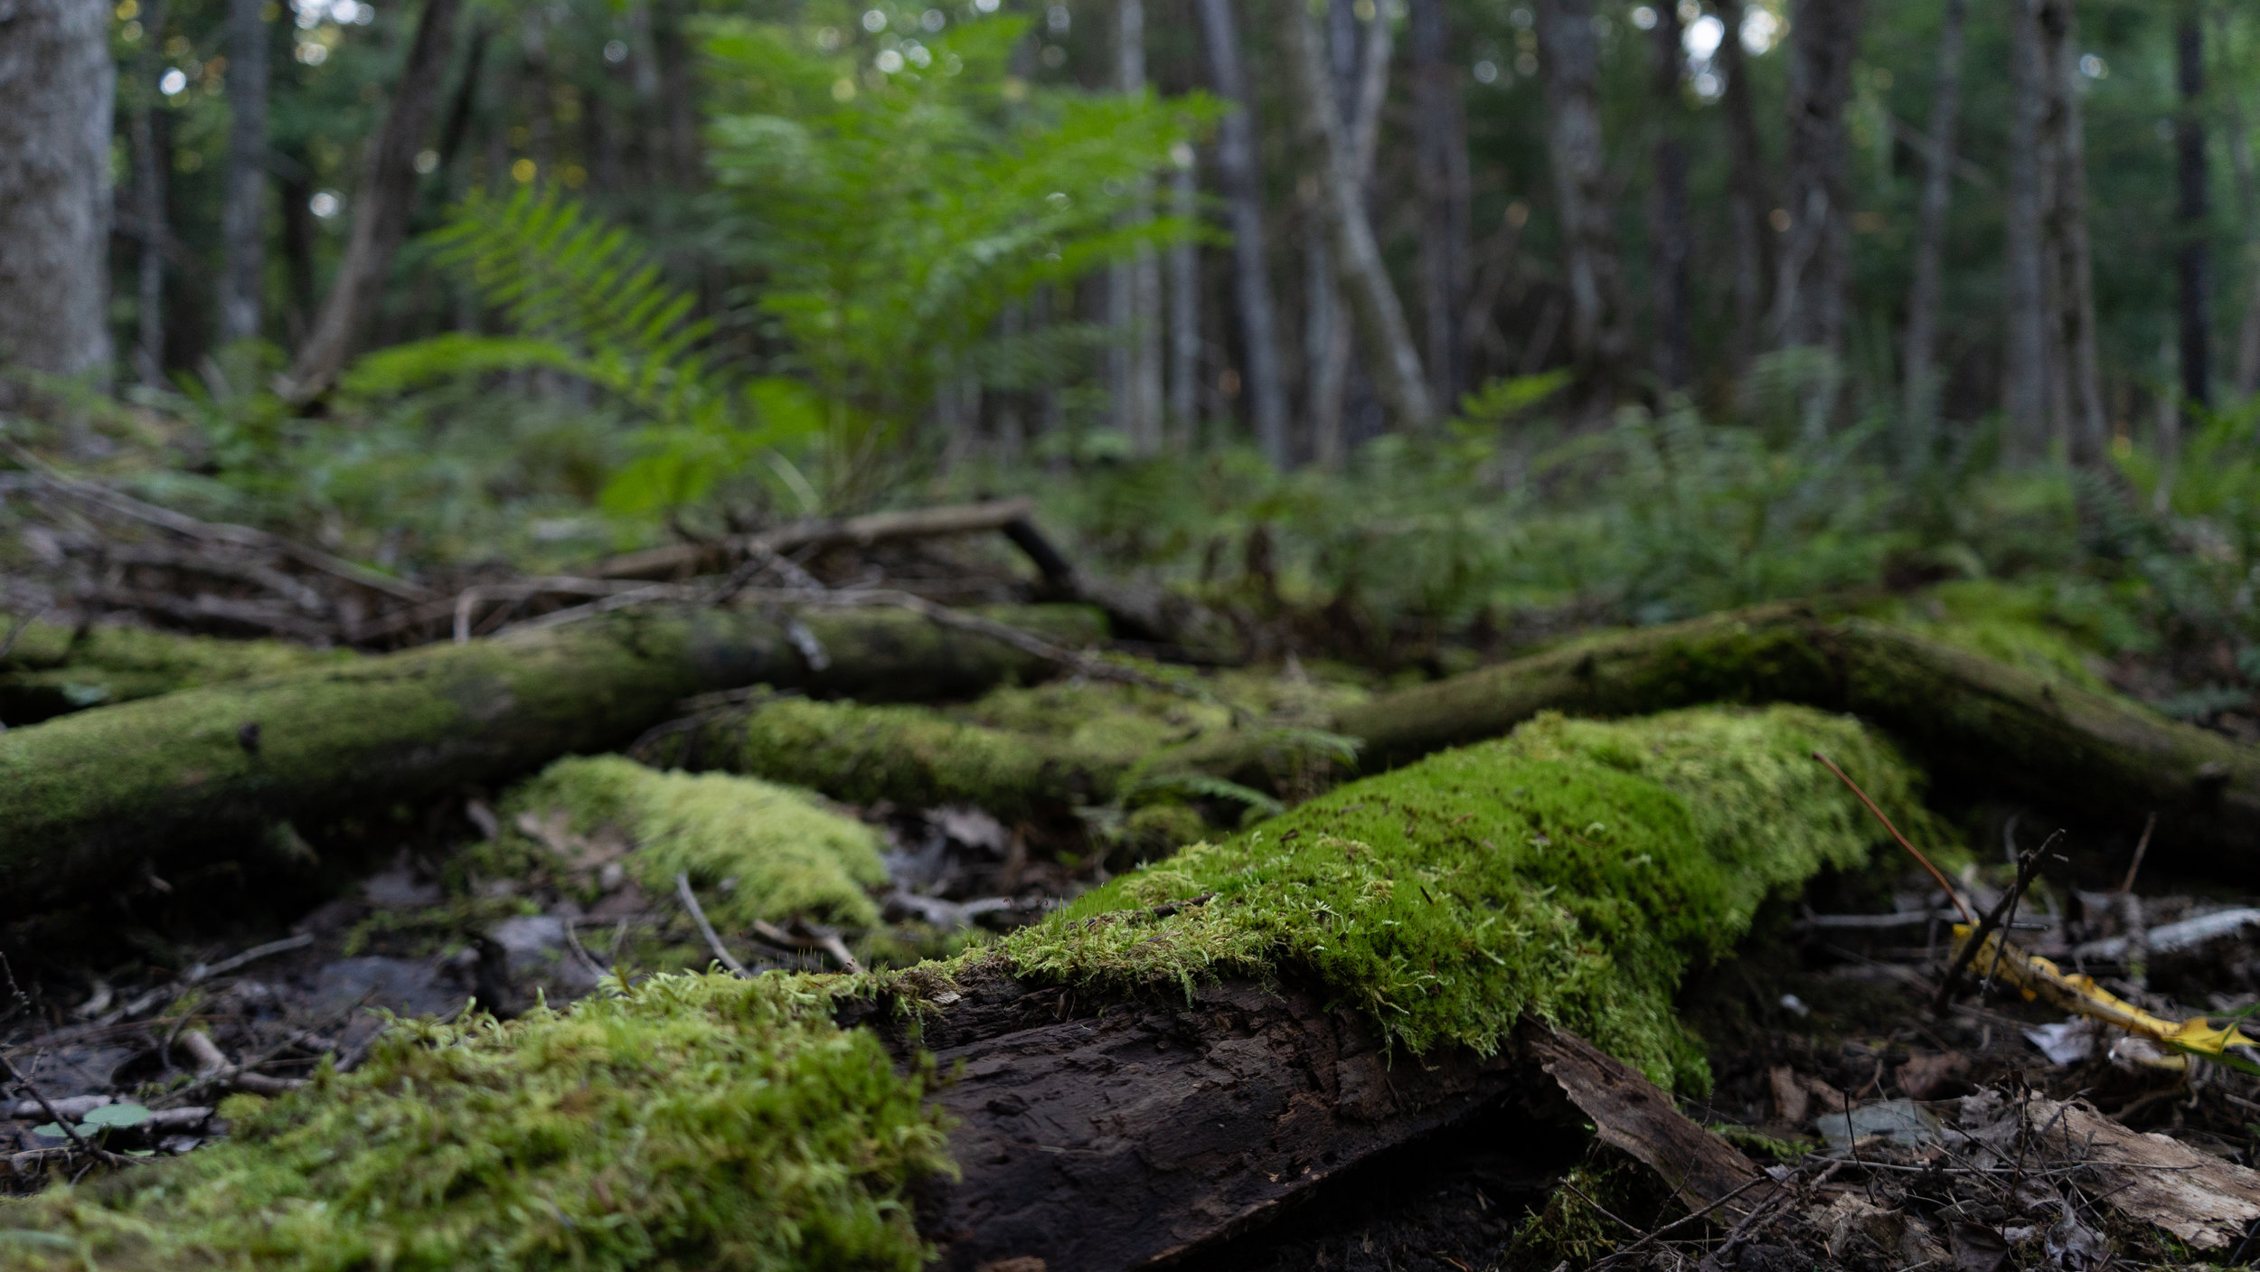
New Brunswick
83% Forest

Slide 25
1870
MANITOBA

Slide 26
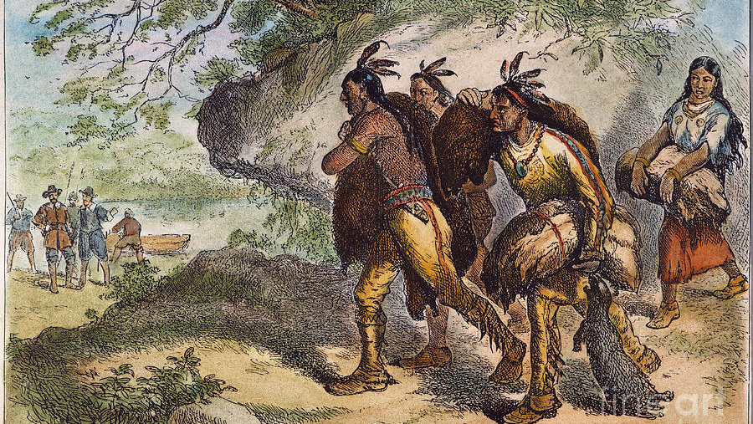
Manitoba
Fur Trade

Slide 27
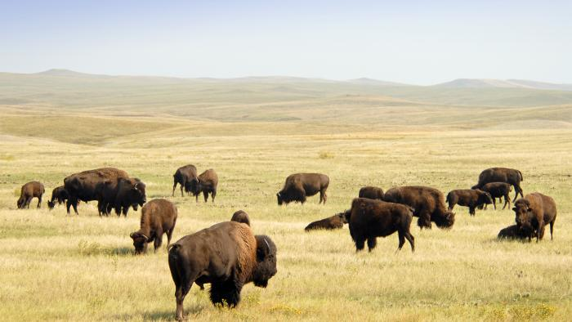
Manitoba
Bison

Slide 28
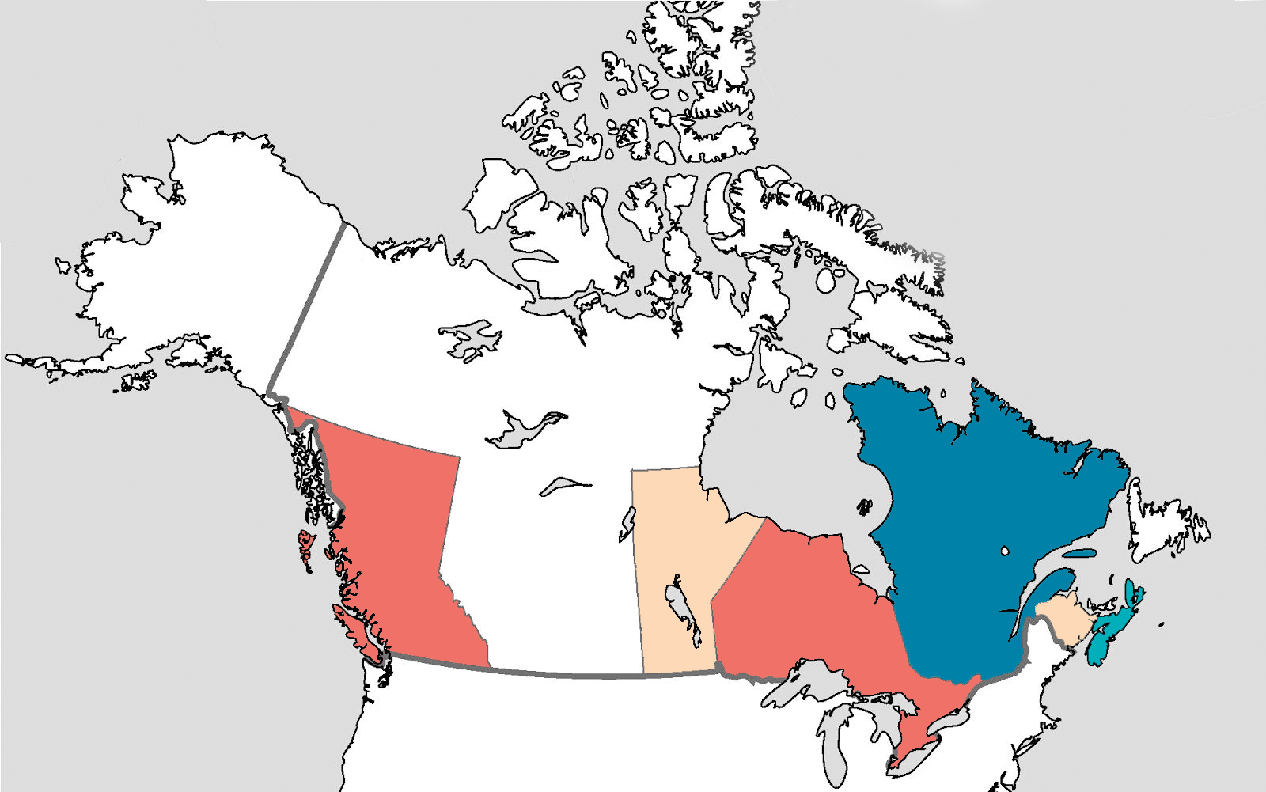
1871
BRITISH
COLUMBIA

Slide 29
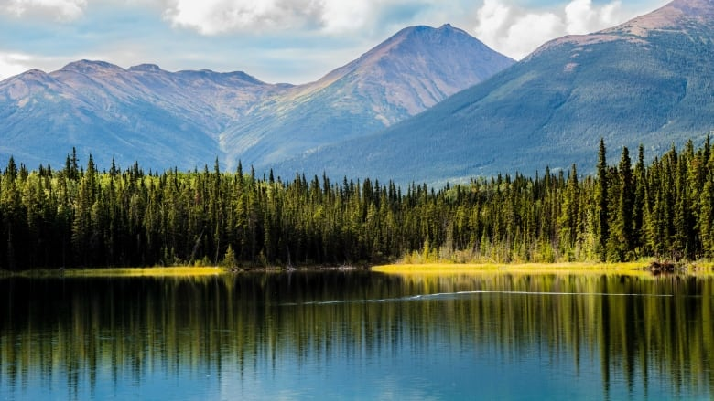
British Columbia
Weather

Slide 30
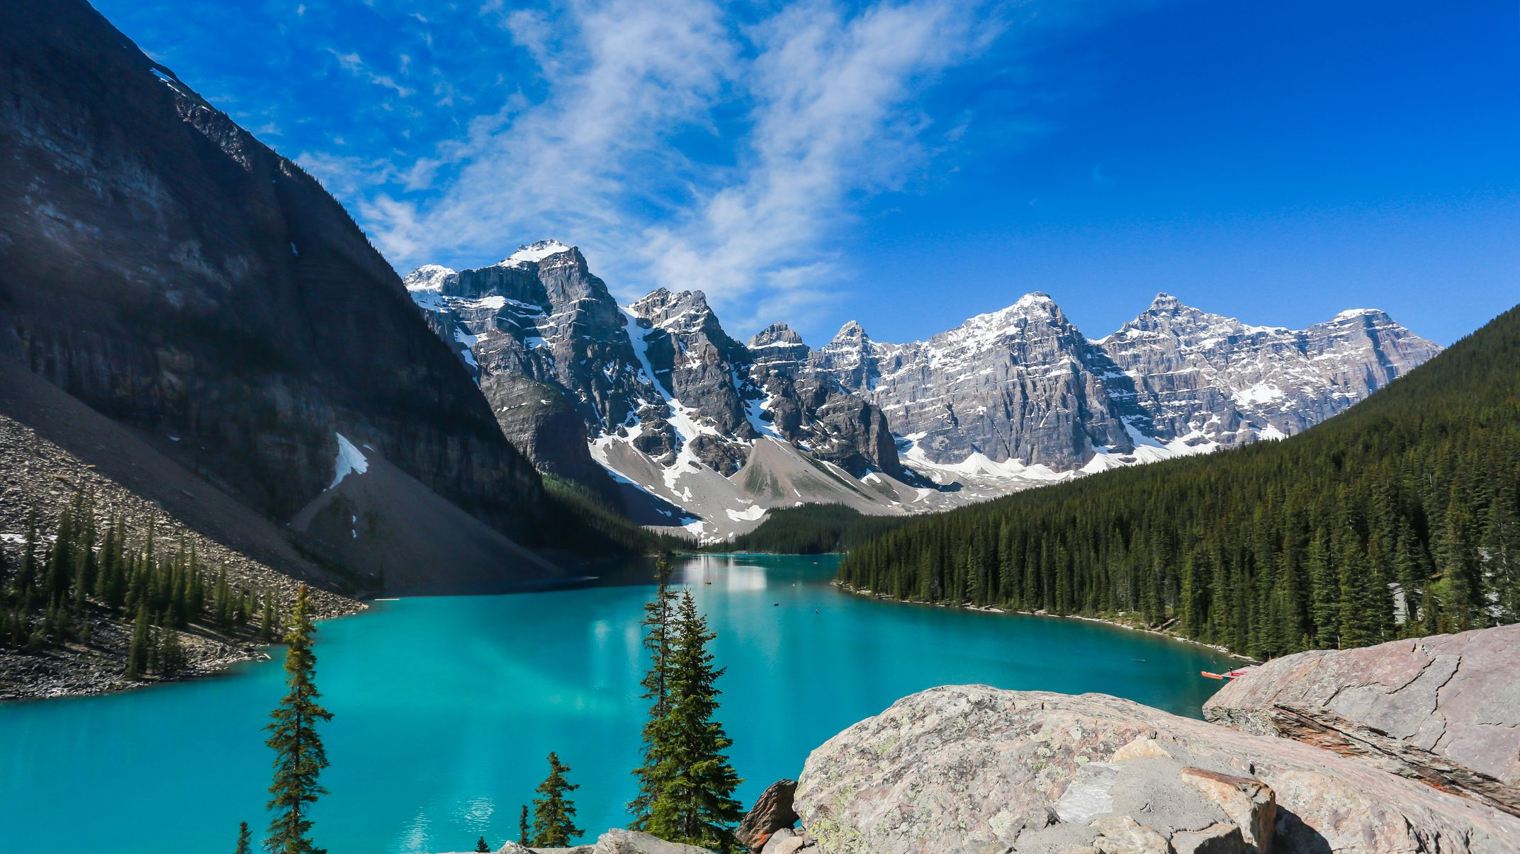
British Columbia
Rocky Mountains

Slide 31
British Columbia
Vegetarians

Slide 32
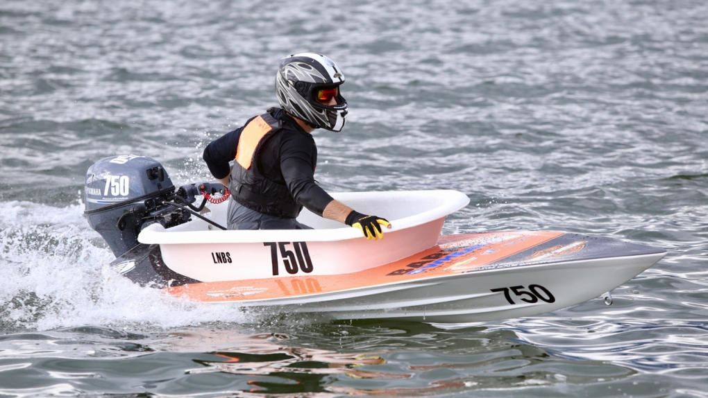
British Columbia
Bathtub Races

Slide 33
1873
PRINCE
EDWARD
ISLAND

Slide 34
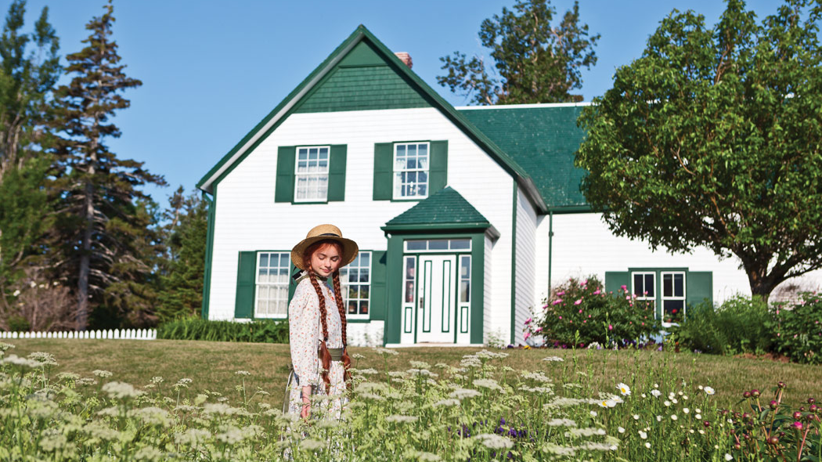
Prince Edward Island
Anne of Green Gables

Slide 35
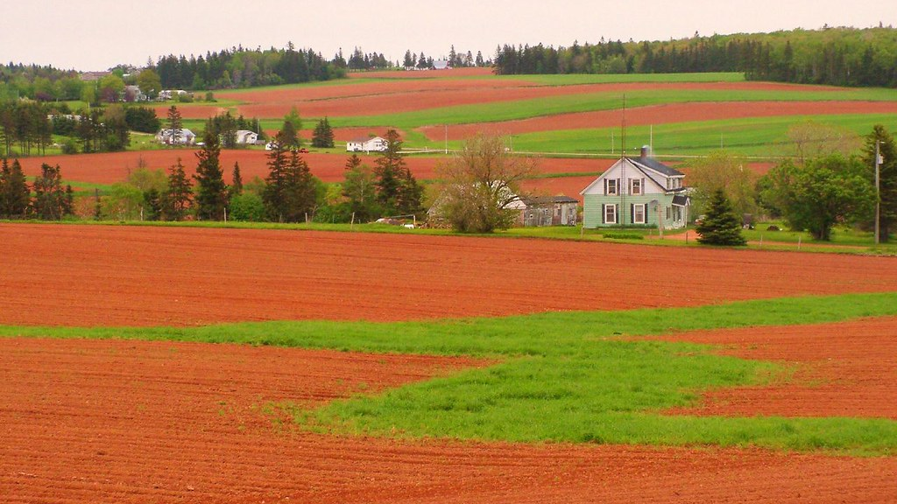
Prince Edward Island
Red Soil / Potatoes

Slide 36
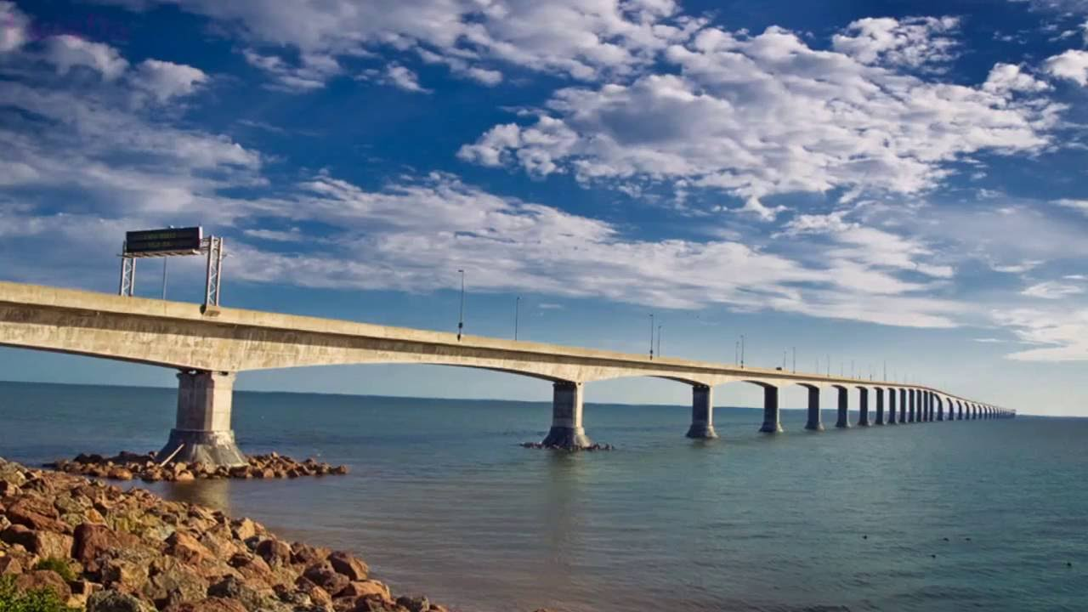
Prince Edward Island
Confederation Bridge

Slide 37
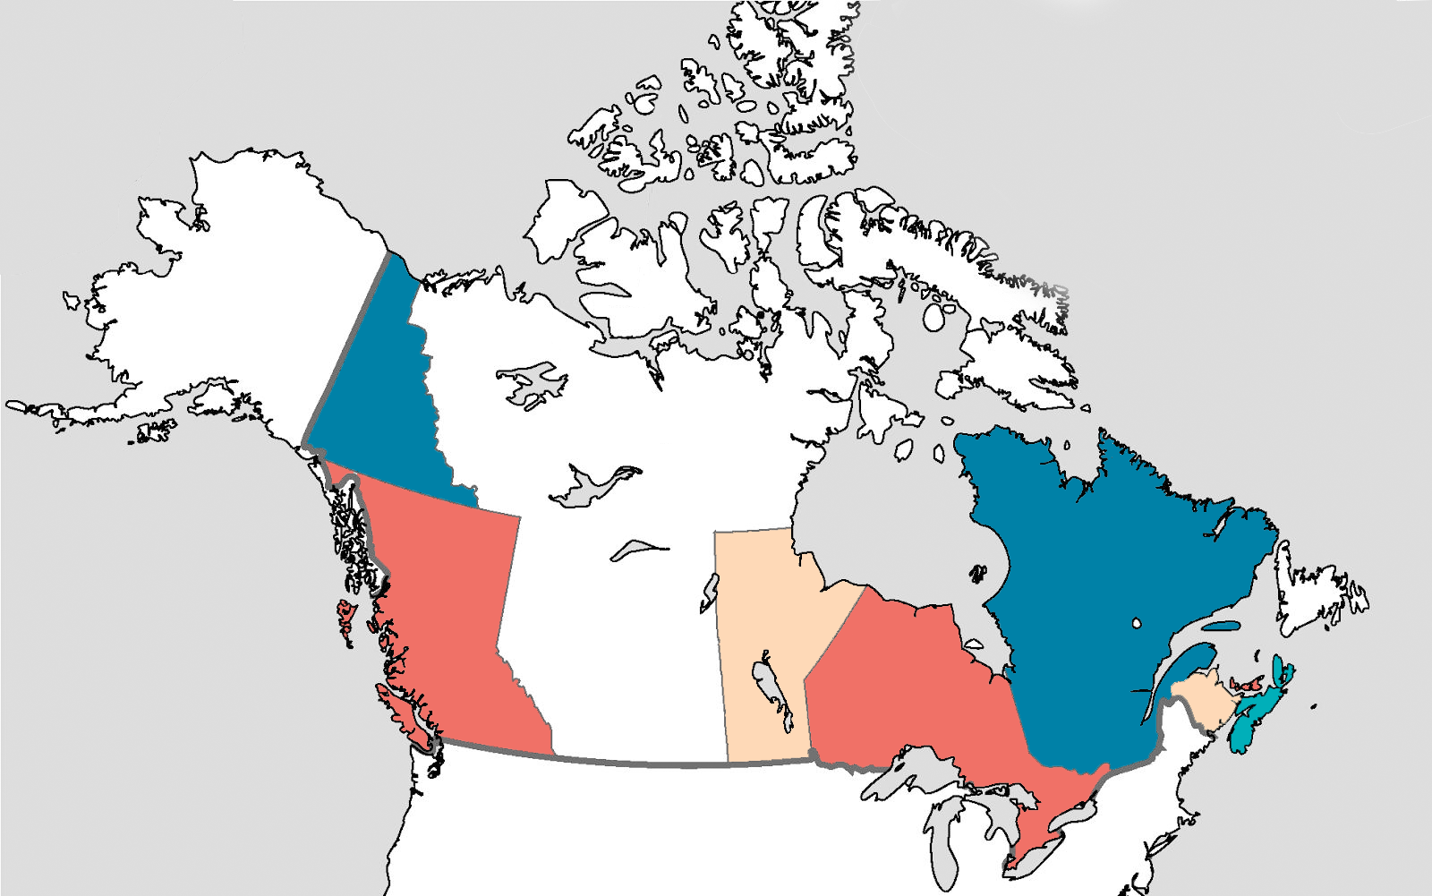
1898
YUKON

Slide 38
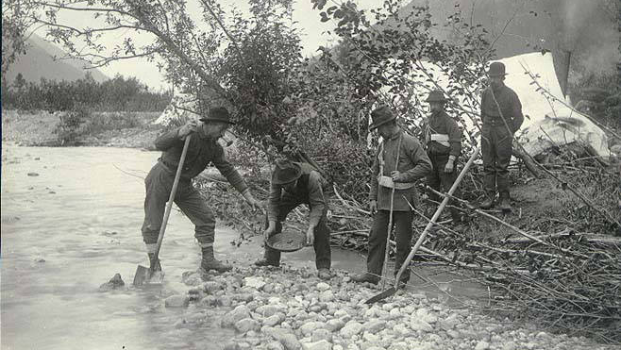
Yukon
Gold Rush

Slide 39
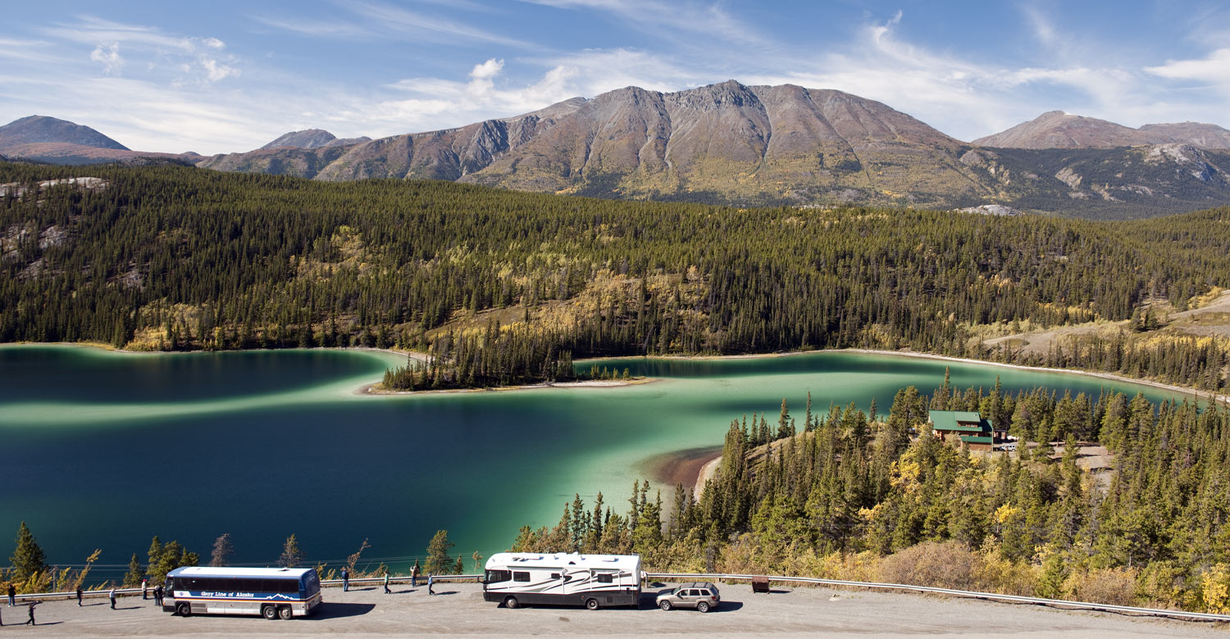
Least Inhabited
Yukon

Slide 40
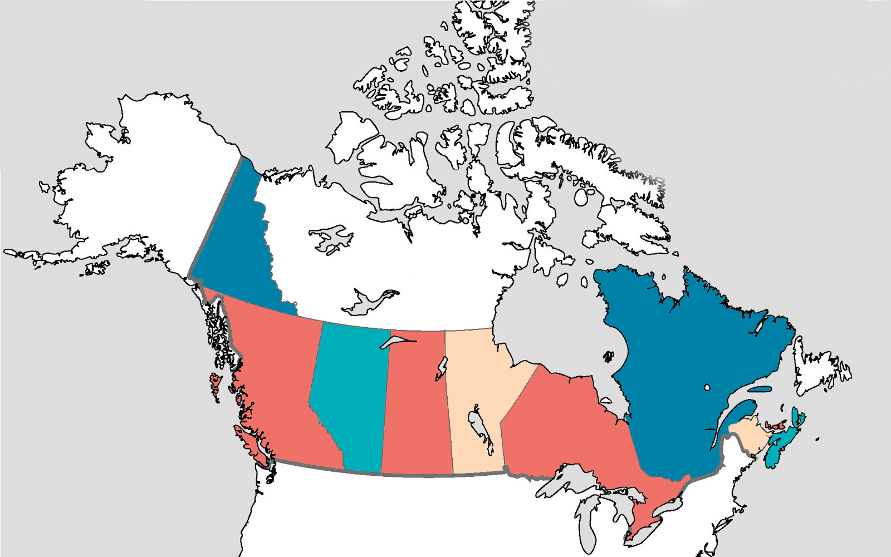
1905
ALBERTA
SASKATCHEWAN

Slide 41
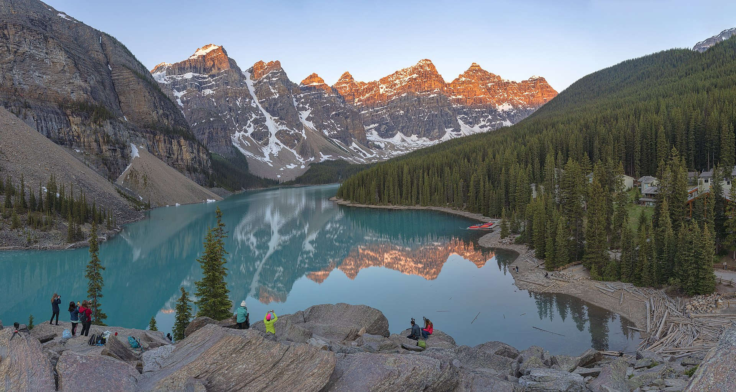
Alberta
Banff

Slide 42
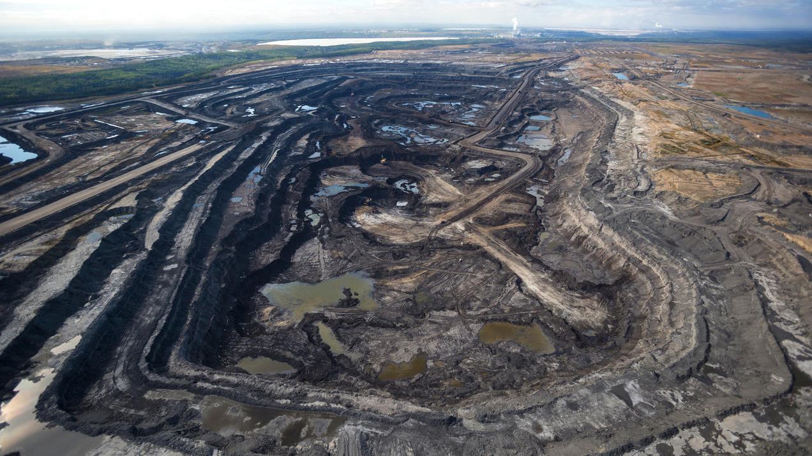
Alberta
Oil Sands

Slide 43
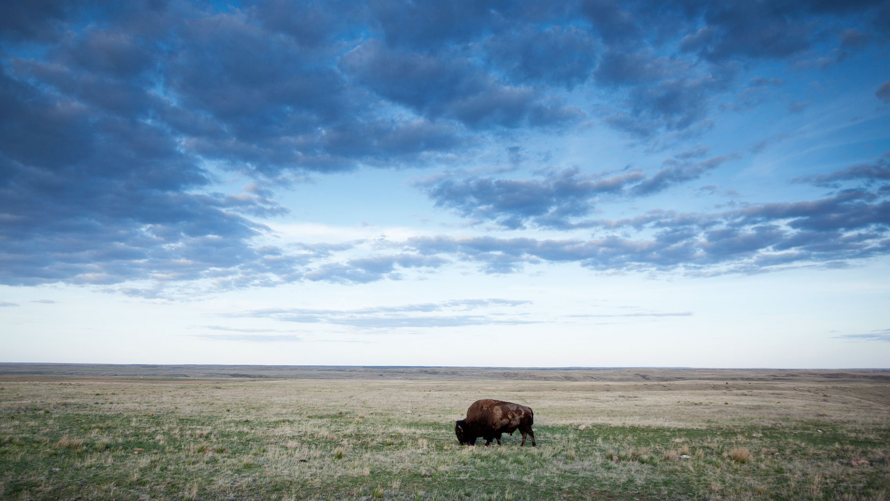
Prairies

Slide 44
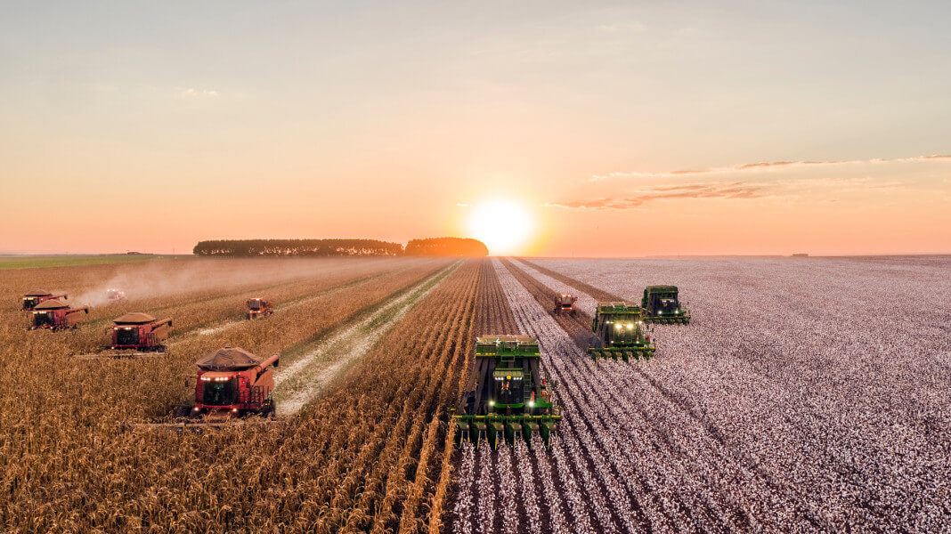
Saskatchewan
Farming

Slide 45
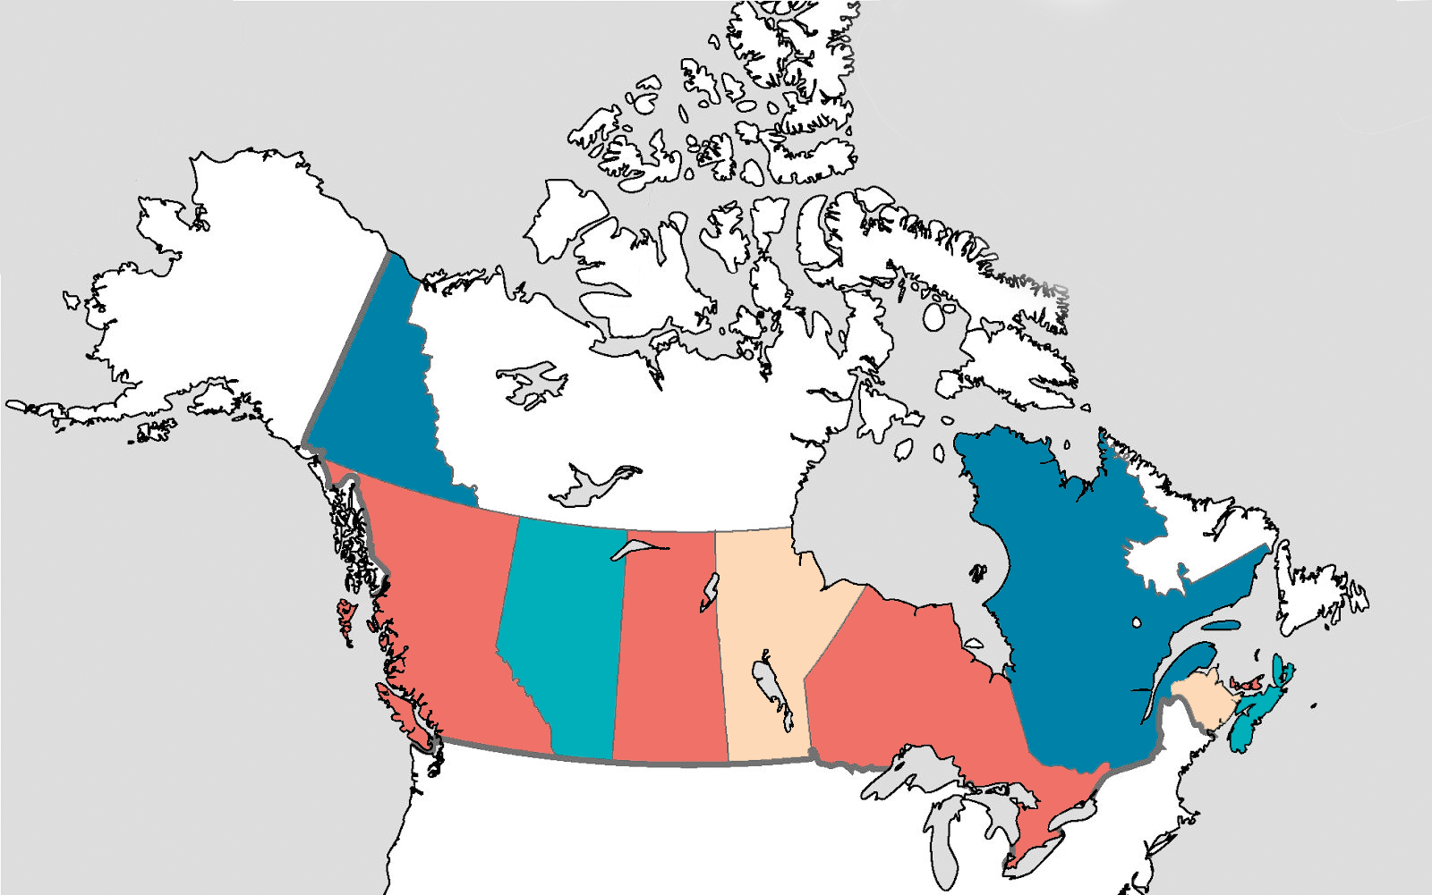
1927
LABRADOR

Slide 46
1949
NEWFOUNDLAND

Slide 47
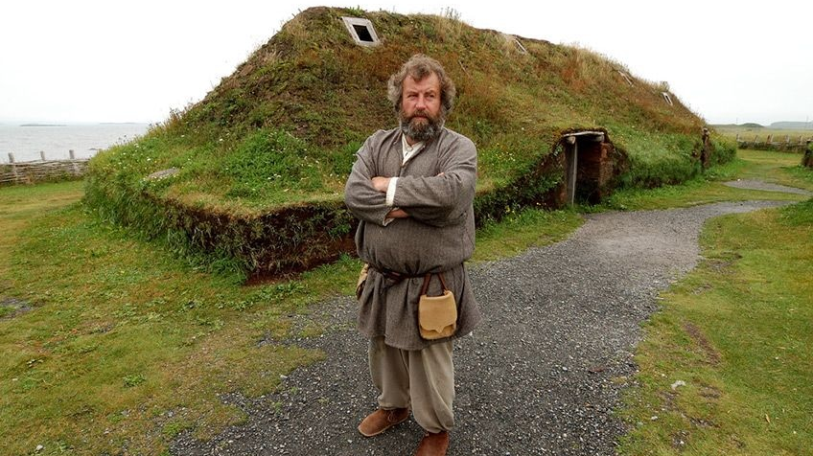
Newfoundland
Vikings Settlement

Slide 48
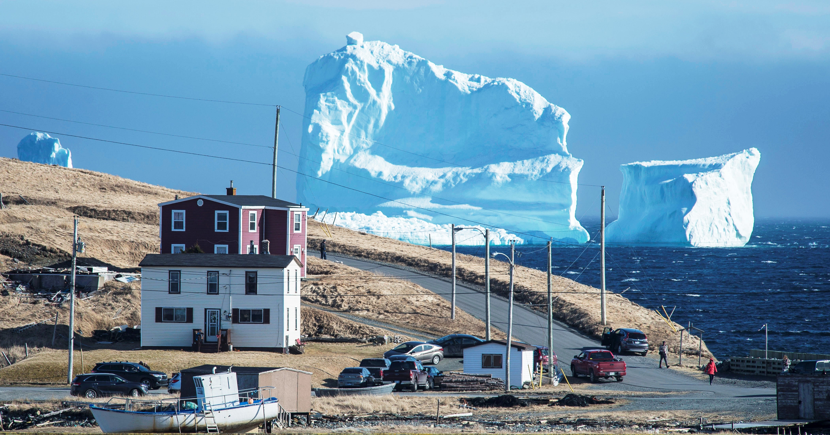
Newfoundland
Iceberg Alley

Slide 49
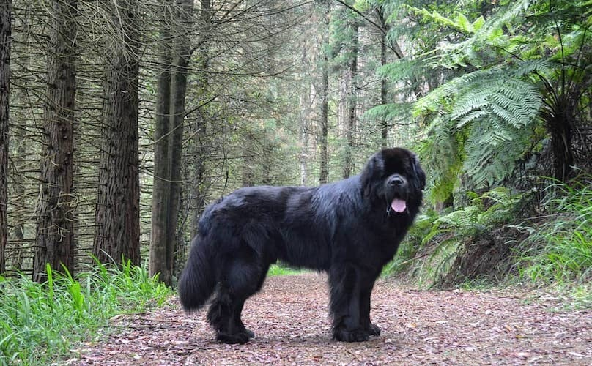
Newfoundland
Dog

Slide 50
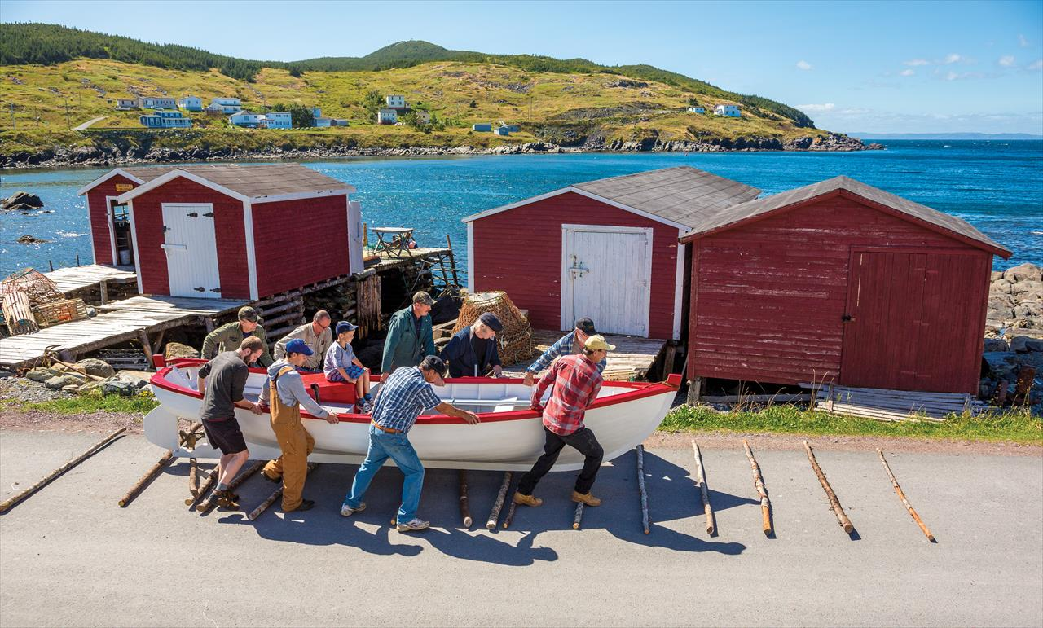
Newfoundland
Culture

Slide 51
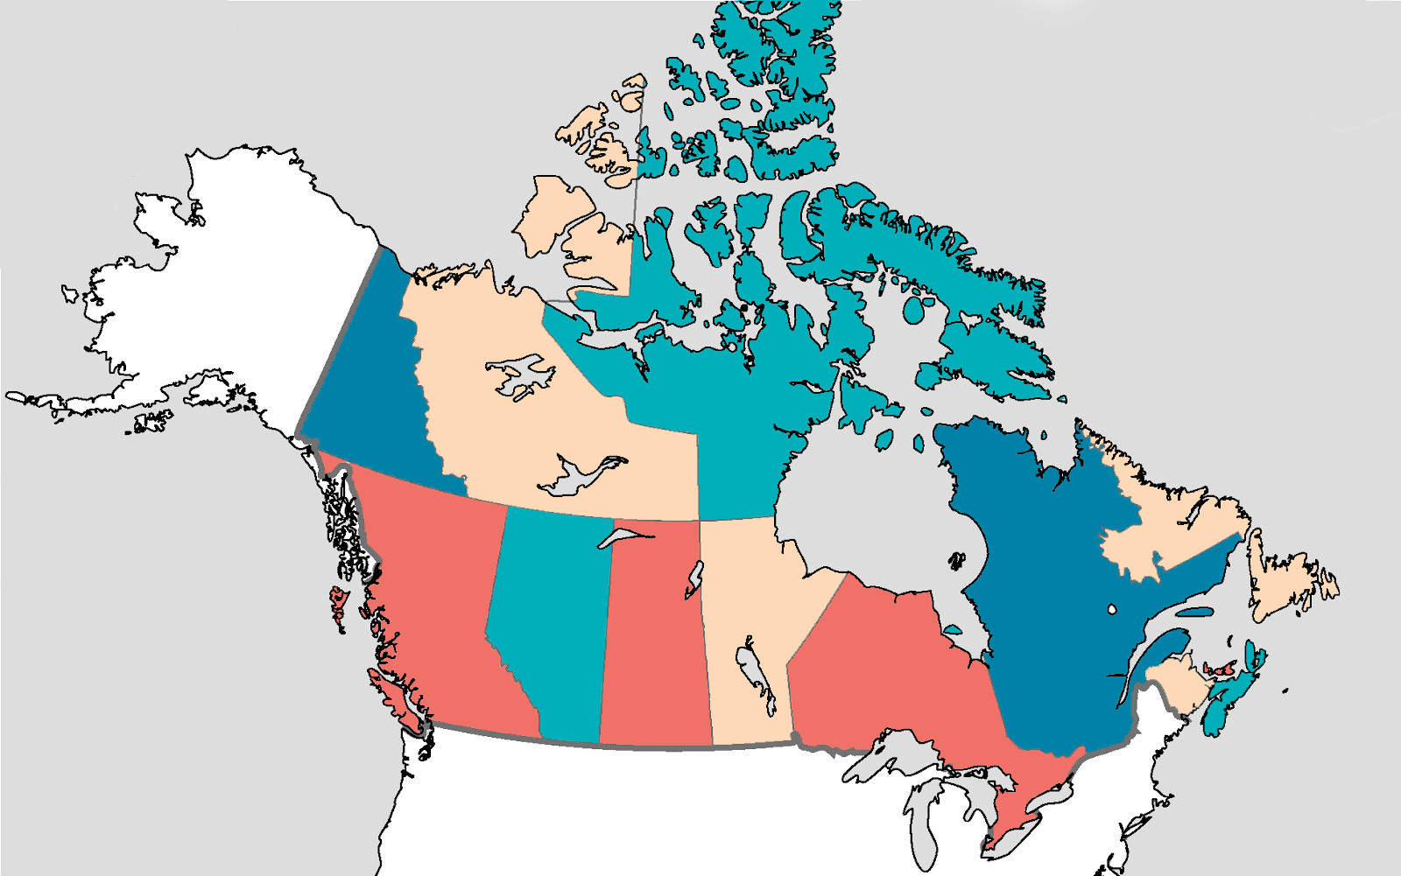
1999
NORTHWEST
TERRITORY
NUNAVUT

Slide 52
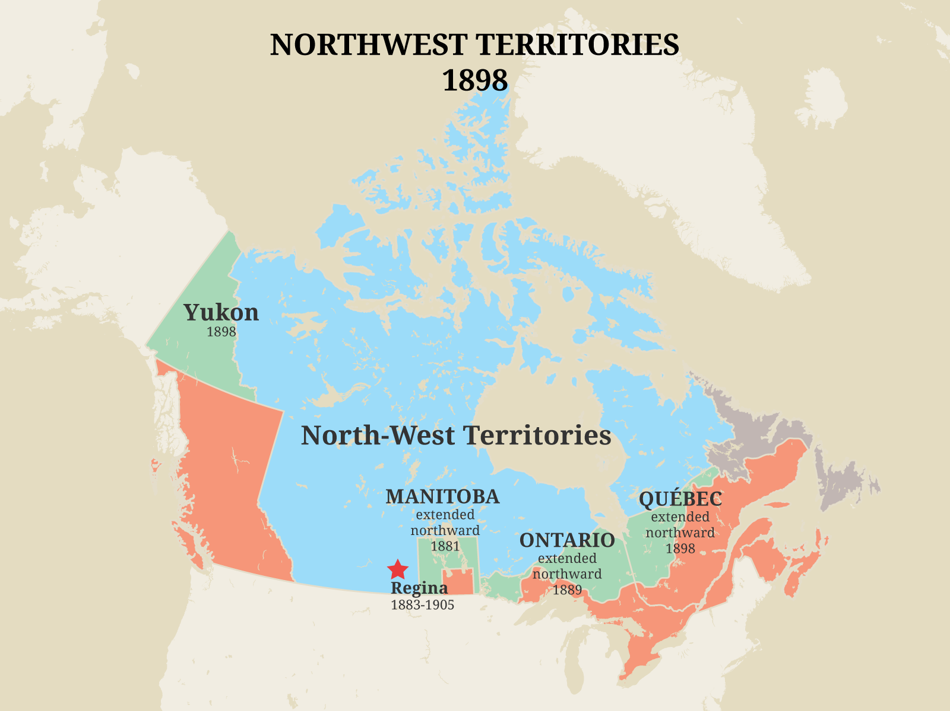

Slide 53
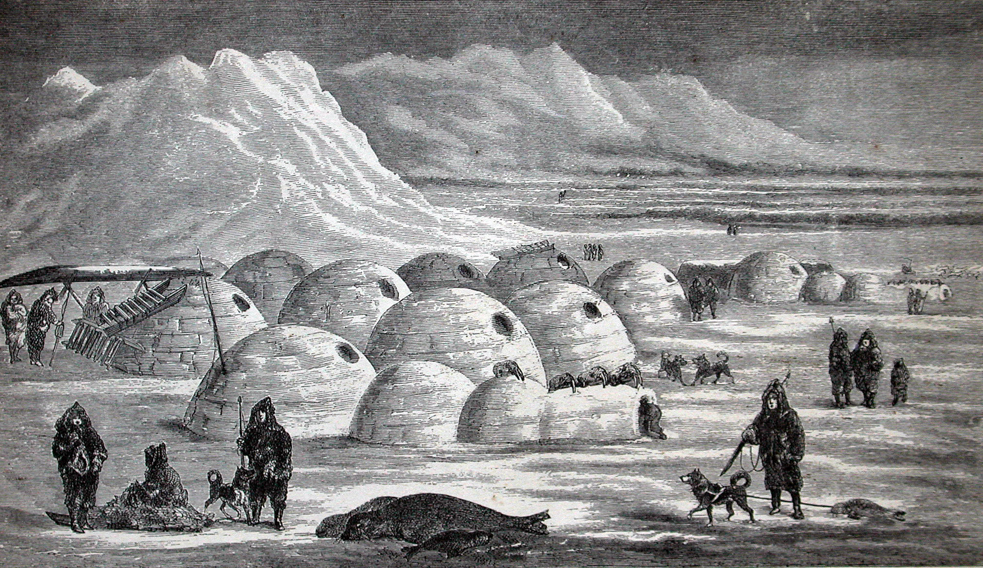
Northwest Territories
Inuit

Slide 54
Nunavut
Inukshuk

Slide 55
Nunavut
Aurora Borealis

Slide 56
PUT
STICKERS
ON THE
CITIES

Slide 57
Ottawa

Slide 58
OTTAWA

Slide 60
Toronto

Slide 61
TORONTO

Slide 63
Quebec
City

Slide 64
QUEBEC
CITY

Slide 66
Vancouver

Slide 67
VANCOUVER

Slide 69
Niagara Falls

Slide 70
NIAGARA
FALLS

Slide 72
CHURCHILL

Slide 73
CHURCHILL

Slide 75
Edmonton

Slide 76
EDMONTON

Slide 78
Calgary

Slide 79
CALGARY

Slide 81
Montreal

Slide 82
MONTREAL

Slide 84
Whistler

Slide 85
WHISTLER

Slide 87
Halifax

Slide 88
HALIFAX

Slide 90
Winnipeg

Slide 91
WINNIPEG

Slide 92
ALERT

Slide 93
ALERT

Slide 94
ALERT

Slide 95
Saint Johns

Slide 96
SAINT
JOHNS

Slide 97
SAINT
JOHNS

Slide 98
Lake Louise

Slide 99
LAKE
LOUISE

Slide 101
Yellowknife

Slide 102
YELLOWKNIFE

Slide 104
YUKON
NORTHWEST
TERRITORY
NUNAVUT
NEWFOUNDLAND
BRITISH
COLUMBIA
ALBERTA
MANITOBA
QUEBEC
SASKATCHEWAN
PRINCE
EDWARD
ISLAND
ONTARIO
NOVA SCOTIA
NEW BRUNSWICK

Slide 105
https://create.kahoot.it/share/enter-kahoot-title/334ab049-eece-45d1-8393-43a371ee56f0

