Slide 1
Christmas

Slide 2
Brainstorm
List as many Christmas things as you can think of.

Slide 3
Candy Cane

Slide 4
Jingle Bells

Slide 5
Santa

Slide 6
Christmas Tree

Slide 7
gift

Slide 8
Snowman

Slide 9
Reindeer

Slide 10
North Pole

Slide 11
mistletoe

Slide 12
Elf

Slide 13
Ornaments

Slide 14
Gingerbread

Slide 15
Stocking

Slide 16
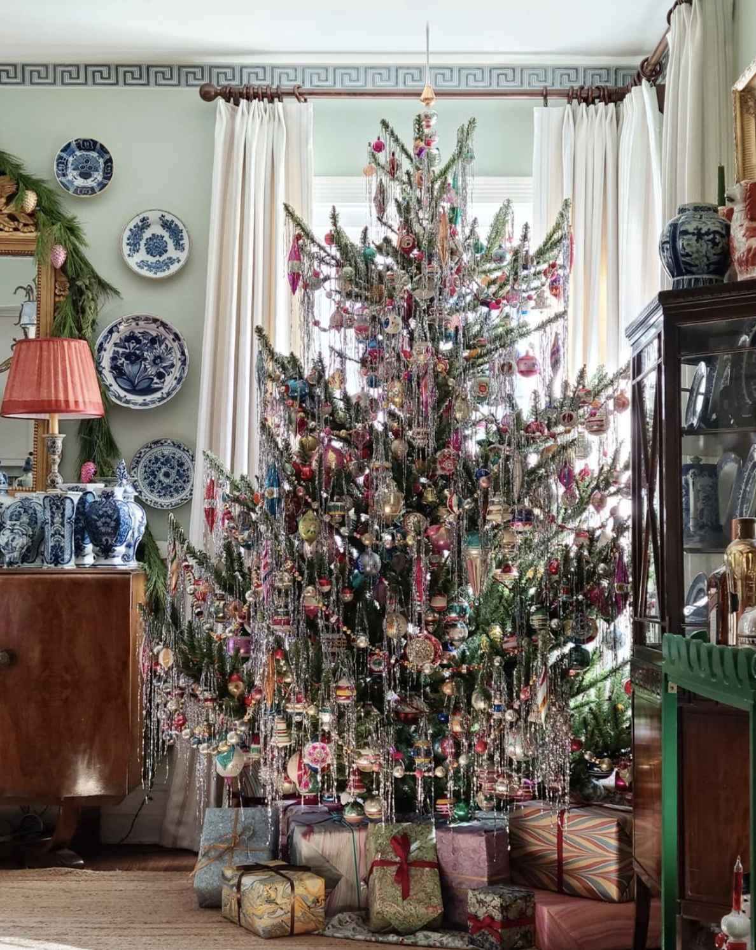
Tinsel

Slide 17
Sleigh

Slide 18
Lights

Slide 19
Star

Slide 20
holly

Slide 21
Chimney

Slide 22
Wreath

Slide 23
Garland

Slide 24
Snowflake

Slide 25
Card

Slide 26
Rudolph

Slide 27
Sack

Slide 28
angel

Slide 29
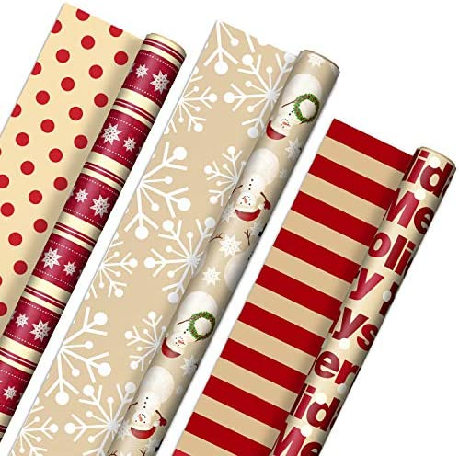
Wrapping
paper

Slide 30
Eggnog

Slide 31
Jolly

Slide 32
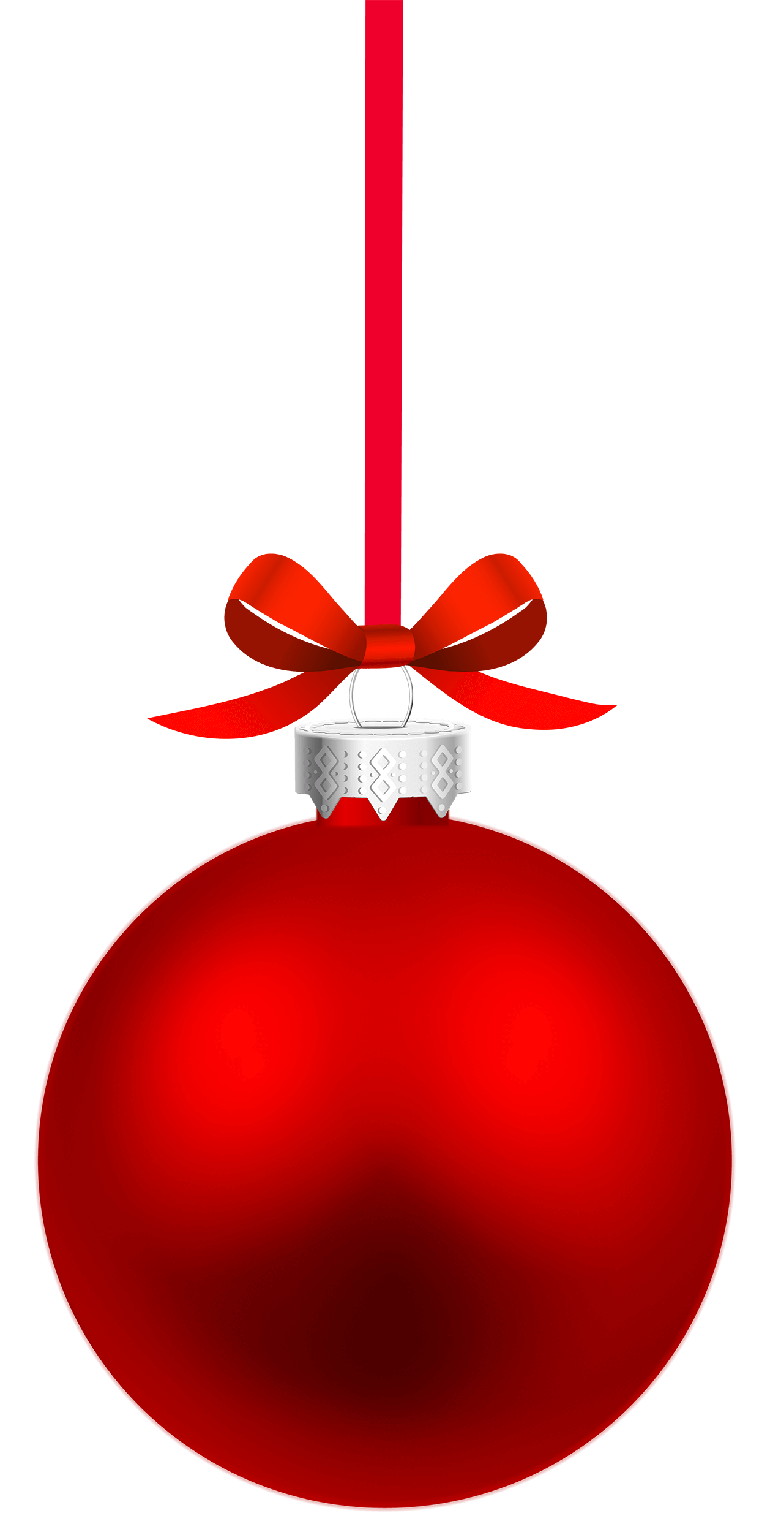
bauble

Slide 33
Christmas Cracker

Slide 34
Carol

Slide 35
Drawing
https://youtu.be/HsGGM-WG2jY

