Slide 1

Gifts

Slide 2
Making a Wishlist
What GIFTS would you like to RECEIVE?

Slide 3
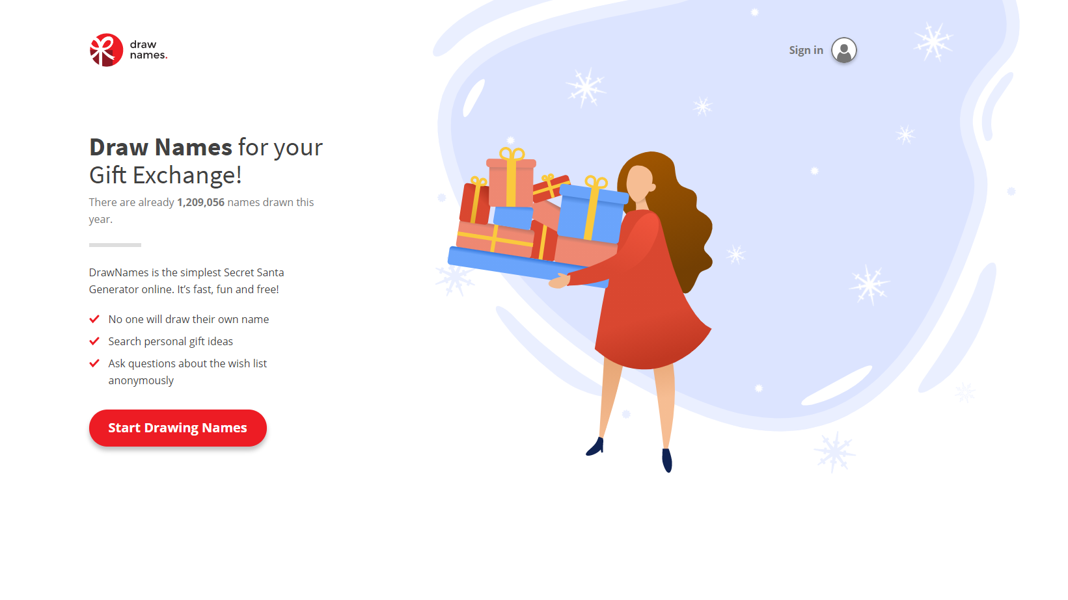

drawnames

Slide 4
What should I do?
1. Follow this link to drawnames.com:
2. Click “Join the Group”
3. Find and click on your name. Do not make a new name.
4. Confirm your email address and follow that link.
5. Click on “Visit the Group Page”
7. Then, “Make a Wishlist”

Slide 5
What can you say?
When you give a gift

Slide 6
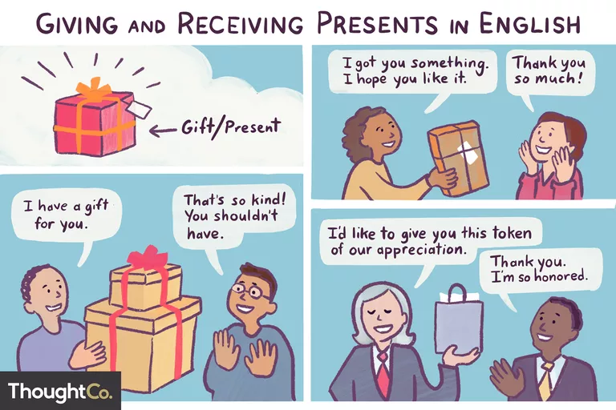

Slide 7

Informal
I got you something. I hope you like it.
Look what I have for you!
I thought you might like this for...
Happy Birthday! Here's a little (gift/present) for you.
Enjoy!
It's only something small, but I hope you like it.
Here's a little present for you.
Guess what I bought you!

Slide 8

Formal
_________, I'd like to give you this (present/gift).
_________, This is a present that (I/we/staff) got you.
I'd like to present you with this...
(very formal, used when giving an award or special present)
In the name of _________, I'd like to give you this present.
(also very formal)
Here is a token of our appreciation.

Slide 9
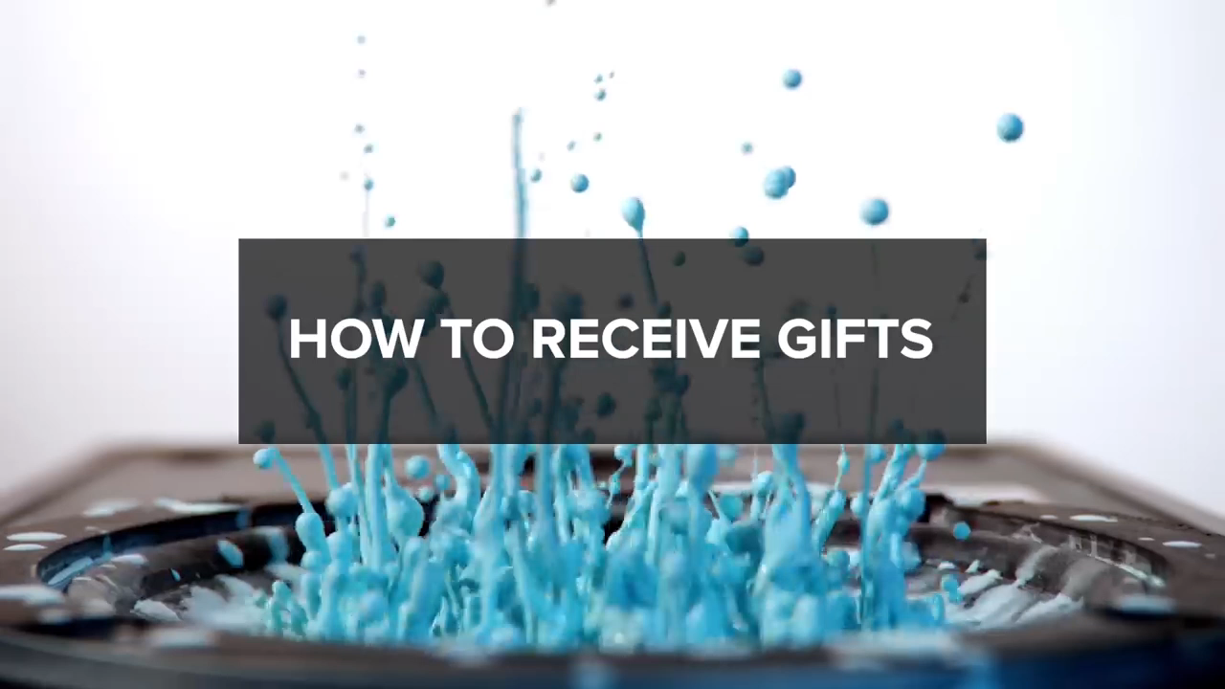

Slide 10
Compliments
You are looking for that ONE piece of TRUTH.

Slide 11
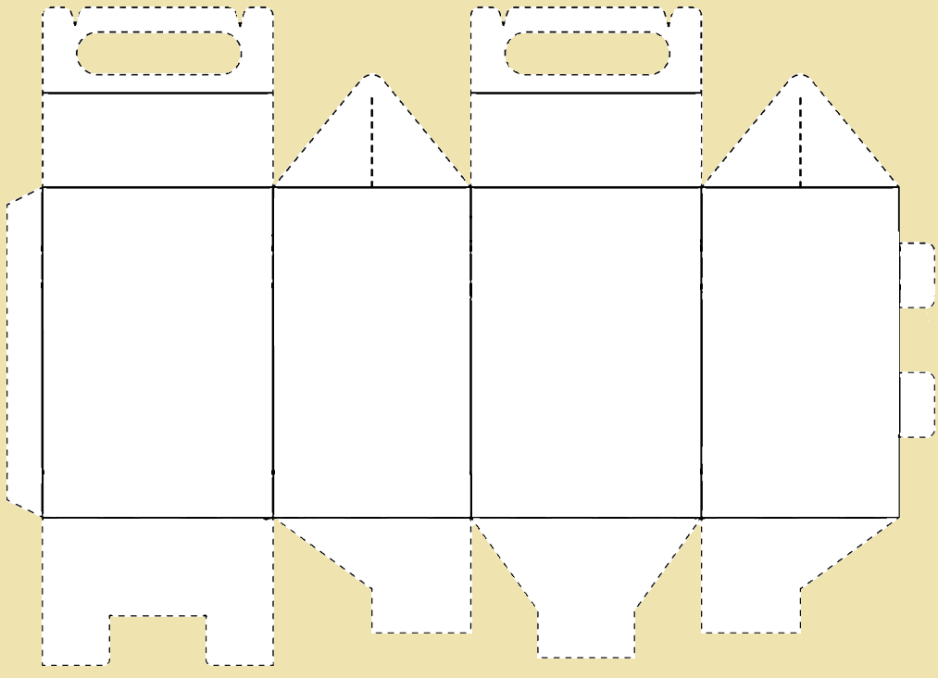
Gift Giving Game

Slide 12
Secret Santa
Rules
Put your name in the hat (app)
Take a name (app)
You must find a gift for that person
Cut something from the magazine that they would like
Put it in the ‘gift box’

Slide 13

Non-Physical Gifts
Gifts are not always physical
High Five
Hug
Help
Homemade
Favors
Friendship/Lover gift certificates
Love

Slide 14
What makes a gift good?
Discuss
What are quality gifts?
What is meaningful?
What do you like?

Slide 15


Slide 16
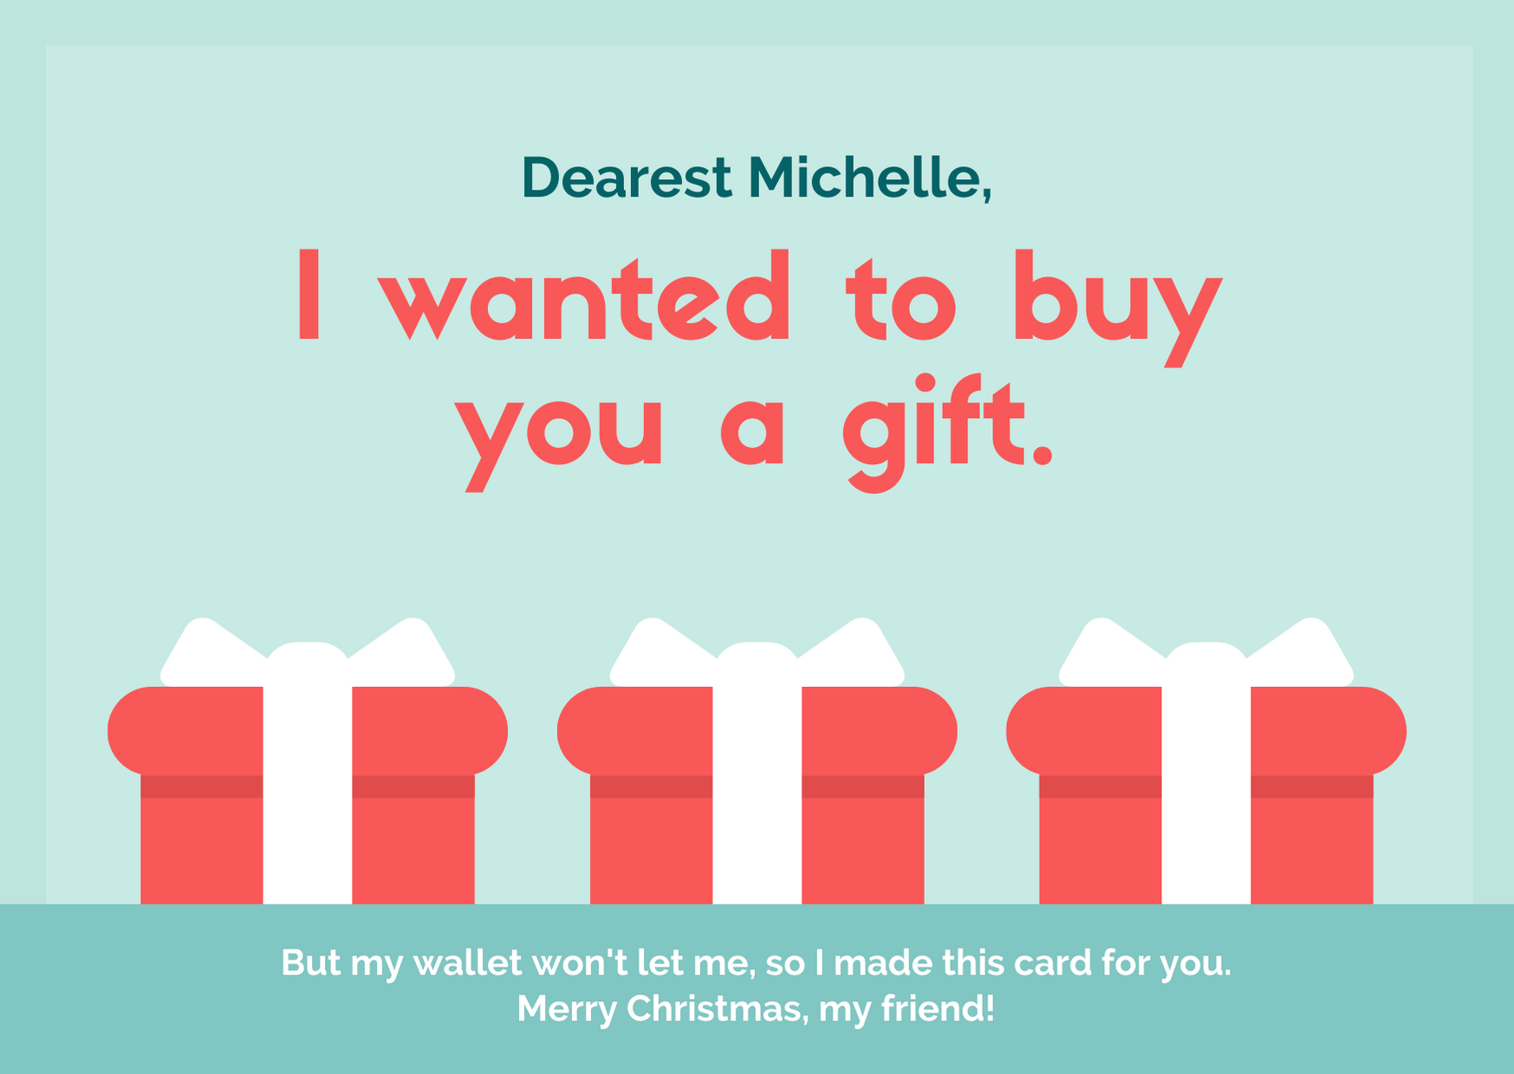
trainees,

Slide 17
Learn What do Say in English When You Give or Receive a Gift
https://www.thoughtco.com/giving-and-receiving-presents-in-english-1212057
Draw Names for your Gift Exchange!
https://www.drawnames.com/

Slide 18
ESL toybox
www.esltoybox.com

