Slide 1
Under my Umbrella
What can go under my umbrella?

Slide 2
Ranking
Discussion Games

Slide 3
Most Popular Emojis
Choose which one you think is most popular on Twitter…

Slide 4
Most Popular Fruit Emoji

Slide 5
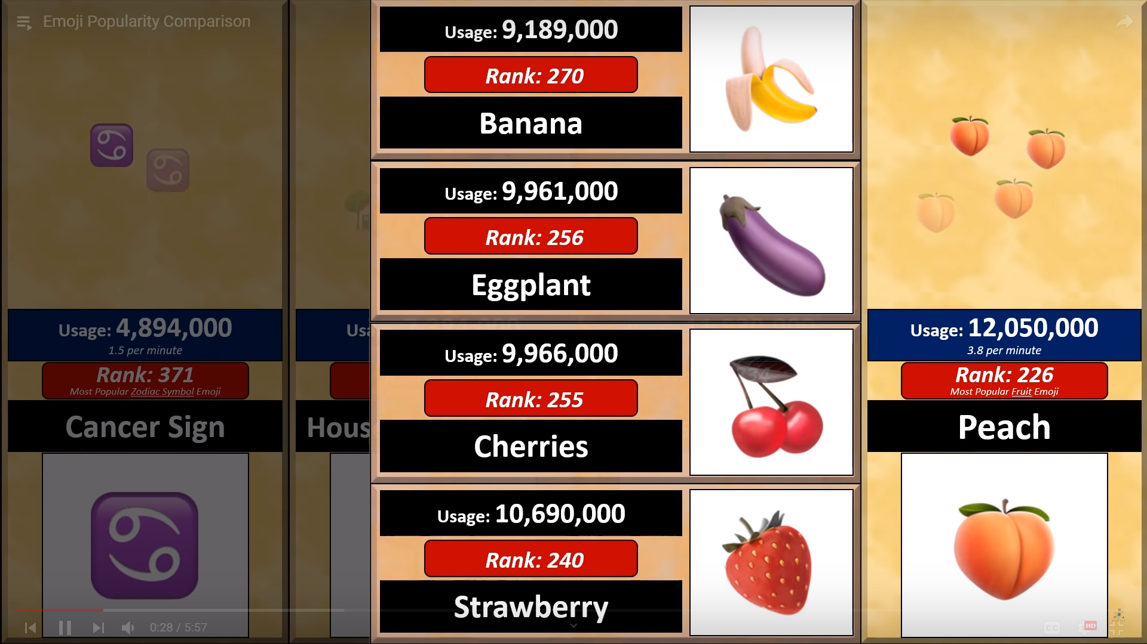

Slide 6
Most Popular Animal Face Emoji

Slide 7
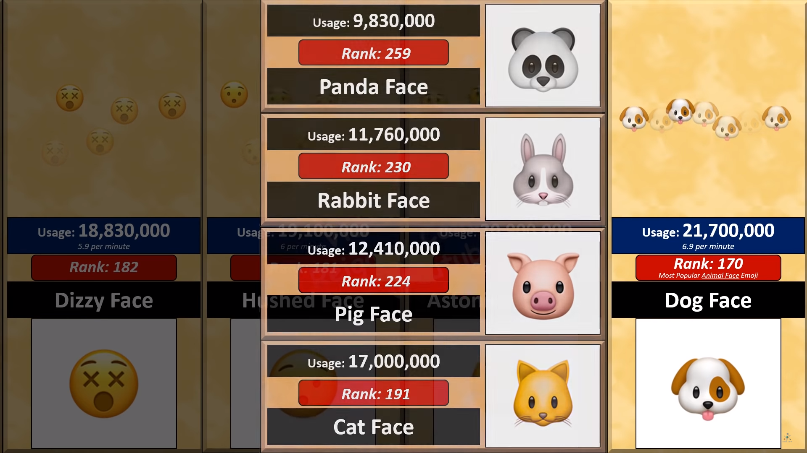

Slide 8
Most Popular Drink Emoji

Slide 9
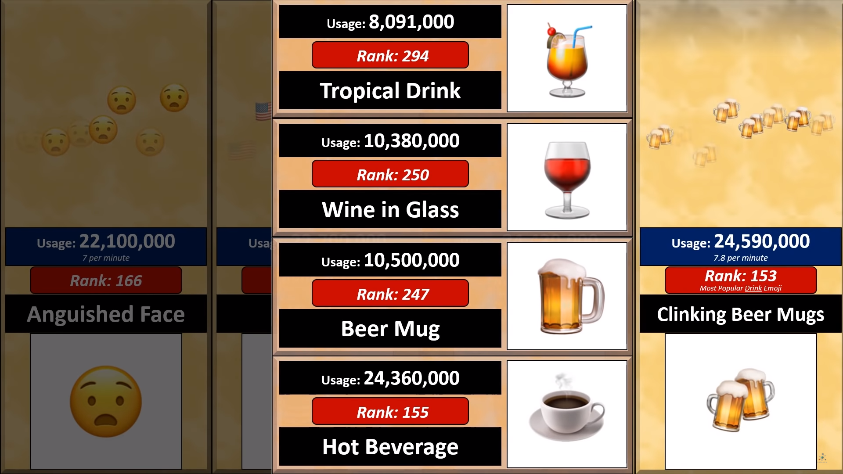

Slide 10
Most Popular Food Emoji

Slide 11
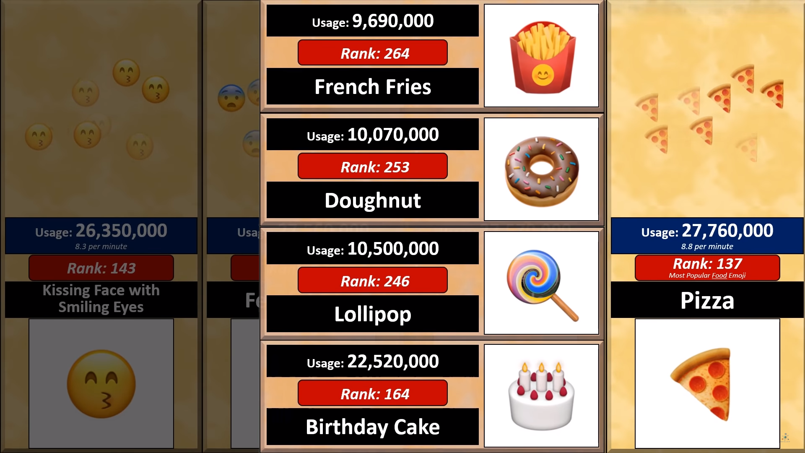

Slide 12
Most Popular Activity Emoji

Slide 13
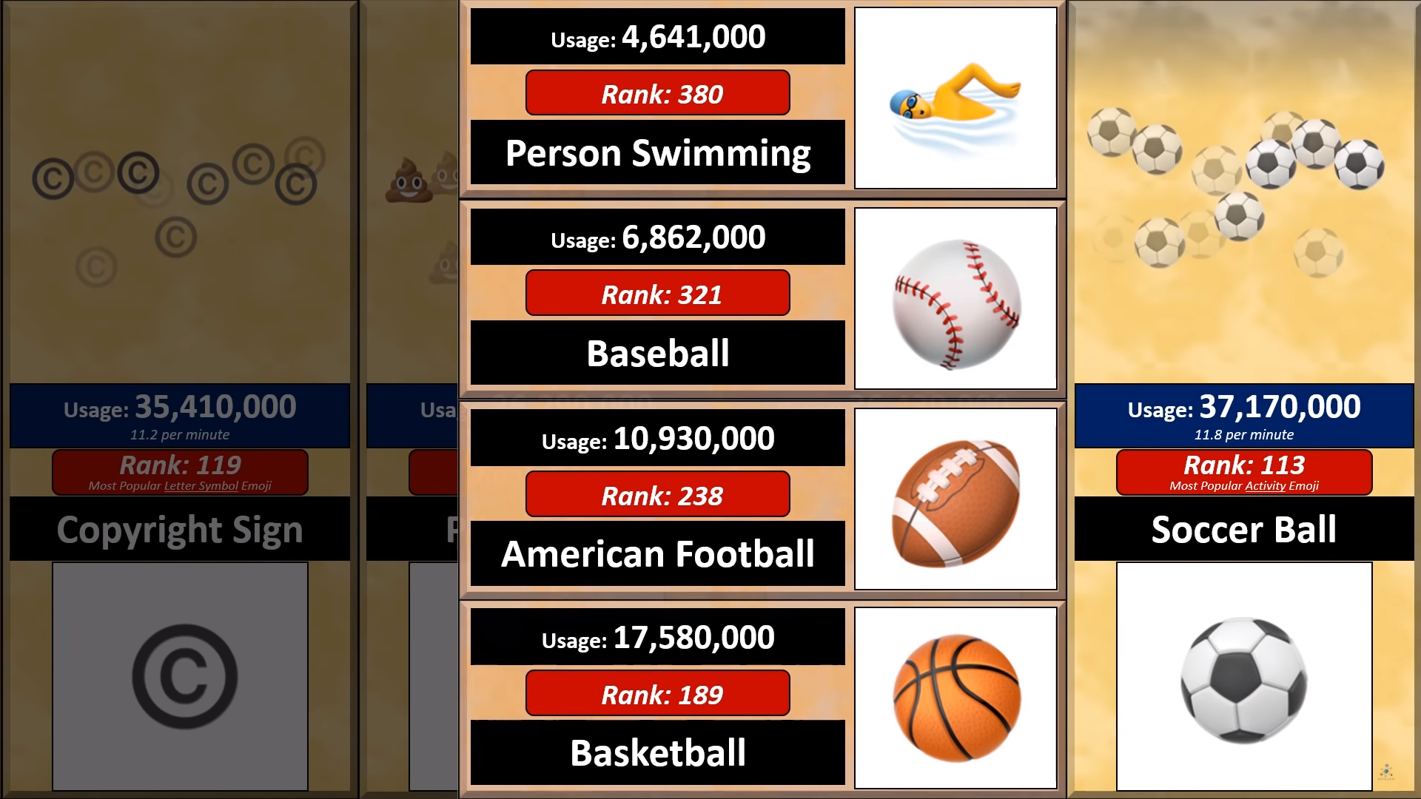

Slide 14
Most Popular Travel and Places Emoji

Slide 15
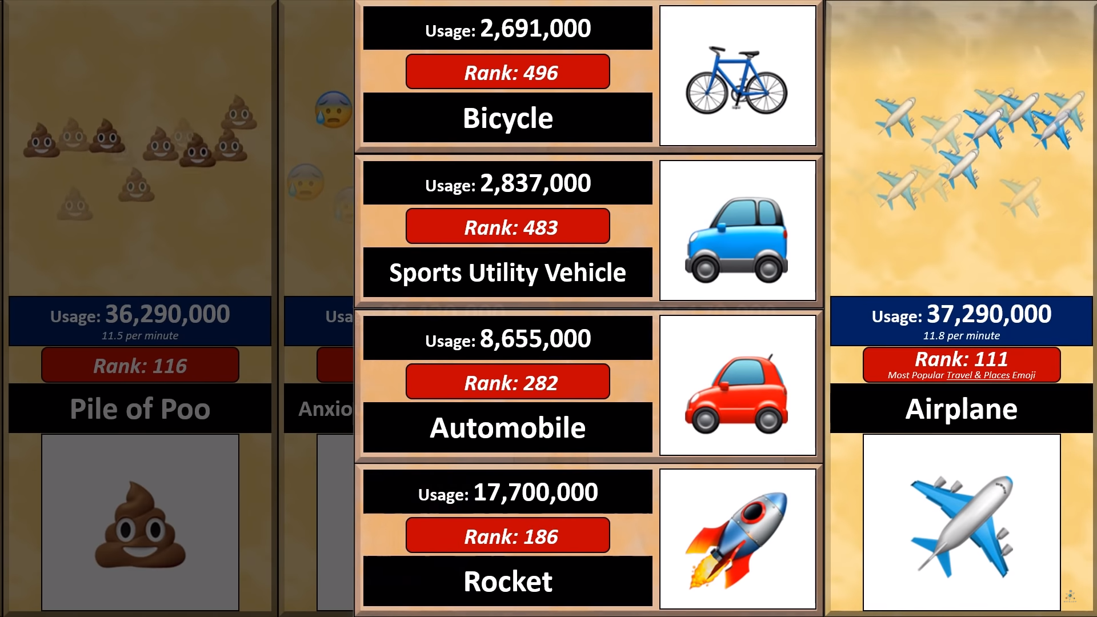

Slide 16
Most Popular Elemental Emoji

Slide 17
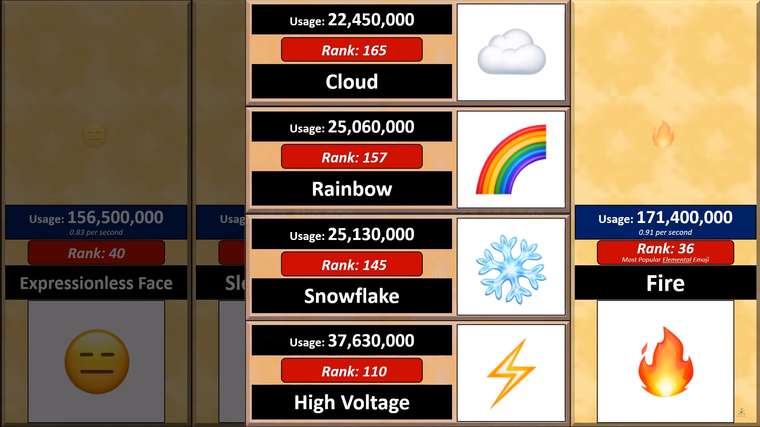

Slide 18
Most Popular Emoji

Slide 19
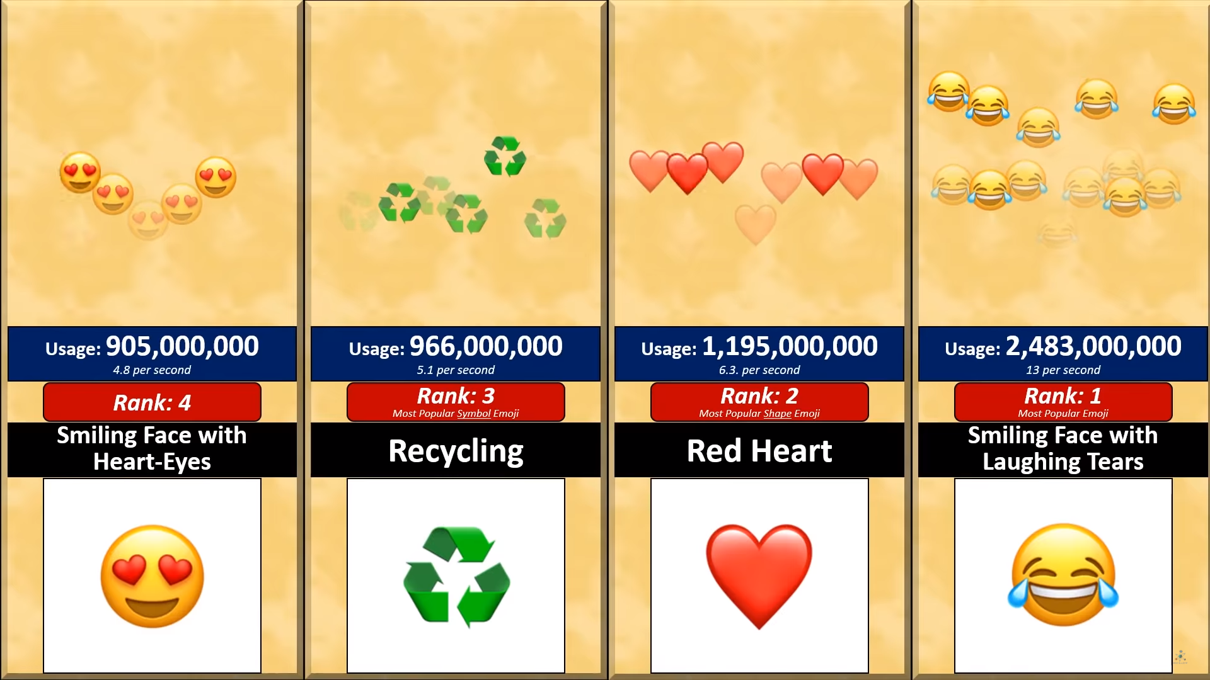

Slide 20
Tier Zoo

Slide 21
S
Tier Zoo
A
Make a list.
Put them in a tier
B
C
D

Slide 22
Category
Choose a category
S
A
B
C
D

Slide 23
S
A
B
C
D
Name ten things in that category
Are you reading?
Random noises
Tim is handsome
Yada yada yada
Blah Blah
Christmas
And smart
Mo mo mo
Ummmm
words

Slide 24
S
Blah Blah Blah
Yada Yada Yada
A
Mo Mo Mo
B
Random Noises
Tear it off and rank it.
Words
C
Ummmm…
D

Slide 25
Make a Tier List
https://tiermaker.com/
Does this Color Turn You Off?
https://www.theage.com.au/national/does-this-colour-turn-you-off-20120816-24bf4.html
Emoji Popularity Comparison
https://www.youtube.com/watch?v=W49KAyAKjHM&list=PL9i6nLIBlfKvunIYrc60Hsw0vNQsANk5n&index=58
Tier Lists
https://knowyourmeme.com/memes/tier-lists
Who Should go to Mars?
https://www.theverge.com/2016/9/30/13099134/space-x-elon-musk-mars-mission-colonists-personality-fitness-health-requirements
Michelin Star Chef Ranks Top 5 Fast Food Chains * Top 5 Breakdown
https://www.youtube.com/watch?v=36oRiPAn4Tw&fbclid=IwAR2gb3SKi2_iAa3gdcgB5cH3Rf660wAyWOTkqY8wPuwxfnt3MtecU5vw6lE

Slide 26
ESL toybox
www.esltoybox.com

