Slide 1
KPOP
MAPL

Slide 2
What is
soft power?
Global influence without the use of military

Slide 3
What is
Hallyu?
The ”Korean” wave

Slide 4
How did Hallyu become popular?

Slide 5
Lifting the travel ban on Korean citizens.
Exposure to other cultures and ways to do business
(especially USA and Europe)

Slide 6
Restructuring Chaebols
IMF loan (1997) – Asian financial Crisis
Only used 19.5B of 97B loan
Paid back by the end of 2001
Restructured chaebols to specialize
Entrepreneurs emerged

Slide 7
Branding of Korean Companies
Samsung, LG…
Foreign markets
Advertising
High quality

Slide 8
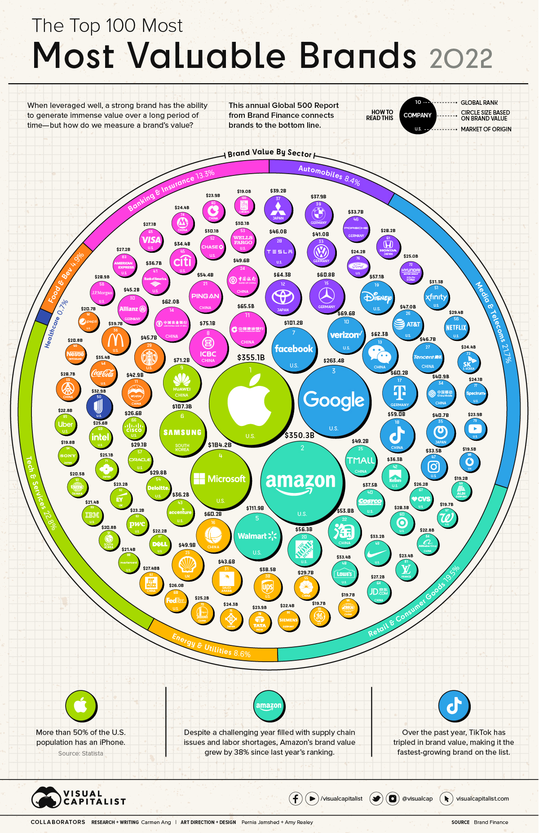
6 – Samsung
72 – Hyundai
73 – SK
91 – LG
https://www.visualcapitalist.com/top-100-most-valuable-brands-in-2022/

Slide 9
Censorship Laws
Lifting of the ban on controversial topics
Freedom in creating media
Emboldened youth

Slide 10
1999 – Swiri (쉬리)
2000 – Joint Security Area (공동경비구역 JSA)
2001 – My Sassy Girl (엽기적인 그녀)
2003 – Old Boy (올드보이)
2004 – Taegukgi (태극기 휘날리며)
2006 – The Host (괴물)
2009 – Haeundae (해운대)
2014 – The Admiral: Roaring Currents (명량)
2016 – A Train to Busan (부산행)
2017 – A Taxi Driver (택시운전사)
2019 – Parasite (기생충)
2021 – Squid Game (오징어 게임)
Guess the
Korean Film

Slide 11
Infrastructure
High tech
Internet infrastructure
Funding venture capital
1/3 of venture capital goes to entertainment

Slide 12
Growing Popularity
Korean brand recognition
Technology, car, beauty
Successful movies
Successful bands
Government support
Hallyu strategy and market research

Slide 13
People like Korea
Japan colonized many Asian countries
China is big and scary
Friendly with America
Olympics
Tourism

Slide 14
Rise of Superstars
Korean celebrities

Slide 15
1 – BTS
2 – EXO
3 – NCT
4 – TVXQ
5 – Twice
6 – Seventeen
7 – SHINee
8 – Super Junior
9 – Girl’s Generation
10 – H.O.T.
11 – Big Bang
The Top
Selling K-Pop
Groups

Slide 16
KPOP
MAPL

Slide 17
Canadian Radio Broadcasting Act (1932 / 1933)

Slide 18
Cultural Development
Public broadcasting system
National Radio
Education
Established a commission to oversee radio communications
Government to stay out of it
Limited to 40% foreign content

Slide 19
Broadcasting Act (1936 / 1949)

Slide 20
Nationalized Media
Creation of the CBC (Canadian Broadcasting Corporation)
Funding

Slide 21
Broadcasting Act (1958 / 1968)

Slide 22
Oversight Committee
Board of Broadcast Governors (BBG)
CBC must report to government and BBG
New technology: cable television
Cable is basically unregulated
CRTC replaces BBG

Slide 23
Broadcasting Act (1973 / 1991)

Slide 24
Modern Regulation
Last before the internet
Amended in 2020 for online content

Slide 25
Canadian Content
Cancon
Radio: 40% Cancon
Television: 55% Cancon
CBC: 60% Cancon
MAPL regulation

Slide 26
M
Music
The music is composed entirely by a Canadian

Slide 27
A
Artist
The music is, or the lyrics are, performed principally by a Canadian

Slide 28
P
Performance
The musical selection consists of a live performance that is
Recorded wholly in Canada or
Performed wholly in Canada and broadcast live in Canada

Slide 29
L
Lyrics
The lyrics are written entirely by a Canadian

Slide 30
as a result…

Slide 31
Keep Artists in Canada
Some Canadian international artists have recording studios in Canada
Anne Murray, Celine Dion, Avril Lavigne, and Shania Twain

Slide 32
Broadcasting Choice
Canadians are exposed to more Canadian content
After midnight, all Canadian
Develop Canadian TV shows
Limited choices for broadcasters like CBC
Bilingual programming / French programming

Slide 33
Promotes Canadian Artists
They have a chance to develop locally
Less competition before going international
“Canadian bands” like Tragically Hip, Great Big Sea, Stompin’ Tom Connors, Arrogant Worms, etc.

Slide 34
A Change in Culture
Media influences culture, culture influences media
More reflective of Canadian issues
Not American centered

Slide 35
What are the key differences between Hallyu and Canadian Content?

Slide 36
Korea
Soft power
Global
Exporting culture

Slide 37
Canada
Laws
Domestic
Promoting homegrown talent

Slide 38
X
O
Guess
the
Canuck

Slide 39
Music Appreciation
Specific Songs to Review
Have trainees suggest songs
How to recommend something

Slide 40
Roll, M. (2021, October 21). Korean Wave (Hallyu) - rise of Korea's Cultural Economy & Pop culture. Martin Roll. Retrieved December 2, 2022, from https://martinroll.com/resources/articles/asia/korean-wave-hallyu-the-rise-of-koreas-cultural-economy-pop-culture/
Ha, S. (2021, August 20). The K-pop groups who sold the most albums to date. allkpop. Retrieved December 2, 2022, from https://www.allkpop.com/article/2021/08/the-k-pop-groups-who-sold-the-most-albums-to-date
Government of Canada, C. R.-television and T. C. (C. R. T. C. (2009, August 10). The MAPL system - defining a Canadian song. CRTC. Retrieved November 23, 2022, from https://crtc.gc.ca/eng/info_sht/r1.htm
https://en.wikipedia.org/wiki/Broadcasting_Act_(Canada)

