Slide 1
Famous
CANADIANS

Slide 2
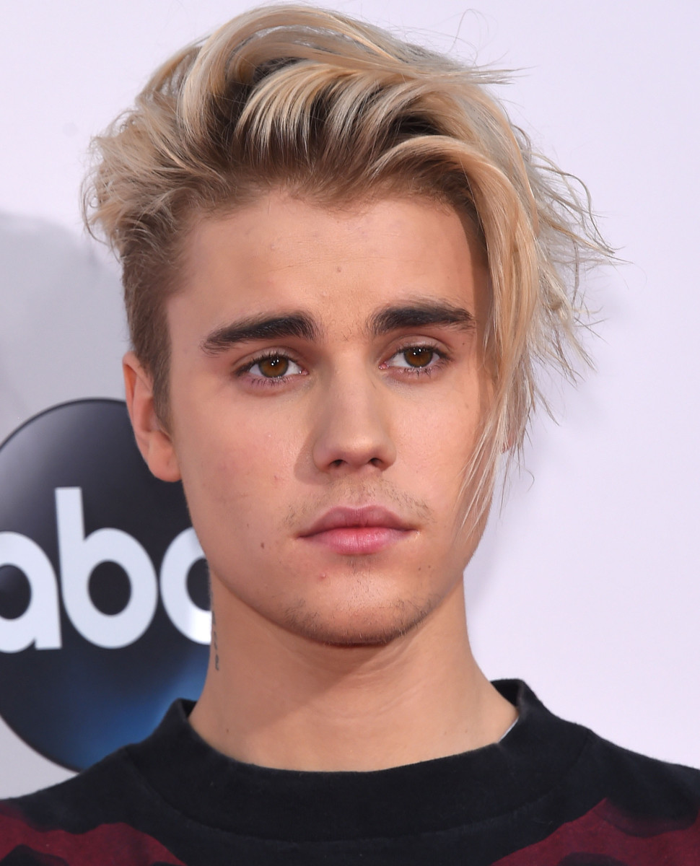
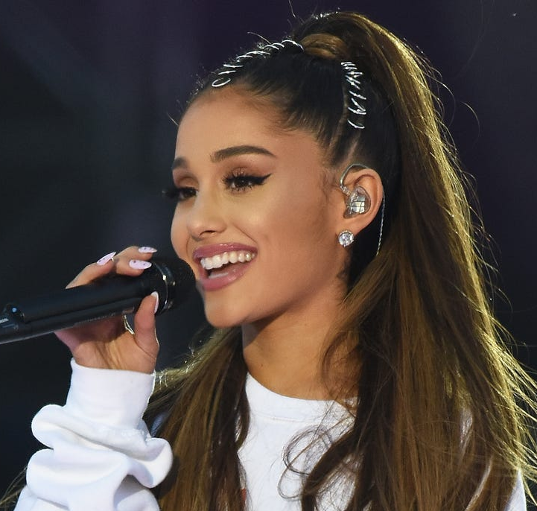
Who is Canadian?
Justin Bieber
Ariana Grande

Slide 3
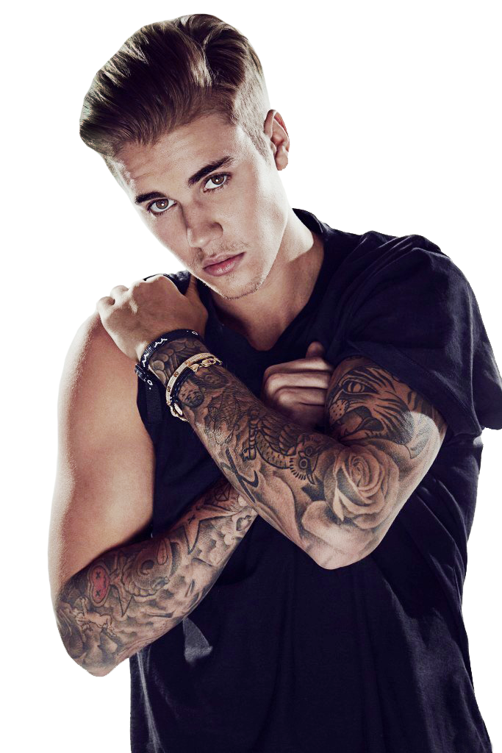
Baby (2010)
As Long as You Love Me (2013)
Let Me Love You (2013)
Love Yourself (2015)
I Don’t Care (2019)
Sorry (2019)

Slide 4
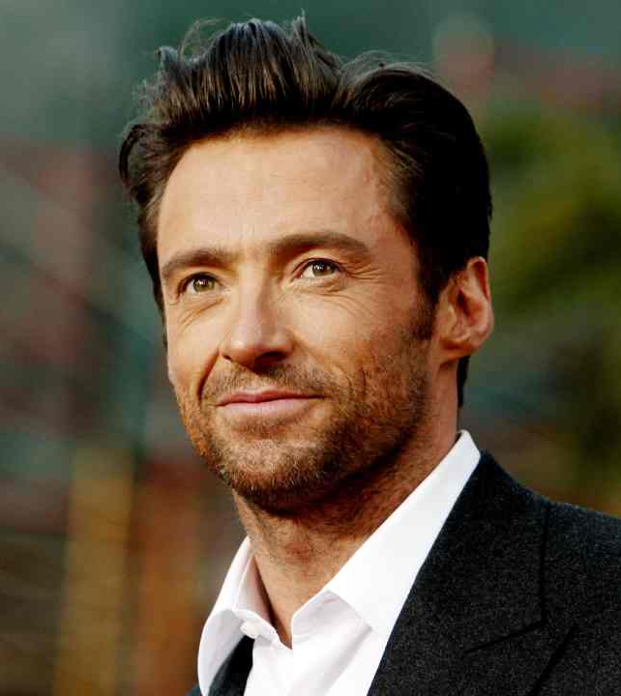
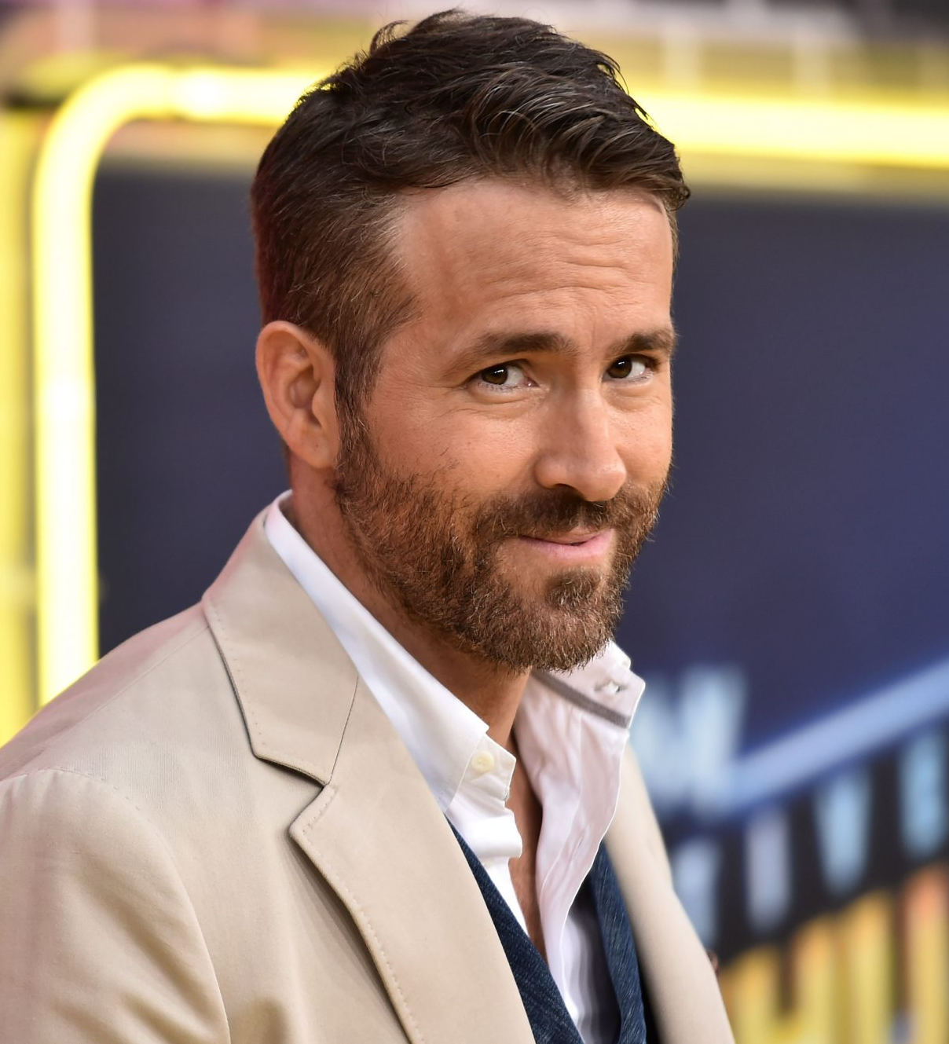
Who is Canadian?
Ryan Reynolds
Hugh Jackman

Slide 6
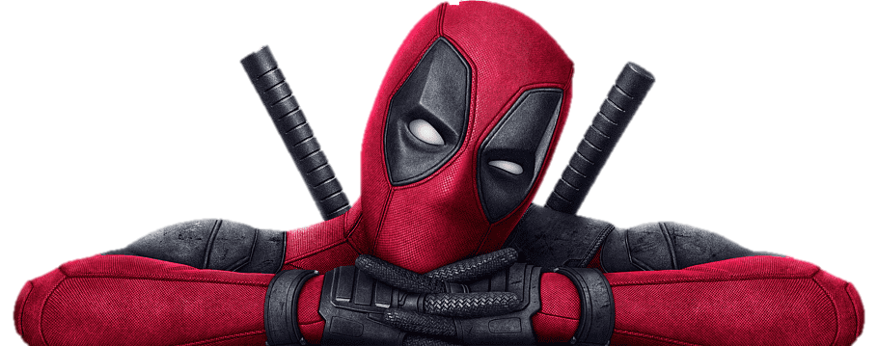
Van Wilder (2002)
The Amityville Horror (2005)
Just Friends (2005)
Buried (2010)
Green Lantern (2011)
Deadpool (2016)
Deadpool 2 (2018)

Slide 7
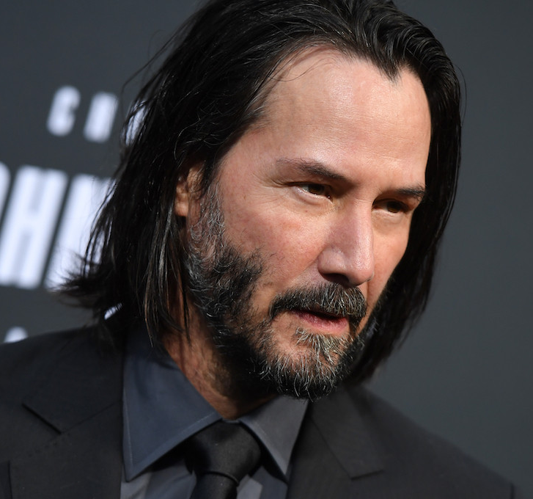
Who is Canadian?
Bruce Willis
Keanu Reeves

Slide 9
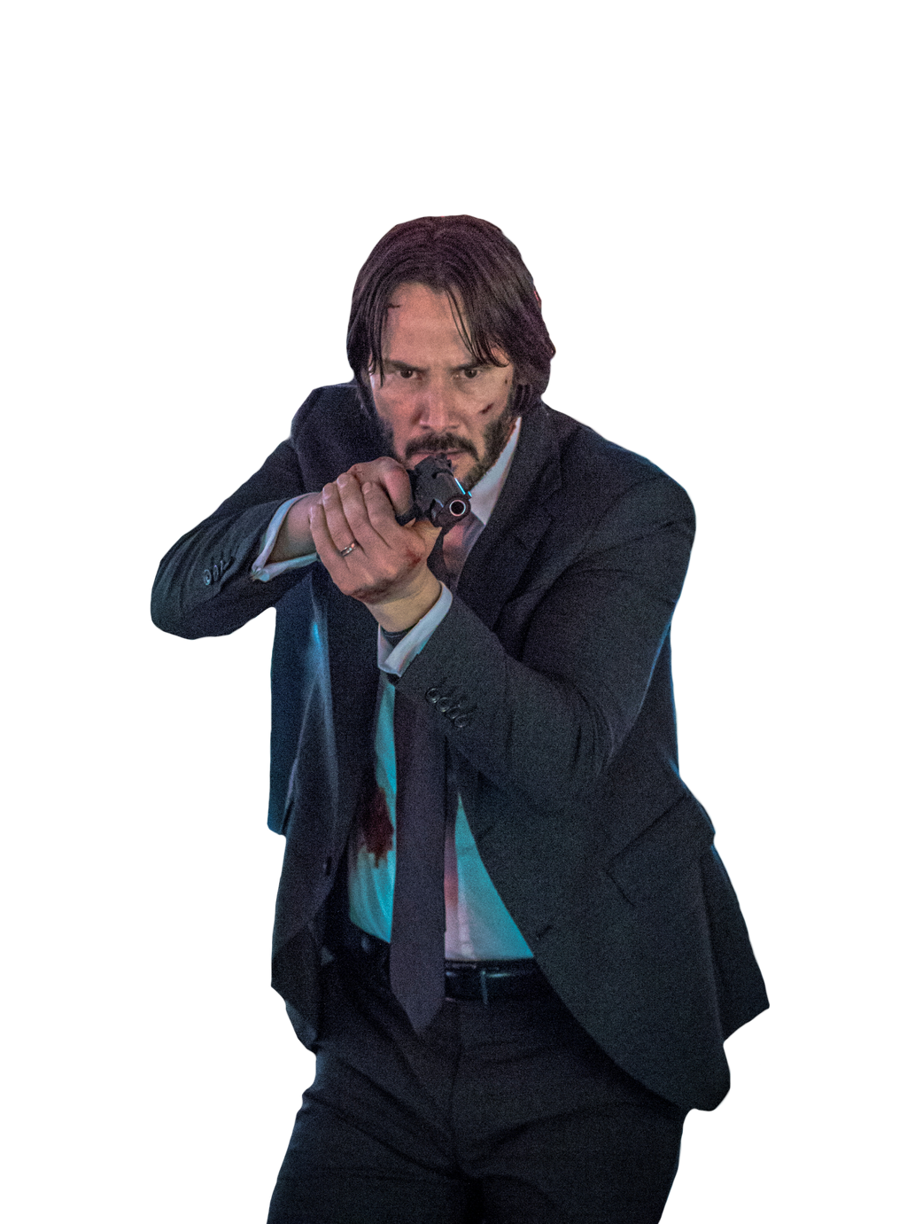
Bill and Ted’s Excellent Adventure (1989)
Point Break (1991)
Speed (1994)
The Matrix (1999)
Constantine (2005)
John Wick (2014)
John Wick: Chapter 2 (2017)
John Wick: Chapter 3 (2019)

Slide 10
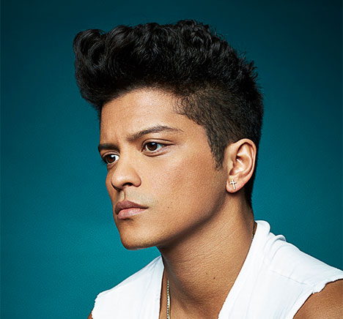
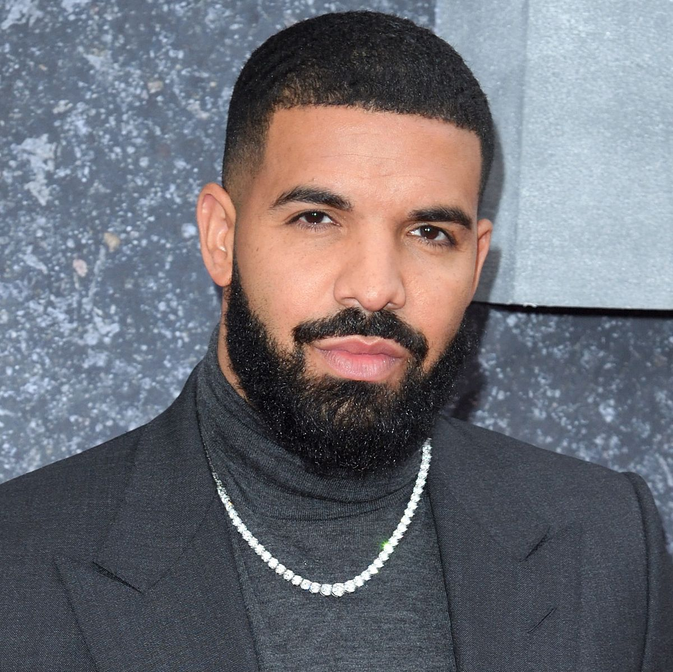
Who is Canadian?
Drake
Bruno Mars

Slide 11
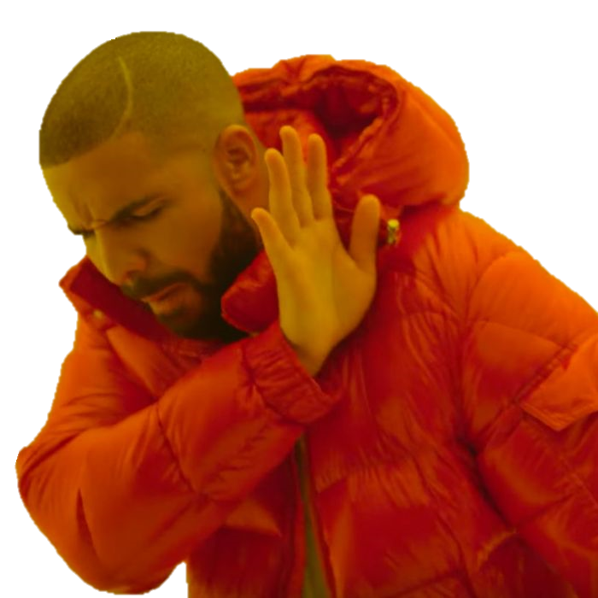
Marvin’s Room (2011)
Take Care (2011)
The Motto (2012)
Hold on, We’re Going Home (2013)
Started From the Bottom (2013)
Hotline Bling (2015)
Passionfruit (2017)
God’s Plan (2018)

Slide 12
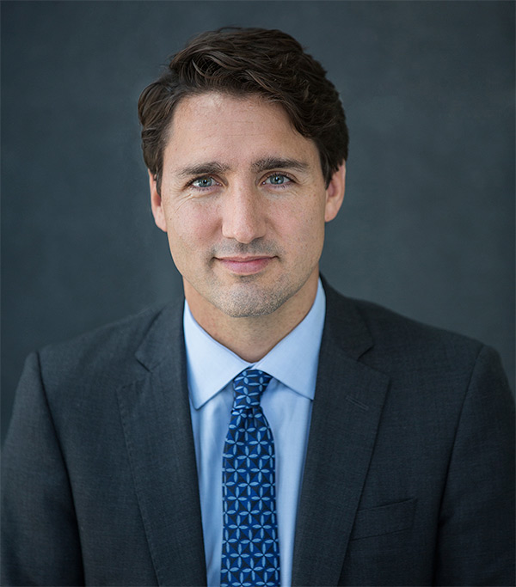
Who is Canadian?
Justin Trudeau
Emanuel Macron

Slide 13
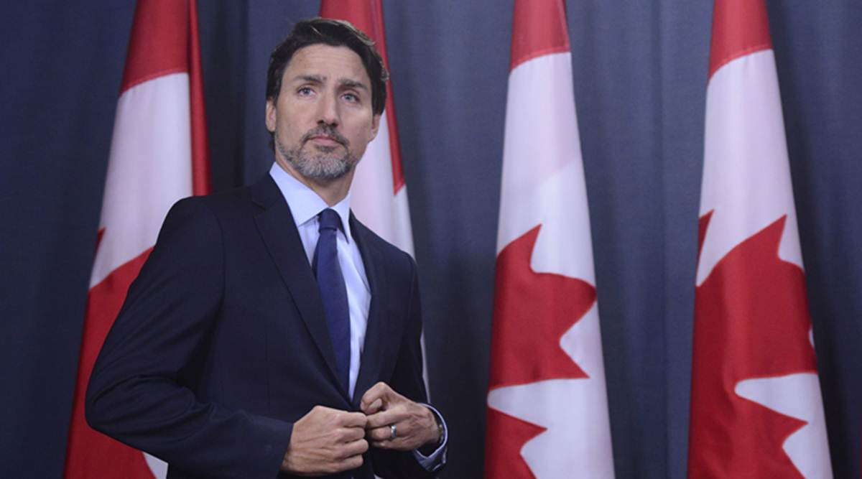

Slide 14
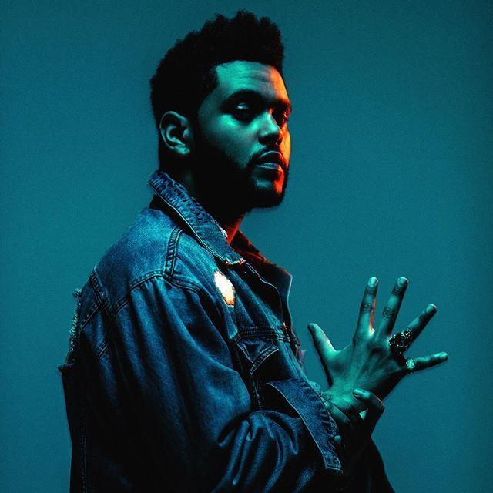
Who is Canadian?
Travis Scott
The Weeknd

Slide 15
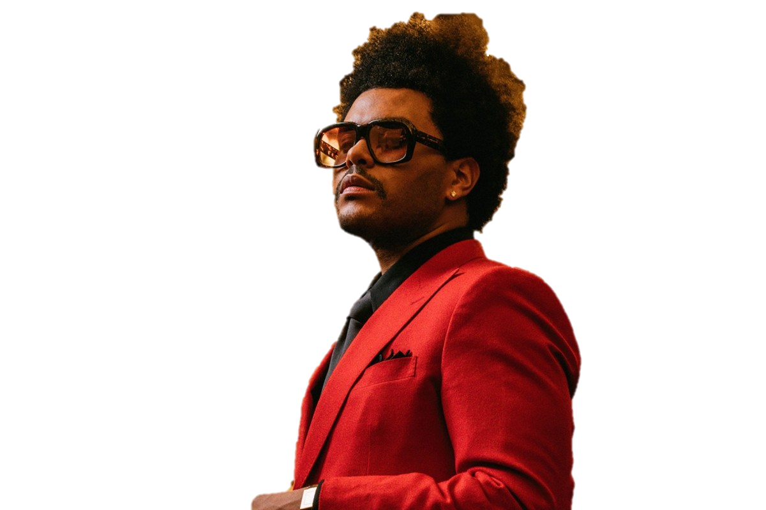
Wicked Games (2011)
The Hills (2015)
Starboy (2016)
I Can’t Feel My Face (2018)

Slide 16
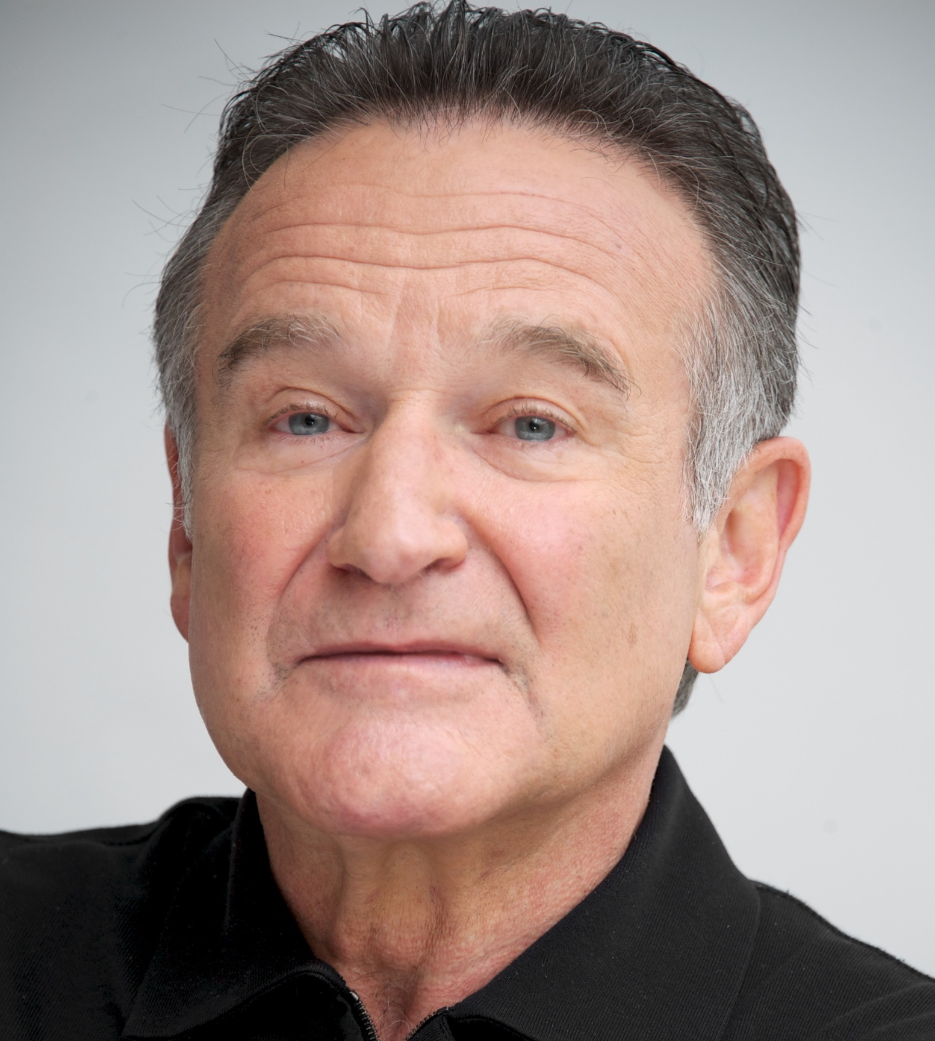
Who is Canadian?
Robbin Williams
Jim Carrey

Slide 18
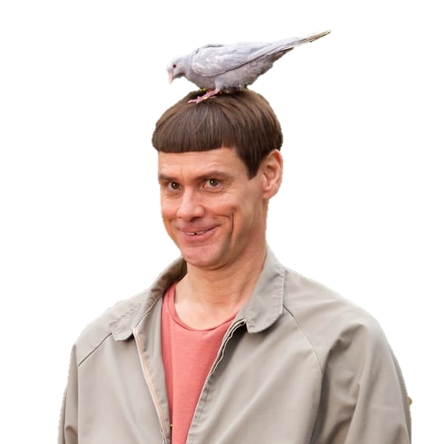
Ace Ventura: Pet Detective (1994)
The Mask (1994)
Dumb and Dumber (1994)
The Cable Guy (1996)
Liar, Liar (1996)
Truman Show (1998)
Man on the Moon (1999)
Me, Myself, and Irine (2000)
How the Grinch Stole Christmas (2000)
Bruce Almighty (2003)
Eternal Sunshine of the Spotless Mind (2004)
A Series of Unfortunate Events (2004)

Slide 19
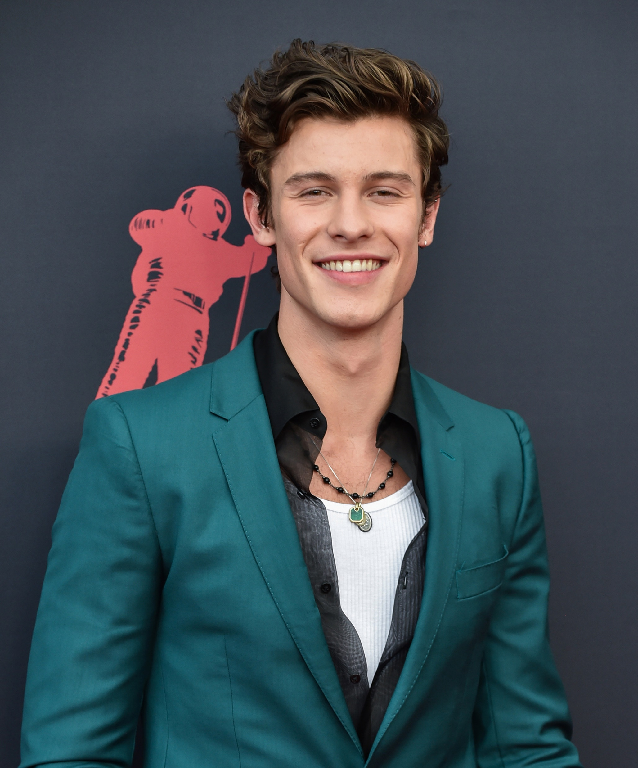
Who is Canadian?
Selena Gomez
Shawn Mendes

Slide 20
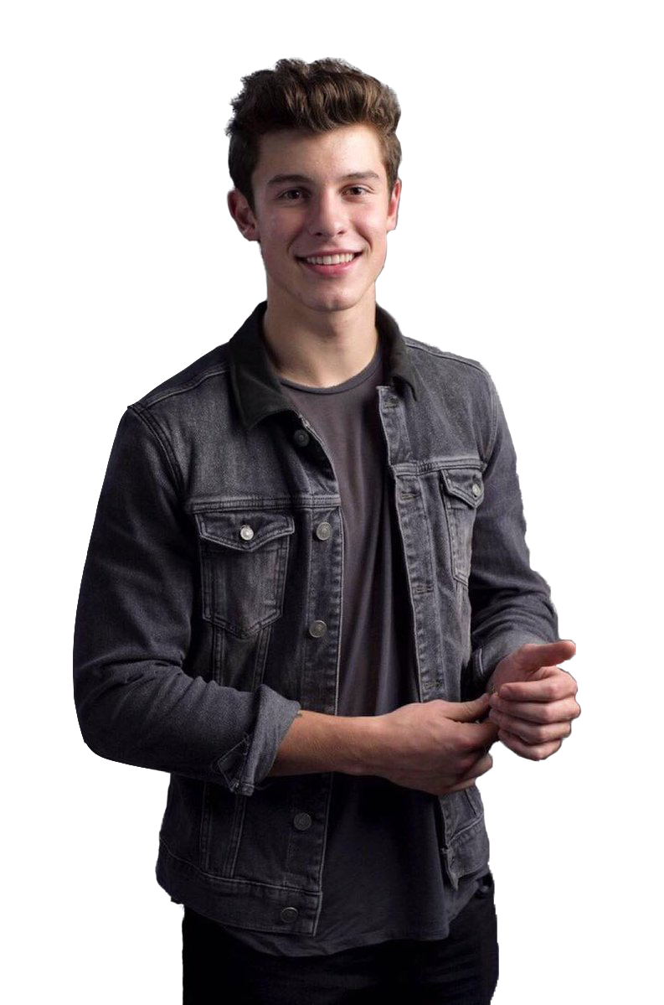
Stitches (2015)
There’s Nothing Holding Me Back (2016)
In My Blood (2018)
Senorita (2019)

Slide 21
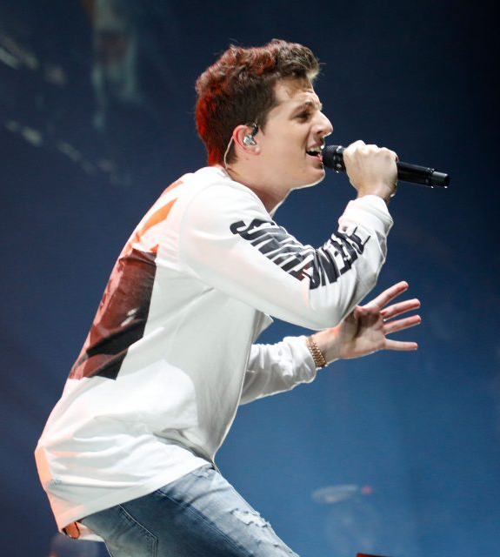
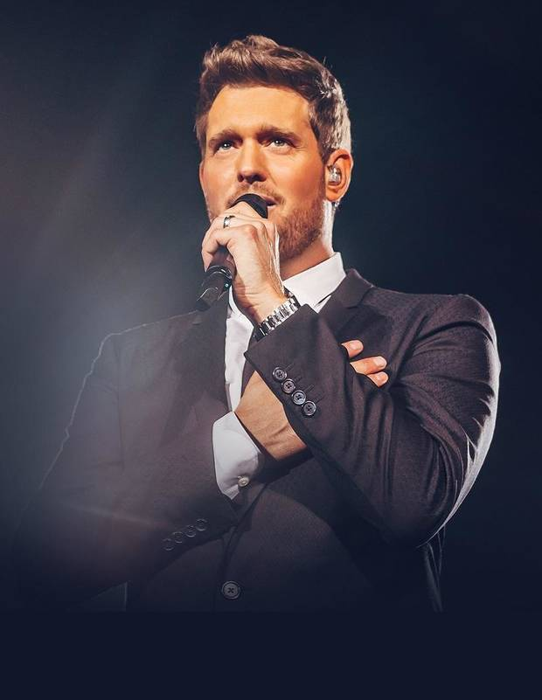
Who is Canadian?
Michael Buble
Charlie Puth

Slide 22
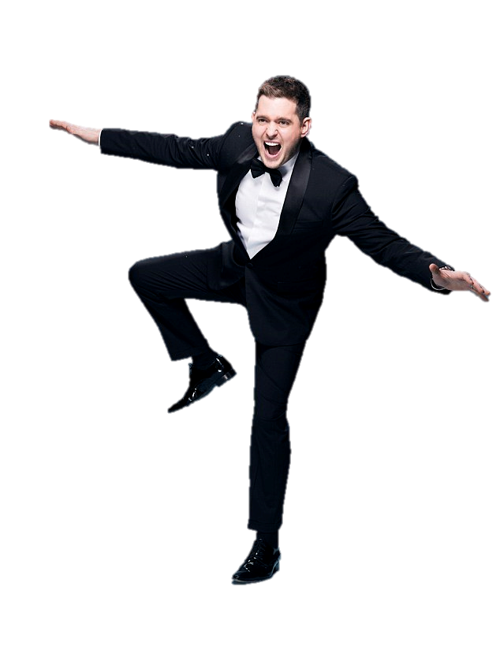
Home (2005)
Save the Last Dance (2005)
Everything (2007)
Haven’t Met You Yet (2009)

Slide 23
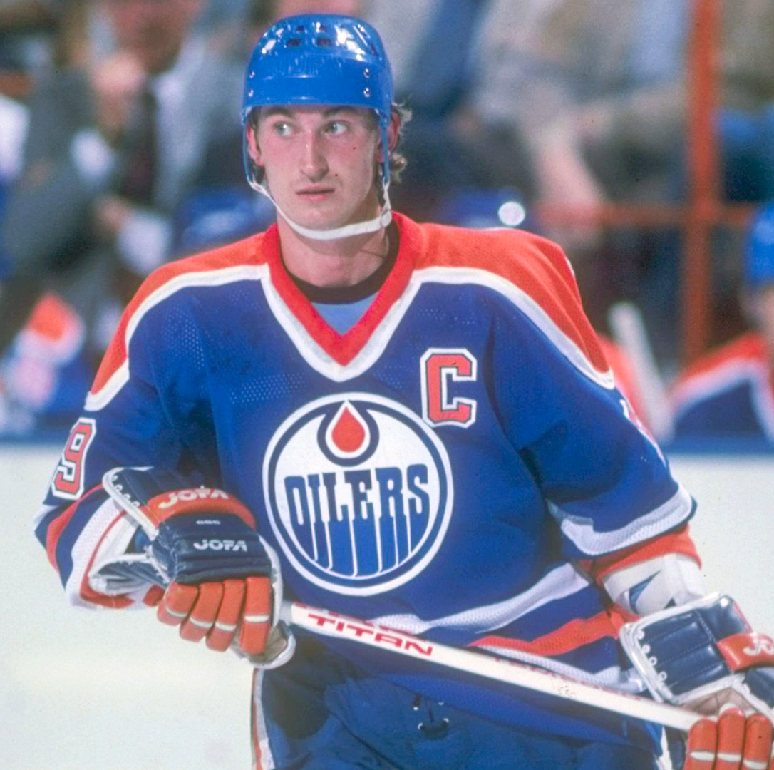
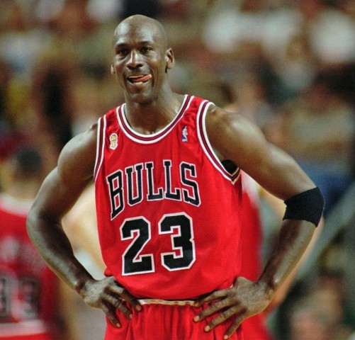
Who is Canadian?
Wayne Gretzky
Michael Jordan

Slide 25
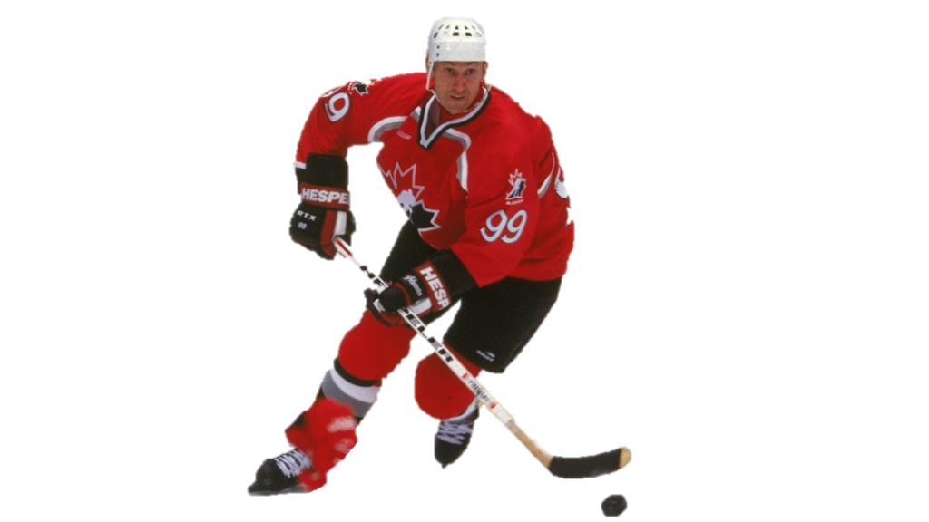
61 NHL records:
Most goals (career)
Most goals (season)
Most assists (career)
Most assists (season)
Most points (career)
Most points (season)
Stanley Cup (1984,1985,1987,1988)
Team Canada
Number has been retired

Slide 26
Who is Canadian?
Gwen Stefani
Celine Dion

Slide 27
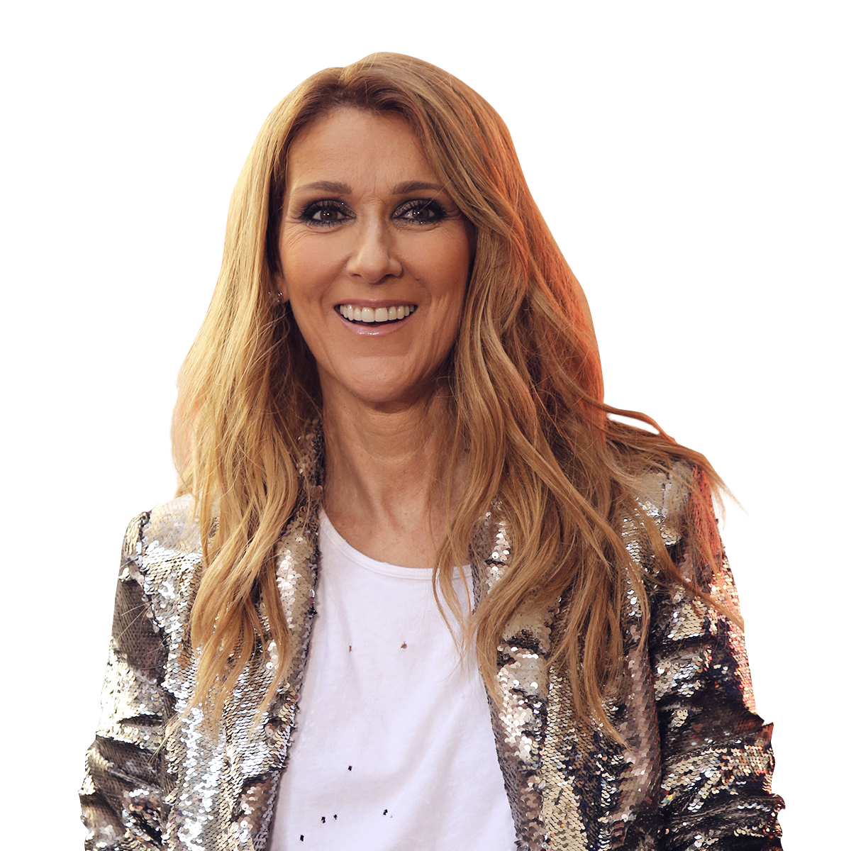
Where Does My Heart Beat Now? (1990)
Beauty and the Beast (1992)
The Power of Love (1993)
It’s All Coming Back to Me (1996)
Because You Loved Me (1996)
All by Myself (1996)
My Heart Will Go On (1997)
I Drove All Night (2000)

Slide 28
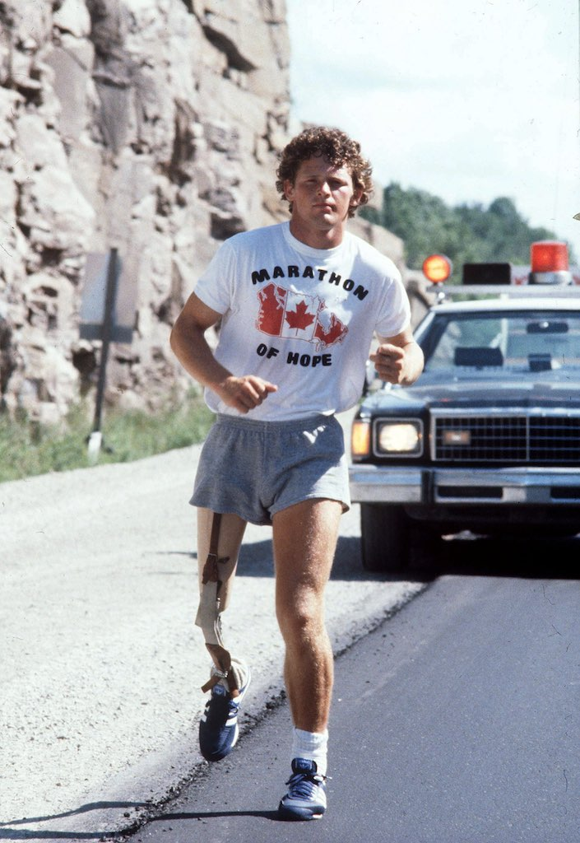
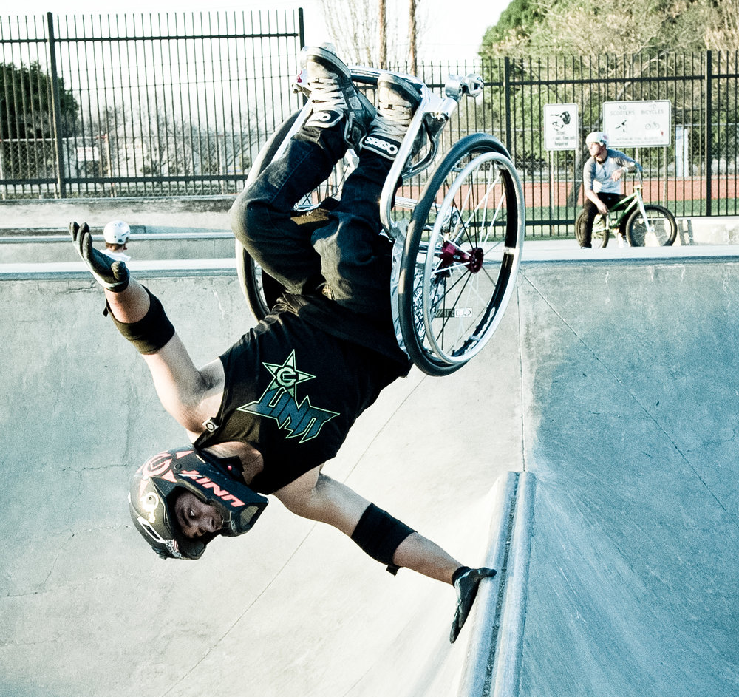
Who is Canadian?
Aaron Fotheringham
Terry Fox

Slide 30
Canadian Athlete
Cancer Research Activist
Marathon of Hope
Tried to run across Canada
143 days, 5,373kms
Died before he could finish
Terry Fox Foundation
Terry Fox Run
Inspiration to many

Slide 31
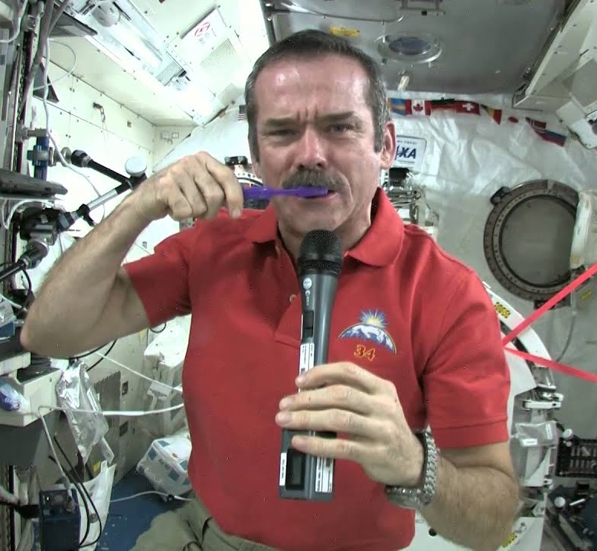
Who is Canadian?
Chris Hadfield
Colin O'Brady

Slide 33
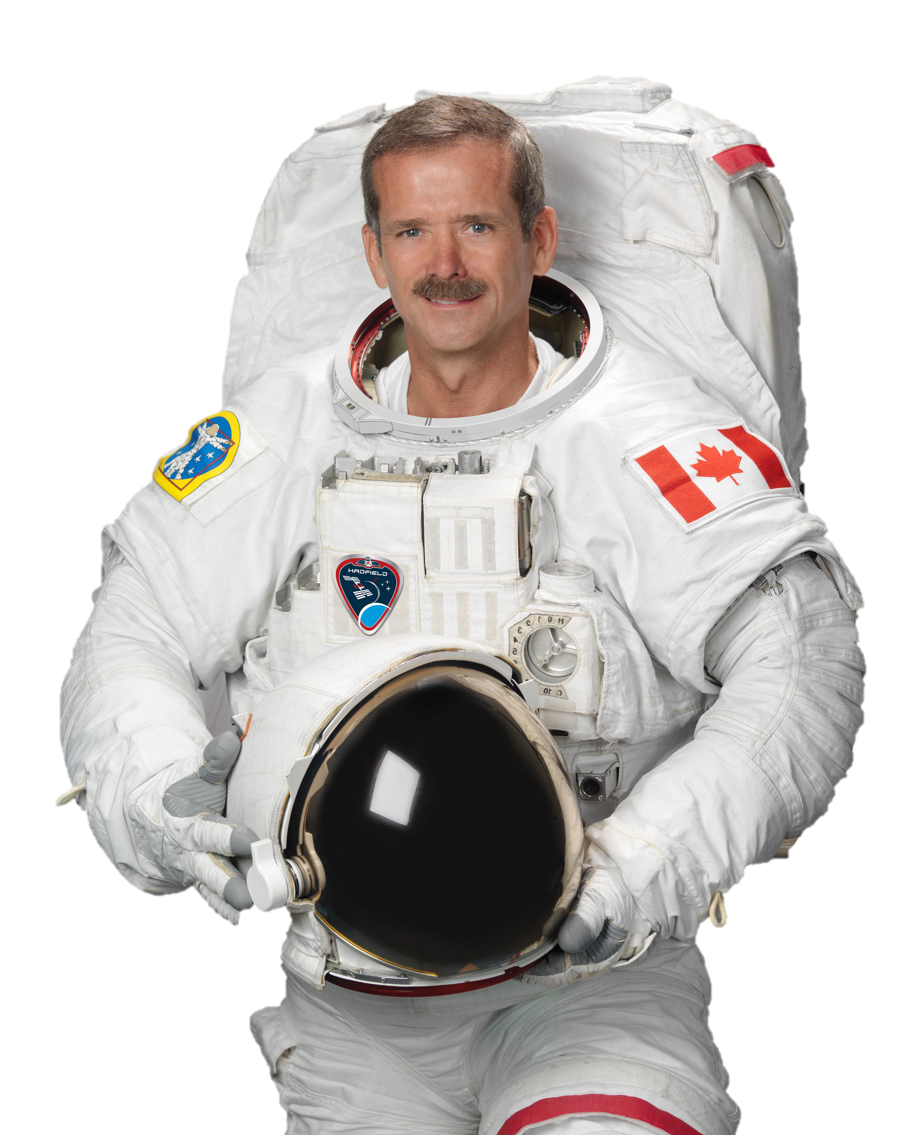
Astronaut (1992)
Science Educator
“Space Oddity”

Slide 34
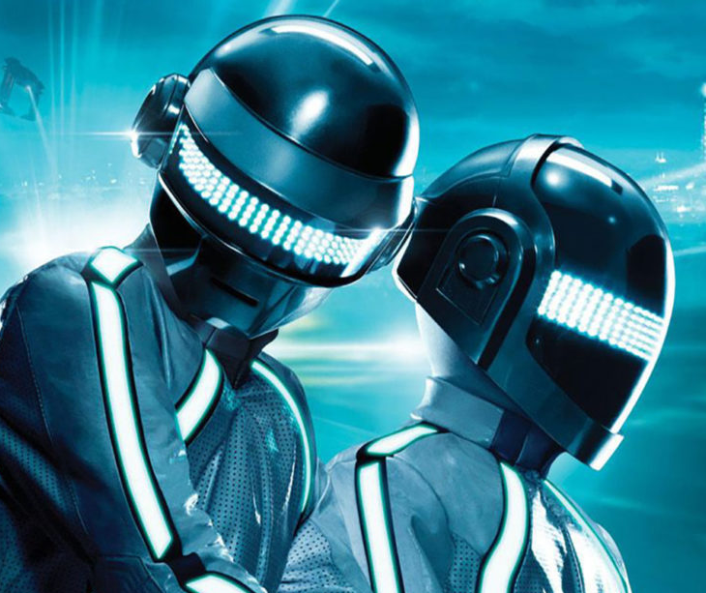
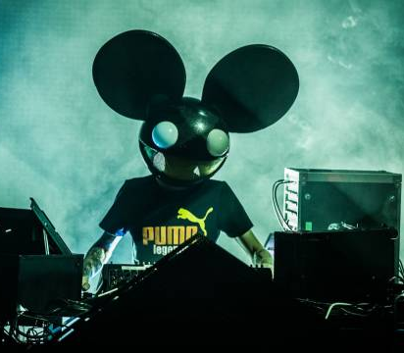
Who is Canadian?
Deadmau5
Daft Punk

Slide 35
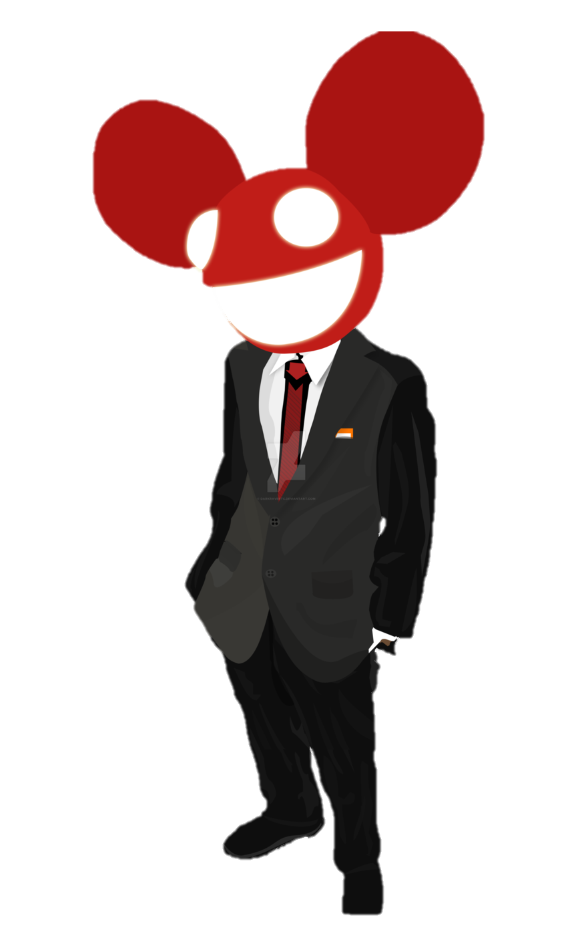
DJ
Top 5 highest paid producer

Slide 36
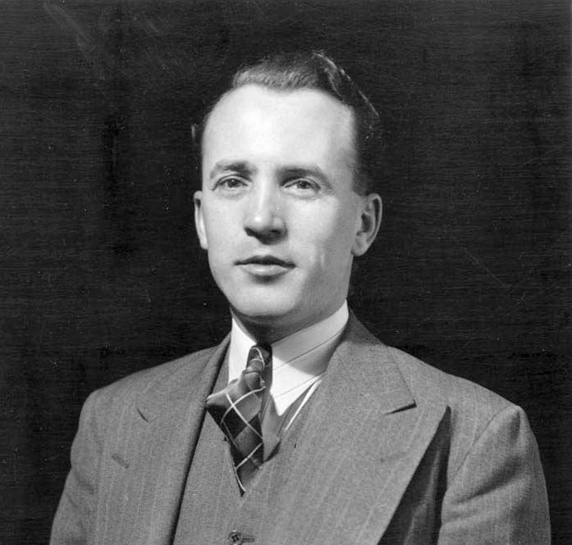
Who is Canadian?
Dwight Eisenhower
Tommy Douglas

Slide 37
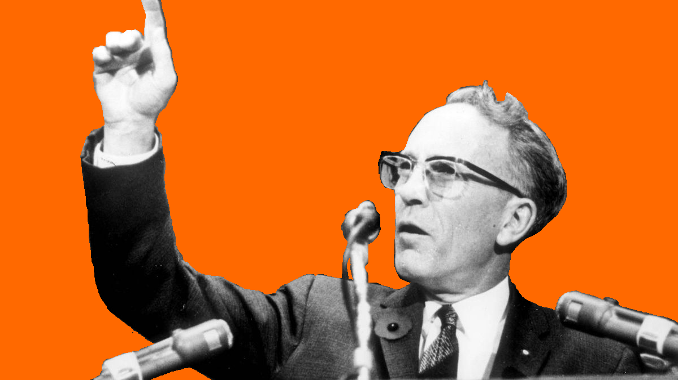
Politician
Universal Health Care
Saskatchewan
First in North America
Order of Canada Award
“Greatest Canadian” (CBC 2004)

Slide 38
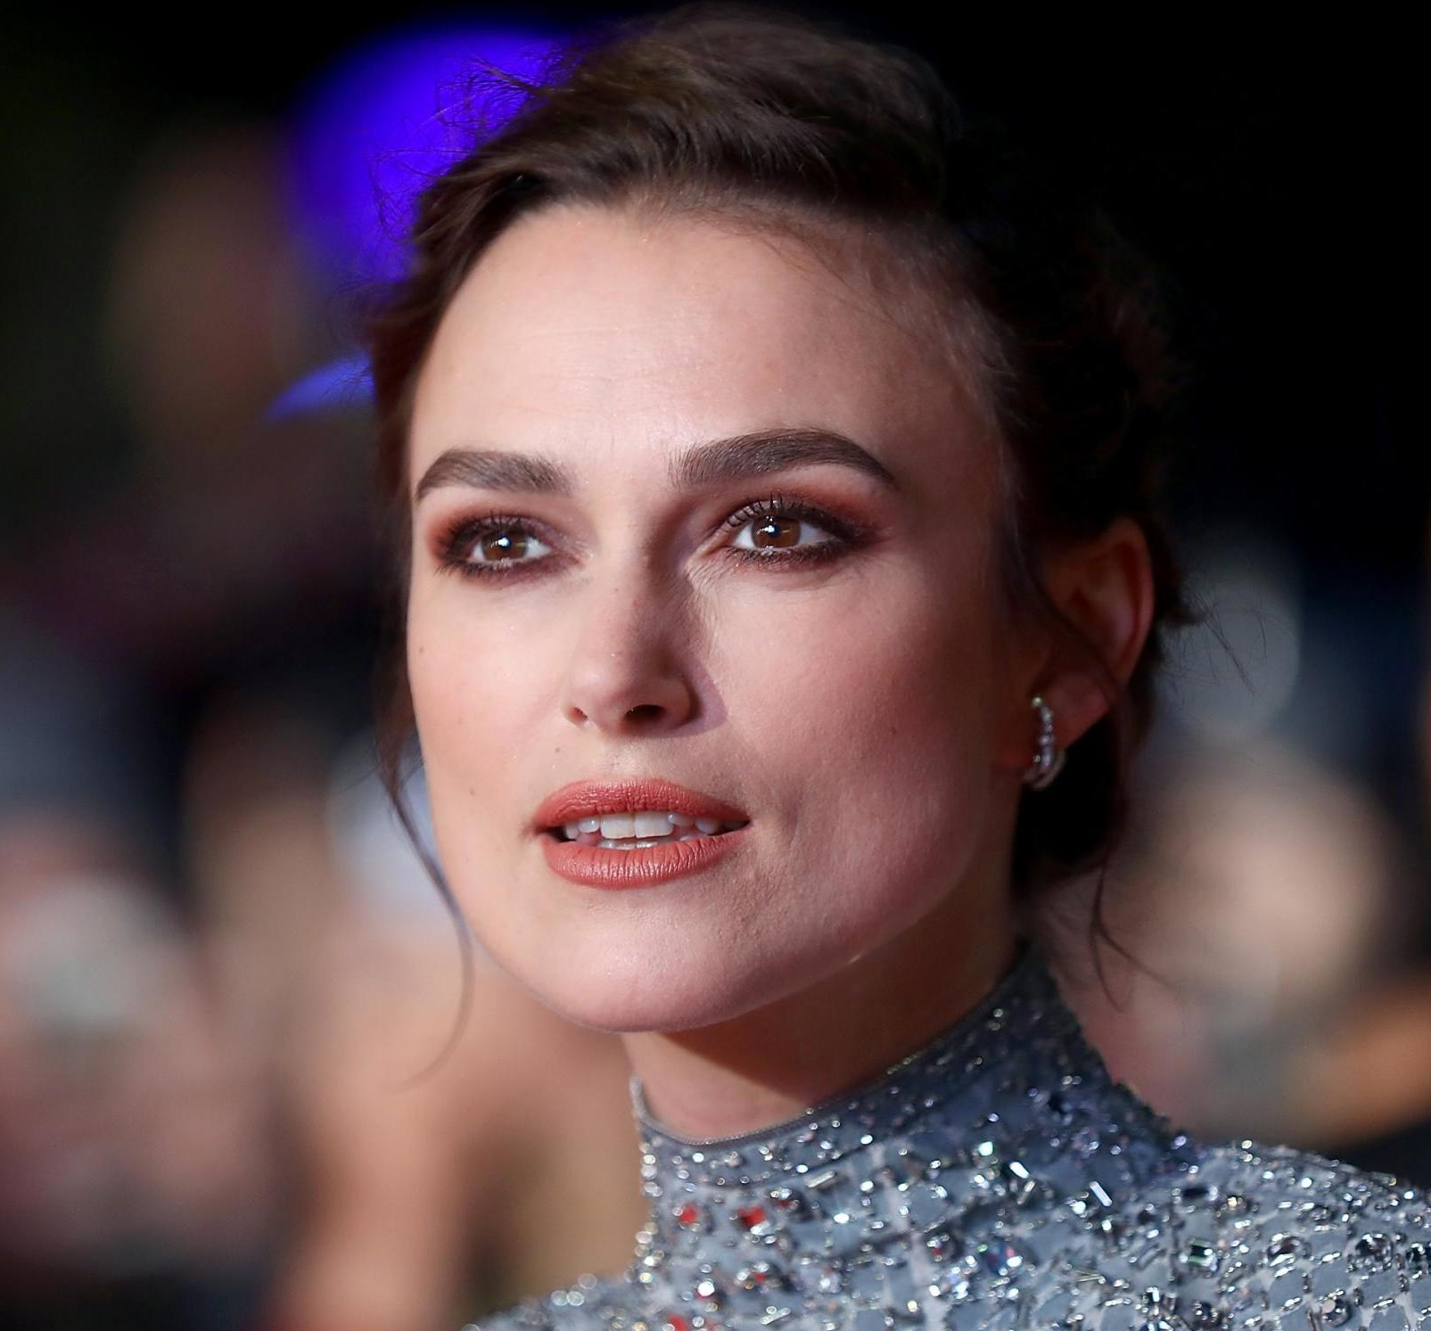
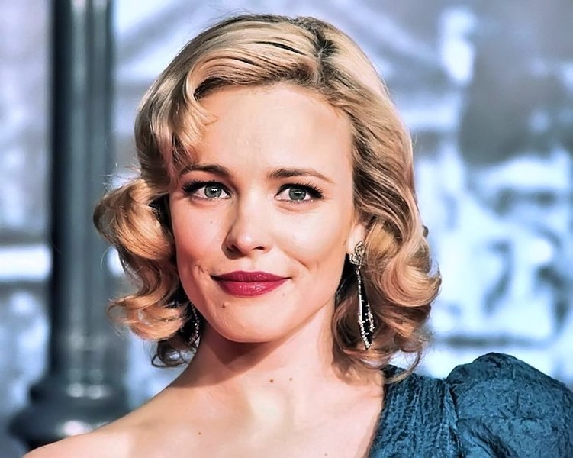
Who is Canadian?
Rachael McAdams
Keira Knightley

Slide 40
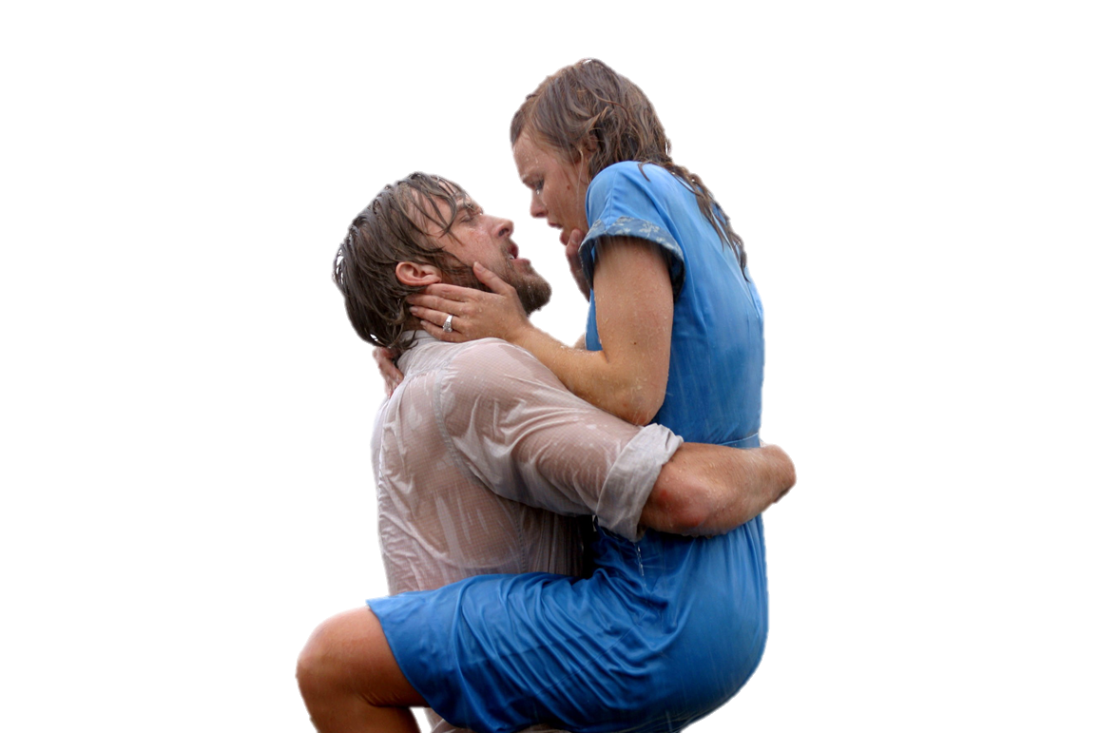
Mean Girls (2004)
The Notebook (2004)
Sherlock Holmes (2009)
Midnight in Paris (2011)

Slide 41
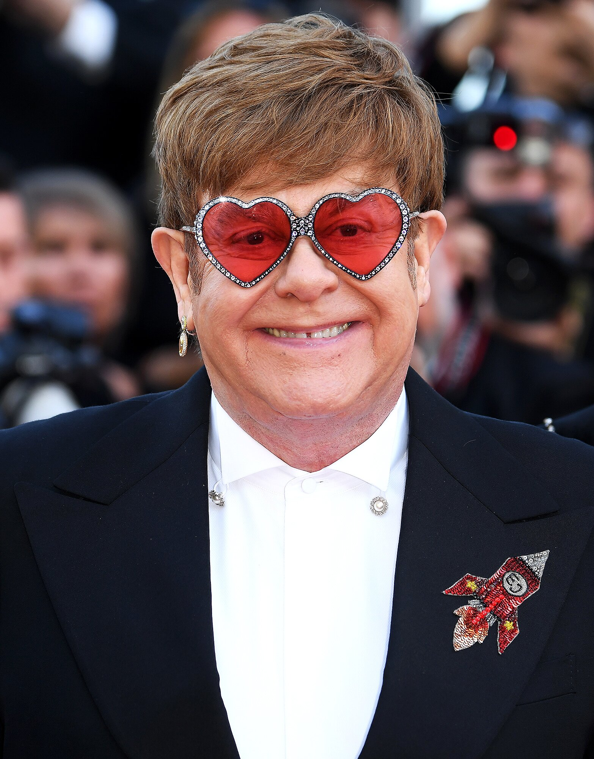
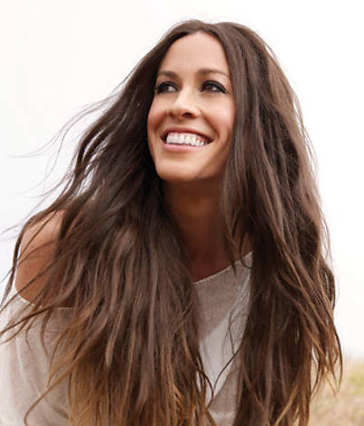
Who is Canadian?
Elton John
Alanis Morrissette

Slide 42
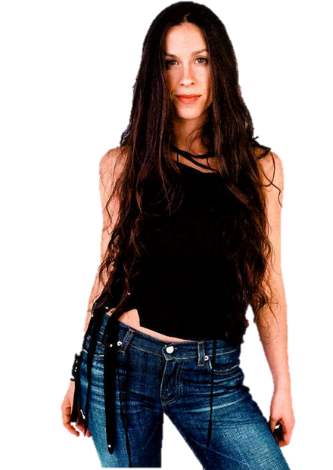
You Learn (1995)
You Oughta Know (1995)
Hand in My Pocket (1995)
Head Over Feet (1995)
Uninvited (1998)
Thank You (1998)
Hands Clean (2002)
Everything (2004)

Slide 43
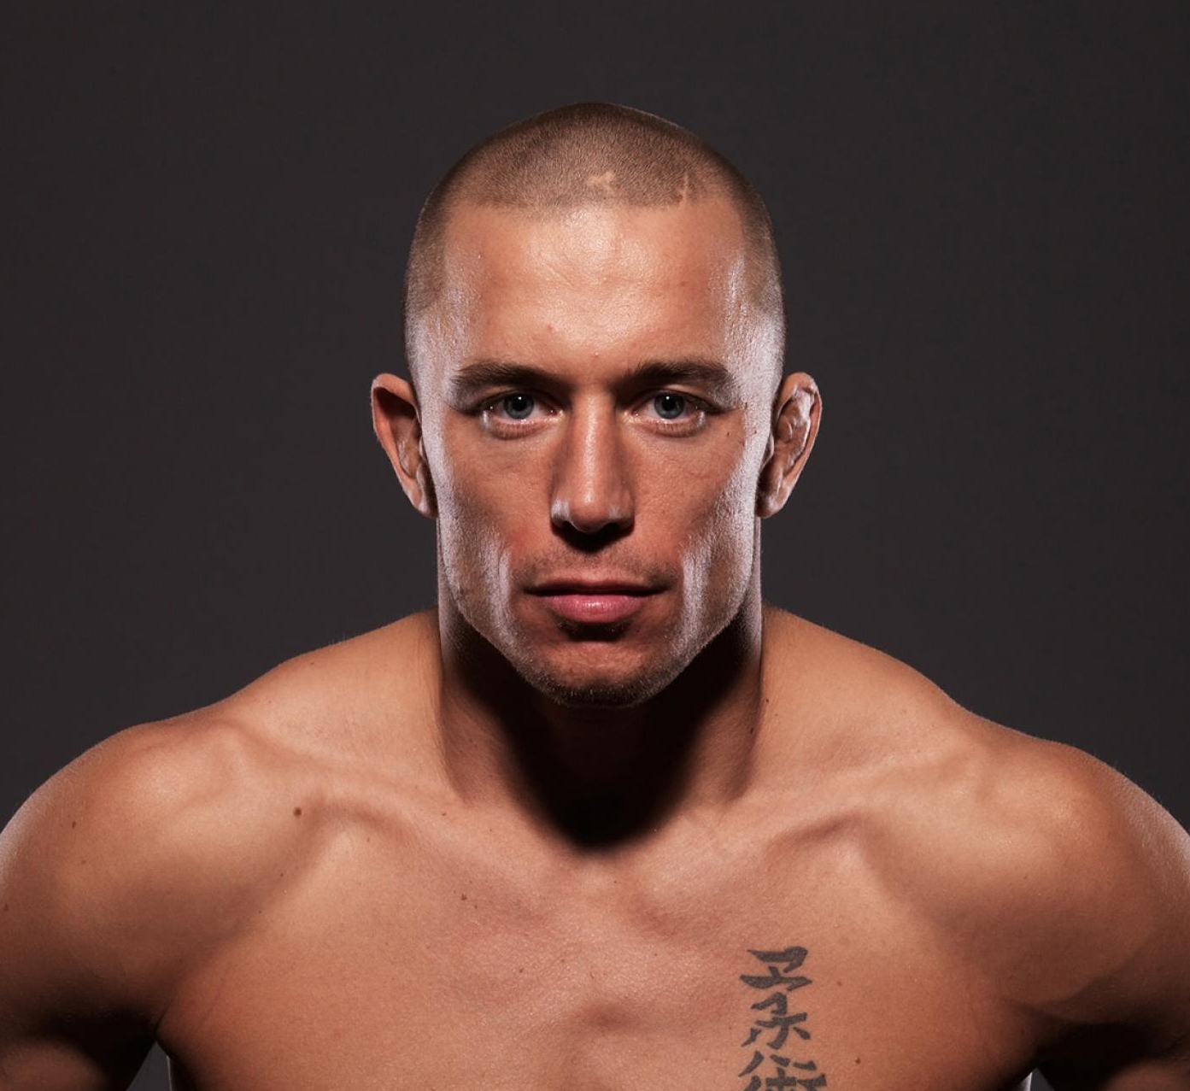
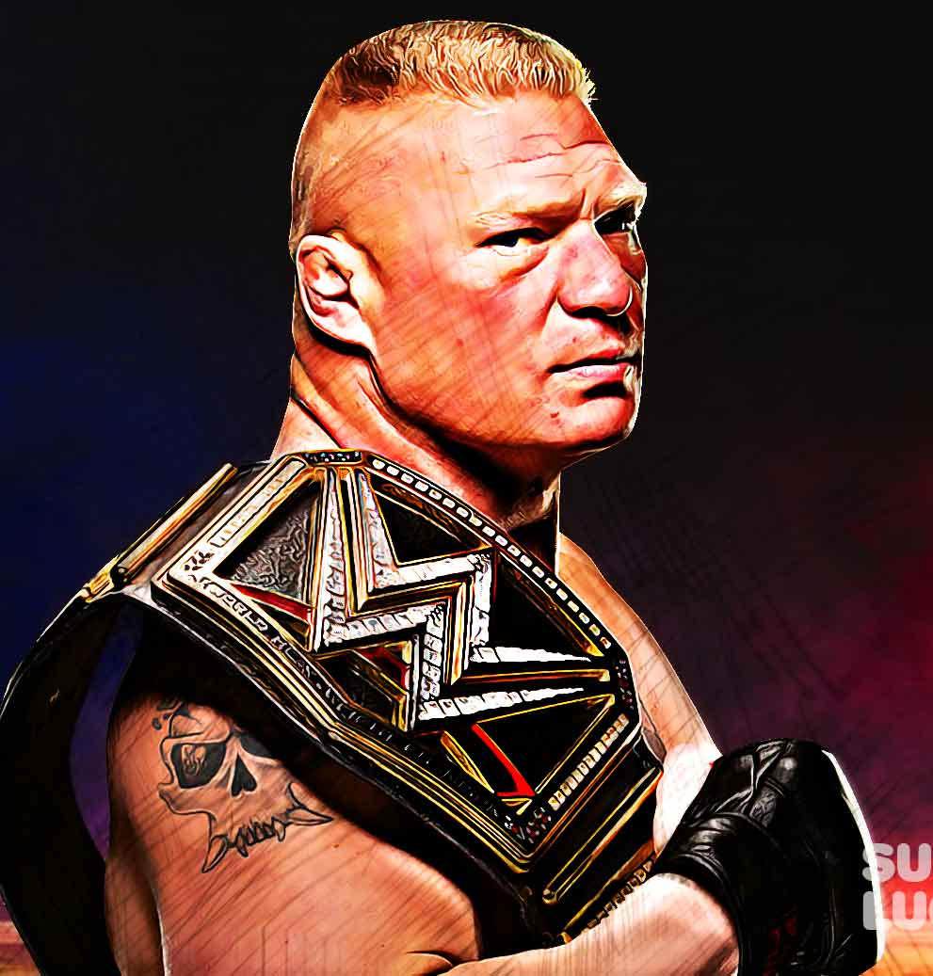
Who is Canadian?
Brock Lesnar
George St. Pierre

Slide 45
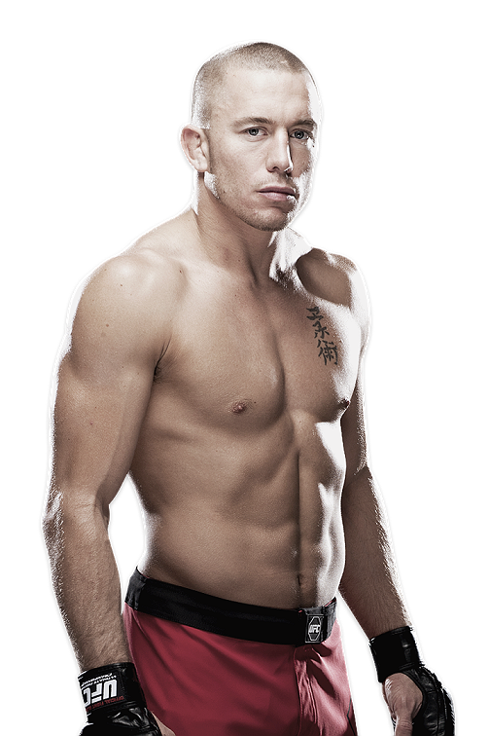
MMA
3x UFC Welterweight Champion
UFC Middleweight Champion
Canadian Athlete of the Year (2008,2009,2010)
Considered one of the greatest

