Slide 1
CANADIAN
CONTENT
RECOMMENDING

Slide 2
I want to recommend this to you.
too formal

Slide 3
Why don’t you…
too demanding

Slide 4
You should listen to…
You should try…
You should check out…
natural

Slide 5
I think you will like it because…
You seem like…
Why are you recommending?

Slide 6
CANADIAN
CONTENT

Slide 7
TITLE
Name of the song

Slide 8
ARTIST
Who sang it?

Slide 9
FEELING
How did it make you feel?

Slide 10
MEANING
Guess what it is about

Slide 11
RECOMMEND
Share it with someone else
Choose someone who will like it

Slide 12
SONG
MEANING

Slide 13
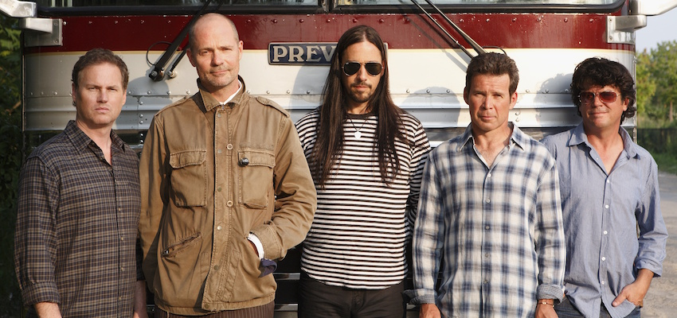
Bobcaygeon
The Tragically Hip

Slide 14
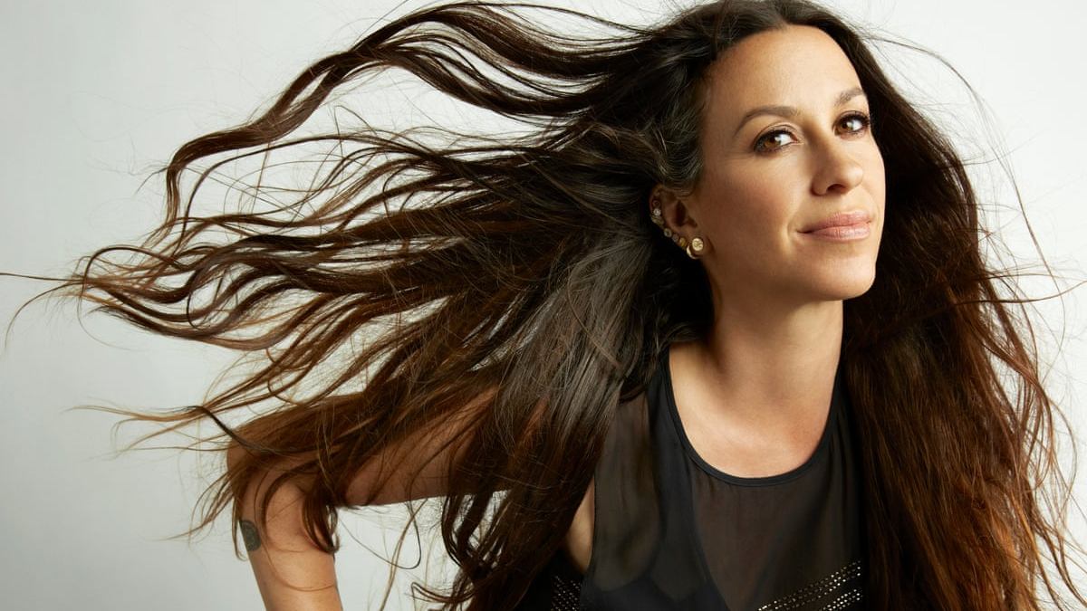
Perfect
Alanis Morrisette

Slide 15
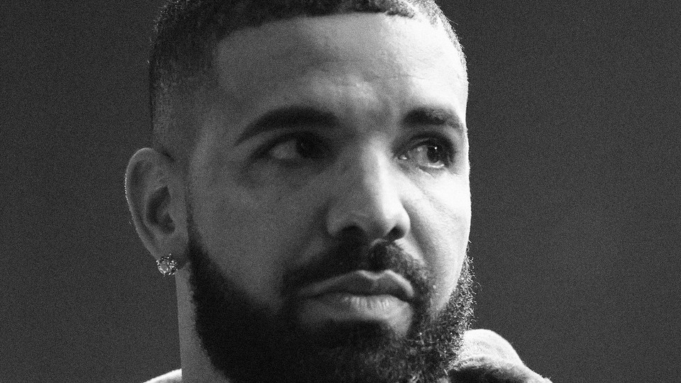
God’s
Plan
Drake

Slide 16
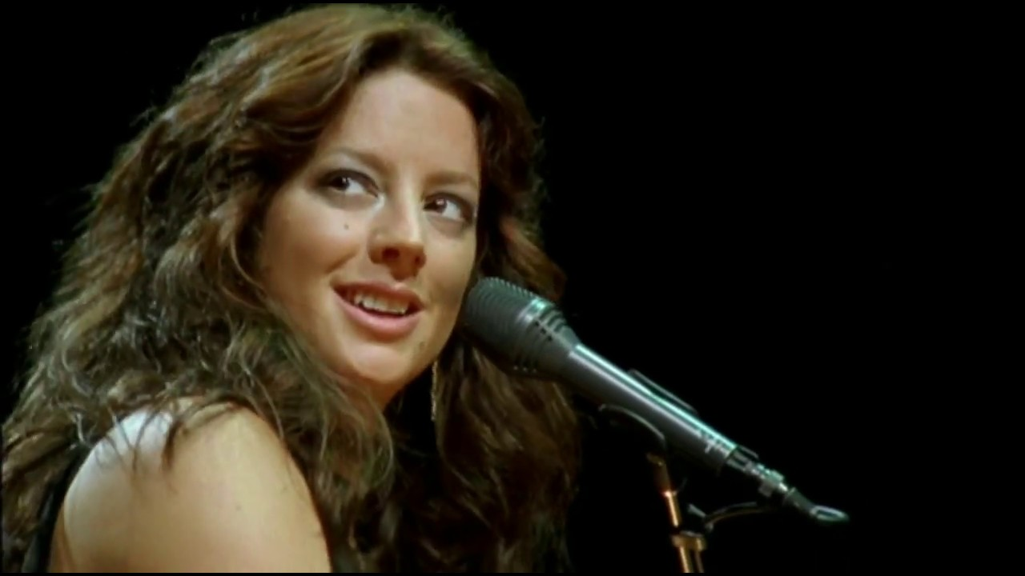
Possession
Sarah McLachlan

Slide 17
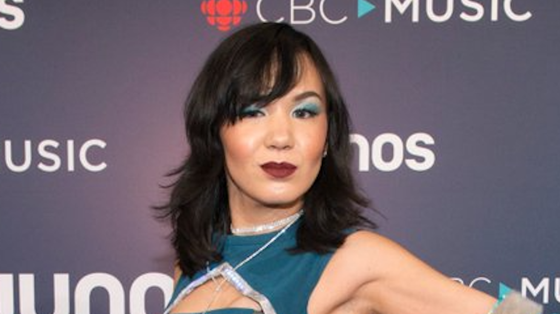
Fight for
the Right
Kelly Fraser

Slide 18
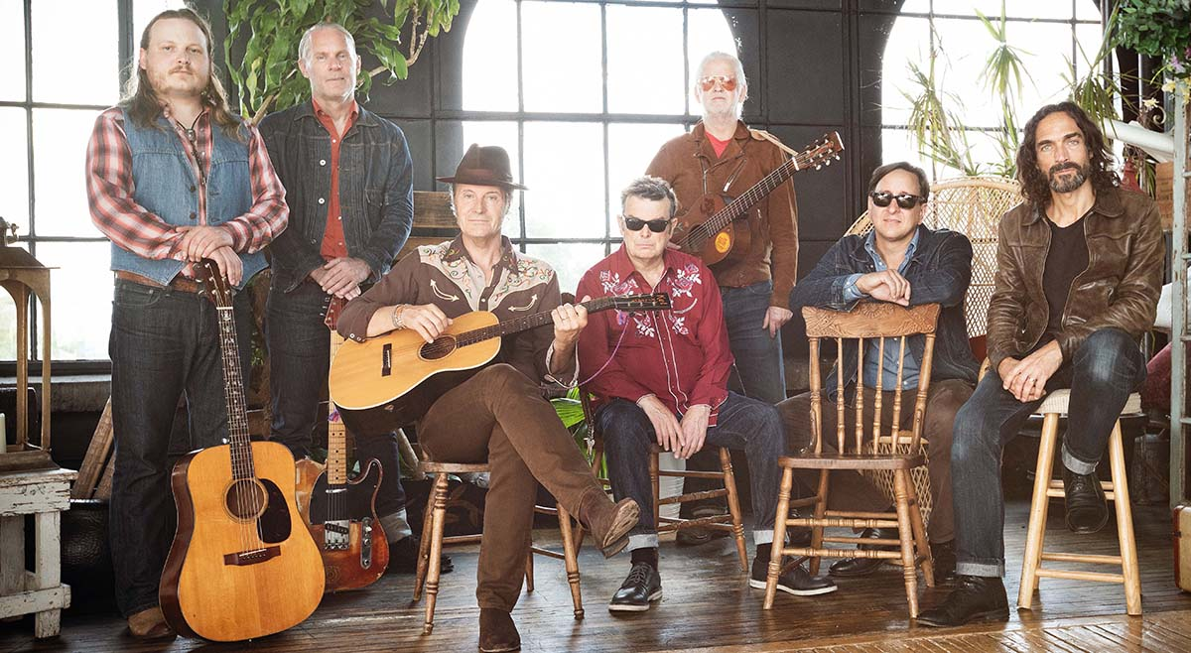
Try
Blue Rodeo

Slide 19
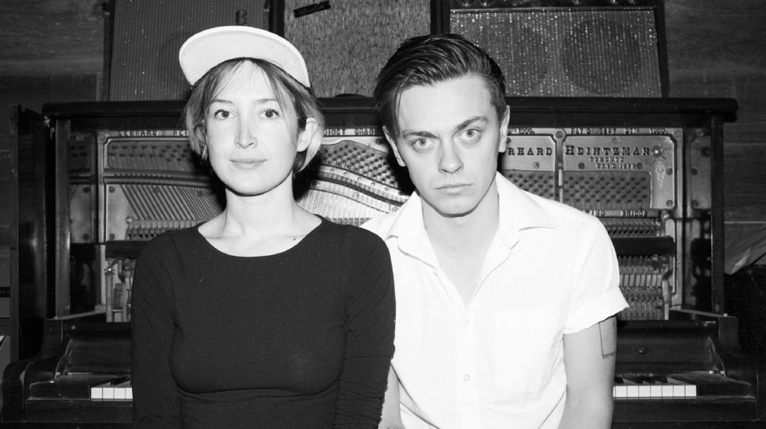
Push and Pull
July Talk

Slide 20
Uja
Tanya Tagaq

Slide 21
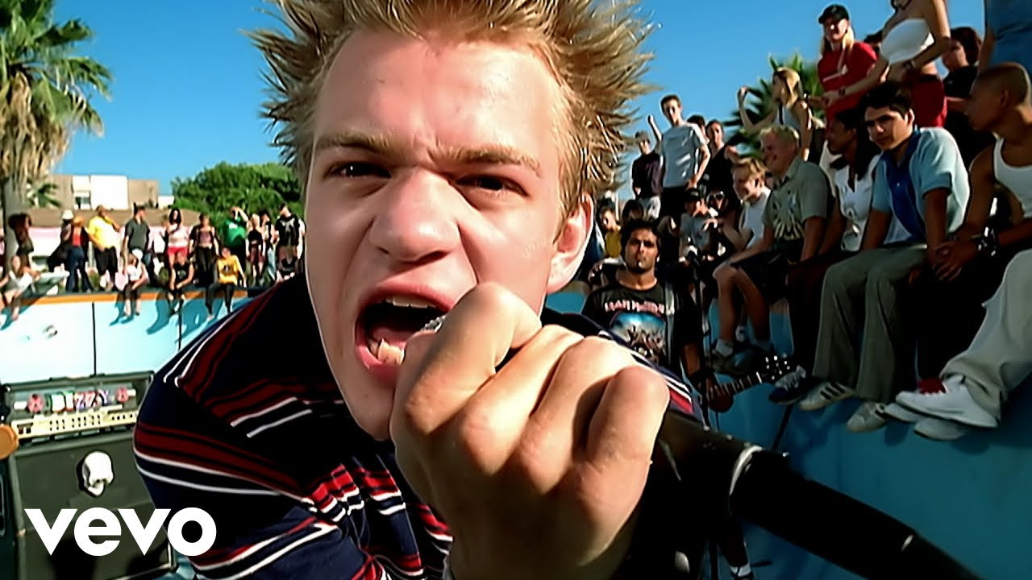
In Too Deep
Sum 41

Slide 22
Stadium
Pow Wow
The Halluci Nation

Slide 23
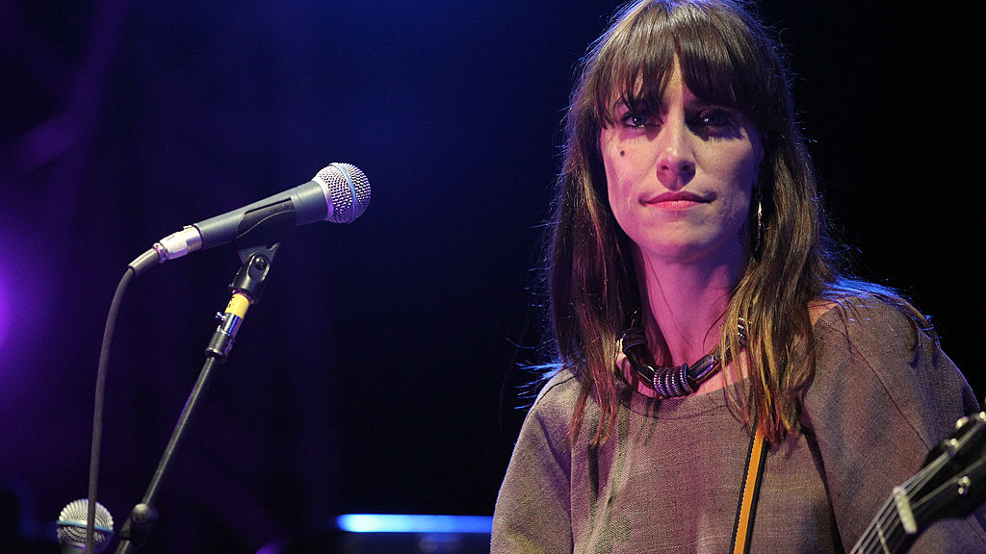
1234
Fiest

Slide 24
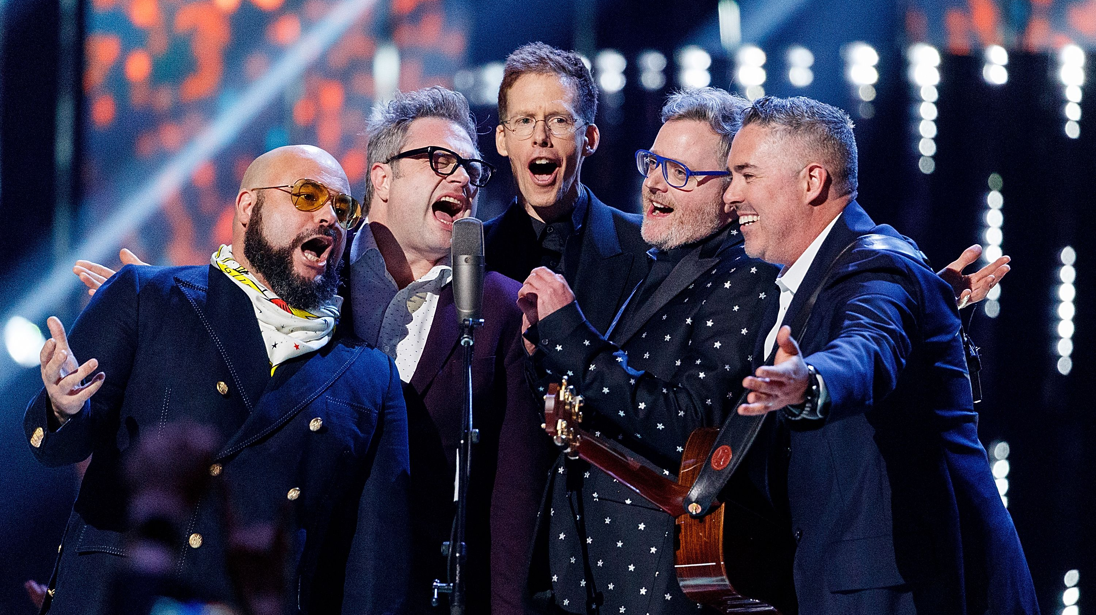
Call and Answer
BNL

Slide 25
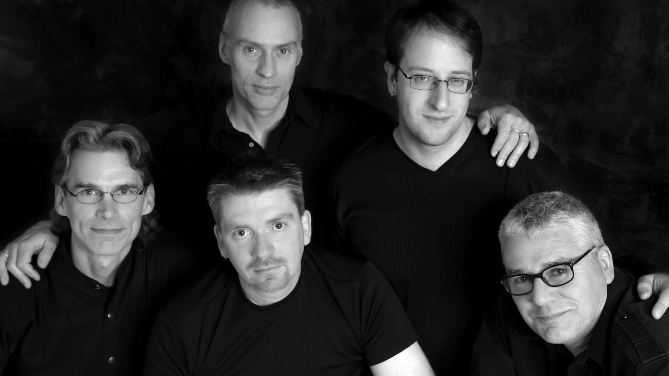
Home for a Rest
Spirt of the West

Slide 26
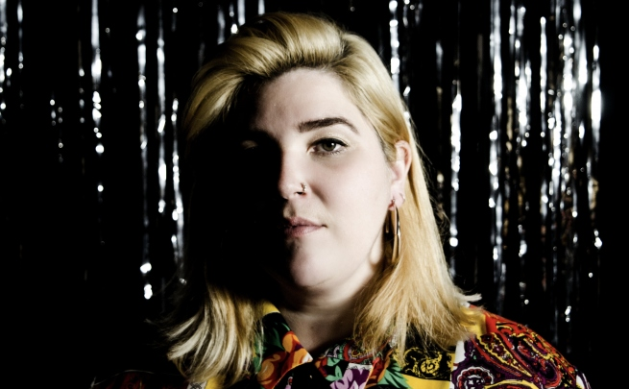
In the
Woods
Kim Harris

Slide 27
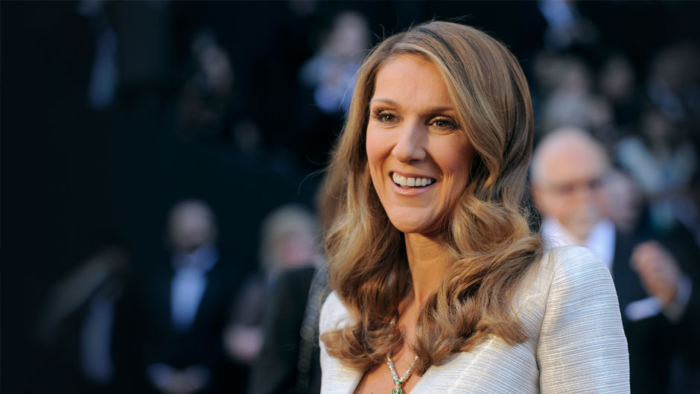
Pour que tu m’aimes encore
Celine Dion

Slide 28
Clumsy
Our Lady Peace

Slide 29
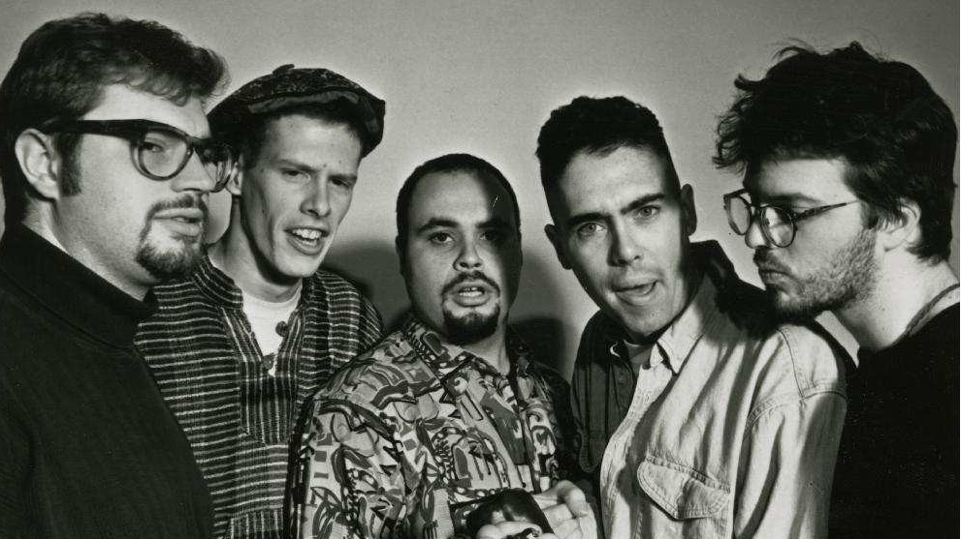
Break Your Heart
BNL

Slide 30
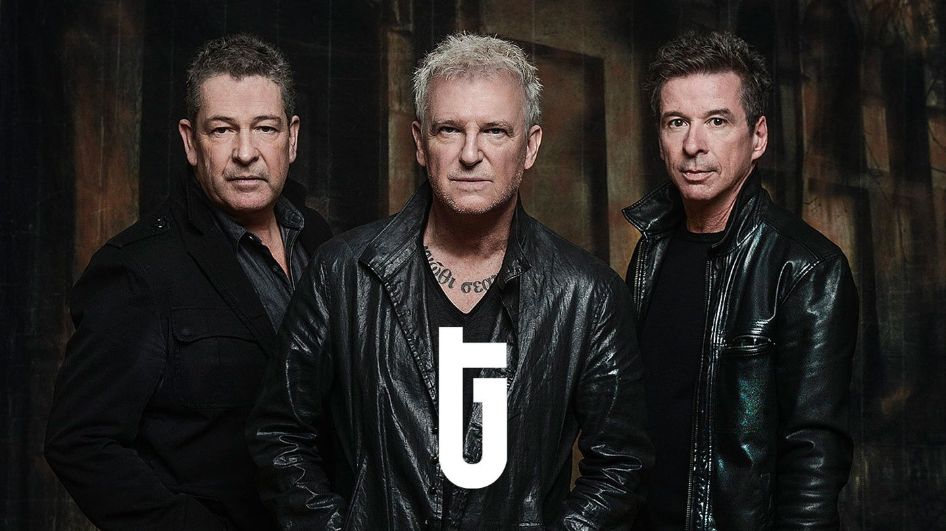
Don’t
Forget Me
Glass Tiger

Slide 31
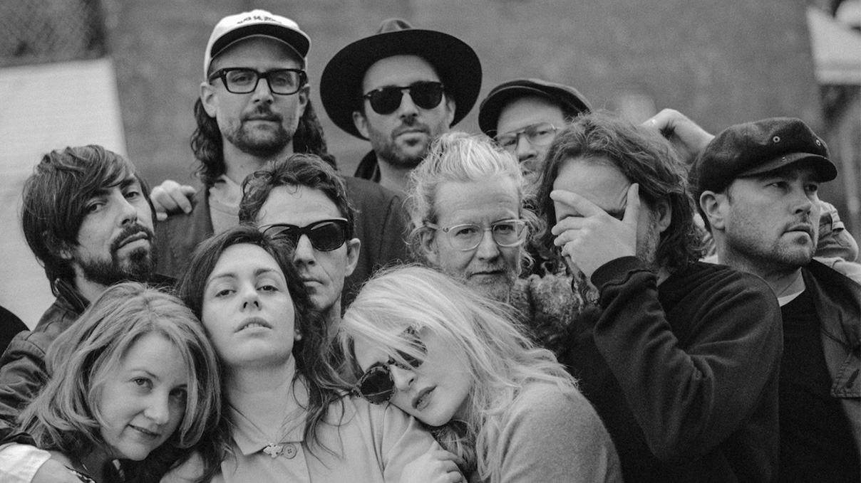
Anthems for a Seventeen-year-old Girl
Broken Social Scene

Slide 32
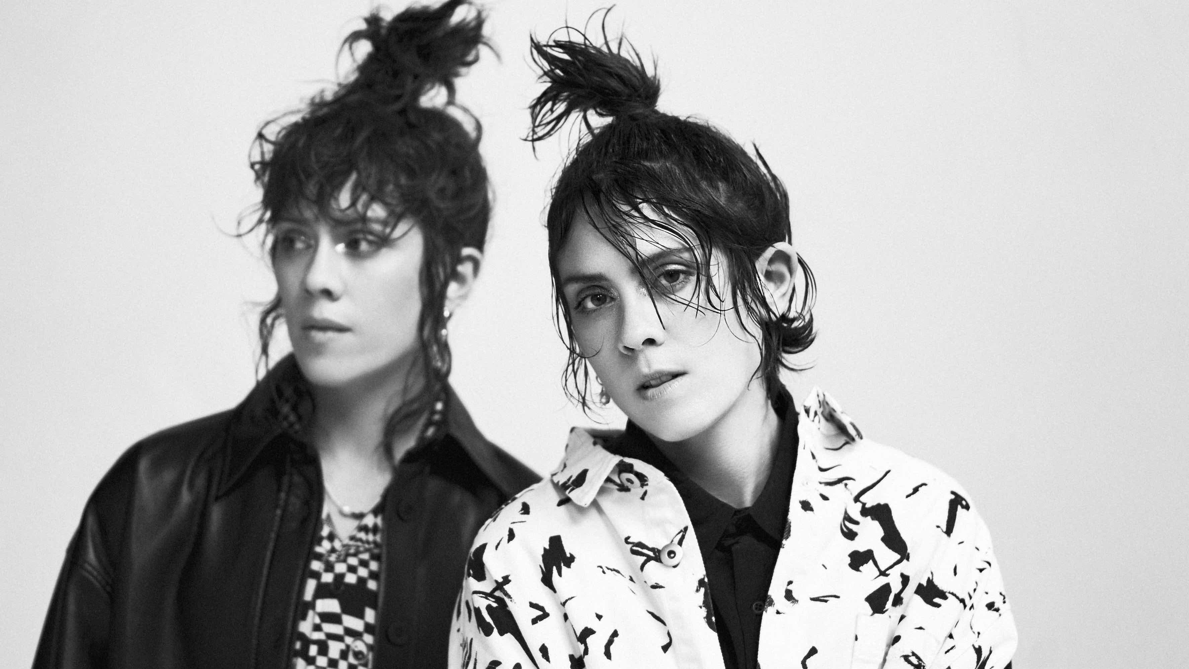
Closer
Tegan and Sara

