Slide 1
Canadian
Wildlife

Slide 2
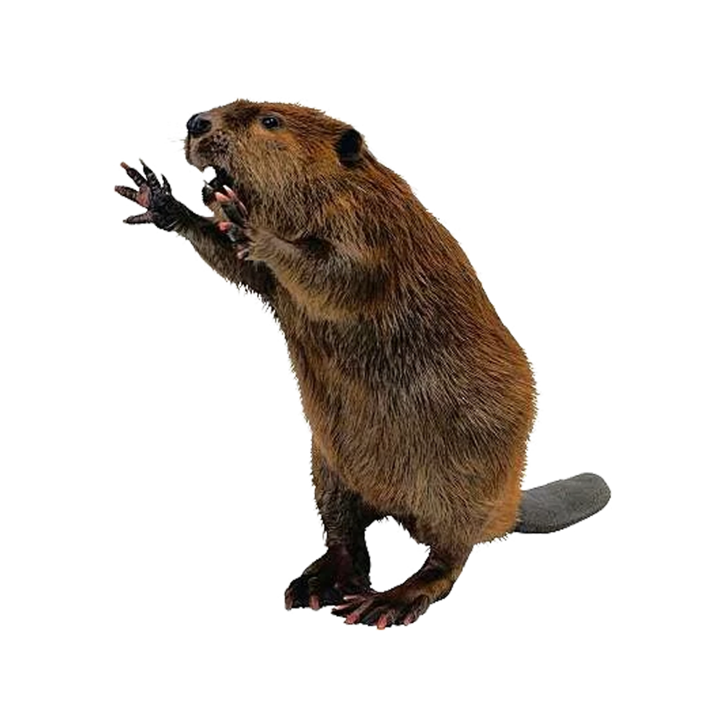
National Animal
Beaver

Slide 3
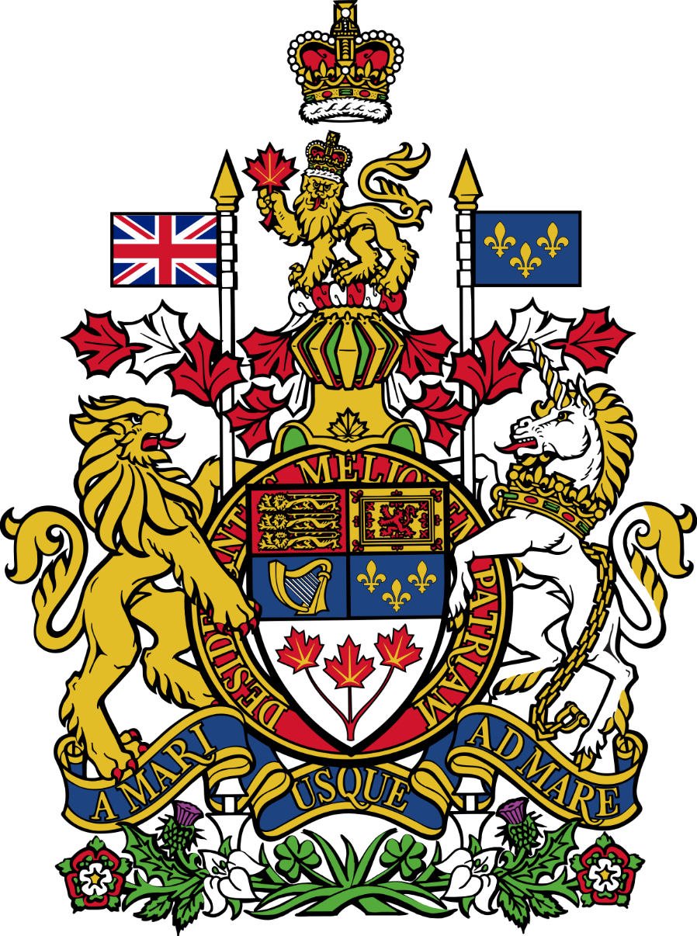
Coat of Arms

Slide 4
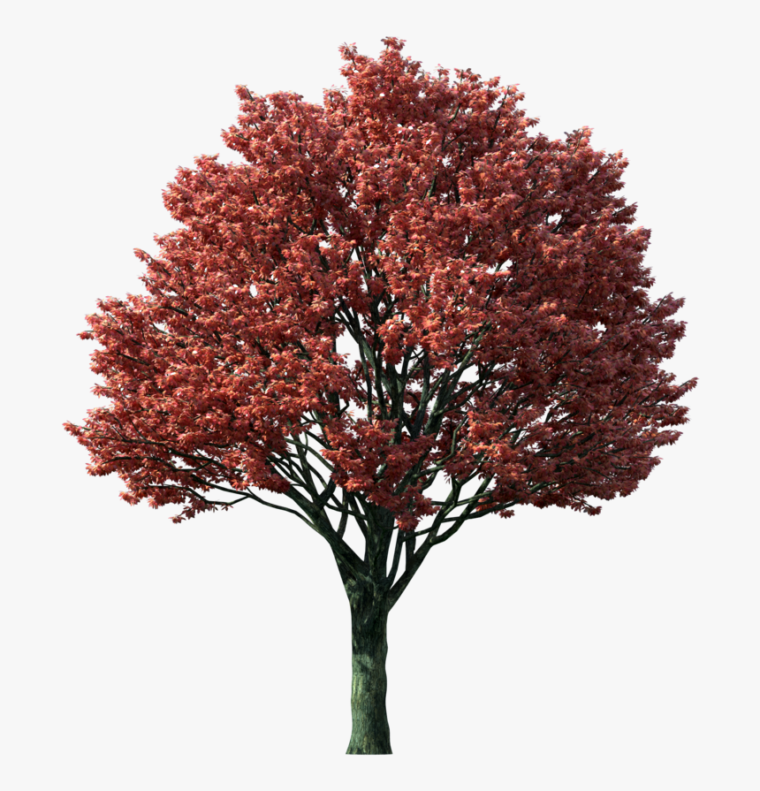
National Tree
Maple

Slide 5
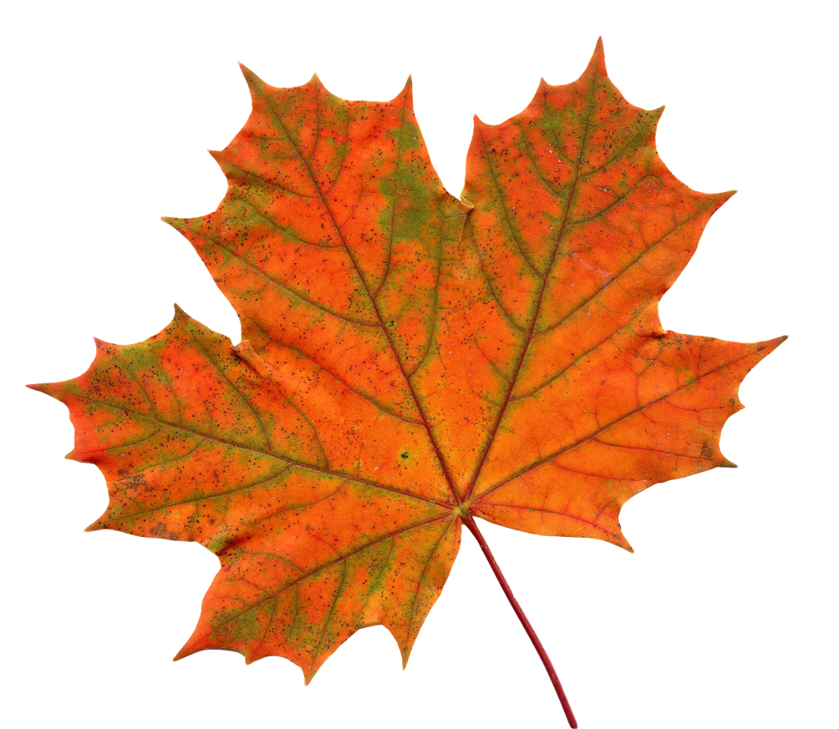
National ‘Flower’
Maple Leaf

Slide 6
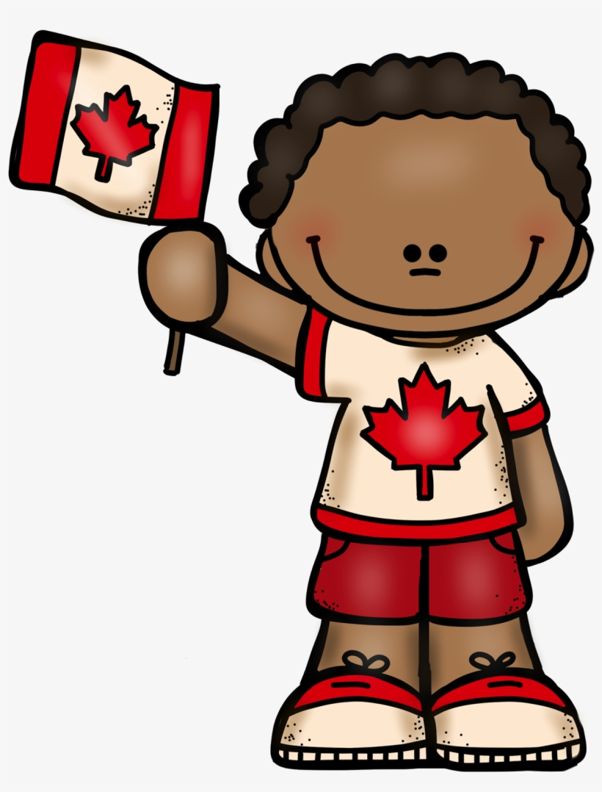
National Anthem
Oh Canada

Slide 7
National Flag

Slide 8
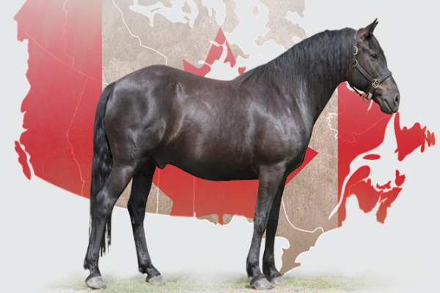
National Horse
Canadian Horse

Slide 9
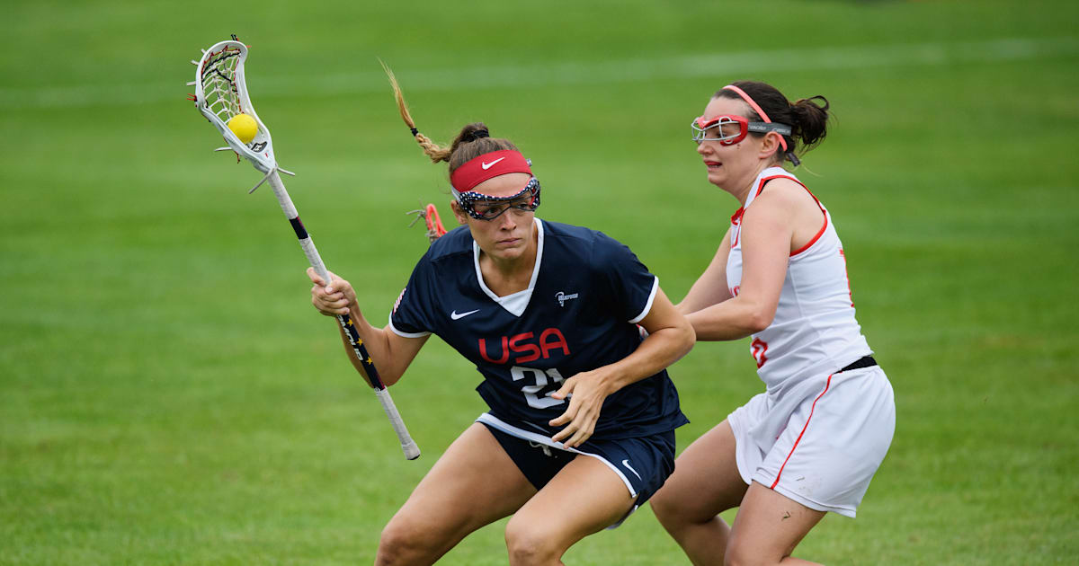
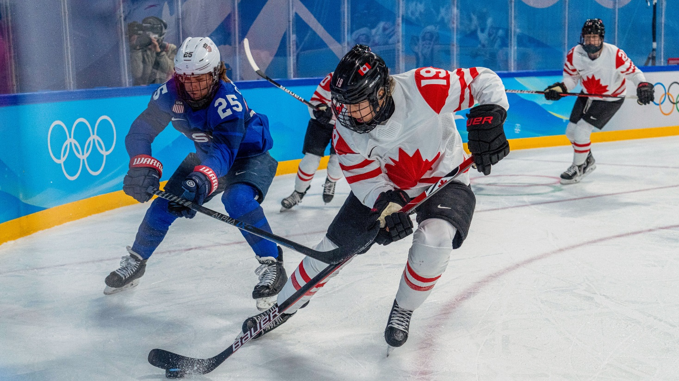
National Sport
Lacrosse / Hockey

Slide 10
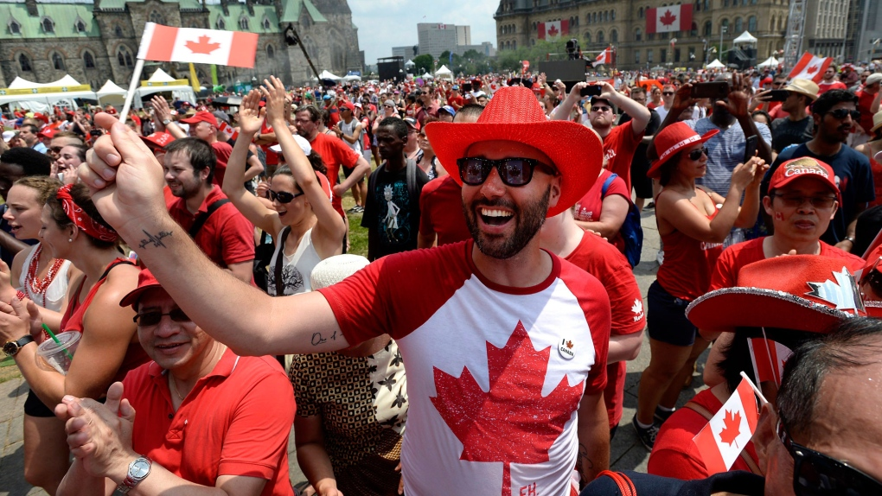
National Colors
Red / White

Slide 11
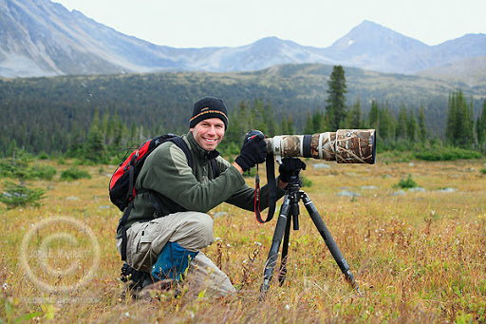

Slide 12
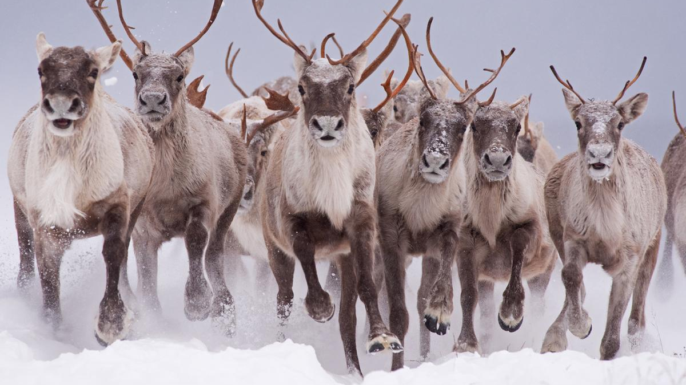
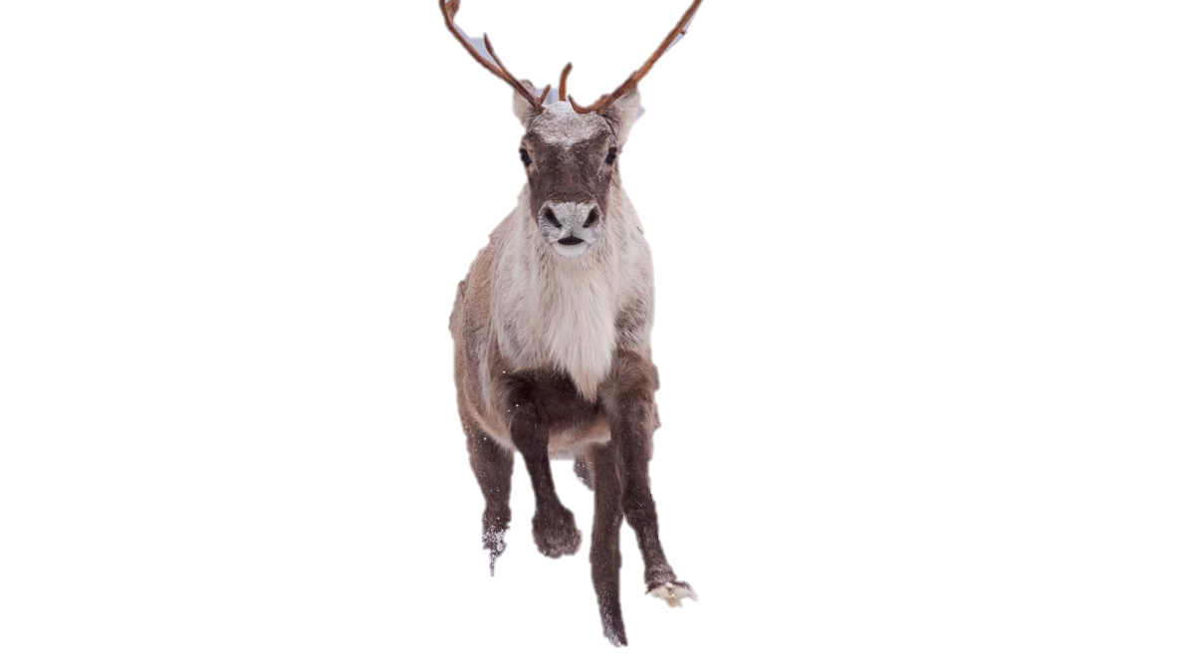
Caribou

Slide 13
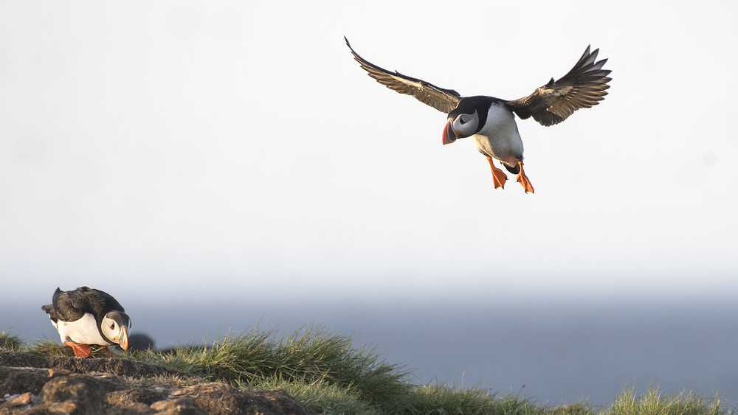
Puffin

Slide 14
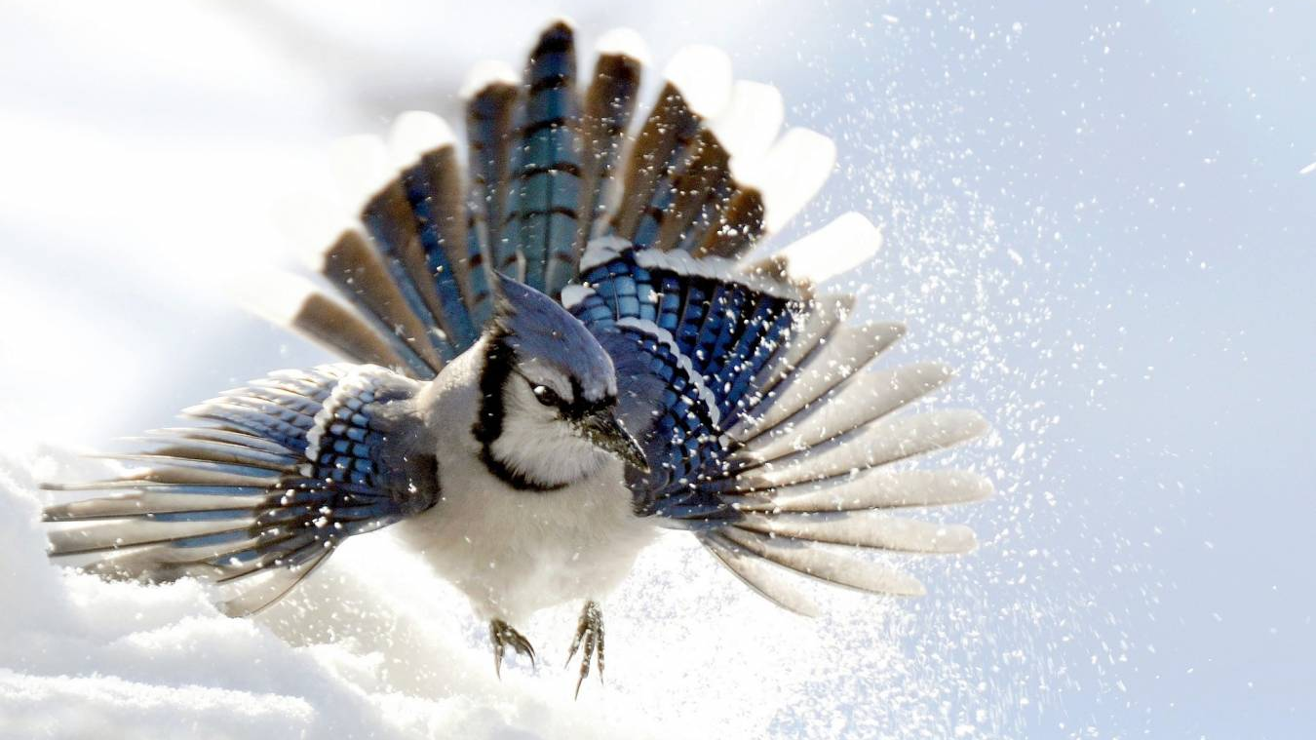
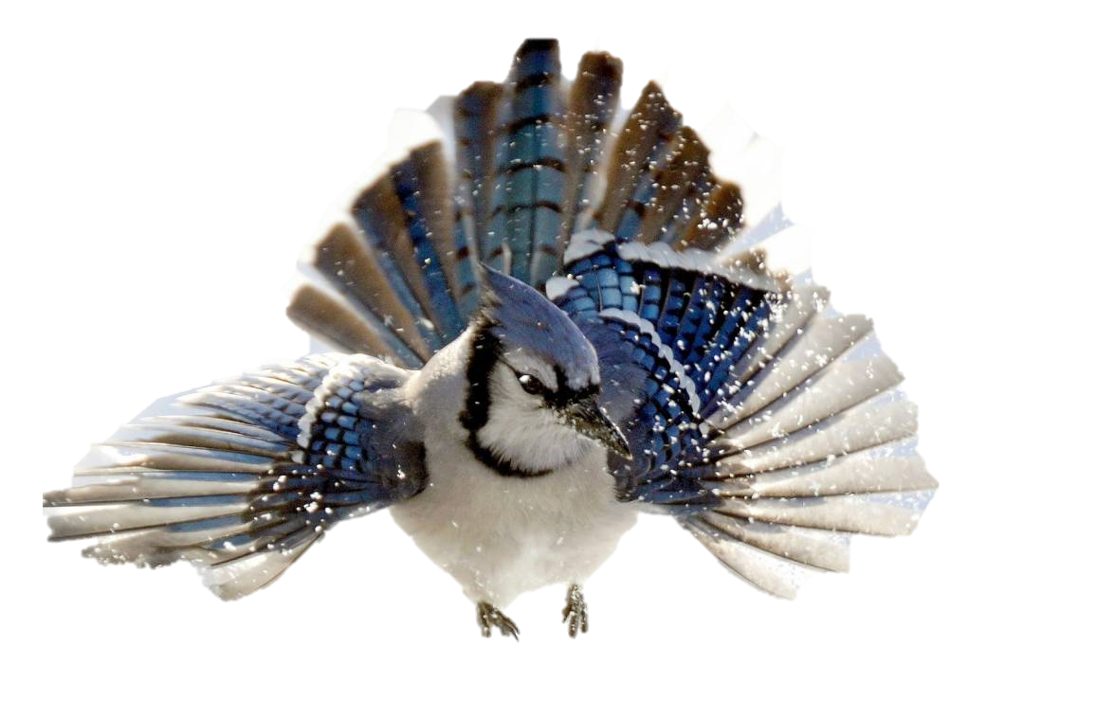
Blue
Jay

Slide 15
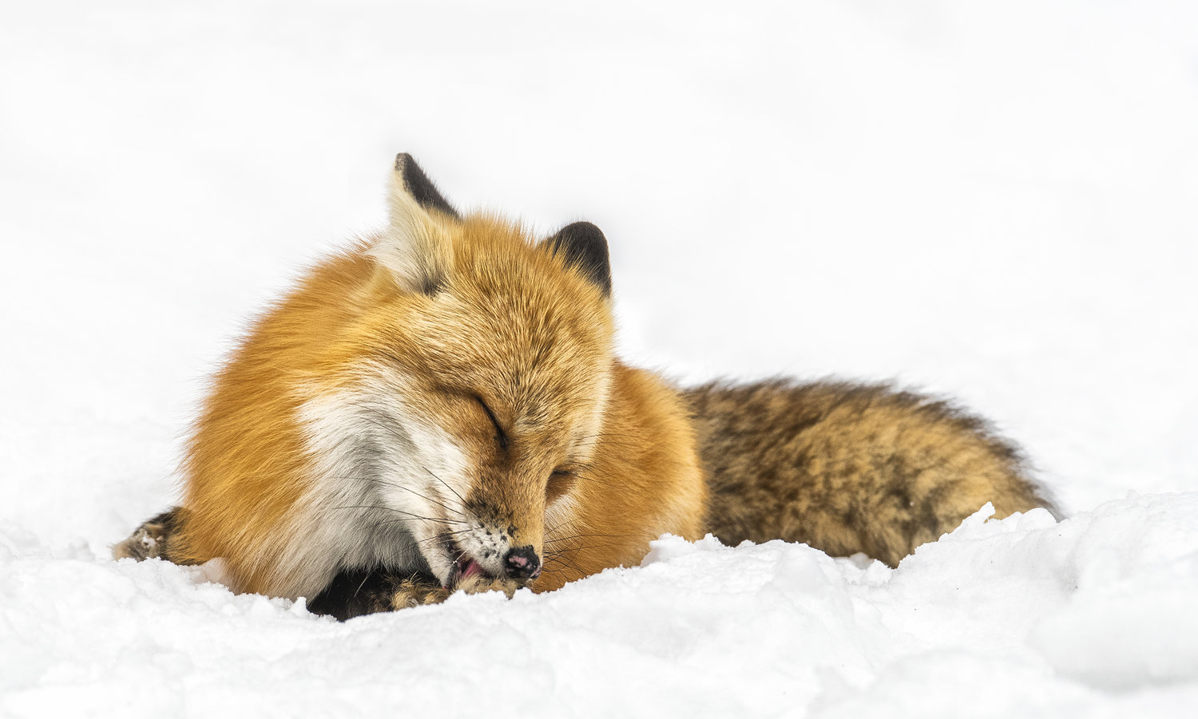
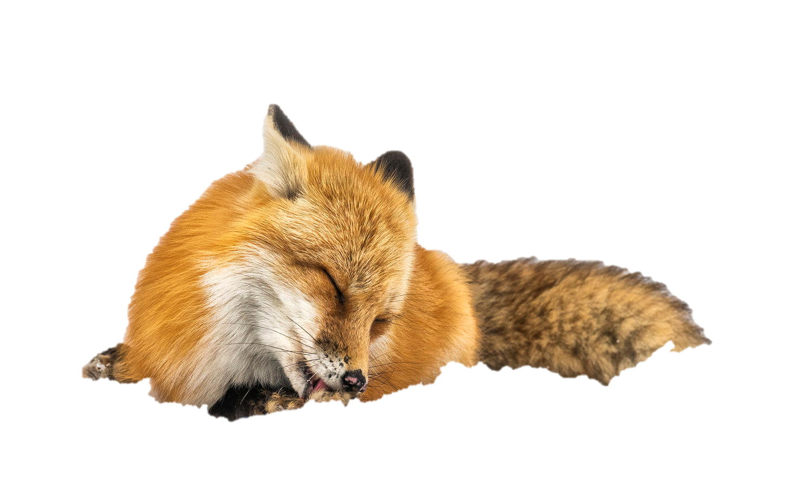
Red Fox

Slide 16
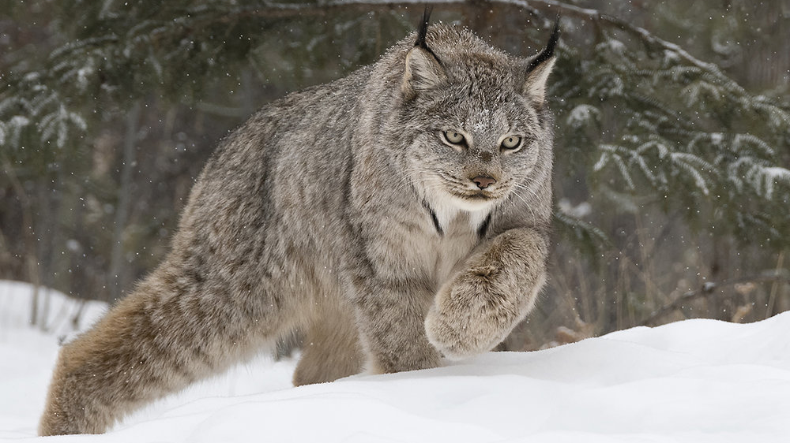
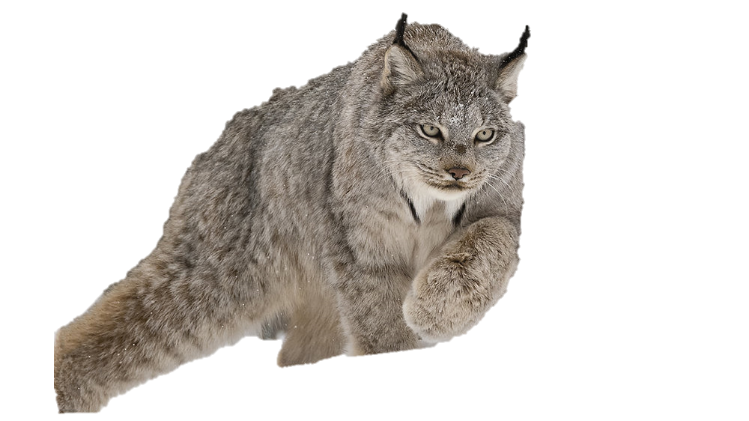
Lynx

Slide 17
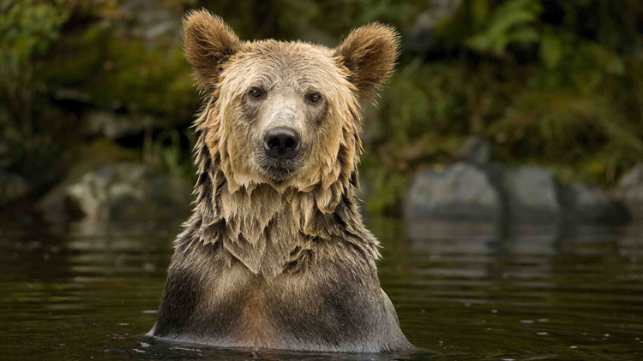
Brown
Bear

Slide 18
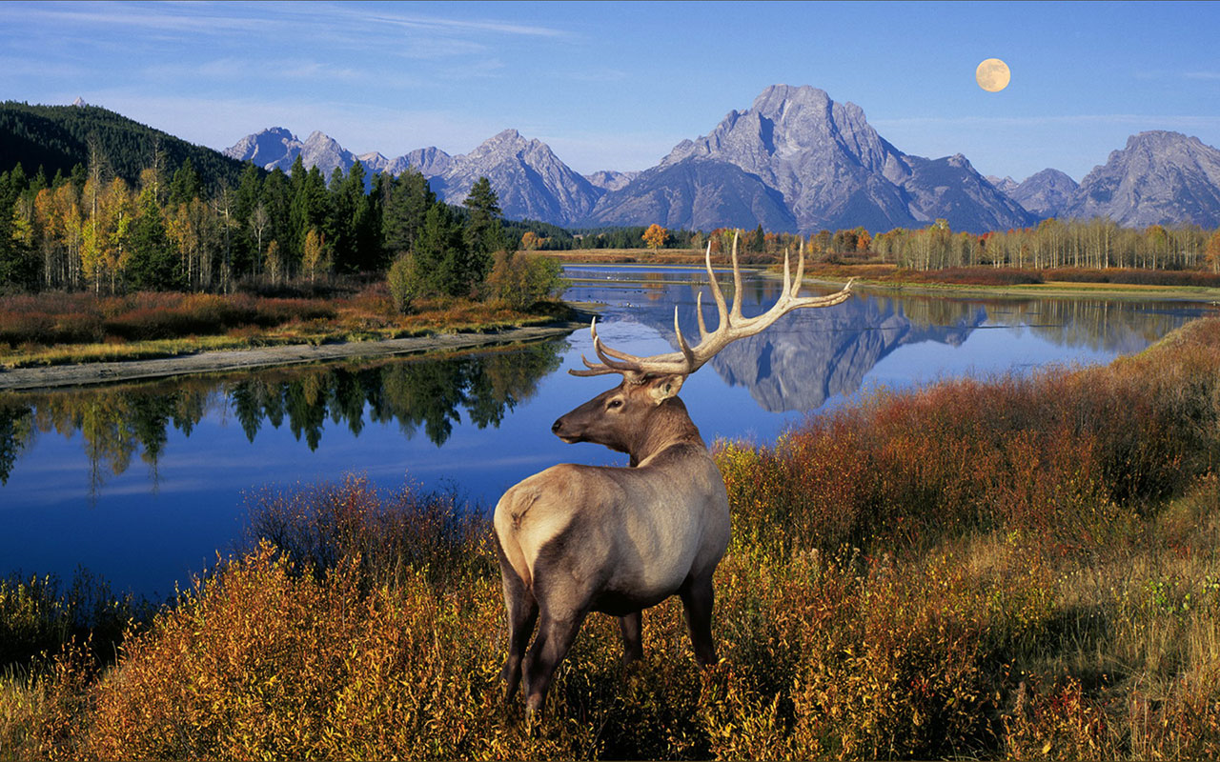
Elk
(Wapiti)

Slide 19
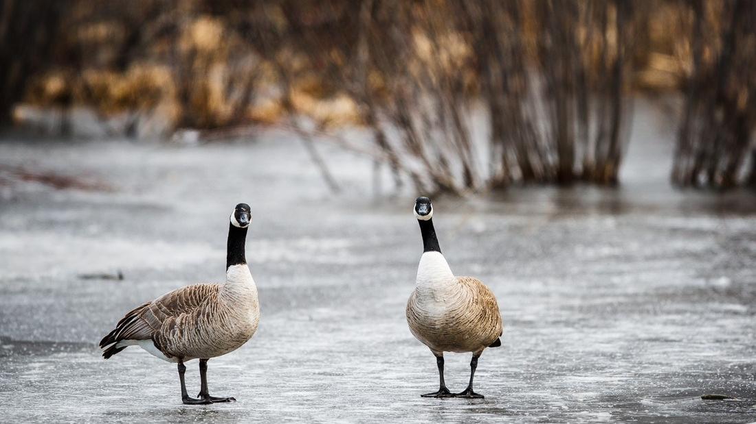
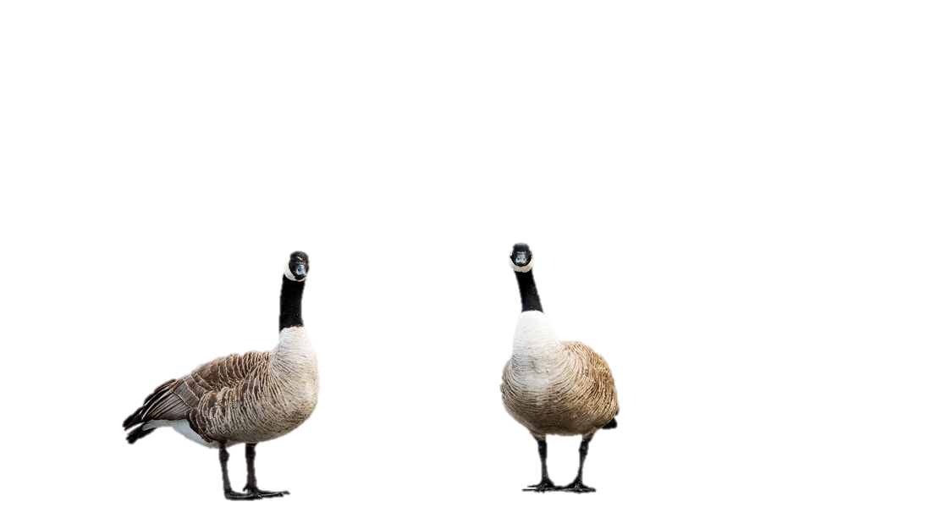
Canadian Goose

Slide 20
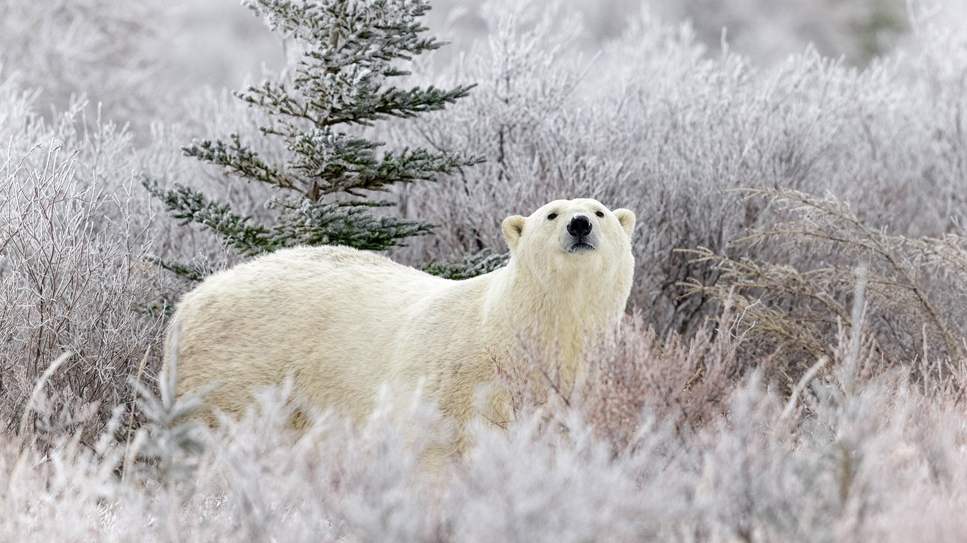
Polar Bear

Slide 21
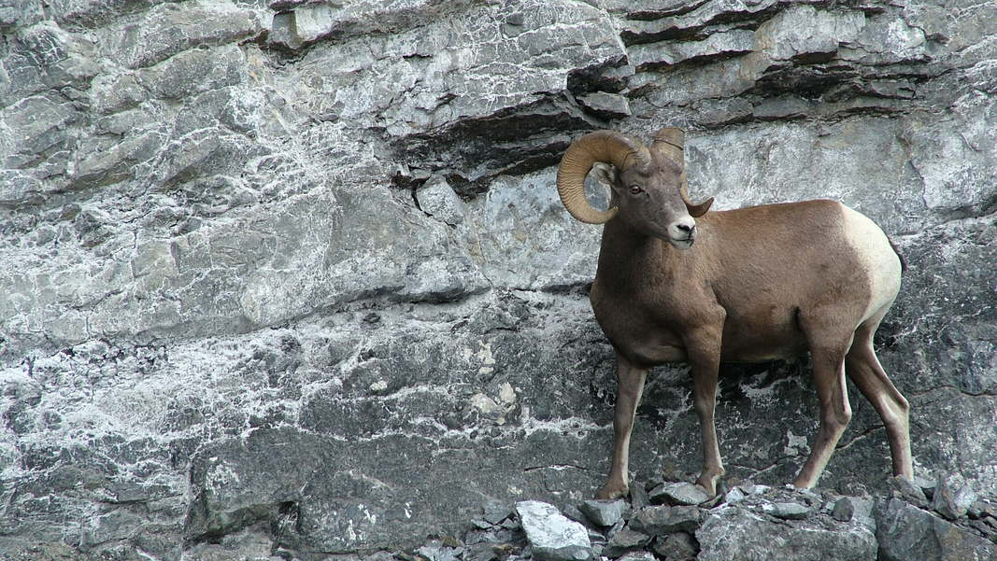
Bighorn
Sheep

Slide 22
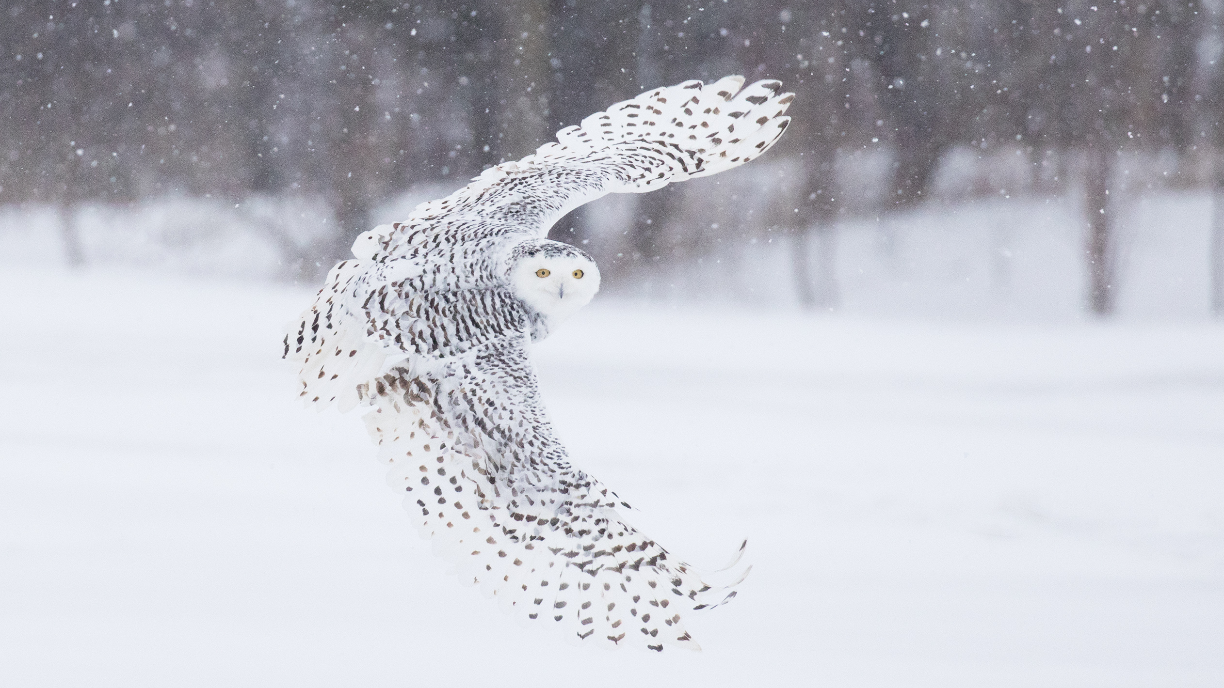
Snowy
Owl

Slide 23
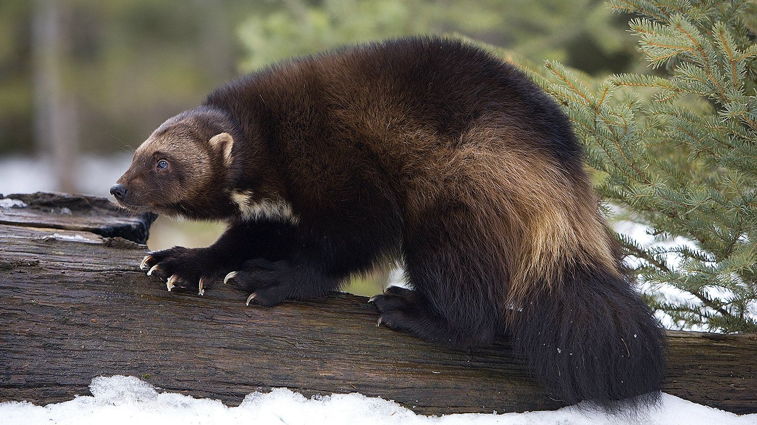
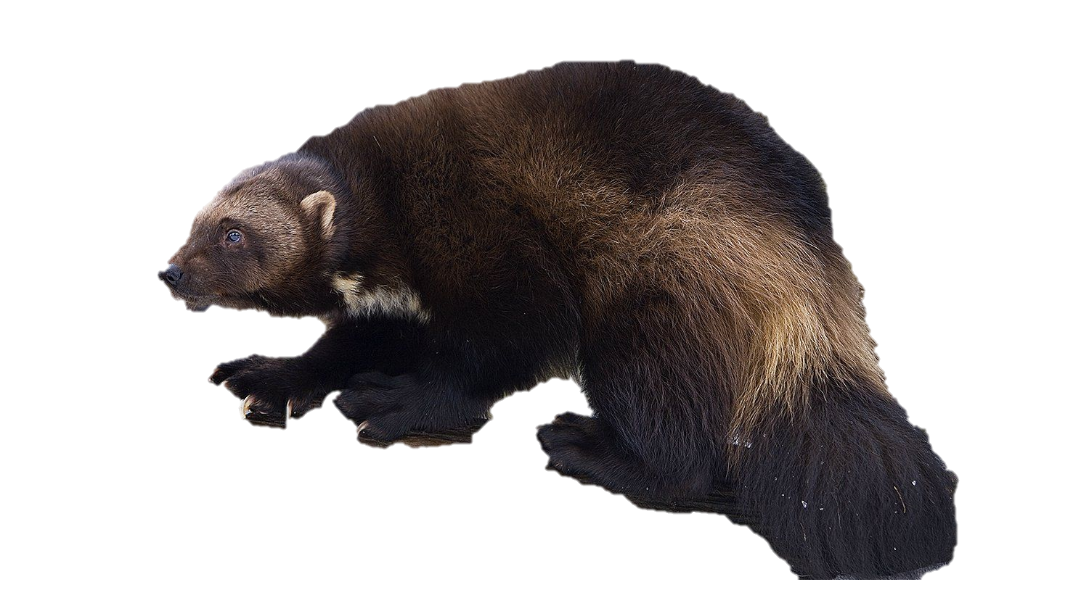
Wolverine

Slide 24
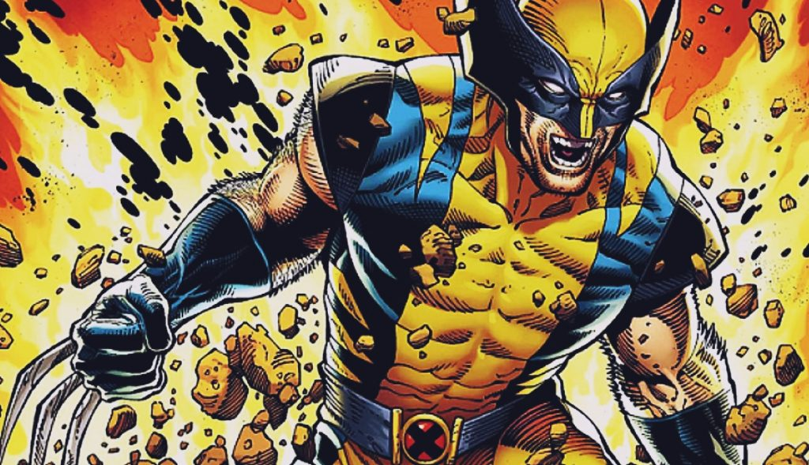

Slide 25
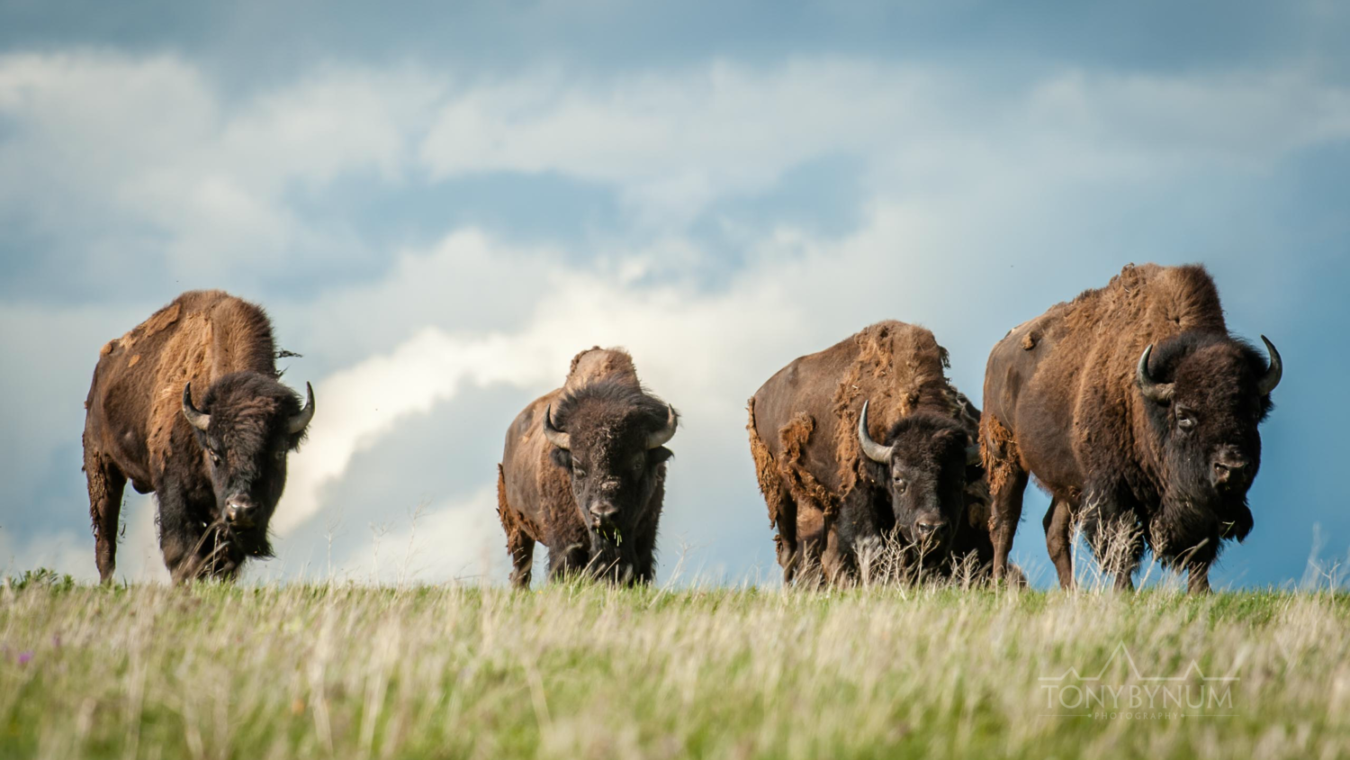
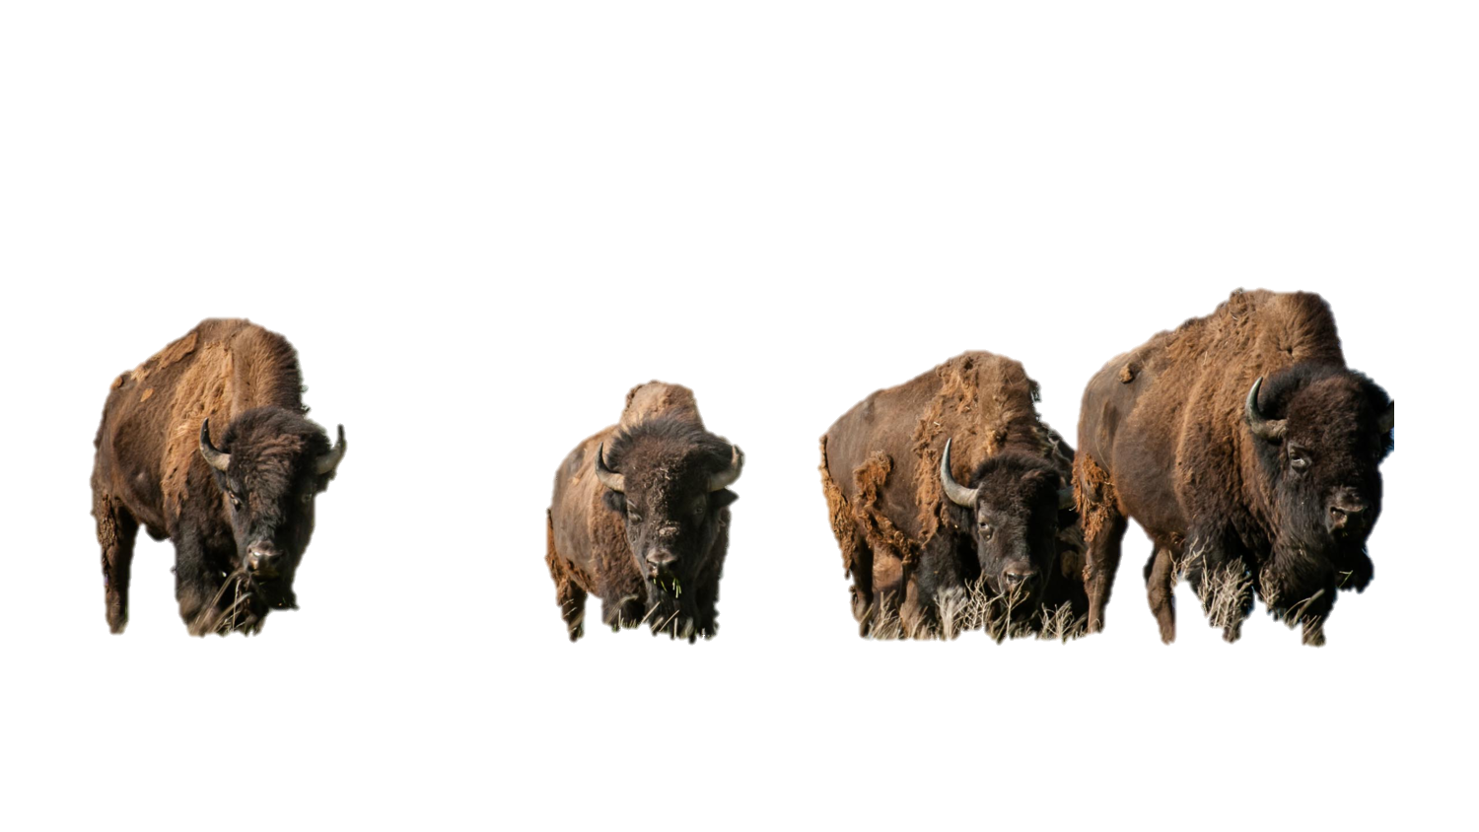
Bison

Slide 26
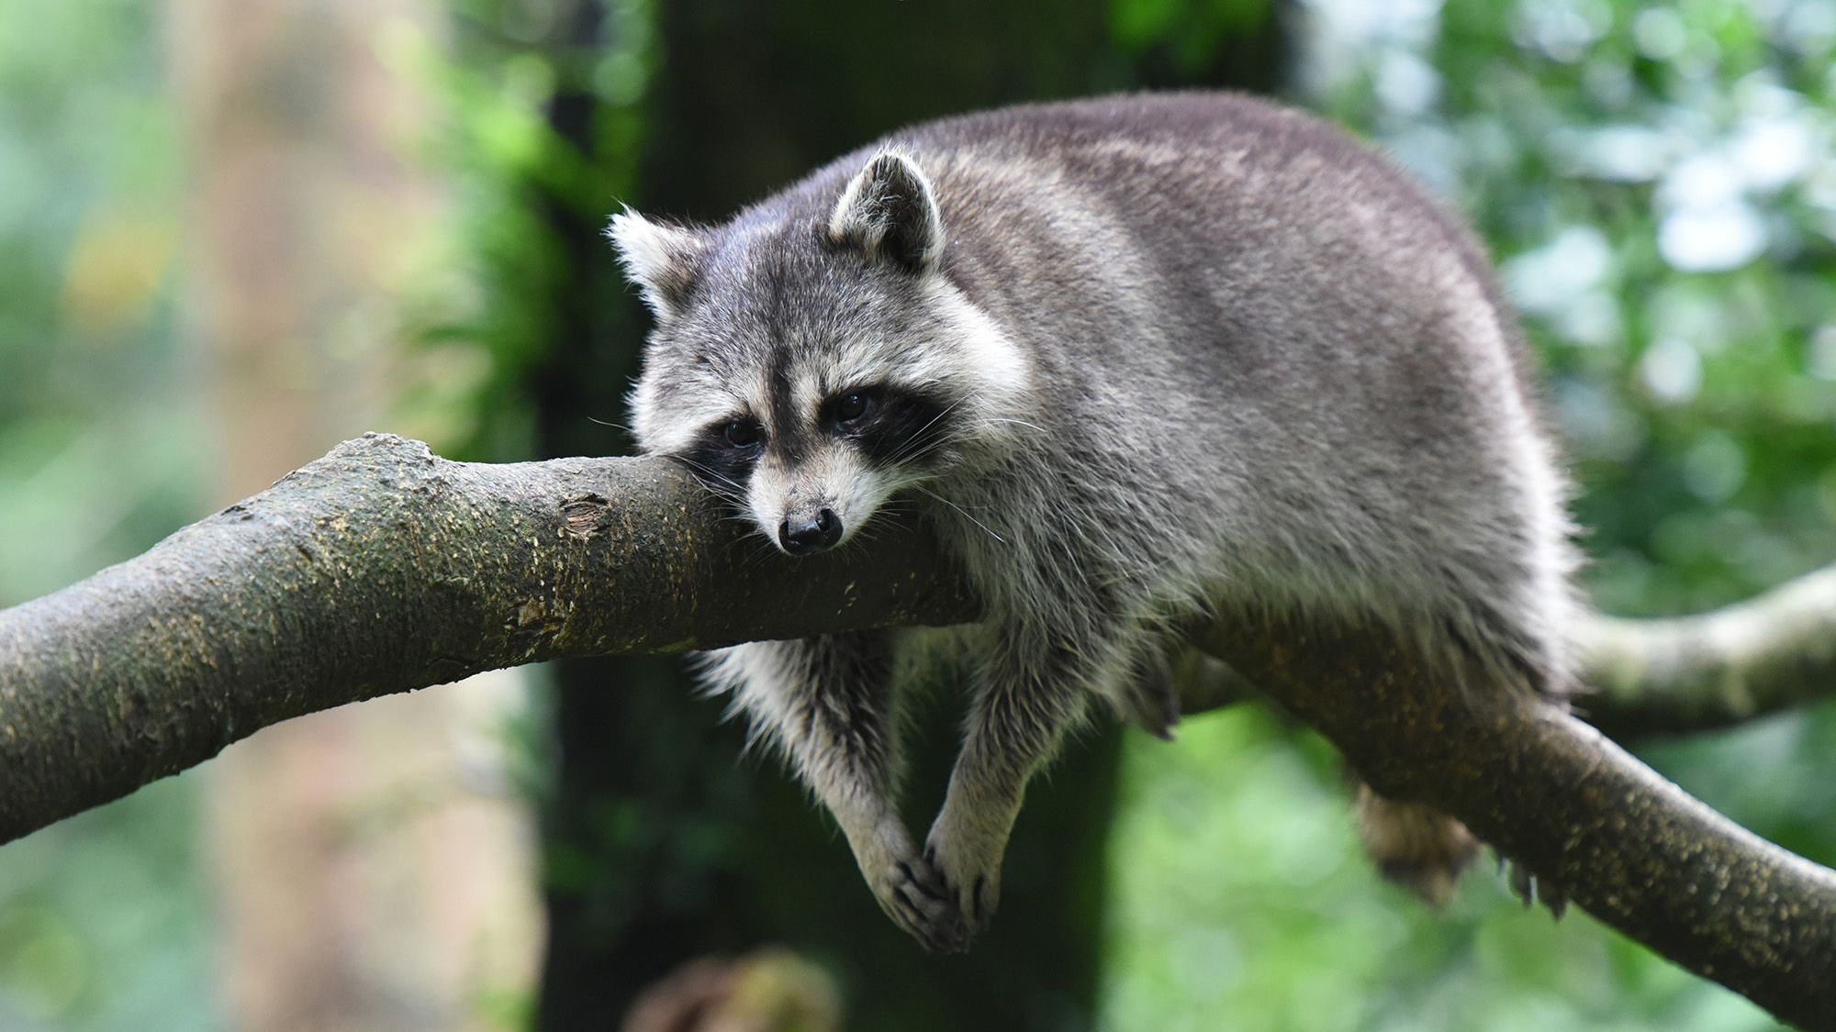
Raccoon

Slide 27
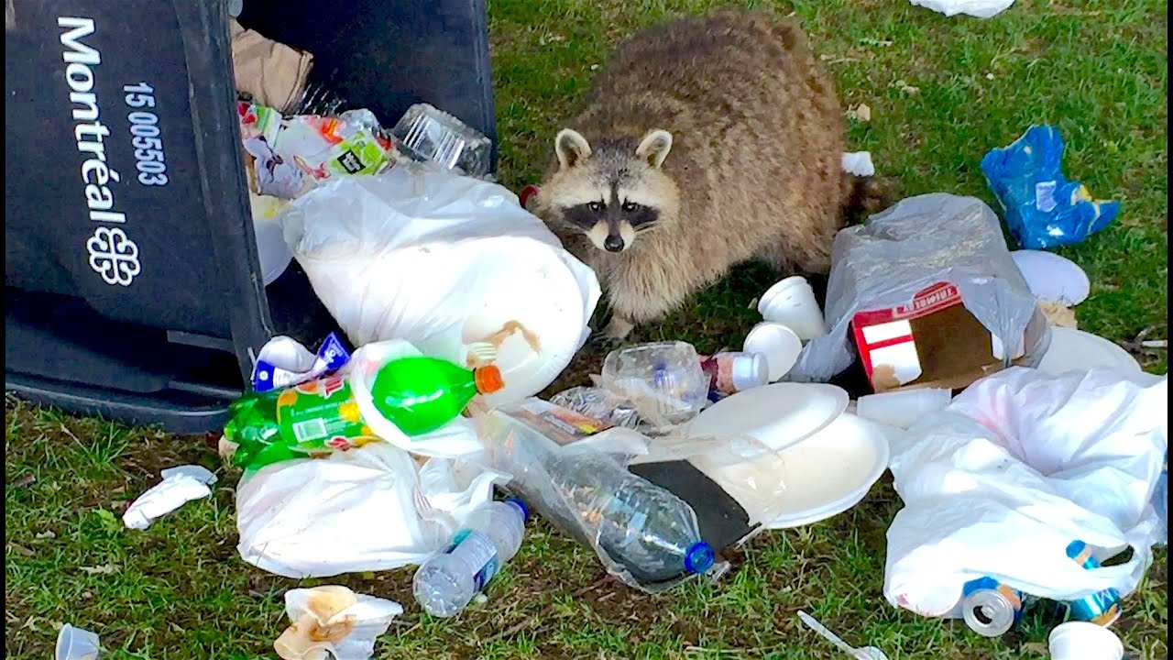

Slide 28
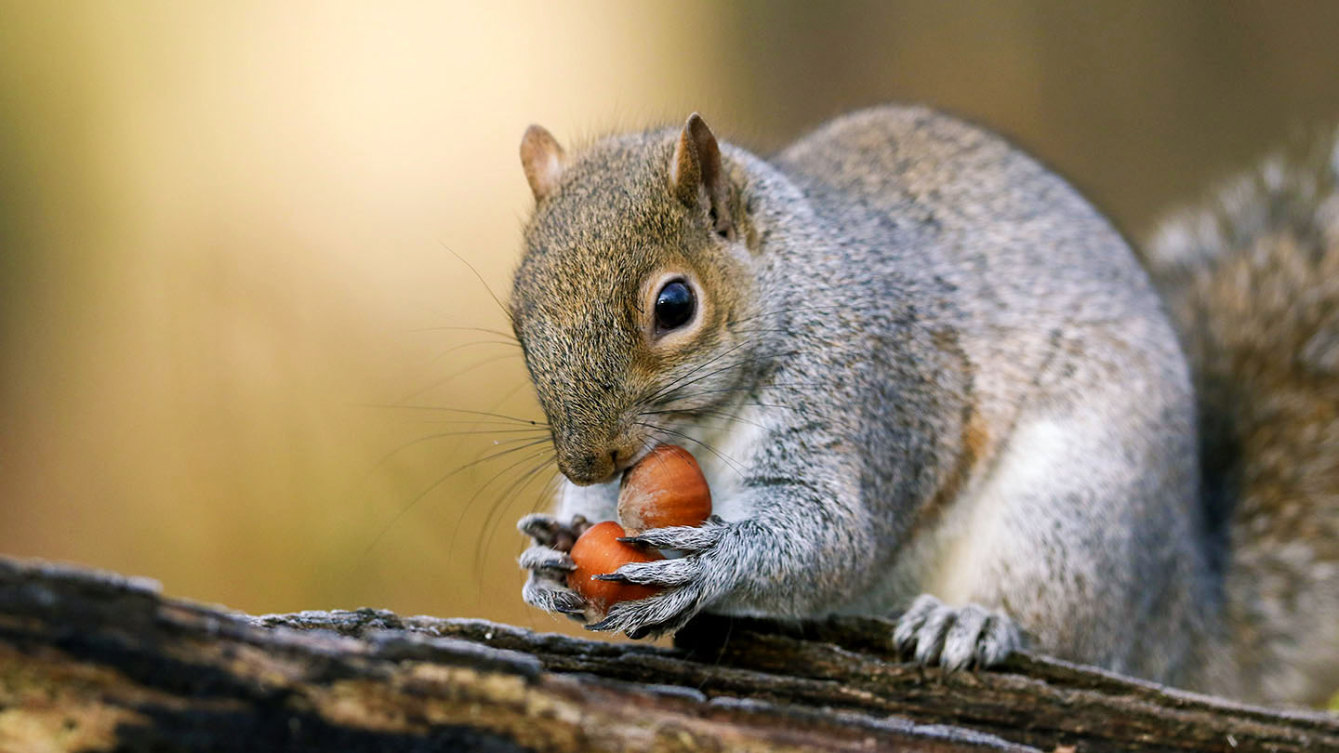
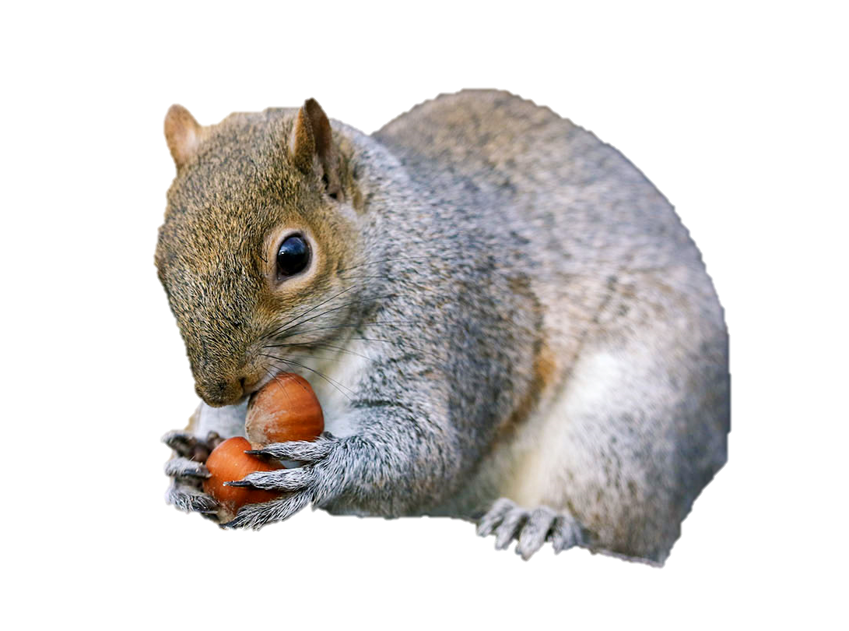
Squirrel

Slide 29
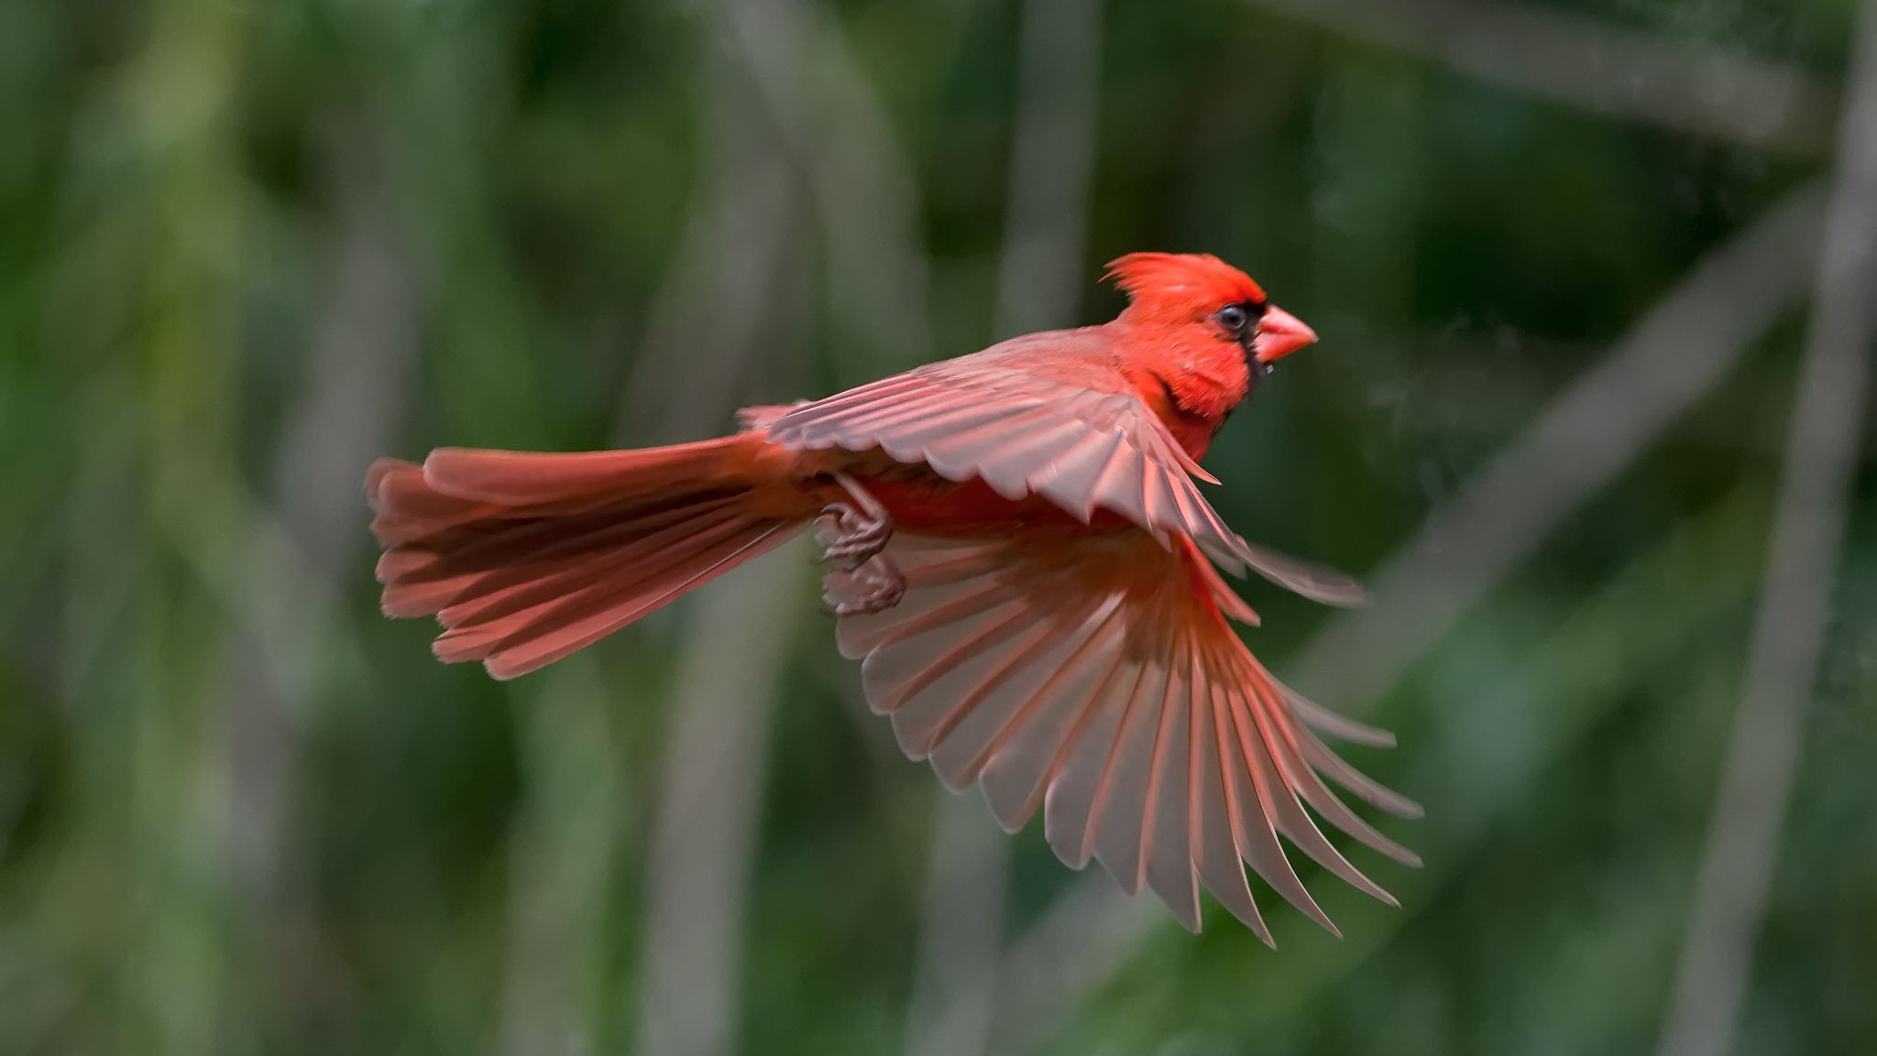
Cardinal

Slide 30
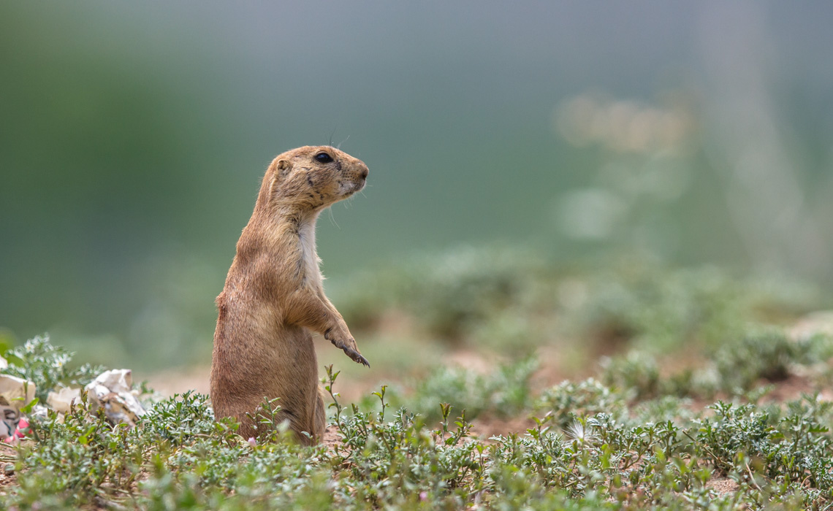
Prairie
Dog

Slide 31
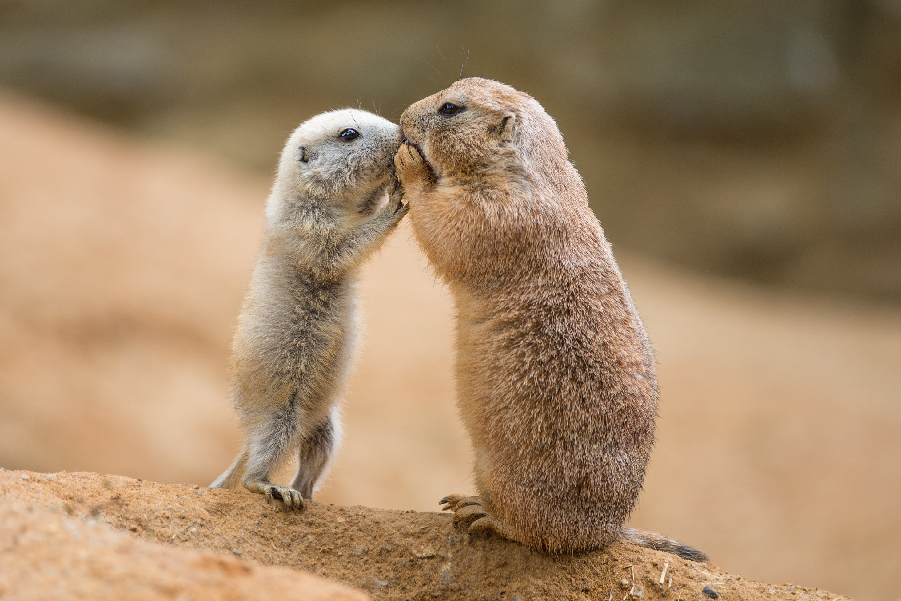

Slide 32
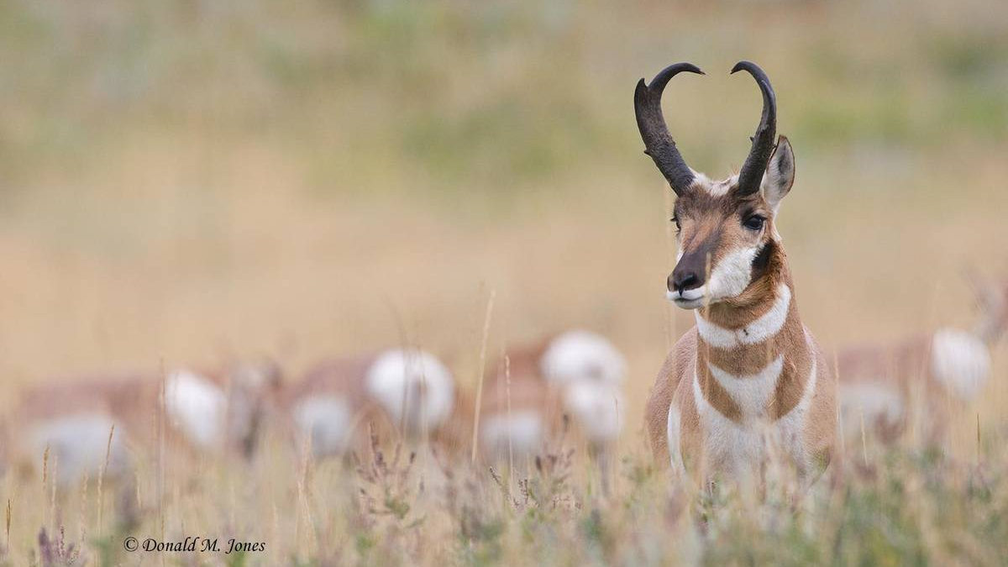
Pronghorn
Antelope

Slide 33
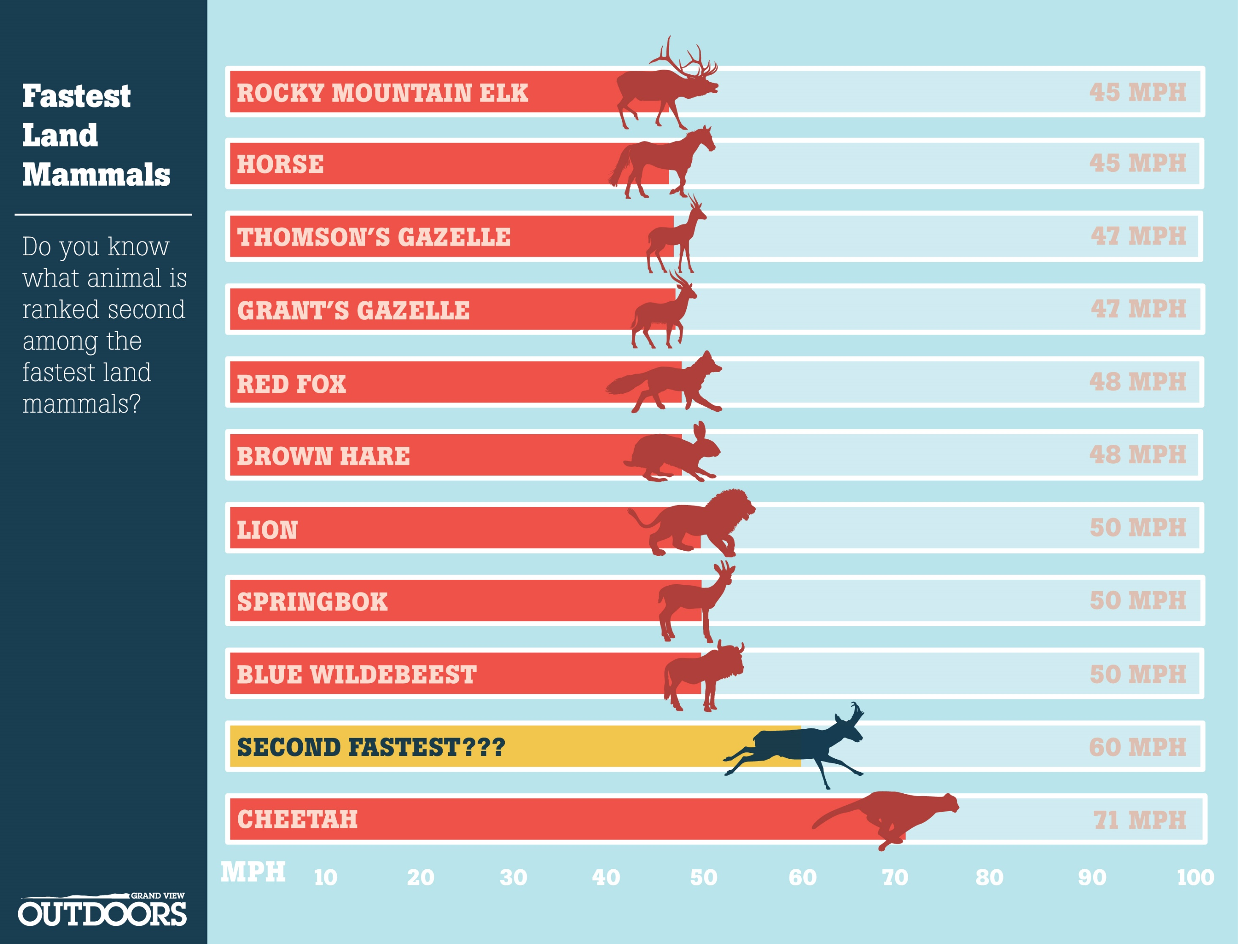

Slide 34
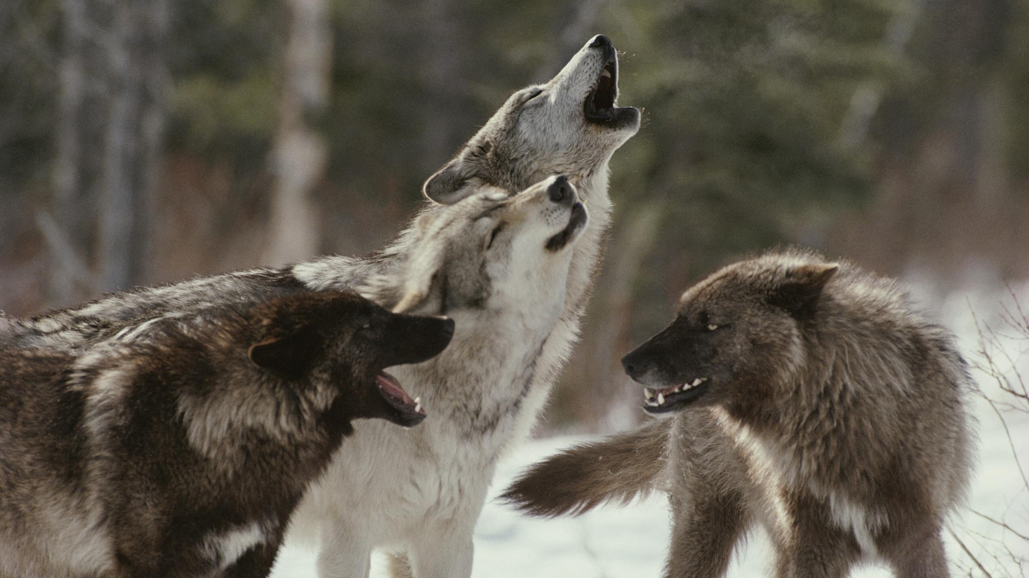
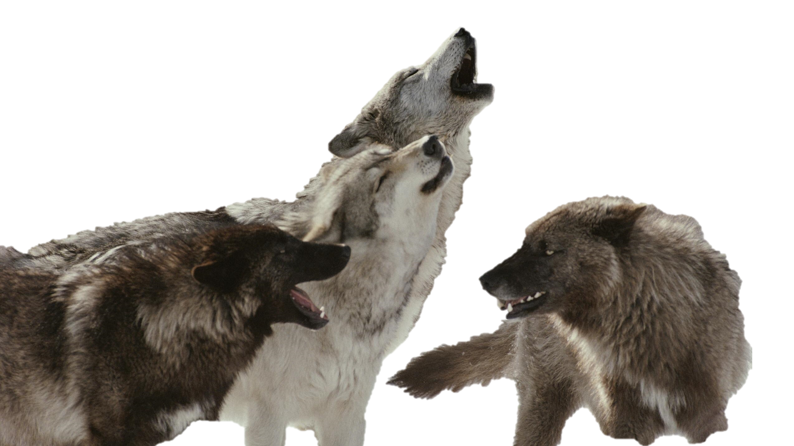
Grey Wolf

Slide 35
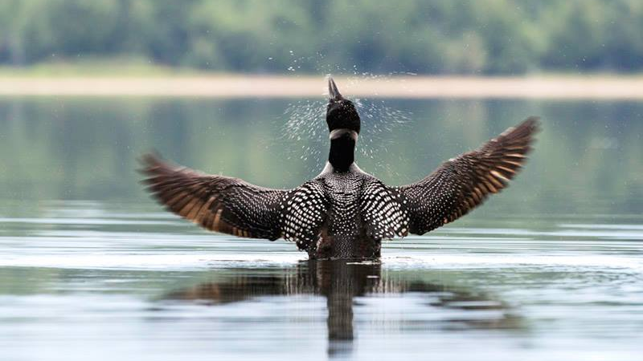
Loon

Slide 36
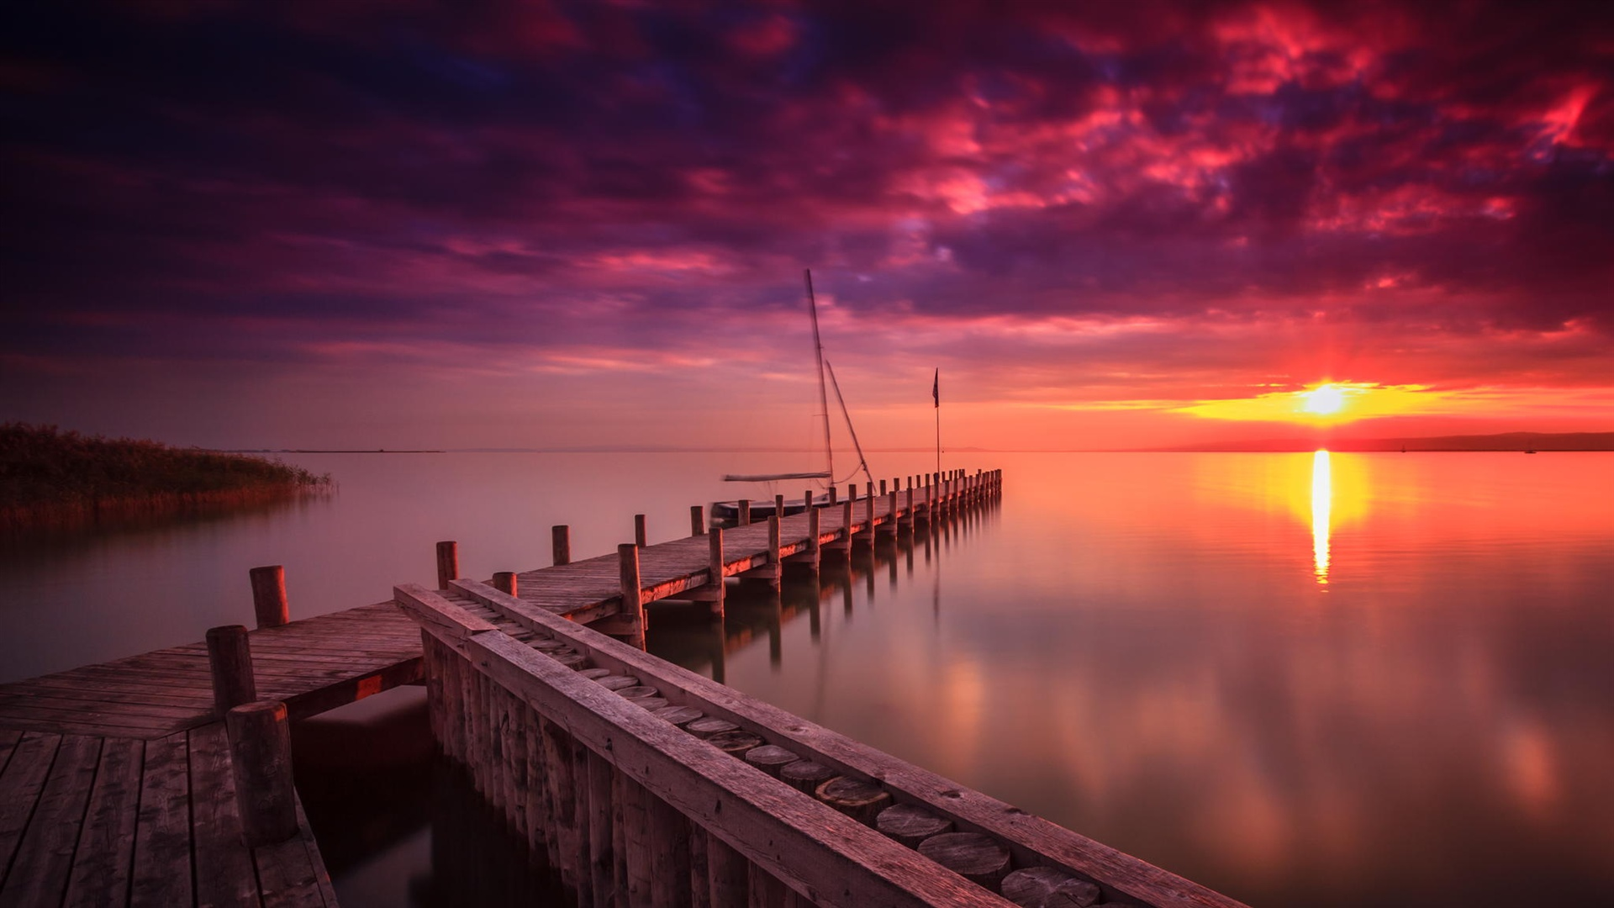

Slide 37
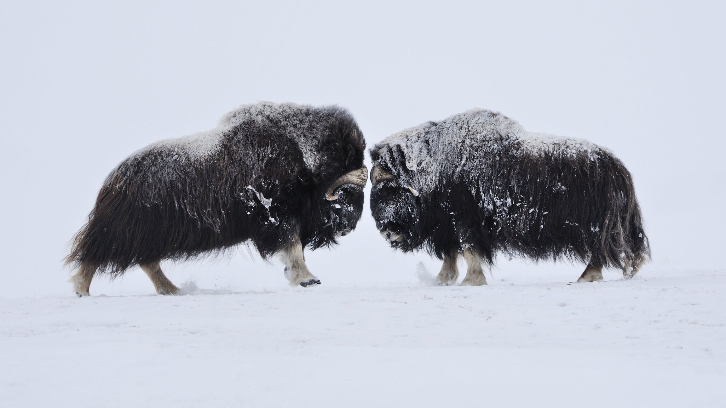
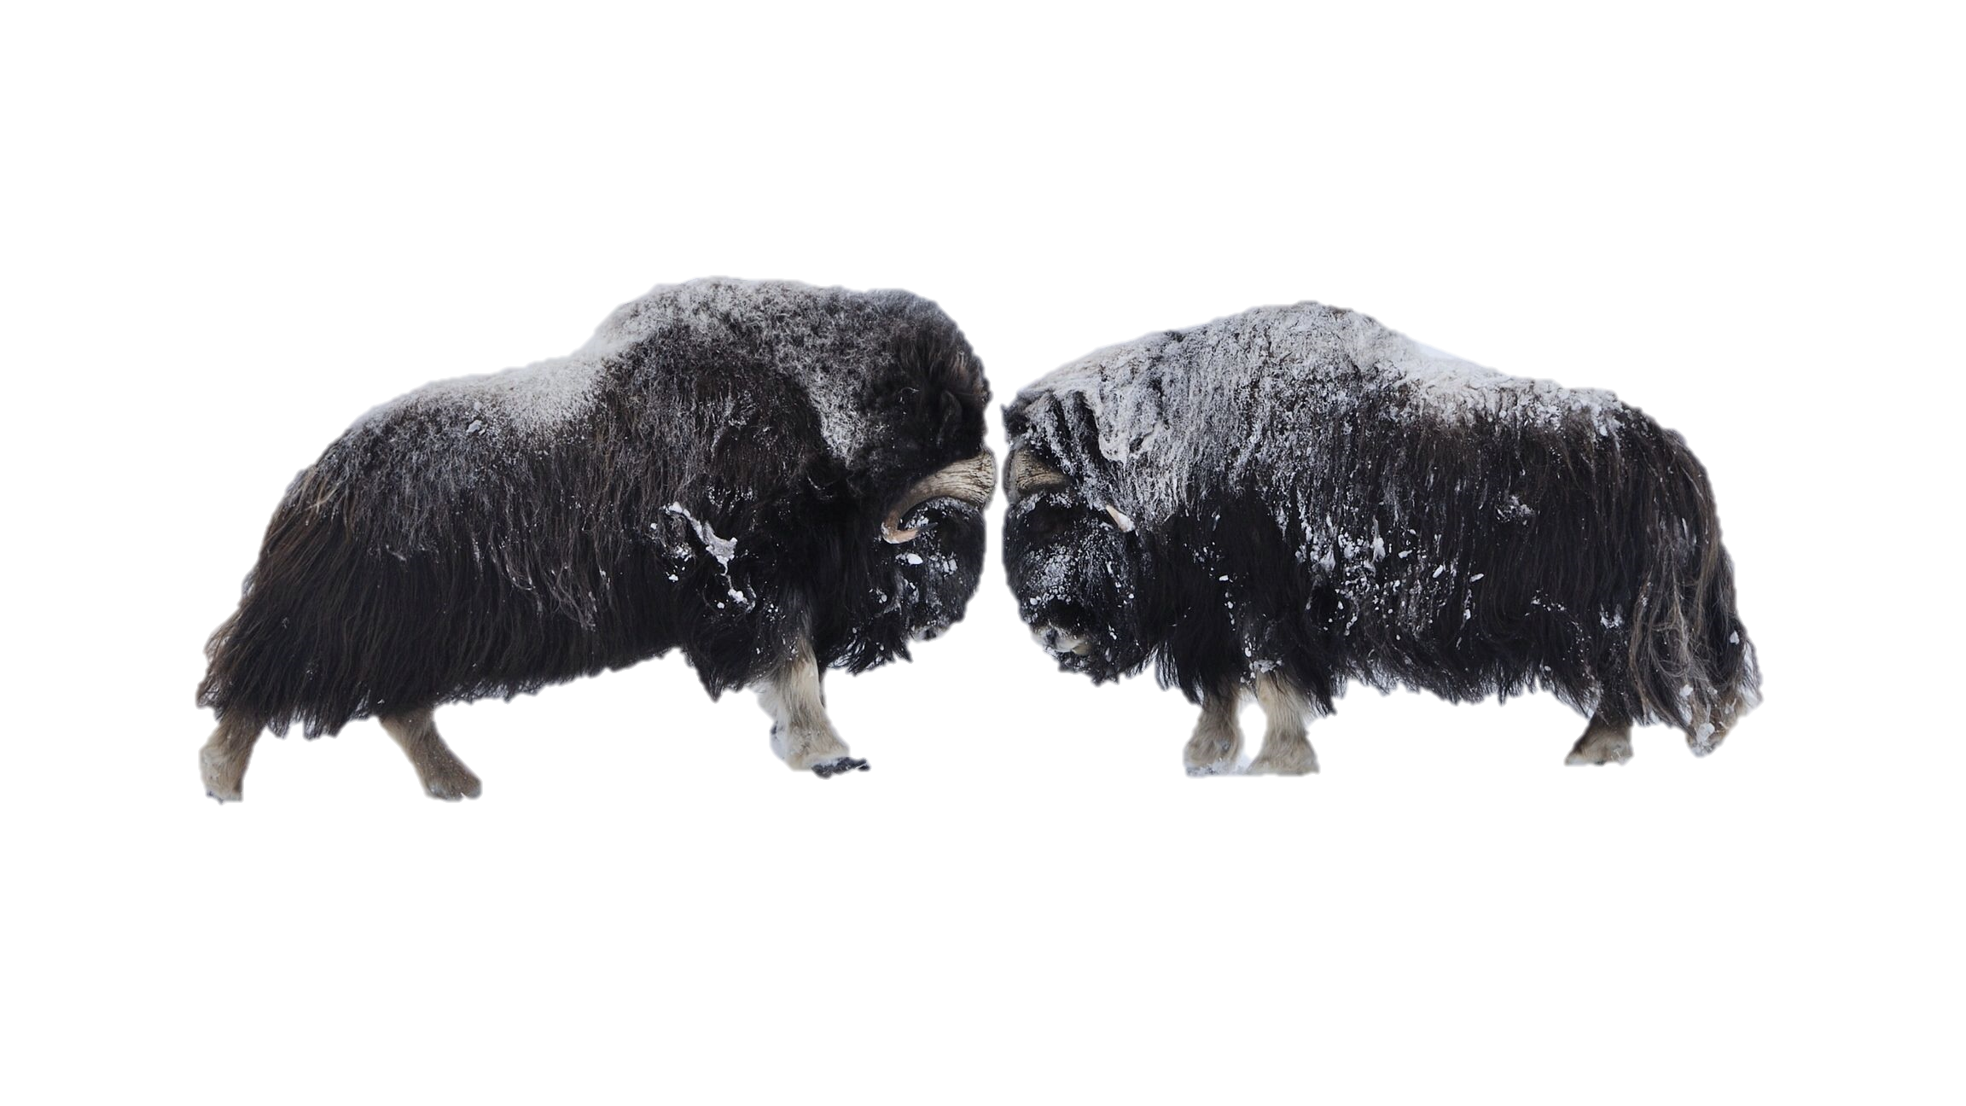
Muskox

Slide 38
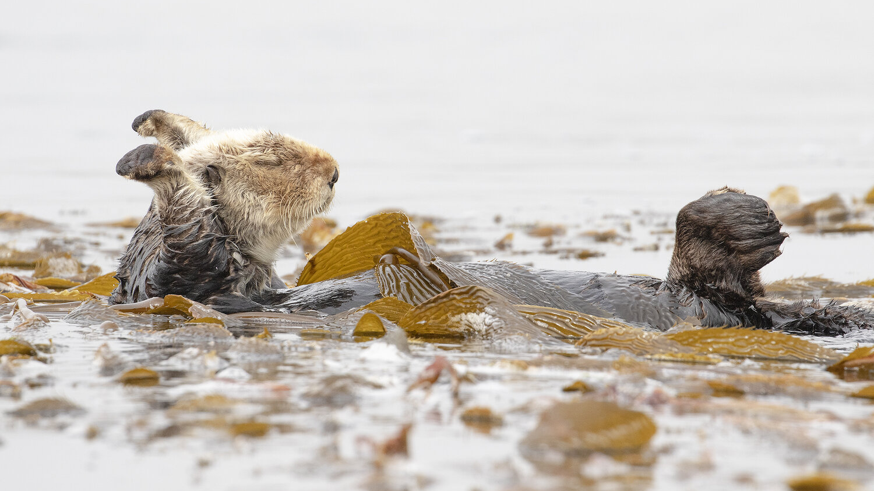
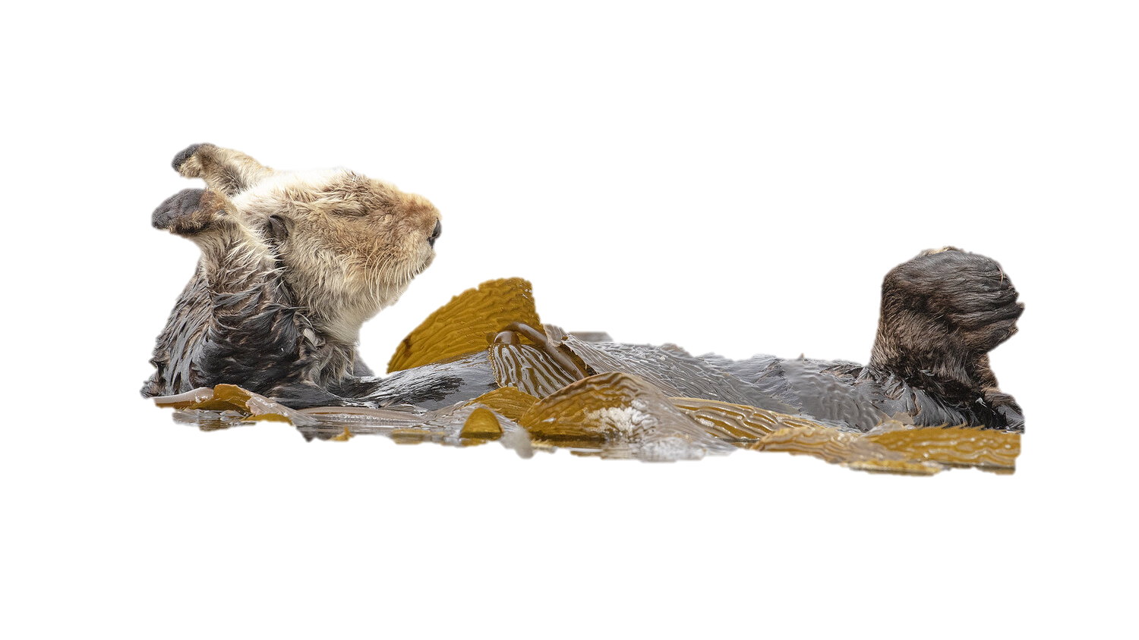
Otter

Slide 39
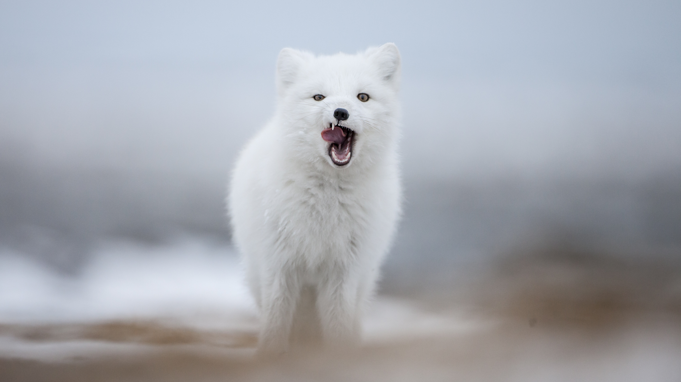
Arctic
Fox

Slide 40
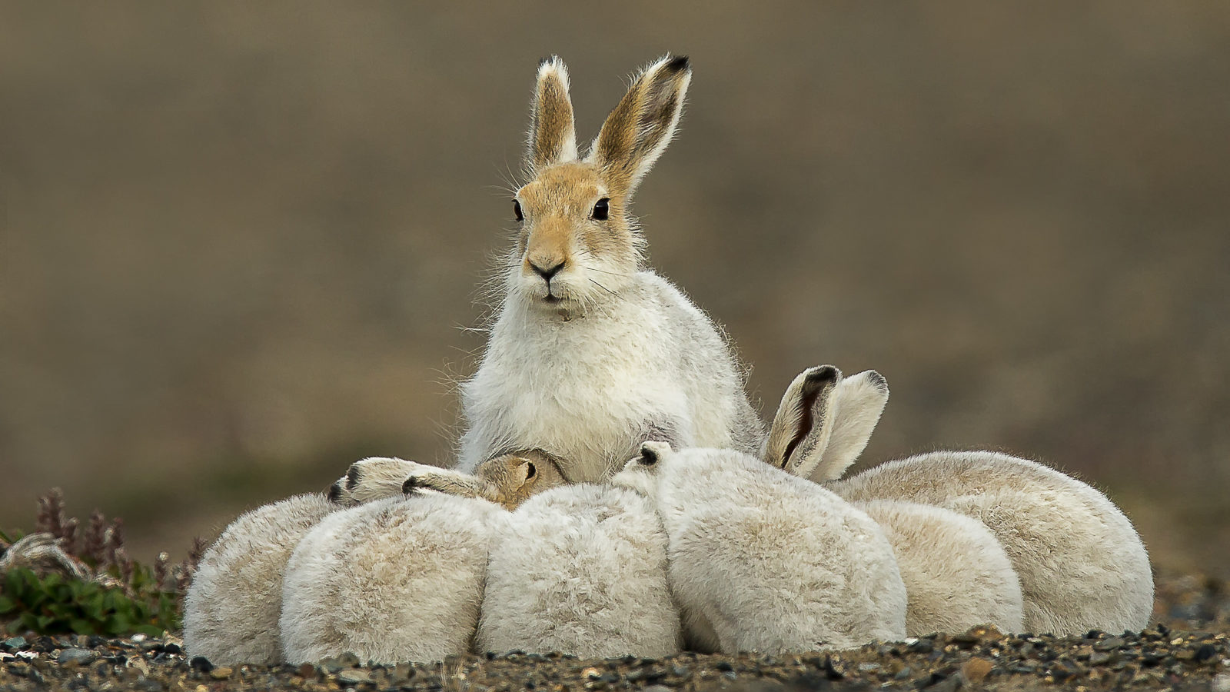
Arctic
Hare

Slide 42
Moose

Slide 44
Orca

Slide 45
Great Blue
Heron

Slide 47
Beaver

Slide 49
Cougar

Slide 50
Walrus

Slide 51
Ruby Throated
Hummingbird

Slide 52
Opossum

Slide 54
Snapping Turtle

Slide 55
Newfoundland
Dog

Slide 56
Beluga

Slide 57
Maple Leaf
Beaver
Bluenose
Caribou
Loon
Polar Bear

Slide 58
Great Blue Heron

Slide 59
Lynx

Slide 60
Polar Bear

Slide 62
Wolverine

Slide 63
Opossum

Slide 64
Puffin

Slide 66
Arctic Fox

Slide 67
Prairie Dog

Slide 68
Raccoon

Slide 69
Pronghorn Antelope

Slide 70
Loon

Slide 71
Muskox

Slide 72
Narwhal

Slide 74
Orca

Slide 76
Moose

Slide 77
Beaver

Slide 78
Canadian Goose

