Slide 1
Canadian
regions

Slide 2
Territories
Provinces

Slide 3
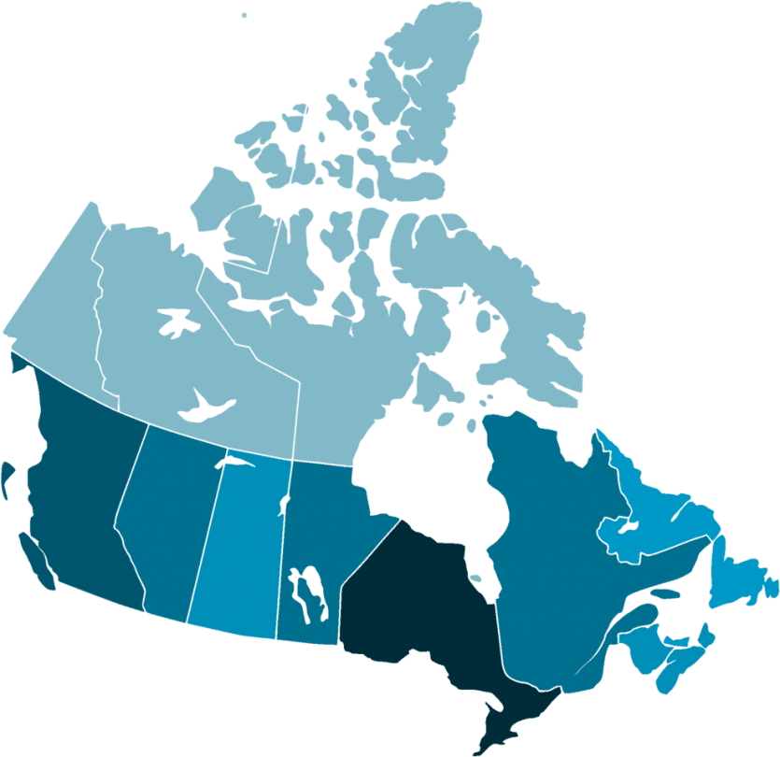
Territories
Provinces

Slide 4
Ontario – 14.57m
Quebec – 8.48m
BC – 5.01m
Alberta – 4.37m
Manitoba – 1.369m
Saskatchewan – 1.174m
Nova Scotia – 971,395
New Brunswick – 776,827
Newfoundland – 521,542
Canada – 38.25m
Regions
P.E.I – 156,947
Yukon – 40,232
population
N.W.T – 44,826
Nunavut – 38,780

Slide 5
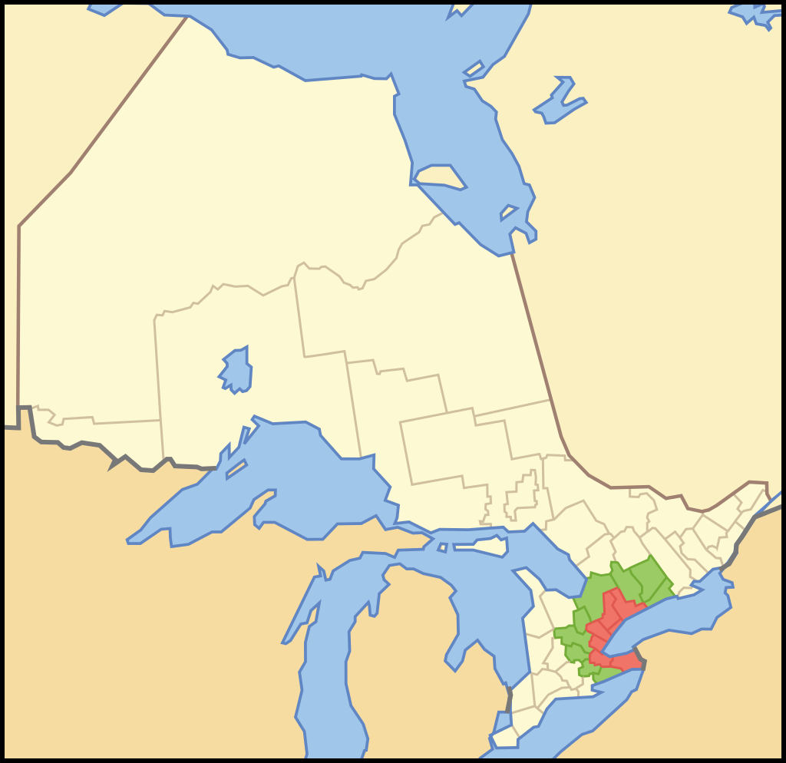
Golden
Horseshoe
Core population: 7,759,635
Greater population: 9,765,188
1 in 5 Canadians live here
https://en.wikipedia.org/wiki/Golden_Horseshoe

Slide 6
Ontario
Quebec
British Columbia
Alberta
Manitoba
Saskatchewan
Nova Scotia
New Brunswick
Newfoundland
Prince Edward Island
Provinces

Slide 7
Yukon
Northwest Territories
Nunavut
Territories

Slide 8
choose a
Province or Territory

Slide 9
Research
Landmarks, destinations, attractions, places of interest, major cities, capital cities, travel, tourism, things to do, recreational activities, population, economy, sports teams, national parks, geography, demographics, travel blog, travel information

Slide 10
Tournament
Try to “sell” your region
Voting with money
Where would you rather go?

